Slide 1
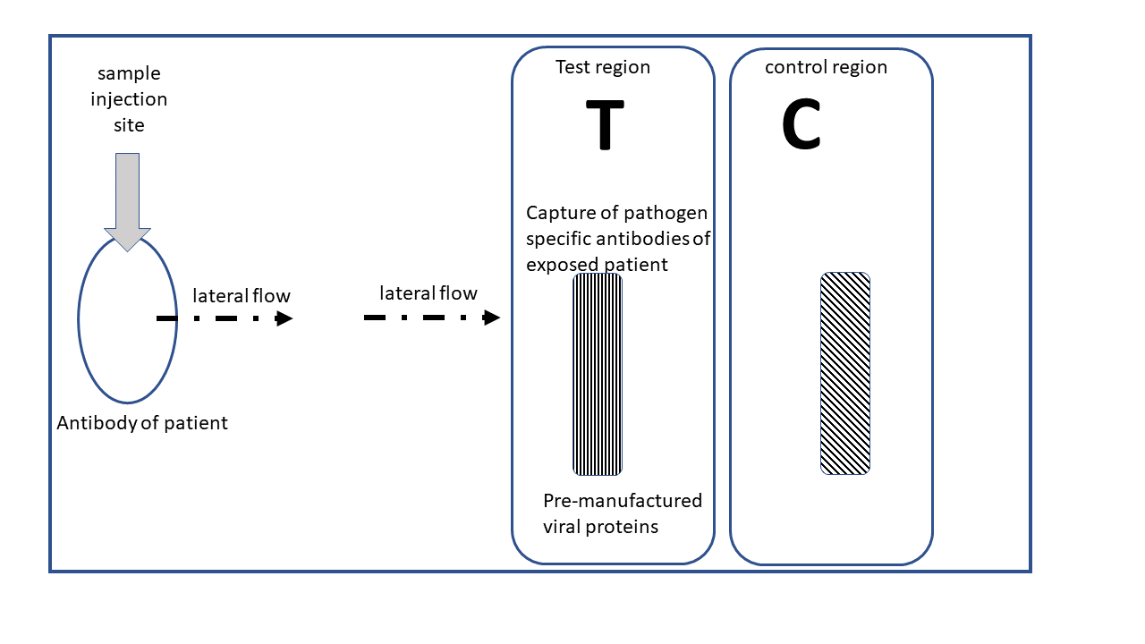
Lab 14 Rapid Diagnostic
Rapid diagnostic testing in microbiology
By Illya Tietzel, 2025 Creative Commons 4.0 BY

Slide 2
Rapid Diagnostic Tests (RDT)
Definition: Rapid identification of disease, pathogen, toxin, or antibiotic resistance within minutes or hours instead of days
Origin: Recent advances in biotechnology (DNA, RNA, proteomics, biotechnology, bioinformatics)
Location: Point of care, urgent care, hospitals, clinical laboratories
Personal experiences: detecting the influenza virus or the virus causing COVID19
Motivation: preparation for professional career as an allied health professional
Content areas :
  advantages,
  uses
  working principles
  details of lateral flow immunochromatography.

Slide 3
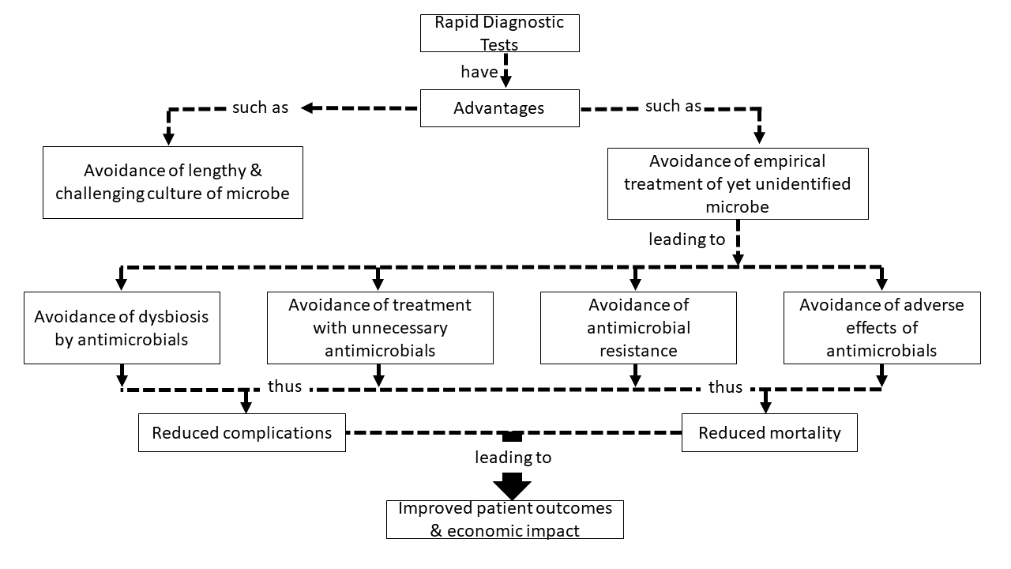
Rapid Diagnostic Tests (RDT) - Advantages
Figure 14.1: Advantages of rapid diagnostic tests. Examples of the advantages of the use of rapid diagnostic tests in microbiology are outlined as a concept map. These advantages include avoid inappropriate treatment leading to reduced complications, reduced mortality and ultimately improved patient outcomes.
Alt Text: Examples of the advantages of the use of rapid diagnostic tests in microbiology are outlined as a concept map. These advantages include avoid inappropriate treatment leading to reduced complications, reduced mortality and ultimately improved patient outcomes.

Slide 4
Rapid Diagnostic Tests (RDT) - Advantages
Check your understanding about Advantages of Rapid Diagnostic Tests
A pediatric patient has a lung infection. The health care team is wondering if they have to use PaxlovidTM to treat COVID19 caused by SARS-CoV-2 virus. The health care team does rapid diagnostic testing that confirms influenza virus and excludes SARS-CoV-2 virus. What advantage of rapid diagnostic tests is illustrated here?
A) Avoidance of dysbiosis by antimicrobial drugs
B) Avoidance of treatment with unnecessary antimicrobials
C) Avoidance of antimicrobial resistance
D) Avoidance of adverse effects of antimicrobials

Slide 5
Rapid Diagnostic Tests (RDT) - Advantages
Check your understanding about Advantages of Rapid Diagnostic Tests
A patient is admitted to the emergency department with an infection causing high fever, relatively low blood pressure, and incoherent patient. The health care team has to decide whether to use a broad spectrum antibiotic that negatively impacts the gut microbiome or a narrow spectrum antibiotic that is not impacting the gut microbiome. A rapid diagnostic test for blood infection identifies a pathogen that can be treated with a narrow spectrum antibiotic. What advantage of rapid diagnostic tests is illustrated here?
A) Avoidance of dysbiosis by antimicrobial drugs
B) Avoidance of treatment with unnecessary antimicrobials
C) Avoidance of antimicrobial resistance
D) Avoidance of adverse effects of antimicrobials

Slide 6
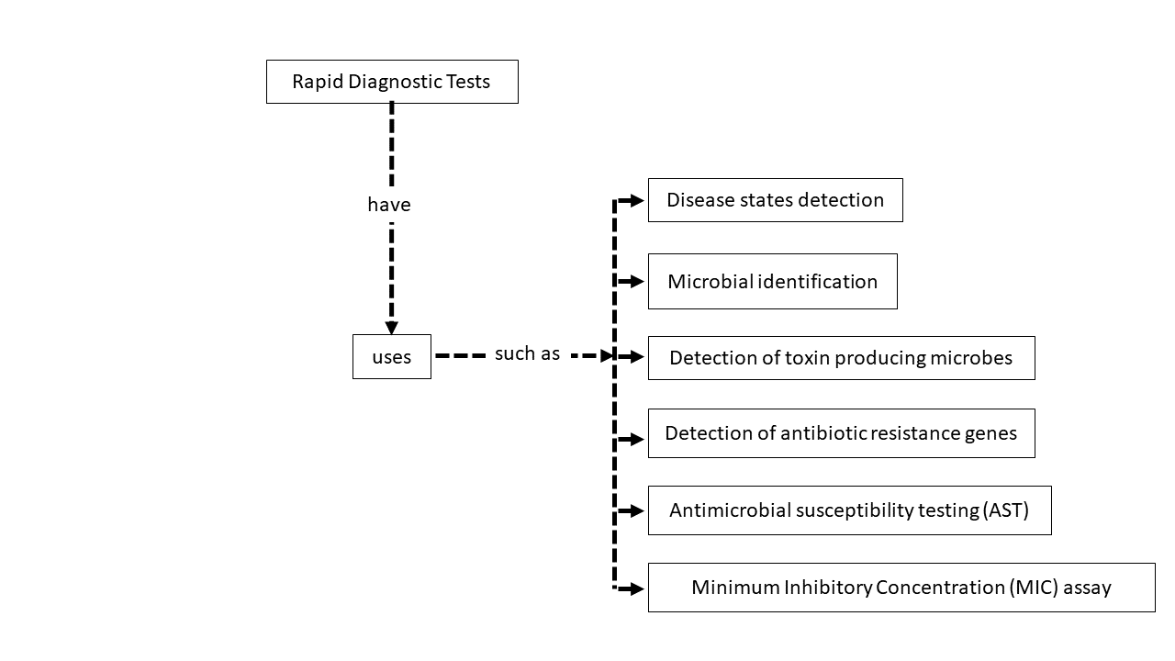
Rapid Diagnostic Tests (RDT) - Uses
Figure 14.2: General uses of Rapid Diagnostic Tests. Shown are some of the uses of rapid diagnostic tests. The uses include detection of disease states, identification of the microbe, detection of toxin producing microbes, detection of antibiotic resistance genes, testing of microbes for antimicrobial susceptibility, and determining the minimum inhibitory concentration of an antimicrobial drug against the pathogen in question.

Slide 7
Rapid Diagnostic Tests (RDT) - Uses
Analyze the description of a "use cases" of rapid diagnostic test and match with type of use:
A rapid diagnostic test of Mycobacterium tuberculosis from 12 patients shows that 5 samples were susceptible to isoniazid but 7 samples were resistant
A) Detection of antibiotic resistance genes
B) Detection of toxin production
C) Microbial identification
D) Minimum Inhibitory Concentration (MIC) assay
E) Disease state detection
F) Antimicrobial susceptibility testing

Slide 8
Rapid Diagnostic Tests (RDT) - Uses
Analyze the description of a "use cases" of rapid diagnostic test and match with type of use:
The rapid diagnostic test “BioFire Film Assay” confirmed that the patient suffers from viral pneumonia
A) Detection of antibiotic resistance genes
B) Detection of toxin production
C) Microbial identification
D) Minimum Inhibitory Concentration (MIC) assay
E) Disease state detection
F) Antimicrobial susceptibility testing

Slide 9
Rapid Diagnostic Tests (RDT) - Uses
Analyze the description of a "use cases" of rapid diagnostic test and match with type of use:
The rapid diagnostic test discovered that patient is infected with Klebsiella pneumoniae that has the blaKPC gene enabling antibiotic resistance to carbapenems
A) Detection of antibiotic resistance genes
B) Detection of toxin production
C) Microbial identification
D) Minimum Inhibitory Concentration (MIC) assay
E) Disease state detection
F) Antimicrobial susceptibility testing

Slide 10
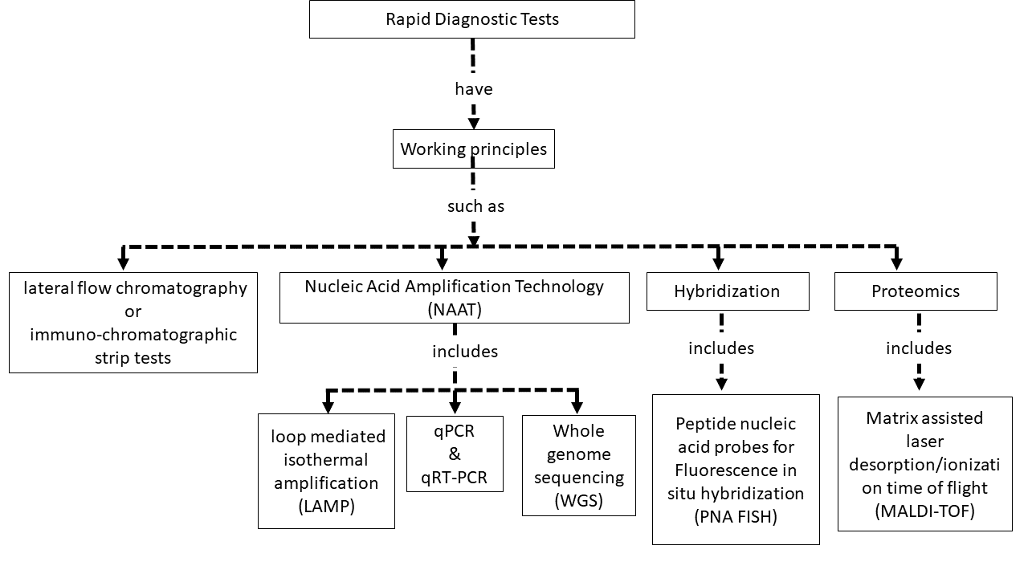
Rapid Diagnostic Tests (RDT) – Working Principles
Figure 14.3: Working principles of rapid diagnostic tests. Shown are examples of working principles of rapid diagnostic tests. Working principles include lateral flow chromatography, Nucleic Acid Amplification Techniques (NAAT such as LAMP, qPCR, qRT-PCR, WGS), hybridization techniques (such as PNA FISH), and proteomic fingerprinting analysis of pathogens using MALDI-TOF. This complex field is fast growing and for more in depth reading review articles are recommended (Vasala et al., 2020).

Slide 11
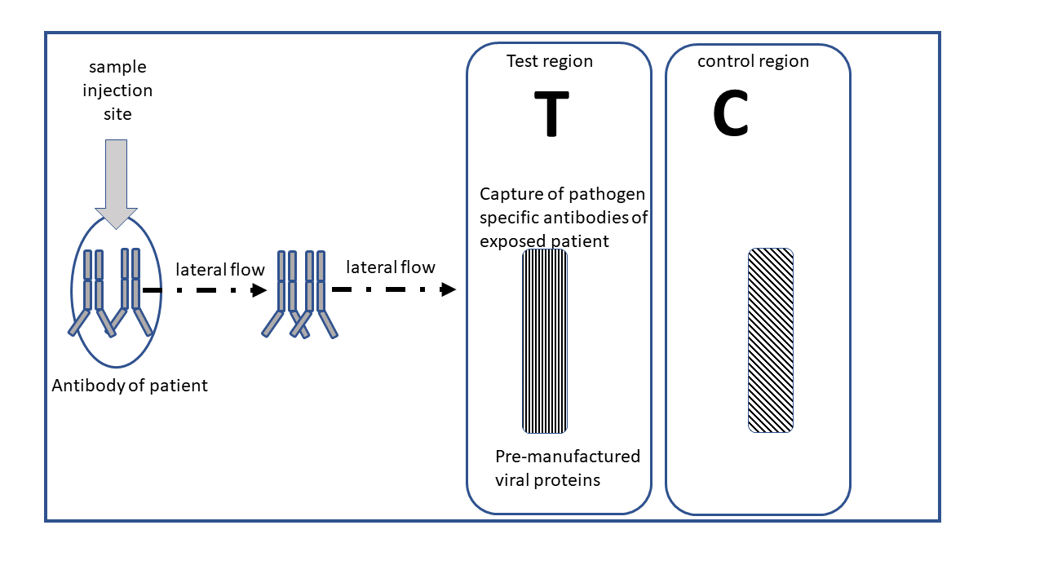
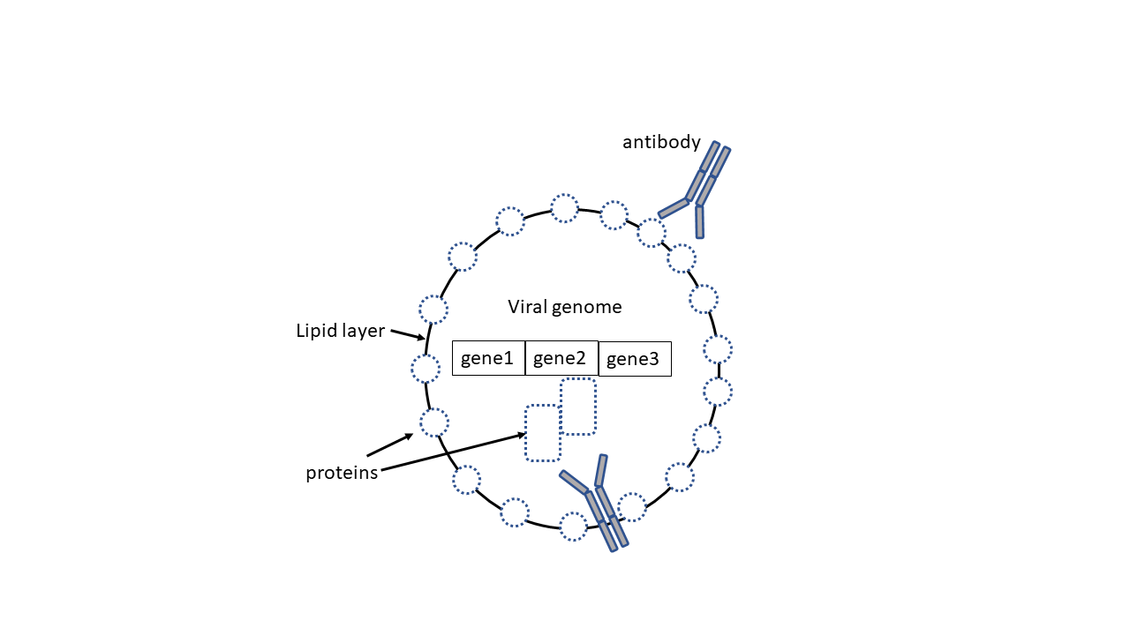
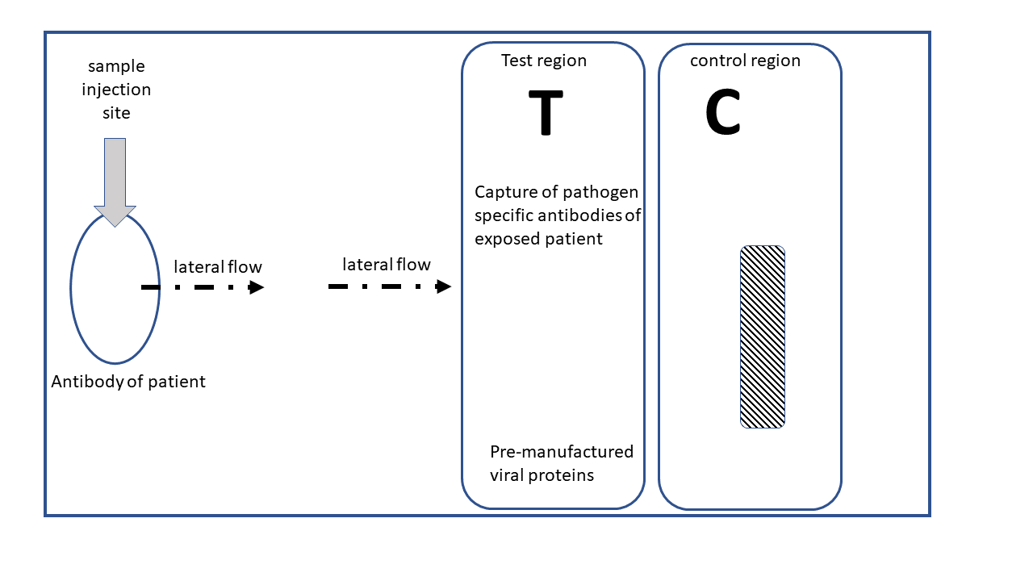
Rapid Diagnostic Tests (RDT) – Working Principles
Lateral flow (immuno-) chromatography
Figure 14.4: Lateral Flow Chromatography as Rapid Diagnostic Test

Slide 12
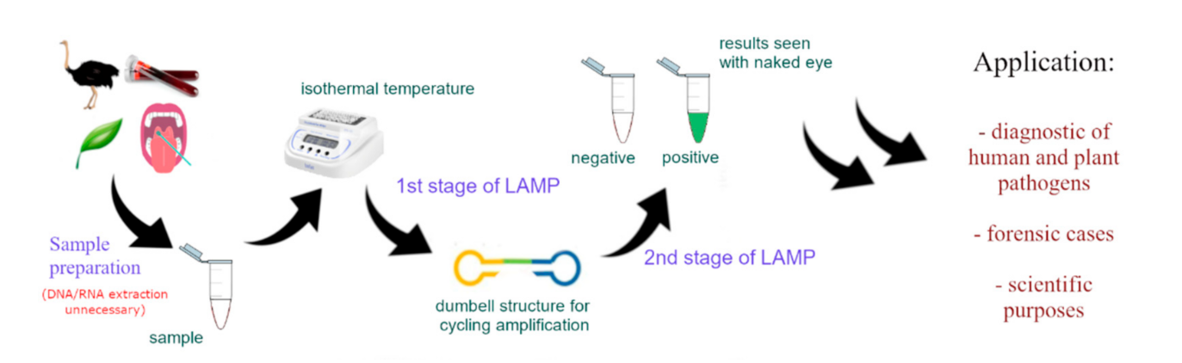
Rapid Diagnostic Tests (RDT) – Working Principles
Loop Mediated Isothermal Amplification (LAMP)
Figure 14.5: Schematic of the LAMP process. Adopted from fig. 3 of Soroka, M., Wasowicz, B., & Rymaszewska, A. (2021). Loop-Mediated Isothermal Amplification (LAMP): The Better Sibling of PCR? Cells, 10(8), 1931. https://doi.org/10.3390/cells10081931. CC-BY. After sample preparation, DNA stem loop structure that resemble a dumbbell structure allows amplification and detection of targeted DNA.

Slide 13
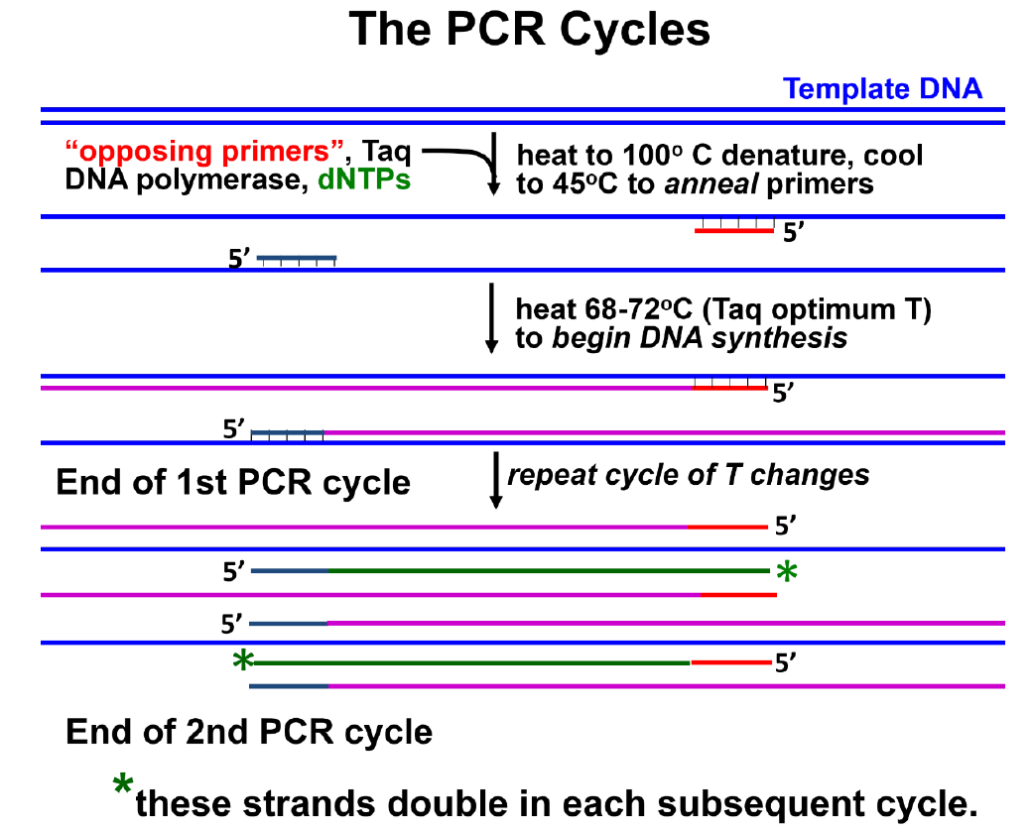
Rapid Diagnostic Tests (RDT) – Working Principles
Polymerase Chain Reaction (PCR)
Figure 14.6: Schematic of the PCR process. Adopted from fig. 15.27 of Annotated Cell and Molecular Biology 5e: What We Know and How We Found Out. (2022) Bergtrom, Gerald. CC-BY. In PCR, a template DNA to be amplified is mixed with a pair of primers whose sequences target opposite ends of the template. Addition of DNA polymerase (usually Taq Polymerase) initiates PCR. The actual sequence to be amplified (from primer to opposing primer) has been synthesized by the end of the second PCR cycle. Multiple cycles of PCR follow during which this ‘primer-to-primer’ DNA will be geometrically amplified.

Slide 14
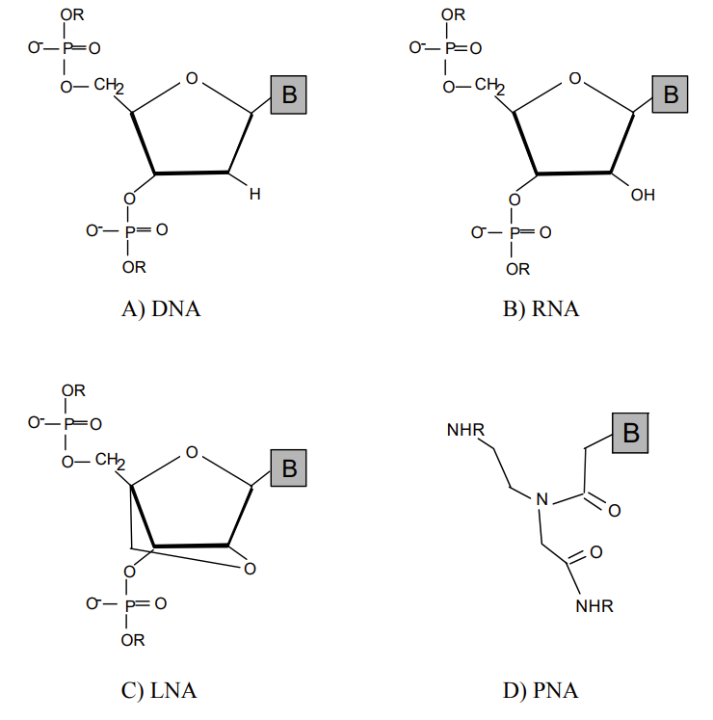
Rapid Diagnostic Tests (RDT) – Working Principles
PNA vs DNA
Figure 14.7: Comparison of DNA, RNA, LNA and PNA. Adopted from fig. 1 of DNA Mimics for the Rapid Identification of Microorganisms by Fluorescence in situ Hybridization (FISH). Cerqueira, L., Azevedo, N. F., Almeida, C., Jardim, T., Keevil, C. W., & Vieira, M. J. (2008).. CC-BY. Chemical structures of DNA, RNA and of the DNA mimics, locked nucleic acid (LNA) and peptide nucleic acid (PNA). DNA has a backbone of sugar and phosphate, but PNA has a polyamide backbone.

Slide 15
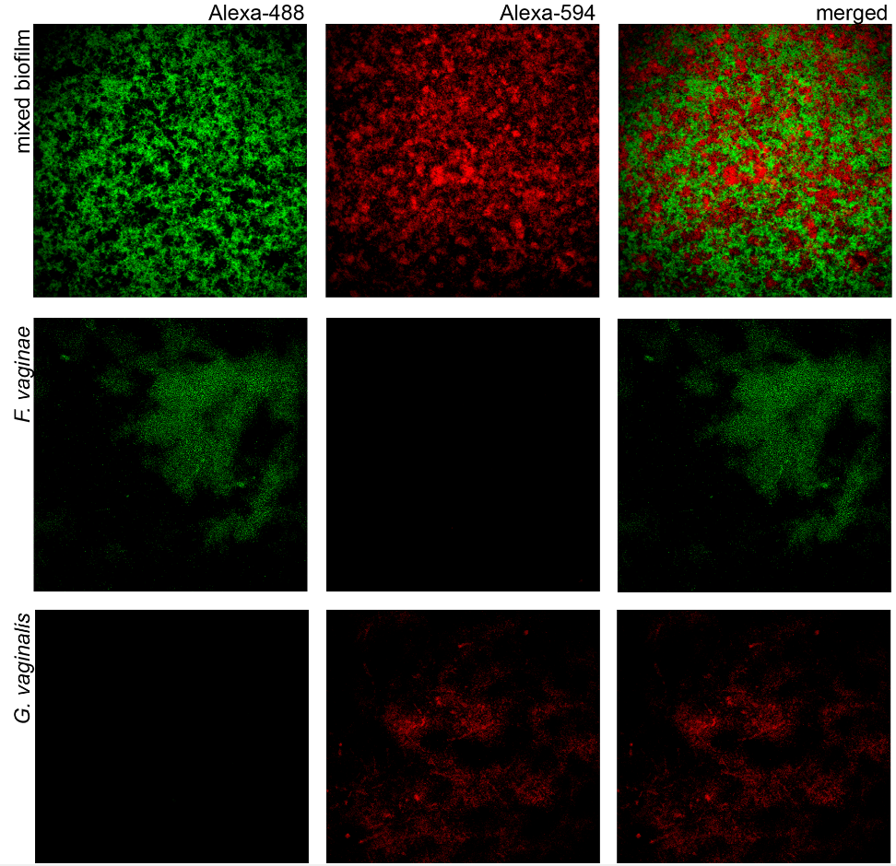
Rapid Diagnostic Tests (RDT) – Working Principles
Peptide Nucleic Acid (PNA) Fluorescence in Situ Hybridization (FISH)
Figure 14.8: Example of PNA FISH. Adopted from fig. 2 of Sousa, L.G.V., Castro, J., França, A., Almeida, C., Muzny, C.A., Cerca, N., 2021. A New PNA-FISH Probe Targeting Fannyhessea vaginae. Front. Cell. Infect. Microbiol. 11. CC-BY. Confocal Laser Scanning Microscopy images of single- and dual-species biofilms hybridization with Gard162 and FvagPNA651 probes. Gard162 probe detected G. vaginalis 24 h single-species biofilm and F. vaginae probe detected F. vaginae 24 h single-species biofilm. The probes were able to detect G. vaginalis (red) and F. vaginae (green) on 24 h dualspecies biofilm. The images were acquired using 40× objective.

Slide 16
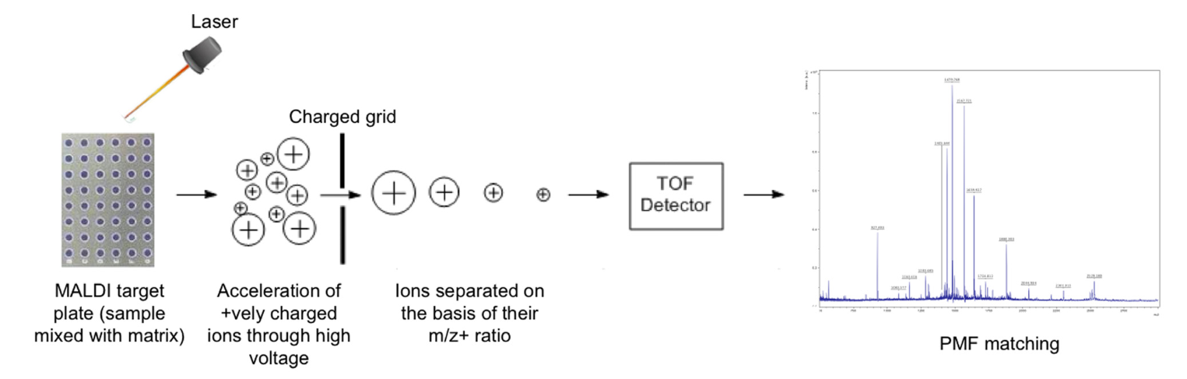
Rapid Diagnostic Tests (RDT) – Working Principles
matrix assisted laser desorption ionization-time of flight mass spectrometry MALDI-TOF
Figure 14.9: Example of MALDI-TOF. Adopted from fig. 1 of Singhal, N., Kumar, M., Kanaujia, P.K., Virdi, J.S., 2015. MALDI-TOF mass spectrometry: an emerging technology for microbial identification and diagnosis. Front. Microbiol. 6. https://doi.org/10.3389/fmicb.2015.00791. CC-BY. Schematic diagram showing the work-flow in a MALDI-TOF MS. Pathogen protein samples are applied and mixed with standardized chemicals in a matrix. After crystallization, laser beams help or assist that the sample molecules are ionized. The ionized molecules then fly through a detection pathway and are separated by their mass and ionic charge. This generates a peptide mass fingerprint (PMF) that can be so characteristic it identifies a specific pathogen.

Slide 17
Rapid Diagnostic Tests (RDT) – Working Principles
Check your understanding of the working principle.
Match description of working principle with the name of the method
Uses antibodies to detect pathogens:
A) MALDI-TOF
B) Lateral flow chromatography or immuno-chromatographic test
C) PNA FISH
D) Loop mediated isothermal amplification
E) PCR or qPCR

Slide 18
Rapid Diagnostic Tests (RDT) – Working Principles
Check your understanding of the working principle.
Match description of working principle with the name of the method
Uses DNA stem loop structure to detect a gene sequence in a pathogen:
A) MALDI-TOF
B) Lateral flow chromatography or immuno-chromatographic test
C) PNA FISH
D) Loop mediated isothermal amplification
E) PCR or qPCR

Slide 19
Rapid Diagnostic Tests (RDT) – Working Principles
Check your understanding of the working principle.
Match description of working principle with the name of the method
Uses cycles with steps of primer annealing, primer extension, and DNA denaturation at different temperatures to detect gene sequences of pathogens:
A) MALDI-TOF
B) Lateral flow chromatography or immuno-chromatographic test
C) PNA FISH
D) Loop mediated isothermal amplification
E) PCR or qPCR

Slide 20
Rapid Diagnostic Tests (RDT) – Working Principles
Check your understanding of the working principle.
Match description of working principle with the name of the method
Uses fluorescent probes made of peptides and nitrogenous bases to detect pathogens:
A) MALDI-TOF
B) Lateral flow chromatography or immuno-chromatographic test
C) PNA FISH
D) Loop mediated isothermal amplification
E) PCR or qPCR

Slide 21
Rapid Diagnostic Tests (RDT) – Working Principles
Check your understanding of the working principle.
Match description of working principle with the name of the method
Uses protein fragments from lysed or homogenized pathogens analyzed with lasers and mass spectrometry:
A) MALDI-TOF
B) Lateral flow chromatography or immuno-chromatographic test
C) PNA FISH
D) Loop mediated isothermal amplification
E) PCR or qPCR

Slide 22
Rapid Diagnostic Tests (RDT) – Details Lateral Flow Immunochromatography

Slide 23
Rapid Diagnostic Tests (RDT) – Details Lateral Flow Immunochromatography
The panel A shows the structure of a virus including the viral genome with viral genes, a lipid envelope, and viral proteins. Viral proteins can be found as part of the lipid envelope, and also associated with the genetic material. Antigen responses to viral pathogens of target viral proteins and are symbolized as y-shaped structures.

Slide 24
Rapid Diagnostic Tests (RDT) – Details Lateral Flow Immunochromatography
The panel B from the top shows the parts of a rapid diagnostic test and working principle. The sample injection site will receive the body fluid or sample of a patient. In this case the sample of a body fluid contains antigens specific for a viral pathogen. The fluid then moves laterally carrying the antibodies with it. When the running front of this chromatography system reaches the test zone with the pre-loaded pre-manufactured viral proteins, the antibodies bind with their antigen binding site the viral protein antigen. Thereby the antibodies are captured. This happens in the “T” or “test” region testing for the presence of the antibodies. Captured antibodies then result in a color reaction that can be observed by the health professional or user. For quality control purposes, there is also a “C” or “control” region to make sure that the test device is not dysfunctional, old, or working incorrectly.

Slide 25
Rapid Diagnostic Tests (RDT) – Details Lateral Flow Immunochromatography
The panel C shows a typical positive result. Both, the “T” and the “C” region should show a visible color strip. In this case, positive means that the patient has antibodies against the pathogen.

Slide 26
Rapid Diagnostic Tests (RDT) – Details Lateral Flow Immunochromatography
The panel D shows a typical negative result. Both, the “T” has no visible color strip but the “C” region should show a visible color strip. In this case, negative means that the patient has no antibodies against the pathogen.

Slide 27
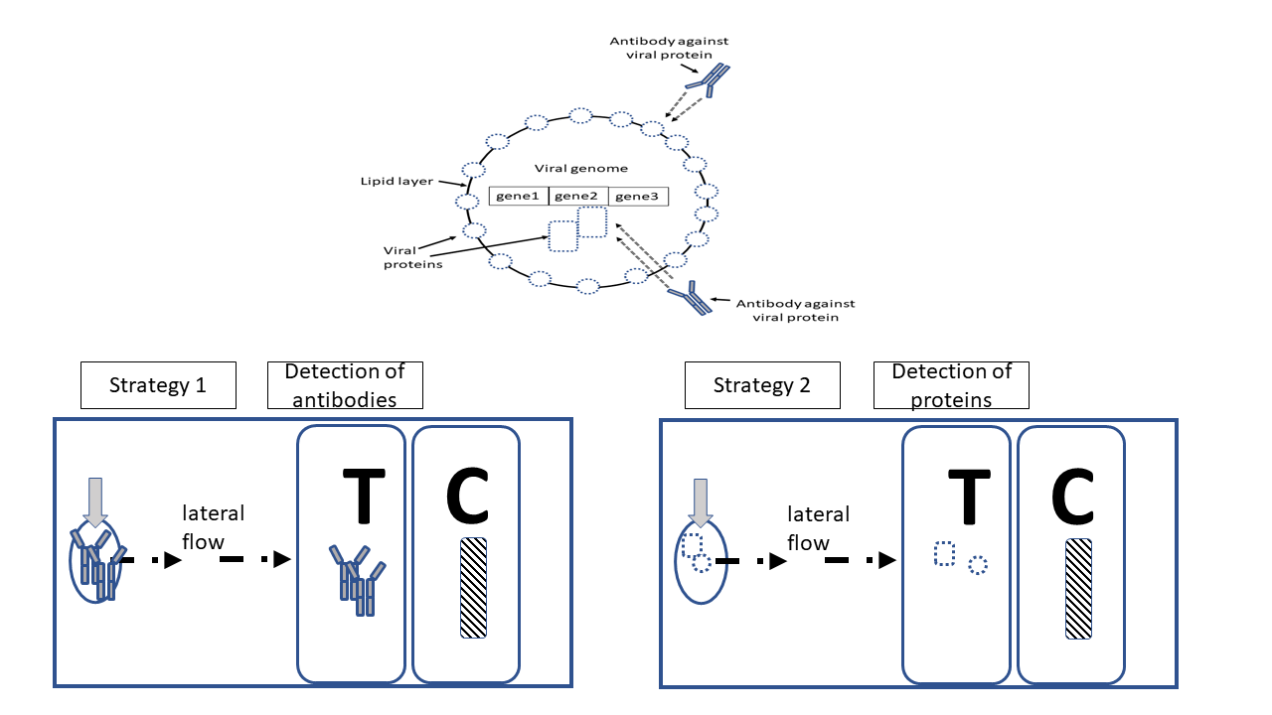
Rapid Diagnostic Tests (RDT) – Details Lateral Flow Immunochromatography
Figure 14.10 Panel A: Lateral flow immunochromatography strategies for viruses. Testing strategy 1 detects antibodies against the virus. Testing strategy 2 detects viral proteins.

Slide 28
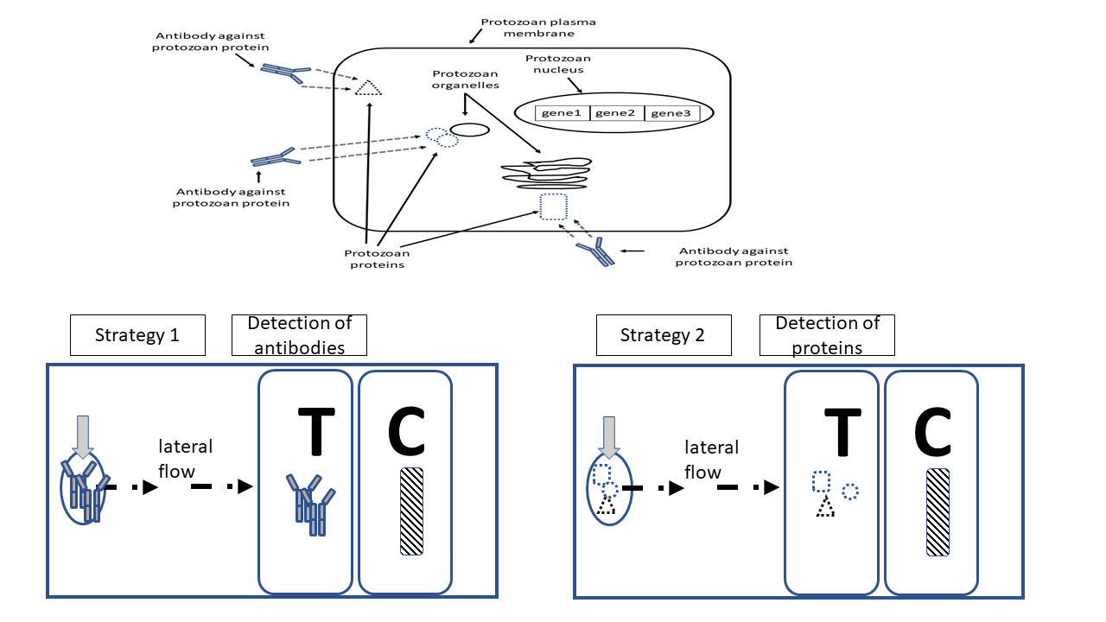
Rapid Diagnostic Tests (RDT) – Details Lateral Flow Immunochromatography
Figure 14.10 Panel B: Lateral flow immunochromatography strategies for protozoan pathogens. Testing strategy 1 detects antibodies against the protozoan. Testing strategy 2 detects proteins made by the protozoan.

Slide 29
Rapid Diagnostic Tests (RDT) – Details Lateral Flow Immunochromatography
Check your understanding about details of lateral flow immuno-chromatography.
Identify correct statements.
There is a lateral flow immuno-chromatography test to detect hepatitis C virus infection.
There is a lateral flow immuno-chromatography test to detect HIV infection.
There is a lateral flow immuno-chromatography test to detect infection with influenza virus.
There is a lateral flow immuno-chromatography test to detect infection with Plasmodium falciparum that causes malaria.
All the statements are correct.

Slide 30
Rapid Diagnostic Tests (RDT) – Details Lateral Flow Immunochromatography
Check your understanding about details of lateral flow immuno-chromatography.
There are different possible strategies how a test works that uses the lateral flow immuno-chromatography.
One strategy is to detect parts or components of the pathogen such as proteins of the pathogen. For example, the strategy aims for detection of viral proteins for a virus.
For this strategy, what would the test then detect ?
Presence of antibodies against virus in samples obtained from the patient.
Presence of proteins made by the virus in samples obtained from the patient.
All of the choices are correct.
None of the choices are correct.

Slide 31
Rapid Diagnostic Tests (RDT) – Details Lateral Flow Immunochromatography
Check your understanding about details of lateral flow immuno-chromatography.
There are different possible strategies how a test works that uses the lateral flow immuno-chromatography.
Another strategy is to detect the immune response of the patient to the pathogen upon infection that includes production of antibodies specific against the pathogen. For example, for infection with hepatitis virus antibodies against this hepatitis virus.
For this strategy, what would the test then detect ?
Presence of antibodies against virus in samples obtained from the patient.
Presence of proteins made by the virus in samples obtained from the patient.
All of the choices are correct.
None of the choices are correct.

Slide 32
Rapid Diagnostic Tests (RDT) – Details Lateral Flow Immunochromatography
Check your understanding about details of lateral flow immuno-chromatography.
What is the meaning of "lateral flow" in lateral flow immuno-chromatography?
Samples or specimen flow sideways from an injection port towards a test region on the opposite side of the testing device.
Antibodies are used to detect pathogen or immune response to pathogen.
All the choices are correct.
None of the choices are correct.

Slide 33
Rapid Diagnostic Tests (RDT) – Details Lateral Flow Immunochromatography
Check your understanding about details of lateral flow immuno-chromatography.
What is the meaning of "immuno" in lateral flow immuno-chromatography?
Samples or specimen flow sideways from an injection port towards a test region on the opposite side of the testing device.
Antibodies are used to detect pathogen or immune response to pathogen.
All the choices are correct.
None of the choices are correct.

Slide 34
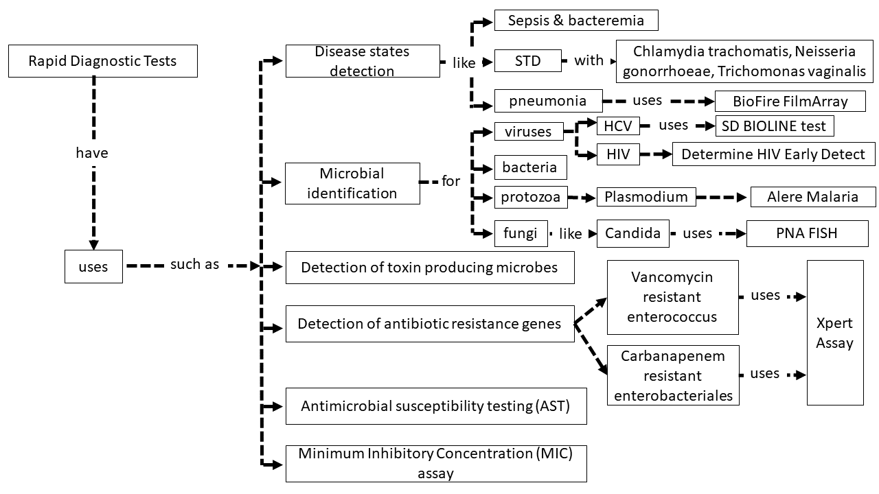
Rapid Diagnostic Tests (RDT) – Other Uses
Figure 14.11: Examples of Use Cases for Diseases and Pathogens. Specific use cases for Rapid Diagnostic Tests are shown. Use cases include disease detection, microbial identification, detection of toxin producing microbes and antibiotic resistance genes, as well as antimicrobial susceptibility testing, and minimum inhibitory concentration assays. For most of the categories, specific examples are given. Additionally, names of some rapid diagnostic tests are given.

Slide 35
Rapid Diagnostic Tests (RDT) – Other Uses
Check your understanding about the other uses of Rapid Diagnostic Tests
Match letter to the following description:
A rapid diagnostic test of Mycobacterium tuberculosis from 12 patients of shows that 5 samples were susceptible to isoniazid but 7 samples were resistant
A) Disease state detection
B) Microbial identification
C) Detection of toxin production
D) Detection of antibiotic resistance genes
E) Antimicrobial susceptibility testing
F) Minimum inhibitory concentration assay (MIC)

Slide 36
Rapid Diagnostic Tests (RDT) – Other Uses
Check your understanding about the other uses of Rapid Diagnostic Tests
Match letter to the following description:
The rapid diagnostic test detected that the patient was infected with a strain of E. coli that produced a toxin
A) Disease state detection
B) Microbial identification
C) Detection of toxin production
D) Detection of antibiotic resistance genes
E) Antimicrobial susceptibility testing
F) Minimum inhibitory concentration assay (MIC)

Slide 37
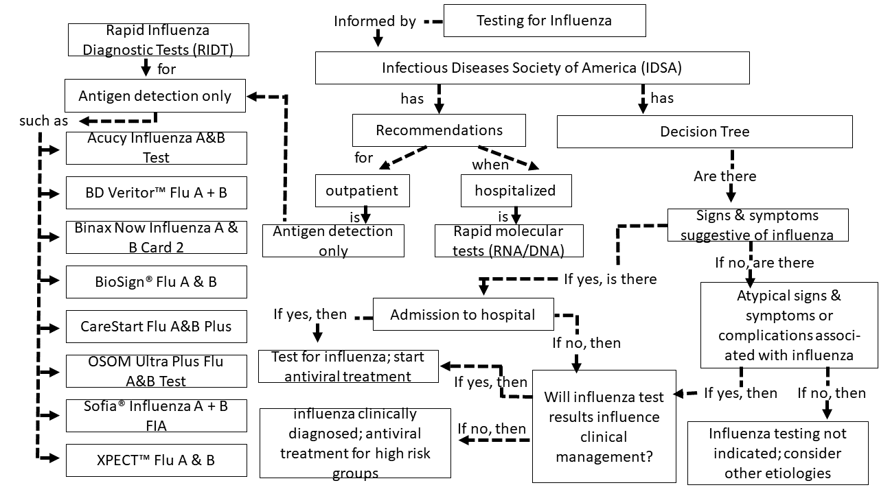
Rapid Diagnostic Tests (RDT) – Influenza
Figure 14.12: Rapid diagnostic tests for influenza. Recommendations of the Infectious Diseases Society of America are shown about what type of diagnostic test to use and when to test if an infection with influenza needs to be tested.

Slide 38
Rapid Diagnostic Tests (RDT) – References
Baker, J., Ho, M.-F., Pelecanos, A., Gatton, M., Chen, N., Abdullah, S., Albertini, A., Ariey, F., Barnwell, J., Bell, D., Cunningham, J., Djalle, D., Echeverry, D.F., Gamboa, D., Hii, J., Kyaw, M.P., Luchavez, J., Membi, C., Menard, D., Murillo, C., Nhem, S., Ogutu, B., Onyor, P., Oyibo, W., Wang, S.Q., McCarthy, J., Cheng, Q., 2010. Global sequence variation in the histidine-rich proteins 2 and 3 of Plasmodium falciparum: implications for the performance of malaria rapid diagnostic tests. Malar J 9, 129. https://doi.org/10.1186/1475-2875-9-129
Banerjee, R., Patel, R., 2023. Molecular diagnostics for genotypic detection of antibiotic resistance: current landscape and future directions. JAC Antimicrob Resist 5, dlad018. https://doi.org/10.1093/jacamr/dlad018
Bergtrom, G., 2022. Annotated Cell and Molecular Biology 5e: What We Know and How We Found Out.
CDC, 2024. Rapid Influenza Diagnostic Tests (RIDTs) [WWW Document]. Influenza (Flu). URL https://www.cdc.gov/flu/hcp/testing-methods/table-ridt.html (accessed 4.17.25)
Center for Devices and Radiological Health, 2025. Nucleic Acid Based Tests. FDA.

Slide 39
Rapid Diagnostic Tests (RDT) – References
Cerqueira, L., Fernandes, R.M., Ferreira, R.M., Carneiro, F., Dinis-Ribeiro, M., Figueiredo, C., Keevil, C.W., Azevedo, N.F., Vieira, M.J., 2011. PNA-FISH as a new diagnostic method for the determination of clarithromycin resistance of Helicobacter pylori. BMC Microbiology 11, 101. https://doi.org/10.1186/1471-2180-11-101
Das, S., Peck, R.B., Barney, R., Jang, I.K., Kahn, M., Zhu, M., Domingo, G.J., 2018. Performance of an ultra-sensitive Plasmodium falciparum HRP2-based rapid diagnostic test with recombinant HRP2, culture parasites, and archived whole blood samples. Malar J 17, 118. https://doi.org/10.1186/s12936-018-2268-7
Howard, R., Uni, S., Aikawa, M., Aley, S., Leech, J., Lewis, A.M., Wellems, T.E., Rener, J., Taylor, D., 1986. Secretion of a malarial histidine-rich protein (Pf HRP II) from Plasmodium falciparum-infected erythrocytes. J Cell Biol 103, 1269–1277.
Lamy, B., Sundqvist, M., Idelevich, E.A., 2020. Bloodstream infections – Standard and progress in pathogen diagnostics. Clinical Microbiology and Infection 26, 142–150. https://doi.org/10.1016/j.cmi.2019.11.017
Miller, M.B., Atrzadeh, F., Burnham, C.A., Cavalieri, S., Dunn, J., Jones, S., Mathews, C., McNult, P., Meduri, J., Newhouse, C., Newton, D., Oberholzer, M., Osiecki, J., Pedersen, D., Sweeney, N., Whitfield, N., Campos, J., ASM Clinical and Public Health Microbiology Committee and the ASM Corporate Council, 2019. Clinical Utility of Advanced Microbiology Testing Tools. J Clin Microbiol 57, e00495-19. https://doi.org/10.1128/JCM.00495-19

Slide 40
Rapid Diagnostic Tests (RDT) – References
Muñoz-Chimeno, M., Valencia, J., Rodriguez-Recio, A., Cuevas, G., Garcia-Lugo, A., Manzano, S., Rodriguez-Paredes, V., Fernandez, B., Morago, L., Casado, C., Avellón, A., Ryan, P., 2023. HCV, HIV AND HBV rapid test diagnosis in non-clinical outreach settings can be as accurate as conventional laboratory tests. Sci Rep 13, 7554. https://doi.org/10.1038/s41598-023-33925-2
Singhal, N., Kumar, M., Kanaujia, P.K., Virdi, J.S., 2015. MALDI-TOF mass spectrometry: an emerging technology for microbial identification and diagnosis. Front. Microbiol. 6. https://doi.org/10.3389/fmicb.2015.00791
Soroka, M., Wasowicz, B., Rymaszewska, A., 2021. Loop-Mediated Isothermal Amplification (LAMP): The Better Sibling of PCR? Cells 10, 1931. https://doi.org/10.3390/cells10081931
Sousa, L.G.V., Castro, J., França, A., Almeida, C., Muzny, C.A., Cerca, N., 2021. A New PNA-FISH Probe Targeting Fannyhessea vaginae. Front. Cell. Infect. Microbiol. 11. https://doi.org/10.3389/fcimb.2021.779376
Spanu, T., Fiori, B., D’Inzeo, T., Canu, G., Campoli, S., Giani, T., Palucci, I., Tumbarello, M., Sanguinetti, M., Rossolini, G.M., 2012. Evaluation of the New NucliSENS EasyQ KPC Test for Rapid Detection of Klebsiella pneumoniae Carbapenemase Genes (bla KPC). Journal of Clinical Microbiology 50, 2783–2785. https://doi.org/10.1128/jcm.00284-12

Slide 41
Rapid Diagnostic Tests (RDT) – References
Timbrook, T.T., Morton, J.B., McConeghy, K.W., Caffrey, A.R., Mylonakis, E., LaPlante, K.L., 2017. The Effect of Molecular Rapid Diagnostic Testing on Clinical Outcomes in Bloodstream Infections: A Systematic Review and Meta-analysis. Clin Infect Dis 64, 15–23. https://doi.org/10.1093/cid/ciw649
Uyeki, T.M., Bernstein, H.H., Bradley, J.S., Englund, J.A., File, T.M., Jr, Fry, A.M., Gravenstein, S., Hayden, F.G., Harper, S.A., Hirshon, J.M., Ison, M.G., Johnston, B.L., Knight, S.L., McGeer, A., Riley, L.E., Wolfe, C.R., Alexander, P.E., Pavia, A.T., 2019. Clinical Practice Guidelines by the Infectious Diseases Society of America: 2018 Update on Diagnosis, Treatment, Chemoprophylaxis, and Institutional Outbreak Management of Seasonal Influenzaa. Clinical Infectious Diseases 68, e1–e47. https://doi.org/10.1093/cid/ciy866
Vasala, A., Hytönen, V.P., Laitinen, O.H., 2020. Modern Tools for Rapid Diagnostics of Antimicrobial Resistance. Front Cell Infect Microbiol 10, 308. https://doi.org/10.3389/fcimb.2020.00308
Zalas-Więcek, P., Bogiel, T., Gospodarek-Komkowska, E., 2022. The Accelerate PhenoTM System—A New Tool in Microbiological Diagnostics of Bloodstream Infections: A Pilot Study from Poland. Pathogens 11, 1415. https://doi.org/10.3390/pathogens11121415

