Slide 1


microbiology
Chapter 19 DISEASES OF THE IMMUNE SYSTEM
PowerPoint Image Slideshow

Slide 2

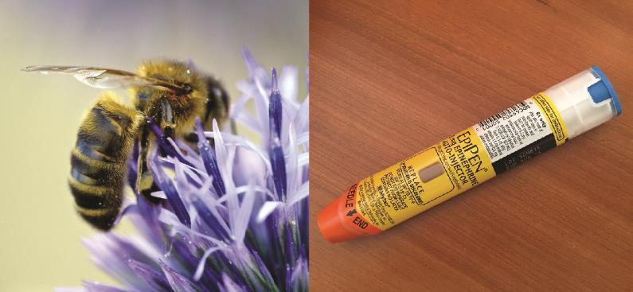
Figure 19.1
Bee stings and other allergens can cause life-threatening, systemic allergic reactions. Sensitive individuals may need to carry an epinephrine auto-injector (e.g., EpiPen) in case of a sting. A bee-sting allergy is an example of an immune response that is harmful to the host rather than protective; epinephrine counteracts the severe drop in blood pressure that can result from the immune response. (credit right: modification of work by Carol Bleistine)

Slide 3
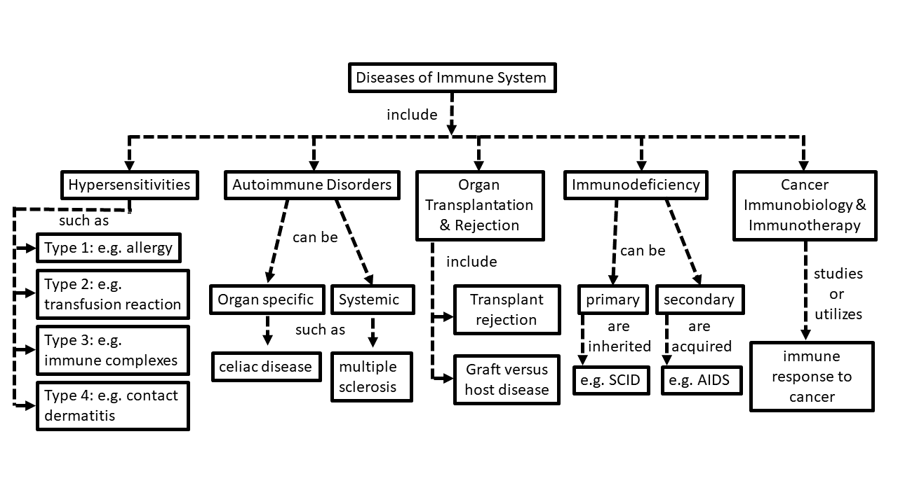
Concept map of the chapter about immune diseases
FIGURE 19.1b Concept map of the chapter about immune diseases (by Illya Tietzel CC 4.0 BY)

Slide 4
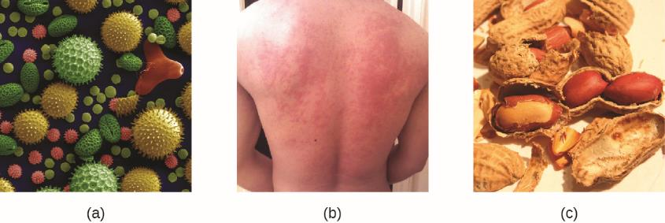
Figure 19.2
Allergens in plant pollen, shown here in a colorized electron micrograph, may trigger allergic rhinitis or hay fever in sensitive individuals.
Skin rashes are often associated with allergic reactions.
Peanuts can be eaten safely by most people but can provoke severe allergic reactions in sensitive individuals.

Slide 5
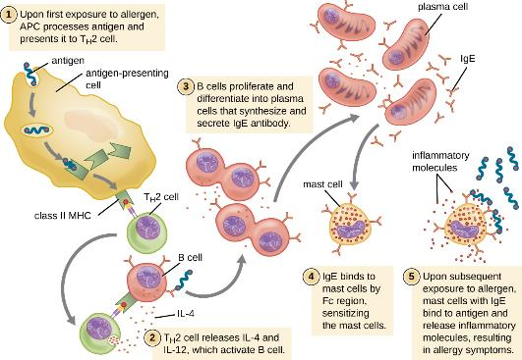
Figure 19.3
On first exposure to an allergen in a susceptible individual, antigen-presenting cells process and present allergen epitopes with major histocompatibility complex (MHC) II to T helper cells. B cells also process and present the same allergen epitope to T_{H}2 cells, which release cytokines IL-4 and IL-13 to stimulate proliferation and differentiation into IgE-secreting plasma cells. The IgE molecules bind to mast cells with their Fc region, sensitizing the mast cells for activation with subsequent exposure to the allergen. With each subsequent exposure, the allergen cross-links IgE molecules on the mast cells, activating the mast cells and causing the release of preformed chemical mediators from granules (degranulation), as well as newly formed chemical mediators that collectively cause the signs and symptoms of type I hypersensitivity reactions.

Slide 6
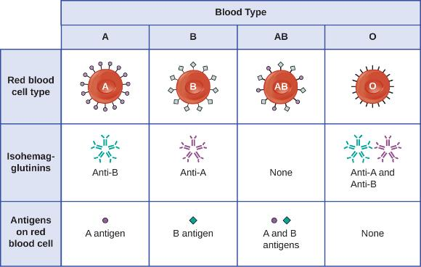
Figure 19.4

Slide 7
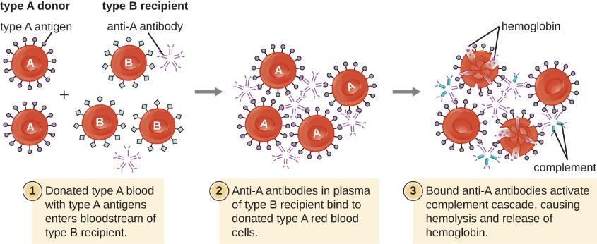
Figure 19.5
A type II hypersensitivity hemolytic transfusion reaction (HTR) leading to hemolytic anemia. Blood from a type A donor is administered to a patient with type B blood. The anti-A isohemagglutinin IgM antibodies in the recipient bind to and agglutinate the incoming donor type A red blood cells. The bound anti-A antibodies activate the classical complement cascade, resulting in destruction of the donor red blood cells.

Slide 8
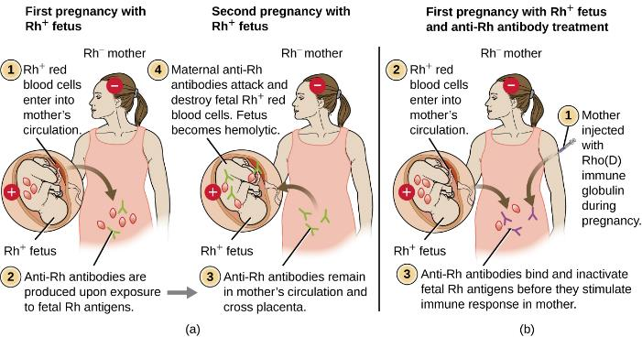
Figure 19.6
When an Rh− mother has an Rh+ fetus, fetal erythrocytes are introduced into the mother’s circulatory system before or during birth, leading to production of anti-Rh IgG antibodies. These antibodies remain in the mother and, if she becomes pregnant with a second Rh+ baby, they can cross the placenta and attach to fetal Rh+ erythrocytes. Complement-mediated hemolysis of fetal erythrocytes results in a lack of sufficient cells for proper oxygenation of the fetus.
HDN can be prevented by administering Rho(D) immune globulin during and after each pregnancy with an Rh+ fetus. The immune globulin binds fetal Rh+ RBCs that gain access to the mother’s bloodstream, preventing activation of her primary immune response.

Slide 9
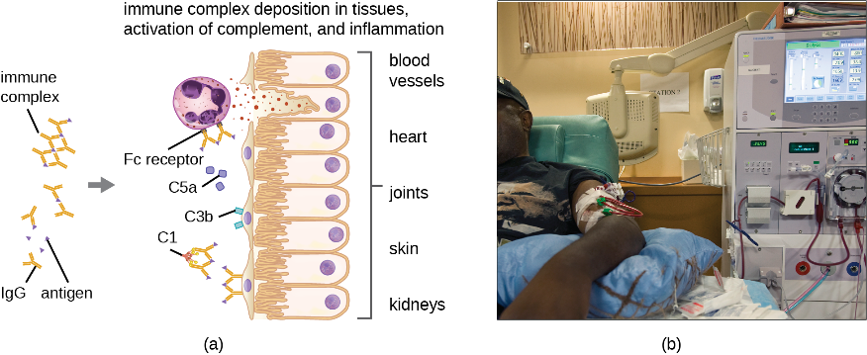
Figure 19.7
Type III hypersensitivities and the systems they affect.
Immune complexes form and deposit in tissue. Complement activation, stimulation of an inflammatory response, and recruitment and activation of neutrophils result in damage to blood vessels, heart tissue, joints, skin, and/or kidneys.
If the kidneys are damaged by a type III hypersensitivity reaction, dialysis may be required.

Slide 10
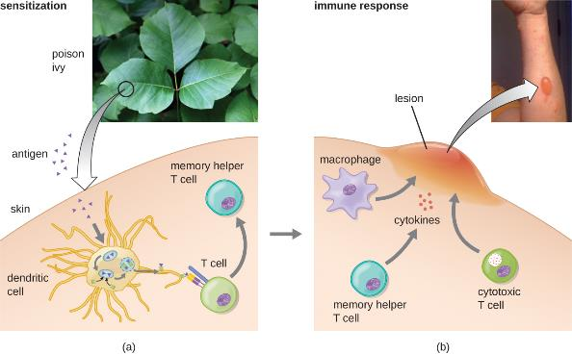
Figure 19.8
Exposure to hapten antigens in poison ivy can cause contact dermatitis, a type IV hypersensitivity.
The first exposure to poison ivy does not result in a reaction. However, sensitization stimulates helper T cells, leading to production of memory helper T cells that can become reactivated on future exposures.
Upon secondary exposure, the memory helper T cells become reactivated, producing inflammatory cytokines that stimulate macrophages and cytotoxic T cells to induce an inflammatory lesion at the exposed site. This lesion, which will persist until the allergen is removed, can inflict significant tissue damage if it continues long enough.

Slide 11
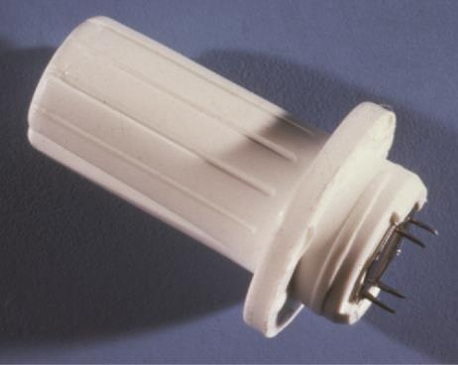
Figure 19.9
The modern version of Pirquet’s scarification is the tine test, which uses devices like this to administer tuberculin antigen into the skin, usually on the inside of the forearm. The tine test is considered less reliable than the Mantoux test. (credit: modification of work by the Centers for Disease Control and Prevention)

Slide 12
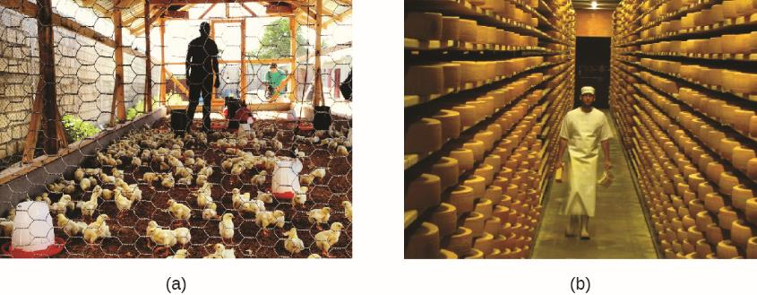
Figure 19.10
Occupational exposure to dust, mold, and other allergens can result in hypersensitivity pneumonitis.
The People exposed daily to large numbers of birds may be susceptible to poultry worker’s lung.
Workers in a cheese factory may become sensitized to different types of molds and develop cheese handler’s disease. (credit a: modification of work by The Global Orphan Project) Project)

Slide 13
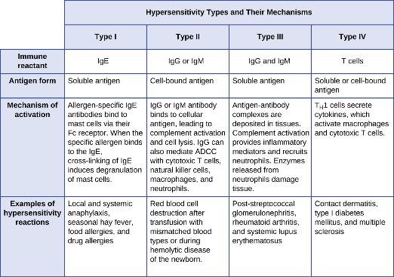
Figure 19.11
Components of the immune system cause four types of hypersensitivities. Notice that types I–III are B-cell/antibody-mediated hypersensitivities, whereas type IV hypersensitivity is exclusively a T-cell phenomenon.

Slide 14
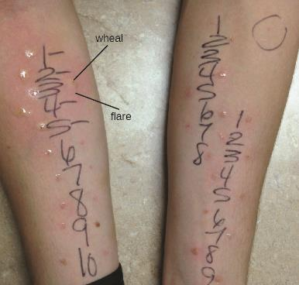
Figure 19.12
Results of an allergy skin-prick test to test for type I hypersensitivity to a group of potential allergens. A positive result is indicated by a raised area (wheal) and surrounding redness (flare). (credit: modification of work by “OakleyOriginals”/Flickr)

Slide 15
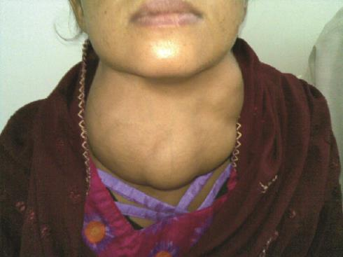
Figure 19.13
Goiter, a hypertrophy of the thyroid, is a symptom of Graves disease and Hashimoto thyroiditis.

Slide 16
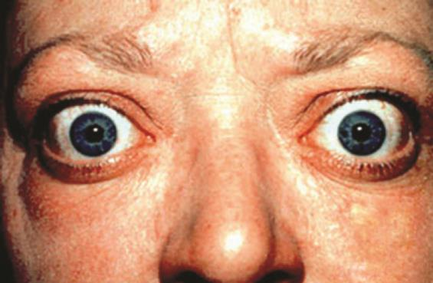
Figure 19.14
Exophthalmia, or Graves ophthalmopathy, is a sign of Graves disease. (credit: modification of work by Jonathan Trobe, University of Michigan Kellogg Eye Center)

Slide 17
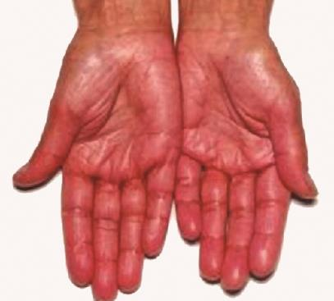
Figure 19.15
Hyperpigmentation is a sign of Addison disease. (credit: modification of work by Petros Perros)

Slide 18
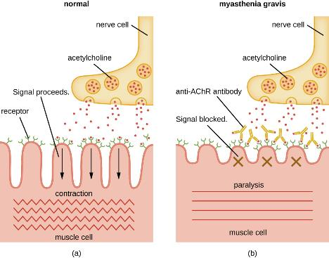
Figure 19.16
Myasthenia gravis and impaired muscle contraction.
Normal release of the neurotransmitter acetylcholine stimulates muscle contraction.
In myasthenia gravis, autoantibodies block the receptors for acetylcholine (AChr) on muscle cells, resulting in paralysis.

Slide 19
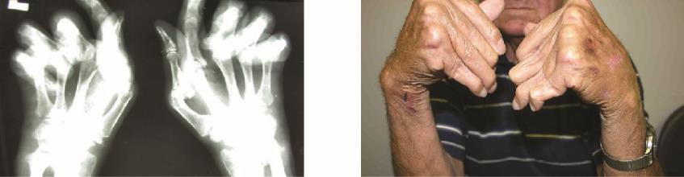
Figure 19.17
The radiograph (left) and photograph (right) show damage to the hands typical of rheumatoid arthritis. (credit right: modification of work by “handarmdoc”/Flickr)

Slide 20
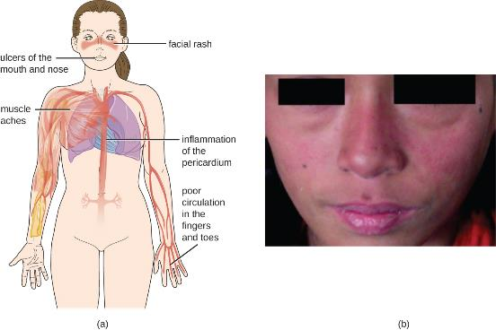
Figure 19.18
Systemic lupus erythematosus is characterized by autoimmunity to the individual’s own DNA and/or proteins.
This patient is presenting with a butterfly rash, one of the characteristic signs of lupus. (credit a: modification of work by Mikael Häggström; credit b: modification of work by Shrestha D, Dhakal AK, Shiva RK, Shakya A, Shah SC, Shakya H)

Slide 21
Select Autoimmune Diseases – Part 1
Select Autoimmune Diseases
Disease | Cause | Signs and Symptoms
Addison disease | Destruction of adrenal gland cells by cytotoxic T cells | Weakness, nausea, hypotension, fatigue; adrenal crisis with severe pain in abdomen, lower back, and legs; circulatory system collapse, kidney failure
Celiac disease | Antibodies to gluten become autoantibodies that target cells of the small intestine | Severe diarrhea, abdominal pain, anemia, malnutrition
Diabetes mellitus (type I) | Cytotoxic T-cell destruction of the insulin-producing β cells of the pancreas | Hyperglycemia, extreme increase in thirst and urination, weight loss, extreme fatigue
Graves disease | Autoantibodies target thyroid-stimulating hormone receptors, resulting in overstimulation of the thyroid | Hyperthyroidism with rapid and irregular heartbeat, heat intolerance, weight loss, goiter, exophthalmia
Hashimoto thyroiditis | Thyroid gland is attacked by cytotoxic T cells, lymphocytes, macrophages, and autoantibodies | Thyroiditis with goiter, cold intolerance, muscle weakness, painful and stiff joints, depression, memory loss

Slide 22
Select Autoimmune Diseases – Part 2
Select Autoimmune Diseases
Disease | Cause | Signs and Symptoms
Multiple sclerosis (MS) | Cytotoxic T-cell destruction of the myelin sheath surrounding nerve axons in the central nervous system | Visual disturbances, muscle weakness, impaired coordination and balance, numbness, prickling or “pins and needles” sensations, impaired cognitive function and memory
Myasthenia gravis | Autoantibodies directed against acetylcholine receptors within the neuromuscular junction | Extreme muscle weakness eventually leading to fatal respiratory arrest
Psoriasis | Cytokine activation of keratinocytes causes rapid and excessive epidermal cell turnover | Itchy or sore patches of thick, red skin with silvery scales; commonly affects elbows, knees, scalp, back, face, palms, feet
Rheumatoid arthritis | Autoantibodies, immune complexes, complement activation, phagocytes, and T cells damage membranes and bone in joints | Joint inflammation, pain and disfigurement, chronic systemic inflammation

Slide 23
Select Autoimmune Diseases – Part 3
Select Autoimmune Diseases
Disease | Cause | Signs and Symptoms
Systemic lupus erythematosus (SLE) | Autoantibodies directed against nuclear and cytoplasmic molecules form immune complexes that deposit in tissues. Phagocytic cells and complement activation cause tissue damage and inflammation | Fatigue, fever, joint pain and swelling, hair loss, anemia, clotting, a sunlight-sensitive "butterfly" rash, skin lesions, photosensitivity, decreased kidney function, memory loss, confusion, depression

Slide 24
Types of Tissue and Organ Grafts and Their Complications
Types of Tissue and Organ Grafts and Their Complications
Graft | Procedure | Complications
Autograft | From self to self | No rejection concerns
Isograft | From identical twin to twin | Little concern of rejection
Allograft | From relative or nonrelative to individual | Rejection possible
Xenograft | From animal to human | Rejection possible
Table 19.7

Slide 25
Types of Tissue and Organ Grafts and Their Complications
Primary and Secondary Immunodeficiencies
Disease |  | Effect on Immune Function | Outcomes
Primary immunodeficiencies | Chronic granulomatous disease | Impaired killing of bacteria within the phagolysosome of neutrophils and macrophages | Chronic infections and granulomas
 | Selective IgA deficiency | Inability to produce secretory IgA | Predisposition to lung and gastrointestinal infections
 | Severe combined immunodeficiency disease (SCID) | Deficient humoral and cell-mediated immune responses | Early development of severe and life-threatening opportunistic infections
 | X-linked agammaglobulinemia | Flawed differentiation of B cells and absence of specific antibodies | Recurrent infections almost exclusively due to pathogens that cause pyogenic infections
Secondary immunodeficiencies | Immunosuppressive therapies (e.g., chemotherapy, radiotherapy) | Impaired humoral and/or cell-mediated immune responses | Opportunistic infections, rare cancers
 | Malnutrition | Impaired humoral and/or cell-mediated immune responses | Opportunistic infections, rare cancers
 | Viral infection (e.g., HIV) | Impaired cell-mediated immune responses due to CD4 T-cell lymphopenia | Opportunistic infections, rare cancers
Table 19.8

Slide 26
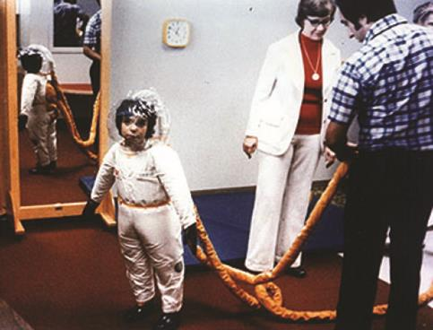
Figure 19.19
David Vetter, popularly known as “The Bubble Boy,” was born with SCID and lived most of his life isolated inside a plastic bubble. Here he is shown outside the bubble in a suit specially built for him by NASA. (credit: NASA Johnson Space Center)

Slide 27
This OpenStax ancillary resource is © Rice University under a CC-BY 4.0 International license; it may be reproduced or modified but must be attributed to OpenStax, Rice University and any changes must be noted.

