Slide 1


microbiology
Chapter 17 INNATE NONSPECIFIC HOST DEFENSES
PowerPoint Image Slideshow

Slide 2
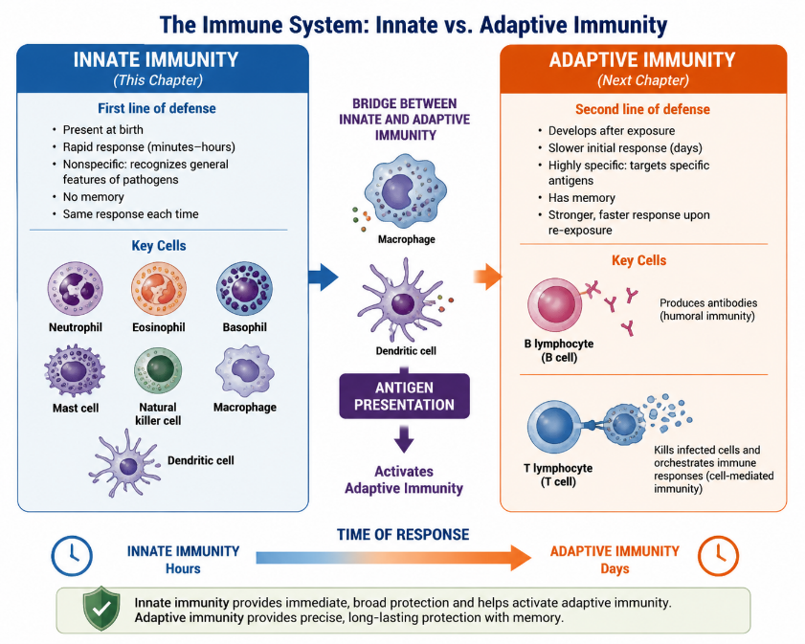
FIGURE 17.1A

Slide 3
FIGURE 17.1A
Innate immunity is fast and nonspecific
Adaptive immunity is slower, specific, and has memory.
Antigen presentation connects the two systems.

Slide 4

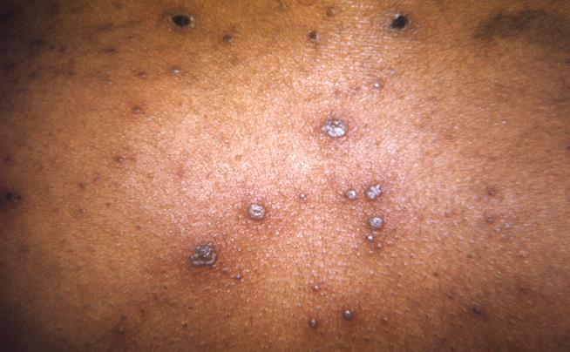
Figure 17.1B
Varicella, or chickenpox, is caused by the highly contagious varicella-zoster virus. The characteristic rash seen here is partly a result of inflammation associated with the body’s immune response to the virus. Inflammation is a response mechanism of innate immunity that helps the body fight off a wide range of infections. (credit: modification of work by Centers for Disease Control and Prevention)

Slide 5
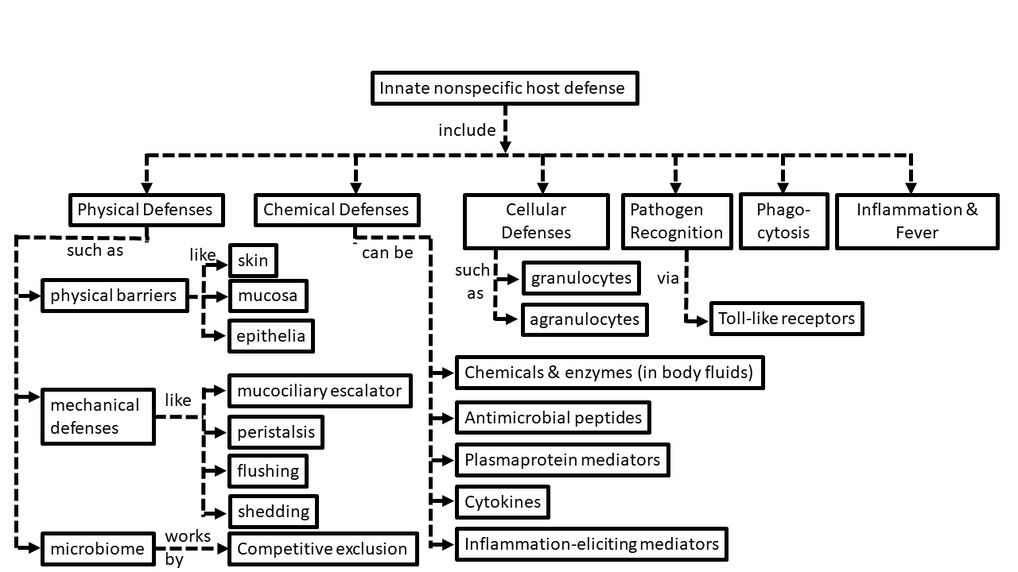
Concept map about the parts of innate immunity

Slide 6
Physical Defenses
17.1 Physical Defenses
Nonspecific innate immunity provides a first line of defense against infection by nonspecifically blocking entry of microbes and targeting them for destruction or removal from the body.
The physical defenses of innate immunity include physical barriers, mechanical actions that remove microbes and debris, and the microbiome, which competes with and inhibits the growth of pathogens.
The skin, mucous membranes, and endothelia throughout the body serve as physical barriers that prevent microbes from reaching potential sites of infection. Tight cell junctions in these tissues prevent microbes from passing through.
Microbes trapped in dead skin cells or mucus are removed from the body by mechanical actions such as shedding of skin cells, mucociliary sweeping, coughing, peristalsis, and flushing of bodily fluids (e.g., urination, tears)
The resident microbiota provide a physical defense by occupying available cellular binding sites and competing with pathogens for available nutrients.

Slide 7
Chemical Defenses
17.2 Chemical Defenses
Numerous chemical mediators produced endogenously and exogenously exhibit nonspecific antimicrobial functions.
Many chemical mediators are found in body fluids such as sebum, saliva, mucus, gastric and intestinal fluids, urine, tears, cerumen, and vaginal secretions.
Antimicrobial peptides (AMPs) found on the skin and in other areas of the body are largely produced in response to the presence of pathogens. These include dermcidin, cathelicidin, defensins, histatins, and bacteriocins.
Plasma contains various proteins that serve as chemical mediators, including acute-phase proteins, complement proteins, and cytokines.
The complement system involves numerous precursor proteins that circulate in plasma. These proteins become activated in a cascading sequence in the presence of microbes, resulting in the opsonization of pathogens, chemoattraction of leukocytes, induction of inflammation, and cytolysis through the formation of a membrane attack complex (MAC).
Cytokines are proteins that facilitate various nonspecific responses by innate immune cells, including production of other chemical mediators, cell proliferation, cell death, and differentiation.
Cytokines play a key role in the inflammatory response, triggering production of inflammation-eliciting mediators such as acute-phase proteins, histamine, leukotrienes, prostaglandins, and bradykinin.

Slide 8
Cellular Defenses
17.3 Cellular Defenses
The formed elements of the blood include red blood cells (erythrocytes), white blood cells (leukocytes), and platelets (thrombocytes). Of these, leukocytes are primarily involved in the immune response.
All formed elements originate in the bone marrow as stem cells (HSCs) that differentiate through hematopoiesis.
Granulocytes are leukocytes characterized by a lobed nucleus and granules in the cytoplasm. These include neutrophils (PMNs), eosinophils, and basophils.
Neutrophils are the leukocytes found in the largest numbers in the bloodstream and they primarily fight bacterial infections.
Eosinophils target parasitic infections. Eosinophils and basophils are involved in allergic reactions. Both release histamine and other proinflammatory compounds from their granules upon stimulation.
Mast cells function similarly to basophils but can be found in tissues outside the bloodstream.
Natural killer (NK) cells are lymphocytes that recognize and kill abnormal or infected cells by releasing proteins that trigger apoptosis.
Monocytes are large, mononuclear leukocytes that circulate in the bloodstream. They may leave the bloodstream and take up residence in body tissues, where they differentiate and become tissue-specific macrophages and dendritic cells.

Slide 9
Pathogen Recognition and Phagocytosis
17.4 Pathogen Recognition and Phagocytosis
Phagocytes are cells that recognize pathogens and destroy them through phagocytosis.
Recognition often takes place by the use of phagocyte receptors that bind molecules commonly found on pathogens, known as pathogen-associated molecular patterns (PAMPs).
The receptors that bind PAMPs are called pattern recognition receptors, or PRRs. Toll-like receptors (TLRs) are one type of PRR found on phagocytes.
Extravasation of white blood cells from the bloodstream into infected tissue occurs through the process of transendothelial migration.
Phagocytes degrade pathogens through phagocytosis, which involves engulfing the pathogen, killing and digesting it within a phagolysosome, and then excreting undigested matter.

Slide 10
Inflammation and Fever
17.5 Inflammation and Fever
Inflammation results from the collective response of chemical mediators and cellular defenses to an injury or infection.
Acute inflammation is short lived and localized to the site of injury or infection. Chronic inflammation occurs when the inflammatory response is unsuccessful, and may result in the formation of granulomas (e.g., with tuberculosis) and scarring (e.g., with hepatitis C viral infections and liver cirrhosis).
The five cardinal signs of inflammation are erythema, edema, heat, pain, and altered function. These largely result from innate responses that draw increased blood flow to the injured or infected tissue.
Fever is a system-wide sign of inflammation that raises the body temperature and stimulates the immune response.
Both inflammation and fever can be harmful if the inflammatory response is too severe.

Slide 11
Overview of Nonspecific Innate Immune Defenses
Overview of Nonspecific Innate Immune Defenses
Physical defenses | Physical barriers
 | Mechanical defenses
 | Microbiome
Chemical defenses | Chemicals and enzymes in body fluids
 | Antimicrobial peptides
 | Plasma protein mediators
 | Cytokines
 | Inflammation-eliciting mediators
Cellular defenses | Granulocytes
 | Agranulocytes
Table 17.1

Slide 12
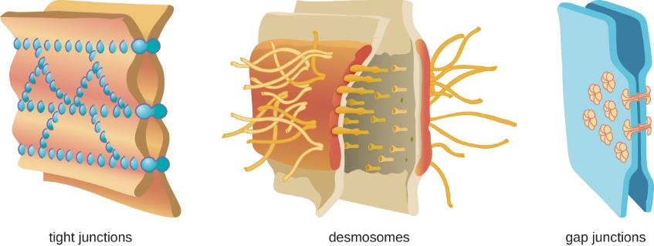
Figure 17.2
There are multiple types of cell junctions in human tissue, three of which are shown here. Tight junctions rivet two adjacent cells together, preventing or limiting material exchange through the spaces between them. Desmosomes have intermediate fibers that act like shoelaces, tying two cells together, allowing small materials to pass through the resulting spaces. Gap junctions are channels between two cells that permit their communication via signals. (credit: modification of work by Mariana Ruiz Villareal)

Slide 13
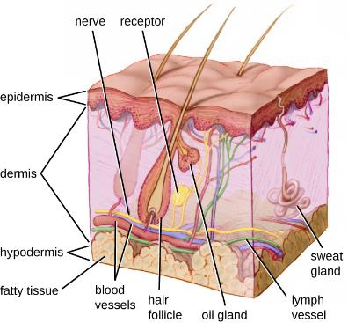
Figure 17.3
Human skin has three layers, the epidermis, the dermis, and the hypodermis, which provide a thick barrier between microbes outside the body and deeper tissues. Dead skin cells on the surface of the epidermis are continually shed, taking with them microbes on the skin’s surface. (credit: modification of work by National Institutes of Health)

Slide 14
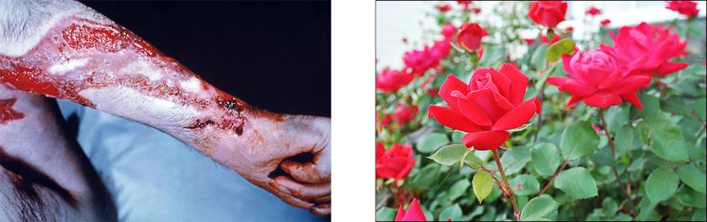
Figure 17.4
Rose gardener’s disease can occur when the fungus Sporothrix schenkii breaches the skin through small cuts, such as might be inflicted by thorns. (credit left: modification of work by Elisa Self; credit right: modification of work by Centers for Disease Control and Prevention)

Slide 15
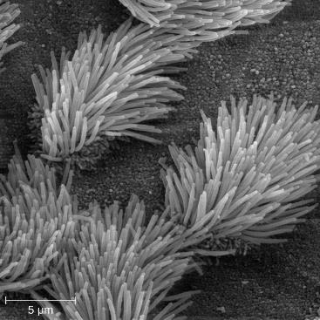
Figure 17.5
This scanning electron micrograph shows ciliated and nonciliated epithelial cells from the human trachea. The mucociliary escalator pushes mucus away from the lungs, along with any debris or microorganisms that may be trapped in the sticky mucus, and the mucus moves up to the esophagus where it can be removed by swallowing.

Slide 16
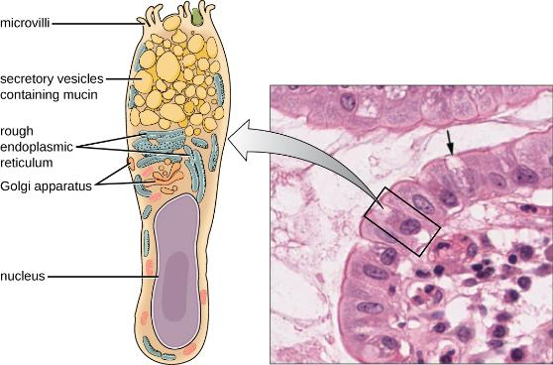
Figure 17.6
Goblet cells produce and secrete mucus. The arrows in this micrograph point to the mucus-secreting goblet cells (magnification 1600✕) in the intestinal epithelium. (credit micrograph: Micrograph provided by the Regents of University of Michigan Medical School © 2012)

Slide 17
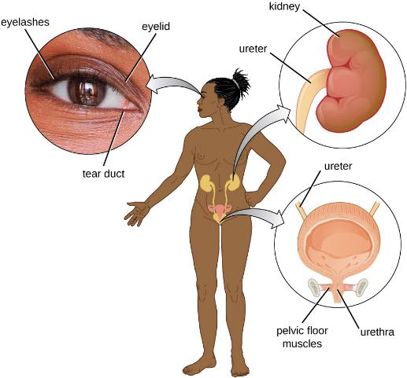
Figure 17.7
Tears flush microbes away from the surface of the eye. Urine washes microbes out of the urinary tract as it passes through; as a result, the urinary system is normally sterile.

Slide 18
Physical Defenses of Nonspecific Innate Immunity
Physical Defenses of Nonspecific Innate Immunity
Defense | Examples | Function
Cellular barriers | Skin, mucous membranes, endothelial cells | Deny entry to pathogens
Mechanical defenses | Shedding of skin cells, mucociliary sweeping, peristalsis, flushing action of urine and tears | Remove pathogens from potential sites of infection
Microbiome | Resident bacteria of the skin, upper respiratory tract, gastrointestinal tract, and genitourinary tract | Compete with pathogens for cellular binding sites and nutrients
Table 17.2

Slide 19
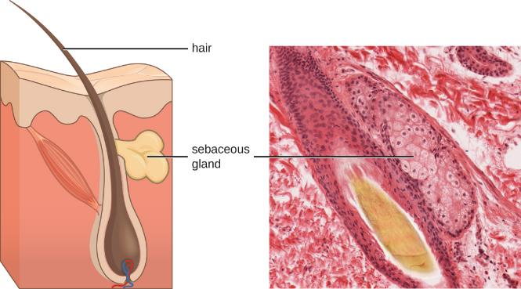
Figure 17.8
Sebaceous glands secrete sebum, a chemical mediator that lubricates and protect the skin from invading microbes. Sebum is also a food source for resident microbes that produce oleic acid, an exogenously produced mediator. (credit micrograph: Micrograph provided by the Regents of University of Michigan Medical School © 2012)

Slide 20
Characteristics of Selected Antimicrobial Peptides (AMPs)
Characteristics of Selected Antimicrobial Peptides (AMPs)
AMP | Secreted by | Body site | Pathogens inhibited | Mode of action
Bacteriocins | Resident microbiota | Gastrointestinal tract | Bacteria | Disrupt membrane
Cathelicidin | Epithelial cells, macrophages, and other cell types | Skin | Bacteria and fungi | Disrupts membrane
Defensins | Epithelial cells, macrophages, neutrophils | Throughout the body | Fungi, bacteria, and many viruses | Disrupt membrane
Dermcidin | Sweat glands | Skin | Bacteria and fungi | Disrupts membrane integrity and ion channels
Histatins | Salivary glands | Oral cavity | Fungi | Disrupt intracellular function
Table 17.3

Slide 21
Some Acute-Phase Proteins and Their Functions
Some Acute-Phase Proteins and Their Functions
C-reactive protein | Coats bacteria (opsonization), preparing them for ingestion by phagocytes
Serum amyloid A
Ferritin | Bind and sequester iron, thereby inhibiting the growth of pathogens
Transferrin
Fibrinogen | Involved in formation of blood clots that trap bacterial pathogens
Mannose-binding lectin | Activates complement cascade
Table 17.4

Slide 22
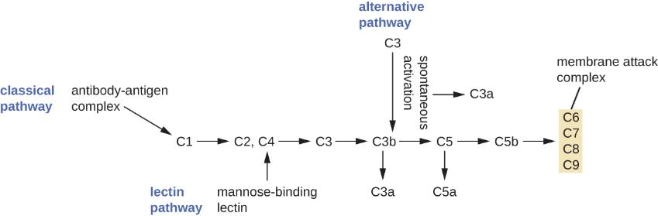
Figure 17.9
The three complement activation pathways have different triggers, as shown here, but all three result in the activation of the complement protein C3, which produces C3a and C3b. The latter binds to the surface of the target cell and then works with other complement proteins to cleave C5 into C5a and C5b. C5b also binds to the cell surface and then recruits C6 through C9; these molecules form a ring structure called the membrane attack complex (MAC), which punches through the cell membrane of the invading pathogen, causing it to swell and burst.

Slide 23
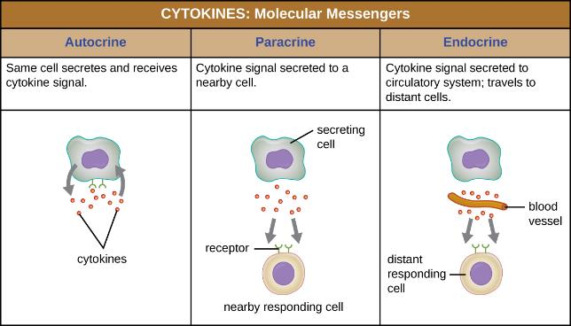
Figure 17.10
Autocrine, paracrine, and endocrine actions describe which cells are targeted by cytokines and how far the cytokines must travel to bind to their intended target cells’ receptors.

Slide 24
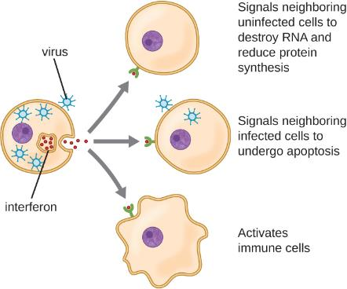
Figure 17.11
Interferons are cytokines released by a cell infected with a virus. Interferon-α and interferon-β signal uninfected neighboring cells to inhibit mRNA synthesis, destroy RNA, and reduce protein synthesis (top arrow). Interferon-α and interferon-β also promote apoptosis in cells infected with the virus (middle arrow). Interferon-γ alerts neighboring immune cells to an attack (bottom arrow). Although interferons do not cure the cell releasing them or other infected cells, which will soon die, their release may prevent additional cells from becoming infected, thus stemming the infection.

Slide 25
Chemical Defenses of Nonspecific Innate Immunity – Part 1
Chemical Defenses of Nonspecific Innate Immunity
Defense | Examples | Function
Chemicals and enzymes in body fluids | Sebum from sebaceous glands | Provides oil barrier protecting hair follicle pores from pathogens
 | Oleic acid from sebum and skin microbiota | Lowers pH to inhibit pathogens
 | Lysozyme in secretions | Kills bacteria by attacking cell wall
 | Acid in stomach, urine, and vagina | Inhibits or kills bacteria
 | Digestive enzymes and bile | Kill bacteria
 | Lactoferrin and transferrin | Bind and sequester iron, inhibiting bacterial growth
 | Surfactant in lungs | Kills bacteria
Antimicrobial peptides | Defensins, bacteriocins, dermcidin, cathelicidin, histatins, | Kill bacteria by attacking membranes or interfering with cell functions
Table 17.5

Slide 26
Chemical Defenses of Nonspecific Innate Immunity – Part 2
Chemical Defenses of Nonspecific Innate Immunity
Defense | Examples | Function
Plasma protein mediators | Acute-phase proteins (C-reactive protein, serum amyloid A, ferritin, fibrinogen, transferrin, and mannose-binding lectin) | Inhibit the growth of bacteria and assist in the trapping and killing of bacteria
 | Complements C3b and C4b | Opsonization of pathogens to aid phagocytosis
 | Complement C5a | Chemoattractant for phagocytes
 | Complements C3a and C5a | Proinflammatory anaphylatoxins
Cytokines | Interleukins | Stimulate and modulate most functions of immune system
 | Chemokines | Recruit white blood cells to infected area
 | Interferons | Alert cells to viral infection, induce apoptosis of virus-infected cells, induce antiviral defenses in infected and nearby uninfected cells, stimulate immune cells to attack virus-infected cells
Table 17.5

Slide 27
Chemical Defenses of Nonspecific Innate Immunity – Part 3
Chemical Defenses of Nonspecific Innate Immunity
Defense | Examples | Function
Inflammation-eliciting mediators | Histamine | Promotes vasodilation, bronchoconstriction, smooth muscle contraction, increased secretion and mucus production
 | Leukotrienes | Promote inflammation; stronger and longer lasting than histamine
 | Prostaglandins | Promote inflammation and fever
 | Bradykinin | Increases vasodilation and vascular permeability, leading to edema
Table 17.5

Slide 28
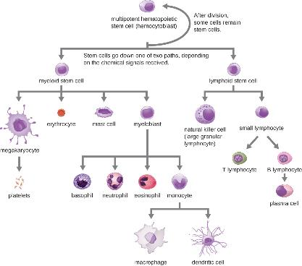
Figure 17.12
All the formed elements of the blood arise by differentiation of hematopoietic stem cells in the bone marrow.

Slide 29
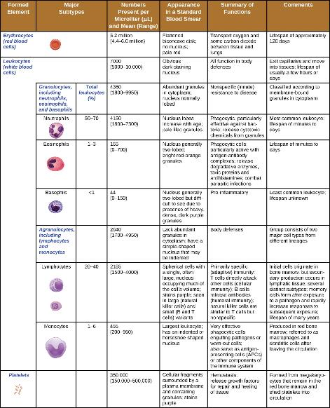
Figure 17.13
Formed elements of blood include erythrocytes (red blood cells), leukocytes (white blood cells), and platelets.

Slide 30
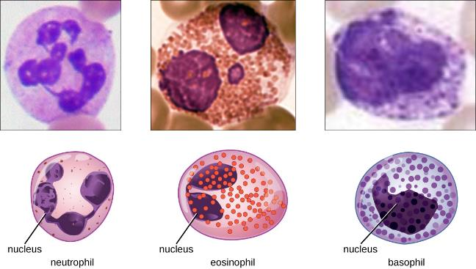
Figure 17.14
Granulocytes can be distinguished by the number of lobes in their nuclei and the staining properties of their granules. (credit “neutrophil” micrograph: modification of work by Ed Uthman)

Slide 31
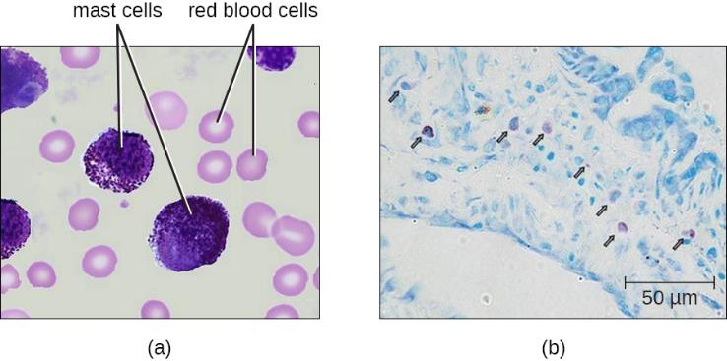
Figure 17.15
Mast cells function similarly to basophils by inducing and promoting inflammatory responses. (a) This figure shows mast cells in blood. In a blood smear, they are difficult to differentiate from basophils (b). Unlike basophils, mast cells migrate from the blood into various tissues. (credit right: modification of work by Greenland JR, Xu X, Sayah DM, Liu FC, Jones KD, Looney MR, Caughey GH)

Slide 32
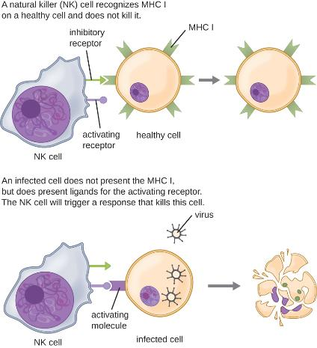
Figure 17.16
Natural killer (NK) cells are inhibited by the presence of the major histocompatibility cell (MHC) receptor on healthy cells. Cancer cells and virus-infected cells have reduced expression of MHC and increased expression of activating molecules. When a NK cell recognizes decreased MHC and increased activating molecules, it will kill the abnormal cell.

Slide 33
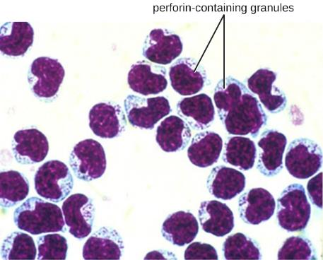
Figure 17.17
Natural killer cell with perforin-containing granules. (credit: modification of work by Rolstad B)

Slide 34
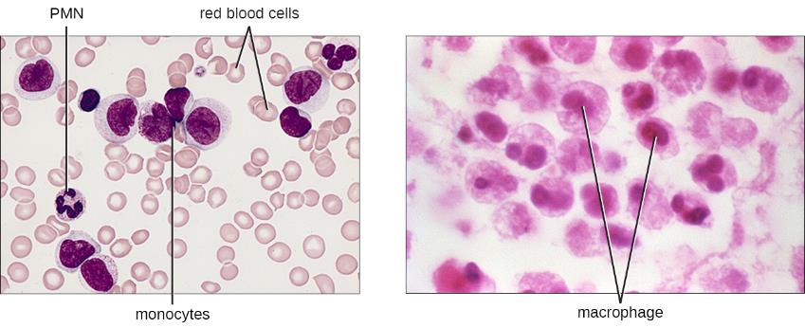
Figure 17.18
Monocytes are large, agranular white blood cells with a nucleus that lacks lobes. When monocytes leave the bloodstream, they differentiate and become macrophages with tissue-specific properties. (credit left: modification of work by Armed Forces Institute of Pathology; credit right: modification of work by Centers for Disease Control and Prevention)

Slide 35
Macrophages Found in Various Body Tissues
Macrophages Found in Various Body Tissues
Tissue | Macrophage
Brain and central nervous system | Microglial cells
Liver | Kupffer cells
Lungs | Alveolar macrophages (dust cells)
Peritoneal cavity | Peritoneal macrophages
Table 17.6

Slide 36
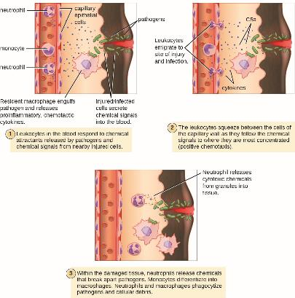
Figure 17.19
Damaged cells and macrophages that have ingested pathogens release cytokines that are proinflammatory and chemotactic for leukocytes. In addition, activation of complement at the site of infection results in production of the chemotactic and proinflammatory C5a. Leukocytes exit the blood vessel and follow the chemoattractant signal of cytokines and C5a to the site of infection. Granulocytes such as neutrophils release chemicals that destroy pathogens. They are also capable of phagocytosis and intracellular killing of bacterial pathogens.

Slide 37
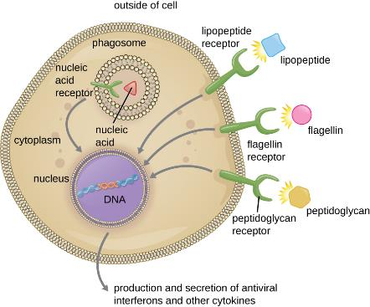
Figure 17.20
Phagocytic cells contain pattern recognition receptors (PRRs) capable of recognizing various pathogen-associated molecular patterns (PAMPs). These PRRs can be found on the plasma membrane or in internal phagosomes. When a PRR recognizes a PAMP, it sends a signal to the nucleus that activates genes involved in phagocytosis, cellular proliferation, production and secretion of antiviral interferons and proinflammatory cytokines, and enhanced intracellular killing.

Slide 38
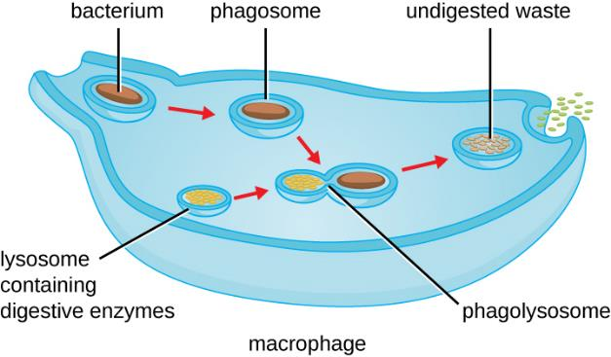
Figure 17.21
The stages of phagocytosis include the engulfment of a pathogen, the formation of a phagosome, the digestion of the pathogenic particle in the phagolysosome, and the expulsion of undigested materials from the cell.

Slide 39
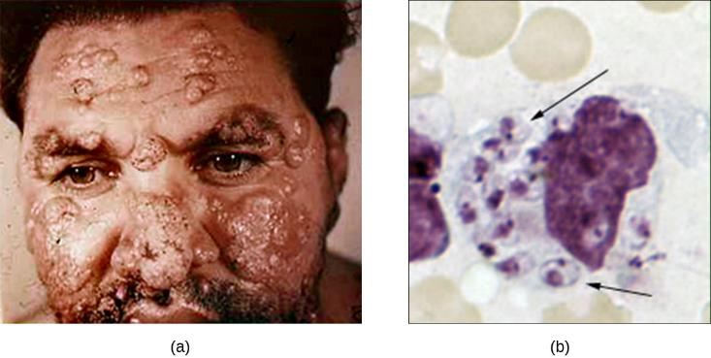
Figure 17.22
Cutaneous leishmaniasis is a disfiguring disease caused by the intracellular flagellate Leishmania tropica, transmitted by the bite of a sand fly.
This light micrograph of a sample taken from a skin lesion shows a large cell, which is a macrophage infected with L. tropica amastigotes (arrows). The amastigotes have lost their flagella but their nuclei are visible. Soon the amastigotes will lyse the macrophage and be engulfed by other phagocytes, spreading the infection. (credit a: modification of work by Otis Historical Archives of “National Museum of Health & Medicine”; credit b: modification of work by Centers for Disease Control and Prevention)

Slide 40
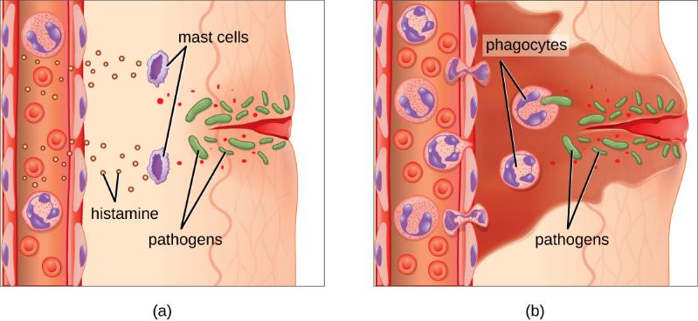
Figure 17.23
Mast cells detect injury to nearby cells and release histamine, initiating an inflammatory response.
Histamine increases blood flow to the wound site, and increased vascular permeability allows fluid, proteins, phagocytes, and other immune cells to enter infected tissue. These events result in the swelling and reddening of the injured site, and the increased blood flow to the injured site causes it to feel warm. Inflammation is also associated with pain due to these events stimulating nerve pain receptors in the tissue. The interaction of phagocyte PRRs with cellular distress signals and PAMPs and opsonins on the surface of pathogens leads to the release of more proinflammatory chemicals, enhancing the inflammatory response.

Slide 41
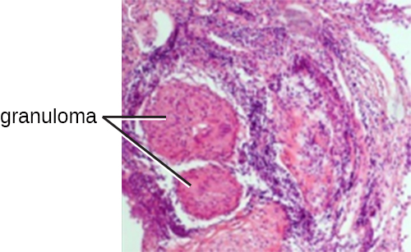
Figure 17.24
A tubercle is a granuloma in the lung tissue of a patient with tuberculosis. In this micrograph, white blood cells (stained purple) have walled off a pocket of tissue infected with Mycobacterium tuberculosis. Granulomas also occur in many other forms of disease. (credit: modification of work by Piotrowski WJ, Górski P, Duda-Szymańska J, Kwiatkowska S)

Slide 42
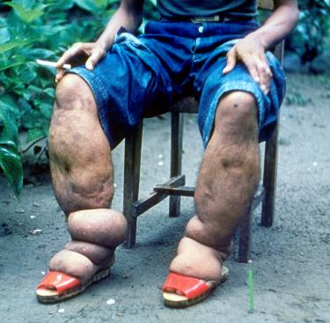
Figure 17.25
Elephantiasis (chronic edema) of the legs due to filariasis. (credit: modification of work by Centers for Disease Control and Prevention)

Slide 43
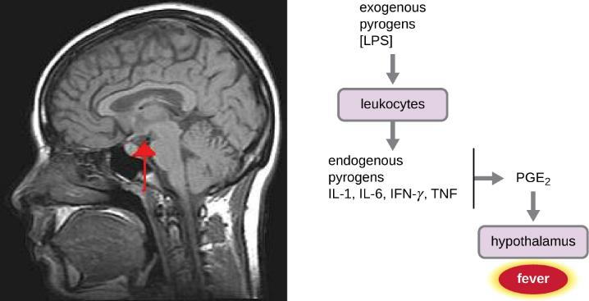
Figure 17.26
The role of the hypothalamus in the inflammatory response. Macrophages recognize pathogens in an area and release cytokines that trigger inflammation. The cytokines also send a signal up the vagus nerve to the hypothalamus.

Slide 44
This OpenStax ancillary resource is © Rice University under a CC-BY 4.0 International license; it may be reproduced or modified but must be attributed to OpenStax, Rice University and any changes must be noted.

