Slide 1

Introduction to Epidemiology
Fundamentals of disease patterns and population health
Notes:
---

Slide 2
Foundations of Epidemiology
Notes:
What is Epidemiology?, Role of Epidemiologists

Slide 3
What is Epidemiology?
Definition and Scope
Epidemiology studies causes and effects of health events in populations, beyond infectious diseases to chronic conditions.
Disease Patterns and Risk Factors
Epidemiologists identify disease patterns and risk factors to improve understanding and health outcomes.
Public Health Impact
Insights from epidemiology guide public health planning and interventions to reduce illness and death.
Notes:
Epidemiology is the scientific study of the causes and effects of health-related events within populations. Traditionally, it focused on infectious disease outbreaks, but modern epidemiology encompasses chronic diseases, environmental factors, and even accidental injuries. The discipline seeks to understand patterns of disease occurrence, identify risk factors, and provide data-driven insights for improving population health. By analyzing how diseases spread and persist, epidemiologists help predict future trends and inform strategies to mitigate health risks. This foundational understanding is critical for public health planning and for developing interventions that reduce morbidity and mortality across diverse communities.

Slide 4

Role of Epidemiologists
Data Collection and Analysis
  Epidemiologists gather and examine data on disease frequency and distribution to identify trends and risk factors.
Public Health Initiatives
  Their findings guide public health policies, resource allocation, and preventive strategies to control disease spread.
Outbreak Investigation
  Epidemiologists investigate outbreaks and implement surveillance programs to monitor and contain diseases.
Health Education and Insights
  They provide actionable insights through education campaigns to improve population health outcomes.
Notes:
Epidemiologists collect and analyze data on disease frequency, distribution, and determinants. Their work involves identifying risk factors associated with disease development and correlating these with demographic, environmental, and behavioral variables. This information forms the basis for public health initiatives, guiding resource allocation, policy development, and preventive measures. Epidemiologists also play a key role in outbreak investigations, surveillance programs, and health education campaigns. By interpreting complex data sets, they provide actionable insights that help reduce disease burden and improve overall population health outcomes.

Slide 5
Public Health and Surveillance
Notes:
Public Health Connection, CDC and Disease Surveillance

Slide 6

Public Health Connection
Epidemiology's Role
  Epidemiology provides critical data to monitor and manage diseases impacting public health.
Policy and Intervention
  Data from epidemiology informs public health policies, interventions, and resource allocation.
Vaccination and Preparedness
  Evidence supports vaccination programs and emergency plans to prevent health threats.
Anticipating Challenges
  Public health uses disease trends to foresee and address emerging health risks proactively.
Notes:
Public health is deeply intertwined with epidemiology, as it relies on epidemiological data to prevent and manage diseases, injuries, and other health threats. Monitoring disease occurrence enables authorities to deploy interventions effectively, allocate funding for research, and shape health policies. Epidemiology provides the evidence base for vaccination programs, screening initiatives, and emergency preparedness plans. By understanding disease trends, public health professionals can anticipate challenges and implement strategies that protect communities from emerging and persistent health risks.

Slide 7

CDC and Disease Surveillance
CDC's Role in Public Health
  The CDC leads national disease surveillance efforts to monitor and control public health threats in the U.S.
National Notifiable Diseases Surveillance System
  NNDSS collects and compiles disease data from state and local agencies for comprehensive tracking.
Morbidity and Mortality Weekly Report
  MMWR publishes timely disease data, offering insights into trends and emerging health threats.
Surveillance for Proactive Response
  Surveillance systems enable analysis and modeling to help policymakers act before outbreaks escalate.
Notes:
In the United States, the Centers for Disease Control and Prevention (CDC) oversees national public health efforts, including disease surveillance. The CDC tracks notifiable diseases through the National Notifiable Diseases Surveillance System (NNDSS), which compiles data from state and local health agencies. These data are published in the Morbidity and Mortality Weekly Report (MMWR), providing timely insights into disease trends. Surveillance systems enable retrospective analysis and predictive modeling, helping policymakers and healthcare providers respond proactively to health threats.

Slide 8
Measuring Disease Occurrence
Notes:
Morbidity and Mortality, Incidence and Prevalence, Calculating and Interpreting Rates

Slide 9
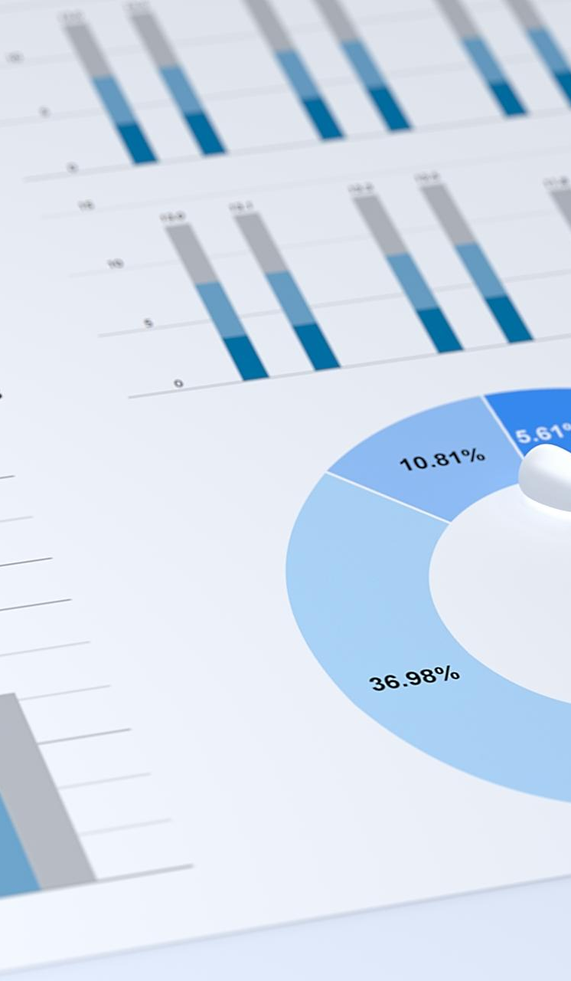
Morbidity and Mortality
Definition of Morbidity
  Morbidity indicates the rate of illness within a population and helps track disease prevalence.
Understanding Mortality
  Mortality measures the rate of death caused by specific diseases in different demographic groups.
Importance of Rates
  Expressing morbidity and mortality as rates allows fair comparison across populations of varying sizes.
Impact on Healthcare
  Analyzing trends helps identify vulnerable groups, evaluate interventions, and prioritize healthcare resources.
Notes:
Morbidity refers to the rate of illness within a population, while mortality measures the rate of death due to a specific disease. Both metrics are essential for assessing disease impact over time and across different demographic groups. Expressing these measures as rates allows for meaningful comparisons between populations of varying sizes. Understanding morbidity and mortality trends helps identify vulnerable populations, evaluate healthcare interventions, and prioritize resource allocation.

Slide 10

Incidence and Prevalence
Definition of Incidence
  Incidence counts new disease cases over a specific time, highlighting risk and spread patterns.
Definition of Prevalence
  Prevalence measures all existing and new cases, showing the overall disease burden in a population.
Expression of Metrics
  Incidence and prevalence rates are expressed per 100, 1,000, or 100,000 people for clarity.
Impact of Disease Duration
  Long-lasting diseases increase prevalence, reflecting higher total case numbers over time.
Notes:
Incidence measures the number of new cases of a disease during a specific time period, providing insight into risk factors and disease spread. Prevalence accounts for all cases—both new and existing—offering a snapshot of the overall disease burden. These metrics are often expressed as rates per 100, 1,000, or 100,000 individuals to facilitate interpretation. For example, an incidence of 5 cases in a population of 200 translates to 2.5% or 25 cases per 1,000 individuals. Prevalence is influenced by disease duration, with chronic conditions showing higher prevalence over time.

Slide 11
Calculating and Interpreting Rates
Purpose of Rates
Rates standardize disease frequency by adjusting for population size and time period, enabling fair comparisons across groups.
Incidence vs Prevalence
Incidence rate measures new cases, while prevalence rate counts all existing cases within the population at a given time.
Scaling Rates for Clarity
Rates can be multiplied by factors like 1,000 to improve clarity and interpretation in public health reporting.
Notes:
Rates standardize disease frequency by accounting for population size and time period. Incidence rate is calculated as the number of new cases divided by the at-risk population, while prevalence rate includes all cases. These measures may be scaled using multipliers for clarity. For instance, a prevalence of 9,400 cases in a population of 80,000 equals 11.75%, or 118 cases per 1,000 individuals. Such calculations help quantify disease impact and guide public health strategies.

Slide 12
Association and Risk Factors
Notes:
Measures of Association

Slide 13

Measures of Association
Comparing Disease Rates
  Epidemiology compares disease rates in exposed versus unexposed groups to identify causal relationships.
Risk Factor Evaluation
  Risk factors like smoking or pollutants are evaluated to see their impact on health outcomes.
Strength of Associations
  Analyzing associations helps determine strength and significance for targeted interventions.
Public Health Implications
  Understanding these associations guides preventive measures to reduce health disparities.
Notes:
Beyond measuring disease frequency, epidemiology seeks to identify causal relationships by comparing disease rates between exposed and unexposed groups. This approach evaluates whether specific risk factors, such as smoking or environmental pollutants, influence health outcomes. By analyzing associations, epidemiologists can determine the strength and significance of these relationships, informing targeted interventions and preventive measures. Understanding these connections is vital for reducing health disparities and improving population health.

