Slide 1
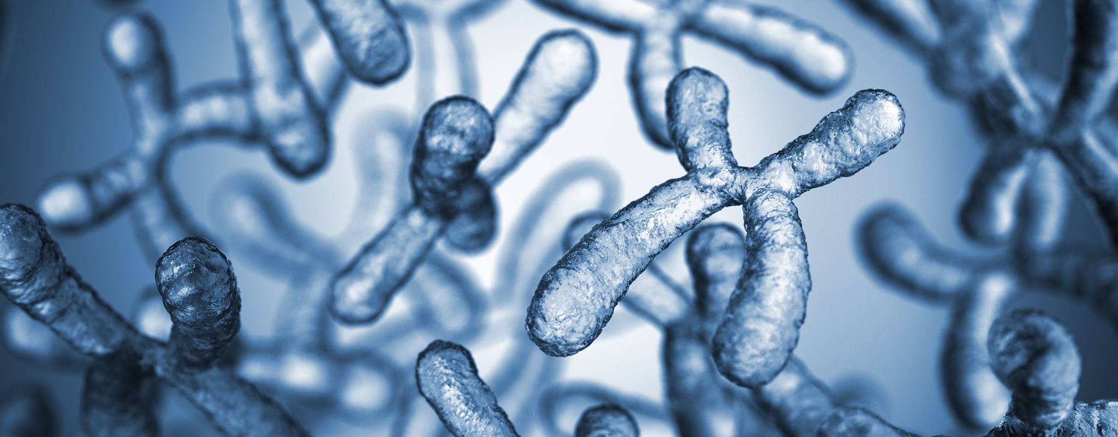

Exploring Microbial Ecology and Microbiomes
Understanding microscopic life and its environmental roles
Notes:
---

Slide 2
Introduction to Prokaryotes and Louisiana Ecosystems
Notes:
Microscopic Engines of Louisiana's Ecosystems

Slide 3
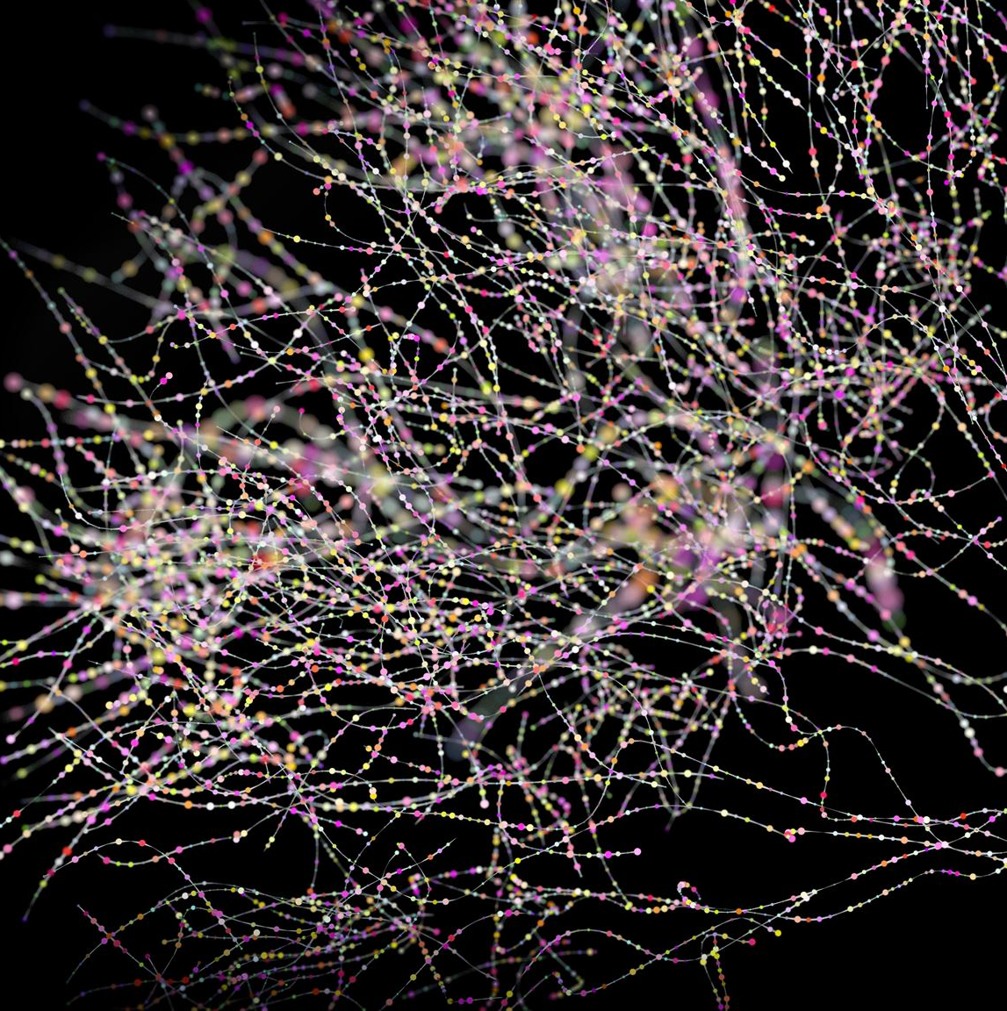
Microscopic Engines of Louisiana's Ecosystems
Role in Nutrient Cycling
  Prokaryotes drive nutrient cycling by decomposing organic matter and recycling essential nutrients in ecosystems.
Ecosystem Foundations
  These microbes form the base of food chains supporting aquatic and terrestrial life in Louisiana's ecosystems.
Environmental Impact
  Microbial activity influences water quality, soil fertility, and ecosystem resilience to environmental changes.
Notes:
Prokaryotes, which include bacteria and archaea, are single-celled organisms that play a fundamental role in sustaining life within Louisiana’s diverse ecosystems. Using a microscope to explore these organisms reveals their critical functions in nutrient cycling and organic matter decomposition. In environments such as the nutrient-rich sediment of the Mississippi River and the warm waters of the Gulf Coast, these microbes act as invisible engines driving ecological processes. They break down organic matter, recycle essential nutrients, and form the foundation of food chains that support aquatic and terrestrial life. Their metabolic activities influence water quality, soil fertility, and even the resilience of ecosystems to environmental changes. Understanding these microscopic organisms provides insight into how ecosystems maintain balance and adapt to stressors, making them indispensable to both natural habitats and human well-being.

Slide 4
Understanding Your Microbiome
Notes:
Importance of Microbiome Diversity, Gut-Brain Axis and Mental Health

Slide 5
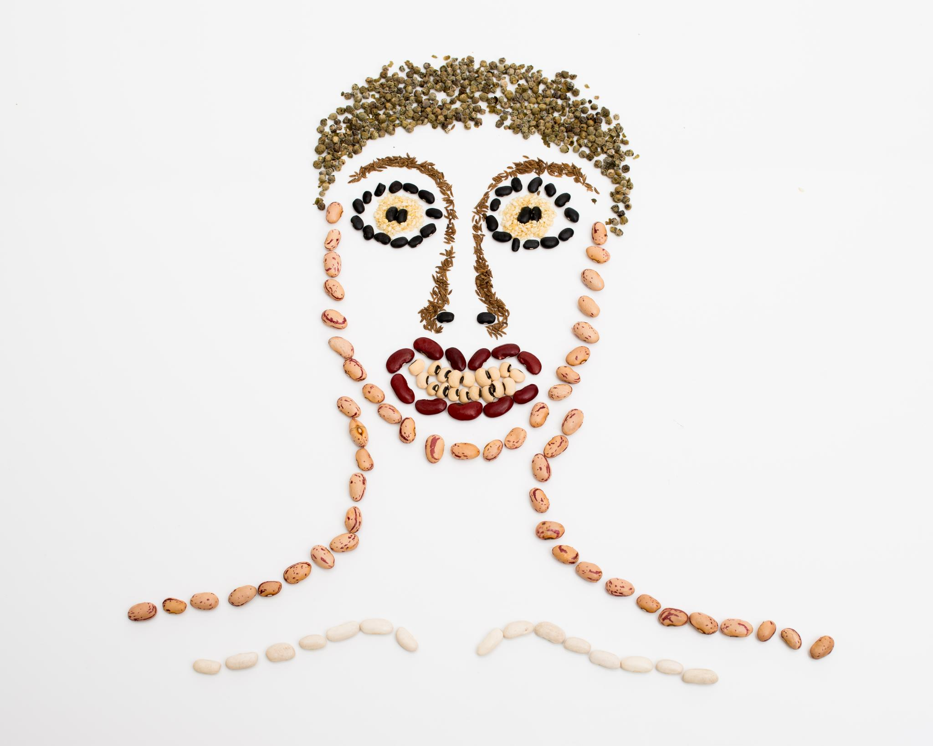
Importance of Microbiome Diversity
Microbiome Diversity and Health
  Diverse microbial communities support immune function and improve resilience against pathogens.
Influencing Factors
  Diet, lifestyle, pollutants, and hygiene practices significantly shape microbiome diversity.
Impact on Chronic Conditions
  Maintaining microbiome diversity is linked to prevention of chronic diseases and improved metabolism.
Notes:
The human microbiome encompasses diverse microbial communities residing in the gut, skin, mouth, and other body sites. These communities are influenced by diet, lifestyle, environmental pollutants, and even personal hygiene practices. Research increasingly shows that a diverse microbiome correlates with better health outcomes, as microbial diversity enhances resilience against pathogens and supports metabolic and immune functions. Factors such as food additives, exercise habits, and exposure to pollutants can alter microbiome composition, potentially impacting long-term health. While the exact mechanisms linking microbiome changes to disease are still being studied, evidence suggests that maintaining diversity is key to preventing chronic conditions. This understanding underscores the importance of mindful dietary choices and lifestyle habits to nurture a healthy microbiome.

Slide 6
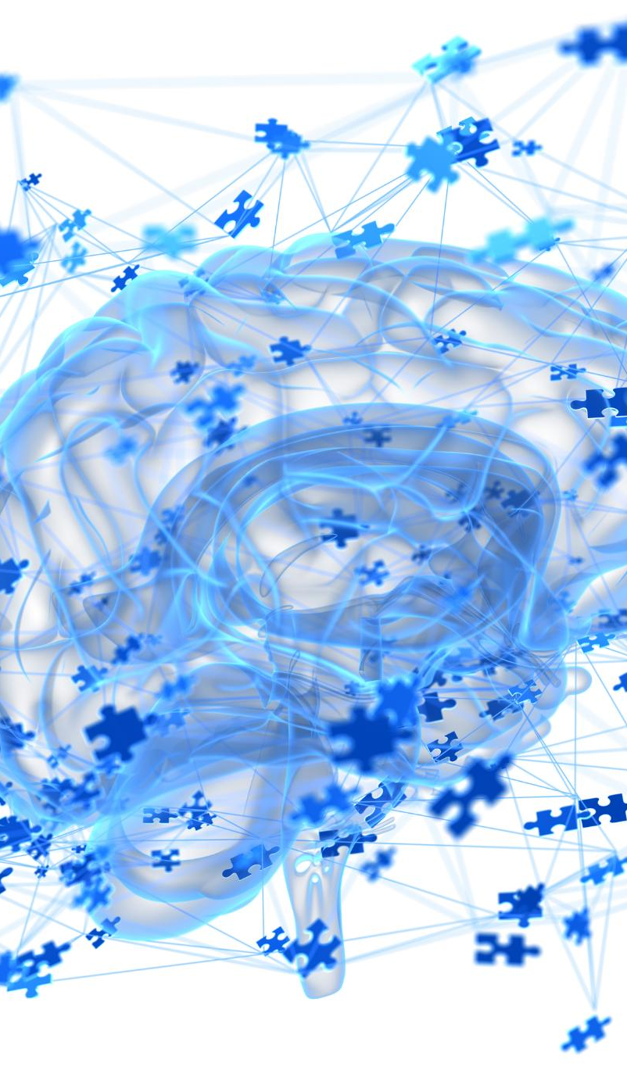
Gut-Brain Axis and Mental Health
Gut-Brain Communication
  The gut-brain axis is a complex network linking the gastrointestinal tract and central nervous system via microbes and metabolites.
Microbes Influence Mood
  Microbes produce neurotransmitters or stimulate intestinal cells affecting mood and cognitive functions.
Mental Health Correlation
  Disruptions in gut microbial balance link to anxiety, depression, and other mental health disorders.
Holistic Health Approach
  Maintaining gut health through diet and lifestyle benefits both psychological well-being and physical health.
Notes:
The gut-brain axis represents a complex communication network between the gastrointestinal tract and the central nervous system, mediated by microbes and their metabolites. Microbes can produce neurotransmitters or stimulate intestinal cells to release them, influencing mood and cognitive functions. Studies reveal that gut health often correlates with mental health, with disruptions in microbial balance linked to anxiety, depression, and other disorders. Interestingly, certain antidepressants have been shown to alleviate gastrointestinal symptoms, highlighting the bidirectional nature of this relationship. Maintaining gut health through diet and lifestyle choices can therefore have profound effects on psychological well-being. This emerging field emphasizes a holistic approach to health, where nurturing the microbiome benefits both body and mind.

Slide 7
Microbial Ecology Experiments
Notes:
Winogradsky Column, Hay Infusion

Slide 8

Winogradsky Column
Stratified Microbial Ecosystem
  Layers of sediment, water, and nutrients form distinct zones where microbes thrive based on metabolic needs.
Oxygen and Sulfide Gradients
  Natural gradients allow coexistence of aerobic and anaerobic microbes, showcasing diverse metabolic processes.
Microbial Processes Visualized
  Photosynthesis, sulfur cycling, and nitrogen fixation are demonstrated within the column's micro-ecosystem.
Educational Microbiology Tool
  The Winogradsky column is a foundational model for teaching microbial ecology and environmental interactions.
Notes:
The Winogradsky column is a classic tool for studying microbial ecology and metabolic diversity. By layering pond sediment, water, and nutrients in a transparent cylinder exposed to light, this model creates a stratified ecosystem where microbes organize into distinct zones based on their metabolic needs. Oxygen and sulfide gradients form naturally, allowing aerobic and anaerobic organisms to thrive in different layers. This setup demonstrates processes such as photosynthesis, sulfur cycling, and nitrogen fixation, offering a visual representation of microbial interactions and biogeochemical cycles. Invented by Sergei Winogradsky, this column remains a cornerstone in microbiology education, illustrating how environmental conditions shape microbial communities and their ecological roles.

Slide 9
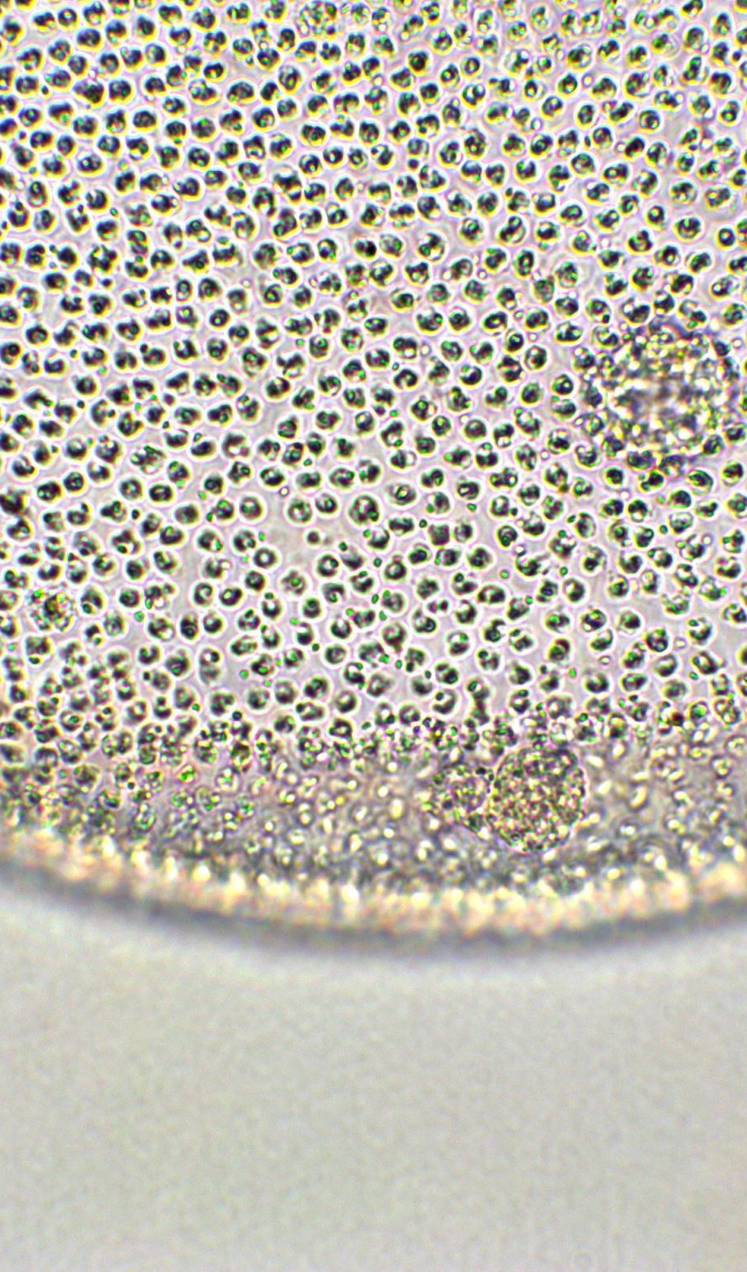
Hay Infusion
Microbial Ecosystem Formation
  Hay infusion creates a nutrient-rich environment fostering diverse microorganisms including bacteria, fungi, and algae.
Ecological Succession
  Different species dominate and decline over time, illustrating ecological succession and microbial competition.
Microscopic Observations
  Observations reveal protozoa like Paramecium, ciliates, flagellates, and small invertebrates such as rotifers and nematodes.
Educational Value
  Hay infusions help study food webs, decomposition, and microbial interactions, supporting education and research.
Notes:
A hay infusion is a simple yet powerful experiment that reveals the complexity of microbial ecosystems. By immersing hay or organic matter in water and allowing decomposition, a nutrient-rich environment emerges, fostering diverse microorganisms such as bacteria, fungi, algae, and protozoa. Over time, ecological succession occurs as different species dominate, compete, and decline. Observations under a microscope can include protozoa like Paramecium, ciliates, flagellates, and even small invertebrates such as rotifers and nematodes. This dynamic system illustrates food webs, decomposition processes, and microbial interactions. Hay infusions provide an accessible way to study ecological principles and microbial diversity, making them invaluable for education and research.

Slide 10
Real-World Applications of Microbiome Research
Notes:
Impact on Health and Disease

Slide 11
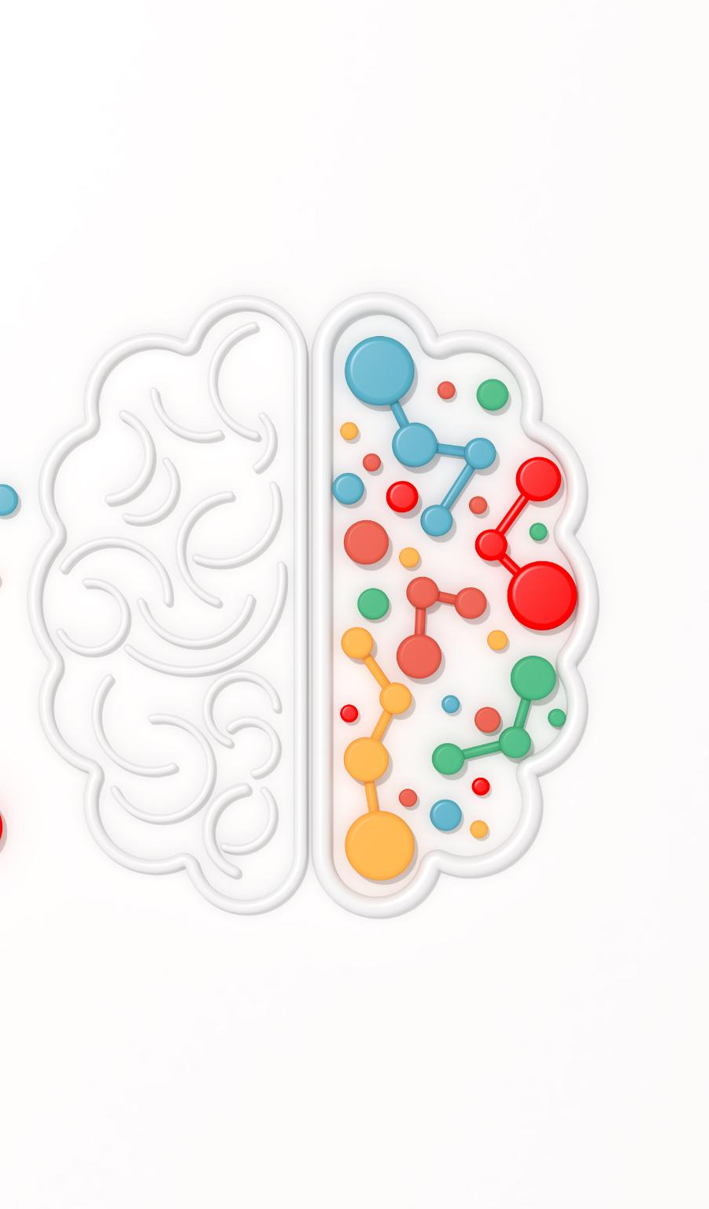
Impact on Health and Disease
Microbiome Influence on Health
  Microbiomes impact metabolic functions, immune responses, and mental health, shaped by diet and lifestyle factors.
Disease Associations
  Disruptions in microbial balance are linked to obesity, diabetes, gastrointestinal and mood disorders.
Therapies to Restore Balance
  Emerging therapies use probiotics, prebiotics, and dietary changes to restore microbial diversity.
Gut-Brain Axis and Well-being
  The gut-brain axis links gut health to mental well-being, integrating microbiology and behavioral science.
Notes:
Microbiome research has far-reaching implications for health, disease prevention, and personalized medicine. Our microbiomes are shaped by diet, environmental exposures, and lifestyle choices, influencing metabolic processes, immune responses, and even mental health. Disruptions in microbial balance have been linked to conditions such as obesity, diabetes, gastrointestinal disorders, and mood disorders. Emerging therapies aim to restore microbial diversity through probiotics, prebiotics, and dietary interventions. Understanding these connections empowers individuals to make informed choices that support long-term health. The gut-brain axis exemplifies this interplay, where improving gut health can enhance mental well-being, creating a holistic approach to healthcare that integrates microbiology and behavioral science.

