Slide 1
Chapter 4: The Eukaryotes of Microbiology
Introduction to Eukaryotic Microorganisms
Based on Louisiana State Open Textbook

Slide 2
Learning Objectives
Define eukaryotes
Identify major eukaryotic groups
Explain medical relevance

Slide 3
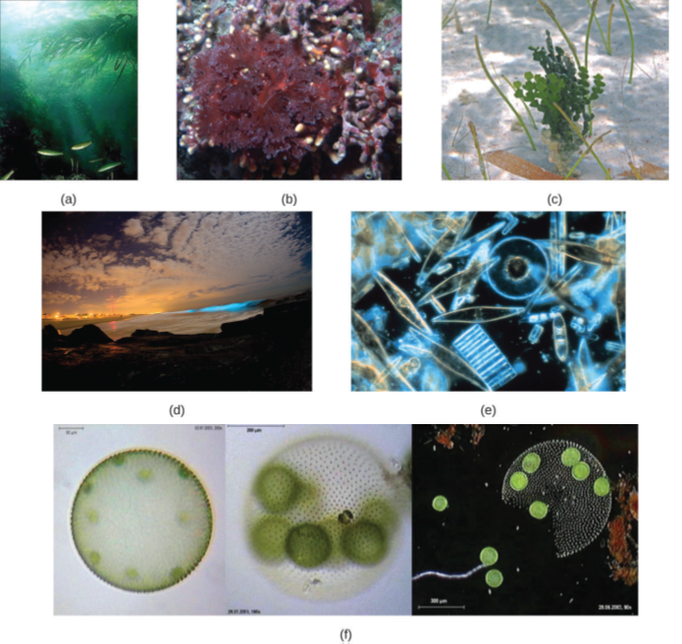
What Are Eukaryotes?
Examples of eukaryotic microorganisms studied in microbiology, including protozoa and fungi.
Cells with nucleus
Membrane-bound organelles
More complex than prokaryotes

Slide 4
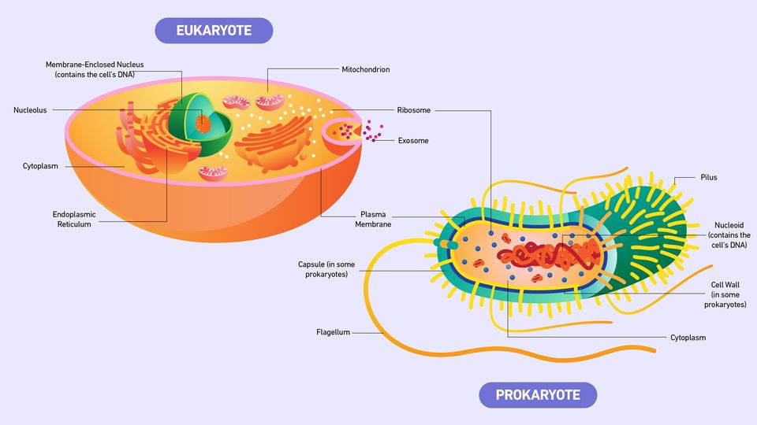
Eukaryotes vs Prokaryotes
Nucleus present
Organelles present
Larger cell size

Slide 5
Why Study Eukaryotes?
Cause disease
Environmental importance
Industrial uses

Slide 6
Major Groups of Eukaryotes
Protozoa
Fungi
Helminths
Algae

Slide 7
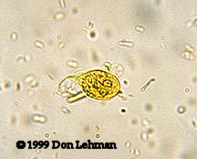
Protozoa Overview
Giardia lamblia trophozoite
Unicellular
Motile
Often parasitic
Flagellated protozoan parasite demonstrating unicellular eukaryotic structure.

Slide 8
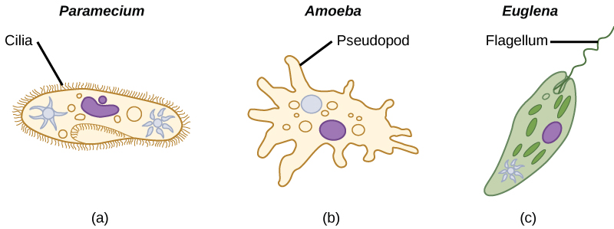
Protozoan Motility
Flagella
Cilia
Pseudopodia
Flagellated protozoan parasite demonstrating unicellular eukaryotic structure.

Slide 9
Protozoan Life Cycles
Sexual & asexual
Cysts & trophozoites

Slide 10
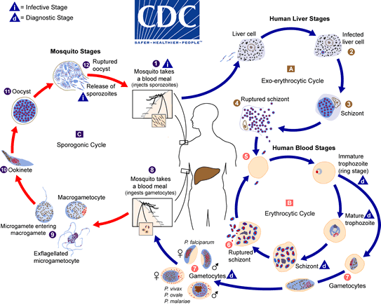
Protozoa and Disease
Malaria
Giardiasis
Amoebiasis
Life cycle of Plasmodium, the protozoan parasite responsible for malaria.

Slide 11
Helminths Overview
Multicellular worms
Parasitic

Slide 12
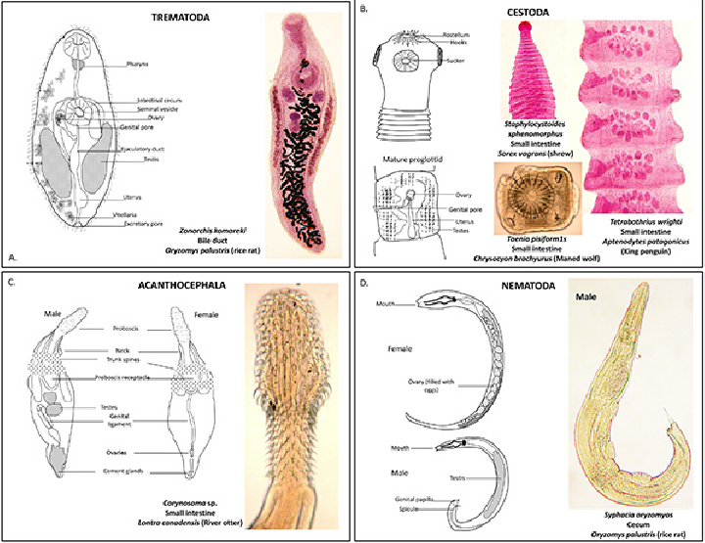
Types of Helminths
Nematodes
Cestodes
Trematodes
Major helminth groups: nematodes, cestodes, and trematodes.

Slide 13
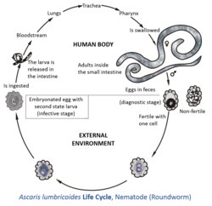
Helminth Life Cycles
Eggs
Larvae
Adult stages

Slide 14
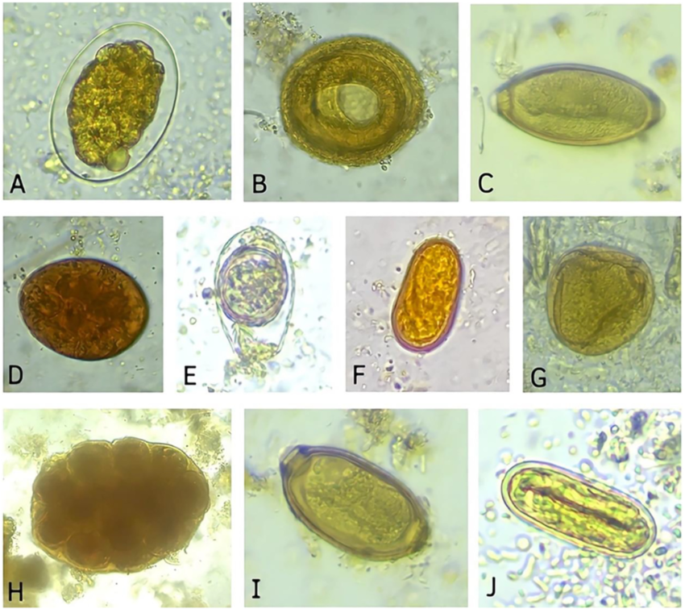
Medical Impact of Helminths
Chronic infections
Global health burden
Microscopic helminth eggs, which are often the infectious stage.

Slide 15
Fungi Overview
Eukaryotic
Heterotrophic
Cell walls of chitin

Slide 16
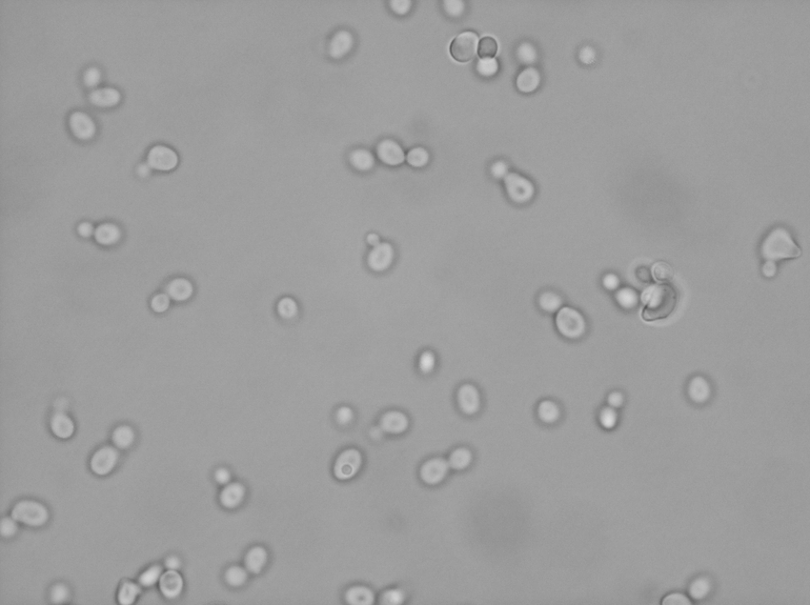
Yeasts
Unicellular fungi
Reproduce by budding
Unicellular yeast reproducing by budding.

Slide 17
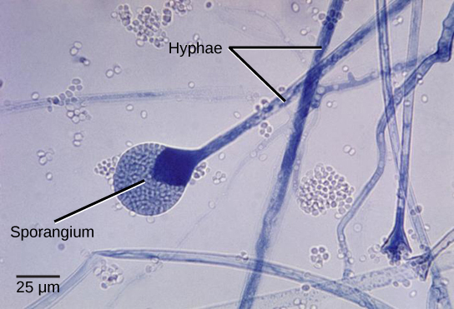
Molds
Multicellular
Hyphae & mycelium
Multicellular fungal structures composed of hyphae forming mycelium.

Slide 18
Fungal Reproduction
Asexual spores
Sexual spores

Slide 19
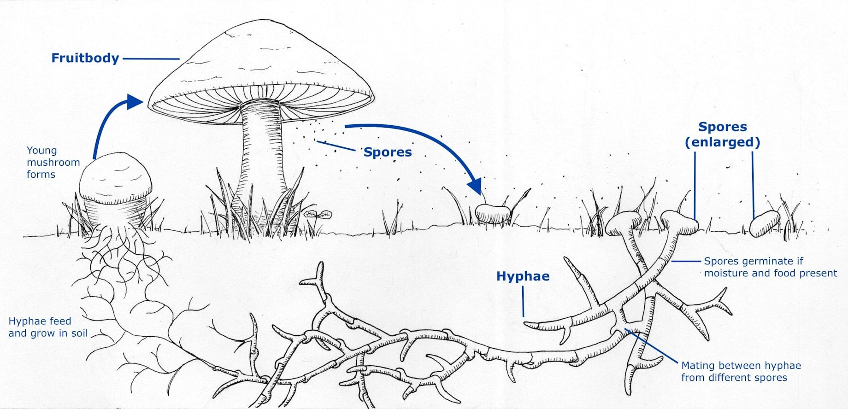
Fungi in Medicine
Pathogens
Antibiotic production
Fungal species used in the production of antibiotics.

Slide 20
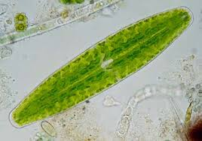
Algae Overview
Photosynthetic eukaryotes
Aquatic
Photosynthetic eukaryotic microorganisms commonly found in aquatic environments.

Slide 21
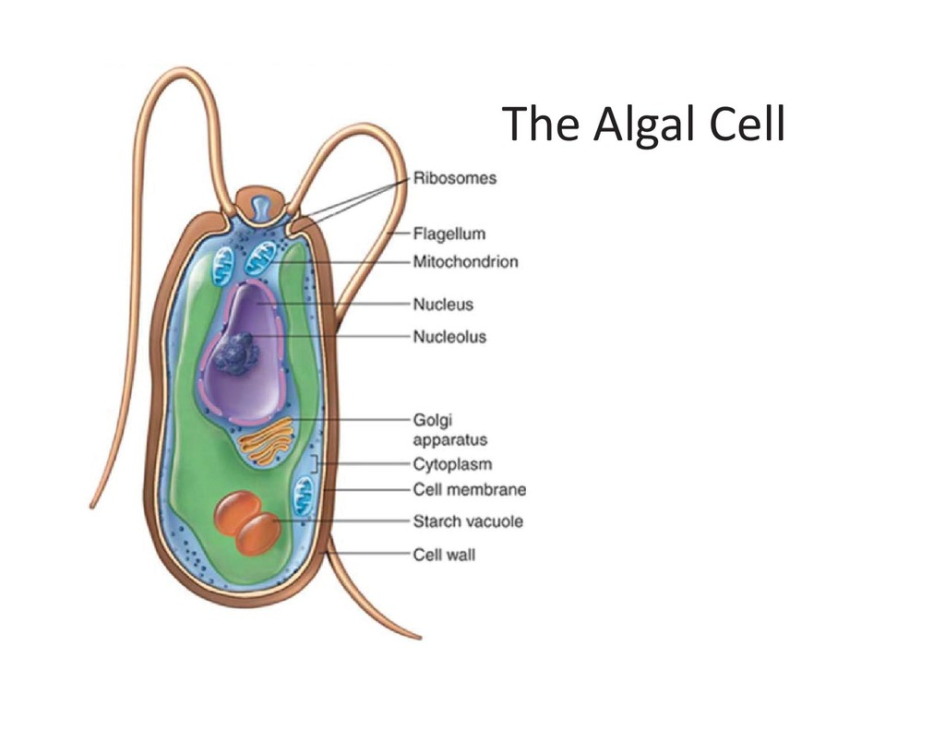
Algae Structure
Chloroplasts
Cell walls

Slide 22
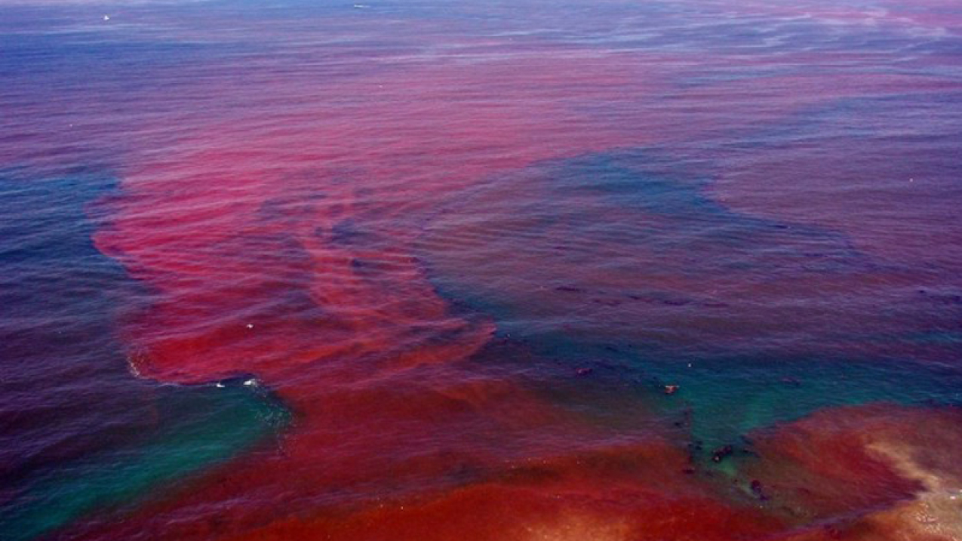
Algae in the Environment
Oxygen production
Food webs
Algal blooms can disrupt ecosystems and pose public health risks.

Slide 23
Comparing Eukaryotic Groups
Eukaryotic Group | Typical Size | Nutrition | Habitat
Protozoa | Microscopic; unicellular | Heterotrophic (ingestion or absorption) | Water, soil, host tissues
Fungi | Microscopic (yeasts) to macroscopic (molds) | Heterotrophic (absorption) | Soil, decaying organic matter, host organisms
Helminths | Macroscopic adults; microscopic eggs/larvae | Heterotrophic (parasitic) | Host organisms; soil or water during life cycle stages
Algae | Microscopic to macroscopic | Autotrophic (photosynthesis) | Aquatic and moist environments

Slide 24
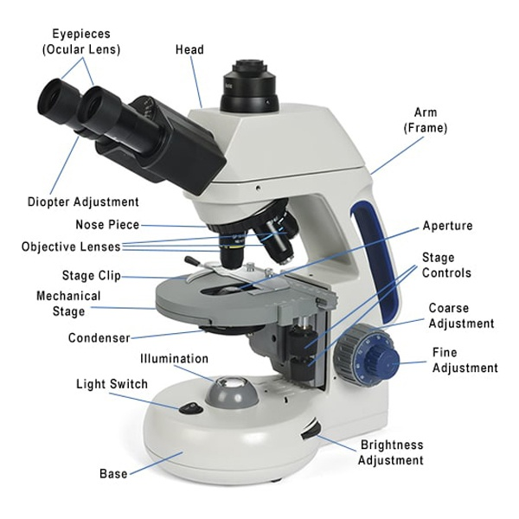
Eukaryotes in the Lab
A compound light microscope commonly used in microbiology laboratories for observing eukaryotic microorganisms.
Culturing fungi
Microscopy

Slide 25
Public Health Relevance
Water safety
Food safety

Slide 26
Case Study Example
Malaria parasite

Slide 27
Key Takeaways
Diverse
Important
Clinically relevant

Slide 28
Review Questions
What defines a eukaryote?
Name one protozoan disease

Slide 29
References
OpenStax. (2018). Eukaryotic cell structure [Diagram]. OpenStax Microbiology.
Wikimedia Commons contributors. (n.d.). Eukaryotic microorganisms under light microscopy [Photograph]. Wikimedia Commons.
OpenStax. (2018). Comparison of prokaryotic and eukaryotic cells [Diagram]. OpenStax Microbiology.
Centers for Disease Control and Prevention. (n.d.). Giardia lamblia trophozoite [Micrograph].
Wikimedia Commons contributors. (n.d.). Protozoan motility types [Diagram]. Wikimedia Commons.
OpenStax. (2018). Plasmodium life cycle [Diagram]. OpenStax Microbiology.
OpenStax. (2018). Helminth classification [Diagram]. OpenStax Microbiology.
Wikimedia Commons contributors. (n.d.). Helminth life cycle diagram [Diagram]. Wikimedia Commons.
Centers for Disease Control and Prevention. (n.d.). Helminth eggs under light microscopy [Micrograph].
OpenStax. (2018). Yeast budding [Micrograph]. OpenStax Microbiology.
Wikimedia Commons contributors. (n.d.). Fungal hyphae and mycelium [Photograph].
Wikimedia Commons.Wikimedia Commons contributors. (n.d.). Penicillium mold [Photograph]. Wikimedia Commons. OpenStax. (2018). Algae under microscopy [Micrograph].
OpenStax Microbiology.Wikimedia Commons contributors. (n.d.). Algal cell structure [Diagram]. Wikimedia Commons.
National Oceanic and Atmospheric Administration. (n.d.). Harmful algal bloom [Photograph].
OpenStax. (2018). Compound light microscope [Diagram]. Microbiology. Rice University. https://openstax.org/details/books/microbiology

