Slide 1
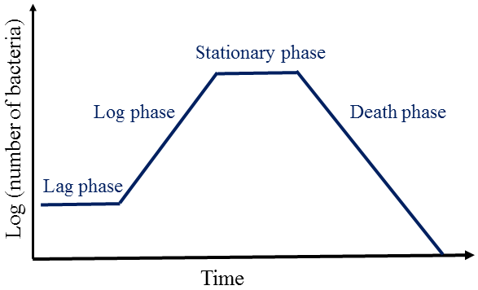
Microbial Growth

Slide 2
Learning Objectives
Define microbial growth
Describe binary fission
Explain growth curves
Identify factors affecting growth

Slide 3
What Is Microbial Growth?
Increase in number of cells, not cell size

Slide 4
Binary Fission
Primary method of bacterial reproduction

Slide 5
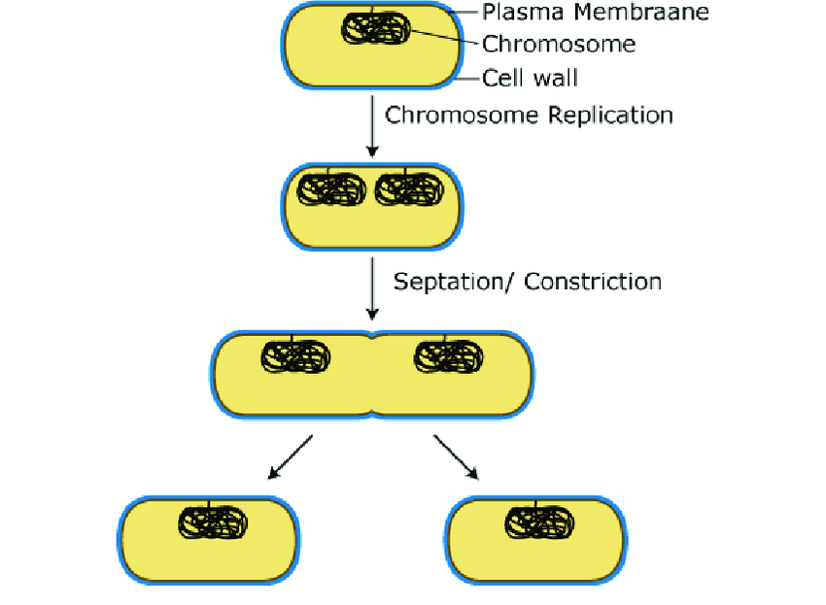
Steps of Binary Fission
DNA replication
Cell elongation
Septum formation
Binary fission is the primary method of bacterial cell division, where one cell splits into two genetically identical daughter cells

Slide 6
Generation Time
Time required for population to double

Slide 7
Exponential Growth
Rapid population increase under ideal conditions

Slide 8
Batch Culture
Closed system used to study growth

Slide 9
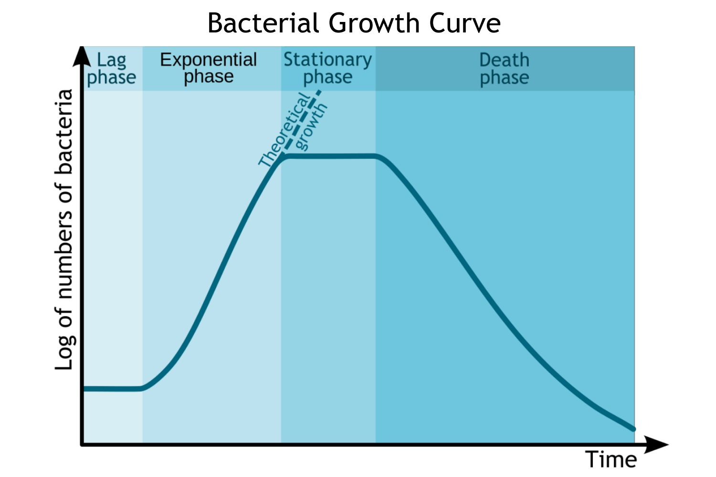
Growth Curve Overview
Lag, Log, Stationary, Death
The bacterial growth curve demonstrates the four phases of population change over time: lag, log (exponential), stationary, and death.

Slide 10
Lag Phase
Cells adapt to new environment

Slide 11
Log Phase
Exponential growth
High metabolic activity

Slide 12
Stationary Phase
Nutrient limitation
Growth = death

Slide 13
Death Phase
Cells die faster than divide

Slide 14
Measuring Growth
Direct vs indirect methods

Slide 15
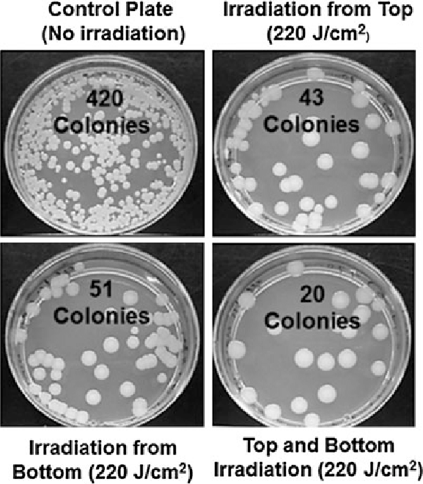
Direct Counts
Plate counts
Microscopic counts
Colony-forming units (CFUs) on solid media represent viable cells capable of growth and reproduction

Slide 16
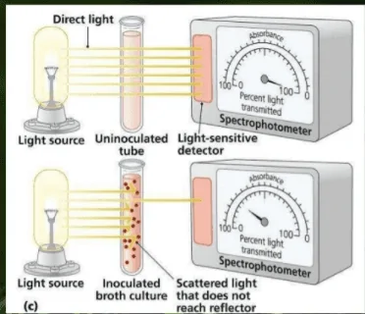
Indirect Measurements
Turbidity
Metabolic activity
A spectrophotometer measures the optical density of a bacterial culture to estimate microbial growth based on turbidity.

Slide 17
Environmental Factors
Temperature
pH
Oxygen
Nutrients

Slide 18
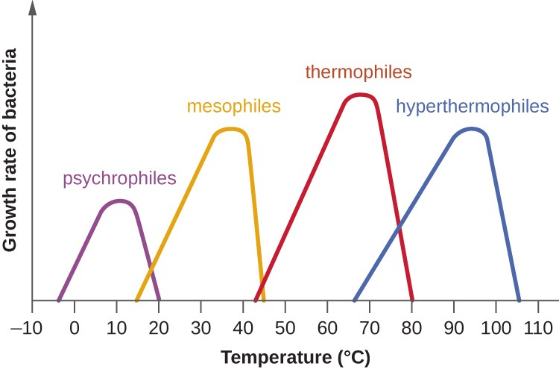
Temperature Effects
Psychrophiles
Mesophiles
Thermophiles
Microorganisms have specific temperature growth ranges — psychrophiles in cold environments, mesophiles in moderate environments, thermophiles at high temperatures, and hyperthermophiles at extreme heat.

Slide 19
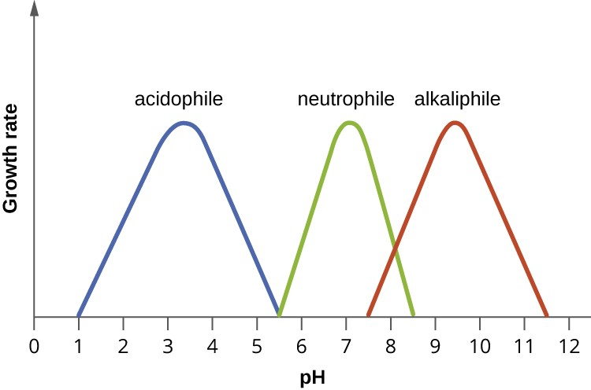
pH Effects
Acidophiles
Neutrophiles
Alkaliphiles
Different microbes prefer different pH environments: acidophiles at low pH, neutrophiles at neutral pH, and alkaliphiles at high pH.

Slide 20
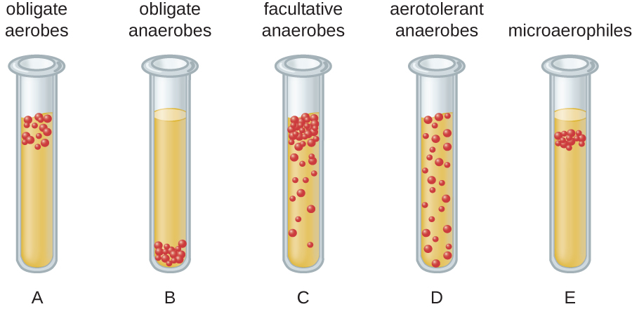
Oxygen Requirements
Obligate aerobes
Facultative anaerobes
Microorganisms vary in their oxygen needs: obligate aerobes require oxygen, obligate anaerobes are harmed by it, facultative anaerobes grow with or without it, and microaerophiles require reduced levels.

Slide 21
Nutrient Requirements
Carbon
Nitrogen
Trace elements

Slide 22
Water Availability
Osmotic pressure affects growth

Slide 23
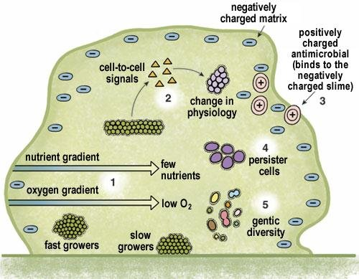
Biofilms
Communities attached to surfaces
Biofilms are structured communities of microorganisms attached to a surface and embedded in an extracellular matrix

Slide 24
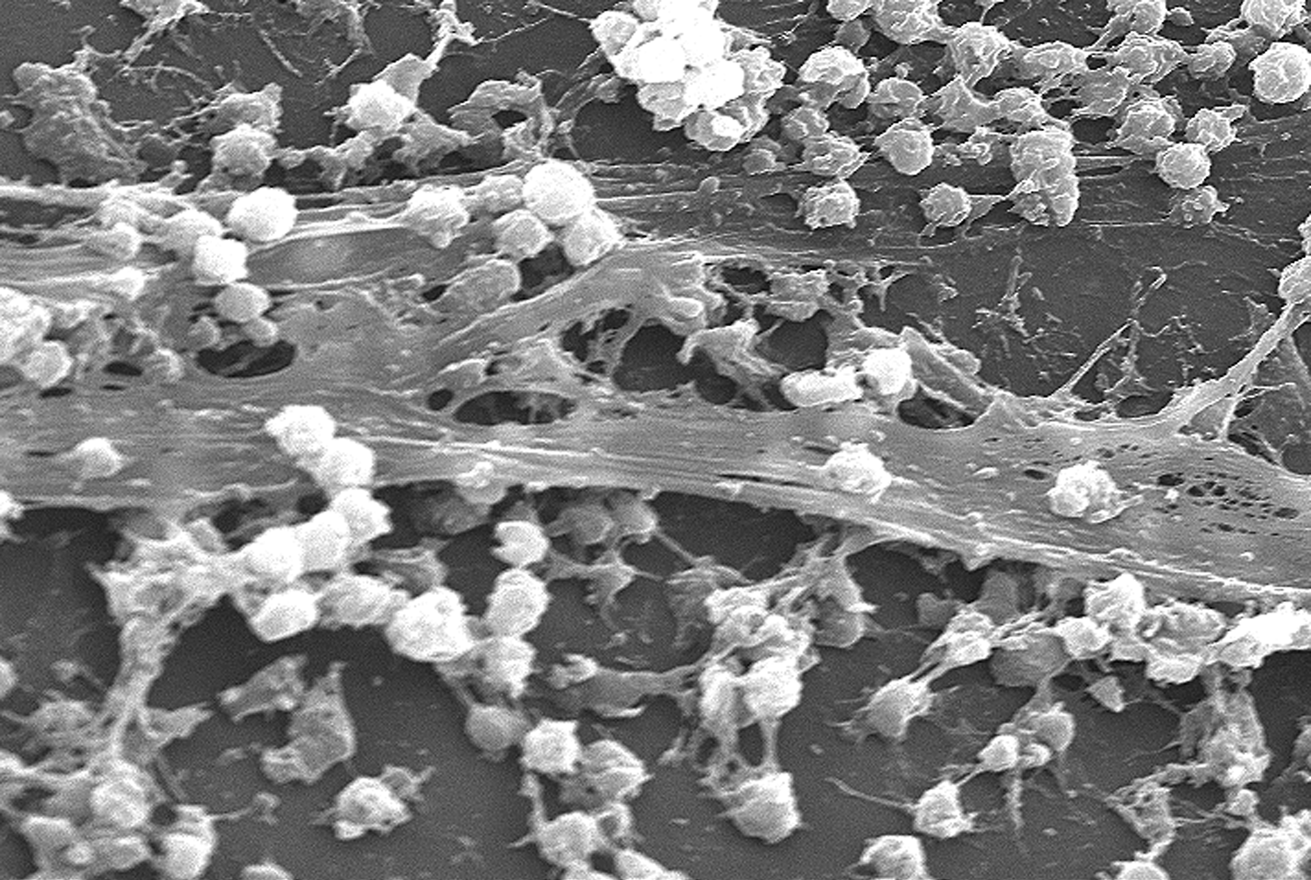
Biofilms & Growth
Protection
Antibiotic resistance
A microscopic view of a microbial biofilm on a surface, showing clusters of cells and extracellular material.

Slide 25
Clinical Relevance
Predict infection progression

Slide 26
Food & Industrial Relevance
Fermentation
Food safety

Slide 27
Summary
Growth is population increase

Slide 28
Review Questions
What phase shows exponential growth?

Slide 29
References
Open Oregon State University. (n.d.). Chapter 7: Microbial growth. In Allied health microbiology.
https://open.oregonstate.education/microbiology/part/chapter-7-microbial-growth/
OpenStax. (2018). Microbiology. Rice University.
https://openstax.org/details/books/microbiology
OpenStax. (2018). Binary fission in bacteria [Diagram]. In Microbiology. Rice University.
https://openstax.org/details/books/microbiology
OpenStax. (2018). Bacterial growth curve [Diagram]. In Microbiology. Rice University.
https://openstax.org/details/books/microbiology
OpenStax. (2018). Environmental factors affecting microbial growth: Temperature, pH, and oxygen requirements [Diagrams]. In Microbiology. Rice University.
https://openstax.org/details/books/microbiology
OpenStax. (2018). Direct and indirect methods for measuring microbial growth [Diagrams]. In Microbiology. Rice University.
https://openstax.org/details/books/microbiology
LibreTexts. (n.d.). Oxygen requirements for microbial growth. In Microbiology.
https://bio.libretexts.org/Bookshelves/Microbiology
LibreTexts. (n.d.). Turbidity as an indirect measure of microbial growth. In Microbiology laboratory techniques.
https://bio.libretexts.org
Wikimedia Commons contributors. (n.d.). Colony-forming units on agar plates [Photograph].
https://commons.wikimedia.org
Wikimedia Commons contributors. (n.d.). Microbial biofilm formation [Diagram and photograph].
https://commons.wikimedia.org
Centers for Disease Control and Prevention. (n.d.). Biosafety and laboratory practices in microbiology.
https://www.cdc.gov/labs

