Slide 1
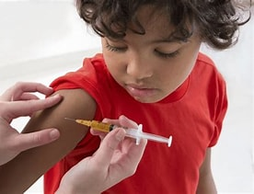
Chapter 8: Antimicrobial Drugs

Slide 2
Learning Objectives
Define antimicrobial drugs
Explain mechanisms of action
Describe resistance and testing

Slide 3
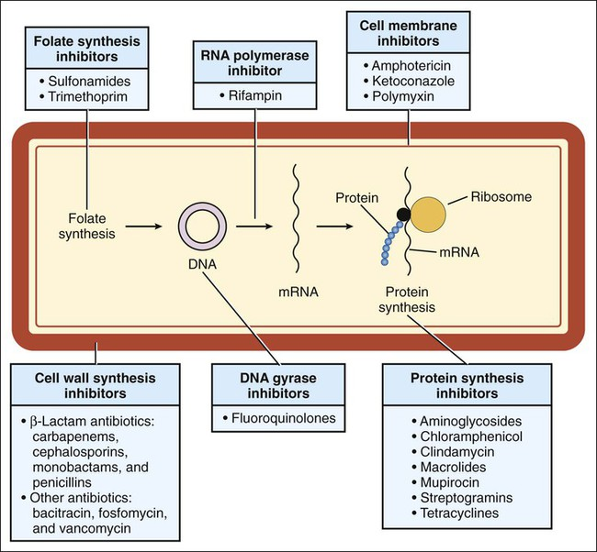
What Are Antimicrobial Drugs?
Agents that kill or inhibit microorganisms
Used to treat infections
Antimicrobial drugs inhibit or kill microorganisms while minimizing harm to the host.

Slide 4
Antimicrobial vs Antibiotic
Antimicrobial: broad term
Antibiotic: naturally produced

Slide 5
Historical Background
Paul Ehrlich
Penicillin discovery

Slide 6
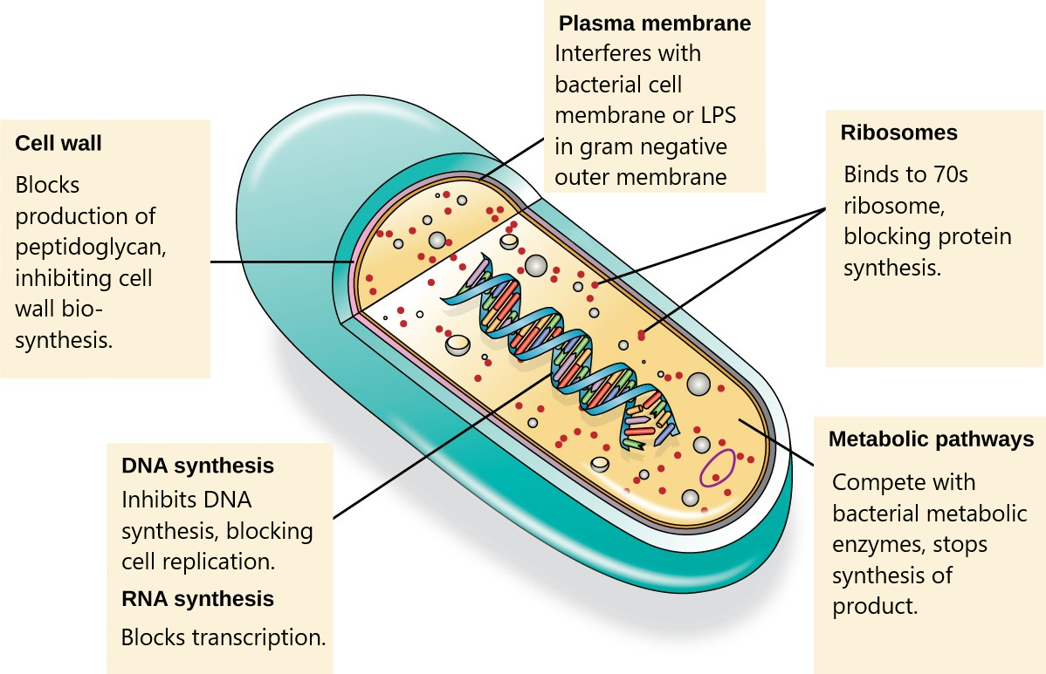
Selective Toxicity
Targets microbes, not host cells
Selective toxicity allows antimicrobial drugs to target microbial structures or pathways not found in human cells.

Slide 7
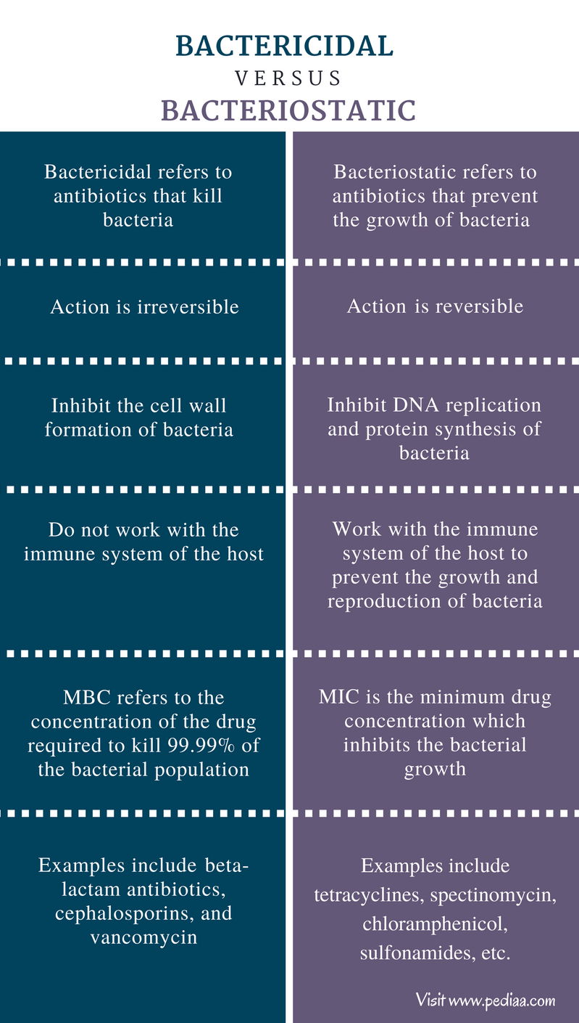
Bacteriostatic vs Bactericidal
Inhibit growth vs kill cells
Bacteriostatic drugs inhibit bacterial growth, whereas bactericidal drugs kill bacterial cells.

Slide 8
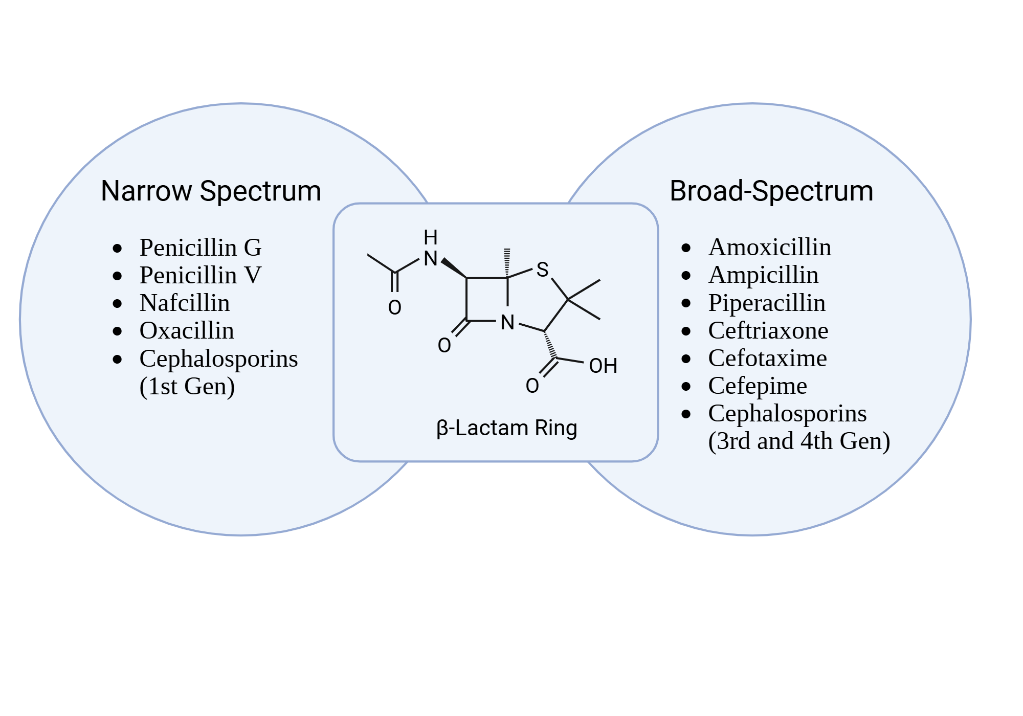
Spectrum of Activity
Narrow vs broad spectrum
Broad-spectrum antimicrobials act against many bacterial species, while narrow-spectrum drugs target specific groups.

Slide 9
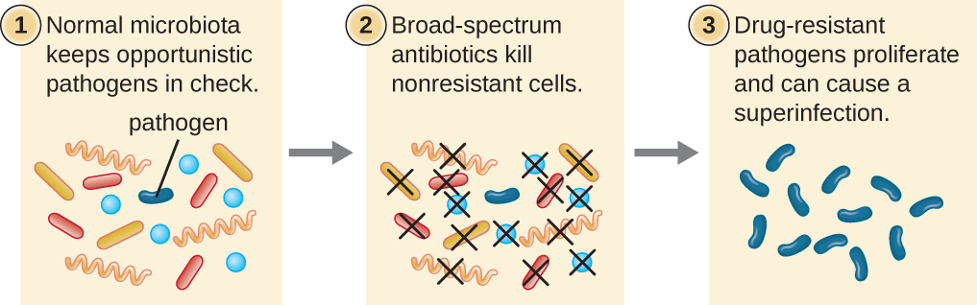
Superinfections
Loss of normal microbiota
Superinfections occur when normal microbiota are disrupted, allowing opportunistic pathogens to grow.

Slide 10
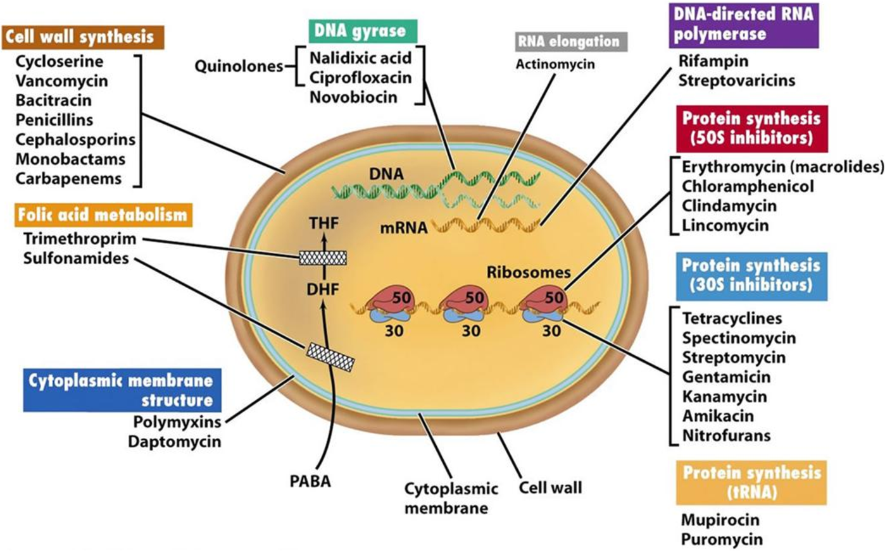
Mechanisms of Action
Cell wall
Protein synthesis
Nucleic acids
Membranes
Major antimicrobial targets include cell wall synthesis, protein synthesis, nucleic acids, and membranes.

Slide 11
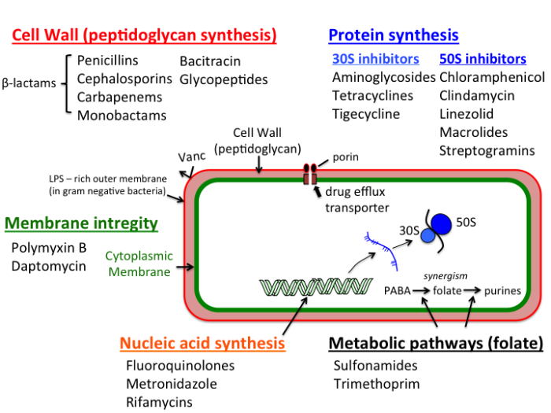
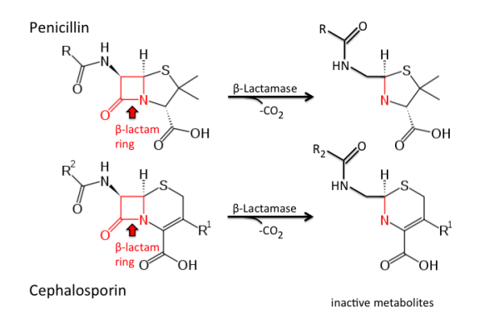
Cell Wall Inhibitors
Beta-lactams
Vancomycin
Beta-lactam antibiotics inhibit peptidoglycan cross-linking, weakening the bacterial cell wall.

Slide 12
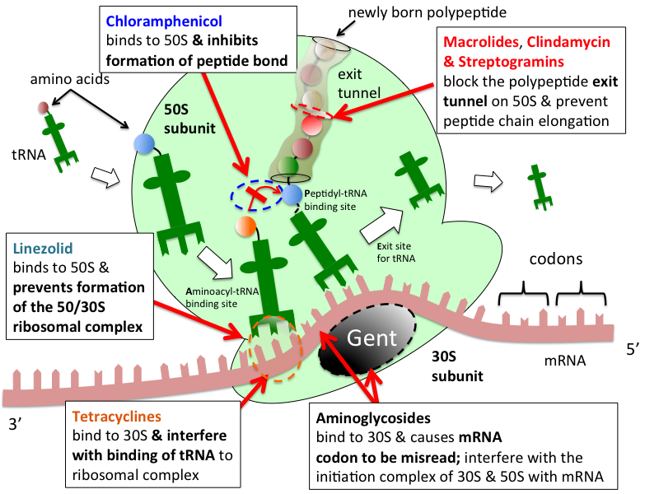
Protein Synthesis Inhibitors
Aminoglycosides
Tetracyclines
Macrolides
Protein synthesis inhibitors target bacterial ribosomes, disrupting translation

Slide 13
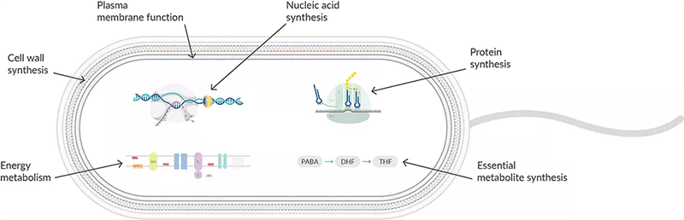
Membrane Disruptors
Polymyxins
Some antimicrobials disrupt bacterial membranes, leading to leakage and cell death.

Slide 14
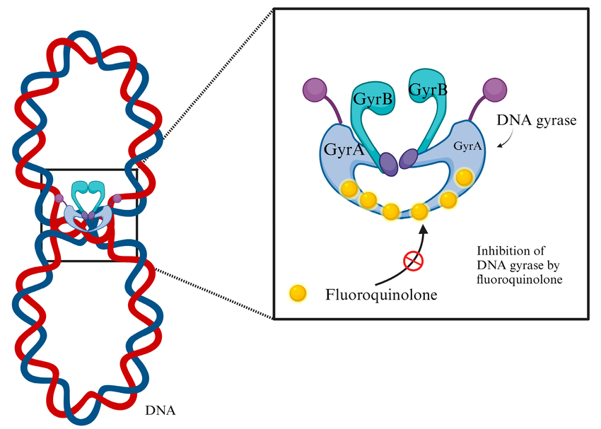
Nucleic Acid Inhibitors
Fluoroquinolones
Rifamycins
Fluoroquinolones inhibit DNA gyrase, preventing DNA replication.

Slide 15
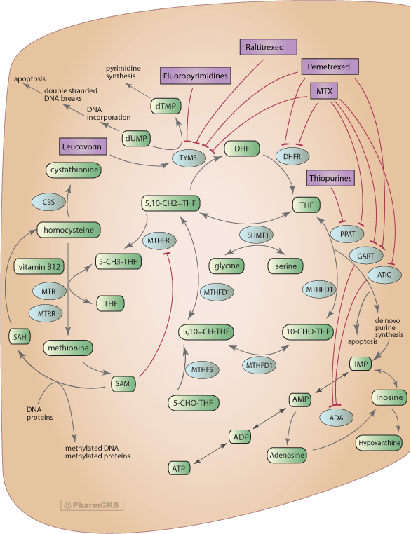
Antimetabolites
Sulfonamides
Trimethoprim
Antimetabolites interfere with metabolic pathways such as folic acid synthesis.

Slide 16
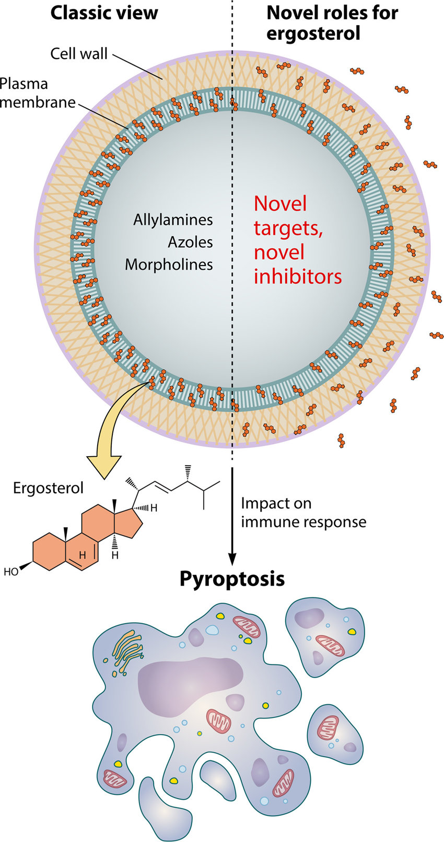
Antifungal Drugs
Target ergosterol
Cell membranes
Antifungal drugs often target ergosterol, a key component of fungal cell membranes.

Slide 17
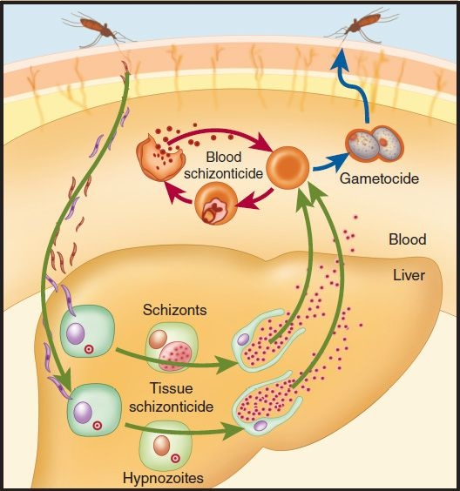
Antiprotozoal Drugs
Target DNA or metabolism
Antiprotozoal drugs interfere with DNA synthesis or metabolic pathways.

Slide 18
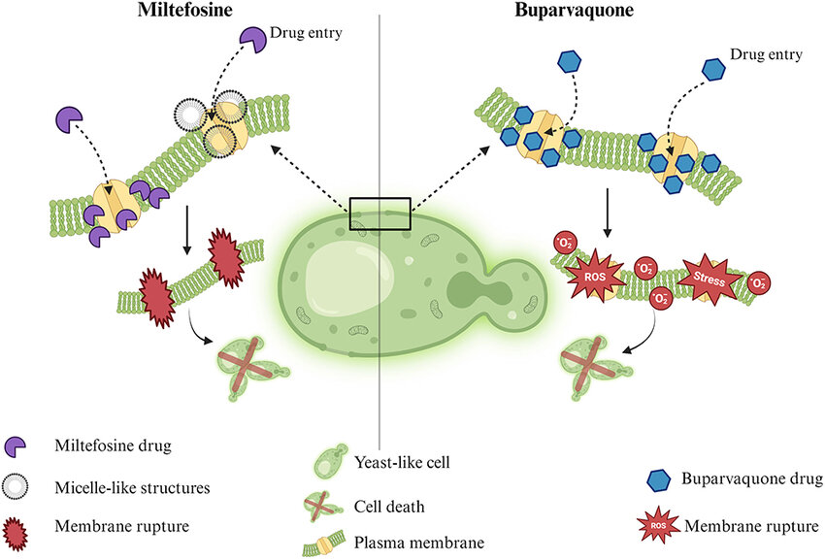
Antihelminthic Drugs
Disrupt neuromuscular function
Antihelminthic drugs disrupt neuromuscular or metabolic processes in parasitic worms.

Slide 19
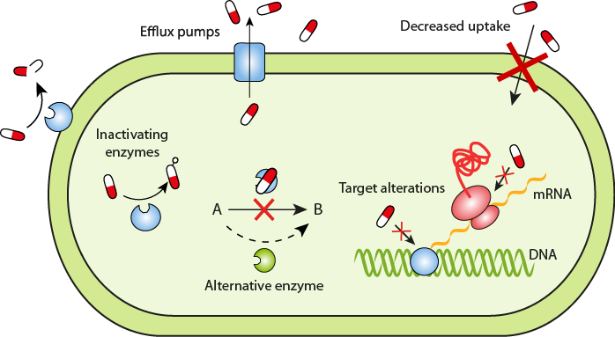
Drug Resistance
Microbial survival mechanisms
Microorganisms develop resistance through enzyme production, target modification, and efflux pumps.

Slide 20
Mechanisms of Resistance
Drug inactivation
Target modification
Efflux pumps

Slide 21
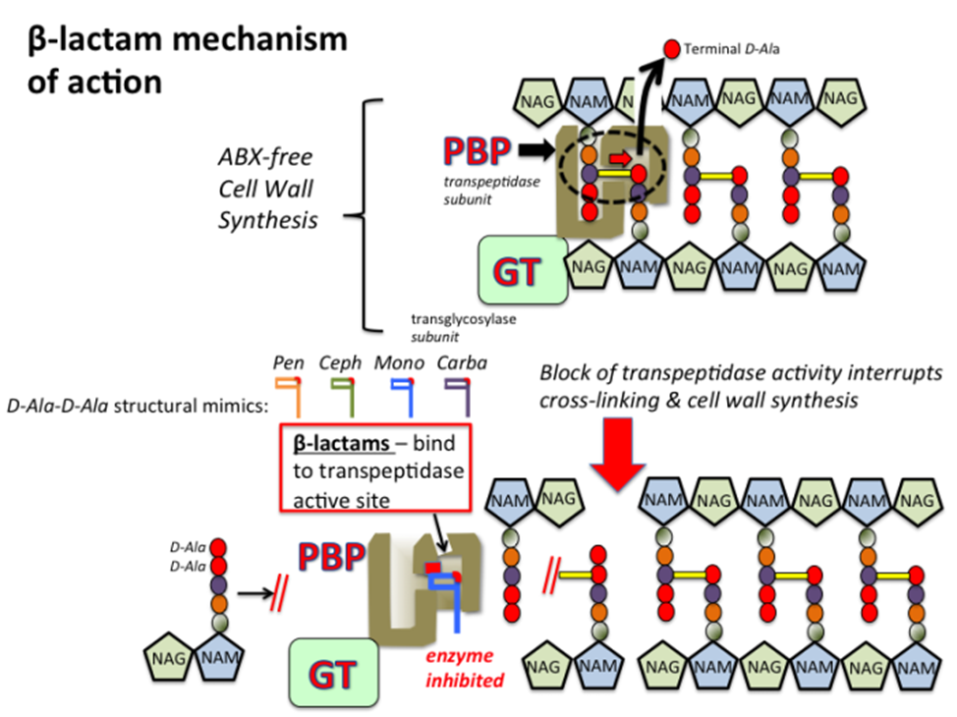
Examples of Resistance
Beta-lactamase
MRSA

Slide 22
Testing Effectiveness
Disk diffusion
MIC
MBC

Slide 23
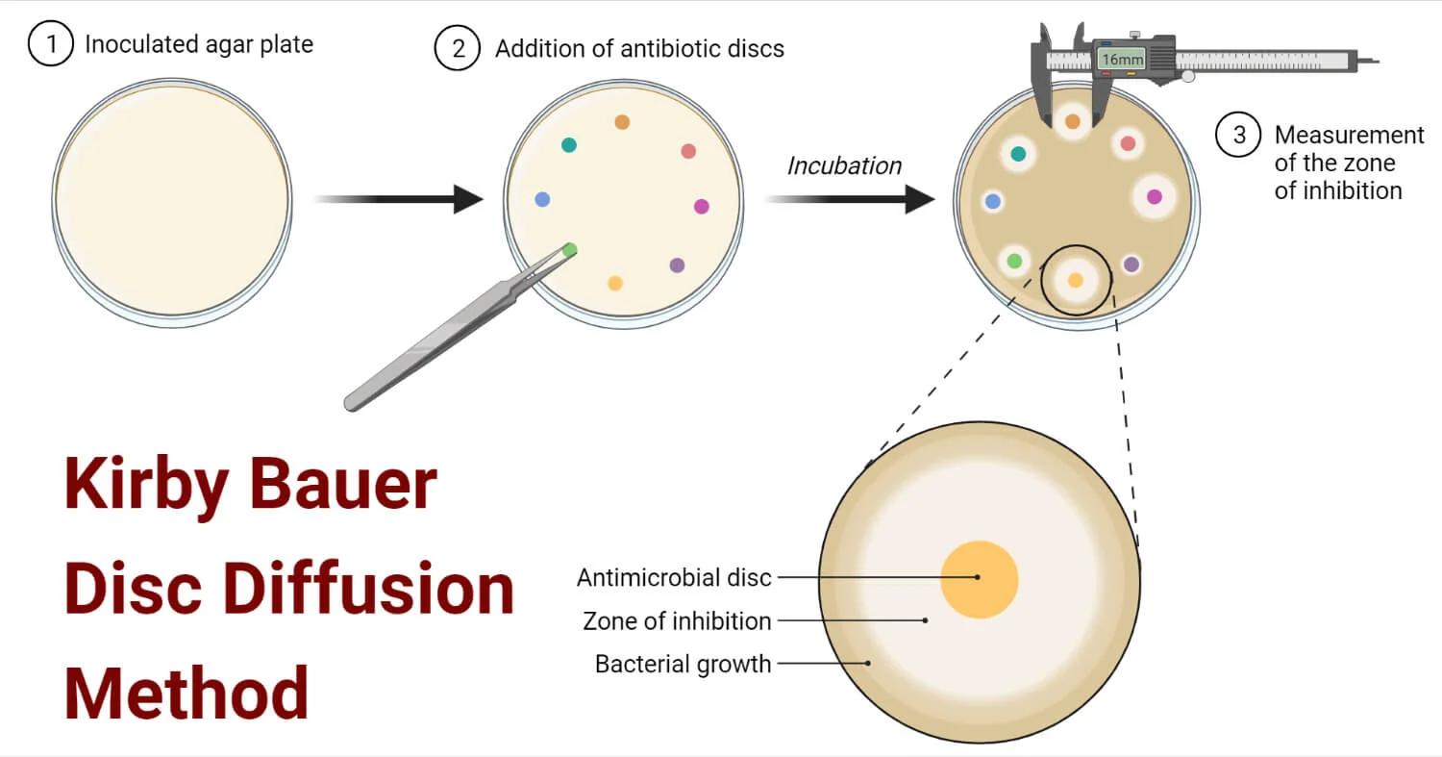
Kirby-Bauer Test
Zones of inhibition
The Kirby–Bauer disk diffusion test measures antimicrobial susceptibility.

Slide 24
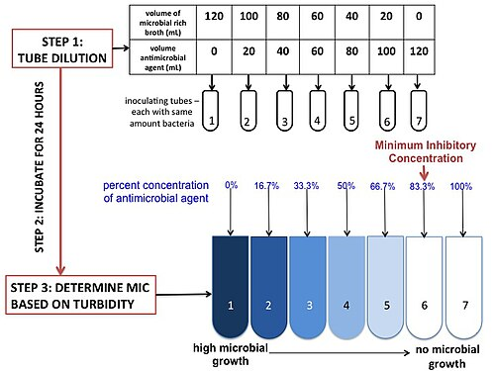
MIC and MBC
Lowest inhibitory and killing doses
Minimum inhibitory concentration (MIC) and minimum bactericidal concentration (MBC) guide clinical treatment.

Slide 25
Drug Discovery
Natural products
Synthetic drugs

Slide 26
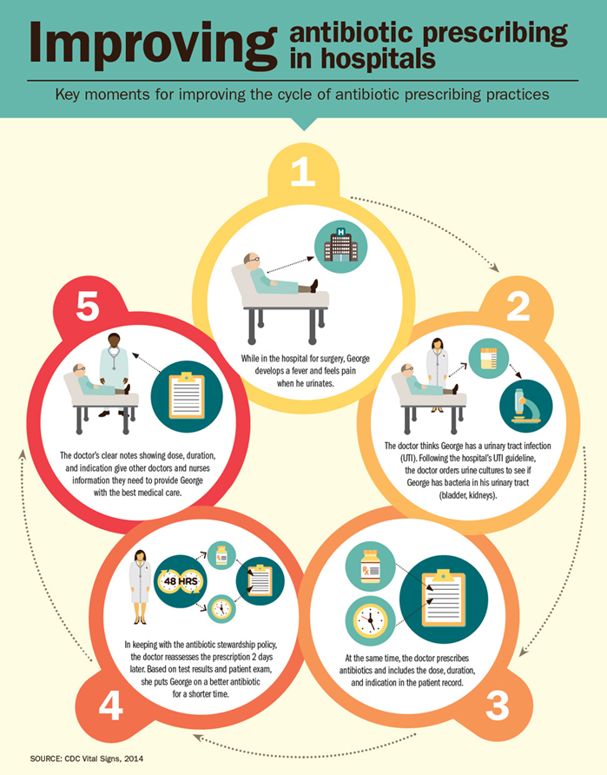
Antimicrobial Stewardship
Responsible drug use
Antimicrobial stewardship promotes responsible drug use to reduce resistance.

Slide 27
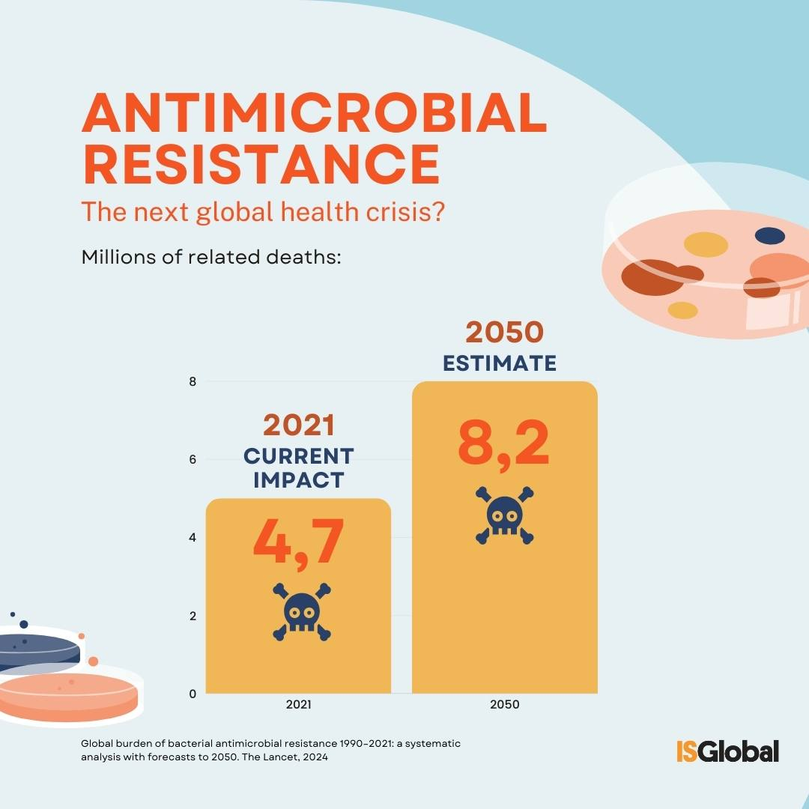
Public Health Impact
Global resistance threat
Antimicrobial resistance is a growing global public health threat.

Slide 28
Summary
Antimicrobials save lives
Resistance is rising

Slide 29
Refrences
Centers for Disease Control and Prevention. (n.d.). Antimicrobial stewardship [Infographic]. https://www.cdc.gov/antibiotic-use
Centers for Disease Control and Prevention. (n.d.). Kirby–Bauer disk diffusion susceptibility test [Photograph]. https://www.cdc.gov/labtraining
Open Oregon State University. (n.d.). Chapter 10: Antimicrobial drugs. In Allied health microbiology. https://open.oregonstate.education/microbiology/part/chapter-10-antimicrobial-drugs/
OpenStax. (2018). Antimicrobial drug mechanisms of action [Diagram]. In Microbiology. Rice University. https://openstax.org/details/books/microbiology
OpenStax. (2018). Selective toxicity of antimicrobial drugs [Diagram]. In Microbiology. Rice University. https://openstax.org/details/books/microbiology
OpenStax. (2018). Spectrum of antimicrobial activity [Diagram]. In Microbiology. Rice University. https://openstax.org/details/books/microbiology
OpenStax. (2018). Mechanisms of antimicrobial resistance [Diagram]. In Microbiology. Rice University. https://openstax.org/details/books/microbiology
World Health Organization. (n.d.). Antimicrobial resistance [Infographic]. https://www.who.int/news-room/fact-sheets/detail/antimicrobial-resistance
Wikimedia Commons contributors. (n.d.). Bacteriostatic versus bactericidal antibiotics [Diagram]. https://commons.wikimedia.org
Wikimedia Commons contributors. (n.d.). Beta-lactam antibiotic mechanism of action [Diagram]. https://commons.wikimedia.org
Wikimedia Commons contributors. (n.d.). Protein synthesis inhibitors targeting bacterial ribosomes [Diagram]. https://commons.wikimedia.orgWikimedia Commons contributors. (n.d.). DNA gyrase inhibition by fluoroquinolones [Diagram]. https://commons.wikimedia.org
Wikimedia Commons contributors. (n.d.). Folic acid synthesis inhibition by sulfonamides [Diagram]. https://commons.wikimedia.org

