Slide 1
Digestive System Infections

Slide 2
Learning Objectives
Describe digestive system infections
Identify major pathogens
Explain transmission and prevention

Slide 3
Introduction
Digestive infections are common worldwide
Often food- or waterborne

Slide 4
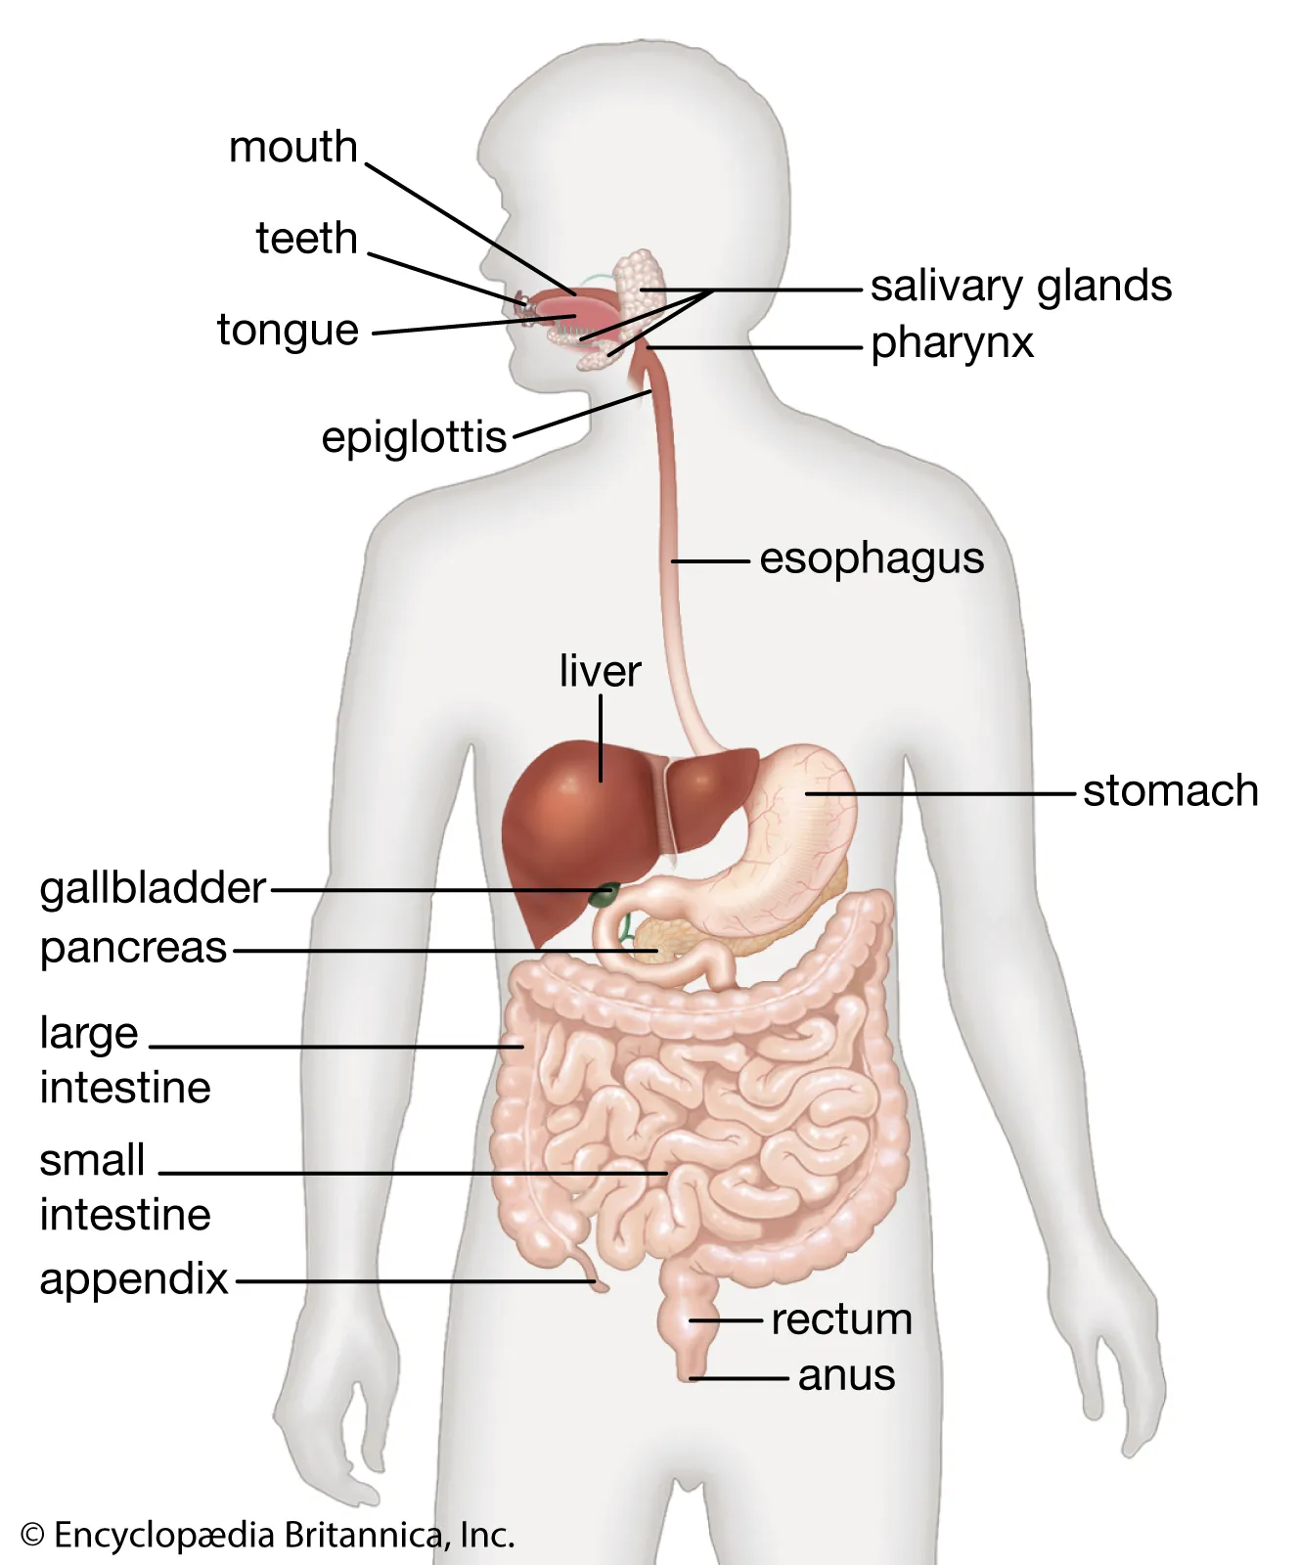
Digestive System Overview
Mouth to anus
Accessory organs
Defense mechanisms
Major structures of the human digestive system, extending from the oral cavity to the anus.

Slide 5
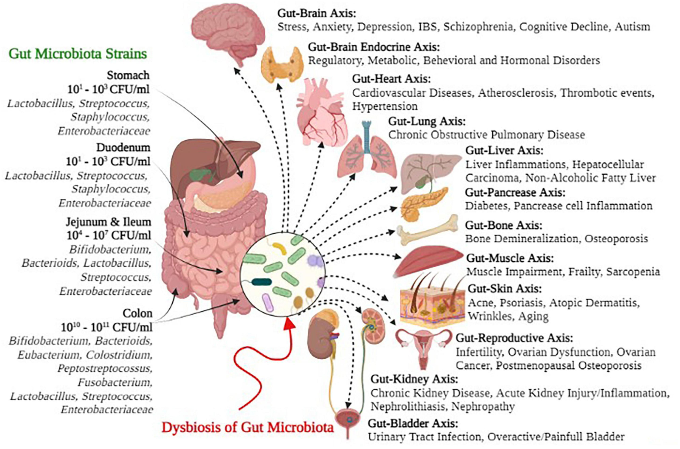
Normal Microbiota
Resident microbes
Protect against pathogens
Normal microbiota of the digestive tract play a key role in digestion and protection against pathogens.

Slide 6
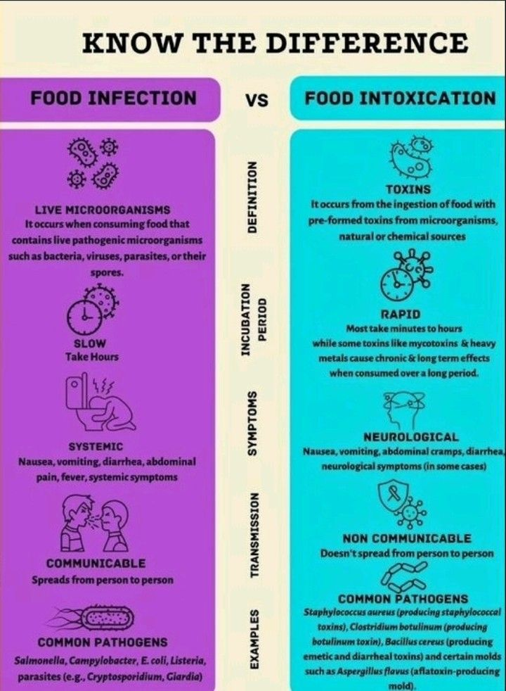
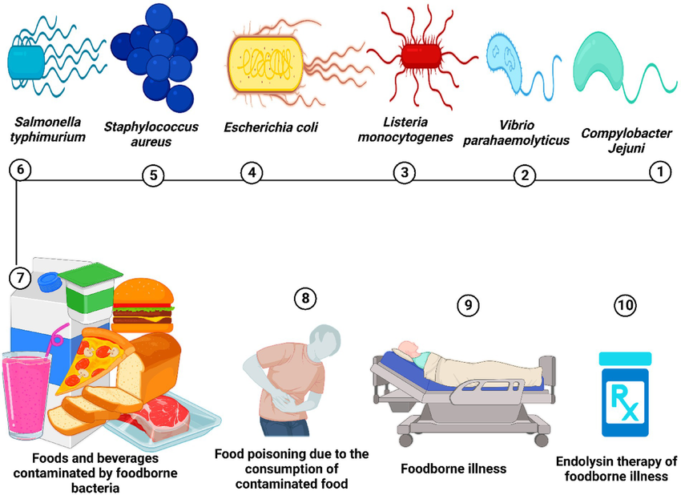
Infection vs Intoxication
Infection: growth in host
Intoxication: preformed toxins
Digestive illnesses may result from microbial infection or ingestion of preformed toxins.

Slide 7
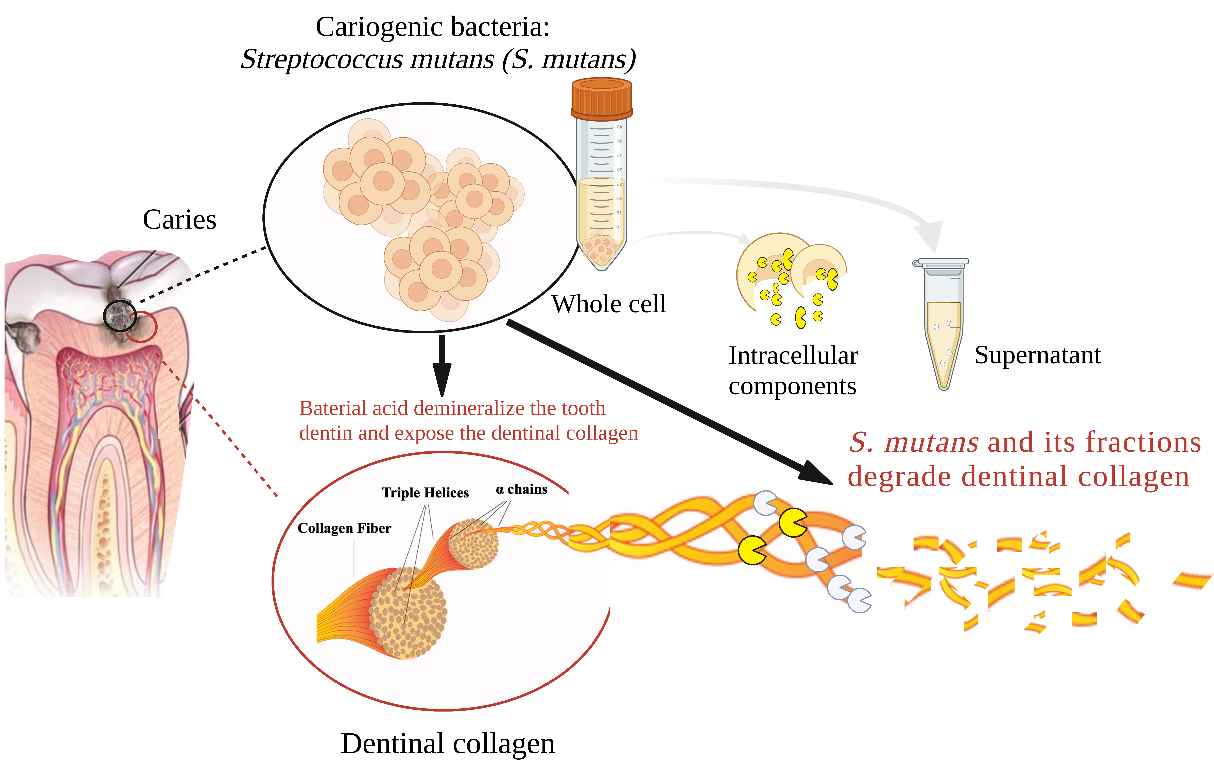
Diseases of the Mouth
Dental caries
Periodontal disease
Biofilm formation on teeth contributes to dental caries and periodontal disease.

Slide 8
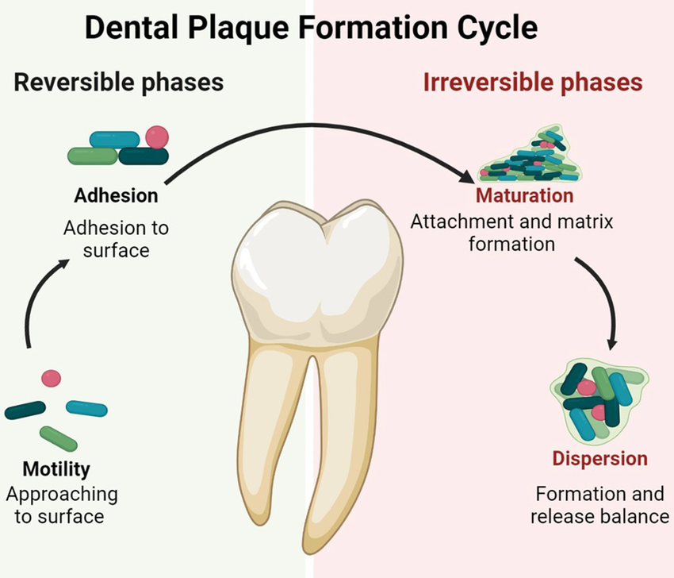
Dental Caries
Streptococcus mutans
Biofilm formation
Acid production by Streptococcus mutans leads to enamel demineralization

Slide 9
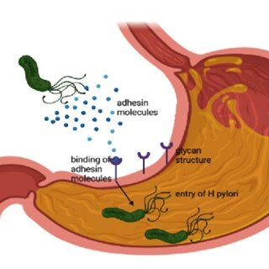
Peptic Ulcer Disease
Helicobacter pylori
Urease production
Colonization of the stomach lining by Helicobacter pylori can result in ulcers.

Slide 10
Bacterial GI Infections
Foodborne and waterborne
Bacterial pathogens commonly cause gastrointestinal infections via contaminated food or water.

Slide 11
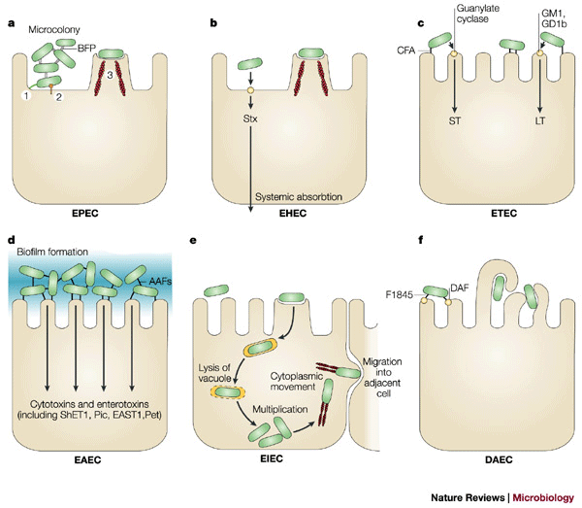
Escherichia coli
Different pathogenic strains
Diarrheal disease
Certain strains of E. coli damage the intestinal lining, leading to diarrhea.

Slide 12
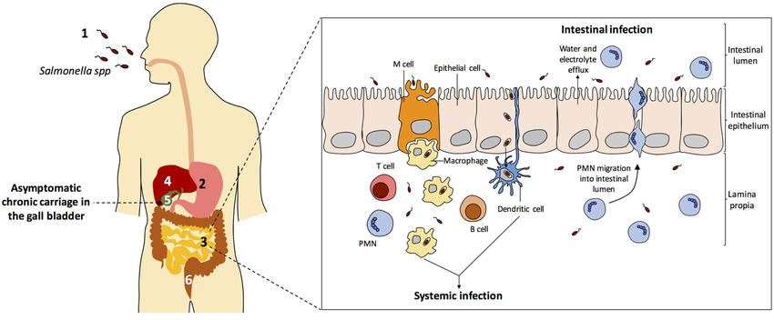
Salmonella
Contaminated food
Diarrhea and fever
Salmonella species invade intestinal cells, causing inflammation and diarrhea.

Slide 13
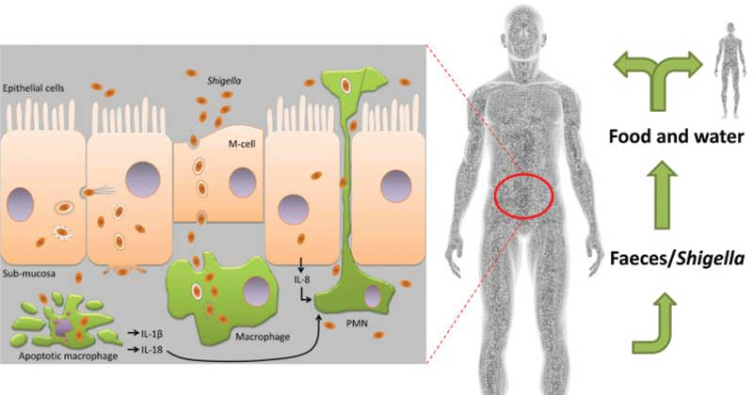
Shigella
Fecal–oral transmission
Dysentery
Shigella infections result in severe intestinal inflammation and dysentery.

Slide 14
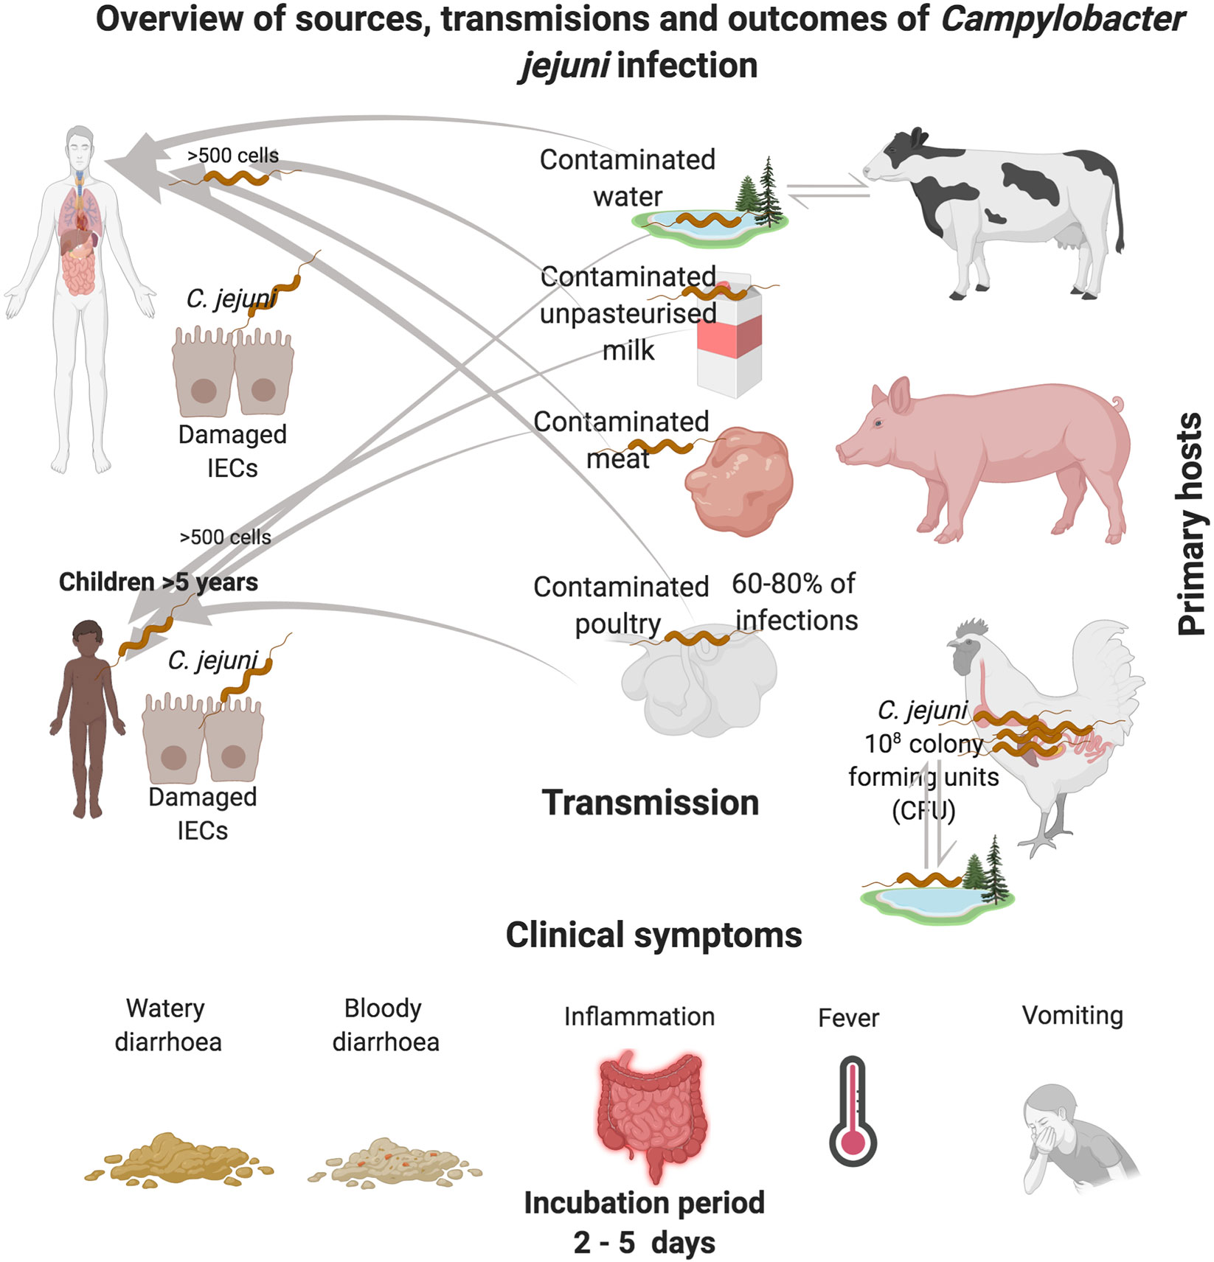
Campylobacter jejuni
Common bacterial cause
Undercooked poultry
Campylobacter jejuni is a leading cause of bacterial gastroenteritis worldwide.

Slide 15
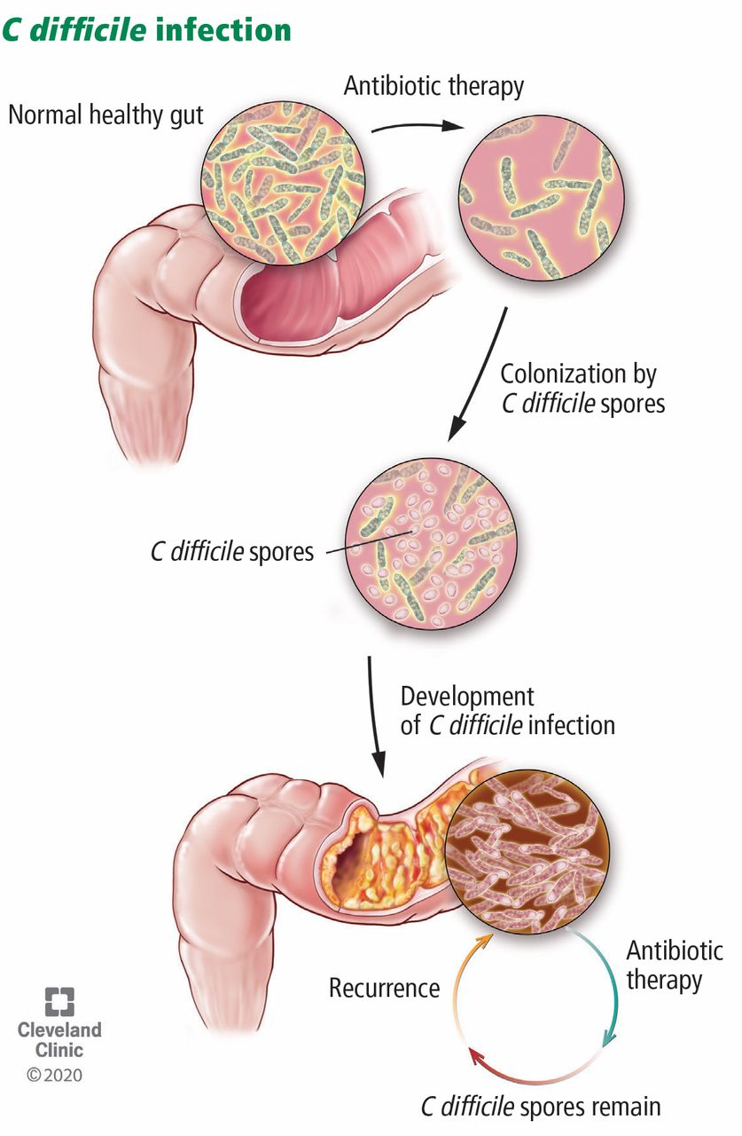
Clostridioides difficile
Antibiotic-associated colitis
Disruption of normal microbiota allows C. difficile overgrowth and toxin production.

Slide 16
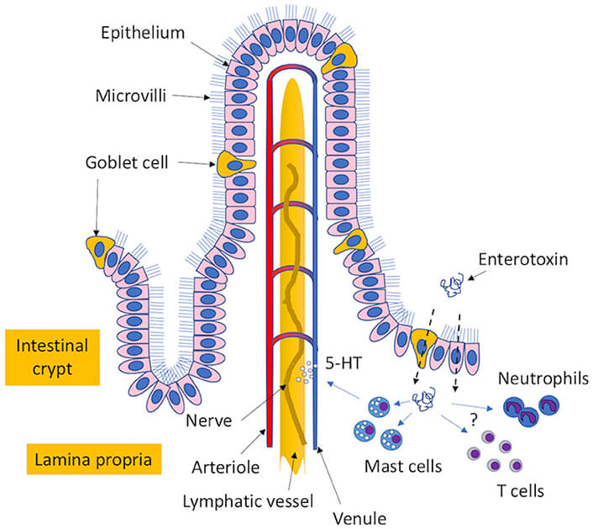
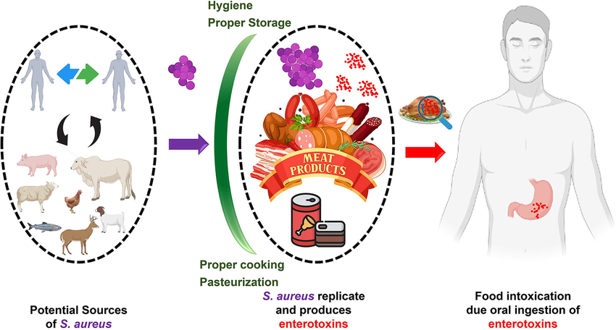
Staphylococcus aureus Enteritis
Preformed enterotoxin
Rapid onset symptoms
Preformed toxins produced by Staphylococcus aureus cause rapid-onset food poisoning.

Slide 17
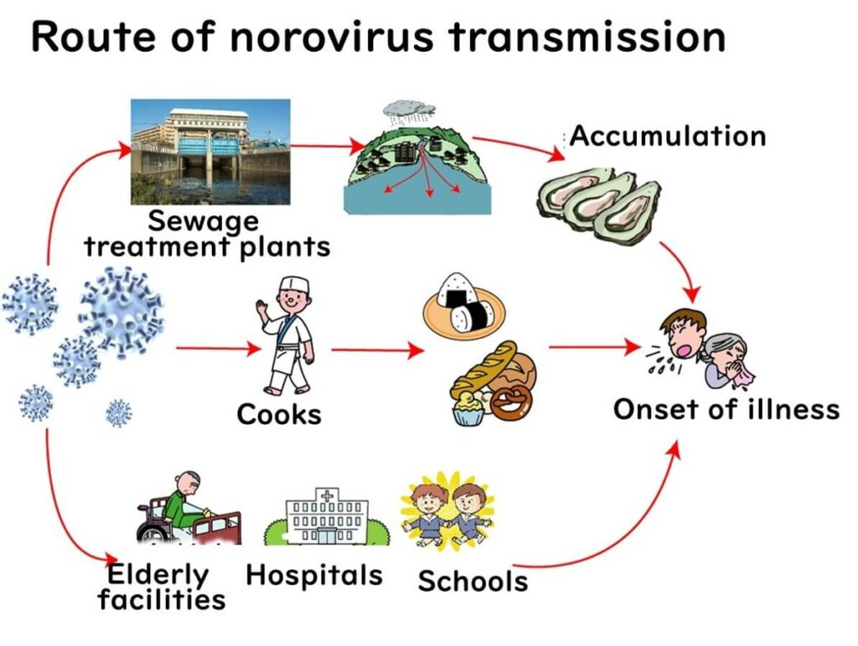
Viral GI Infections
Norovirus
Rotavirus
Viruses are a common cause of acute gastroenteritis, especially in crowded environments.

Slide 18
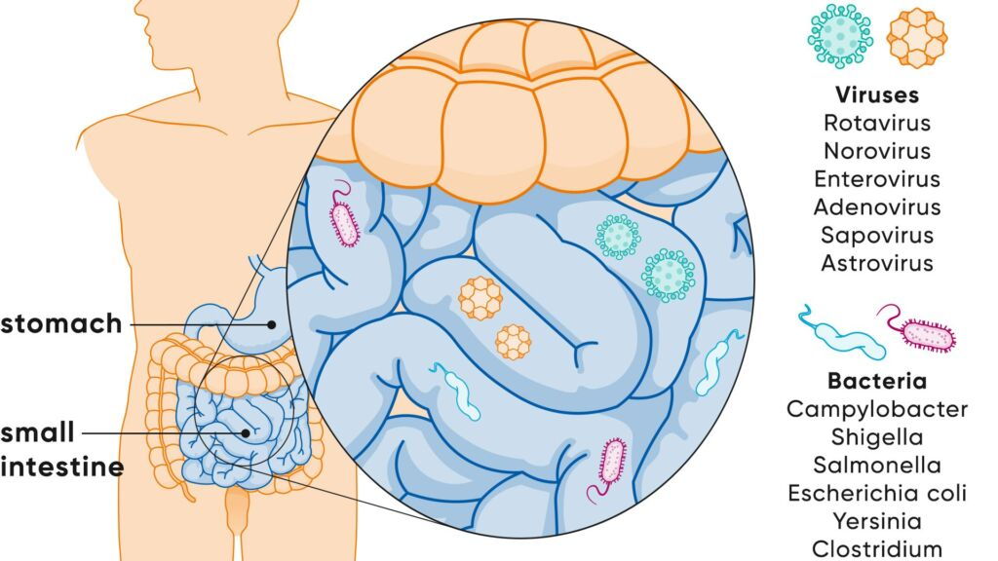
Norovirus
Highly contagious
Outbreaks
Norovirus spreads easily via the fecal–oral route and causes outbreaks.

Slide 19
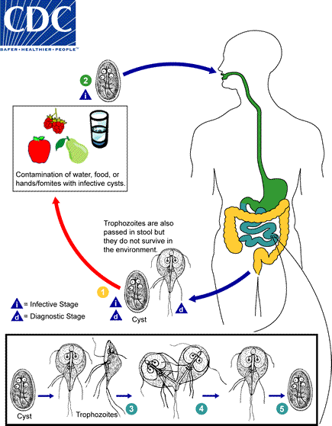
Protozoan GI Infections
Giardia duodenalis

Slide 20
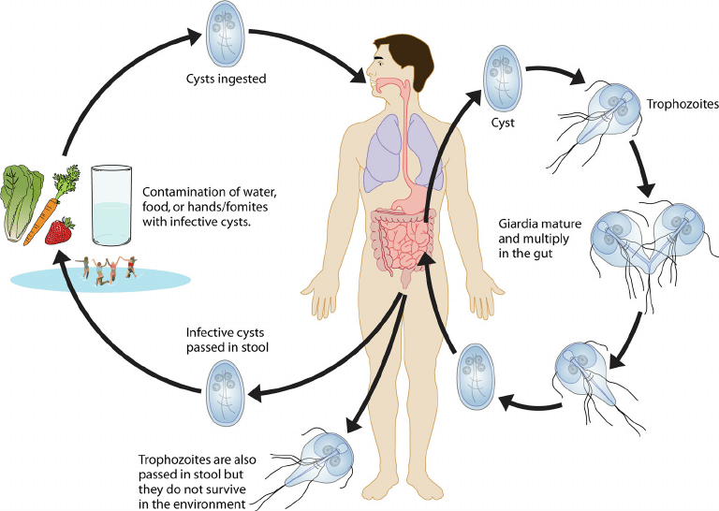
Giardiasis
Malabsorption
Watery diarrhea
Giardia duodenalis causes malabsorption and watery diarrhea.

Slide 21
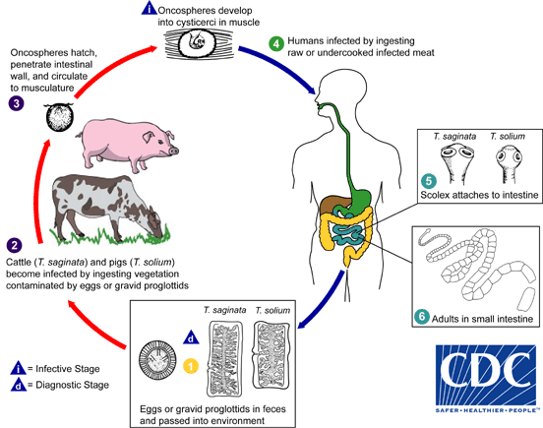
Helminth Infections
Tapeworms
Roundworms
Helminths infect the digestive system and compete for host nutrients.

Slide 22
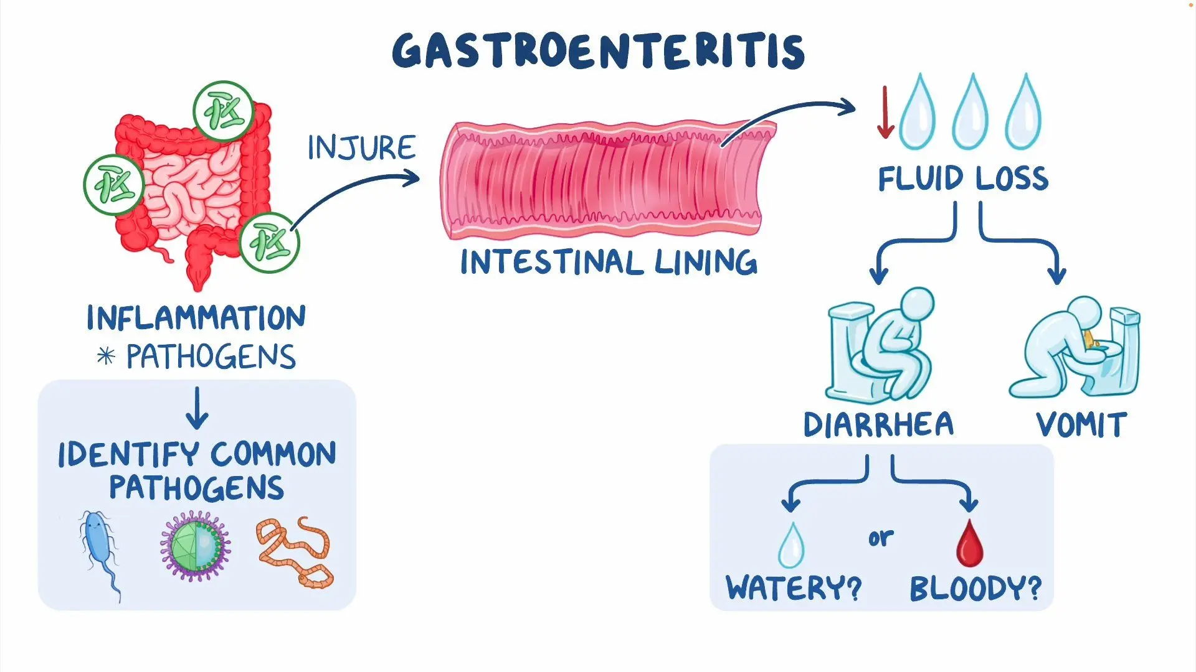
Symptoms
Diarrhea
Vomiting
Abdominal cramps
Common symptoms of digestive system infections include diarrhea, vomiting, and abdominal pain.

Slide 23
Transmission
Fecal–oral route

Slide 24
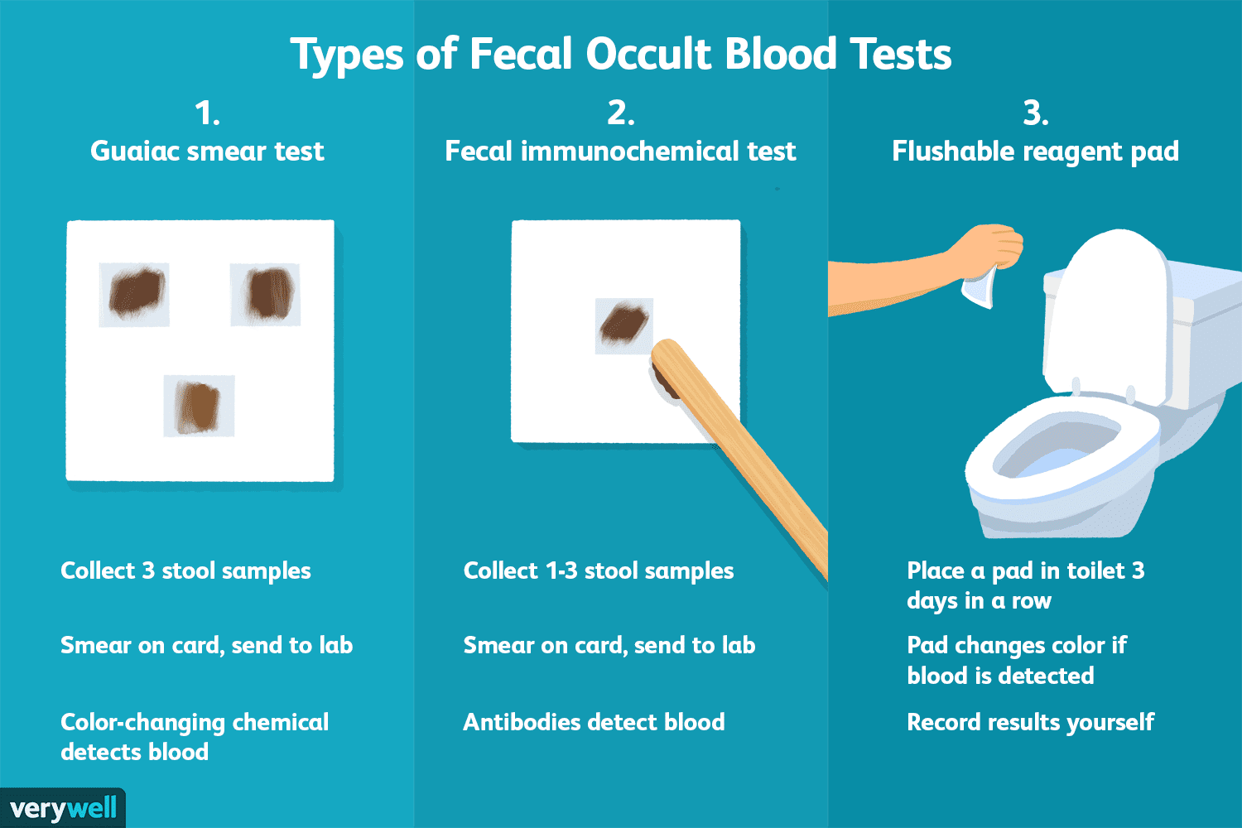
Diagnosis
Stool tests
PCR
Laboratory analysis of stool samples is used to identify digestive pathogens.

Slide 25
Treatment
Rehydration
Targeted antimicrobials

Slide 26
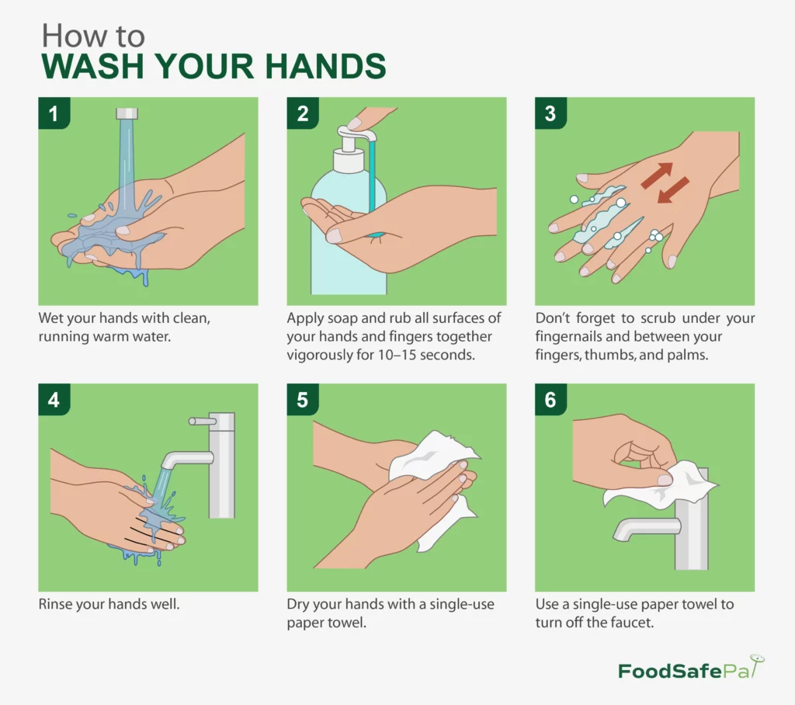
Prevention
Handwashing
Food safety
Proper hygiene and food handling reduce the risk of digestive infections.

Slide 27
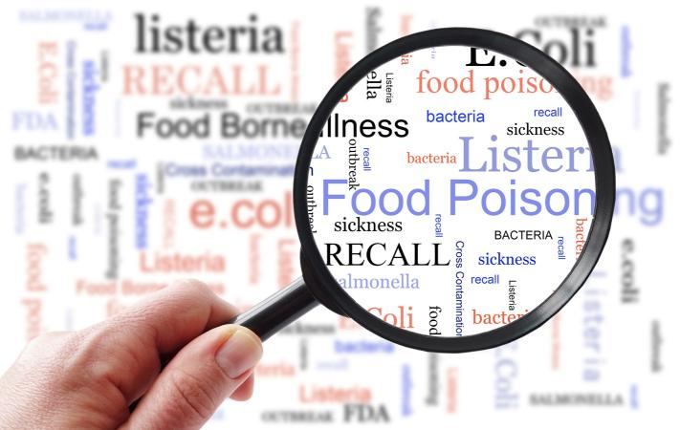
Public Health Impact
Outbreaks
Global burden
Digestive system infections can result in large-scale foodborne outbreaks.

Slide 28
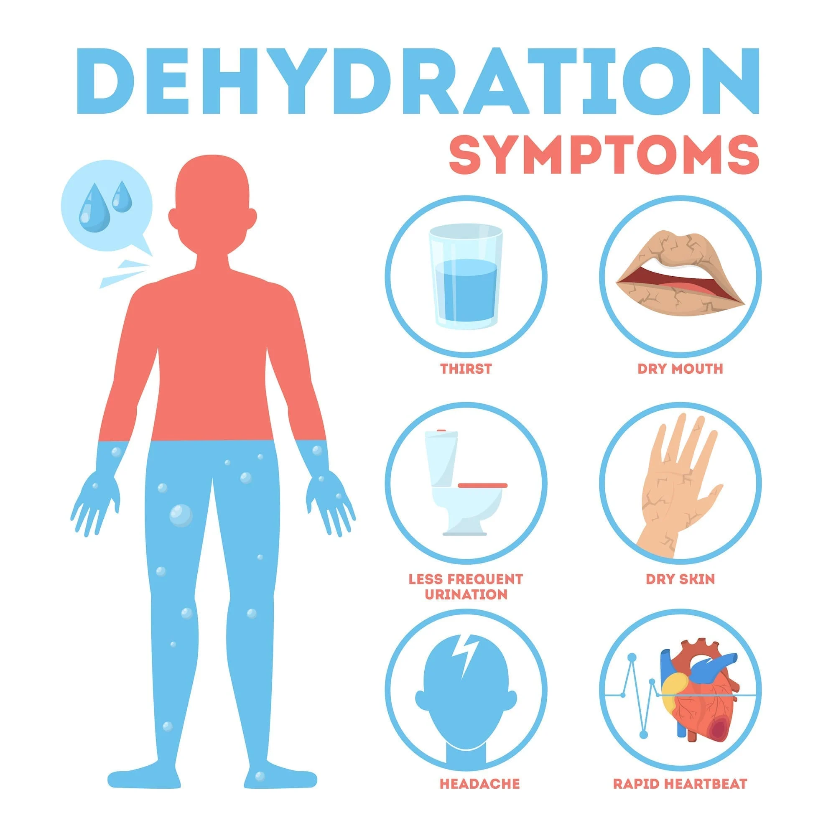
Complications
Dehydration
Electrolyte imbalance
Severe dehydration is a major complication of gastrointestinal infections.

Slide 29
Summary
Multiple pathogens
Prevention is key

Slide 30
Review Questions
Difference between infection and intoxication?

Slide 31
References
Centers for Disease Control and Prevention. (n.d.). Norovirus: Transmission and prevention [Diagram]. https://www.cdc.gov/norovirus
Centers for Disease Control and Prevention. (n.d.). Handwashing: Clean hands save lives [Infographic]. https://www.cdc.gov/handwashing
Open Oregon State University. (n.d.). Chapter 19: Digestive system infections. In Allied health microbiology.
https://open.oregonstate.education/microbiology/part/chapter-19-digestive-system-infections/
OpenStax. (2018). Anatomy and normal microbiota of the digestive system [Diagram]. In Microbiology. Rice University.
https://openstax.org/details/books/microbiology
OpenStax. (2018). Foodborne infection versus intoxication [Diagram]. In Microbiology. Rice University.
https://openstax.org/details/books/microbiology
OpenStax. (2018). Dental caries and biofilm formation [Diagram]. In Microbiology. Rice University.
https://openstax.org/details/books/microbiology
OpenStax. (2018). Helicobacter pylori and peptic ulcer disease [Diagram]. In Microbiology. Rice University.
https://openstax.org/details/books/microbiology
OpenStax. (2018). Bacterial digestive system infections [Diagrams]. In Microbiology. Rice University.
https://openstax.org/details/books/microbiology
OpenStax. (2018). Clostridioides difficile infection and toxin production [Diagram]. In Microbiology. Rice University.
https://openstax.org/details/books/microbiology
OpenStax. (2018). Staphylococcal food intoxication [Diagram]. In Microbiology. Rice University.
https://openstax.org/details/books/microbiology
OpenStax. (2018). Giardia duodenalis life cycle and pathogenesis [Diagram]. In Microbiology. Rice University.
https://openstax.org/details/books/microbiology
OpenStax. (2018). Helminth infections of the digestive system [Diagram]. In Microbiology. Rice University.
https://openstax.org/details/books/microbiology
World Health Organization. (n.d.). Foodborne diseases [Infographic]. https://www.who.int/news-room/fact-sheets/detail/foodborne-diseases

