Slide 1
Ubiquity of Microorganisms Lab
Microbiology Laboratory

Slide 2
Lab Purpose
Explore the presence of microorganisms in everyday environments

Slide 3
Learning Outcomes
Explain microbial ubiquity
Demonstrate aseptic technique
Interpret microbial growth

Slide 4
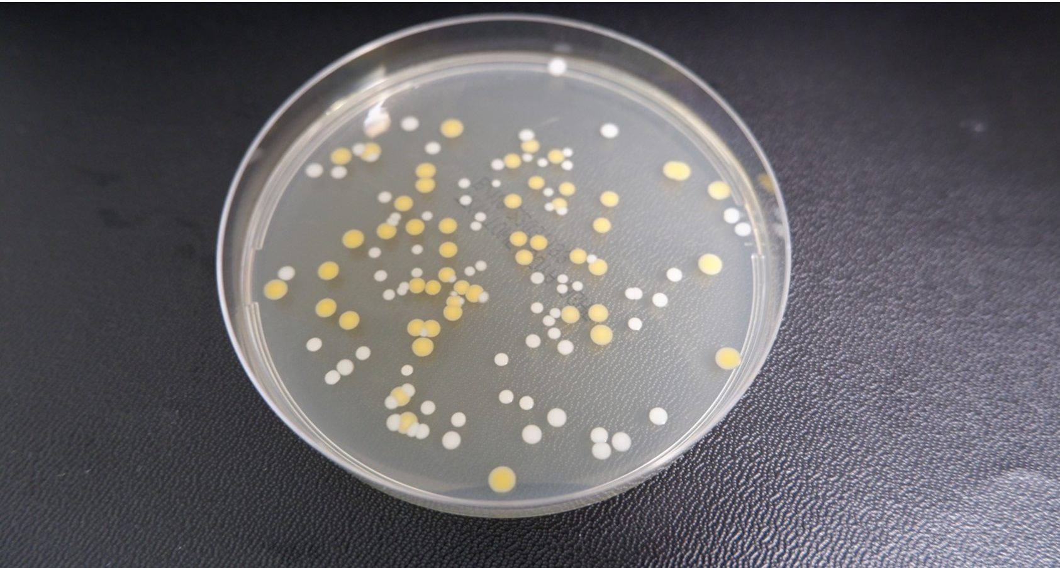
What Does Ubiquity Mean?
Microorganisms are found everywhere
Microbial colonies growing on agar plates after exposure to common environmental surfaces demonstrate the ubiquity of microorganisms.

Slide 5
Why Microbes Are Everywhere
Small size
Rapid reproduction
Environmental adaptability

Slide 6
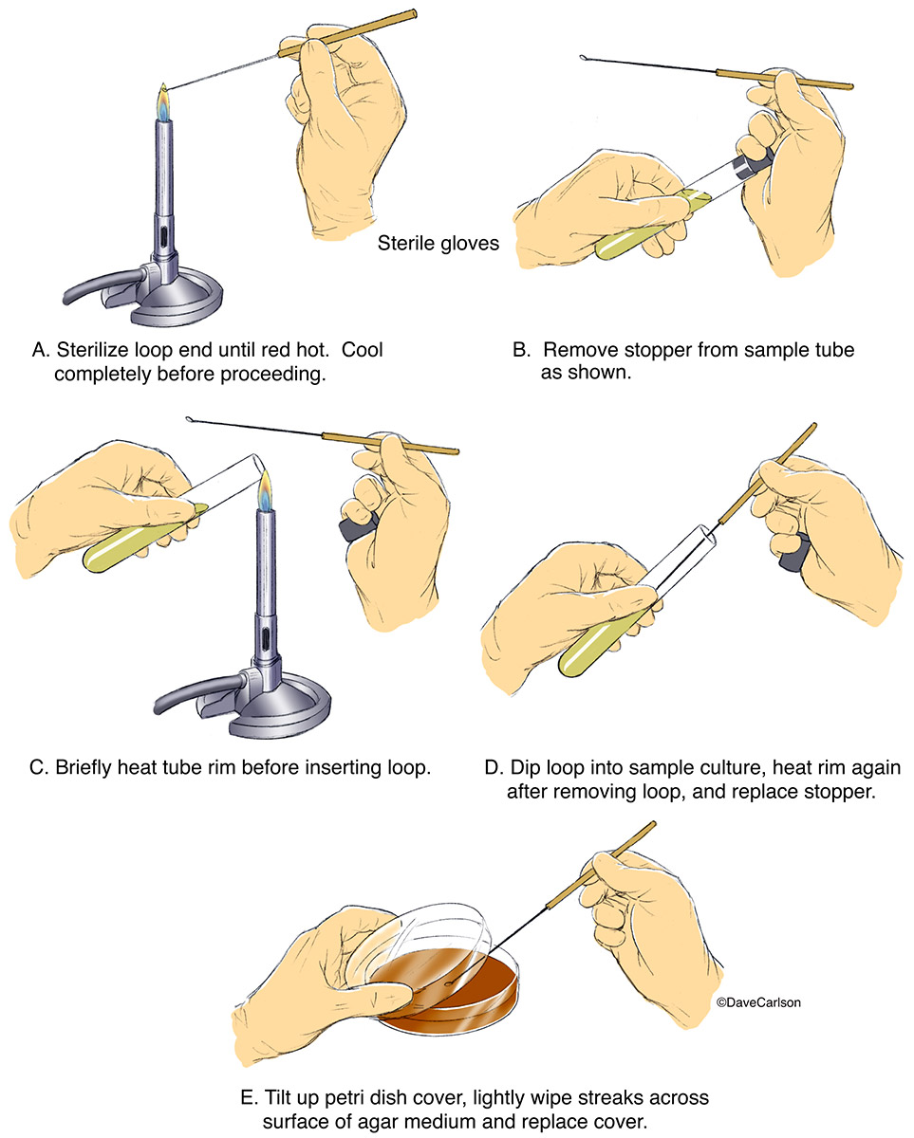
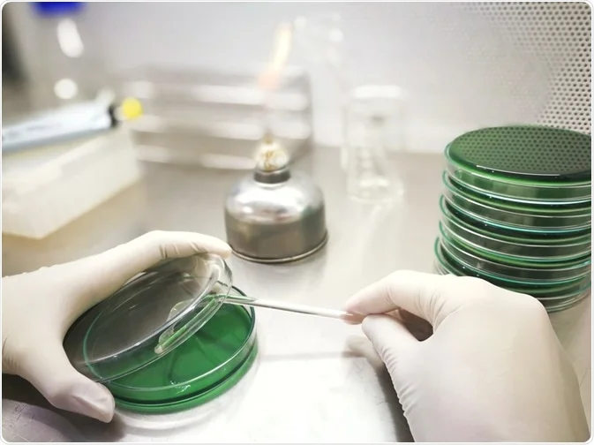
Aseptic Technique
Prevents contamination
Protects students and samples
Proper aseptic technique minimizes contamination and ensures accurate microbiological observations.

Slide 7
Materials Used
Agar plates
Sterile swabs
Incubator

Slide 8
Sampling Locations
Hands
Lab bench
Personal items
Air

Slide 9
Experimental Overview
Collect samples
Inoculate plates
Incubate

Slide 10
Incubation & Observation
Plates incubated 24–48 hours

Slide 11
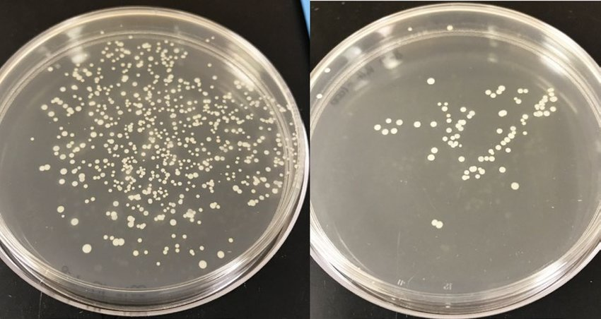
Expected Results
Colonies appear on most plates
Microbial colonies growing on agar plates after exposure to common environmental surfaces demonstrate the ubiquity of microorganisms.

Slide 12
Interpreting Growth
Differences due to exposure and contact

Slide 13
Why This Matters
Hygiene
Infection control

Slide 14
Lab Safety
Wear PPE
Do not open plates after incubation

Slide 15
Lab Wrap-Up
Microorganisms are ubiquitous

