Slide 1
Microbiology of Food Lab
Microbiology Laboratory

Slide 2
Lab Purpose
Examine microbial contamination in food

Slide 3
Learning Outcomes
Perform serial dilutions
Calculate CFUs
Explain food safety

Slide 4
Microbes & Food
Food supports microbial growth

Slide 5
Food Safety & Public Health
Foodborne illness risk

Slide 6
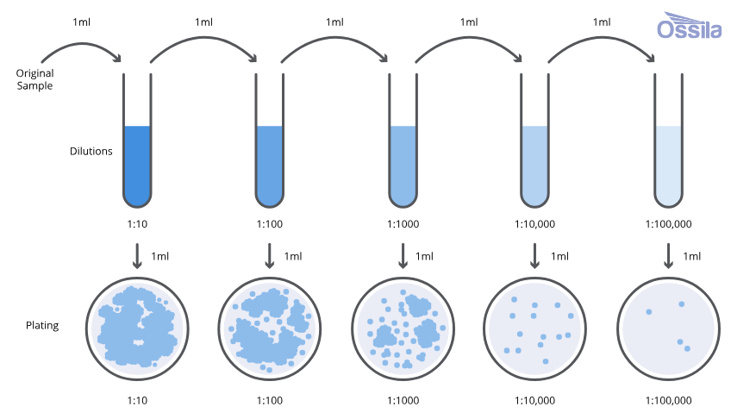
Key Techniques
Serial dilution
Standard plate count

Slide 7
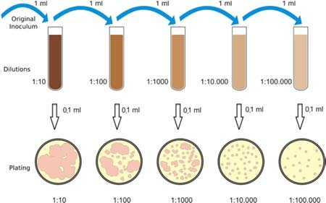
Serial Dilution Overview
Reduces concentration to countable levels
Serial dilution reduces microbial concentration to levels suitable for counting and analysis.

Slide 8
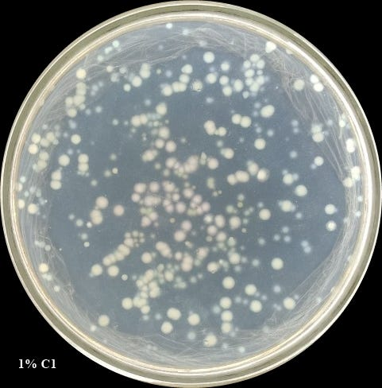
Standard Plate Count
30–300 colonies are countable

Slide 9
CFU Calculations
Estimate microbial load

Slide 10
Pasteurization
Reduces microbial populations

Slide 11
Experimental Overview
Dilute sample
Plate
Incubate

Slide 12
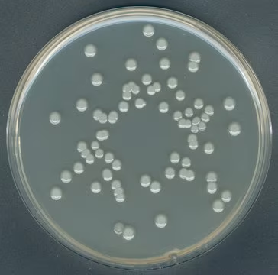
Expected Results
Different foods show different CFU counts
Plates containing 30–300 colonies are considered countable and are used to calculate CFUs.

Slide 13
Interpreting Results
Higher CFUs = higher contamination risk

Slide 14
Why This Matters
Food handling
Storage practices

Slide 15
Lab Wrap-Up
Food microbiology informs safety

