Slide 1
Lesson 16.1
The body’s demands during exercise

Slide 2
Various Aspects of Fitness
Cardiorespiratory
  aerobic/endurance training
Strength
  resistance/weight training
Flexibility
  maintaining range of movement
Body Composition
  balance between fat/lean

Slide 3
Health Benefits of Fitness
Decreased risk of obesity, CVD, type 2 diabetes, osteoporosis, joint disorders, and possibly some types of cancer
Slows common changes that occur with aging
Psychological benefits

Slide 4
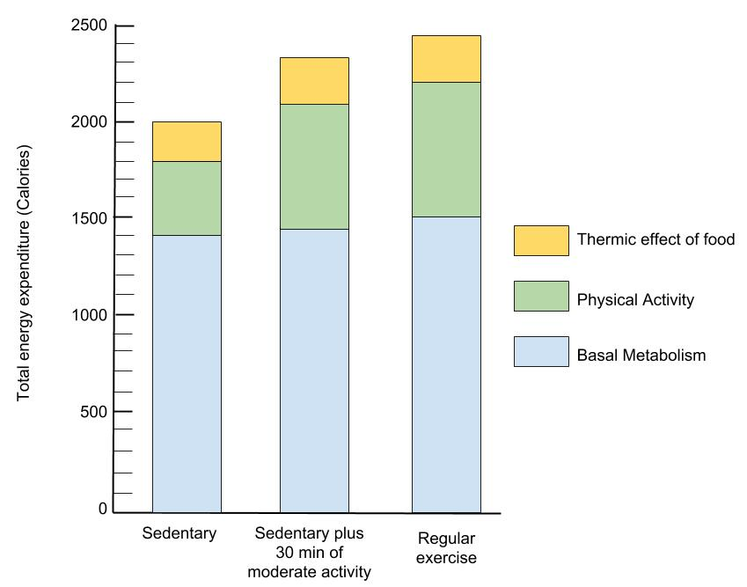
Total Energy Expenditure vs Type of Exercis
Habitual exercise increases energy expenditure
  PA
    Kcal burned from activity
  BMR
    Kcal burned during recovery

Slide 5
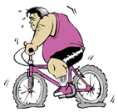
Energy Expenditure During Exercise
Varies according to:
  Type of activity (muscle groups involved, intensity/speed)
  Duration of activity
  Body weight of the individual

Slide 6
Energy Required to Jog or Run One Mile:
The Impact of Body Weight
Body Weight kcal Expended
(lbs) .
110 80
140 100
200 145
______________________________________

Slide 7
Energy Required to Jog or Run:
The Impact of Intensity
For a 155 lb person:
Pace kcal Expended per hour
(min/mile) .
12 494
10 635
8 811
6 1058
______________________________________
Did you know… if we re-calculate these values as kcal/mile, you burn almost the
same amount of kcal per mile (98-106 kcal)? It just depends on how many miles you run!

Slide 8
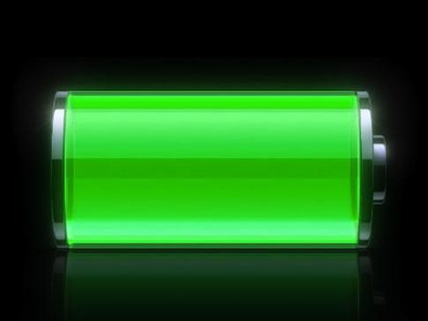

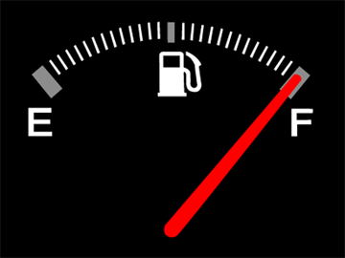
Primary fuel sources
ATP and creatine phosphate
Glucose (glycogen)
Fatty acids
Protein
Notes:
Picture source: http://www.townofeagle.org/images/pages/N256//full_tank.png
http://images.cyberimg.com/iphone/2012/03/27/Battery-.jpg
http://www.homebusinesssmart.com/wp-content/uploads/2011/05/sports-nutrition.jpg

Slide 9
Factors Influencing the Fuel Mix
During Exercise
1) Intensity of Exercise
↑intensity → ↑Carbohydrate use, ATP/creatine phosphate
2) Duration of Activity
↑duration → ↑Fat use
3) State of Training
↑endurance training → ↑Fat use

Slide 10
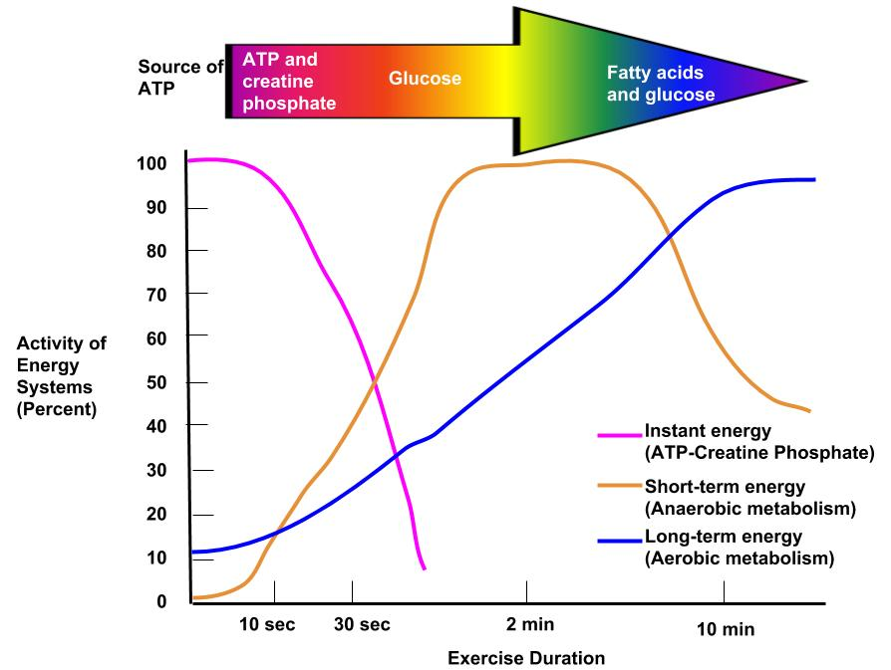
The Effect of Exercise Duration & Intensity

Slide 11
Aerobic vs anaerobic
Aerobic (with oxygen) | Anaerobic (without oxygen)
Long distance | Sprint, weight lifting (esp. power lifting)
Low/moderate intensity | High intensity
 | Produces lactic acid

Slide 12
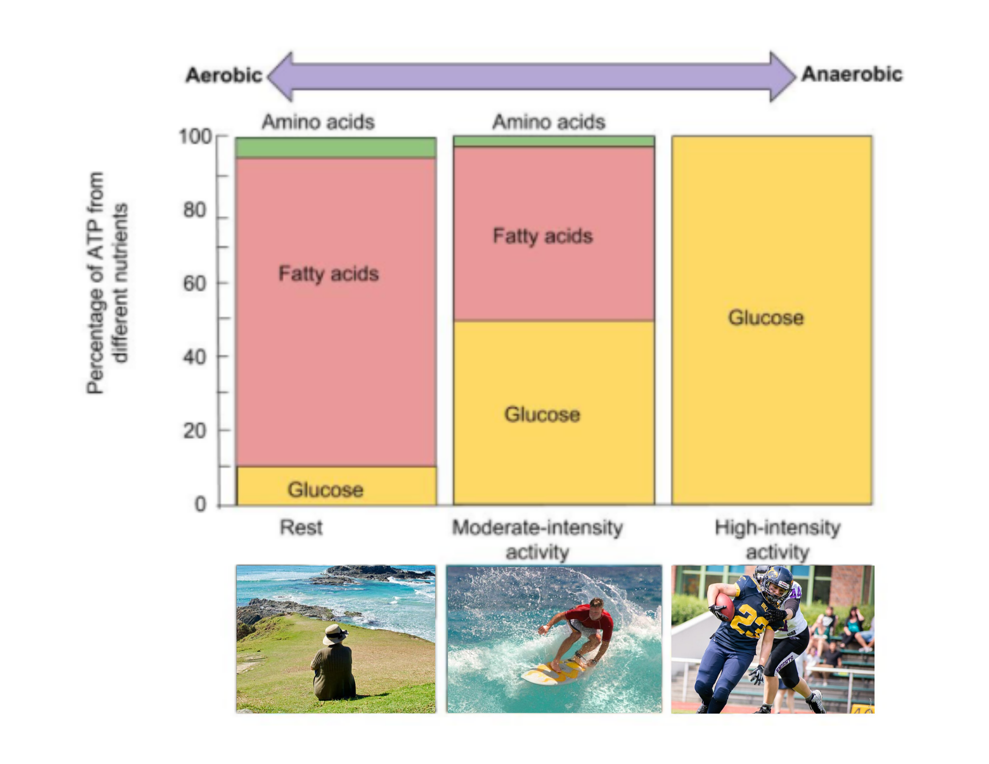
Fuel Use During Exercise
Notes:
Sources:
https://www.pxfuel.com/en/free-photo-qupmb
https://commons.wikimedia.org/wiki/File:Surfing_in_Hawaii_retouched.jpg
https://commons.wikimedia.org/w/index.php?sort=relevance&search=football+defense&title=Special:Search&profile=advanced&fulltext=1&advancedSearch-current=%7B%7D&ns0=1&ns6=1&ns12=1&ns14=1&ns100=1&ns106=1#/media/File:Football_Spiel_Berlin_Kobra_Ladies_gegen_Berlin_Knights_Ladies_in_Berlin,_2019-06-01_0112.jpg

Slide 13
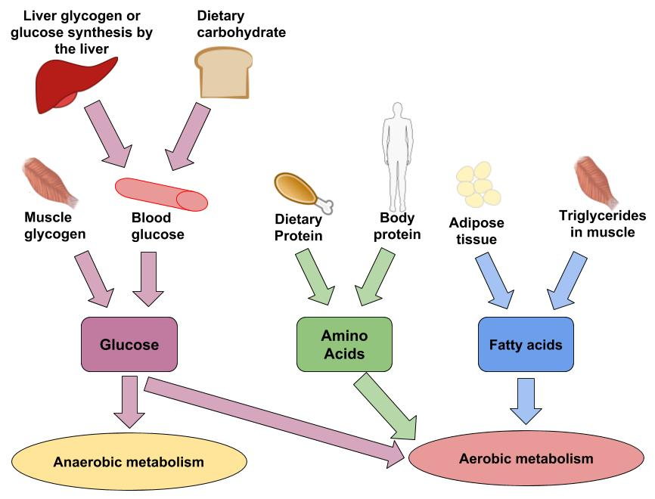
Where does our fuel come from?

Slide 14
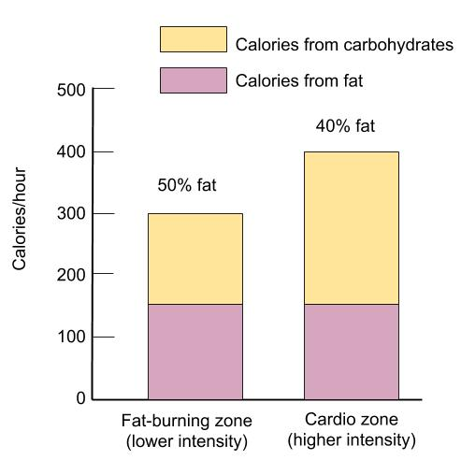
Does the “fat burning zone” exist?
It doesn’t matter what energy source is used during exercise. What results in fat loss is a negative energy balance at the end of the day, week, month, and year!

Slide 15
Summary
Fitness depends on 4 components:
  Cardiorespiratory - Strength
  Flexibility - Body Composition
There are many benefits of regular exercise for good health, weight maintenance, and increased energy expenditure.
Energy expenditure varies according to the type/intensity of activity, duration, and body weight.
Primary fuel sources:
  ATP/creatine phosphate - Glucose/glycogen
  Fatty acids - Protein
Fuel sources change over the first few minutes of exercise and between aerobic and anaerobic activities.

