Slide 1
LESSON 13.1
Pregnancy: Physiology

Slide 2
New vocabulary
Placenta- organ that exchanges nutrients and wastes between mom and baby
Gestation- another word for pregnancy
Lactation- production and secretion of milk
Teratogen- a substance that causes birth defects

Slide 3
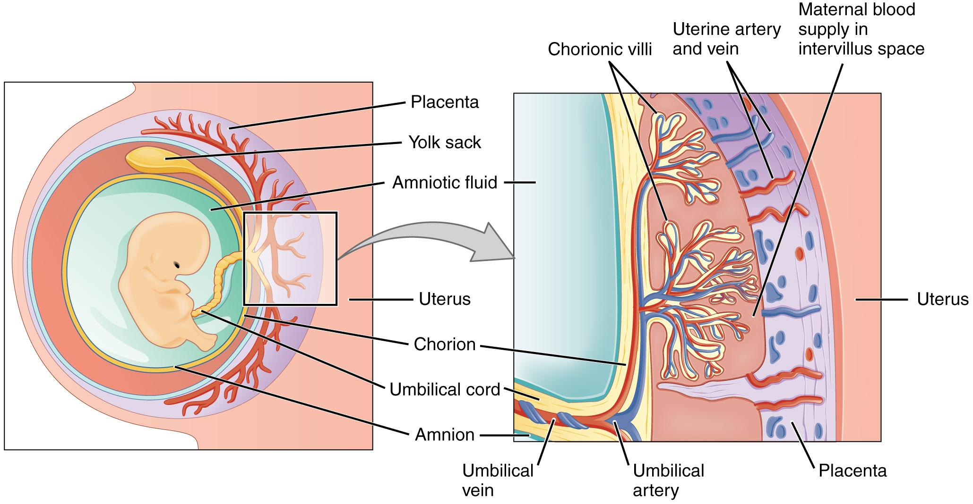
Nutrients for baby
Nutrients from mom cross through the placenta and enter the baby’s bloodstream.
The umbilical cord contains arteries and veins that interface with the placenta.
Source: https://en.wikipedia.org/wiki/File:2910_The_Placenta-02.jpg

Slide 4
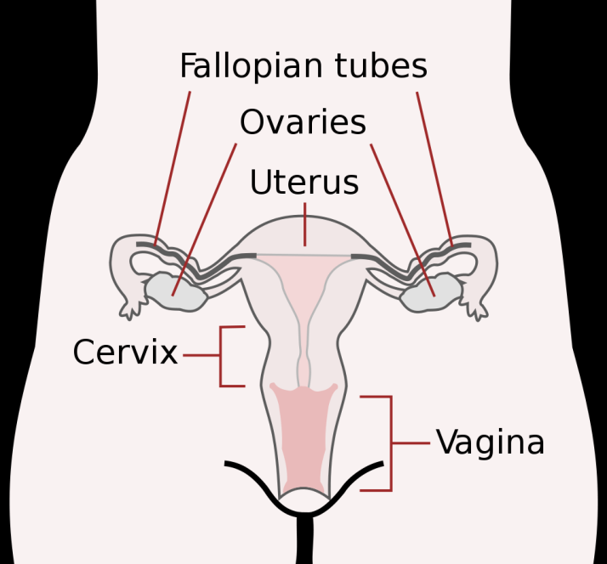
Stages of Development
Zygote
  Fertilized egg
Weeks 0-2
Until implantation in
uterine wall

Slide 5
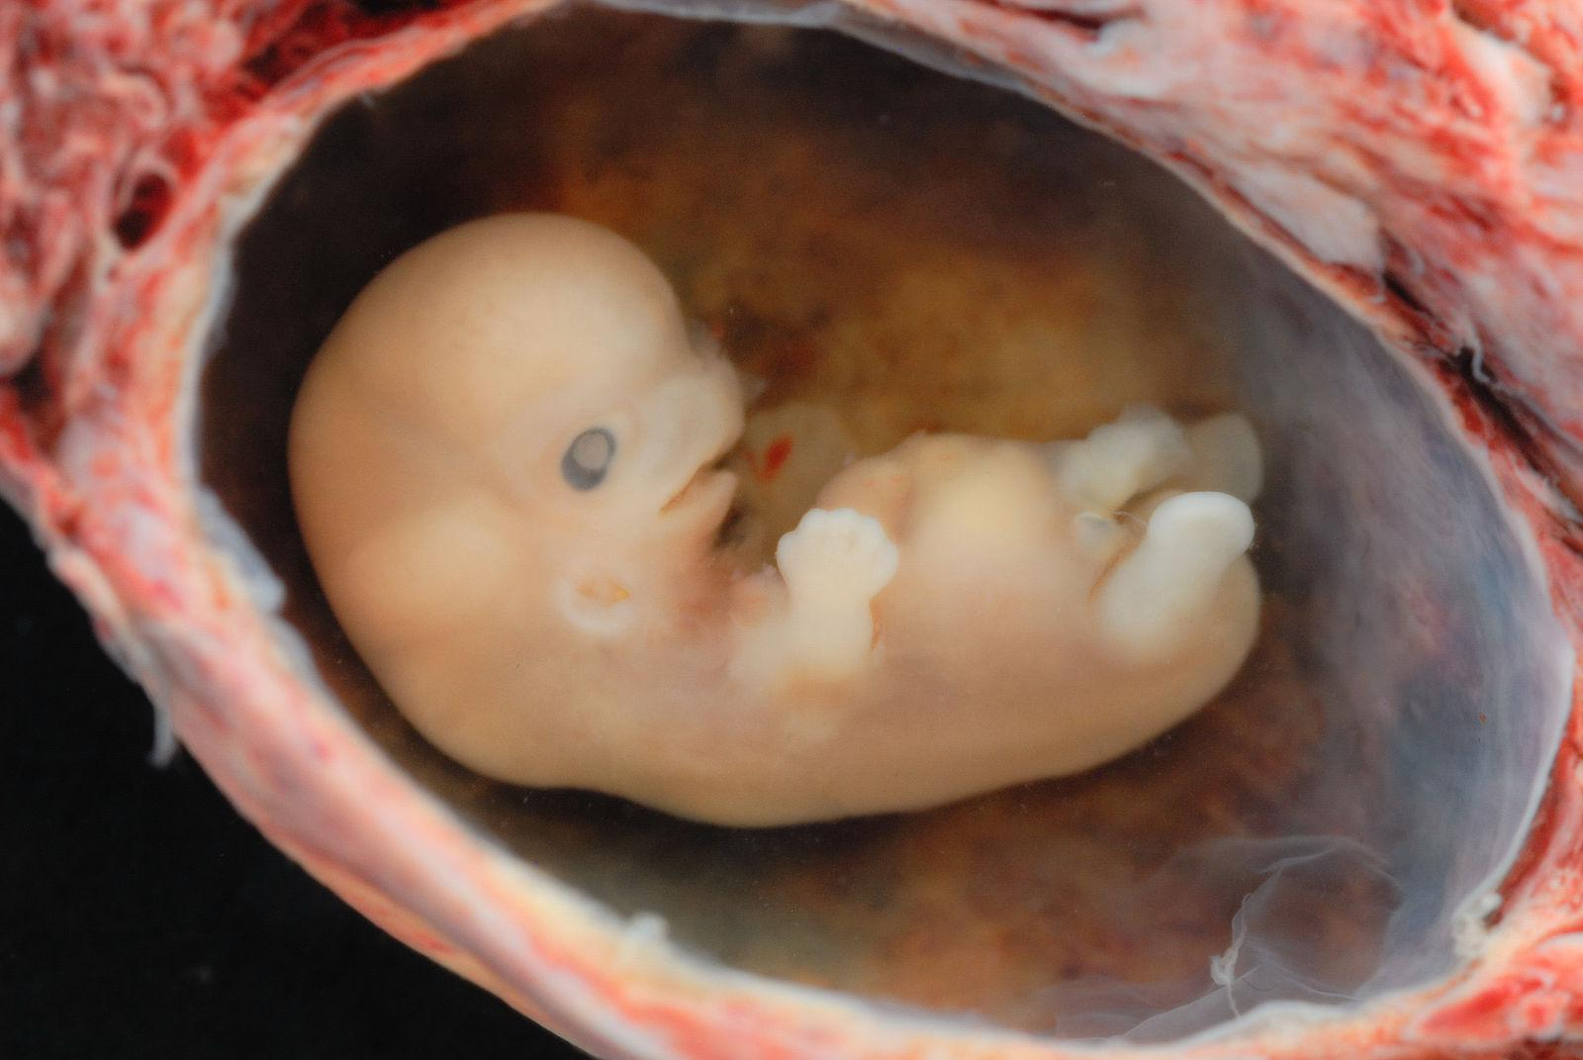
Stages of Development
Embryo
Weeks 2-8
Cell differentiation
External and internal body structures formed
High risk of damage
Source: https://commons.wikimedia.org/wiki/File:Human_Embryo_-_Approximately_8_weeks_estimated_gestational_age.jpg

Slide 6
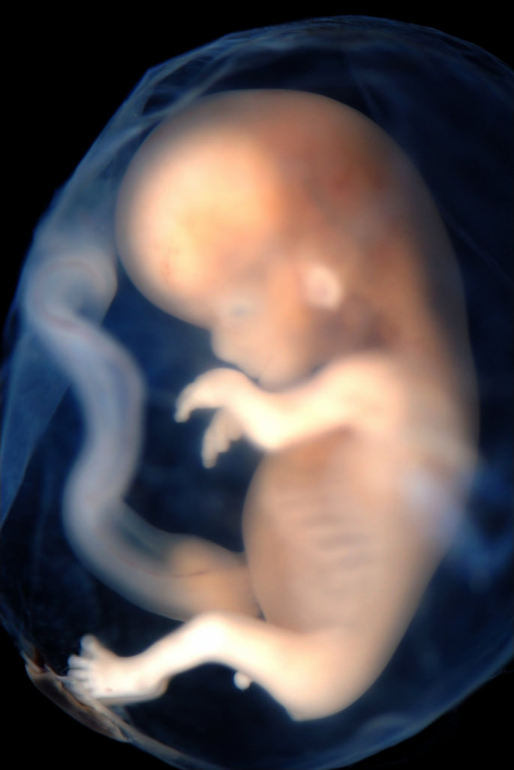
Stages of Development
Fetus
Weeks 9-term
Lots of growth!
Source: https://www.flickr.com/photos/lunarcaustic/2128618333

Slide 7
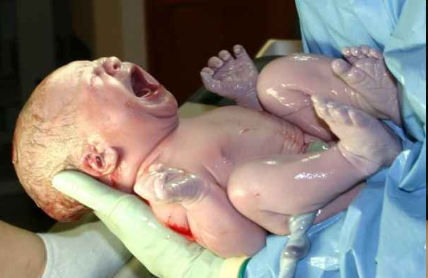
Stages of Development
Infant
  After birth
  38-42 weeks
“pre-term”
  born before 37 wks

Slide 8
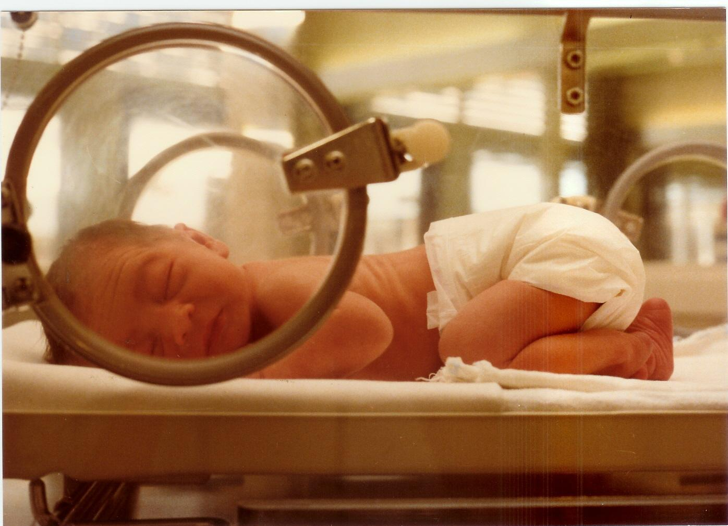
Stages of Development
Low birth weight
  less than 2.5 kg (5.5 lbs)
Small for Gestational Age
  Born at term, but smaller than average
Source: https://en.wikipedia.org/wiki/Neonatal_nursing

Slide 9
What’s happening to Mom?
Growth of adipose, breast, uterine tissues
Increase blood volume
Slower GI motility
9

Slide 10
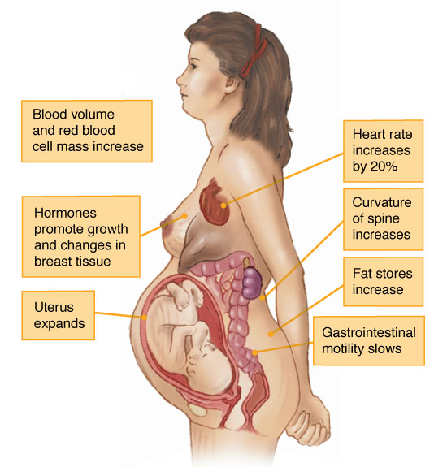
The Effects of Pregnancy
10

Slide 11
GI tract crowding
Pressure from the growing baby on the stomach may cause heartburn
  stomach acid leaks through the esophageal sphincter into the esophagus
Constipation often occurs for 2 reasons
  Slower GI transit due to relaxed muscles
  Pressure on large intestine from the growing baby

Slide 12
The First Trimester
First 13-14 weeks of pregnancy
  Nutritional deficiency or toxicity can be harmful
Medication, drugs, radiation, trauma can also be harmful
Hyperplasia
  More cells
Hypertrophy
  Bigger cells

Slide 13
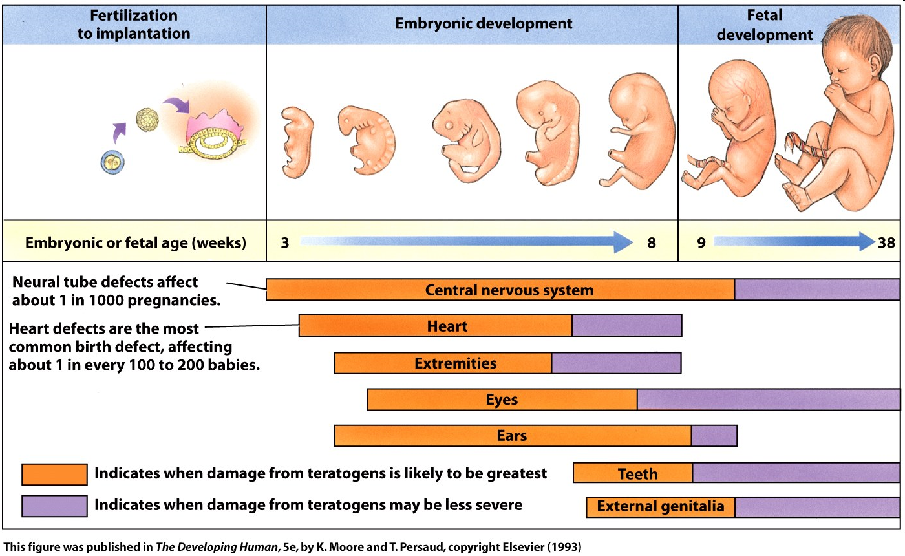
Risk of birth defects

Slide 14
The Second Trimester
Fetus looks like an infant
Still can be affected by toxin exposure
Nutritional deficiency affects mother’s ability to breastfeed
Maternal deposits of breast tissue and fat tissue

Slide 15

The Third Trimester
Rapid growth
Deposition of calcium and iron to the fetus during the last month
Baby may deplete mom’s store of iron if there is low intake
Source: https://www.pexels.com/photo/pregnancy-pregnant-motherboard-parenthoof-57529/

Slide 16
Healthy mom = Healthy baby
High risk mom
  <18 yrs old, > 35 yrs old
  Previous pregnancy problems
  Abnormal weight (<85%, >135% of ideal wt)
  Low iron
  Low kcal
  Lifestyle factors- smoking, drug use, alcohol use
High risk moms have a greater chance of an adverse outcome during pregnancy

