Slide 1
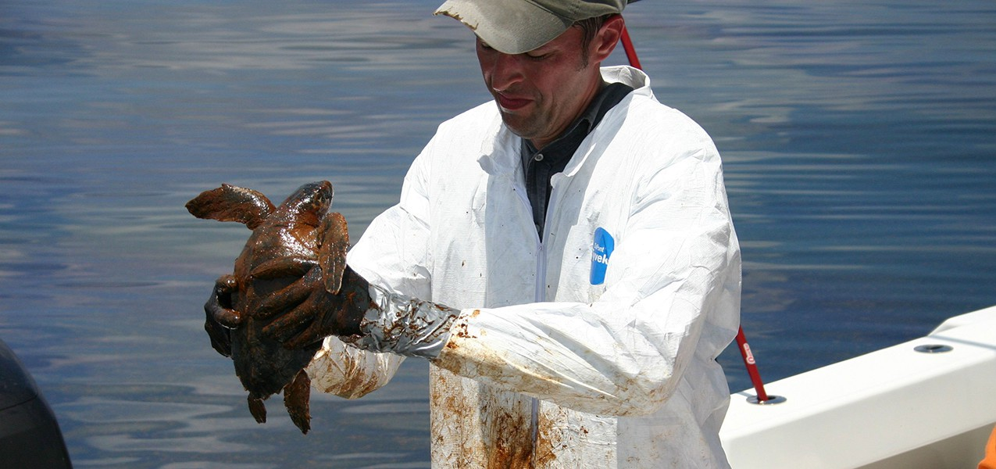
AN INVISIBLE WORLD
Chapter 1 • Foundations of Microbiology
From invisible microbes to clinical decision-making
History • Classification • Clinical relevance • Ethics
Big idea
Microbes are largely invisible, but their ecological, medical, and technological impact is enormous.
Source basis: Ch 1 Invisible World.docx
1

Slide 2
Why the Invisible World Matters
OVERVIEW
Everywhere
Essential
Clinical
Microorganisms occur from boiling hot springs to deep beneath Antarctic ice.
Microbes support ecosystems, food webs, biofuels, medicines, and fermented foods.
Some microbes are harmless or beneficial; others cause disease and can be life-threatening.
Teaching frame
• Move students from “germs = bad” to a balanced host–microbe perspective.
• Use history to show why microbiology became a clinical science.
• Connect taxonomy and identification to real diagnostic decisions.
Source basis: Ch 1 Invisible World.docx
2

Slide 3
Learning Objectives
OVERVIEW
By the end of the chapter, students should be able to:
01
02
Explain how humans used microbes before they could see them.
Describe major historical events that established microbiology.
03
04
Explain how microorganisms are classified and identified.
Compare historical and modern systems of taxonomy.
05
06
Connect microbial identification to infection prevention and treatment.
Recognize ethical responsibilities in microbiology and clinical practice.
Source basis: Ch 1 Invisible World.docx
3

Slide 4
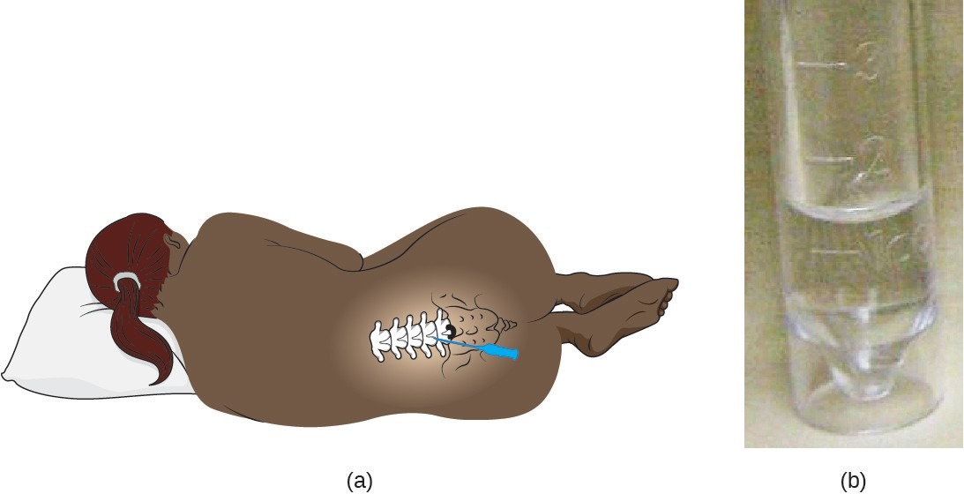
Clinical Focus: Cora
CLINICAL REASONING
Presentation
41-year-old with severe headache, fever, stiff neck, confusion, and drowsiness. Meningitis is suspected.
Lumbar puncture / CSF sampling
Diagnostic question
• What specimen is being collected?
• What laboratory methods can distinguish bacterial from other causes?
• Why might treatment begin before a definitive organism is identified?
Source basis: Ch 1 Invisible World.docx
4

Slide 5
From Specimen to Diagnosis
CLINICAL REASONING
1
2
3
4
5
Visual exam
Microscopy
Gram stain
Culture
Additional tests
Color / clarity
Cells / abnormal forms
Gram-positive vs. Gram-negative
Grow bacteria or fungi
Molecular or other targeted testing
Clinical principle
Microbiology is a sequence of observations and tests. Each step narrows the diagnostic possibilities and supports targeted treatment.
Source basis: Ch 1 Invisible World.docx
5

Slide 6
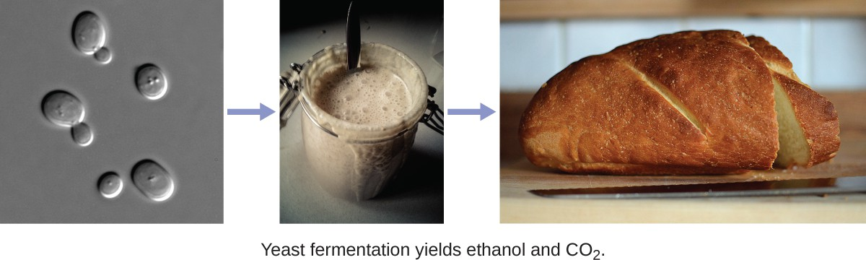
What Our Ancestors Knew
SECTION 1
Fermentation
Microbial fermentation uses bacteria, molds, or yeast to convert sugars into alcohols, gases, and organic acids.
Yeast fermentation: CO₂ production causes bread to rise
• Fermented foods and beverages have been produced throughout recorded history.
• Archaeological evidence from China indicates fermented beverages as early as 7000 BC.
• Humans learned to harness microbial activity before understanding microbes.
Source basis: Ch 1 Invisible World.docx
6

Slide 7
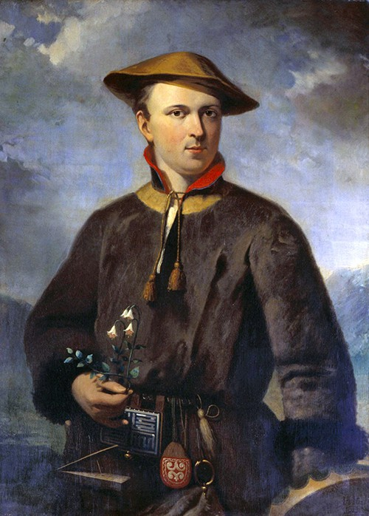
Disease Before the Microscope
SECTION 1
Ötzi: evidence of early treatment
Ancient explanations
A 5,300-year-old mummy showed evidence of Trichuris trichiura and Borrelia burgdorferi. Researchers also found a fungus with laxative and antibiotic properties.
Illness was often attributed to fate, supernatural causes, or environmental influences.
Key teaching point
Humans attempted to prevent and treat disease long before they could directly observe the organisms involved.
Ötzi the Iceman
Source basis: Ch 1 Invisible World.docx
7

Slide 8
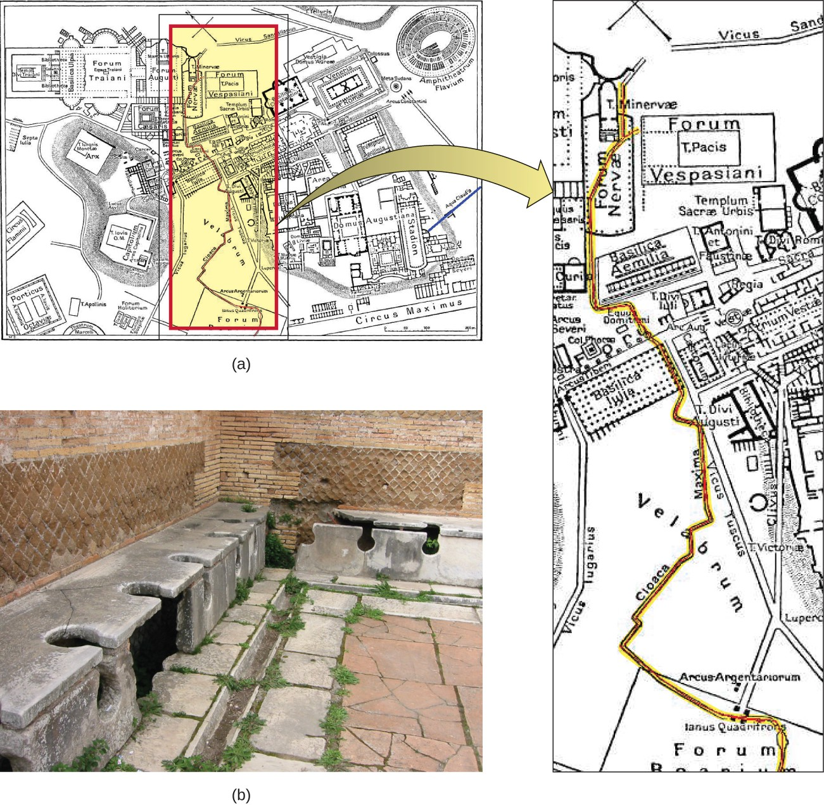
Contagion, Sanitation, and Public Health
SECTION 1
Indus Valley Civilization
Mohenjo-daro and Harappa had wells, baths, and drainage systems by about 2500 BCE.
Ancient Greece
Disease was attributed in part to “miasmatic odors,” shaping hygiene practices.
Ancient Roman sanitation infrastructure
Rome
Aqueducts brought fresh water; the Cloaca Maxima carried waste away.
Source basis: Ch 1 Invisible World.docx
8

Slide 9
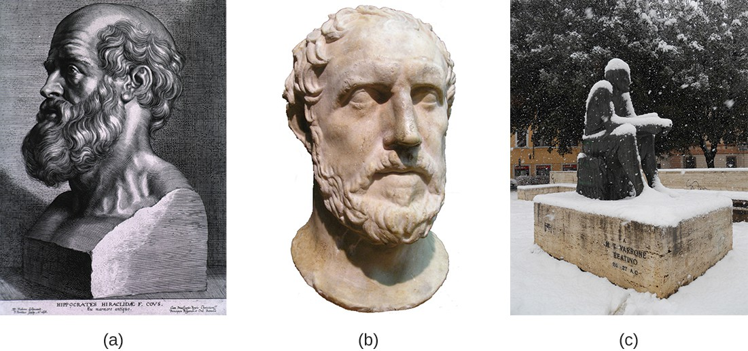
Early Thinkers: From Natural Causes to Invisible Agents
SECTION 1
Hippocrates
Argued that disease had natural causes rather than supernatural causes.
Thucydides
Observed that survivors of the Athenian plague were not re-infected—an early observation related to immunity.
Hippocrates • Thucydides • Varro
Varro
Proposed that invisible “minute creatures” could enter the body and cause disease.
Source basis: Ch 1 Invisible World.docx
9

Slide 10
Medical Knowledge Beyond Europe
SECTION 1
The chapter emphasizes a broader history of medical reasoning.
al-Razi
Ibn Sina (Avicenna)
Used experimental approaches in medicine, including distinguishing measles from smallpox and testing treatments.
The Canon of Medicine described contagion, transmission by breath, and isolation of sick people.
Instructor prompt
How does experimental reasoning differ from simply naming symptoms?
Source basis: Ch 1 Invisible World.docx
10

Slide 11
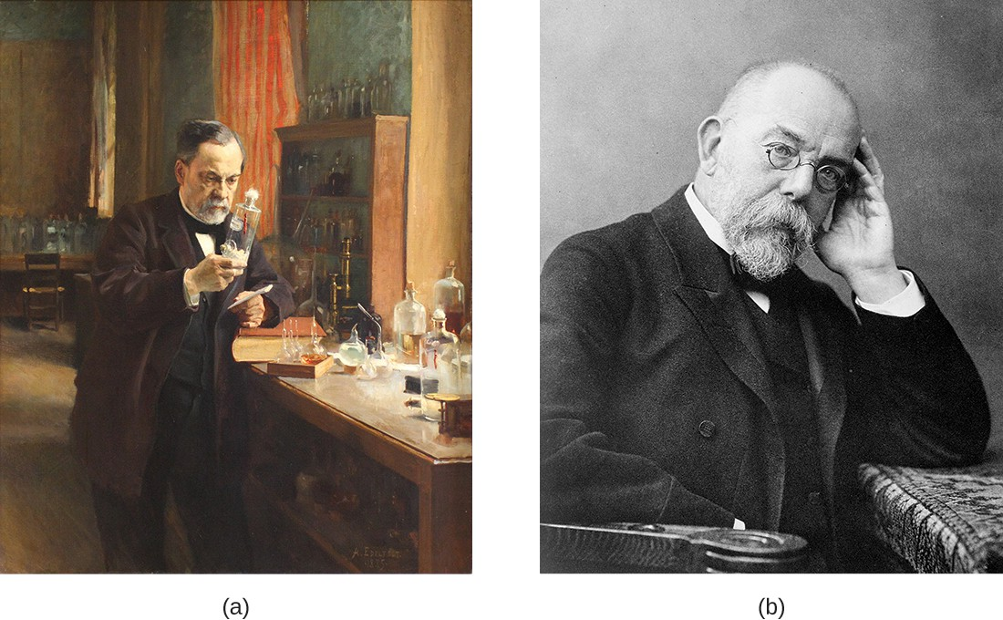
The Birth of Microbiology
SECTION 1
Antonie van Leeuwenhoek
In 1675, using a simple but powerful microscope, he observed single-celled organisms in rainwater and described them as “animalcules.”
Historical microscopy / early microbiology
Robert Hooke
Micrographia (1665) included detailed microscopic illustrations and helped establish the term “cell” from observations of cork.
Source basis: Ch 1 Invisible World.docx
11

Slide 12
The Golden Age of Microbiology
SECTION 1
1857
Pasteur
Fermentation caused by microorganisms
1860s
Pasteur
Swan-neck flask; pasteurization; vaccines
Pasteur and Koch
1876–1883
Koch
Anthrax, TB, and cholera organisms
1857–1914
Golden Age
Rapid expansion of microbiology
Source basis: Ch 1 Invisible World.docx
12

Slide 13
Disproving Spontaneous Generation
SECTION 1
A sequence of experiments shifted microbiology toward controlled evidence.
Francesco Redi
Lazzaro Spallanzani
Louis Pasteur
Maggots came from flies, not spontaneous generation.
Boiled broth could remain free of microbial growth.
Sterilized broth remained free of microbes unless exposed to contaminated air.
1668
1760s
1860s
Conceptual shift: observation → controlled experiment → causal explanation
Source basis: Ch 1 Invisible World.docx
13

Slide 14
Germ Theory: Connecting Microbes to Disease
SECTION 1
Ignaz Semmelweis
Joseph Lister
Robert Koch
Handwashing in obstetric clinics sharply reduced maternal deaths from puerperal fever.
Introduced antiseptic surgery, using carbolic acid to reduce surgical infection.
Provided experimental evidence linking specific microbes to specific diseases; developed Koch’s postulates.
Clinical implication
Infection prevention is not separate from microbiology—it is an application of microbial causation.
Source basis: Ch 1 Invisible World.docx
14

Slide 15
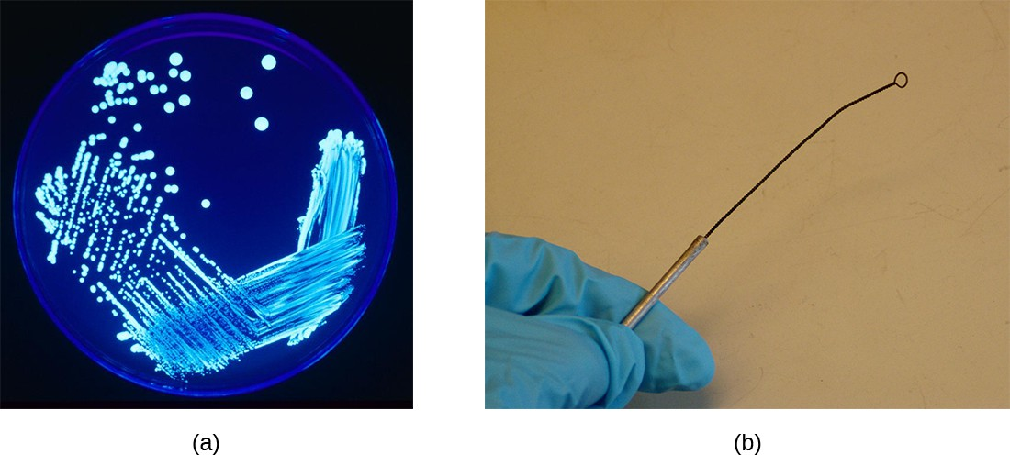
Laboratory Techniques That Changed the Field
SECTION 1
Agar
Fanny Angelina Hesse introduced agar as a solidifying agent for microbial growth media.
Gram stain
Streak plate and inoculating loop
Hans Christian Gram’s 1884 stain became a crucial method for differentiating bacteria.
Isolation
Solid media and culture techniques allowed growth of pure cultures for study.
Source basis: Ch 1 Invisible World.docx
15

Slide 16
The Modern Microbiology Toolbox
SECTION 1
Microscope
Stains & dyes
Growth media
Magnifies microbes, cells, tissues, and specimens.
Add contrast or exploit cellular differences.
Provide nutrients and selective conditions.
Petri dish
Test tube
Inoculation loop
Holds agar or other growth media.
Supports broth, semisolid, or solid media.
Transfers and streaks microorganisms.
Bunsen burner / microincinerator
Sterilizes equipment; open flames are increasingly replaced.
Source basis: Ch 1 Invisible World.docx
16

Slide 17
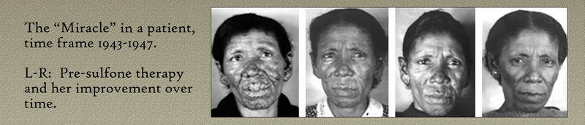
Louisiana Focus: Hansen’s Disease and Carville
SECTION 2
Carville
The national leprosarium in the continental U.S. was located in Louisiana and operated as a treatment, research, and education center.
Historical photographs associated with Hansen’s disease
Stigma and isolation
Patients were often forcibly relocated and faced long-term isolation because leprosy was mistakenly believed to be highly contagious.
Public health lesson
Scientific advances changed both treatment and the rationale for isolation, while advocacy helped address stigma and patient rights.
Source basis: Ch 1 Invisible World.docx
17

Slide 18
Armadillos, Ecology, and Zoonotic Disease
SECTION 2
Natural host
Nine-banded armadillos can naturally harbor Mycobacterium leprae.
Reservoir and exposure
Environmental and public-health context
In parts of the southern U.S., armadillos may act as a natural reservoir; zoonotic transmission is rare but documented in the chapter.
Clinical/public-health link
Understanding ecology helps explain disease risk, prevention messages, and the need to reduce stigma.
Source basis: Ch 1 Invisible World.docx
18

Slide 19
A Diverse Approach to Microbiology
SECTION 2
Microbiology is also a social and public-health discipline.
Health disparities
Cultural context
Historical injustice
The chapter highlights differences in infectious-disease burden, vaccination, antibiotics, and healthcare access.
Public-health interventions must consider cultural settings, vaccine hesitancy, and trust.
Disease stigma and unethical research can shape trust in medicine and science.
Instructor prompt
Ask: What happens to infection-control strategies when trust, access, and cultural context are ignored?
Source basis: Ch 1 Invisible World.docx
19

Slide 20
A Systematic Approach to Microbiology
SECTION 3
Clinical microbiology can be organized around four recurring questions:
1
2
3
4
What is it?
How do we know?
Why does it matter?
What should we do?
Classification
Identification
Clinical relevance
Treatment / susceptibility
This structure supports evidence-based decisions in infection prevention, diagnosis, and treatment.
Source basis: Ch 1 Invisible World.docx
20

Slide 21
Classifying Microorganisms
SECTION 3
Bacteria
Viruses
Fungi
Protozoa
Cell structure, Gram reaction, shape, and oxygen requirements.
Not cellular; classification and identification rely on other characteristics and methods.
A major microbial group with clinical and environmental importance.
Microbial eukaryotes included among the broad categories used in the chapter.
Example
Gram-positive Staphylococcus aureus is associated with skin infections; Gram-negative Escherichia coli is frequently implicated in UTIs.
Source basis: Ch 1 Invisible World.docx
21

Slide 22
How Microorganisms Are Identified
SECTION 3
Microscopy
Culture
Biochemical tests
Direct visual evidence
Grow organisms under controlled conditions
Detect characteristic metabolic traits
PCR / molecular methods
Serology
DNA / rRNA sequencing
Detect nucleic-acid signatures
Detect specific antigen–antibody reactions
Identify and classify organisms
Clinical payoff
Faster, more accurate identification can support targeted treatment and improve outcomes.
Source basis: Ch 1 Invisible World.docx
22

Slide 23
Clinical Relevance: Not Every Microbe Is a Pathogen
SECTION 3
Commensal
Pathogenic
Opportunistic
Normally present without causing disease under typical conditions.
Capable of causing disease in a susceptible host.
May cause disease when host defenses or the microbial environment change.
Example: C. difficile
Small numbers may be present in the intestine, but antibiotic disruption of normal gut flora can allow severe diarrhea and colitis to develop.
Source basis: Ch 1 Invisible World.docx
23

Slide 24
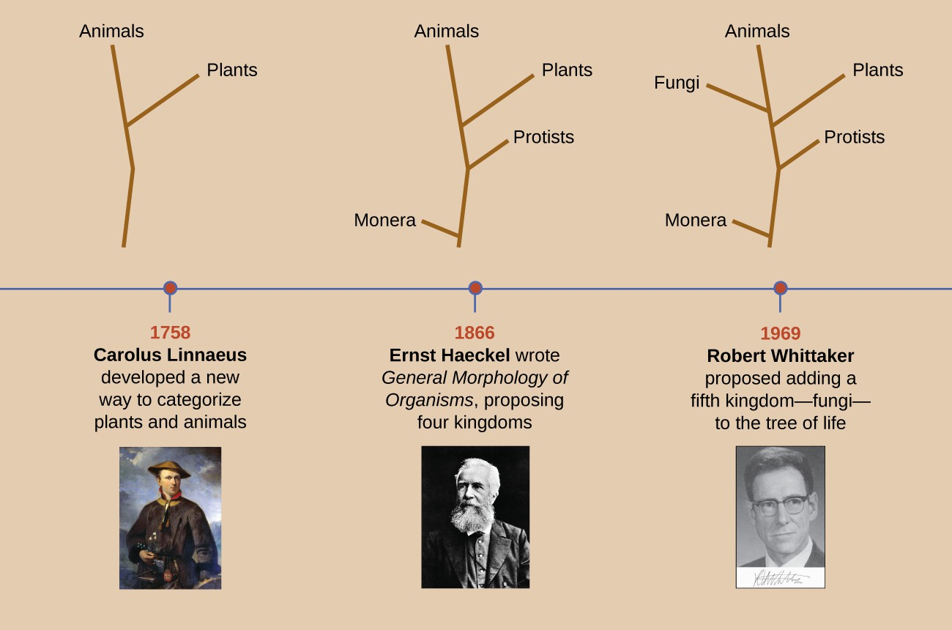
Taxonomy: Organizing the Invisible World
SECTION 3
Taxonomy
Classification, nomenclature, and identification of microbes.
Linnaeus
Evolution of classification systems
Developed a standardized hierarchy and binomial nomenclature.
Hierarchy
Kingdom → Class → Order → Family → Genus → Species. Species remains the most specific/basic unit.
Source basis: Ch 1 Invisible World.docx
24

Slide 25
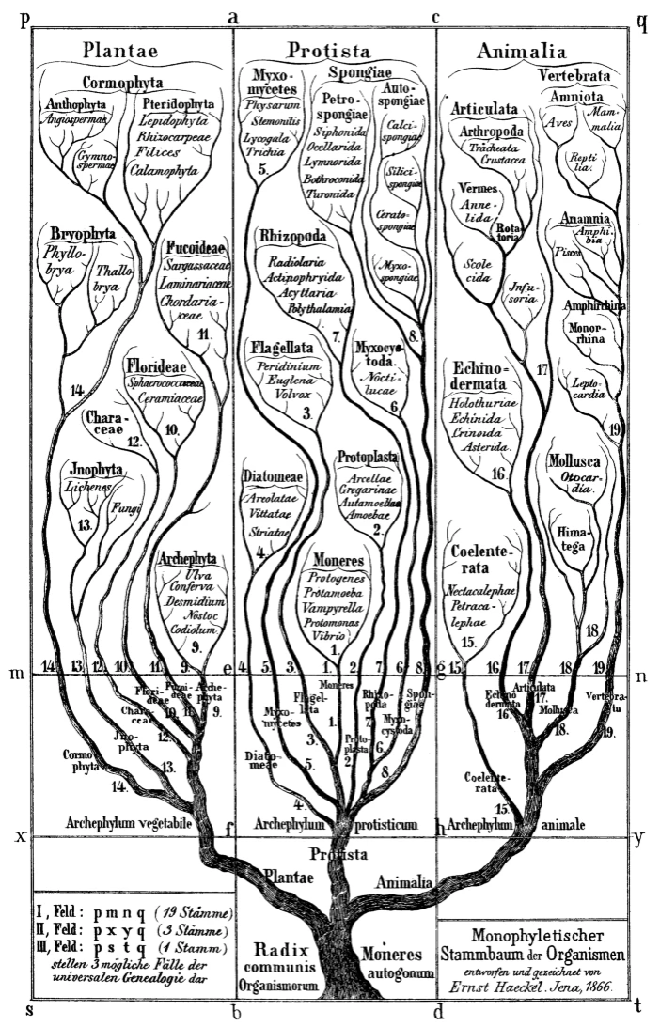
From Kingdoms to Phylogenies
SECTION 3
Haeckel (1866)
Added Protista and later Monera to earlier animal/plant groupings.
Whittaker (1969)
Proposed five kingdoms: Animalia, Plantae, Protista, Fungi, and Monera.
Early phylogenetic representation
Phylogeny
Classification increasingly emphasized evolutionary relationships rather than appearance alone.
Source basis: Ch 1 Invisible World.docx
25

Slide 26
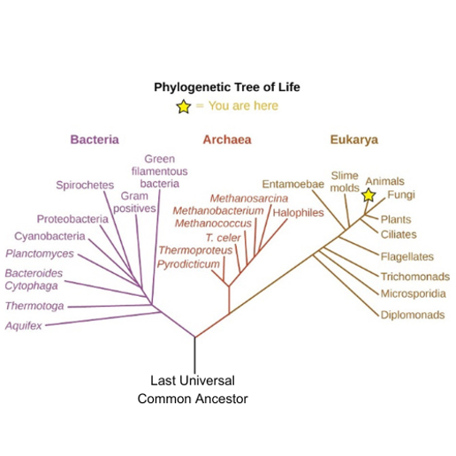
Modern Taxonomy: Three Domains
SECTION 3
Bacteria
Prokaryotic organisms.
Archaea
Prokaryotic organisms that differ substantially from bacteria in rRNA sequences.
Eukarya
Genetics-based phylogenetic tree
Eukaryotic organisms.
Modern relationships are inferred from DNA, RNA, and protein comparisons; horizontal gene transfer can complicate a simple “tree” model.
Source basis: Ch 1 Invisible World.docx
26

Slide 27
Naming Microbes: Binomial Nomenclature
SECTION 3
Two words create a globally standardized scientific name.
Genus
Specific epithet
Format
Capitalized
Lowercase
Both italicized
Homo sapiens
Example convention: Escherichia coli → E. coli after the first full mention.
Source basis: Ch 1 Invisible World.docx
27

Slide 28
Same Species ≠ Same Clinical Behavior
SECTION 3
Strains are subtypes within a species and can differ substantially in attributes.
E. coli — most strains
E. coli O157:H7
Clinical reasoning
Many strains are normal gut organisms that contribute to digestion and other beneficial functions.
A pathogenic strain associated with abdominal cramps and diarrhea; outbreaks have been linked to contaminated food.
Species-level identification may not be enough; strain-level differences can matter.
Source basis: Ch 1 Invisible World.docx
28

Slide 29
Bergey’s Manuals and Microbiology as a Field
SECTION 3
Bergey’s Manuals
Major subfields
Standard references for identifying and classifying prokaryotes. Biochemical, serological, DNA, and rRNA methods supplement visual observations.
Bacteriology • Mycology • Protozoology • Parasitology • Virology • Immunology
Applied areas
Clinical • Environmental • Applied • Food microbiology
The chapter emphasizes clinical applications while showing how the subfields remain interconnected.
Source basis: Ch 1 Invisible World.docx
29

Slide 30
Eye on Ethics: Scientific Progress Requires Ethical Limits
SECTION 3
Guatemala syphilis experiment
Informed consent
• More than 1,300 people were intentionally exposed to STDs without informed consent.
• Only some subjects received penicillin; 83 subjects died by 1953, likely as a result of the study.
• The case illustrates why scientific goals do not justify unethical methods.
Participants understand the purpose, procedures, and risks.
Patient rights
Respect autonomy, dignity, confidentiality, and accurate communication.
Oversight
IRB approval is required for human-subject research; animal protocols require appropriate review.
Discussion: Can a scientifically valuable question ever justify an unethical method?
Source basis: Ch 1 Invisible World.docx
30

Slide 31
Clinical Focus Resolution: Cora
CLINICAL REASONING
What changed?
Key findings
Antibiotics did not help, CSF cultures were negative, and neurological symptoms progressed.
No CSF inflammation/infection expected for viral meningitis; elevated 14-3-3 protein; abnormal EEG.
Conclusion
Creutzfeldt–Jakob disease (CJD), a transmissible spongiform encephalopathy (TSE).
Teaching point: the clinical picture evolved because laboratory evidence progressively ruled out common infectious causes.
Source basis: Ch 1 Invisible World.docx
31

Slide 32
Chapter Synthesis: What Should Students Remember?
WRAP-UP
01
02
Microbes are ancient partners and threats; humans used them before seeing them.
Microscopy transformed microbiology from inference to direct observation.
03
04
Pasteur, Koch, Semmelweis, Lister, and others linked microbes to disease and prevention.
Modern classification increasingly relies on molecular evidence.
05
06
Clinical microbiology connects classification → identification → clinical significance → treatment.
Ethics, equity, culture, and patient rights are integral to microbiology practice.
Source basis: Ch 1 Invisible World.docx
32

Slide 33
Instructor Review Questions
ASSESSMENT
Review
Review
1. How did fermentation demonstrate the usefulness of microbes before microscopy?
2. What evidence shifted thinking from spontaneous generation toward microbial causation?
Review
Review
3. Why does Gram staining matter in clinical microbiology?
4. How does modern molecular taxonomy differ from appearance-based classification?
Review
Review
5. Why can two strains of the same species have different clinical effects?
6. What ethical safeguards should guide human-subject microbiology research?
Suggested use: formative discussion, exit ticket, or exam review.
Source basis: Ch 1 Invisible World.docx
33

Slide 34
References & Source Basis
Primary source
Ch 1 Invisible World.docx — user-provided chapter source used as the content basis for this lecture deck.
Figures and image material
Figures embedded in the provided chapter document were reused where appropriate. Figure credits are retained conceptually from the source document.
Design note
High-contrast palette, large instructional typography, visual hierarchy, and limited text density were used for classroom projection.
34

