Slide 1
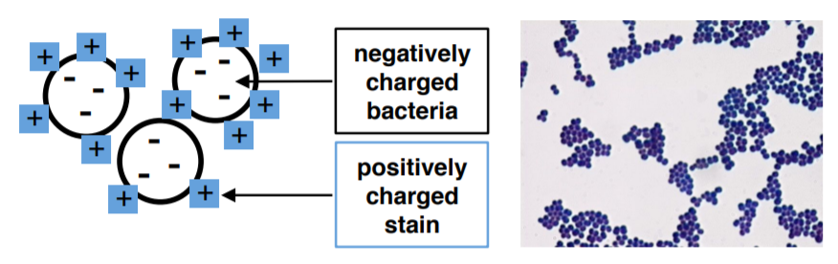
Simple staining
https://bio.libretexts.org/Learning_Objects/Laboratory_Experiments/Microbiology_Labs/Book%3A_General_Microbiology_Lab_Manual_(Pakpour_and_Horgan)/Lab_03%3A_Simple_Negative_and_Gram_Stain
LibreTexts content is licensed by CC BY-NC-SA 3.0
Notes:
https://bio.libretexts.org/Learning_Objects/Laboratory_Experiments/Microbiology_Labs/Book%3A_General_Microbiology_Lab_Manual_(Pakpour_and_Horgan)/Lab_03%3A_Simple_Negative_and_Gram_Stain
LibreTexts content is licensed by CC BY-NC-SA 3.0

Slide 2
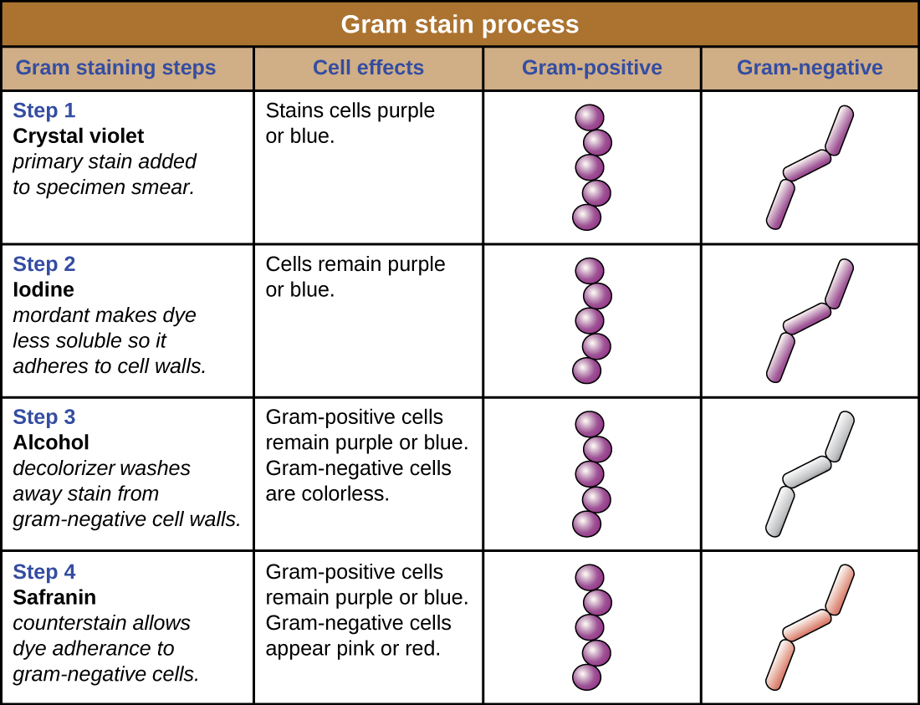
Image: Figure 2.33/OpenStax Microbiology/Creative Commons/cropped
Notes:
Figure 3, Chapter 2 Openstax Microbiology. Cropped

Slide 3
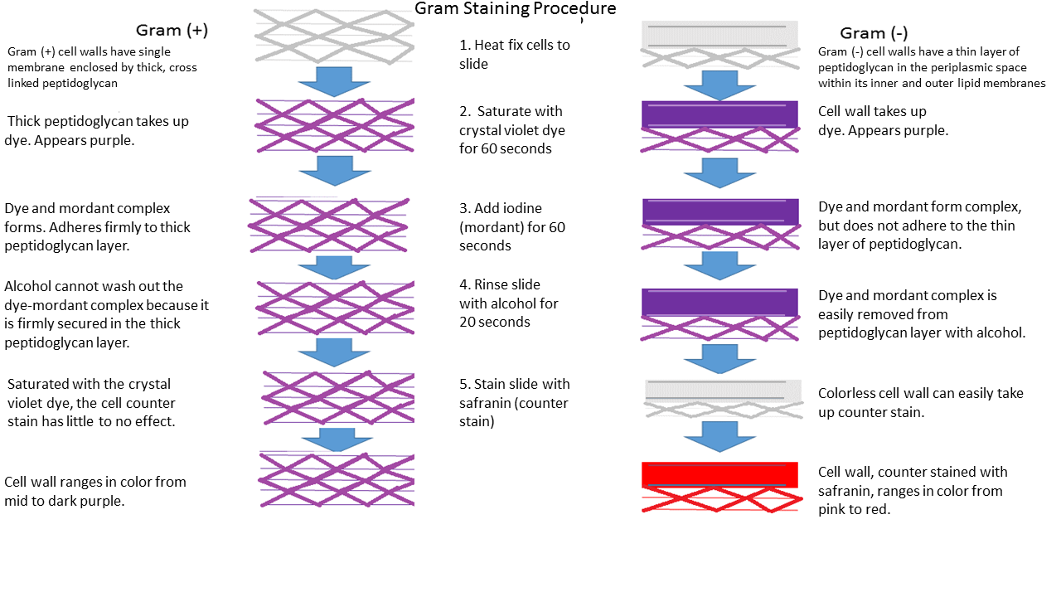
File:Gram Stain.png, Paityn Donaldson, CC BY-SA 4.0
Notes:
CC BY-SA 4.0
File:Gram Stain.png
Paityn Donaldson
https://commons.wikimedia.org/wiki/File:Gram_Stain.png#/media/File:Gram_Stain.png

Slide 4
Image: Figure 2.33/OpenStax Microbiology/Creative Commons
Notes:
Figure 3, Chapter 2 Openstax Microbiology

Slide 5
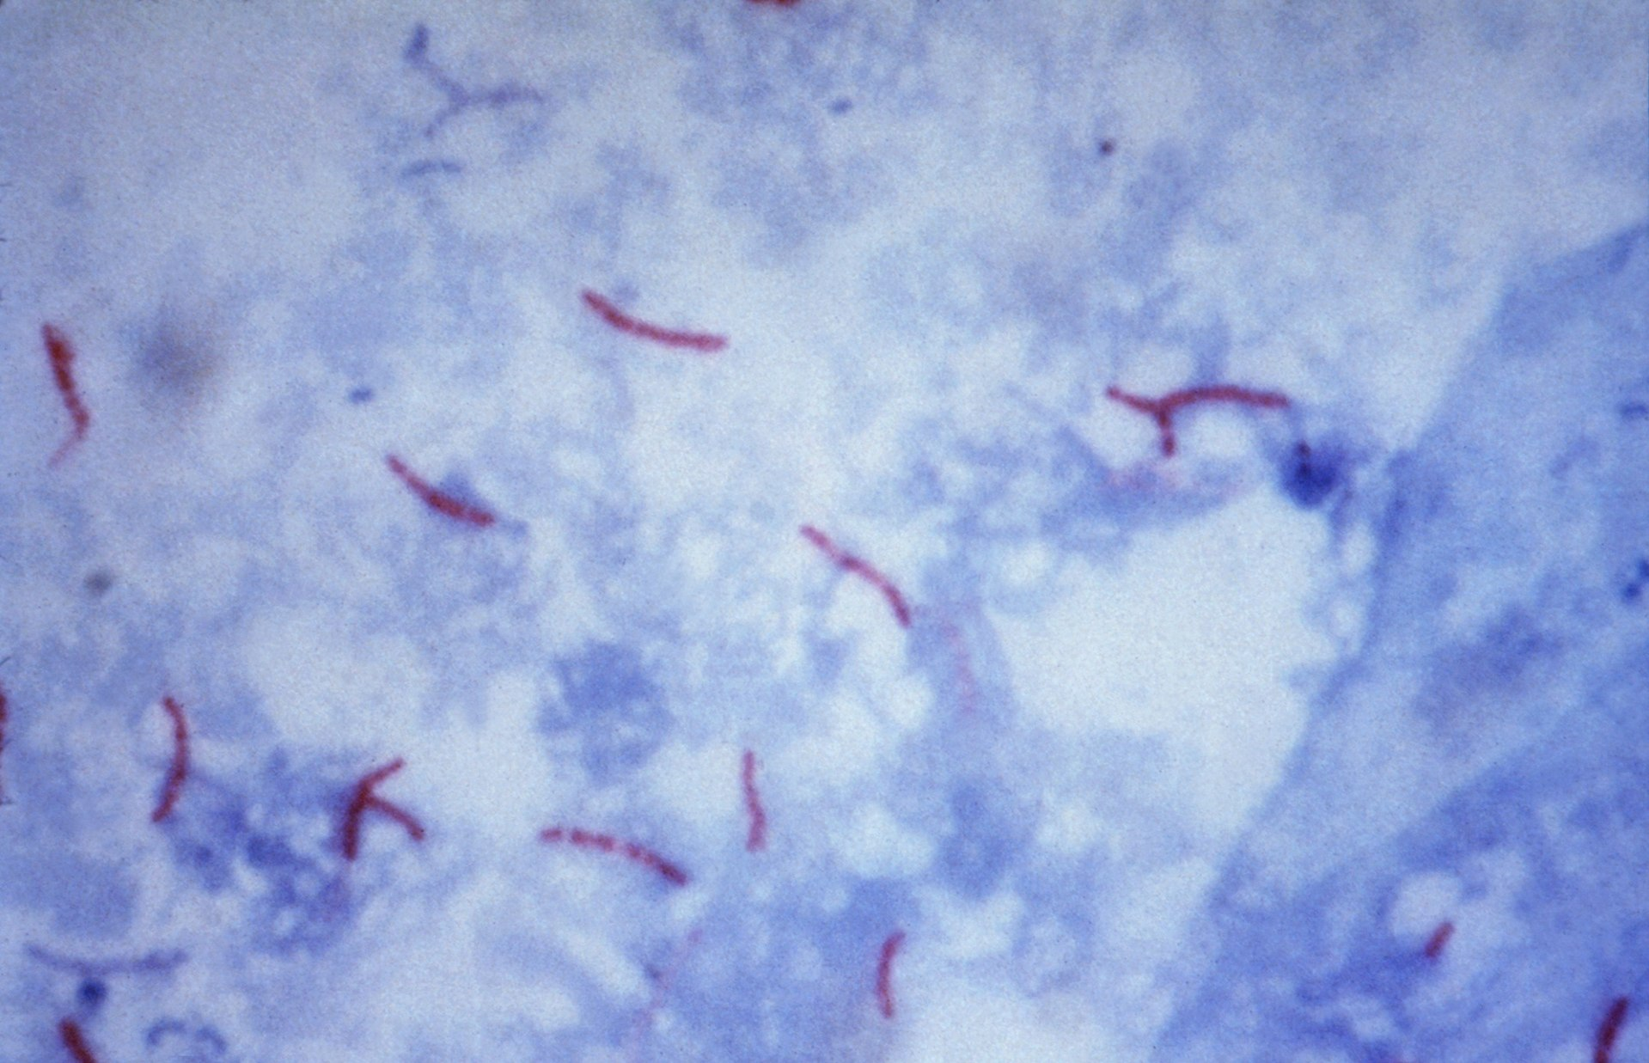
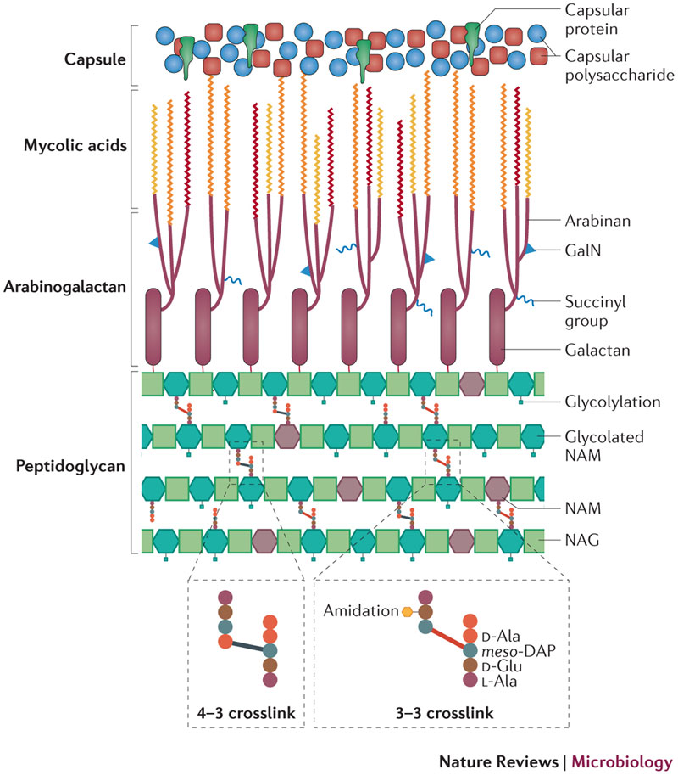
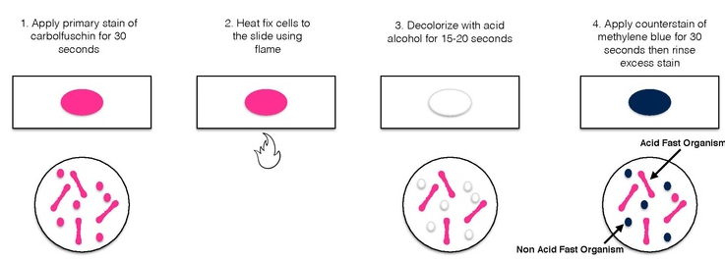
The acid-fast stain is used to stain species of Mycobacterium
Specimen: Mycobacterium tuberculosis Ziehl-Neelsen stain 02.jpg, Public Domain, CDC/Dr. George P. Kubica - phil.cdc.gov CDC-PHIL ID #5789
http://www.nature.com/nrmicro/journal/v12/n8/box/nrmicro3299_BX1.html
Staining procedure: File:Acid Fast Stain.pdf, Elizabeth Gray, Creative Commons Attribution-Share Alike 4.0 International
Notes:
Cell Wall Image: http://www.nature.com/nrmicro/journal/v12/n8/box/nrmicro3299_BX1.html NOT CC
Staining procedure: File:Acid Fast Stain.pdf
Elizabeth Gray
Creative Commons Attribution-Share Alike 4.0 International
Specimen: Mycobacterium tuberculosis Ziehl-Neelsen stain 02.jpg
Public Domain
CDC/Dr. George P. Kubica - phil.cdc.gov CDC-PHIL ID #5789

Slide 6
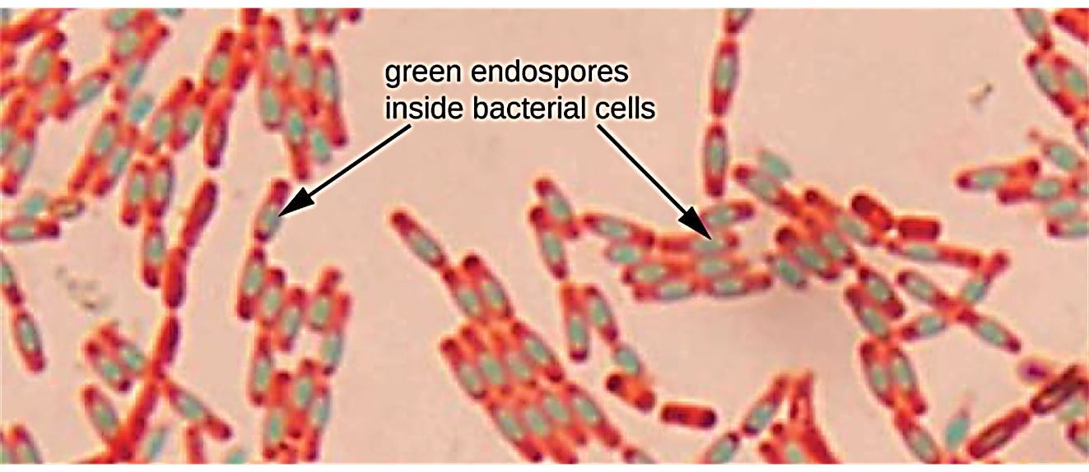
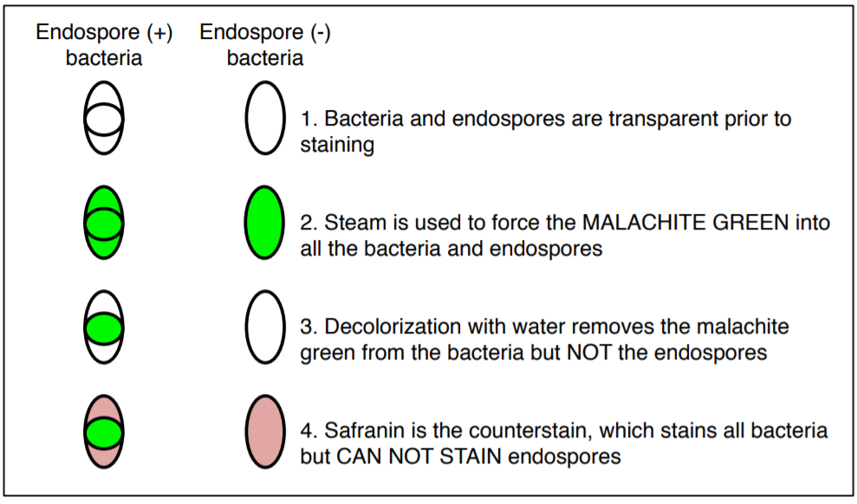
The spore stain is used to detect endospores in species of Bacillus and Clostridium
Image: Figure 2.38 OpenStax Microbiology/Creative Commons
https://bio.libretexts.org/Learning_Objects/Laboratory_Experiments/Microbiology_Labs/Book%3A_General_Microbiology_Lab_Manual_(Pakpour_and_Horgan)/Lab_04%3A_Acid-Fast_Spores_and_Capsule_Stains
LibreTexts content is licensed by CC BY-NC-SA 3.0
Notes:
Image: Figure 8, Chapter 2 Openstax Microbiology
Staining procedure: https://bio.libretexts.org/Learning_Objects/Laboratory_Experiments/Microbiology_Labs/Book%3A_General_Microbiology_Lab_Manual_(Pakpour_and_Horgan)/Lab_04%3A_Acid-Fast_Spores_and_Capsule_Stains
LibreTexts content is licensed by CC BY-NC-SA 3.0

