Slide 1
LESSON 13.2
Pregnancy: Weight Gain and Nutrient Needs

Slide 2
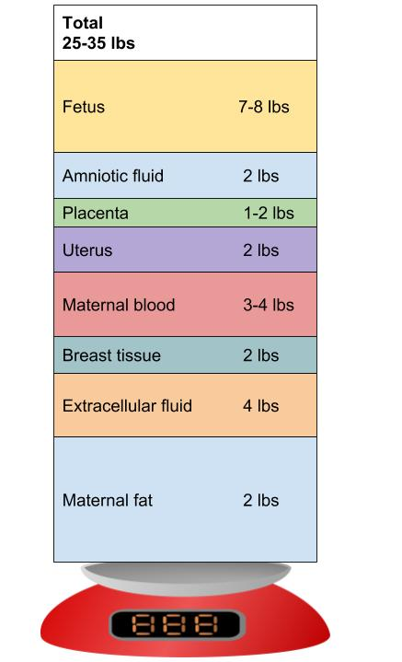
Pregnancy Weight Gain
A successful pregnancy will result in weight gain
This figure shows distribution of weight gain for a woman who was a healthy weight prior to pregnancy

Slide 3
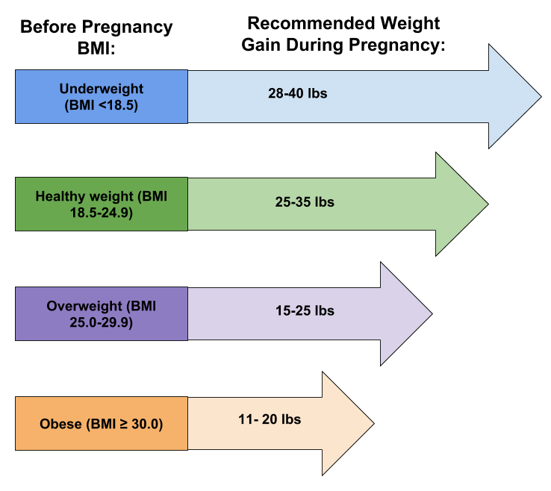
What is appropriate weight gain?

Slide 4
Nutrition for Mom
Overall goals
  Adequate weight gain
  Adequate nutrients for baby
  Minimal toxins

Slide 5
Energy Needs
1st Trimester
  Balanced and adequate diet during the first trimester
2nd trimester
  + 340 kcal/day
3rd trimester
  + 450 kcal/day
MAIN GOAL: Must have adequate weight gain

Slide 6
Nutrient Needs
Protein RDA is 1.1 g/kg or + 25 g/day during the second half of pregnancy
Carbohydrate RDA is + 45 g/day
Omega-3 and Omega-6 fatty acids needed for fetal development

Slide 7

Nutrient Needs
Many micronutrients increase during pregnancy
A prenatal supplement is recommended
  Specially formulated for pregnancy

Slide 8
Potential toxins
Caffeine
Mercury in fish
  Tuna is ok!
  Avoid swordfish, shark, king mackerel
Cigarette smoke
  Linked with SIDS
Foodborne illness
Alcohol

Slide 9
Vegetarian and Pregnant
Lacto-ovo or lacto-vegetarian women can usually meet nutritional needs
Vegan must plan diet carefully
  Requires sufficient protein; vitamins D, B-6, B-12; iron, calcium, and zinc
Prenatal supplements usually necessary

Slide 10
General recommendations
Choose nutrient dense foods
Drink lots of fluids
Indulge cravings within reason

Slide 11
Impact of Malnutrition
Compromised fetal growth and development
Later in life, child has higher risk of
  Heart disease
  Stroke
  Obesity
  Diabetes

Slide 12
U.S. Child Nutrition and Food Assistance Programs
Overview of USDA & Food and Nutrition Service (FNS) Programs

Slide 13
School Meals and Dietary Guidelines
Meal patterns consistent with the 2020–2025 Dietary Guidelines for Americans
Supports science-based improvements in school meals
Advances USDA’s commitment to nutrition security
National School Lunch Program (NSLP)

Slide 14
WIC Program
USDA Special Supplemental Nutrition Program for Women, Infants, and Children
Provides free, healthy foods such as fruits, vegetables, milk, eggs, and baby food
Offers personalized nutrition education and breastfeeding support
Connects participants to medical, dental, mental health, and community services

Slide 15
Supplemental Nutrition Assistance Program (SNAP)
Provides food benefits to low-income individuals and families
Helps supplement grocery budgets
Improves access to nutritious foods
Supports overall health and well-being

Slide 16
Meals for Schools and Childcare
Federal programs that ensure access to nutritious meals
Support children in schools and childcare settings
Administered by USDA Food and Nutrition Service
Implemented by states and local agencies

Slide 17
School Breakfast Program (SBP)
Provides reimbursement for nonprofit breakfast programs
Operates in schools and residential childcare institutions
Administered federally by FNS and at the state level by education agencies
Improves student readiness and academic performance

Slide 18
Child and Adult Care Food Program (CACFP)
Provides reimbursements for nutritious meals and snacks
Serves children and adults in childcare and adult day care centers
Includes afterschool programs and emergency shelters
Promotes healthy growth, development, and wellness

Slide 19
Patrick Leahy Farm to School Program
Connects schools with local farmers
Incorporates local foods into child nutrition programs
Supports tribal food sovereignty
Encourages traditional foodways in meal programs

Slide 20
Special Milk Program (SMP)
Provides milk to children in schools and childcare institutions
Serves sites not participating in other federal meal programs
Reimburses schools for milk served
Supports half-day pre-kindergarten and kindergarten programs

Slide 21
Food Insecurity and Program Participation (2023)
58% of food-insecure households received assistance from at least one major federal program
42% participated in SNAP
Children in 28.9% of food-insecure households received free or reduced-price school lunches
7.0% of food-insecure households received WIC benefits

Slide 22
Households With Very Low Food Security
55.8% participated in at least one major federal food assistance program
SNAP had the highest participation rate (43.5%)
Federal nutrition programs play a critical role in reducing food insecurity

