Slide 1
Lesson 13.3
Pregnancy: Discomforts, complications and other issues

Slide 2
Discomforts of pregnancy
Rarely cause life-threatening problems for mom or baby
Due to physiological and hormonal changes within a woman’s body

Slide 3
Discomforts of pregnancy
Heartburn
Constipation
Edema
Morning Sickness
  Excessive vomiting
  may cause dehydration
Taste aversions/cravings
  pica

Slide 4
Complications of pregnancy
May cause harm to mom and/or baby if not treated
Routine prenatal exams monitor for symptoms of these complications

Slide 5
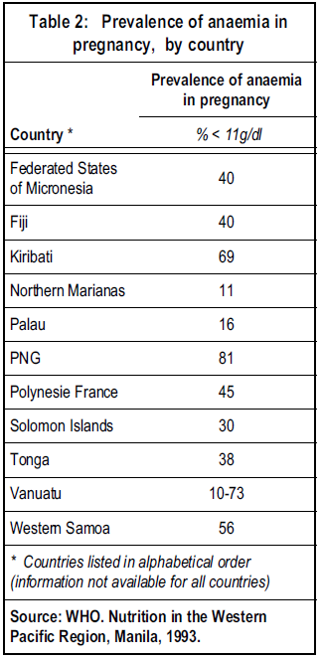
Complications of pregnancy
Physiological anemia
  Low RBC count because blood volume increases
  May need more iron

Slide 6
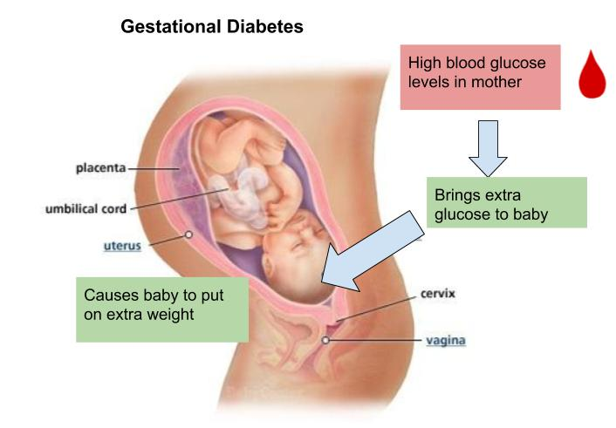
Complications of pregnancy
Gestational diabetes
Hormones from placenta interfere with insulin
Dietary intervention, sometimes insulin needed

Slide 7
Complications of Pregnancy
Preeclampsia (mild) and Eclampsia (severe)
Initial symptoms
  Elevated blood pressure
  Protein in the urine
  Edema
Results in convulsions, slows fetal growth, still birth possible, maternal death if not treated

Slide 8
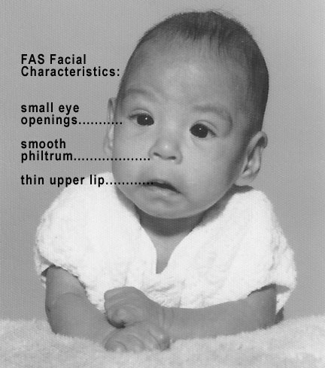
Fetal Alcohol Syndrome
Cluster of physical and mental abnormalities
Source: https://commons.wikimedia.org/wiki/File:Photo_of_baby_with_FAS.jpg

Slide 9

Teen pregnancies
US has highest rate for developed countries
Mom is still growing/maturing
Higher rates of stillbirths, preterm births, and LBW
Many have limited financial resources

Slide 10
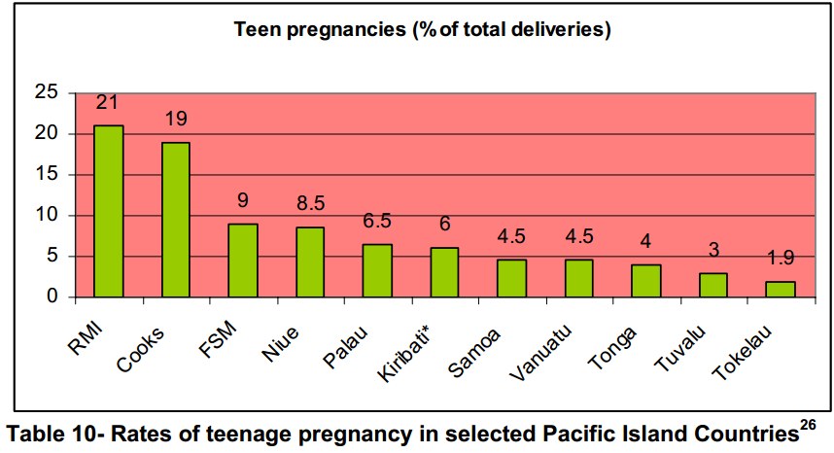
Teen Pregnancies in the Pacific
Source: Children and AIDS in the Pacific Islands Countries, UNICEF, 2006

Slide 11

Older women
Increasing rate of first births to women over age 35
Cesarean sections twice as common
Babies at higher risk genetic abnormalities such as Down’s Syndrome

Slide 12
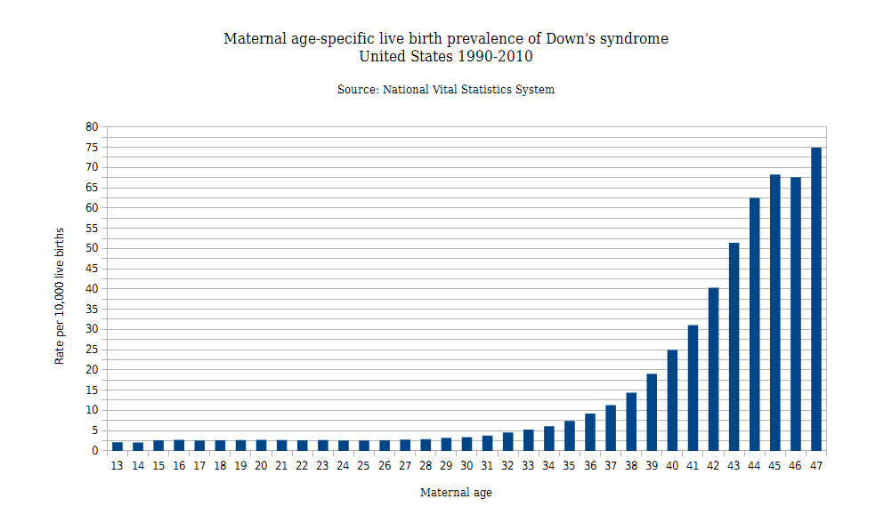
Risk of Down Syndrome
Source: https://commons.wikimedia.org/wiki/File:Maternal_age-specific_live_birth_prevalence_of_Down%27s_syndrome_in_the_United_States_1990-2010.png

Slide 13
Conclusion
Discomforts = rarely life threatening
Complications = life threatening if not treated
Drinking alcohol during pregnancy leads to Fetal Alcohol Syndrome
Teen pregnancies increases risk for babies
Older mommies (>35 y) increased risk for babies with Down’s Syndrome

