Slide 1
Chapter 13.4
Lactation and Infant Nutrition

Slide 2
Breastfeeding
Recommended for the first 6 months
Only about 70% of all mothers nurse in the hospital
Number of moms still breastfeeding decreases as infant gets older (20% at 6 mo.)
Breastfeeding data in Pacific is limited and varies

Slide 3
Breastfeeding in the Pacific
Percent of infants never breastfed by country
Notes
American Samoa – 20
Cook Islands – 5
Federated States of Micronesia – 5
Fiji – 22
Guam – 44
Kiribati – 0 #
Marshall Islands – 2
Northern Marianas – 10
Niue – 2
Palau – 5
Papua New Guinea – 0 #
Polynesie France – 70
Solomon Islands – 0 #
Tokelau – 0 #
Tonga – 0 #
Tuvalu – 0 #
Vanuatu – 13
Western Samoa – 6
Countries listed in alphabetical order (information not available for all countries).
# = “0” means no children were reported as “never breastfed.”
Source: WHO. Nutrition in the Western Pacific Region, Manila, 1993.

Slide 4
Breast feeding
To breastfeed, does size of breast matter?
NO

Slide 5
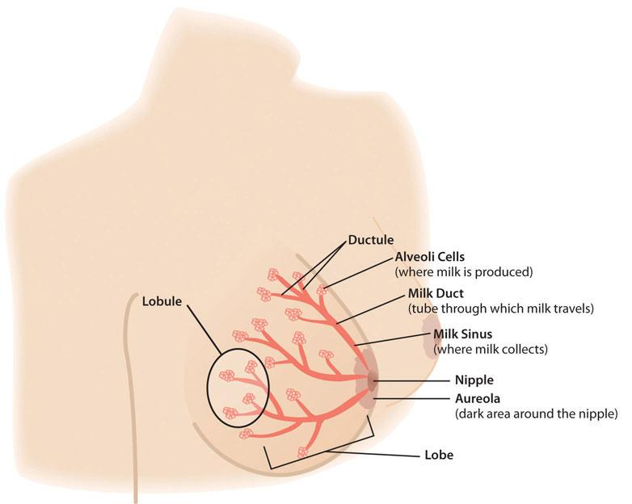
Milk Production
Let-down
Release of milk
An infant suckling
at the breast
usually causes
let-down.
Hormones
Prolactin = milk production
Oxytocin = let down

Slide 6
Colostrum
First fluid produced after birth
Thick, yellow fluid
Contains antibodies, immune-system cells and Lactobacillus bifidus factor
  protects infant against infections
Facilitates the passage of 1st stool

Slide 7
Mature Milk
Thin, watery, slightly bluish
Composition changes during “meal”
Easy to digest
Linoleic acid and cholesterol
  brain development
Omega-3 fatty acids
  synthesis of brain tissues, central nervous system, eyes

Slide 8
Nutrients for Lactation
Milk production requires ~800 kcal/day
Contributes to weight loss after pregnancy
  1-4 lbs/month is healthy
Protein RDA same as for pregnancy
Omega-3 FA
  Must come from mom’s diet

Slide 9
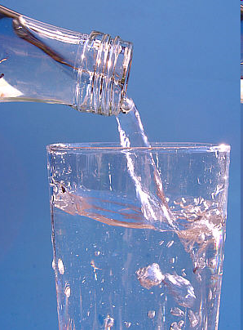
Nutrients for lactation (Continued)
Change in some vitamins and minerals
  Decreased iron, folate
  Increases in others
Fluid needs ↑ (13 cups/day)

Slide 10
Mom’s Menu Considerations
“When baby drinks, mom drinks”
  At least 3 servings milk/day
Watch substances secreted in the breast milk
  Alcohol, caffeine, strong foods, peanuts
  Smoking decreases milk production
Eat fish at least 1/ week
(Maybe add Fluoride, Vit. D and B12)

Slide 11
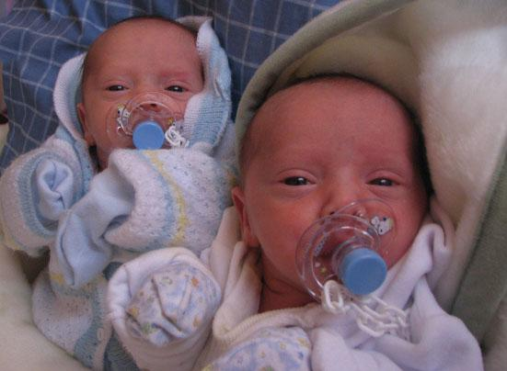
Breast Milk
Is there enough breast milk to supply the needs for twins or triplets?
YES Usually supply = demand.

Slide 12
Benefits of Breastfeeding
“Perfect nutrition” tailored to meet baby’s nutrient needs exclusively.
  Lowers obesity risk
  Fewer infections
  Fresh, convenient and less expense
  Helps GI maturation
  Reduces some food allergies risks
  Better jaw and teeth development

Slide 13
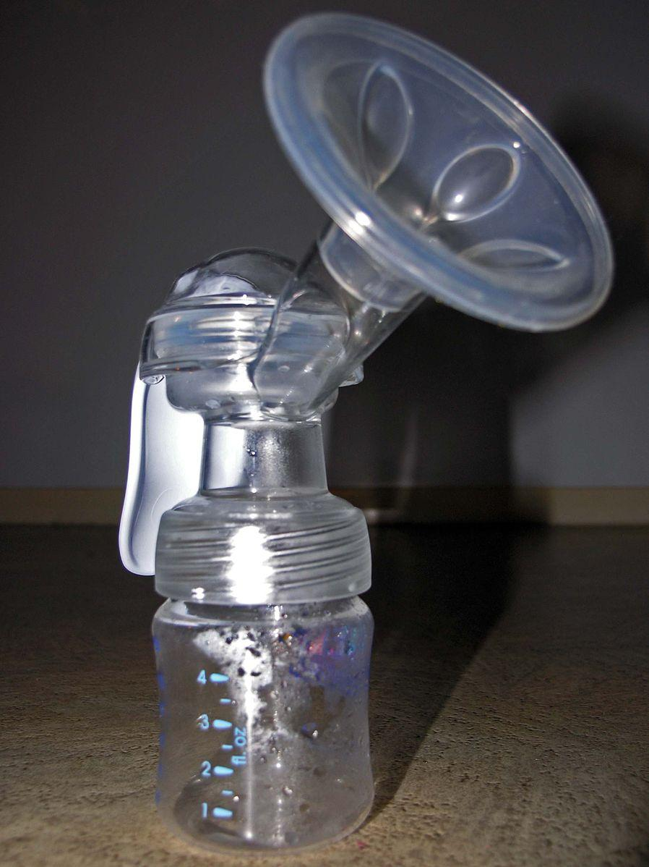
Alternative options
Breast milk can be pumped and stored
Infant formula- must be prepared and has no antibodies.
NEVER
  Use cow’s milk
  Pressure mother to breastfeed
  PKU, HIV consider
Source: https://commons.wikimedia.org/wiki/File:Manual_Breast_Pump_2005_SeanMcClean.jpg

Slide 14
Breast milk vs Formula
Similar amounts of carbohydrate, protein, lipid
Breast milk contains low amounts of iron and zinc
  However, these are both easily absorbed
Breast milk contains low amount of Vitamin D
  Supplement recommended
Formula does not contain antibodies and other immune factors

Slide 15

Infant growth
Weight gain
  Double by 4 mo
  Triple by 1 yr
Length gain
  Increase 50% by 1 yr
Growth charts are
important and vary

Slide 16
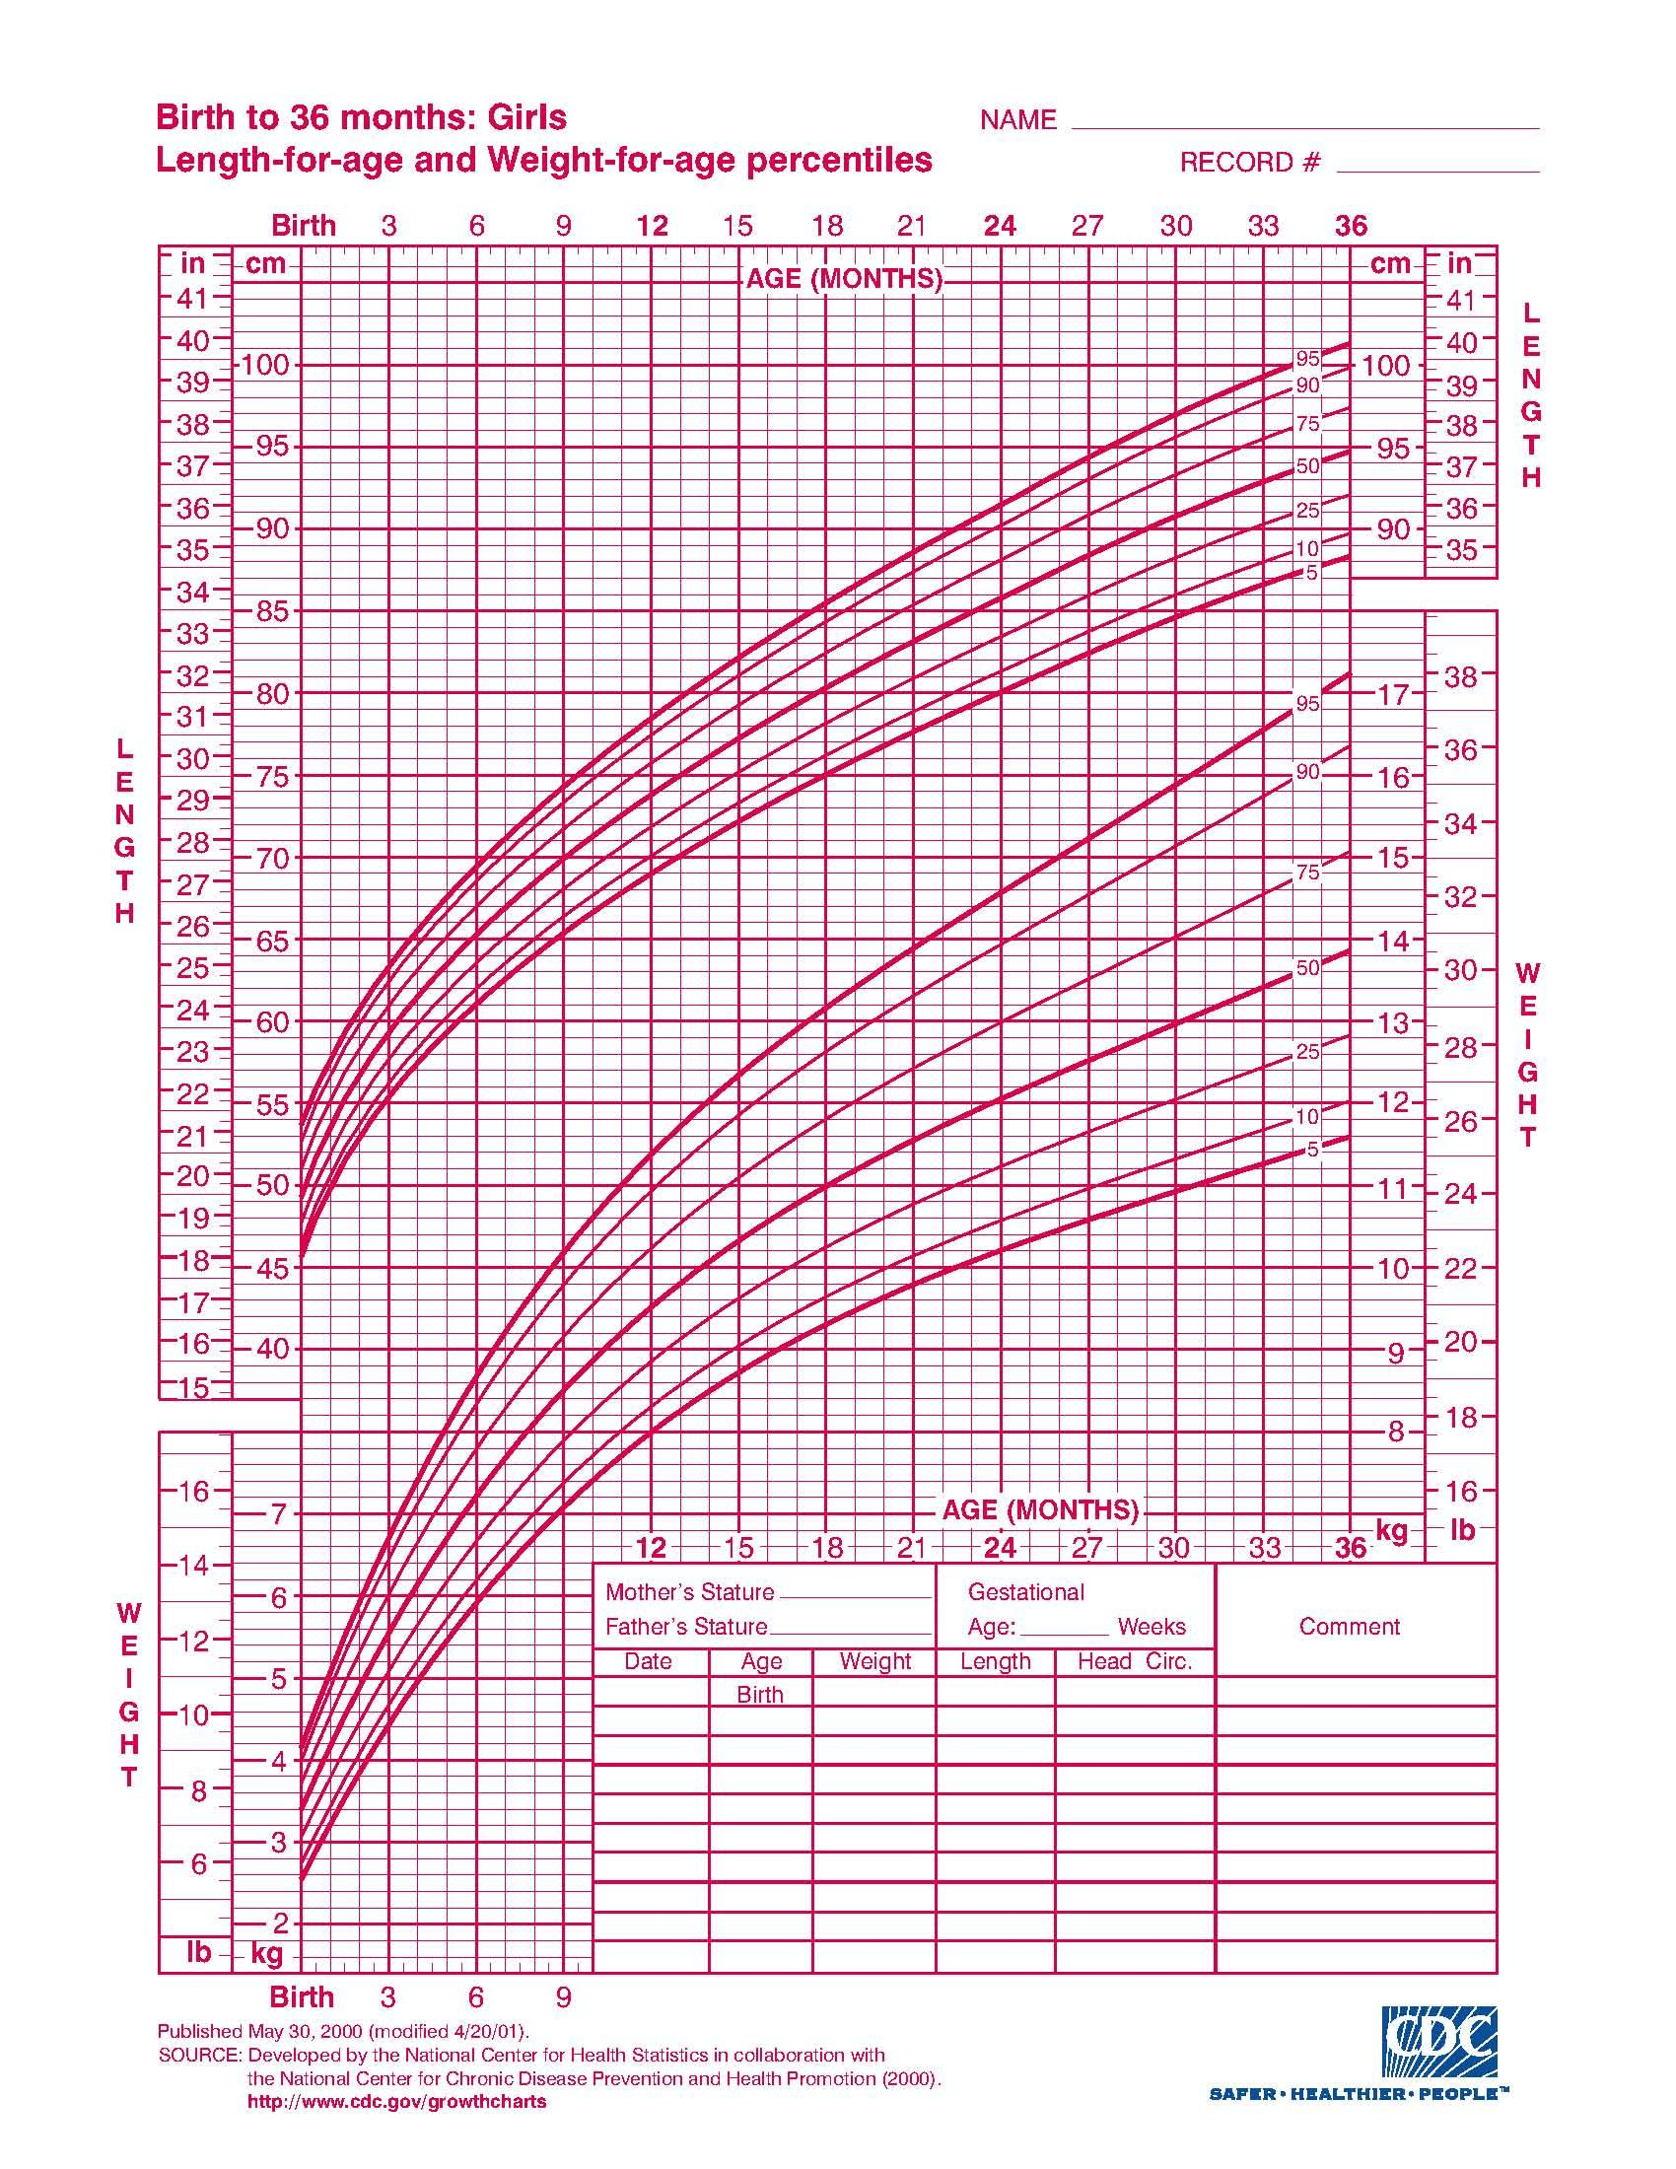
Growth Chart for Girls

Slide 17
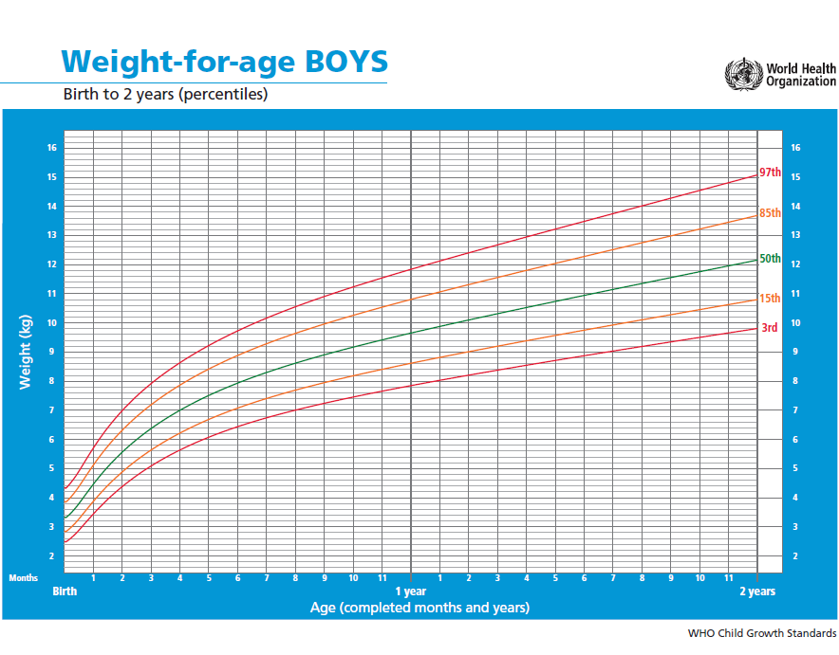
Growth Chart for Boys
WHO infant charts are GLOBALLY BASED on the growth of healthy breastfed infants from 6 countries

Slide 18
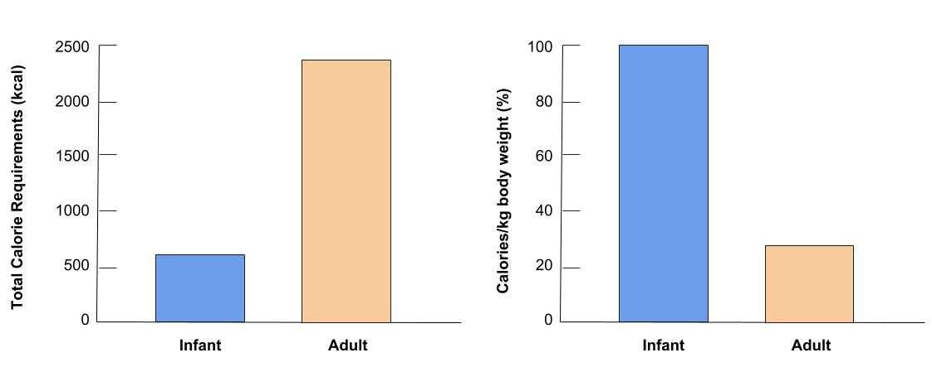
Infants and Adults’ Total Calorie Requirements and Calories/kg body weight
Infants require fewer total kcal than an adult, but when expressed as kcal/kg, infants require 4x’s as Calories/kg body wmuch!

Slide 19
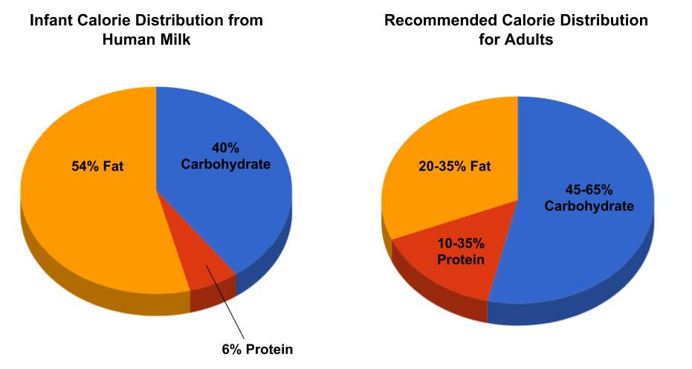
General nutrient needs:
Infant vs Adults

Slide 20
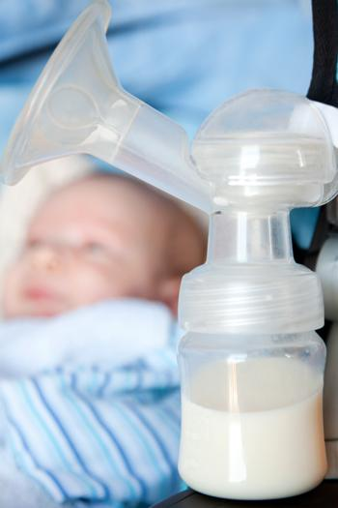
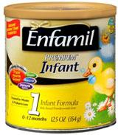
An infant’s diet
Breast milk or formula until 4-6 mo
  If breast milk, need iron, vit D, fluoride supp
Solid food introduction depends on skills

Slide 21
Feeding skills
Chewing movements
  Jaw, lips, tongue
“Pincer grasp”
  Index finger and thumb
Visual coordination
  hand-eye
All of these skills will be learned over the course of several months
Exact age varies depending on development
Results
  Eating with a spoon
  Drinking with a cup
  Eating small pieces

Slide 22
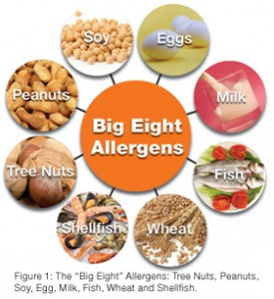
Food allergies
Infants are very sensitive
Avoid
  Eggs
  Cow’s milk
First food?
  Rice cereal; low risk of allergy, well accepted by the baby

Slide 23
Conclusion
Breastfeeding recommended way to feed baby for first 6 months
  Multiple benefits: contains antibodies
Nutrient requirements for lactation related to energy, protein, omega-3 FAs, water
Infant growth monitored by growth charts
Feeding skills learned
Selective with first foods

