Slide 1
Lesson 14.1
Childhood Nutrition

Slide 2
Nutrition for children
Energy needs increase with age
% of fat decreases with age
Problem nutrients
  Calcium, vitamin D
  Iron
Dental caries are common

Slide 3
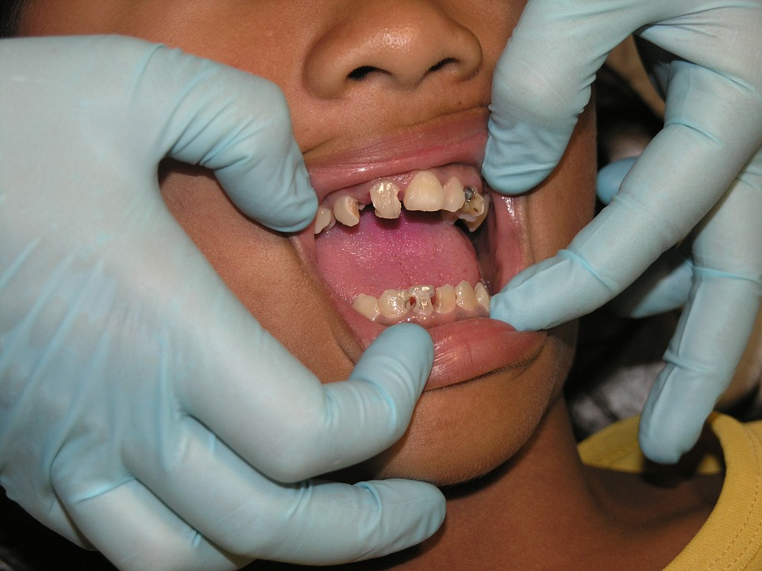
Dental Caries
Caused by continual access to bottle or sippy-cup
Also termed “nursing bottle caries”
Source: https://pixabay.com/en/bad-teeth-toothache-dental-treatment-1177038/

Slide 4
Risk of choking
Some types of small foods should be avoided
Raw carrots
Hot dog slices
Marshmallows
Popcorn
Whole grapes
Hard/gel candies

Slide 5

Transitioning to Cow’s Milk
1-2 yrs old
  Start drinking cow’s milk
  Whole milk
2-5 yrs old
  Gradual transition to low-fat milk

Slide 6
“I only like rice!”
What you should know when introducing new foods…
  Familiar foods are comforting
  New foods should not be forced
  Introduce new foods one at a time
    Look for adverse reactions (allergy)
  8-10 exposures to new food for acceptance
  Family role models are very important!
Notes:
Original headline quote: “I only like hot dogs!”
Changed to: “I only like rice/bread!”

Slide 7
Best practices for good nutrition
Caregiver chooses what and when to eat
  Meal time consistency is important
Child chooses whether to eat and how much
Avoid food as a reward or punishment
Offer a balanced and varied diet
  Based on whole grains, vegetables, fruits, dairy and other high-protein foods
  Moderate amounts of fat and sodium
Remember to be a good role model!

Slide 8
The Independent Preschooler
CONTROL!
Self-regulating food intake
  Increased food intake before growth spurt
Involve children in food preparation

Slide 9
School-Aged Children
Breakfast
  More likely to meet their nutritional needs if kids eat breakfast
  Glucose is required for brain function
  Children who eat breakfast perform better in school and miss fewer school days

Slide 10

School-Aged Children
School lunch programs
  Designed to meet federal nutrition guidelines
Nutrition education in schools promotes wise food choices
Notes:
Original image: MyPyramid for Kids
Changed to: MyPlate Kids Place

Slide 11
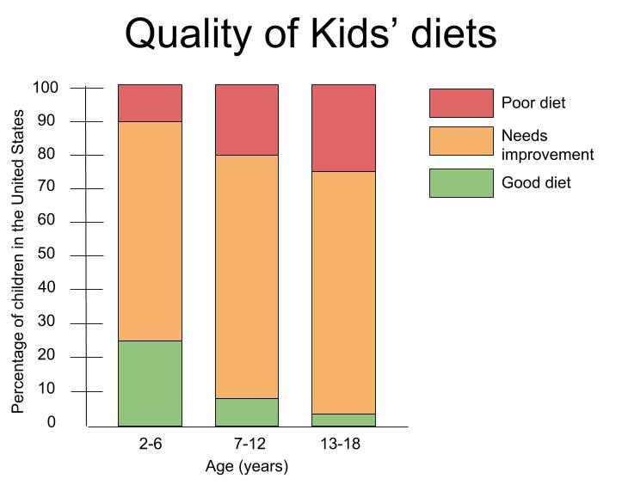
Quality of Kids’ diets

Slide 12
Childhood Obesity
Affects 17% of children ages 2-19 yrs
Based on BMI percentile rank

Slide 13
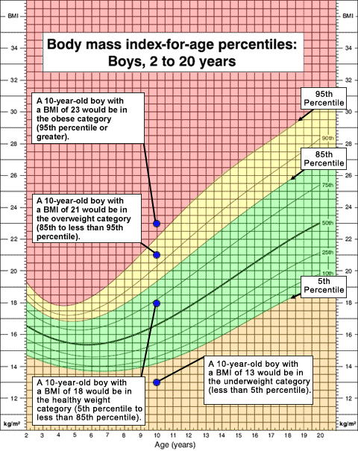
BMI for Age percentiles: Boys, 2 to 20 years
Source: https://www.cdc.gov/healthyweight/assessing/bmi/childrens_bmi/about_childrens_bmi.html

Slide 14
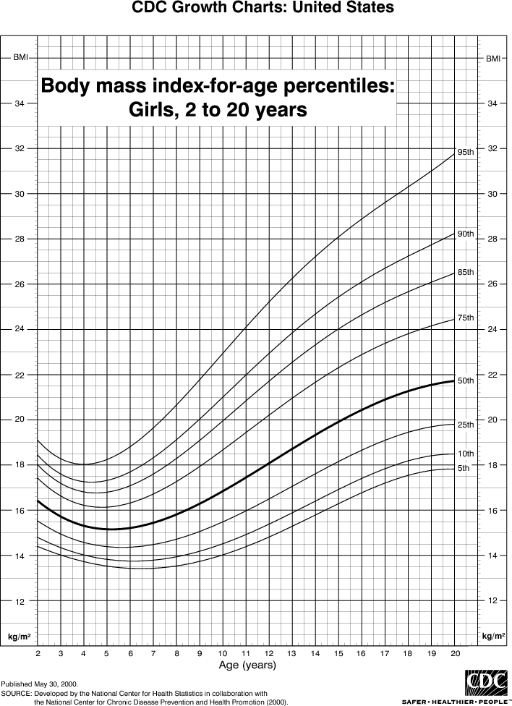
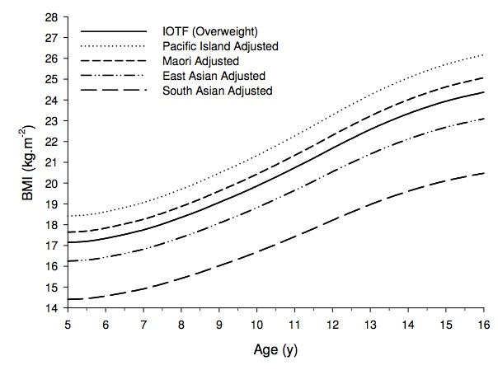
Comparing BMI curves
→ overweight
Center for Disease Control and Prevention (CDC)
International Obesity TaskForce (IOTF) and ethnic-specific BMI curves for Girls, 5-16 years
Higher cutoff
Source: Duncan et al., 2010
Notes:
Here are body mass index curves for girls from different sources. The CDC chart on the left coincides with the boys’ chart from the previous slide. The chart on the right shows the International Obesity TaskForce cut-point for overweight girls, as well as adjusted cut points for different ethnicities. Note that there are different curves for girls of the same age but from different ethnicities. Compare them to the CDC curve for girls of all ethnicities.

Slide 15
Trends in childhood obesity
20
1988-1994
1999-2002
15
Percentage of children who are obese
2003-2006
10
5
0
2-5
6-11
12-19
Age (years)

Slide 16
Treating Obesity
Weight maintenance, not weight loss
  Most children can “grow” into their weight
Involve children in meal planning and preparation
Psychological support
Focus on “how to eat” not “what to eat”

Slide 17


Treating Obesity
Parental role-model
  Lifestyle
  Food choices
Access to healthy foods
Physical activity
  60 minutes/day
  Avoid sedentary activities
    TV
    Video games
    Computer games
Notes:
Changed picture..
Source: http://stage.nature.org/ourinitiatives/regions/asiaandthepacific/micronesia/explore/index.htm
https://www.facebook.com/guamkokoroadrace?filter=1

Slide 18

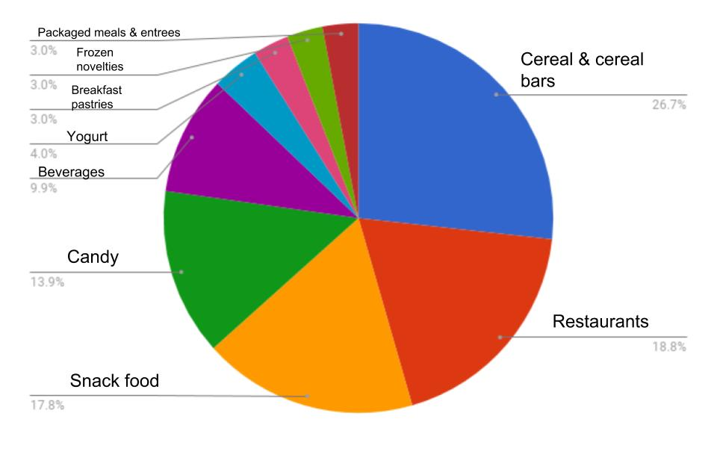
Role of TV in Obesity
Is it inactivity?
Or the advertising?
Food Advertising During Kids Programs
Source: https://www.flickr.com/photos/mliu92/35277888254/in/photostream/

Slide 19
Impact of Childhood Obesity
Later in Life
Children who are overweight or obese are at higher risk of:
  Being overweight or obese as an adult
  Type-2 diabetes
  High blood pressure
  Cardiovascular disease

Slide 20
Other concerns
Hyperactivity
  Extreme physical activity, excitability, short attention span, low tolerance for frustration
  No link to sugar (really!), usually an environmental cue triggers hyperactivity
    Ex: excitement at a birthday party, not the birthday cake
Lead poisoning
  Causes learning disabilities and behavior problems

Slide 21
Summary
Children’s diets require more total energy & nutrients with age, but less energy & protein per kilogram of body weight.
  ↓ calcium, vitamin D, and iron puts them at risk for low bone density and anemia
  ↑ calories, fat, & sugar (with low physical activity) puts them at risk for obesity & other chronic diseases.
Obesity continues to be a growing epidemic in the US, as well as the Pacific region.
  Television watching contributes to more eating & less activity.
Caregivers should offer a variety of healthy foods and water at meals and snacks throughout the day.
  Children decide whether to eat and how much.
Be positive family role models for children!

