Slide 1
Lesson 14.2
Adolescent Nutrition

Slide 2
A growing adolescent
Growth spurt
  Girls ages 10-13, gain 10 inches
  Boys ages 12-15, gain 12 inches
Linked with increased appetite

Slide 3
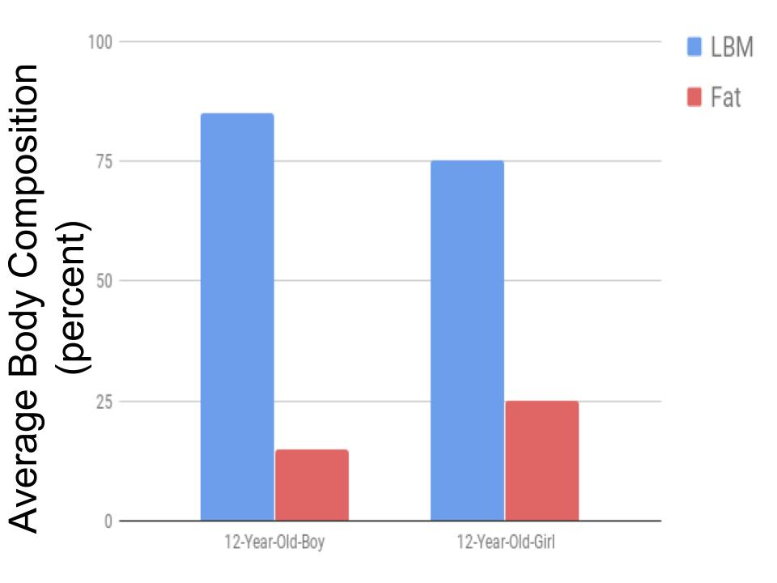
A growing adolescent
Changes in body composition
  Girls gain proportionally more body fat than boys
Increased blood volume
Increased bone length and mass

Slide 4
Adolescent nutrition
Energy needs vary
  Rate of growth, body comp, physical activity
Most vitamin/mineral needs increase
Major problem nutrient: calcium
  Needed for bone growth
Typically the “worst” diet of any age group

Slide 5
Basic nutrition recommendations for teens
Balance “unhealthy” with “healthy”
Eat breakfast
Choose your snacks wisely
Don’t forget calcium!

Slide 6
Nutritional Problems of Teens
Excessive dieting and eating disorders (mainly in girls)
Poor food choices
  Low nutrient density
Iron-deficiency anemia in menstruating girls
  Iron requirements increase at the onset of menstruation
  Many teen girls lack good sources of iron in the diet

Slide 7
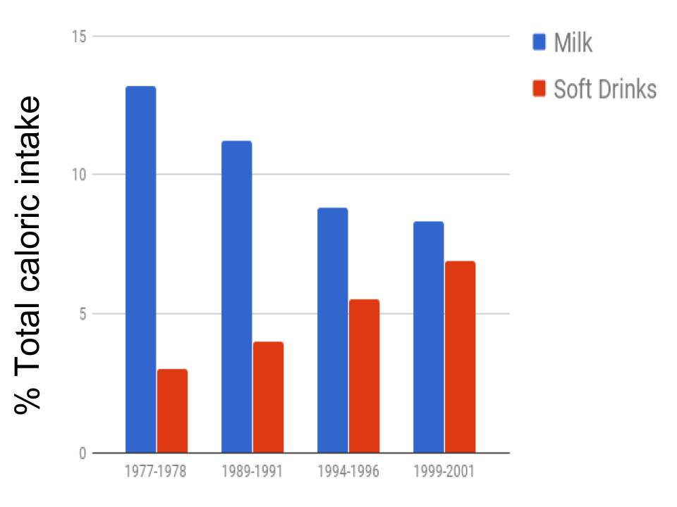
Nutritional Problems of Teens
Girls stop drinking milk, often replaced with soda
Over the last 35 years, teens have increased soft drink consumption and decreased milk consumption

Slide 8
Eating Disorders (ED)
Psychological problem linked with a nutritional problem
Women 5x more likely to have an ED than men
EDs are increasing in US
  Americans value thinness

Slide 9
Anorexia Nervosa
Distortion of body shape perception
Severe kcal restriction
  May eat very slowly
Less than 85% ideal body weight

Slide 10
Bulimia Nervosa
Binge eating followed by compensatory behavior
  purging (vomiting, laxative use)
  excessive exercise
Body weight fluctuates

Slide 11
Binge-eating disorder
“New” eating disorder
Usually restricted eating for several days
Followed by high kcal intake
  Usually followed by guilt, self-loathing
Cycle continues, no purging

Slide 12
Anorexia Health Problems
Low body temperature
Lanugo (fine body hair) and loss of hair
Nutrient deficiencies
Constipation, amenorrhea

Slide 13
Bulimia Health Problems
Vomiting causes most health problems
  Demineralization of teeth
  Stomach ulcers and bleeding
Constipation

Slide 14
What causes eating disorders?
Theory 1
  Psychological issues that manifest as nutritional deficiencies
  Basis for conventional treatment in the US
Theory 2
  Nutritional deficiencies allow psychological issues to develop
  Basis for treatment at Karolinska Institute, Sweden

Slide 15
Eating Disorders
High risk
  Adolescent girls, athletes, dieting at young age
Treatment
  Psychological and/or nutritional intervention
    Many include hospitalization
  Weight-gain
  Normalize eating behaviors
  Involve family members
  Successful if started early
    1/3 are “cured”, 1/3 have recurring problems, 1/3 will die of complications

Slide 16
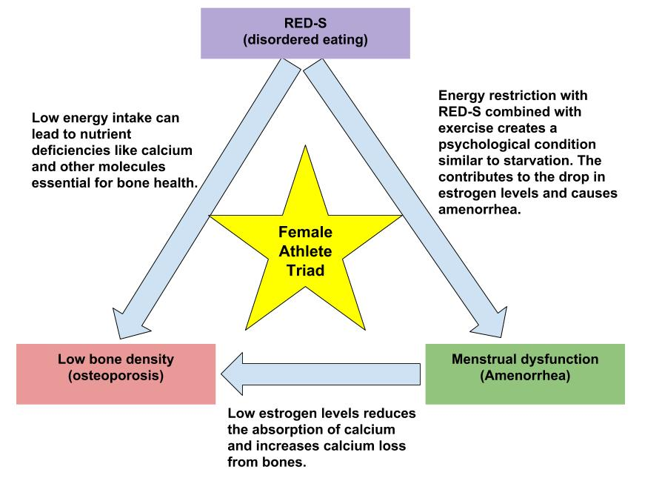
Eating Disorders: the female athlete triad
Issue for women and girls
  Amenorrhea = loss of menstrual cycle
Typically seen in athletes such as runners, gymnasts and dancers

Slide 17
Goals of Treatment
• Healthy eating habits
• Healthy weight
• Stop harmful behaviors
• Improve mental health

Slide 18
Psychotherapy
• Main treatment method
• Changes thoughts and behaviors
• Builds coping skills

Slide 19
Therapy Types
• Cognitive Behavioral Therapy (CBT)
• Family-Based Therapy (Maudsley)

Slide 20
Medical Care
• Regular check-ups
• Monitors physical health
• Treats complications

Slide 21
Nutritional Counseling
• Balanced meal plans
• Healthy relationship with food

Slide 22
Medications
• Antidepressants
• Helpful for bulimia
• Treat anxiety/depression

Slide 23
Hospitalization
• Severe cases only
• Ensures safety and nutrition

Slide 24
Recovery
• Personalized treatment
• Early help works best
• Full recovery is possible

