Slide 1
Lesson 15.1
Nutrition During Older Adulthood

Slide 2

Adulthood: some facts
Lifespan is ~130 years
  Maximum age a human can reach
Life expectancy is 77 years
  Average # years a person will live
70-80% of life expectancy is nutrition related

Slide 3
Increasing longevity
Best diets
  Whole foods, balanced in nutrients
Saturated fat, excess kcal linked to chronic disease
Avoid highly processed foods
Energy restriction
  Allows animals to live longer, what about humans?

Slide 4
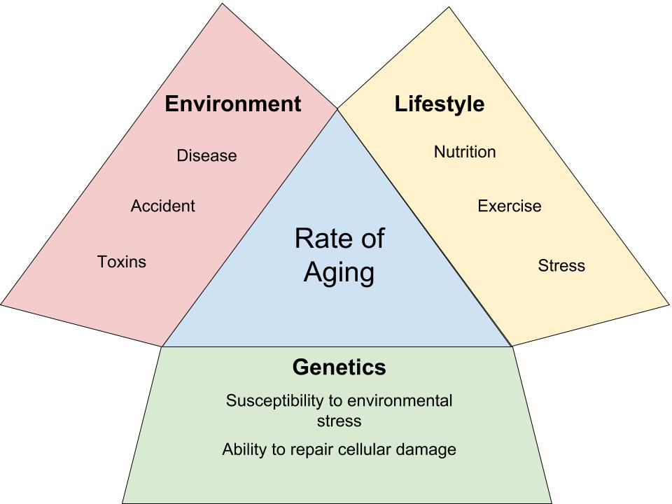
What determines aging?

Slide 5
“Graying” of America: some facts
About 13% of the population is 65 years or older
Accounts for ~30% of all prescription medications used
~40% of acute care hospital stays
~50% of the federal health budget
Of this group, 85% have nutrition-related problems

Slide 6
Our aging body
As our body ages several physiological changes occur:
  Many people gain weight (via fat mass)
  Organ functions decrease
  Diminished sensory abilities: eye sight, hearing, taste
What does nutrition have to do with these?

Slide 7
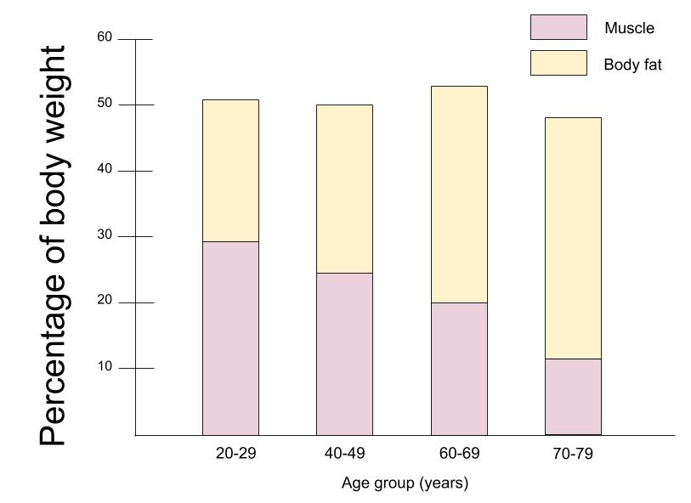
We will inevitably get fat, but why?

Slide 8
BMR and aging
Basal metabolic rate
  Energy required to maintain life at rest
BMR decreases with age
  Caused by decreased lean muscle mass
Implications
  Need fewer kcal to maintain weight
  Weight gain if diet not modified

Slide 9
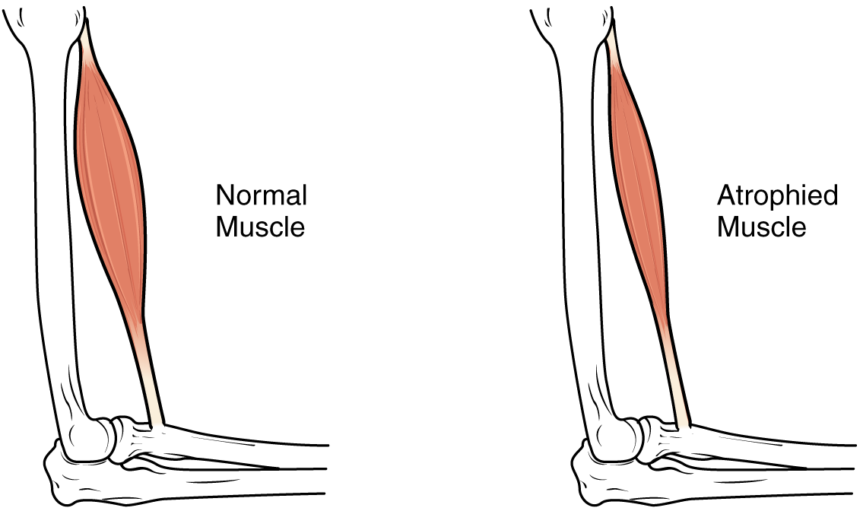
Why do we lose muscle mass?
Sarcopenia: loss of muscle mass
Due to lack of physical activity
  May be caused by joint, cardiovascular and/or respiratory problems,
Why is sarcopenia a problem?
  Lack of strength = less mobility and independence
Source: https://commons.wikimedia.org/wiki/File:1025_Atrophy.png

Slide 10

Sensory Loss
Failing eyesight
Poor taste, smell
Reduction in sense of thirst
Decreased hearing
May be linked to ↓ zinc intake
May affect nutritional status
  When food doesn’t taste good, may be less inclined to eat

Slide 11

Decreased digestive tract function
Intestinal wall loses strength
Lack of HCl
  May impact iron, vitamin B-12
  status
Difficulty swallowing
  Warm beverages with a meal
  may help swallowing reflex

Slide 12

Tooth loss
Dentures are less effective than real teeth
Fruit and veg consumption ↓
  Low fiber, low vitamin/mineral

Slide 13
Energy and Nutrient Needs for Older Adults
Energy needs decrease 5% per decade
% of carbohydrates, fat, and protein (AMDR) don’t change
Most micronutrient needs stay the same
  Vitamin B-6, B-12, D, Calcium, Magnesium increase compared to ages 19-30 yrs

Slide 14
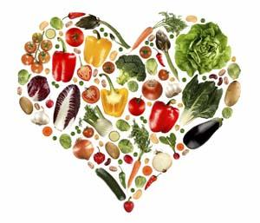
What Should the Elderly Eat?
Increased nutrient density
Lean meats for protein, zinc and
vitamin B-12
Adequate fiber
Six to eight cups of fluids a day
  Dehydration is COMMON- can impair brain function

Slide 15
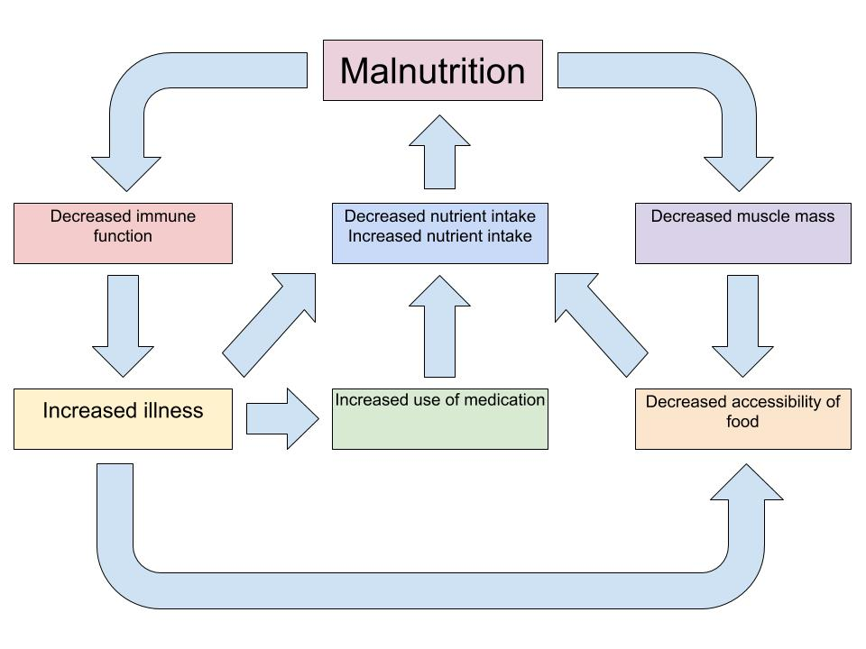
Impact of poor nutrition on overall health
Fig 12.16 pg 420

Slide 16
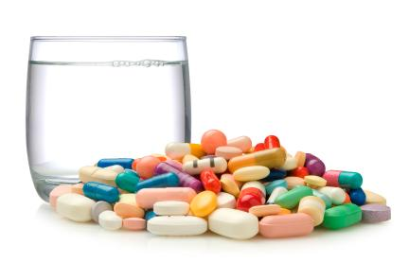
Medications and nutrition
Alter food intake
Alter digestion, absorption, metabolism
Drugs may treat one problem and cause a different problem
  EX: antacids + B12, folate, iron

Slide 17

Benefits of Good Nutrition
Delays onset of some diseases
Improves current condition
Improves quality of life
Decreases the length
of stay in hospitals
More independence

