Slide 1
Lesson 16.2
Good nutrition for exercise

Slide 2
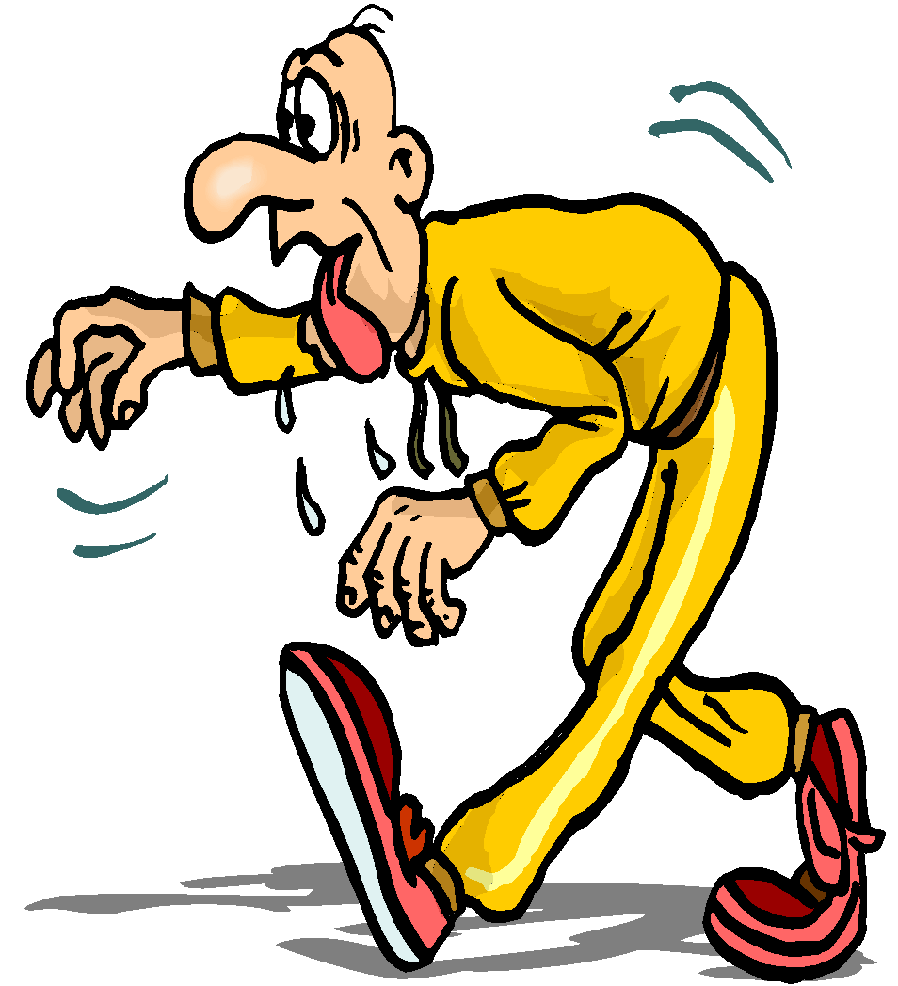
The Body’s Greatest Needs During Exercise
Water
Carbohydrate
Sodium

Slide 3
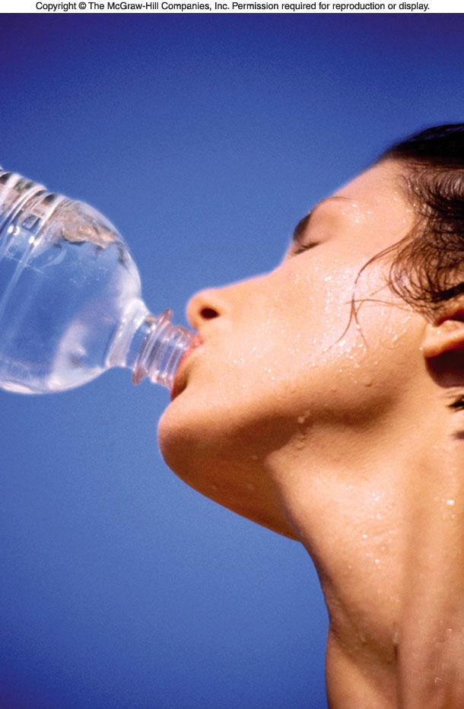
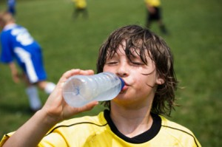
WATER
Water is the nutrient lost most rapidly during exercise.
Most water loss occurs through sweat and respiration.
Notes:
Picture: http://champion-athletes.net/site/articles/sports-nutrition-series-hydration-water-vs-gatorade/

Slide 4
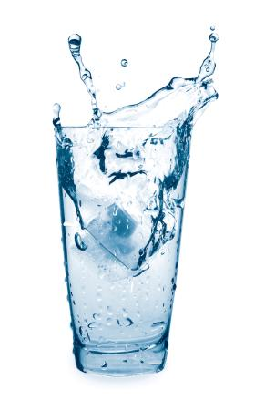
Why does the body lose so much water during exercise?
Working muscles → heat
Blood flow carries heat to the skin
Evaporation of water from the body surface is the most efficient way to remove heat
**water both transports and removes heat**
Notes:
http://www.bodybynatalia.com/E-Magazine/water.JPG

Slide 5
Water Loss During Exercise
WATER LOSS DURING EXERCISE
Average conditions: 1.5 liters/hr
Maximal sweat rates: 2 to 3 liters/hr
(in trained athletes & hot conditions)

Slide 6
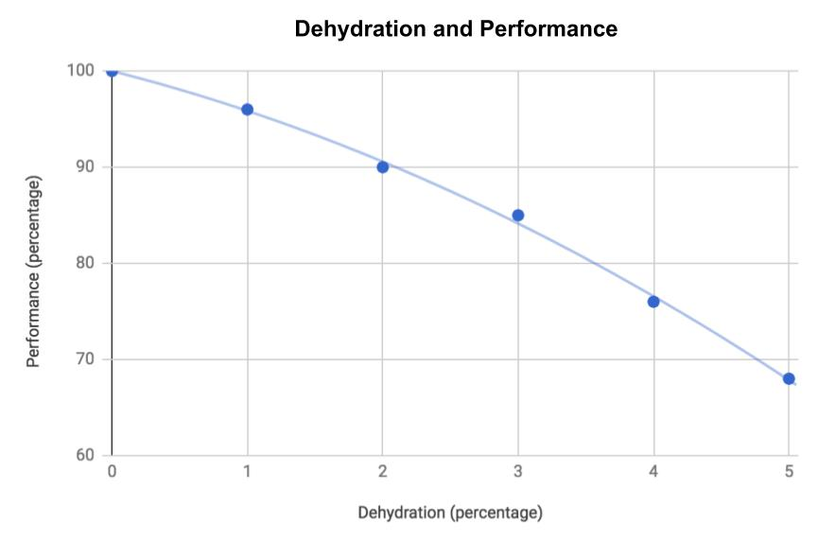
Dehydration Impairs Athletic Performance
Water loss as little as 2% of body weight
can impair physical and mental performance
2% weight loss for 150 lb person = 3 lbs
1.5 liters = ~ 1.5 quarts = 3 lbs

Slide 7
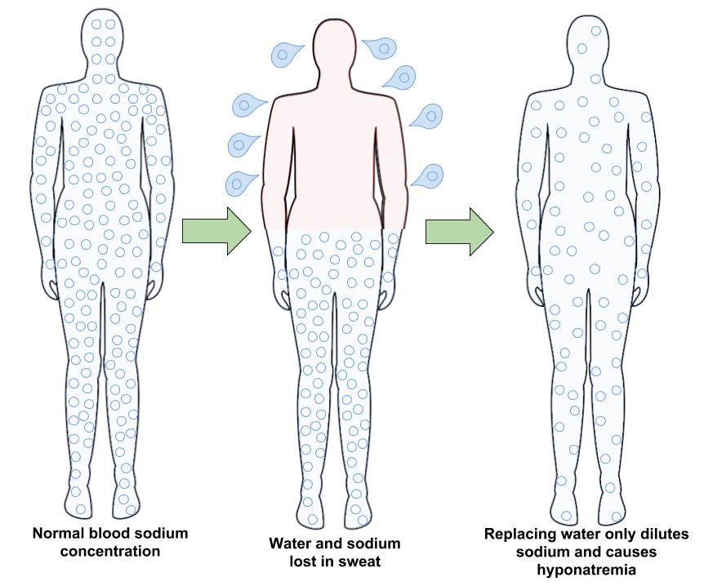
Hyponatremia

Slide 8
Hyponatremia
Hyponatremia occurs when our body’s sodium concentrations drop too low
Causes nausea, cramps, disorientation, seizure, coma, possibly death
  These symptoms are very similar to dehydration
Treatment
  Replace electrolytes (sodium)
  May require medical treatment

Slide 9
Sports Beverages
Provide the body with:
  water
  carbohydrate
  sodium chloride
“Properly diluted Fruit Punch with a pinch of salt”
If the carbohydrate or salt is too concentrated, it slows stomach emptying
Notes:
Changed “KoolAid” to “Fruit Punch”

Slide 10
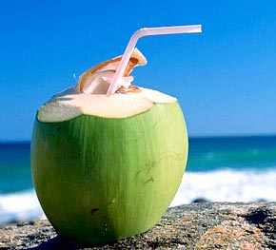
What about coconut water?
Coconut water is juice from the young coconut with no added sugars
Provides the body with
  Water
  Carbohydrate
  Sodium chloride & potassium
“Mother nature’s sports beverage!”

Slide 11
A Strategy for Meeting Water Needs (1)
Before Exercise
____________________________________
2 hours before exercise:
about 16 oz water or sports drink
____________________________________
Helps to establish normal state of hydration

Slide 12
A Strategy for Meeting Water Needs (2)
Immediately Before Exercise
____________________________________
0 to 10 minutes before exercise:
7 to 12 oz of water or sports drink
(200 to 360 mL)
____________________________________
Since urine production decreases during exercise,
this fluid is likely to be used for sweat production.

Slide 13
A Strategy for Meeting Water Needs (3)
During Exercise
____________________________________
Drink 6 to 12 oz every 15-20 minutes
(150 to 350 mL)
____________________________________
Hot and humid conditions and higher exercise
intensity increase sweat loss and water needs

Slide 14
A Strategy for Meeting Water Needs (4)
After Exercise
____________________________________
Within 4-6 hours following exercise
drink enough fluid (along with food)
to replace body weight lost during exercise
(requires 16 to 24 oz fluids / pound of weight lost)
____________________________________
Complete rehydration requires consuming
enough carbohydrate to replace glycogen stores

Slide 15
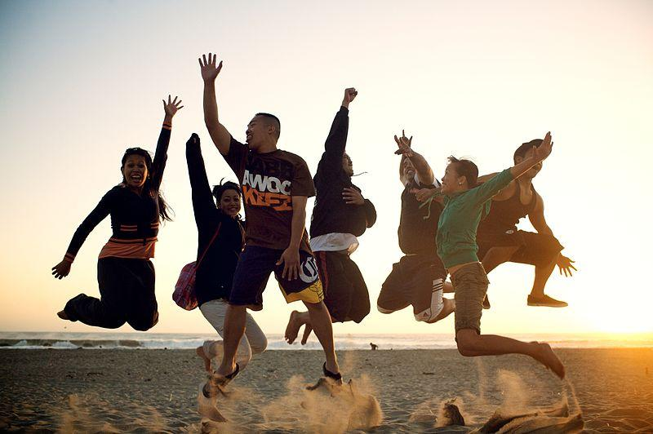
Goals of Sports Nutrition
Meet all nutrient needs of athletes
Promote good health
Promote rapid recovery after workouts
Maximize adaptation to training stress
Provide optimal support for competition
Notes:
Picture: https://commons.wikimedia.org/wiki/File:People_jumping_on_the_beach.jpg

Slide 16
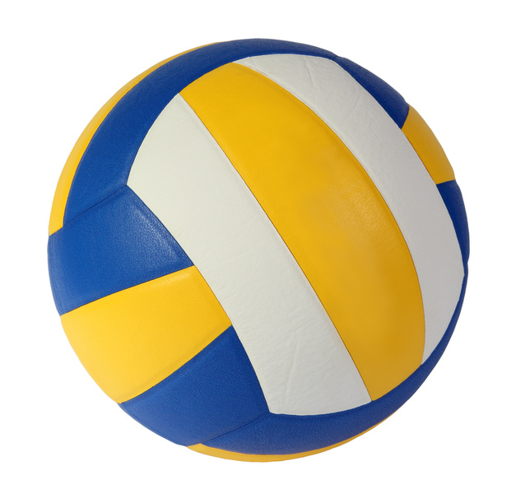
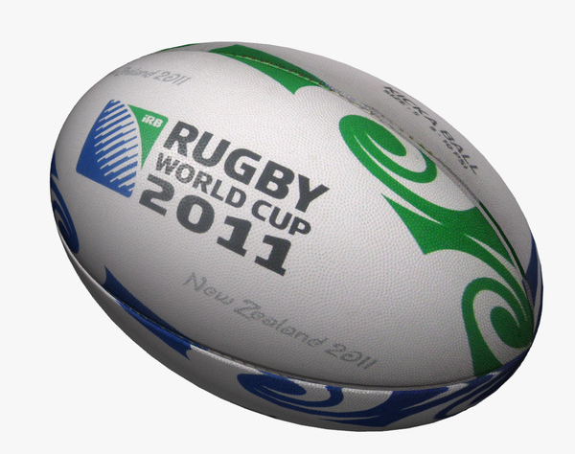
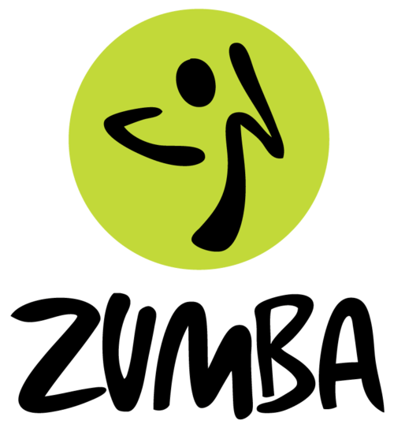
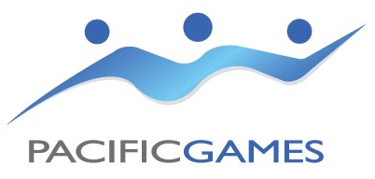
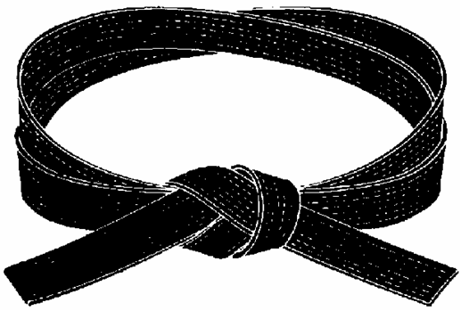


Who is an athlete?
You don’t have to be training for the Olympics. If you workout every day for 60 min or more at a moderate to vigorous effort, then you are an athlete.
Notes:
Picture: http://www.tokelau.org.nz/site/tokelau/images/Pacific%20Games%20Logo.jpg
http://drakemagazine.com/wp-content/uploads/2013/03/zumba-logo.png
http://www.paysonutah.org/img/Image/RECREATION/GrlsVllyball/2630volley_ball%5B1%5D.jpg
http://preview.turbosquid.com/Preview/2011/10/04__12_25_29/ball2.bmp25574d55-e0c8-4d92-a51b-7517972bc0d3Large.jpg
http://soccer-boys-varsity.stafford.brooke.schoolfusion.us/modules/groups/homepagefiles/group_webpage/133868-247502-285.png
http://www.clker.com/cliparts/n/q/8/X/M/m/running-md.png
http://bellsmartialarts.ca/wp-content/uploads/2013/04/Black-Belt.png

Slide 17
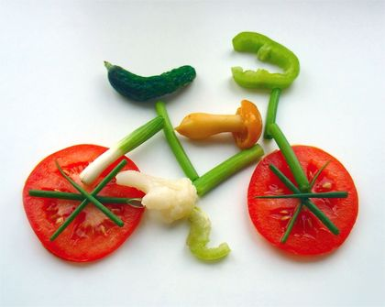
Factors That Influence Athletic Performance
Genetic Endowment - determines performance potential
Training - necessary to reach personal potential
Nutrition - supports optimal training & competition
“Hard work beats talent!”
Notes:
Picture: http://www.faqs.org/nutrition/Smi-Z/Sports-Nutrition.html#b

Slide 18
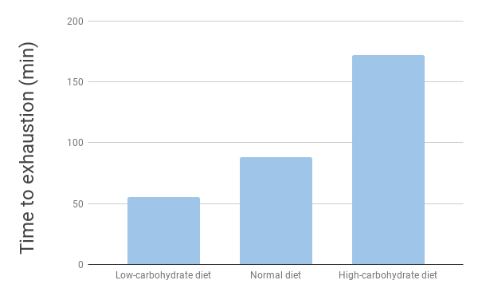
Carbohydrates:
Is a low carb diet good for exercising?
Carbohydrate is like high octane fuel!
- It is necessary for high intensity efforts.
- When carbohydrate runs low, the athlete must slow down.

Slide 19
Carbohydrate Loading
Key features
1) Reduce training during the week prior to an event, why? It reduces glycogen use which allows it to accumulate in the body
2) Consume 500 to 600 g CHO/day, 2-3 days before event, why? It maximizes glycogen storage in muscles & liver

Slide 20
Carbohydrate Loading: pros and cons
Advantages
  Double muscle glycogen levels
  Increase exercise endurance capacity
  Store ~3 g water with each g glycogen
  Glycogen use during exercise releases this
  Extra water for use in sweat production
Disadvantages
  Carrying extra weight: 1 lb of glycogen + 3 lbs of water= 4 lbs
  Best suited for people participating in events longer than 90 minutes

Slide 21
Protein Needs Depend on Extent of Training
and Dietary Protein Sources
Recommended Protein Intakes
  Most adults: 0.8 g/kg body weight
  Endurance athletes: 1.2 to 1.4 g/kg body weight
  Vegetarian endurance athletes: 1.3 to 1.5 g/kg body weight
  Strength athletes: 1.6 to 1.7 g/kg body weight
  Vegetarian strength athletes: 1.7 to 1.8 g/kg body weight
Dietary Reference Intakes, 2002
ACSM/ADA/Dietitians of Canada Position Statement:
Nutrition & Athletic Performance, 2001

Slide 22
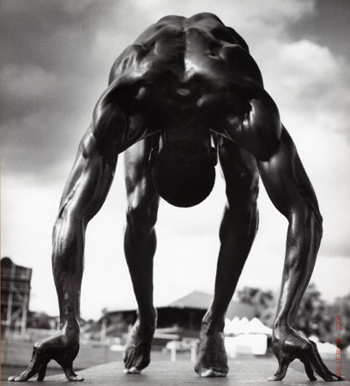
Ergogenic Aids
Vitamins & Minerals
A substance, an appliance, or a procedure that improves athletic performance
Include
supplements for →
Possible side effects?
  Physiological
  Psychological
  Behavioral
Muscle Building
Performance Enhancement
Endurance Enhancement
Notes:
Picture: http://www.unchainedfitness.com/wordpress/wp-content/uploads/2011/09/Athlte.jpg

Slide 23

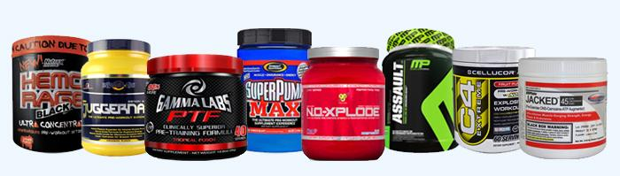
Supplements
Popular and common:
Amino Acids
  Branched-chain amino acids
  Glutamine
Creatine
Caffeine
Glucosamine &/or Chondroitin
Herbs
Limited to no good research evidence to support benefits
Not evaluated by the Food and Drug Administration (FDA)
  No assurance of purity, safety, or effectiveness
Source: Academy of Nutrition and Dietetics; Sports, Cardiovascular, and Wellness Nutrition (SCAN)
Notes:
References:
1. Academy of Nutrition and Dietetics (2012). Sports Nutrition Care Manual. http://www.nutritioncaremanual.org/index.cfm
2. Sports, Cardiovascular, and Wellness Nutrition (2012). “Nutrition Fact Sheet: Dietary Supplement or Conventional Food.” Issue 16.
Photos:
http://www.whatisthebestpreworkout.com/wp-content/uploads/2012/02/Best-Pre-Workout-Supplements-Banner1.jpg
http://www.clker.com/cliparts/p/8/M/C/2/4/caution-icon-md.png

Slide 24
Iron Deficiency Common Among Athletes
Potential Daily Iron Losses in Endurance Athletes
 | Male (mg/day) | Female (mg/day)
Sedentary | 1 | 1.5
Athlete | 1.8 | 2.5
Difference | 0.8 | 1.0
↑ Dietary Need* | 8 | 10
*Assumes 10% absorption efficiency

Slide 25
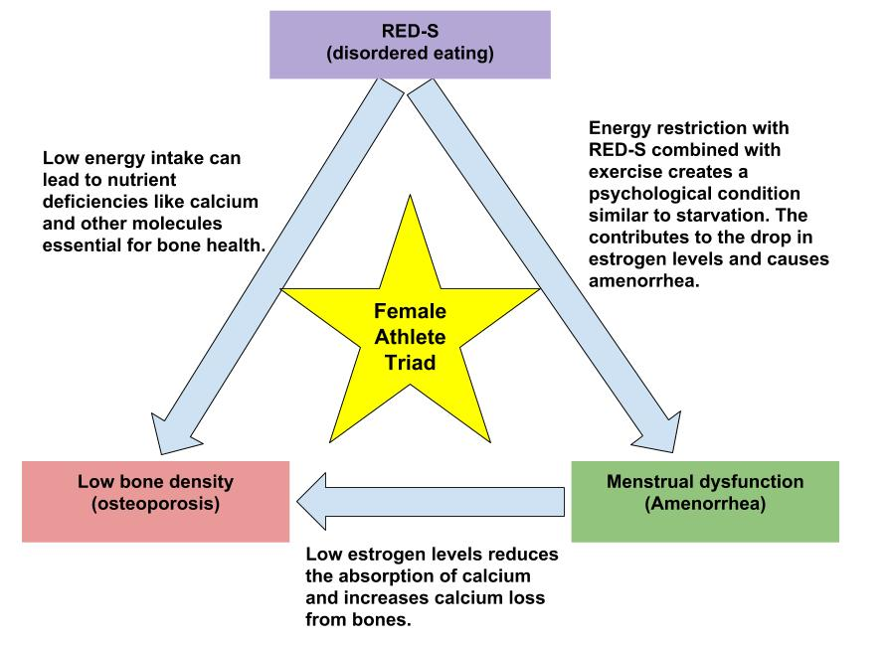
Calcium Loss in Female Athletes
Female Athlete Triad
Notes:
Notes:
Amenorrhea, an absence of the menstrual cycle for three consecutive months, is the strongest indicator of the Triad and most often associated with low energy availability
Low energy availability can result in:
• Compromised nutrition (dehydration, glycogen depletion, insufficient nutrient intake)
• Early fatique
• Immune suppression
• Stress fractures and other injuries
• Infertility
Source: SCAN (2010). Nutrition Fact Sheet: The Female Athlete Triad. Issue 10.

Slide 26
Should athletes follow a special diet?
If athletes are to meet their energy needs from a reasonable balanced diet, they typically consume adequate amounts of essential nutrients.

Slide 27
Summary
Water – transports & removes heat
  Water loss during exercise occurs mostly through sweat & respiration.
  Inadequate water intake increases risk of dehydration.
  Drink fluids: before, during, & after exercise
Carbohydrate & electrolytes (sodium)
  Exercise > 1 hour: include carbohydrate & electrolytes (sodium)
  Drinking plain water during longer exercise increases the risk of hyponatremia.
Sports nutrition: meeting all nutrient needs of athletes
  Carbohydrate loading can maximize glycogen stores in the body.
  Protein intake should be relative to the extent of training & protein sources.
  Ergogenic aids are marketed to improve athletic performance, but there is a limited (if not any) research evidence to support benefits.
  Potential side effects and risks should be considered before taking supplements.
Athletes who restrict food intake may be at risk for:
  Iron deficiency - Disordered Eating - Female Athlete Triad
Athletes who meet energy needs from a reasonable balanced diet typically consume adequate amounts of essential nutrients.

