Slide 1


BIOLOGY 2e
Chapter 28 INVERTEBRATES
PowerPoint Image Slideshow
This work is licensed under a Creative Commons Attribution-NonCommercial-ShareAlike 4.0 International License.

Slide 2
Invertebrates
All of the animals without vertebrate
About 97% of all the animals on Earth
Many are aquatic

Slide 3
Terminology
Parazoa – no true embryonic tissues
  Sponges
  Symmetry – asymmetrical (no symmetry)
Eumetazoa (Metazoa) – true embryonic tissues
  All other animals (except sponges)
  Symmetry:
      Radial Symmetry
        Diploblastic – 2 embryonic tissues (endoderm and ectoderm)
        Cnidarians and Ctenophores
      Bilateral Symmetry
        Triploblastic – 3 embryonic tissues (endoderm, mesoderm, ectoderm)
        3 main groups:
            Platyhelminthes
            Protostomes – mouth first
            Deuterostomes – anus first

Slide 4
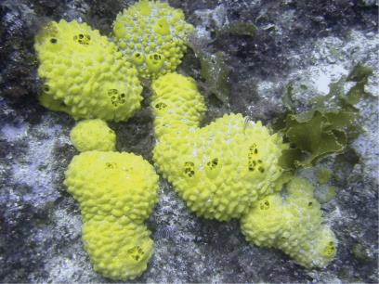
Sponges – Phylum Porifera
Sponges are the simplest of all the animals
All are aquatic
Parazoans – no true tissues
Asymmetrical
Adults are sessile but larvae have motility (will settle on substrate and grow)

Slide 5
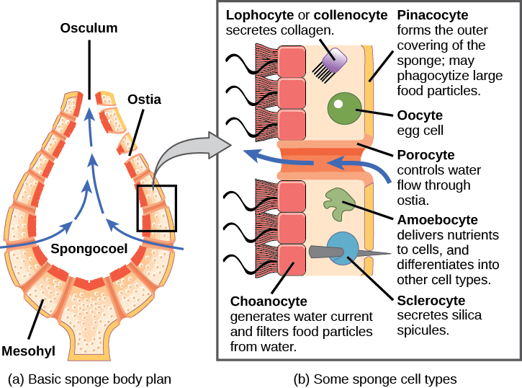
Sponges – Phylum Porifera
Download for free at http://cnx.org/contents/185cbf87-c72e-48f5-b51e-f14f21b5eabd@10.61

Slide 6
Sponges – Phylum Porifera
Sponges have NO digestive, respiratory, circulatory, reproductive or nervous system
They are filter feeders and trap particles in the water with the choanocytes as it flows through the osculum
  Watch this video:
  https://www.youtube.com/watch?v=T7E1rq7zHLc
Reproduction
  Asexual – through budding
  Sexual – sponges are hermaphroditic; release egg and sperm into the water

Slide 7
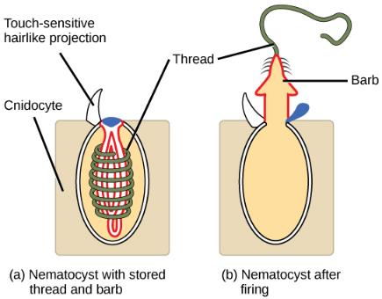
Phylum Cnidaria
Cnidarians are metazoans
  Diploblastic – endoderm and ectoderm
  Radial symmetry
Cnidarians contain specialized cells called cnidocytes that contain nematocysts
Download for free at http://cnx.org/contents/185cbf87-c72e-48f5-b51e-f14f21b5eabd@10.61

Slide 8
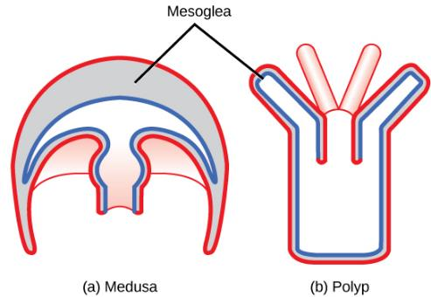
Phylum Cnidaria
Cnidarians display 2 distinct body plans:
  Polyp – sessile
  Medusa
  Some cnidarians display both body plans during life cycle
Download for free at http://cnx.org/contents/185cbf87-c72e-48f5-b51e-f14f21b5eabd@10.61

Slide 9
Phylum Cnidaria
Reproduction
  Asexual – budding (as we see in corals)
  Sexual – release of gametes into the water
Primitive nervous system – nerve net
Gastrovascular cavity
  One opening, serves as both mouth and anus
  Digestion takes place here, exchange of gases, etc
  carnivorous

Slide 10
Phylum Cnidaria
Class Anthozoa
Class Scyphozoa
Class Cubozoa
Class Hydrozoa

Slide 11
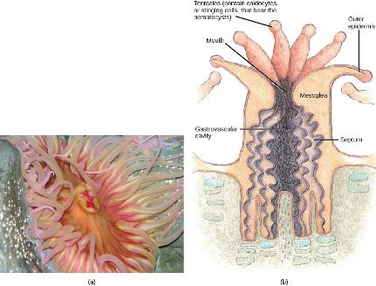
Phylum Cnidaria
Class Anthozoa
  Corals, sea anemones
  Polyp body plan
  Watch this video:
  https://www.youtube.com/watch?v=ysOmq71fcMk
Caption: Closed Brain Coral (c) RevolverOcelet, Public domain

Slide 12
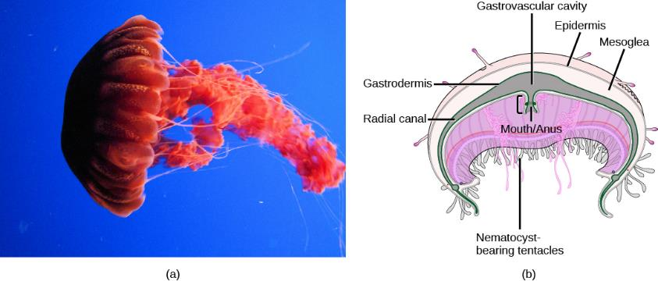
Phylum Cnidaria
Class Scyphozoa
  Medusa is prominent
  “jellies”
Download for free at http://cnx.org/contents/185cbf87-c72e-48f5-b51e-f14f21b5eabd@10.61

Slide 13
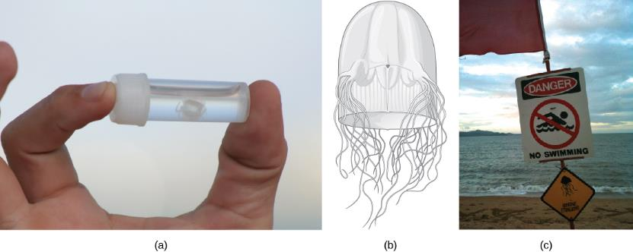
Phylum Cnidaria
Class Cubozoa
  Box shaped medusa – “box jellies”
  Most dangerous of all the cnidarians
Download for free at http://cnx.org/contents/185cbf87-c72e-48f5-b51e-f14f21b5eabd@10.61

Slide 14
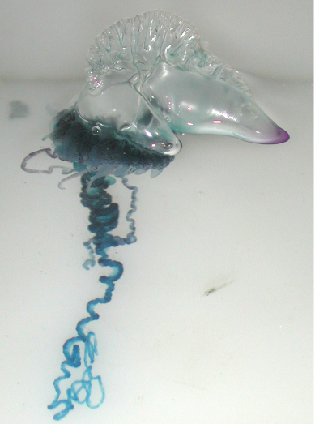
Phylum Cnidaria
Class Hydrozoa
  Both polyp and medusa forms
  Includes Hydra and Portuguese-man-of-war
Download for free at http://cnx.org/contents/185cbf87-c72e-48f5-b51e-f14f21b5eabd@10.61

Slide 15
Bilateral animals
Have bilateral symmetry
Triploblastic – ectoderm, mesoderm, endoderm
3 groups –
  Platyhelminthes – acoelomates
  Protostomes – coelomates
    Lophotrochozoans (sometimes Platyhelminthes lumped into this group)
    Ecdysozoans
  Deuterostomes – coelomates
    Echinoderms
    Chordates

Slide 16
Phylum Platyhelminthes
The Platyhelminthes are the flatworms
Have a gastrovascular cavity – do not have complete gut
Hermaphroditic
Flame cells – primitive excretory system
Some are free-living, some are parasitic
Start to see development of cephalization in the animals
  Head region where sensory organs are congregated

Slide 17
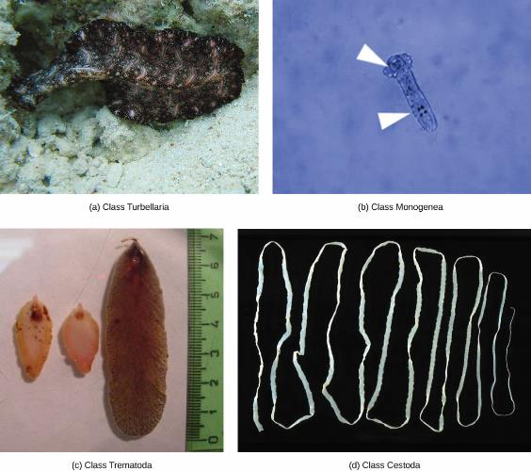
Phylum Platyhelminthes
Class Turbellaria – planaria
Class Trematoda – flukes
Class Cestoda – tapeworms
Download for free at http://cnx.org/contents/185cbf87-c72e-48f5-b51e-f14f21b5eabd@10.61

Slide 18
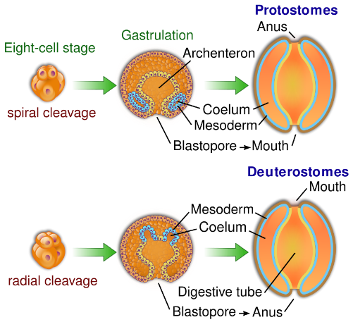
Protostomes
During embryological development, a blastopore will start to develop in the blastula
Caption: protovsdeuterostomes (c) YassinMrabet, Public domain

Slide 19
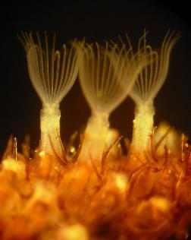
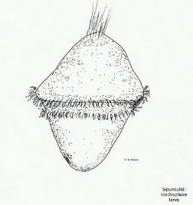
Protostomes
Superphylum Lophotrochozoa
A lot of the lophotrochozoans have a lophophore
  Used to filter feed and used in gas exchange
A lot have a larval form called a trochophore larvae
Caption: Flustrellidra hispida 2090a (c) Arruz, Public domain
Caption: Spinuculid Trochophore Larvae (c) M Ready, Public domain

Slide 20
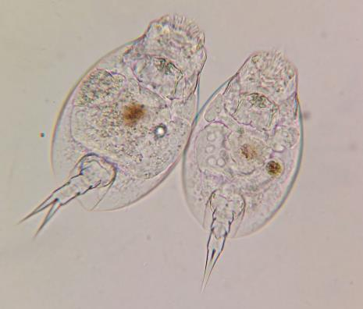
Protostomes
Superphylum Lophotrochozoa
Phylum Rotifera
  Microscopic animals – part of the zooplankton
Caption: Pair of Rotifers, likely Euchlanis, from Northeast US Pond sample (c) Matthew A Robinson, Public domain

Slide 21
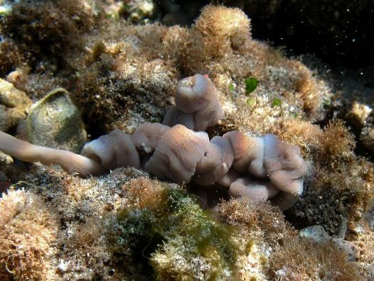
Protostomes
Superphylum Lophotrochozoan
Phylum Nemertea – ribbon worms
  Watch this video:
  https://www.youtube.com/watch?v=55wChToy5fM
Caption: Nemertea Reunion (c) Philippe Bourjon, Public domain

Slide 22
Protostomes
Superphylum Lophotrochozoa
Phylum Mollusca
  Predominantly marine
  Body plan: mantle (secretes shell), muscular foot, visceral mass (where the organs are)
  Complete digestive system
  Have gills for respiration
  Open circulatory system (except for the cephalopods that have a closed circulatory system)

Slide 23
Phylum Mollusca
Class Polyplacophora
Class Gastropoda
Class Bivalvia
Class Cephalopoda

Slide 24
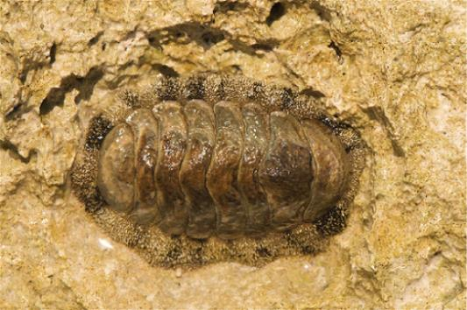
Phylum Mollusca
Class Polyplacophora
  Many plates
  Have a radula to scrap algae off rocks
Download for free at http://cnx.org/contents/185cbf87-c72e-48f5-b51e-f14f21b5eabd@10.61

Slide 25
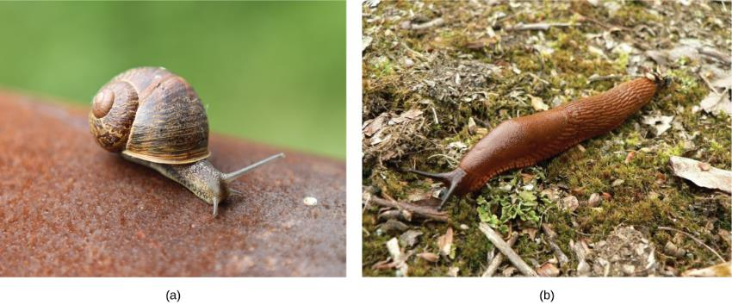
Phylum Mollusca
Class Gastropoda
  Snails, slugs (slugs don’t have a shell), conchs, nudibranchs
Download for free at http://cnx.org/contents/185cbf87-c72e-48f5-b51e-f14f21b5eabd@10.61

Slide 26
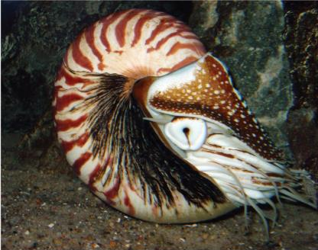

Phylum Mollusca
Class Cephalopoda – “head-foot”
  Octopus, squid, nautilus
  Most unique group of molluscs
    Closed circulatory system
    “intelligent” group of invertebrates
    Watch this video: https://www.youtube.com/watch?v=S0Bal56bF2E
Download for free at http://cnx.org/contents/185cbf87-c72e-48f5-b51e-f14f21b5eabd@10.61

Slide 27
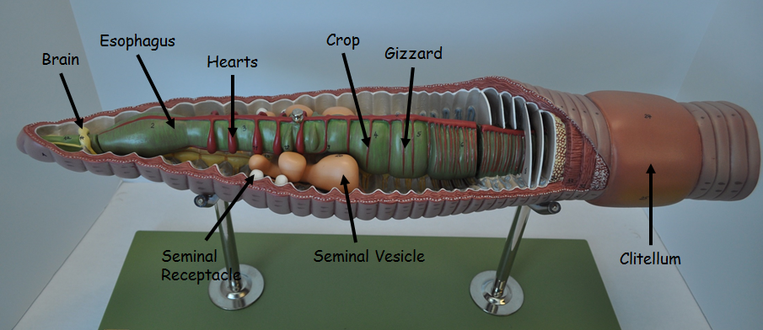
Protostomes
Superphylum Lophotrochozoa
Phylum Annelida
  Segmented worms – repeated body segments
  Most advanced worms
  Complete digestive system
  Closed circulatory system

Slide 28
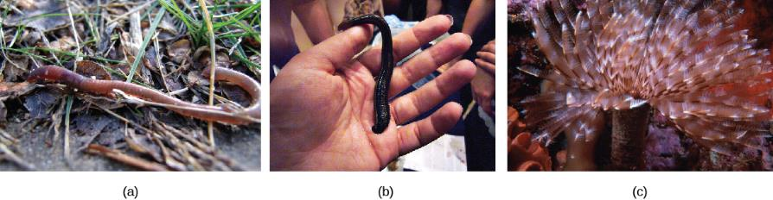
Phylum Annelida
Class Oligiochaeta – earthworm
Class Hirudinea – leeches
Class Polychaeta – marine worms
Download for free at http://cnx.org/contents/185cbf87-c72e-48f5-b51e-f14f21b5eabd@10.61

Slide 29
Protostome
Superphylum Ecdysozoa
Superphylum Ecdysozoa
  Huge group of animals
    Includes the Arthropods and Nematodes
    External covering called cuticle that molts – ecdysis

Slide 30
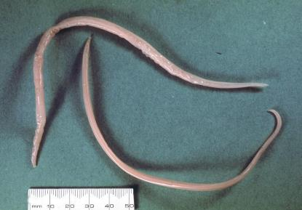
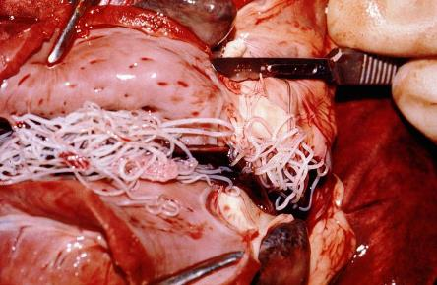
Protostome
Superphylum Ecdysozoa
Phylum Nematoda
  “pseudocoelomates”
  Many are parasitic (complex life cycles)
  Why are C elegans used for research? – watch this video:
  https://www.youtube.com/watch?v=ADiGY5jyNmk
Caption: Asaris-suum (c) Alan Walker, Public domain
Caption:Dirofilaria-immitis-dog-heart (c) Alan Walker, Public domain

Slide 31
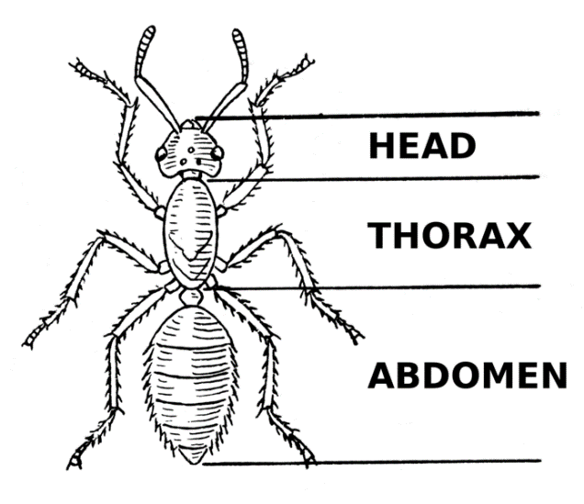
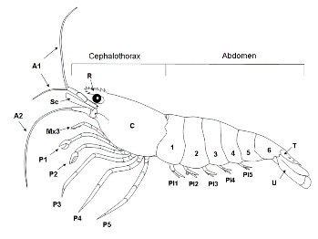
Protostome
Superphylum Ecdysozoa
Phylum Arthropoda
  “jointed legs”
  This group dominates the animal kingdom
  Exoskeleton made of chitin
  Open circulatory system
    Hemocoel – cavity containing organs
  Respiration:
    Gills found in crustaceans
    Tracheae (tubes) in insects
Caption: Abdomen (c) Foresman, Public domain
Caption: Anatomy of a Shrimp 2 (c) JCD, Public domain

Slide 32
Phylum Arthropoda
Subphylum Hexapoda
Subphylum Myriapoda
Subphylum Crustacea
Subphylum Chelicerata

Slide 33
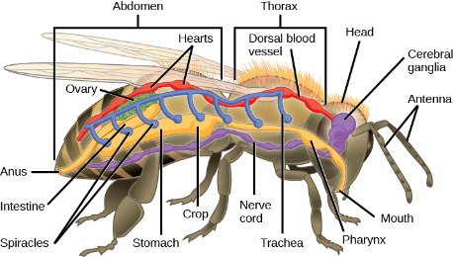
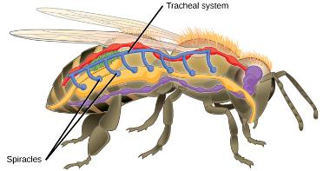
Protostome
Superphylum Ecdysozoa
Phylum Arthropoda
  Subphylum Hexapoda – 6 legs, includes the insects
  Respiration – openings (spiracles) in exoskeleton lead to tubes (tracheae) that branch through body
Download for free at http://cnx.org/contents/185cbf87-c72e-48f5-b51e-f14f21b5eabd@10.61

Slide 34
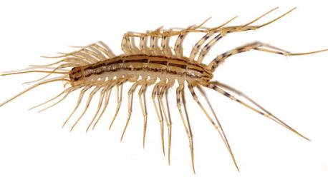
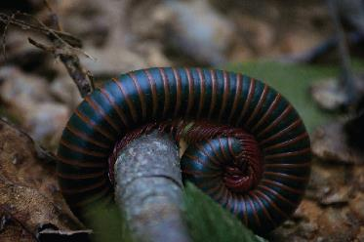
Protostome
Superphylum Ecdysozoa
Phylum Arthropoda
  Subphylum Myriapoda
    Chilopods – centipedes (1 set of legs per segment)
      carnivores
    Diplopoda – millipedes (2 sets of legs per segment)
      herbivores
Download for free at http://cnx.org/contents/185cbf87-c72e-48f5-b51e-f14f21b5eabd@10.61

Slide 35
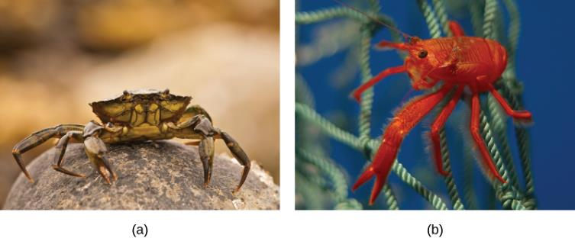
Protostome
Superphylum Ecdysozoa
Phylum Arthropoda
  Subphylum Crustacea
  Mostly aquatic
  Respiration – gills
  Covering is referred to as a carapace
Download for free at http://cnx.org/contents/185cbf87-c72e-48f5-b51e-f14f21b5eabd@10.61

Slide 36
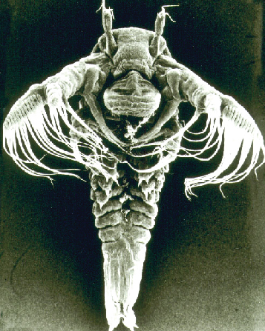
Protostome
Superphylum Ecdysozoa
Subphylum Crustacea
  Giant isopod – watch this video:
  https://www.youtube.com/watch?v=L5lrbcLX_rw
  Largest land crab:
  https://www.youtube.com/watch?v=Z_mq_63fEdI
  Larval form in this group is mainly the naupilus larvae
Download for free at http://cnx.org/contents/185cbf87-c72e-48f5-b51e-f14f21b5eabd@10.61

Slide 37
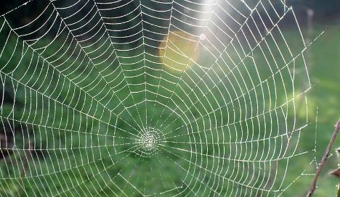
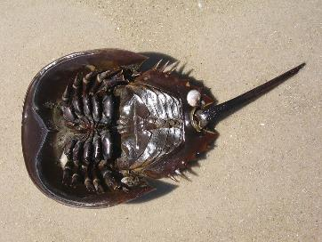
Protostome
Superphylum Ecdysozoa
Phylum Anthropoda
  Subphylum Chelicerata – spiders, horseshoe crabs
  Chelicerae – claw-like or fang-like mouth parts
Caption: Spider Web (c) vastateparkstaff, Public domain
Caption: The horseshoe crab looks like Darth Vader (c) Adam Sofen, Public domain

Slide 38
Deuterostome animals
Up until this point, we’ve talked about the protostome animals
We will now talk about the deuterostome animals
  Deuterostomes
    Echinoderms
    Chordates
      This chapter only deals with the invertebrate chordates
      The next chapter will deal with the Vertebrates

Slide 39
Deuterostome
Phylum Echinodermata
Phylum Echinodermata
  Echino – “spiny”, derma – “skin”
  Adult echinoderms exhibit pentaradial symmetry
  Larval forms have bilateral symmetry
  Capable of regeneration
  Water vascular system
  Up until this point, we’ve seen further development of cephalization in the animals, but the Echinoderms lack a head region
    Do have a nerve ring

Slide 40
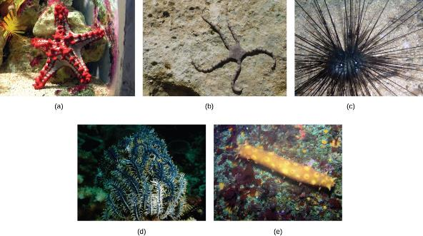
Deuterostome
Phylum Echinodermata
Phylum Echinodermata
  Class Asteroidea – Sea Star
  Class Ophiuroidea – brittle stars
  Class Echinoidea – sea urchins, sand dollars
  Class Crinoidea – sea lilies
  Class Holothuroidea – sea cucumbers
Download for free at http://cnx.org/contents/185cbf87-c72e-48f5-b51e-f14f21b5eabd@10.61

Slide 41
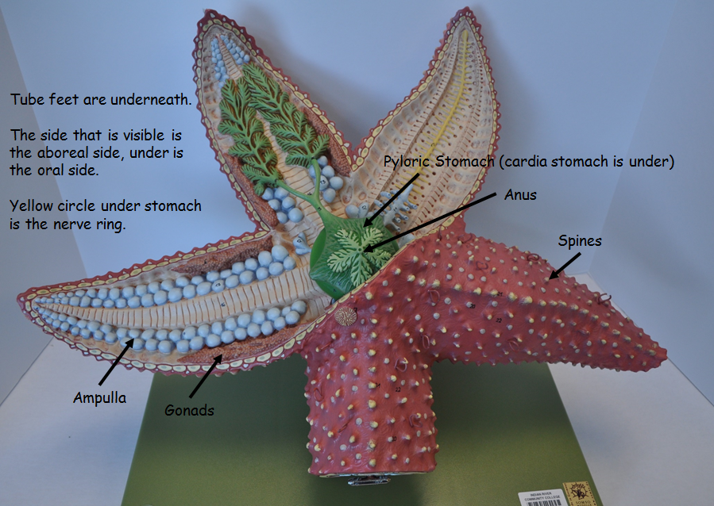
Deuterostome
Phylum Echinodermata

