Slide 1


Biology 2e
Chapter 29 VERTEBRATES
PowerPoint Image Slideshow

Slide 2
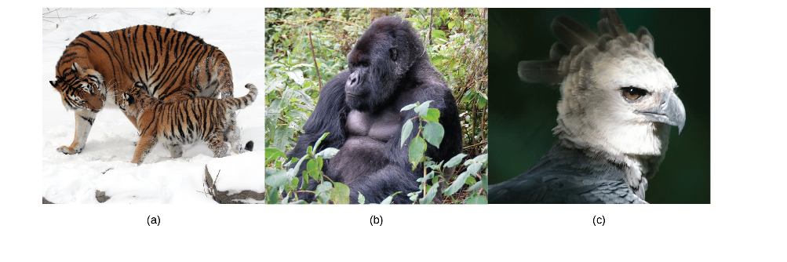
Figure 29.1
Examples of critically endangered vertebrate species include (a) the Siberian tiger (Panthera tigris), (b) the mountain gorilla (Gorilla beringei), and (c) the harpy eagle (Harpia harpyja). (The harpy eagle is considered "near threatened" globally, but critically endangered in much of its former range in Mexico and Central America.) (credit a: modification of work by Dave Pape; credit b: modification of work by Dave Proffer; credit c: modification of work by Haui Ared)

Slide 3
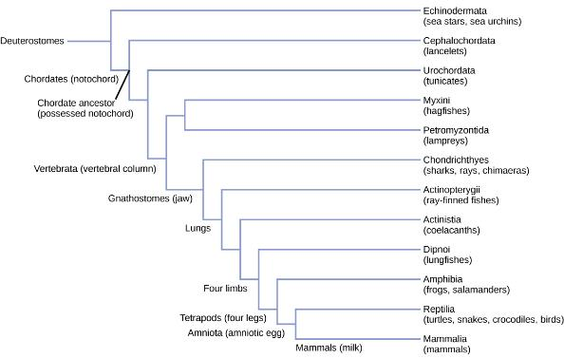
Figure 29.2
Deuterostome phylogeny. All chordates are deuterostomes possessing a notochord at some stage of their life cycle.

Slide 4
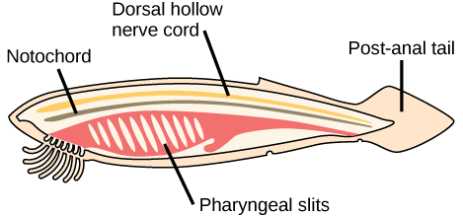
Figure 29.3
Chordate features. In chordates, four common features appear at some point during development: a notochord, a dorsal hollow nerve cord, pharyngeal slits, and a post-anal tail. The endostyle is embedded in the floor of the pharynx.

Slide 5
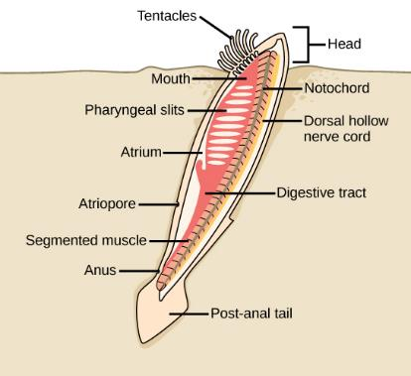
Figure 29.4
Cephalochordate anatomy. In the lancelet and other cephalochordates, the notochord extends into the head region. Adult lancelets retain all five key characteristics of chordates: a notochord, a dorsal hollow nerve cord, pharyngeal slits, an endostyle, and a post-anal tail.

Slide 6
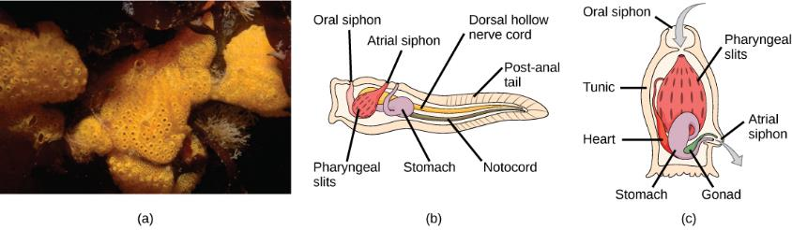
Figure 29.5
Urochordate anatomy. (a) This photograph shows a colony of the tunicate Botrylloides violaceus. (b) The larval stage of the tunicate possesses all of the features characteristic of chordates: a notochord, a dorsal hollow nerve cord, pharyngeal slits, an endostyle, and a post-anal tail. (c) In the adult stage, the notochord, nerve cord, and tail disappear, leaving just the pharyngeal slits and endostyle. (credit: modification of work by Dann Blackwood, USGS)

Slide 7
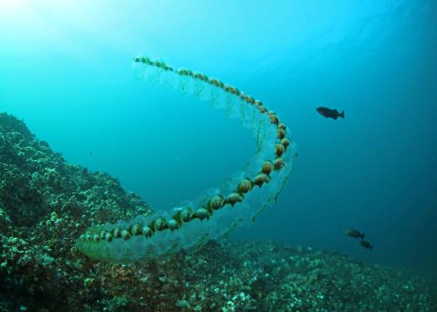
Figure 29.6
Salps. These colonial tunicates feed on phytoplankton. Salps are sequential hermaphrodites, with younger female colonies fertilized by older male colonies. (credit: Oregon Department of Fish & Wildlife via Wikimedia Commons)

Slide 8
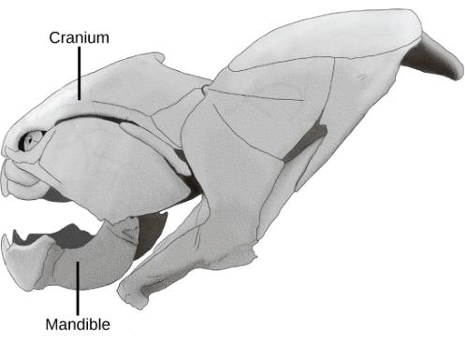
Figure 29.7
A craniate skull. The subphylum Craniata (or Vertebrata), including this placoderm fish (Dunkleosteus sp.), are characterized by the presence of a cranium, mandible, and other facial bones. (credit: “Steveoc 86”/Wikimedia Commons)

Slide 9
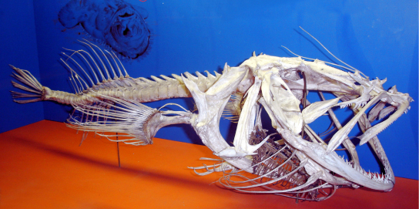
Figure 29.8
A vertebrate skeleton. Vertebrata are characterized by the presence of a backbone, such as the one that runs through the middle of this fish. All vertebrates are in the Craniata clade and have a cranium. (credit: Ernest V. More; taken at Smithsonian Museum of Natural History, Washington, D.C.)

Slide 10
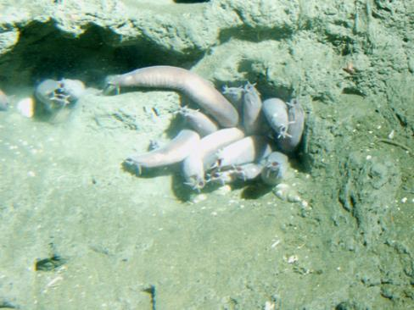
Figure 29.9
Hagfish. Pacific hagfish are scavengers that live on the ocean floor. (credit: Linda Snook, NOAA/CBNMS)

Slide 11
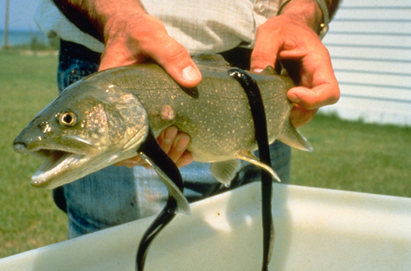
Figure 29.10
Lamprey. These parasitic sea lampreys, Petromyzon marinus, attach by suction to their lake trout host, and use their rough tongues to rasp away flesh in order to feed on the trout’s blood. (credit: USGS)

Slide 12
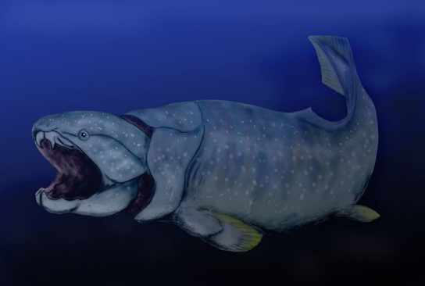
Figure 29.11
A placoderm. Dunkleosteus was an enormous placoderm from the Devonian period, 380 to 360 million years ago. It measured up to 10 meters in length and weighed up to 3.6 tons. Its head and neck were armored with heavy bony plates. Although Dunkleosteus had no true teeth, the edge of the jaw was armed with sharp bony blades. (credit: Nobu Tamura)

Slide 13
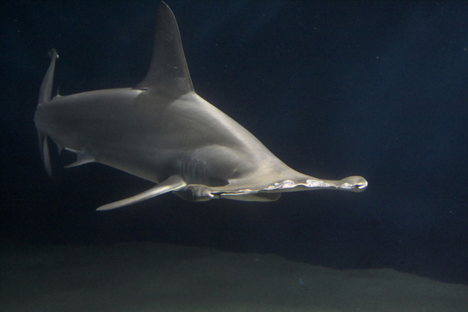
Figure 29.12
Shark. Hammerhead sharks tend to school during the day and hunt prey at night. (credit: Masashi Sugawara)

Slide 14
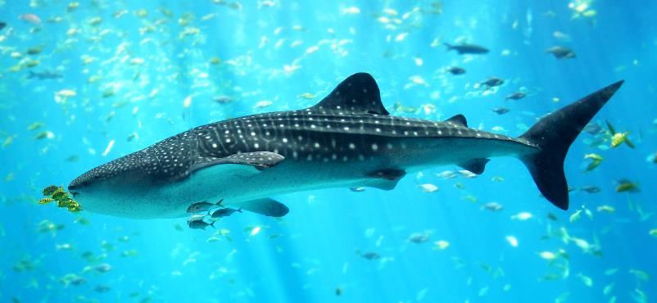
Figure 29.13
Shark. Hammerhead sharks tend to school during the day and hunt prey at night. (credit: Masashi Sugawara)

Slide 15
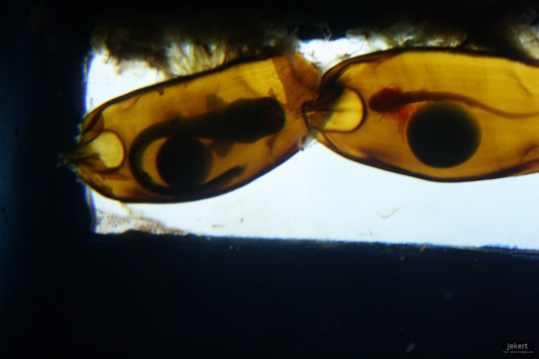
Figure 29.14
Shark egg cases. Shark embryos are clearly visible through these transparent egg cases. The round structure is the yolk that nourishes the growing embryo. (credit: Jek Bacarisas)

Slide 16
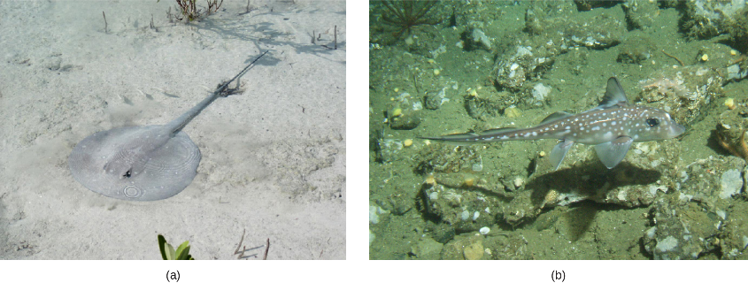
Figure 29.15
Cartilaginous fish. (a) Stingray. This stingray blends into the sandy bottom of the ocean floor. A spotted ratfish (b) Hydrolagus colliei credit a "Sailn1"/Flickr; (credit: a "Sailn1"/Flickr b: Linda Snook / MBNMS [Public domain], via Wikimedia Commons.)

Slide 17
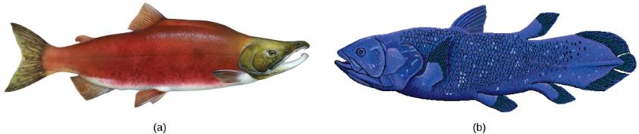
Figure 29.16
The (a) sockeye salmon and (b) coelacanth are both bony fishes of the Osteichthyes clade. The coelacanth, sometimes called a lobe-finned fish, was thought to have gone extinct in the Late Cretaceous period, 100 million years ago, until one was discovered in 1938 near the Comoros Islands between Africa and Madagascar. (credit a: modification of work by Timothy Knepp, USFWS; credit b: modification of work by Robbie Cada)

Slide 18
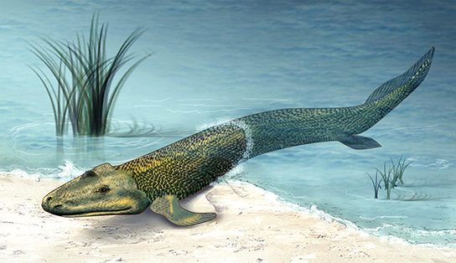
Figure 29.17
Tiktaalik. The recent fossil discovery of Tiktaalik roseae suggests evidence for an animal intermediate to finned fish and legged tetrapods, sometimes called a "fishapod." (credit: Zina Deretsky, National Science Foundation)

Slide 19
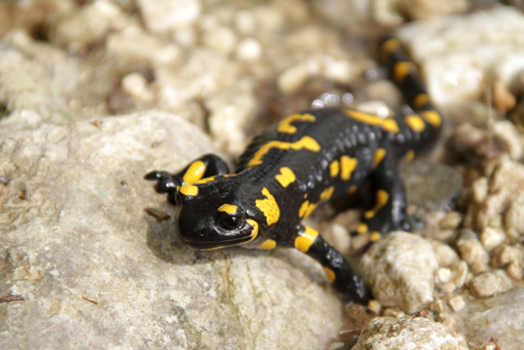
Figure 29.18
Salamander. Most salamanders have legs and a tail, but respiration varies among species. (credit: Valentina Storti)

Slide 20
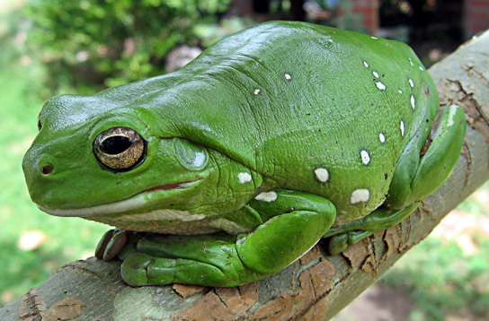
Figure 29.19
Tree frog. The Australian green tree frog is a nocturnal predator that lives in the canopies of trees near a water source.

Slide 21
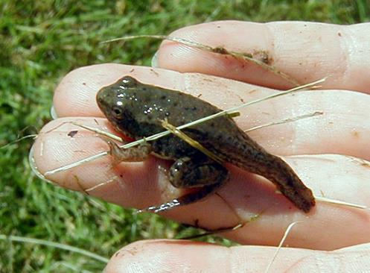
Figure 29.20
Amphibian metamorphosis. A juvenile frog metamorphoses into a frog. Here, the frog has started to develop limbs, but its tadpole tail is still evident.

Slide 22
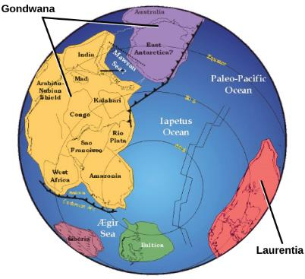
Figure 29.21
Paleozoic continents. During the Paleozoic Era, around 550 million years ago, the continent Gondwana formed. Both Gondwana and the continent Laurentia were located near the equator.

Slide 23
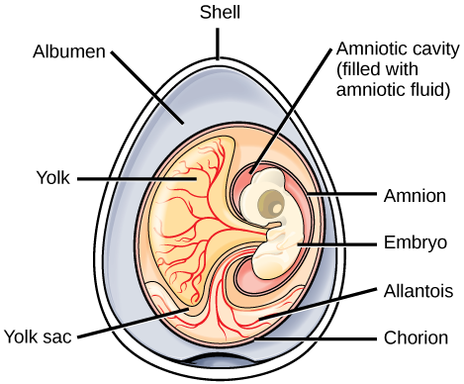
Figure 29.22
An amniotic egg. The key features of an amniotic egg are shown.

Slide 24
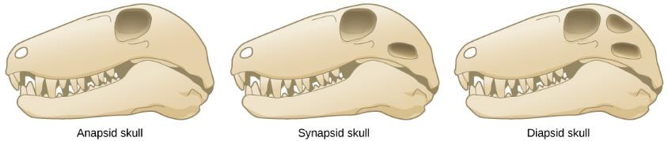
Figure 29.23
Amniote skulls. Compare the skulls and temporal fenestrae of anapsids, synapsids, and diapsids. Anapsids have no openings, synapsids have one opening, and diapsids have two openings.

Slide 25
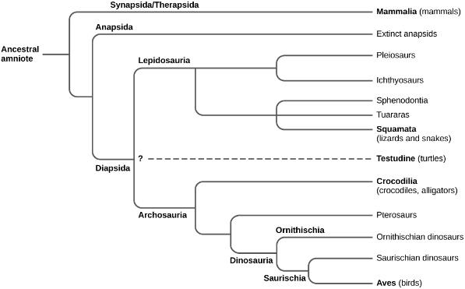
Figure 29.24
Amniote phylogeny. This chart shows the evolution of amniotes. The placement of Testudines (turtles) is currently still debated.

Slide 26
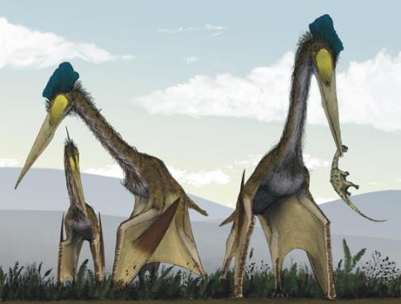
Figure 29.25
Pterosaurs. Pterosaurs, such as this Quetzalcoatlus, which existed from the late Triassic to the Cretaceous period (230 to 65.5 million years ago), possessed wings but are not believed to have been capable of powered flight. Instead, they may have been able to soar after launching from cliffs. (credit: Mark Witton, Darren Naish)

Slide 27
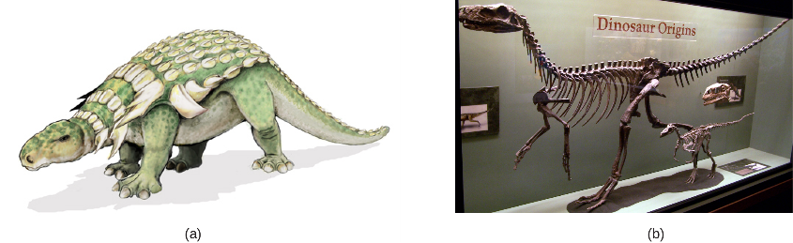
Figure 29.26
Ornithischian and saurischian Dinosaurs. Edmontonia was an armored dinosaur that lived in the Late Cretaceous period, 145.5 to 65.6 million years ago. Herrerrasaurus and Eoraptor (b) were late Triassic saurischian dinosaurs dating to about 230 million years ago. (credit: a Mariana Ruiz Villareal b Zach Tirrell from Plymouth, USA, Dino Origins)

Slide 28
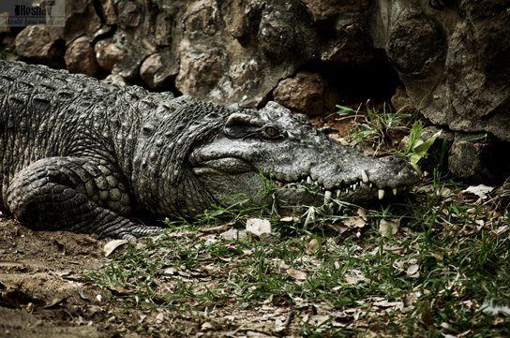
Figure 29.27
A crocodilian. Crocodilians, such as this Siamese crocodile (Crocodylus siamensis), provide parental care for their offspring. (credit: Keshav Mukund Kandhadai)

Slide 29
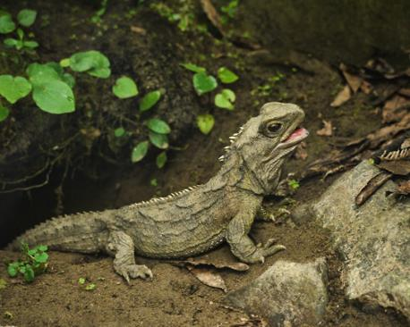
Figure 29.28
A tuatara. This tuatara from New Zealand may resemble a lizard but belongs to a distinct lineage, the Sphenodontidae family. (credit: Sid Mosdell)

Slide 30
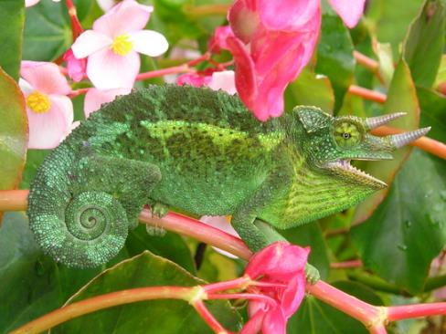
Figure 29.29
A chameleon. This Jackson’s chameleon (Trioceros jacksonii) blends in with its surroundings.

Slide 31
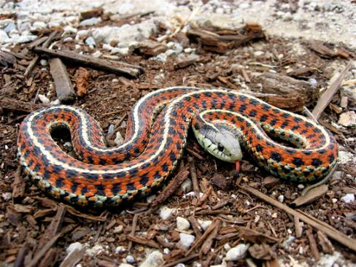
Figure 29.30
A nonvenomous snake. The garter snake belongs to the genus Thamnophis, the most widely distributed reptile genus in North America. (credit: Steve Jurvetson)

Slide 32
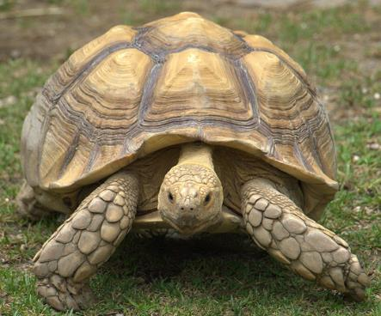
Figure 29.31
A tortoise. The African spurred tortoise (Geochelone sulcata) lives at the southern edge of the Sahara Desert. It is the third largest tortoise in the world. (credit: Jim Bowen)

Slide 33
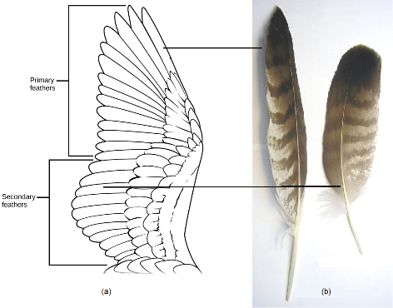
Figure 29.32
Flight feathers. (a) Primary feathers are located at the wing tip and provide thrust; secondary feathers are located close to the body and provide lift. (b) Primary and secondary feathers from a common buzzard (Buteo buteo). (Credit b: Mod. from S. Seyfert https://commons.wikimedia.org/w/index.php?curid=613813)

Slide 34
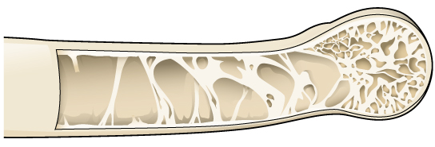
Figure 29.33
Pneumatic bone. Many birds have hollow, pneumatic bones, which make flight easier.

Slide 35
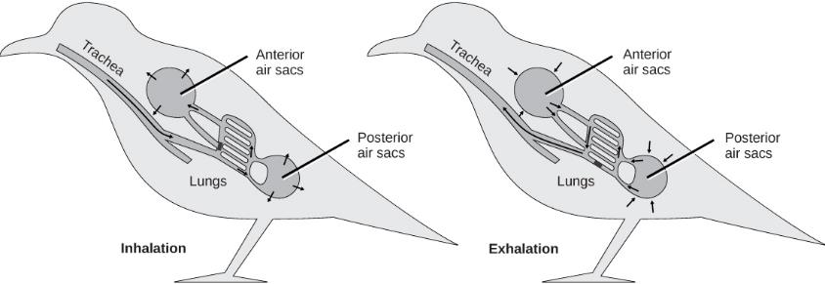
Figure 29.34
Air flow in bird lungs. Avian respiration is an efficient system of gas exchange with air flowing unidirectionally. A full ventilation cycle takes two breathing cycles. During the first inhalation, air passes from the trachea into posterior air sacs, then during the first exhalation into the lungs. The second inhalation moves the air in the lungs to the anterior air sacs, and the second exhalation moves the air in the anterior air sacs out of the body. Overall, each inhalation moves air into the air sacs, while each exhalation moves fresh air through the lungs and "used" air out of the body. The air sacs are connected to the hollow interior of bones. (credit: modification of work by L. Shyamal)

Slide 36
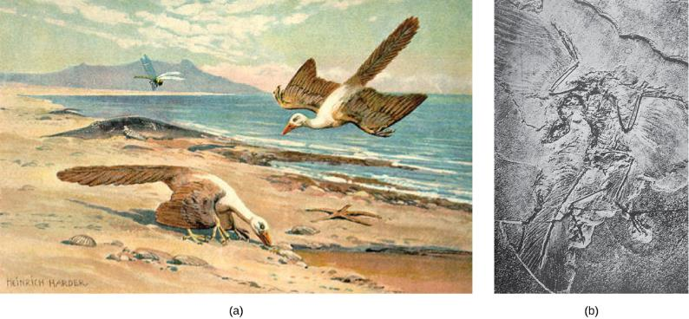
Figure 29.35
Archaeopteryx. (a) Archaeopteryx lived in the late Jurassic period around 150 million years ago. It had cuplike thecodont teeth like a dinosaur, but had (b) flight feathers like modern birds, which can be seen in this fossil. Note the claws on the wings, which are still found in a number of birds, such as the newborn chicks of the South American Hoatzin.

Slide 37
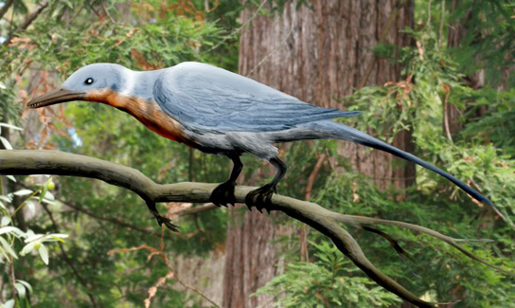
Figure 29.36
Enantiornithean bird. Shanweiniao cooperorum was a species of Enantiornithes that did not survive past the Cretaceous period. (credit: Nobu Tamura)

Slide 38
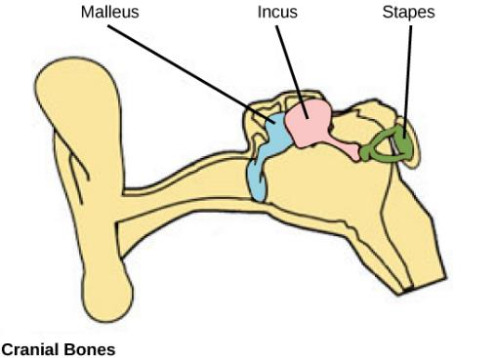
Figure 29.37
Mammalian ear bones. Bones of the mammalian middle ear are modified from bones of the jaw and skull in reptiles. The stapes is found in other vertebrates (e.g., the columella of birds) whereas in mammals, the malleus and incus are derived from the articular and quadrate bones, respectively. (credit: NCI)

Slide 39
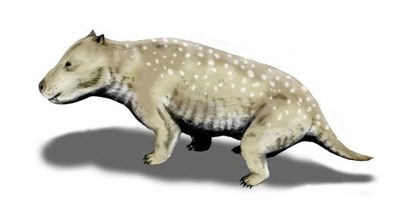
Figure 29.38
Cynodont. Cynodonts ("dog teeth"), which first appeared in the Late Permian period 260 million years ago, are thought to be the ancestors of modern mammals. Holes in the upper jaws of cynodonts suggest that they had whiskers, which might also indicate the presence of hair. (credit: Nobu Tamura)

Slide 40
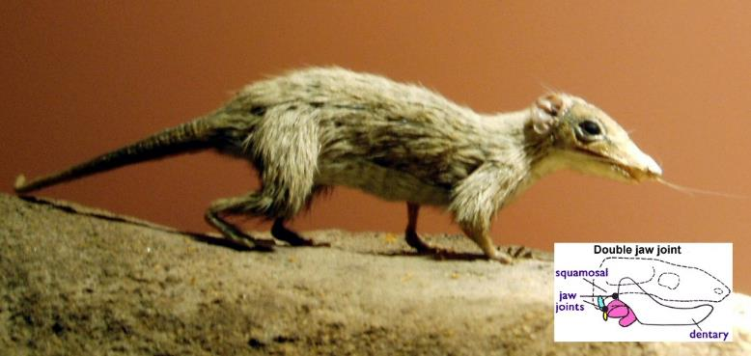
Figure 29.39
A morganucodont. This morganucodont Megazotrodon, an extinct basal mammal, may have been nocturnal and insectivorous. Inset: Jaw of a morganucodont, showing a double hinge, one between the dentary and squamosal and one between the articular (yellow) and quadrate (blue) bones. In living mammals, the articular and quadrate bones have been incorporated into the middle ear. (Credit: By Nordelch [Megazostrodon Natural History Museum] Wikimedia Commons. Credit inset: Mod from Philcha. https://commons.wikimedia.org/w/index.php? curid=3631949)

Slide 41
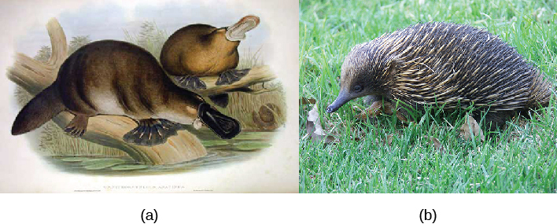
Figure 29.40
Egg-laying mammals. (a) The platypus, a monotreme, possesses a leathery beak and lays eggs rather than giving birth to live young. (b) The echidna is another monotreme, with long hairs modified into spines. (credit b: modification of work by Barry Thomas)

Slide 42
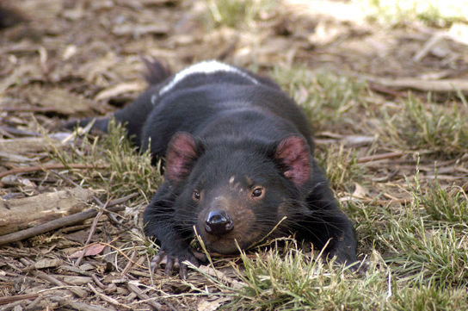
Figure 29.41
A marsupial mammal. The Tasmanian devil is one of several marsupials native to Australia. (credit: Wayne McLean)

Slide 43
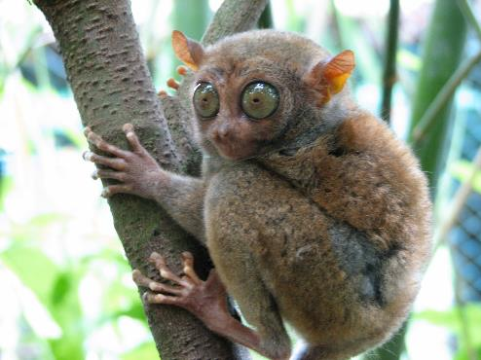
Figure 29.42
A Philippine tarsier. This tarsier, Carlito syrichta, is one of the smallest primates—about 5 inches long, from nose to the base of the tail. The tail is not shown, but is about twice the length of the body. Note the large eyes, each of which is about the same size as the animal's brain, and the long hind legs. (credit: mtoz (http://creativecommons.org/licenses/by-sa/2.0), via Wikimedia Commons)

Slide 44
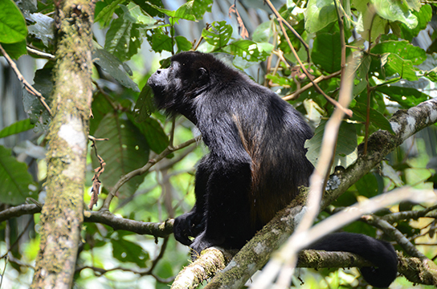
Figure 29.43
A New World monkey. The howler monkey is native to Central and South America. It makes a call that sounds like a lion roaring. (credit: Xavi Talleda)

Slide 45
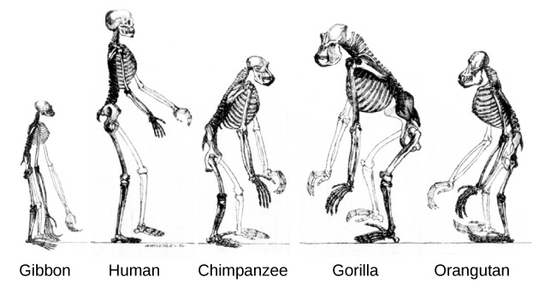
Figure 29.44
Primate skeletons. All great apes have a similar skeletal structure. (credit: modification of work by Tim Vickers)

Slide 46
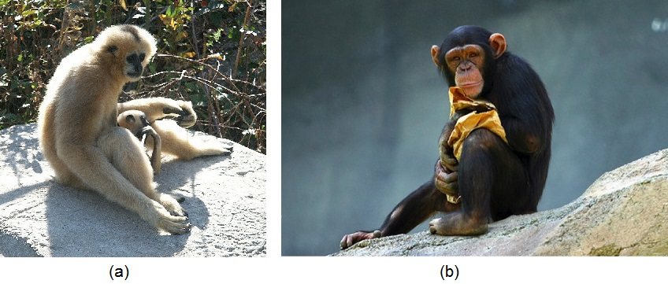
Figure 29.45
Lesser and great apes. This white-cheeked gibbon (a) is a lesser ape. In gibbons of this species, females and infants are buff and males are black. This young chimpanzee (b) is one of the great apes. It possesses a relatively large brain and has no tail. (credit a: MAC. credit b: modification of work by Aaron Logan)

Slide 47
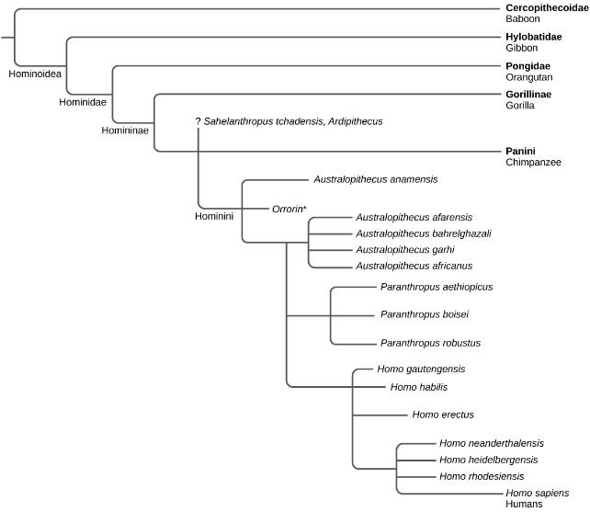
Figure 29.46
Hominin phylogeny. This chart shows the evolutionary relationship among Hominins and hypothesized relation to modern humans. (*still debated phylogeny position)

Slide 48
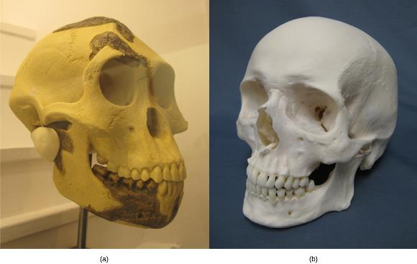
Figure 29.47
Australopithicene and modern human skulls. The skull of (a) Australopithecus afarensis, an early hominid that lived between two and three million years ago, resembled that of (b) modern humans but was smaller with a sloped forehead, larger teeth, and a prominent jaw.

Slide 49
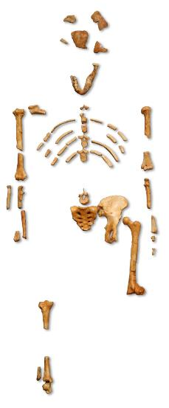
Figure 29.48
Lucy. This adult female Australopithecus afarensis skeleton, nicknamed Lucy, was discovered in the mid-1970s. (credit: “120”/Wikimedia Commons)

Slide 50
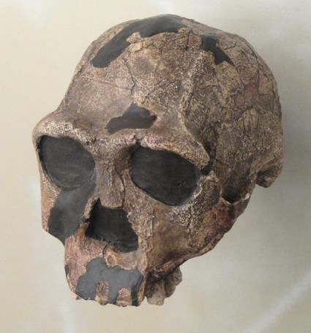
Figure 29.49
Homo erectus. Homo erectus had a prominent brow and a nose that pointed downward rather than forward.

Slide 51
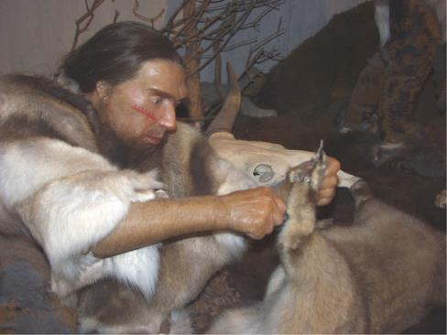
Figure 29.45
Neanderthal. The Homo neanderthalensis used tools and may have worn clothing.

