Slide 1


BIOLOGY 2e
Chapter 31 SOIL AND PLANT NUTRITION
PowerPoint Image Slideshow
This work is licensed under a Creative Commons Attribution-NonCommercial-ShareAlike 4.0 International License.

Slide 2
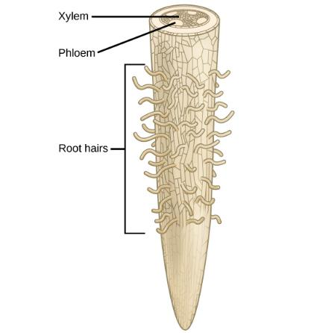
Essential materials
Most plans obtain water from the soil.
Water is absorbed through the root hairs and moves up the xylem to the leaves.

Slide 3
Essential nutrients
Macronutrients | Micronutrients
Carbon (C) | Iron (Fe)
Hydrogen (H) | Manganese (Mn)
Oxygen (O) | Boron (B)
Nitrogen (N) | Molybdenum (Mo)
Phosphorus (P) | Copper (Cu)
Potassium (K) | Zinc (Zn)
Calcium (Ca) | Chlorine (Cl)
Magnesium (Mg) | Nickel (Ni)
Sulfur (S) | Cobalt (Co)
 | Sodium (Na)
 | Silicon (Si)

Slide 4
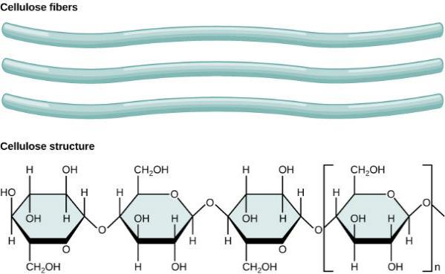
cellulose
Cellulose, the main structural component of the plant cell wall, makes up over thirty percent of plant matter. It is the most abundant organic compound on earth. Plants are able to make their own cellulose, but need carbon from the soil to do so.

Slide 5
Soil composition
Soils can be divided into two groups:
Organic soils are formed from sedimentation and primarily composed of organic matter,
Mineral soils are formed from the weathering of rocks and are primarily composed of inorganic material.
  Mineral soils are predominant in terrestrial ecosystems, where soils may be covered by water for part of the year or exposed to the atmosphere.
Soil consists of these major components:
inorganic mineral matter, about 40 to 45 percent of the soil volume
organic matter, about 5 percent of the soil volume
water and air, about 50 percent of the soil volume

Slide 6
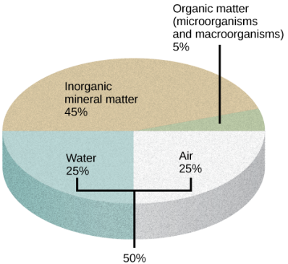
Soil composition
The four major components of soil are shown: inorganic minerals, organic matter, water, and air.

Slide 7
Soil composition
The organic material of soil, called humus, is made up of microorganisms (dead and alive), and dead animals and plants in varying stages of decay.
The inorganic material of soil consists of rock, slowly broken down into smaller particles that vary in size.
Sand: Soil particles that are 0.1 to 2 mm in diameter.
Silt: Soil particles between 0.002 and 0.1 mm.
Clay: Smaller particles, less than 0.002 mm in diameter.
Loams: soils that have no dominant particle size and contain a mixture of sand, silt, and humus.

Slide 8
Soil formation
The soil profile has four distinct layers: 1) O horizon; 2) A horizon; 3) B horizon, or subsoil; and 4) C horizon, or soil base.
The O horizon has freshly decomposing organic matter—humus—at its surface, with decomposed vegetation at its base.
The A horizon consists of a mixture of organic material with inorganic products of weathering, and it is therefore the beginning of true mineral soil.
The B horizon is an accumulation of mostly fine material that has moved downward, resulting in a dense layer in the soil. In some soils, the B horizon contains nodules or a layer of calcium carbonate.
The C horizon, or soil base, includes the parent material, plus the organic and inorganic material that is broken down to form soil.
Beneath the C horizon lies bedrock.

Slide 9
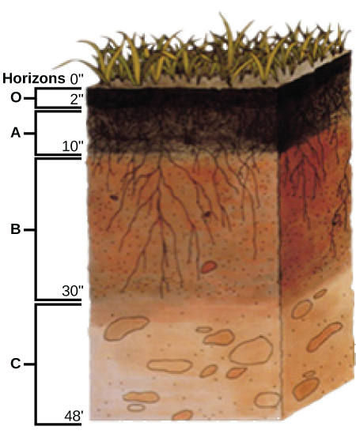
Soil profile
This soil profile shows the different soil layers (O horizon, A horizon, B horizon, and C horizon) found in typical soils. (credit: modification of work by USDA)

Slide 10
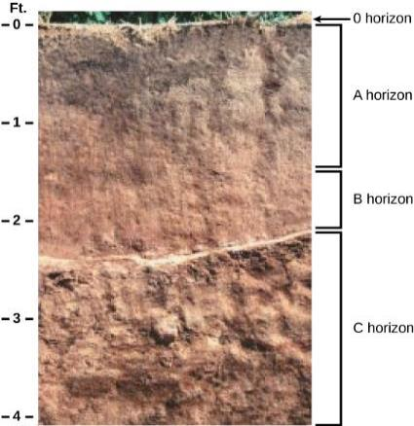
Soil profile
The San Joaquin soil profile has an O horizon, A horizon, B horizon, and C horizon. (credit: modification of work by USDA)

Slide 11
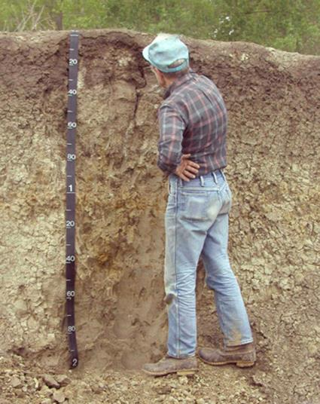
Studying soil composition
This soil scientist is studying the horizons and composition of soil at a research site. (credit: USDA)

Slide 12
Nitrogen fixation
Biological nitrogen fixation (BNF) is the conversion of atmospheric nitrogen (N₂) into ammonia (NH₃), exclusively carried out by prokaryotes such as soil bacteria or cyanobacteria.
Equation:
N2+16 ATP + 8 e− + 8 H+ → 2NH3 + 16 ADP + 16 Pi + H2
The most important source of BNF is the symbiotic interaction between soil bacteria and legume plants.

Slide 13
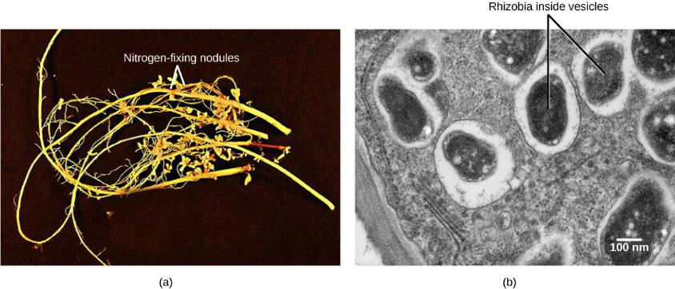
Nitrogen Fixation
Soybean roots contain (a) nitrogen-fixing nodules. Cells within the nodules are infected with Bradyrhyzobium japonicum, a rhizobia or “root-loving” bacterium. The bacteria are encased in (b) vesicles inside the cell, as can be seen in this transmission electron micrograph. (credit a: modification of work by USDA; credit b: modification of work by Louisa Howard, Dartmouth Electron Microscope Facility; scale-bar data from Matt Russell)

Slide 14
Mycorrhizae
Most plants rely on fungi to facilitate the uptake of minerals from the soil.
Fungi form symbiotic associations called mycorrhizae with plant roots, in which the fungi are integrated into the physical structure of the root.
The benefit to fungi is that they can obtain up to 20 percent of the total carbon accessed by plants.

Slide 15
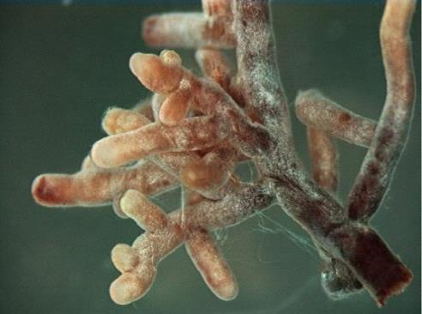
Mycorrhizae
Root tips proliferate in the presence of mycorrhizal infection, which appears as offwhite fuzz in this image. (credit: modification of work by Nilsson et al., BMC Bioinformatics 2005)

Slide 16
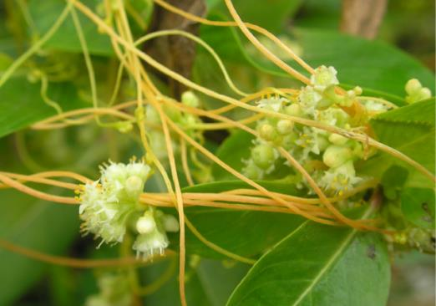
Parasitic plants
Rely on host for nutrients, water, or food.
Over 4100 species of parasitic plants.
Some have chlorophyll, others do not.
The dodder is a holoparasite that penetrates the host’s vascular tissue and diverts nutrients for its own growth. Note that the vines of the dodder, which has white flowers, are beige. The dodder has no chlorophyll and cannot produce its own food. (credit: “Lalithamba”/Flickr)

Slide 17
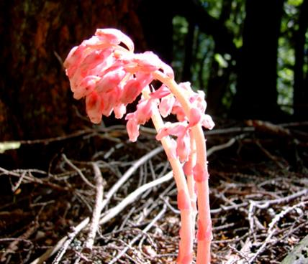
saprophytes
A saprophyte is a plant that does not have chlorophyll and gets its food from dead matter, similar to bacteria and fungi.
Use enzymes to convert organic food materials into simpler forms from which they can absorb nutrients.
Often rely on fungi that directly digest the dead matter.

