Slide 1
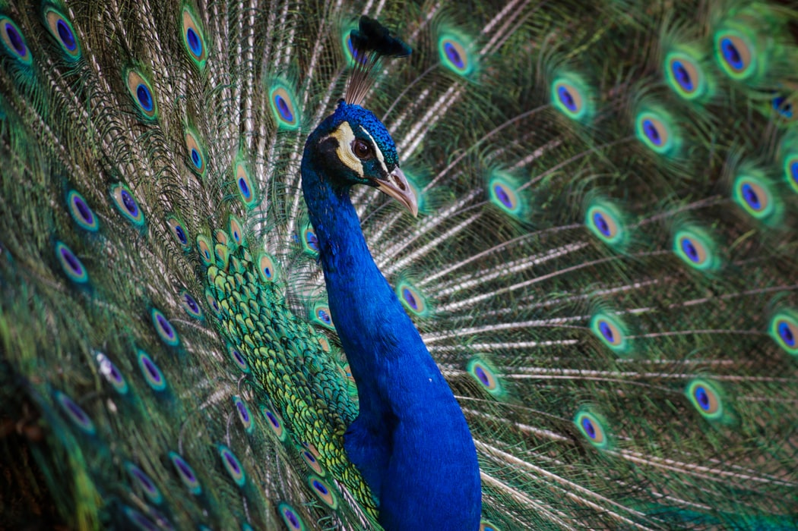
The Musculoskeletal System
General Biology II
Notes:
All text in these slides is taken from https://courses.lumenlearning.com/wm-biology1/ where it is published under one or more open licenses.
All images in these slides are attributed in the notes of the slide on which they appear and licensed as indicated.
Cover Image: "Peacock Feathers." Authored by: Andre Mouton. Provided by: Unsplash. Located at: https://unsplash.com/photos/_d3sppFprWI. Content Type: CC Licensed Content, Shared Previously. License: CC0: No Rights Reserved

Slide 2
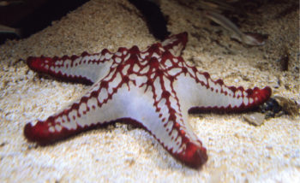
Types of Skeletons: Hydrostatic
A hydrostatic skeleton is formed by a fluid-filled compartment held under hydrostatic pressure; movement is created by the muscles producing pressure on the fluid
Notes:
(credit: “Amada44”/Wikimedia Commons) in Biology. Provided by: OpenStax CNX. Located at: http://cnx.org/contents/185cbf87-c72e-48f5-b51e-f14f21b5eabd@10.8. License: CC BY: Attribution. License Terms: Download for free at http://cnx.org/contents/185cbf87-c72e-48f5-b51e-f14f21b5eabd@10.8

Slide 3
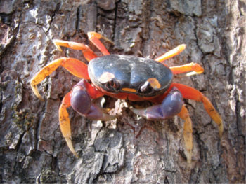
Exoskeleton
An exoskeleton is a hard external skeleton that protects the outer surface of an organism and enables movement through muscles attached on the inside
Notes:
Biology. Provided by: OpenStax CNX. Located at: http://cnx.org/contents/185cbf87-c72e-48f5-b51e-f14f21b5eabd@10.8. License: CC BY: Attribution. License Terms: Download for free at http://cnx.org/contents/185cbf87-c72e-48f5-b51e-f14f21b5eabd@10.8

Slide 4
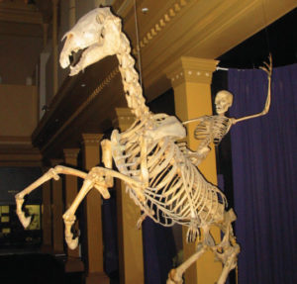
Endoskeleton
An endoskeleton is an internal skeleton composed of hard, mineralized tissue that also enables movement by attachment to muscles
Notes:
(credit: Ross Murphy) in Biology. Provided by: OpenStax CNX. Located at: http://cnx.org/contents/185cbf87-c72e-48f5-b51e-f14f21b5eabd@10.8. License: CC BY: Attribution. License Terms: Download for free at http://cnx.org/contents/185cbf87-c72e-48f5-b51e-f14f21b5eabd@10.8

Slide 5
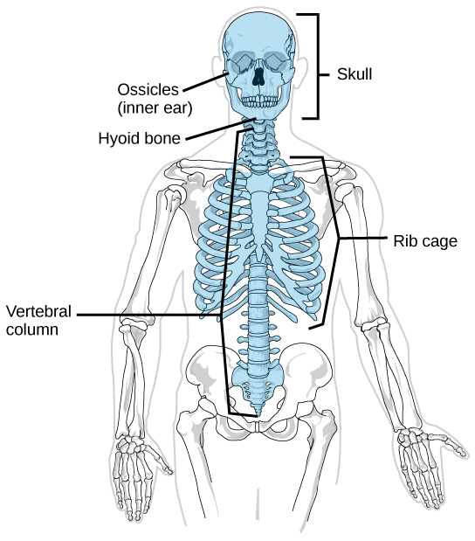
Axial Skeleton
Notes:
(credit: modification of work by Mariana Ruiz Villareal) in Biology. Provided by: OpenStax CNX. Located at: http://cnx.org/contents/185cbf87-c72e-48f5-b51e-f14f21b5eabd@10.8. License: CC BY: Attribution. License Terms: Download for free at http://cnx.org/contents/185cbf87-c72e-48f5-b51e-f14f21b5eabd@10.8

Slide 6
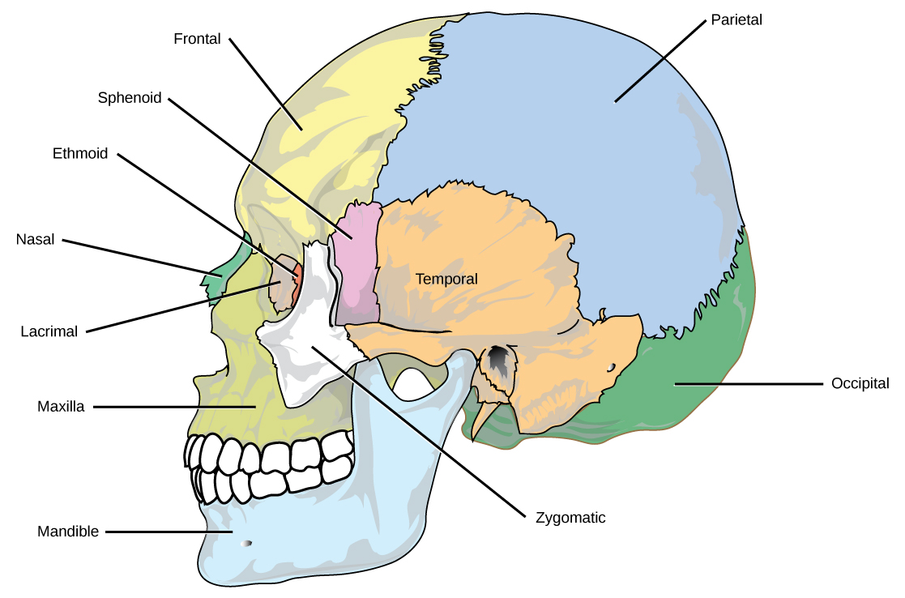
The Skull
The bones of the skull support the structures of the face and protect the brain
Notes:
(credit: modification of work by Mariana Ruiz Villareal)Biology. Provided by: OpenStax CNX. Located at: http://cnx.org/contents/185cbf87-c72e-48f5-b51e-f14f21b5eabd@10.8. License: CC BY: Attribution. License Terms: Download for free at http://cnx.org/contents/185cbf87-c72e-48f5-b51e-f14f21b5eabd@10.8

Slide 7
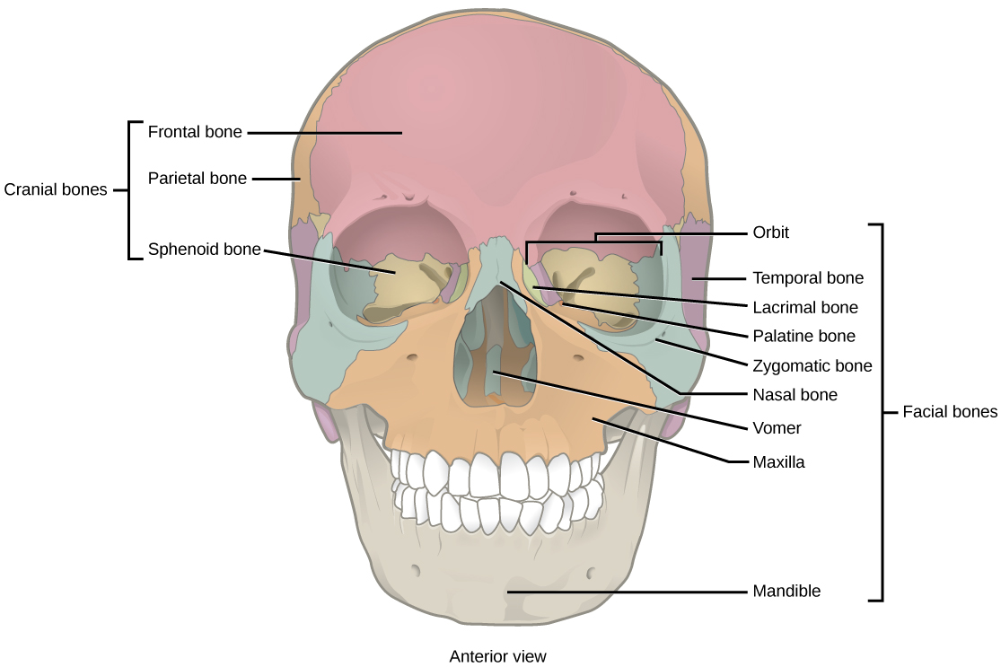
Cranial and Facial Bones
Notes:
Biology. Provided by: OpenStax CNX. Located at: http://cnx.org/contents/185cbf87-c72e-48f5-b51e-f14f21b5eabd@10.8. License: CC BY: Attribution. License Terms: Download for free at http://cnx.org/contents/185cbf87-c72e-48f5-b51e-f14f21b5eabd@10.8

Slide 8
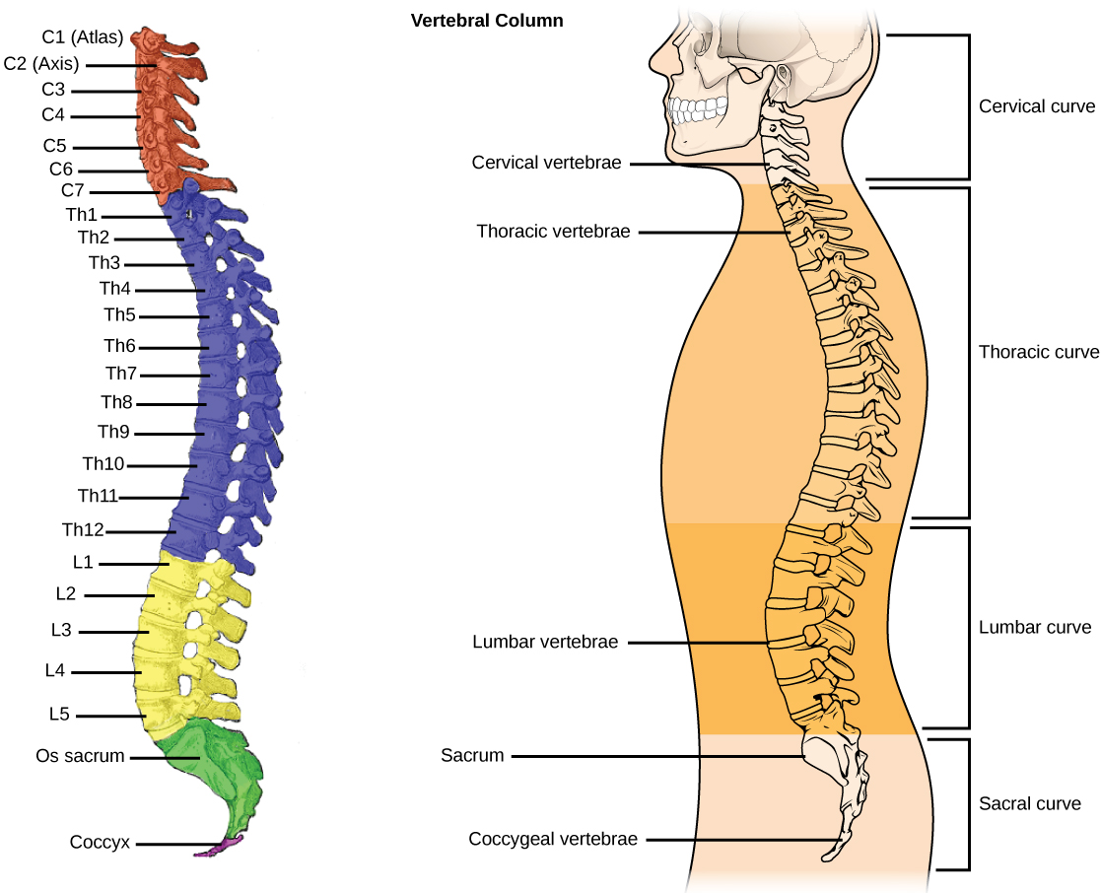
Vertebral Column
Notes:
(credit a: modification of work by Uwe Gille based on original work by Gray’s Anatomy; credit b: modification of work by NCI, NIH) in Biology. Provided by: OpenStax CNX. Located at: http://cnx.org/contents/185cbf87-c72e-48f5-b51e-f14f21b5eabd@10.8. License: CC BY: Attribution. License Terms: Download for free at http://cnx.org/contents/185cbf87-c72e-48f5-b51e-f14f21b5eabd@10.8

Slide 9
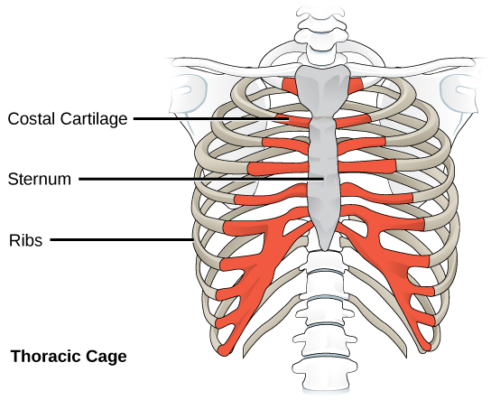
Thoracic Cage
Notes:
(credit: modification of work by NCI, NIH) in Biology. Provided by: OpenStax CNX. Located at: http://cnx.org/contents/185cbf87-c72e-48f5-b51e-f14f21b5eabd@10.8. License: CC BY: Attribution. License Terms: Download for free at http://cnx.org/contents/185cbf87-c72e-48f5-b51e-f14f21b5eabd@10.8

Slide 10
Practice Question #1
What is the function of the thoracic cage?
Notes:
Protect the heart and lungs

Slide 11
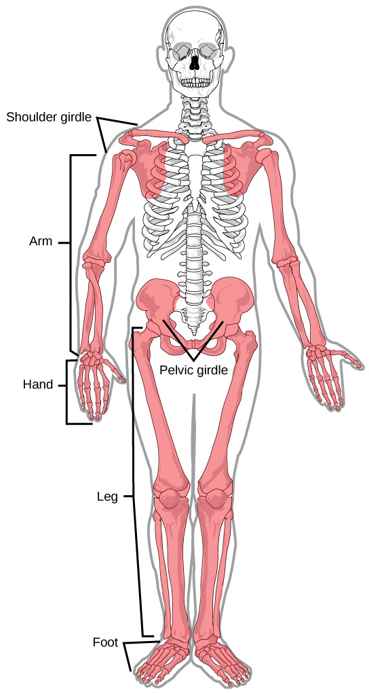
Human Appendicular Skeleton
Notes:
(credit: modification of work by Mariana Ruiz Villareal) in Biology. Provided by: OpenStax CNX. Located at: http://cnx.org/contents/185cbf87-c72e-48f5-b51e-f14f21b5eabd@10.8. License: CC BY: Attribution. License Terms: Download for free at http://cnx.org/contents/185cbf87-c72e-48f5-b51e-f14f21b5eabd@10.8

Slide 12
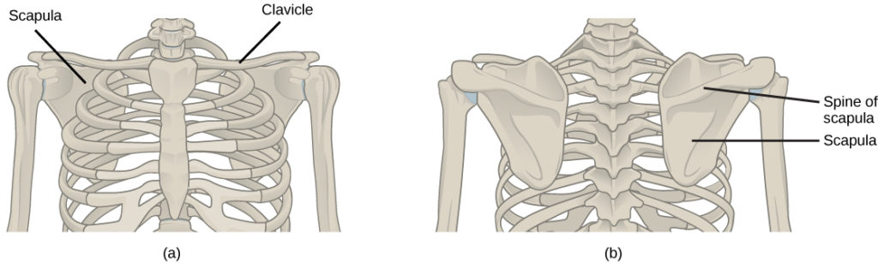
Pectoral Girdle
Notes:
Biology. Provided by: OpenStax CNX. Located at: http://cnx.org/contents/185cbf87-c72e-48f5-b51e-f14f21b5eabd@10.8. License: CC BY: Attribution. License Terms: Download for free at http://cnx.org/contents/185cbf87-c72e-48f5-b51e-f14f21b5eabd@10.8

Slide 13
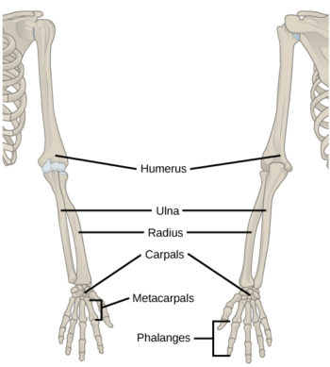
The Upper Limb
Notes:
Biology. Provided by: OpenStax CNX. Located at: http://cnx.org/contents/185cbf87-c72e-48f5-b51e-f14f21b5eabd@10.8. License: CC BY: Attribution. License Terms: Download for free at http://cnx.org/contents/185cbf87-c72e-48f5-b51e-f14f21b5eabd@10.8

Slide 14
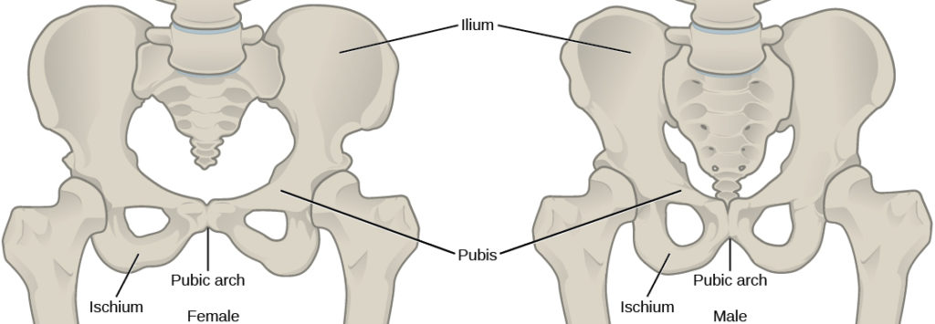
The Pelvic Girdle
Notes:
Biology. Provided by: OpenStax CNX. Located at: http://cnx.org/contents/185cbf87-c72e-48f5-b51e-f14f21b5eabd@10.8. License: CC BY: Attribution. License Terms: Download for free at http://cnx.org/contents/185cbf87-c72e-48f5-b51e-f14f21b5eabd@10.8

Slide 15
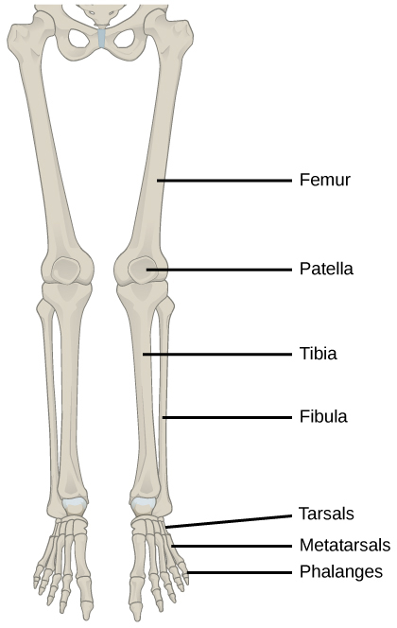
The Lower Limb
Notes:
Biology. Provided by: OpenStax CNX. Located at: http://cnx.org/contents/185cbf87-c72e-48f5-b51e-f14f21b5eabd@10.8. License: CC BY: Attribution. License Terms: Download for free at http://cnx.org/contents/185cbf87-c72e-48f5-b51e-f14f21b5eabd@10.8

Slide 16
Bone and Calcification
Bone, or osseous tissue, is a connective tissue that constitutes the endoskeleton
It contains specialized cells and a matrix of mineral salts and collagen fibers
The mineral salts primarily include hydroxyapatite, a mineral formed from calcium phosphate
Calcification is the process of deposition of mineral salts on the collagen fiber matrix that crystallizes and hardens the tissue

Slide 17
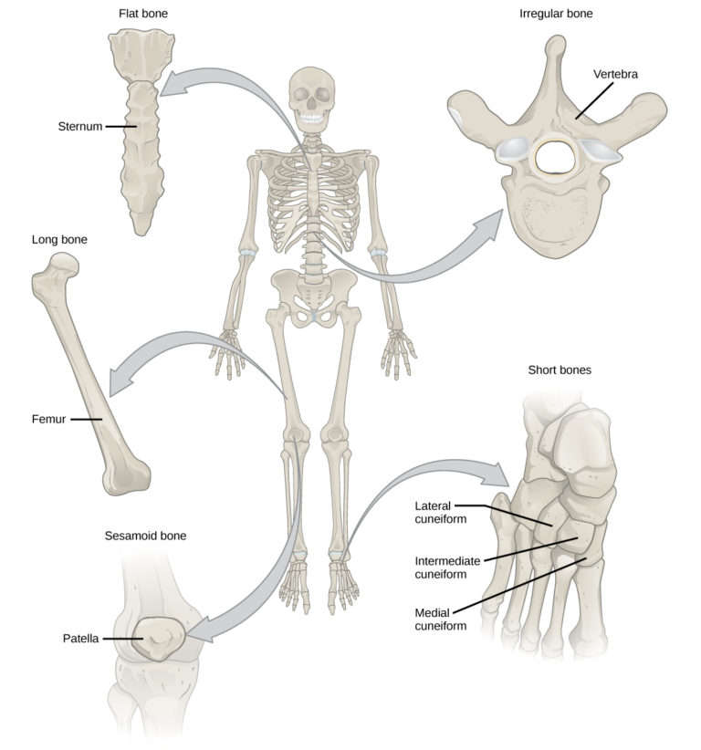
Types of Bones
Notes:
Biology. Provided by: OpenStax CNX. Located at: http://cnx.org/contents/185cbf87-c72e-48f5-b51e-f14f21b5eabd@10.8. License: CC BY: Attribution. License Terms: Download for free at http://cnx.org/contents/185cbf87-c72e-48f5-b51e-f14f21b5eabd@10.8

Slide 18
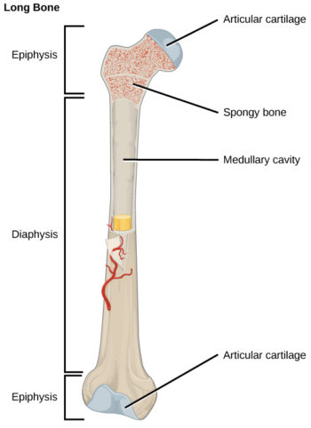
Long Bones
Long bones are longer than they are wide and have a shaft and two ends. The diaphysis, or central shaft, contains bone marrow in a marrow cavity. The rounded ends, the epiphyses, are covered with articular cartilage and are filled with red bone marrow, which produces blood cells
Notes:
Biology. Provided by: OpenStax CNX. Located at: http://cnx.org/contents/185cbf87-c72e-48f5-b51e-f14f21b5eabd@10.8. License: CC BY: Attribution. License Terms: Download for free at http://cnx.org/contents/185cbf87-c72e-48f5-b51e-f14f21b5eabd@10.8

Slide 19
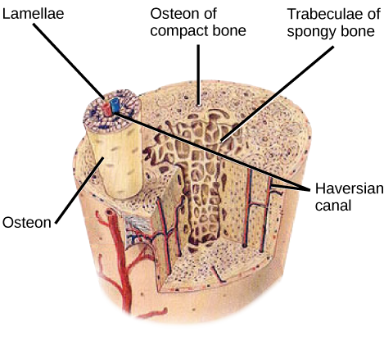
Compact Bone
Compact bone tissue is composed of osteons and forms the external layer of all bones
Notes:
(credit: modification of work by NCI, NIH) in Biology. Provided by: OpenStax CNX. Located at: http://cnx.org/contents/2e737be8-ea65-48c3-aa0a-9f35b4c6a966@10.1. License: CC BY: Attribution. License Terms: Download for free at http://cnx.org/contents/185cbf87-c72e-48f5-b51e-f14f21b5eabd@10.8

Slide 20
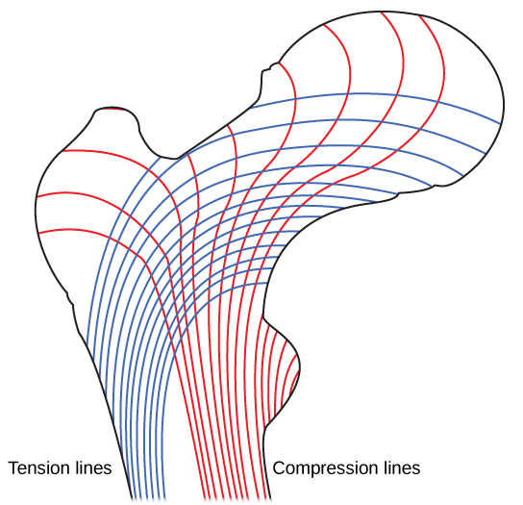
Spongy Bone
Spongy bone tissue is composed of trabeculae and forms the inner part of all bones. Trabeculae in spongy bone are arranged such that one side of the bone bears tension and the other withstands compression
Notes:
Biology. Provided by: OpenStax CNX. Located at: http://cnx.org/contents/2e737be8-ea65-48c3-aa0a-9f35b4c6a966@10.1. License: CC BY: Attribution. License Terms: Download for free at http://cnx.org/contents/185cbf87-c72e-48f5-b51e-f14f21b5eabd@10.8

Slide 21
Osteoblasts
Osteoblasts are bone cells that are responsible for bone formation. Osteoblasts synthesize and secrete the organic part and inorganic part of the extracellular matrix of bone tissue, and collagen fibers. Osteoblasts become trapped in these secretions and differentiate into less active osteocytes

Slide 22
Osteoclasts
Osteoclasts are large bone cells with up to 50 nuclei that remove bone structure by releasing lysosomal enzymes and acids that dissolve the bony matrix. These minerals, released from bones into the blood, help regulate calcium concentrations in body fluids. Bone may also be resorbed for remodeling, if the applied stresses have changed

Slide 23
Osteocytes
Osteocytes are mature bone cells and are the main cells in bony connective tissue
These cells cannot divide
Osteocytes maintain normal bone structure by recycling the mineral salts in the bony matrix

Slide 24
Osteoprogenitor Cells
Osteoprogenitor cells are squamous stem cells that divide to produce daughter cells that differentiate into osteoblasts
Osteoprogenitor cells are important in the repair of fractures

Slide 25
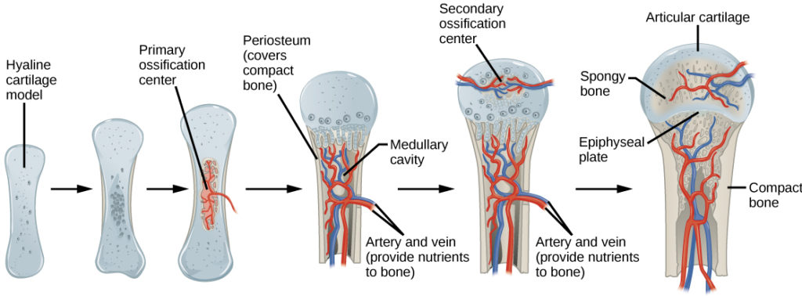
Endochondral Ossification

Slide 26
Classification of Joints
The functional classification divides joints into three categories: synarthroses, amphiarthroses, and diarthroses:
Synarthroses are a joints that are immovable. This includes sutures, gomphoses, and synchondroses.
Amphiarthroses are joints that allow slight movement, including syndesmoses and symphyses.
Diarthroses are joints that allow for free movement of the joint, as in synovial joints.

Slide 27
Fibrous Joints
The bones of fibrous joints are held together by fibrous connective tissue. There is no cavity, or space, present between the bones and so most fibrous joints do not move at all, or are only capable of minor movements. There are three types of fibrous joints:
Sutures
Syndesmoses
Gomphoses

Slide 28
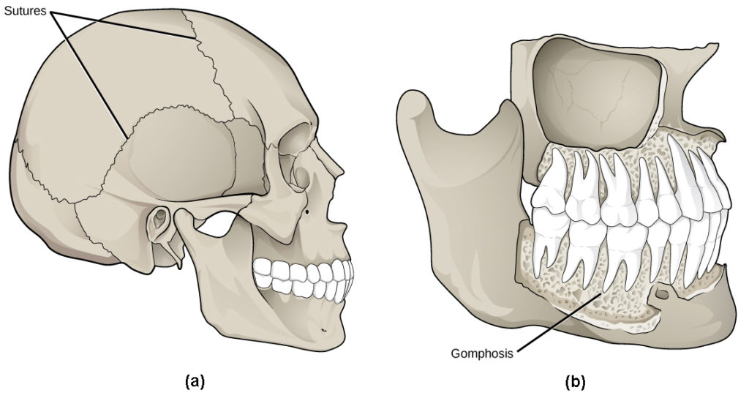
Sutures and Gomphosis
Notes:
(b credit: modification of work by Gray’s Anatomy) in Biology. Provided by: OpenStax CNX. Located at: http://cnx.org/contents/185cbf87-c72e-48f5-b51e-f14f21b5eabd@10.8. License: CC BY: Attribution. License Terms: Download for free at http://cnx.org/contents/185cbf87-c72e-48f5-b51e-f14f21b5eabd@10.8

Slide 29
Cartilaginous Joints
The bones are connected by cartilage. The two types of cartilaginous joints allow for very little movement:
In a synchondrosis, the bones are joined by hyaline cartilage. Synchondroses are found in the epiphyseal plates of growing bones in children
In symphyses, hyaline cartilage covers the end of the bone but the connection between bones occurs through fibrocartilage. Symphyses are found at the joints between vertebrae

Slide 30
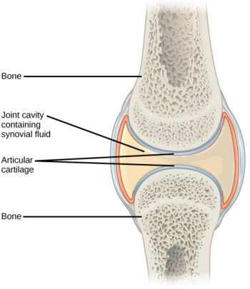
Synovial Joints
Notes:
Biology. Provided by: OpenStax CNX. Located at: http://cnx.org/contents/185cbf87-c72e-48f5-b51e-f14f21b5eabd@10.8. License: CC BY: Attribution. License Terms: Download for free at http://cnx.org/contents/185cbf87-c72e-48f5-b51e-f14f21b5eabd@10.8

Slide 31
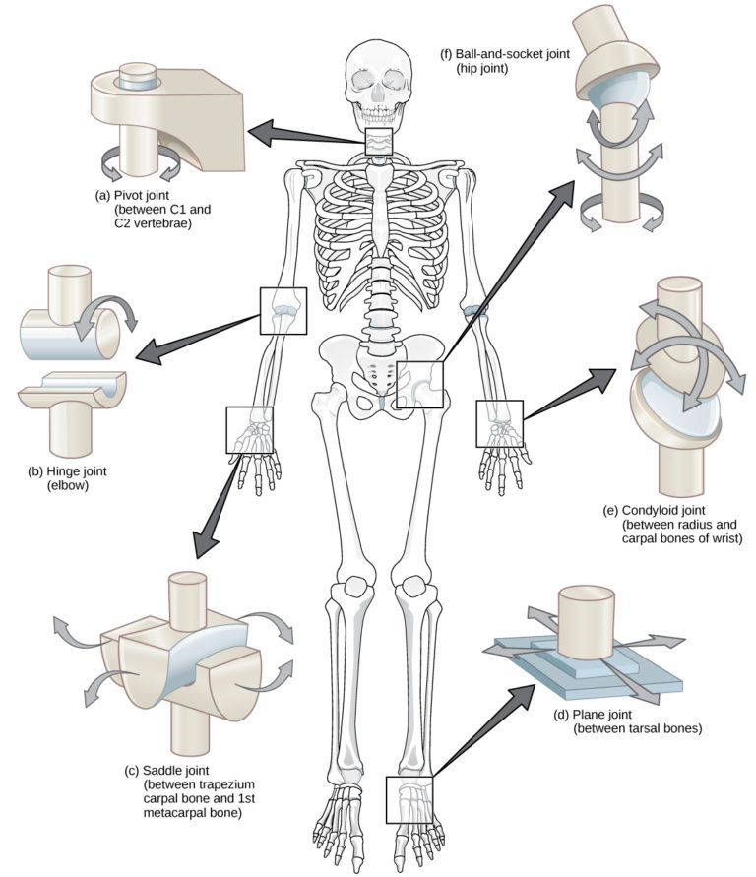
Types of Synovial Joints
Notes:
Biology. Provided by: OpenStax CNX. Located at: http://cnx.org/contents/185cbf87-c72e-48f5-b51e-f14f21b5eabd@10.8. License: CC BY: Attribution. License Terms: Download for free at http://cnx.org/contents/185cbf87-c72e-48f5-b51e-f14f21b5eabd@10.8

Slide 32
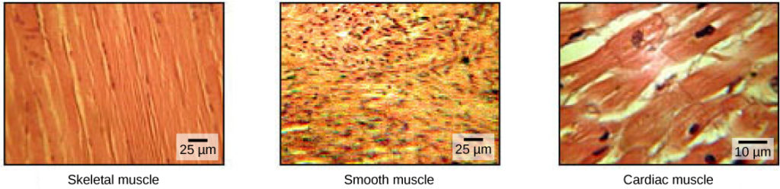
Types of Muscle Tissue
Notes:
(credit: modification of work by NCI, NIH; scale-bar data from Matt Russell) in Biology. Provided by: OpenStax CNX. Located at: http://cnx.org/contents/185cbf87-c72e-48f5-b51e-f14f21b5eabd@10.8. License: CC BY: Attribution. License Terms: Download for free at http://cnx.org/contents/185cbf87-c72e-48f5-b51e-f14f21b5eabd@10.8

Slide 33
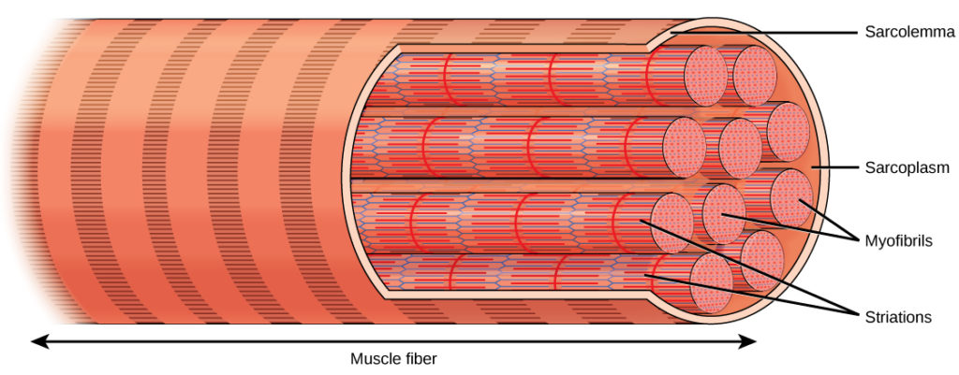
Skeletal Muscle Fiber Structure
Notes:
Biology. Provided by: OpenStax CNX. Located at: http://cnx.org/contents/185cbf87-c72e-48f5-b51e-f14f21b5eabd@10.8. License: CC BY: Attribution. License Terms: Download for free at http://cnx.org/contents/185cbf87-c72e-48f5-b51e-f14f21b5eabd@10.8

Slide 34
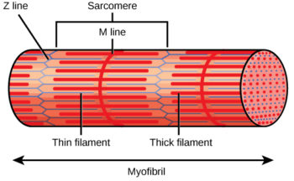
Myofibril
Notes:
Biology. Provided by: OpenStax CNX. Located at: http://cnx.org/contents/185cbf87-c72e-48f5-b51e-f14f21b5eabd@10.8. License: CC BY: Attribution. License Terms: Download for free at http://cnx.org/contents/185cbf87-c72e-48f5-b51e-f14f21b5eabd@10.8

Slide 35
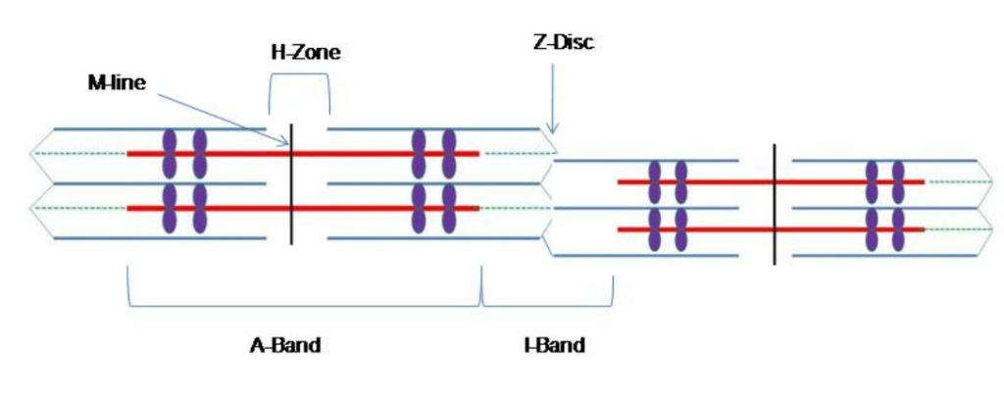
H Zones in the Sarcomere
Notes:
H Zone Diagram. Authored by: Bruce Forciea. Located at: http://www.bruceforciea.com/etextchapters/etexthumananatrevmay12.pdf. License: CC BY: Attribution

Slide 36
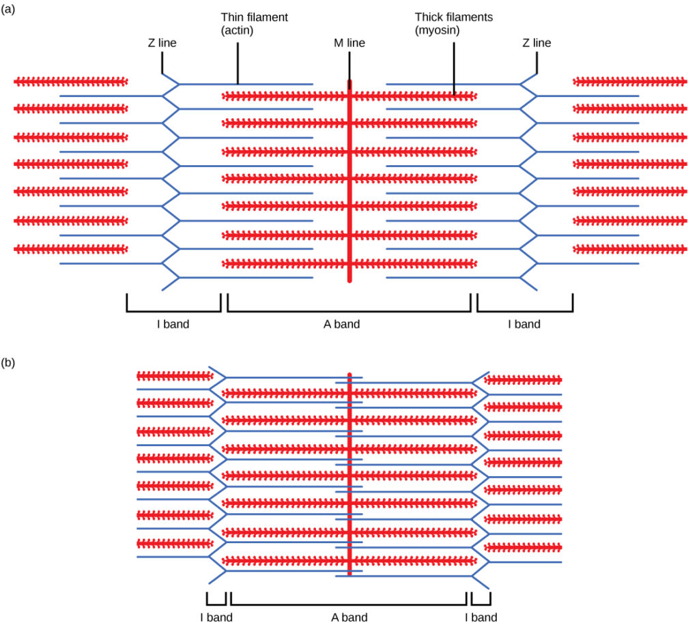
Sliding Filament Model of Contraction
Notes:
Biology. Provided by: OpenStax CNX. Located at: http://cnx.org/contents/185cbf87-c72e-48f5-b51e-f14f21b5eabd@10.8. License: CC BY: Attribution. License Terms: Download for free at http://cnx.org/contents/185cbf87-c72e-48f5-b51e-f14f21b5eabd@10.8

Slide 37
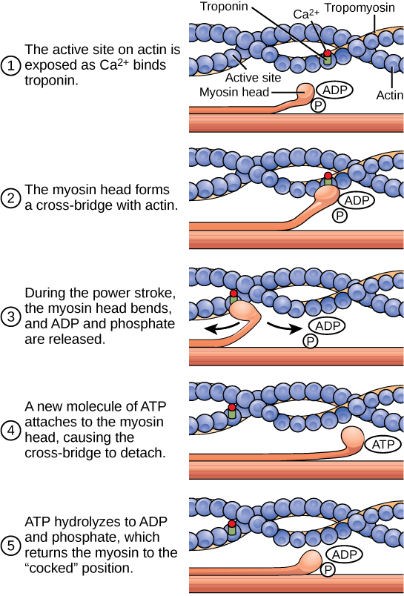
ATP and Muscle Contraction
The cross-bridge muscle contraction cycle, which is triggered by Ca2+ binding to the actin active site, is shown. With each contraction cycle, actin moves relative to myosin
Notes:
Biology. Provided by: OpenStax CNX. Located at: http://cnx.org/contents/185cbf87-c72e-48f5-b51e-f14f21b5eabd@10.8. License: CC BY: Attribution. License Terms: Download for free at http://cnx.org/contents/185cbf87-c72e-48f5-b51e-f14f21b5eabd@10.8

Slide 38
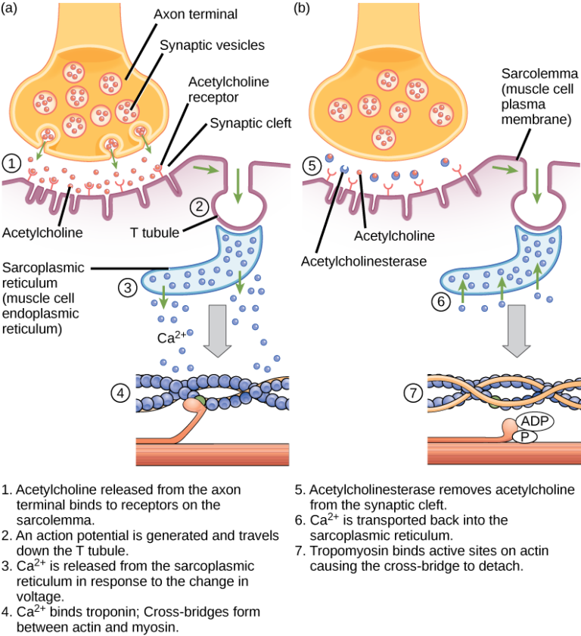
Excitation-Contraction Coupling
Notes:
Biology. Provided by: OpenStax CNX. Located at: http://cnx.org/contents/185cbf87-c72e-48f5-b51e-f14f21b5eabd@10.8. License: CC BY: Attribution. License Terms: Download for free at http://cnx.org/contents/185cbf87-c72e-48f5-b51e-f14f21b5eabd@10.8

Slide 39
Steps of a skeletal muscle contraction:
An action potential reaches the axon of the motor neuron
The action potential activates voltage gated calcium ion channels on the axon, and calcium rushes in
The calcium causes acetylcholine vesicles in the axon to fuse with the membrane, releasing the acetylcholine into the cleft between the axon and the motor end plate of the muscle fiber
The skeletal muscle fiber is excited by large mylenated nerve fibers which attach to the neuromuscular junction. There is one neuromuscular junction for each fiber

Slide 40
Steps of Muscle Contraction Continued
The acetylcholine diffuses across the cleft and binds to nicotinic receptors on the motor end plate, opening channels in the membrane for sodium and potassium. Sodium rushes in, and potassium rushes out. However, because sodium is more permeable, the muscle fiber membrane becomes more positively charged, triggering an action potential
The action potential on the muscle fiber causes the sarcoplasmic reticulum to release calcium ions(Ca++)
The calcium binds to the troponin present on the thin filaments of the myofibrils. The troponin then allosterically modulates the tropomyosin. Normally the tropomyosin physically obstructs binding sites for cross-bridge; once calcium binds to the troponin, the troponin forces the tropomyosin to move out of the way, unblocking the binding sites

Slide 41
More Steps of Muscle Contraction
The cross-bridge (which is already in a ready-state) binds to the newly uncovered binding sites. It then delivers a power stroke
ATP binds the cross-bridge, forcing it to conform in such a way as to break the actin-myosin bond. Another ATP is split to energize the cross bridge again
Steps 7 and 8 repeat as long as calcium is present on thin filament
Throughout this process, the calcium is actively pumped back into the sarcoplasmic reticulum. When no longer present on the thin filament, the tropomyosin changes back to its previous state, so as to block the binding sites again. The cross-bridge then ceases binding to the thin filament, and the contractions cease as well
Muscle contraction remains as long as Ca⁺² is abundant in sarcoplasm

Slide 42
Types of Muscle Contractions
Isometric contraction: muscle does not shorten during contraction and does not require the sliding of myofibrils but muscles are stiff
Isotonic contraction: inertia is used to move or work. More energy is used by the muscle and contraction lasts longer than isometric contraction. Isotonic muscle contraction is divided into two categories:
  concentric, where the muscle fibers shorten as the muscle contracts (ie. biceps brachialis on the up phase of a biceps curl)
  eccentric, where the muscle fibers lengthen as they contract (ie. biceps brachialis on the down phase of a biceps curl)
Twitch: exciting the nerve to a muscle or by passing electrical stimulus through muscle itself. Some fibers contract quickly while others contract slowly
Tonic: maintaining postural tone against the force of gravity

Slide 43
Practice Question #2
Why is it important to eat a diet rich in Calcium?
Notes:
Calcium is essential for both bones and muscles to function properly.

Slide 44
Quick Review
What are the different types of skeletal systems?
What is the structure and function of bones?
How do Biologists classify the different types of joints on the basis of structure?
What is the role of muscles in locomotion?

