Slide 1
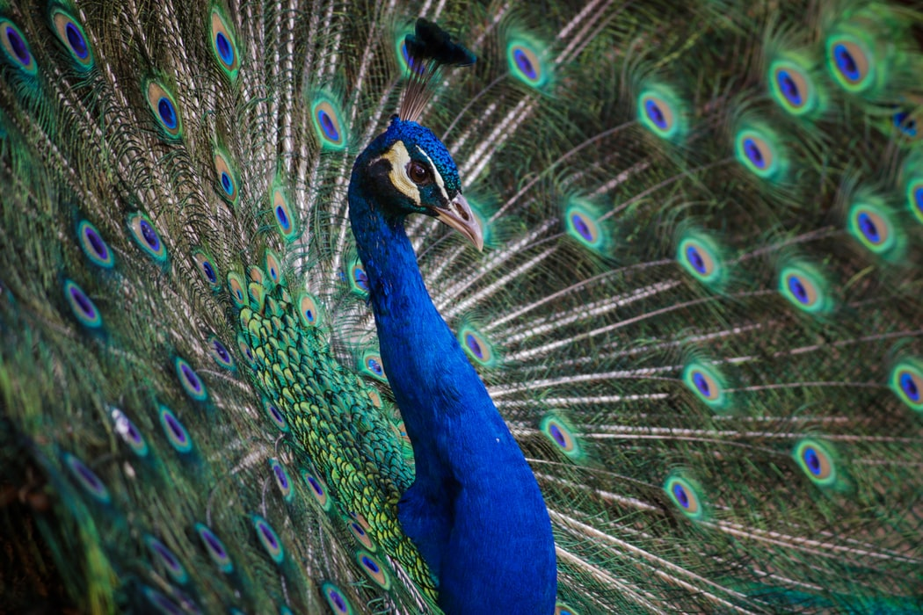
The Nervous System
General Biology II
Notes:
All text in these slides is taken from https://courses.lumenlearning.com/wm-biology1/ where it is published under one or more open licenses.
All images in these slides are attributed in the notes of the slide on which they appear and licensed as indicated.
Cover Image: "Peacock Feathers." Authored by: Andre Mouton. Provided by: Unsplash. Located at: https://unsplash.com/photos/_d3sppFprWI. Content Type: CC Licensed Content, Shared Previously. License: CC0: No Rights Reserved.

Slide 2
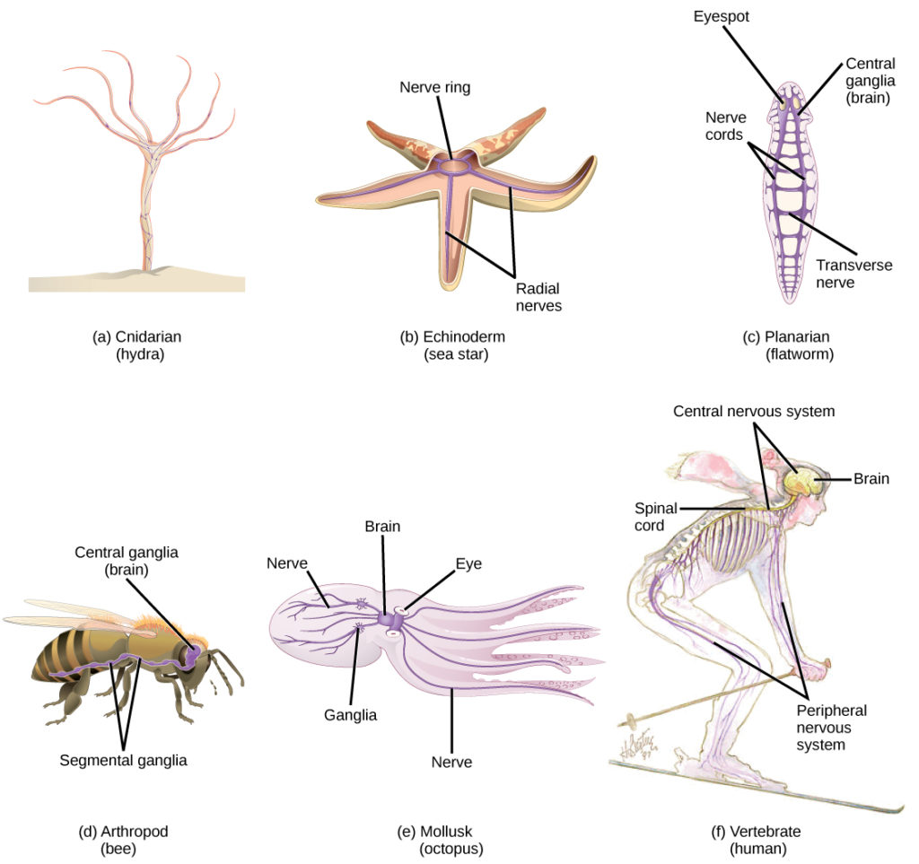
Nervous Systems
Notes:
(credit e: modification of work by Michael Vecchione, Clyde F.E. Roper, and Michael J. Sweeney, NOAA; credit f: modification of work by NIH) in Biology. Provided by: OpenStax CNX. Located at: http://cnx.org/contents/185cbf87-c72e-48f5-b51e-f14f21b5eabd@10.8. License: CC BY: Attribution. License Terms: Download for free at http://cnx.org/contents/185cbf87-c72e-48f5-b51e-f14f21b5eabd@10.8

Slide 3
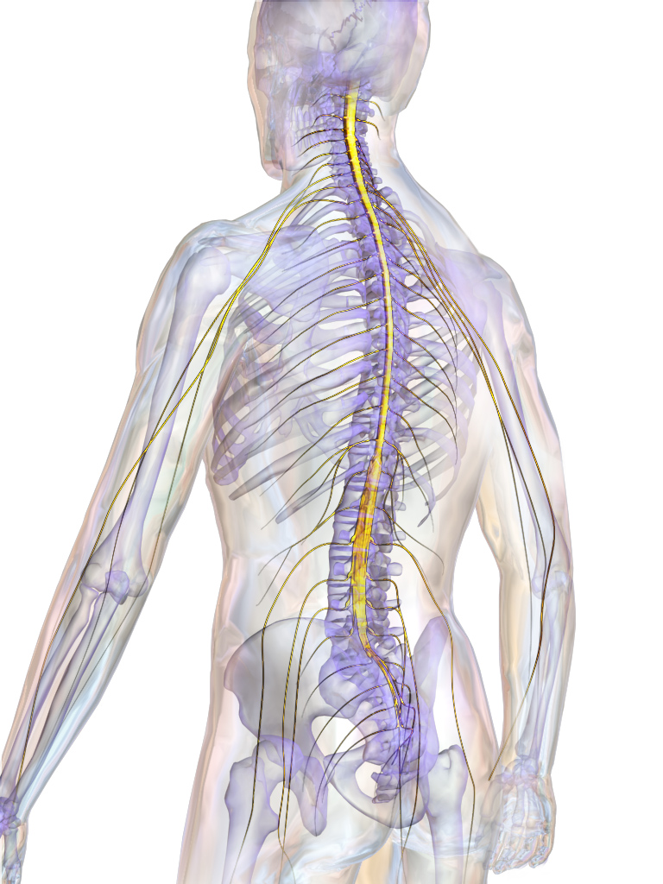
Introduction to
The Nervous System
The central nervous system CNS consists of the brain and spinal cord.
The peripheral nervous system PNS is comprised of the somatic and autonomic nervous systems.
Notes:
Spinal Cord. Authored by: BruceBlaus. Provided by: Wikimedia. Located at: https://en.wikipedia.org/wiki/Surfer%27s_myelopathy#/media/File:Blausen_0822_SpinalCord.png. License: CC BY: Attribution

Slide 4
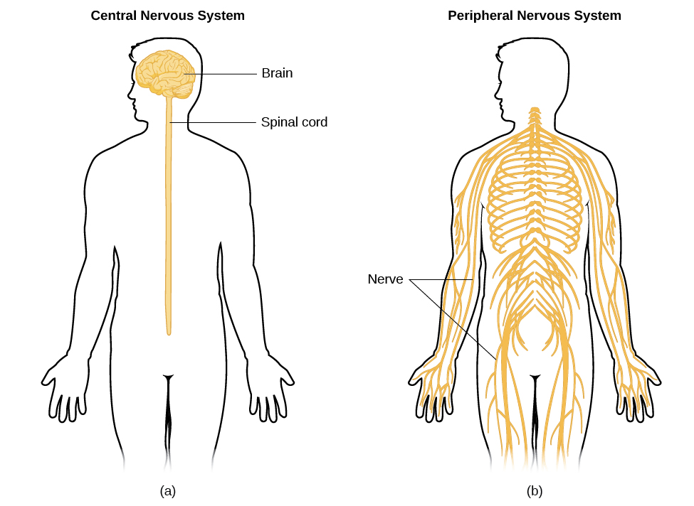
Central and Peripheral Nervous System
Notes:
Parts of the Nervous System. Authored by: OpenStax College. Located at: http://cnx.org/contents/Sr8Ev5Og@5.49:-xs7Ve8V@6/Parts-of-the-Nervous-System#CNX_Psych_03_03_Autonomic. License: CC BY: Attribution. License Terms: Download for free at http://cnx.org/content/col11629/latest/.

Slide 5
The Peripheral Nervous System
The somatic nervous system transmits sensory and motor signals to and from the central nervous system.
The autonomic nervous system controls the function of our organs and glands, and can be divided into the sympathetic and parasympathetic divisions.

Slide 6
PNS: The Autonomic Nervous System
Sympathetic activation prepares us for fight or flight
Parasympathetic activation is associated with normal functioning under relaxed conditions.

Slide 7
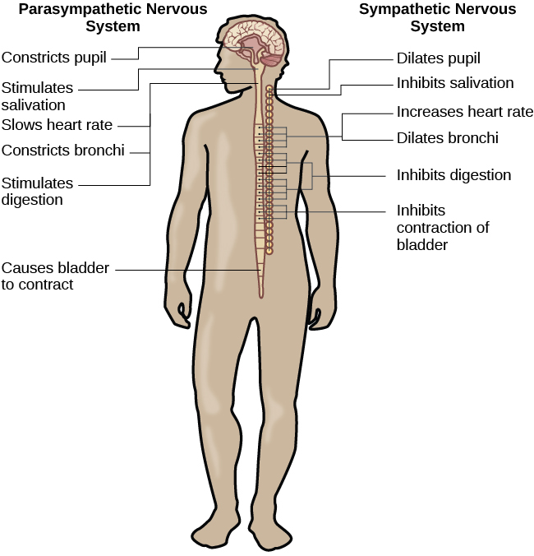
PNS: the Autonomic Nervous System
(continued)
Notes:
Parts of the Nervous System. Authored by: OpenStax College. Located at: http://cnx.org/contents/Sr8Ev5Og@5.49:-xs7Ve8V@6/Parts-of-the-Nervous-System#CNX_Psych_03_03_Autonomic. License: CC BY: Attribution. License Terms: Download for free at http://cnx.org/content/col11629/latest/.

Slide 8
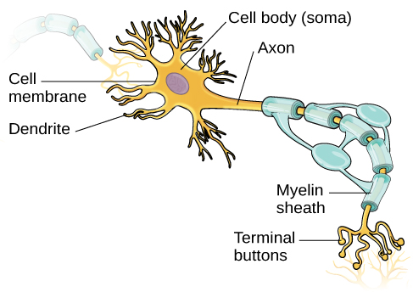
Neuron Structure
Notes:
Cells of the Nervous System. Authored by: OpenStax College. Located at: http://cnx.org/contents/Sr8Ev5Og@5.49:SO2ufnKm@7/Cells-of-the-Nervous-System. License: CC BY: Attribution. License Terms: Download for free at http://cnx.org/content/col11629/latest/.

Slide 9
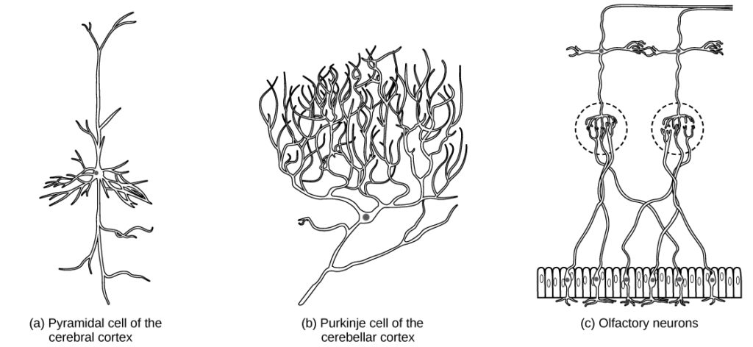
Diversity of Neurons
Notes:
Biology. Provided by: OpenStax CNX. Located at: http://cnx.org/contents/185cbf87-c72e-48f5-b51e-f14f21b5eabd@10.8. License: CC BY: Attribution. License Terms: Download for free at http://cnx.org/contents/185cbf87-c72e-48f5-b51e-f14f21b5eabd@10.8

Slide 10
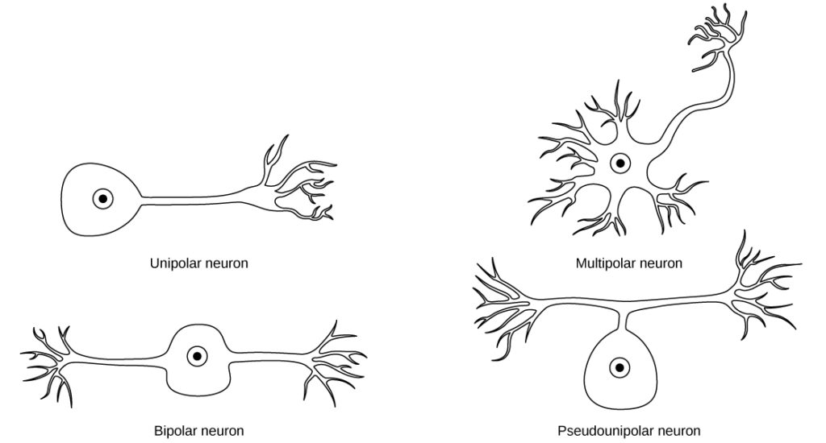
Types of Neurons
Notes:
Biology. Provided by: OpenStax CNX. Located at: http://cnx.org/contents/185cbf87-c72e-48f5-b51e-f14f21b5eabd@10.8. License: CC BY: Attribution. License Terms: Download for free at http://cnx.org/contents/185cbf87-c72e-48f5-b51e-f14f21b5eabd@10.8

Slide 11
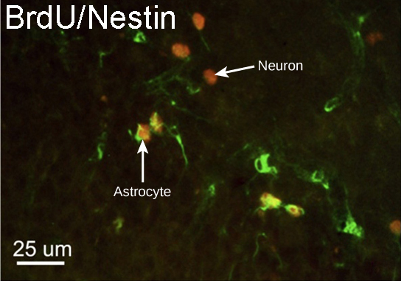
Neurogenesis
About 1000 new neurons develop in the hippocampus (a brain structure involved in learning and memory shown at right) each day
Notes:
(credit: modification of work by Dr. Maryam Faiz, et. al., University of Barcelona; scale-bar data from Matt Russell) in Biology. Provided by: OpenStax CNX. Located at: http://cnx.org/contents/185cbf87-c72e-48f5-b51e-f14f21b5eabd@10.8. License: CC BY: Attribution. License Terms: Download for free at http://cnx.org/contents/185cbf87-c72e-48f5-b51e-f14f21b5eabd@10.8

Slide 12
Glial Cells
Glial cells support neurons and maintain their environment
Glial cells of the (a) central nervous system include oligodendrocytes, astrocytes, ependymal cells, and microglial cells. Oligodendrocytes form the myelin sheath around axons. Astrocytes provide nutrients to neurons, maintain their extracellular environment, and provide structural support. Microglia scavenge pathogens and dead cells. Ependymal cells produce cerebrospinal fluid that cushions the neurons. Glial cells of the (b) peripheral nervous system include Schwann cells, which form the myelin sheath, and satellite cells, which provide nutrients and structural support to neurons

Slide 13
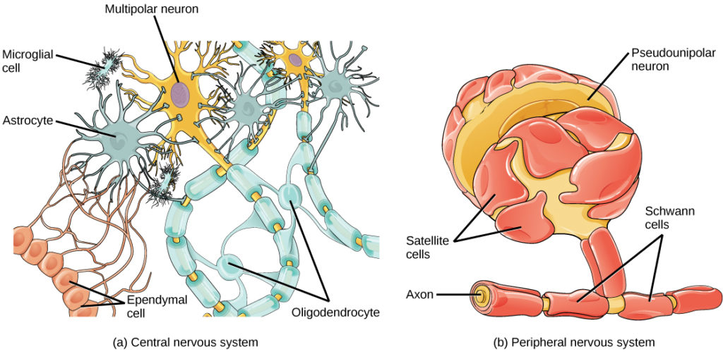
Glial Cells in the CNS
Glial cells of the central nervous system include oligodendrocytes, astrocytes, ependymal cells, and microglial cells. Oligodendrocytes form the myelin sheath around axons. Astrocytes provide nutrients to neurons, maintain their extracellular environment, and provide structural support. Microglia scavenge pathogens and dead cells. Ependymal cells produce cerebrospinal fluid that cushions the neurons
Notes:
Biology. Provided by: OpenStax CNX. Located at: http://cnx.org/contents/185cbf87-c72e-48f5-b51e-f14f21b5eabd@10.8. License: CC BY: Attribution. License Terms: Download for free at http://cnx.org/contents/185cbf87-c72e-48f5-b51e-f14f21b5eabd@10.8

Slide 14
Glial Cells in the PNS
Glial cells of the peripheral nervous system include Schwann cells, which form the myelin sheath, and satellite cells, which provide nutrients and structural support to neurons
Notes:
Biology. Provided by: OpenStax CNX. Located at: http://cnx.org/contents/185cbf87-c72e-48f5-b51e-f14f21b5eabd@10.8. License: CC BY: Attribution. License Terms: Download for free at http://cnx.org/contents/185cbf87-c72e-48f5-b51e-f14f21b5eabd@10.8

Slide 15
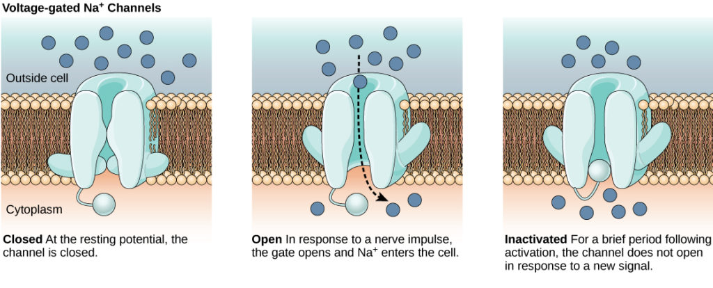
Voltage-gated Na+ Channels
Voltage-gated ion channels open in response to changes in membrane voltage. Membrane potential is the difference in total charge between the inside and outside of the cell.
Notes:
Biology. Provided by: OpenStax CNX. Located at: http://cnx.org/contents/185cbf87-c72e-48f5-b51e-f14f21b5eabd@10.8. License: CC BY: Attribution. License Terms: Download for free at http://cnx.org/contents/185cbf87-c72e-48f5-b51e-f14f21b5eabd@10.8

Slide 16
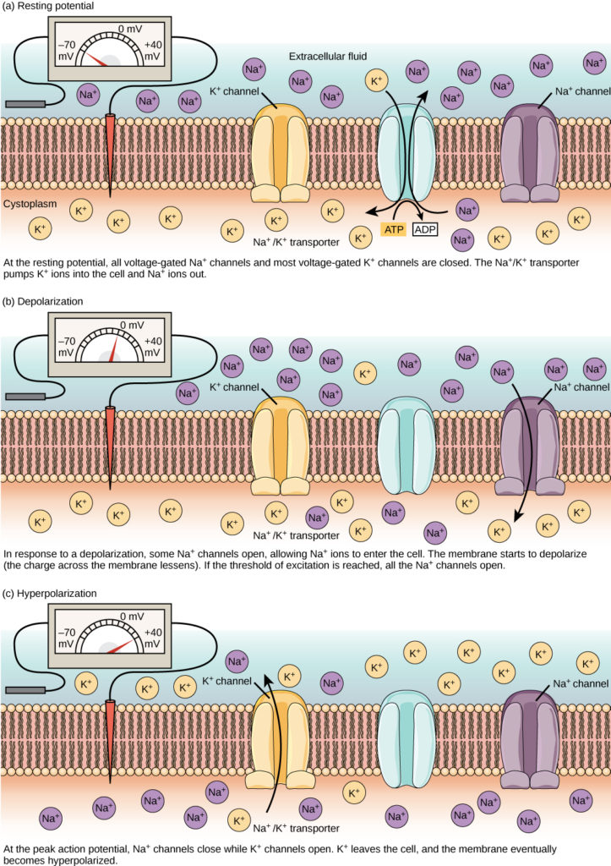
Resting Potential
Notes:
Biology. Provided by: OpenStax CNX. Located at: http://cnx.org/contents/185cbf87-c72e-48f5-b51e-f14f21b5eabd@10.8. License: CC BY: Attribution. License Terms: Download for free at http://cnx.org/contents/185cbf87-c72e-48f5-b51e-f14f21b5eabd@10.8

Slide 17
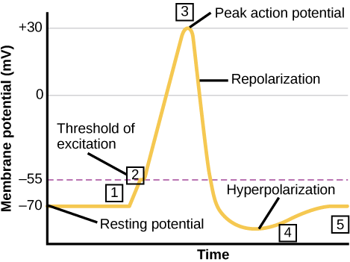
Action Potential
Notes:
Biology. Provided by: OpenStax CNX. Located at: http://cnx.org/contents/185cbf87-c72e-48f5-b51e-f14f21b5eabd@10.8. License: CC BY: Attribution. License Terms: Download for free at http://cnx.org/contents/185cbf87-c72e-48f5-b51e-f14f21b5eabd@10.8

Slide 18
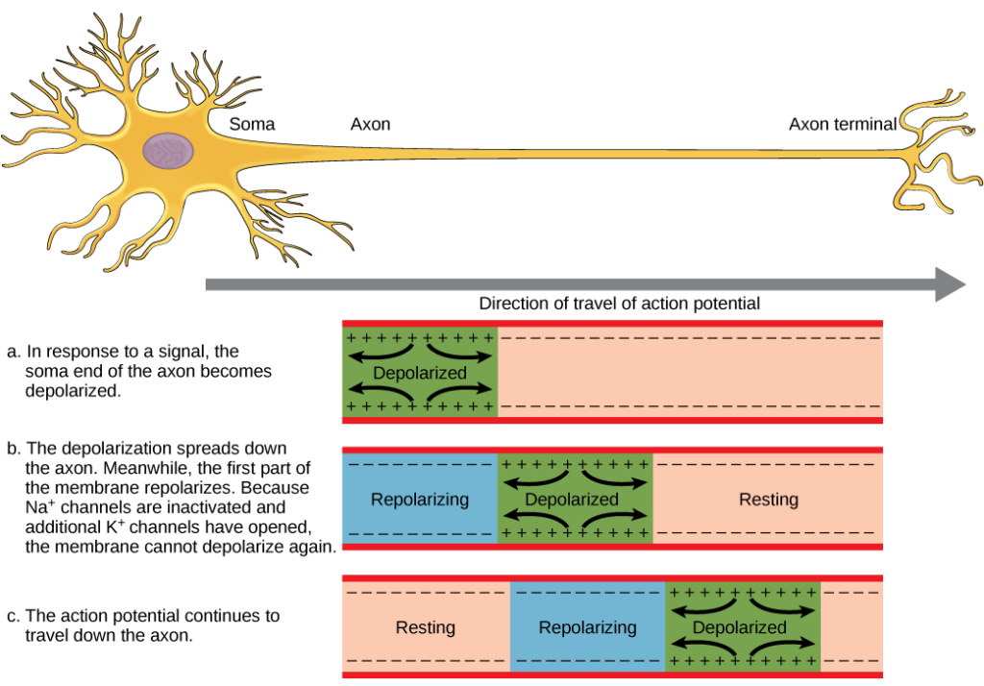
Action Potential is Conducted Down the Axon
Notes:
Biology. Provided by: OpenStax CNX. Located at: http://cnx.org/contents/185cbf87-c72e-48f5-b51e-f14f21b5eabd@10.8. License: CC BY: Attribution. License Terms: Download for free at http://cnx.org/contents/185cbf87-c72e-48f5-b51e-f14f21b5eabd@10.8

Slide 19
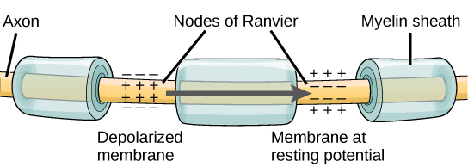
Nodes of Ranvier
Nodes of Ranvier are gaps in myelin coverage along axons. Nodes contain voltage-gated K⁺ and Na⁺ channels. Action potentials travel down the axon by jumping from one node to the next
Notes:
Biology. Provided by: OpenStax CNX. Located at: http://cnx.org/contents/185cbf87-c72e-48f5-b51e-f14f21b5eabd@10.8. License: CC BY: Attribution. License Terms: Download for free at http://cnx.org/contents/185cbf87-c72e-48f5-b51e-f14f21b5eabd@10.8

Slide 20
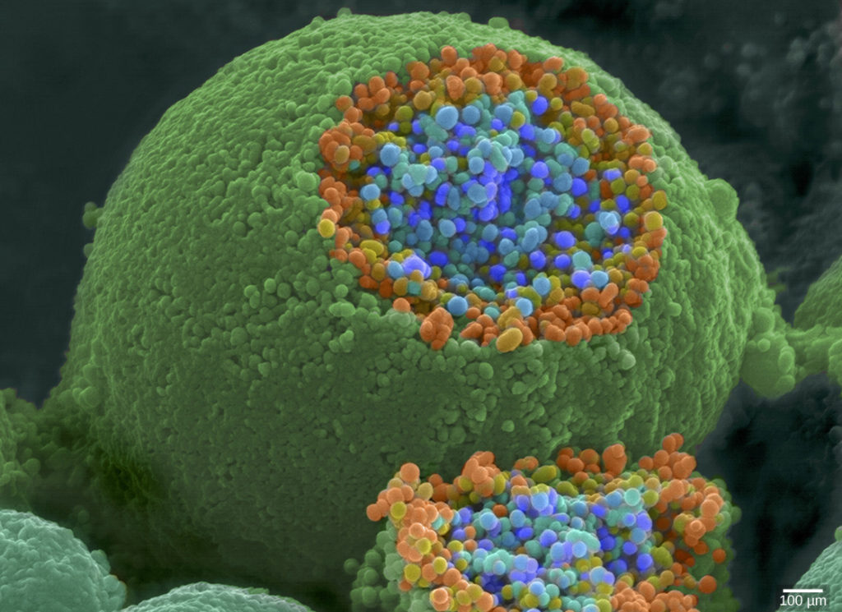
Synaptic Vesicles
This pseudocolored image taken with a scanning electron microscope shows an axon terminal that was broken open to reveal synaptic vesicles (blue and orange) inside the neuron
Notes:
(credit: modification of work by Tina Carvalho, NIH-NIGMS; scale-bar data from Matt Russell) in Biology. Provided by: OpenStax CNX. Located at: http://cnx.org/contents/185cbf87-c72e-48f5-b51e-f14f21b5eabd@10.8. License: CC BY: Attribution. License Terms: Download for free at http://cnx.org/contents/185cbf87-c72e-48f5-b51e-f14f21b5eabd@10.8

Slide 21
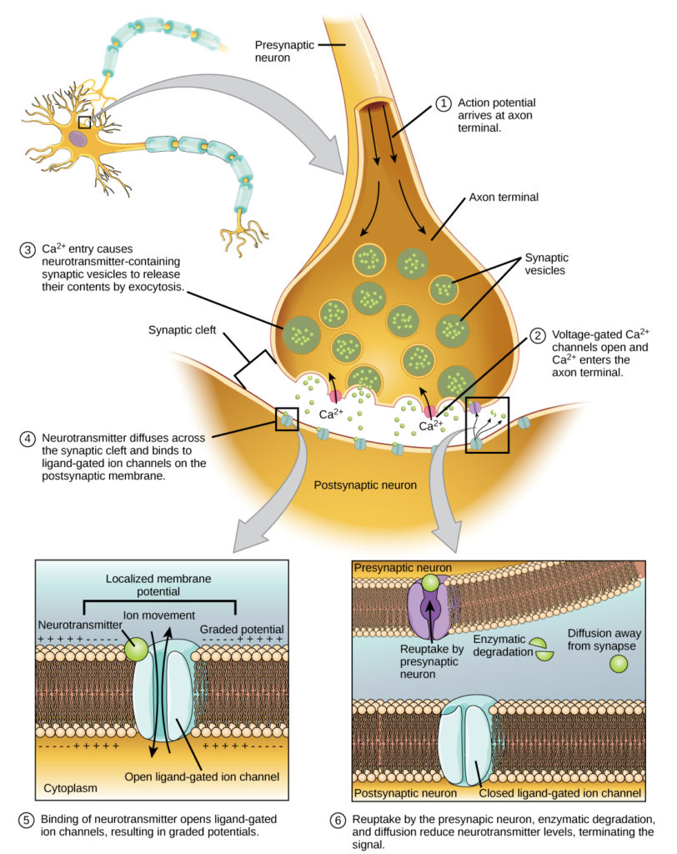
Chemical Synapses
Notes:
Biology. Provided by: OpenStax CNX. Located at: http://cnx.org/contents/185cbf87-c72e-48f5-b51e-f14f21b5eabd@10.8. License: CC BY: Attribution. License Terms: Download for free at http://cnx.org/contents/185cbf87-c72e-48f5-b51e-f14f21b5eabd@10.8

Slide 22
Neurotransmitters
Neurotransmitter | Function | Location
Acetylcholine | muscle control, memory | CNS and/or PNS
Serotonin | intestinal movement, mood regulation, sleep | gut, CNS
Dopamine | voluntary muscle movements, cognition, reward pathways | hypothalamus
Norepinephrine | fight or flight response | adrenal medulla
GABA | inhibits CNS | brain
Glutamate | generally an excitatory neurotransmitter, memory | CNS, PNS
Notes:
Biology. Provided by: OpenStax CNX. Located at: http://cnx.org/contents/185cbf87-c72e-48f5-b51e-f14f21b5eabd@10.8. License: CC BY: Attribution. License Terms: Download for free at http://cnx.org/contents/185cbf87-c72e-48f5-b51e-f14f21b5eabd@10.8

Slide 23
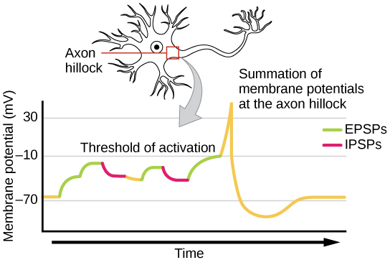
Signal Summation
Notes:
Biology. Provided by: OpenStax CNX. Located at: http://cnx.org/contents/185cbf87-c72e-48f5-b51e-f14f21b5eabd@10.8. License: CC BY: Attribution. License Terms: Download for free at http://cnx.org/contents/185cbf87-c72e-48f5-b51e-f14f21b5eabd@10.8

Slide 24
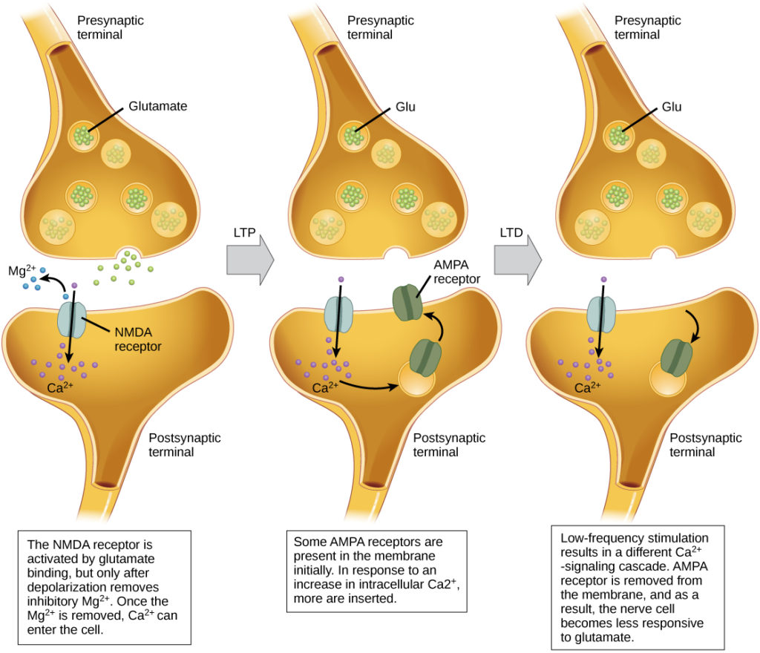
Synaptic Plasticity
Notes:
Biology. Provided by: OpenStax CNX. Located at: http://cnx.org/contents/185cbf87-c72e-48f5-b51e-f14f21b5eabd@10.8. License: CC BY: Attribution. License Terms: Download for free at http://cnx.org/contents/185cbf87-c72e-48f5-b51e-f14f21b5eabd@10.8

Slide 25
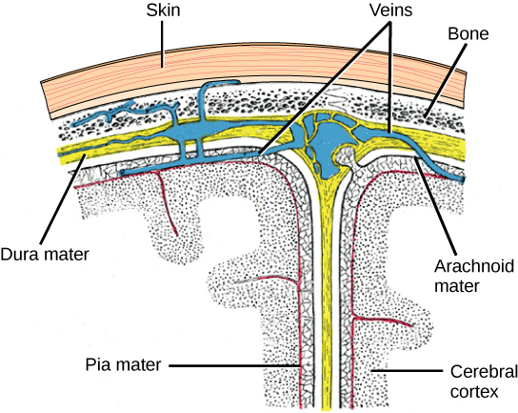
Components of the CNS
The cerebral cortex is covered by three layers of meninges: the dura, arachnoid, and pia maters
Notes:
(credit: modification of work by Gray’s Anatomy) in

Slide 26
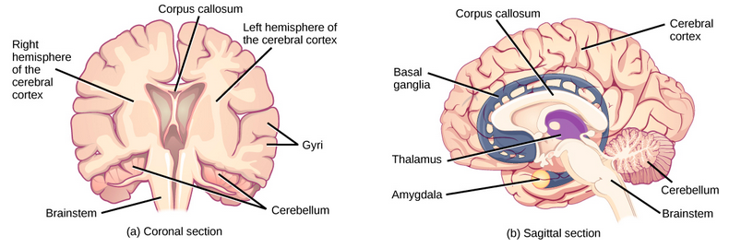
The Human Brain
Notes:
Biology. Provided by: OpenStax CNX. Located at: http://cnx.org/contents/185cbf87-c72e-48f5-b51e-f14f21b5eabd@10.8. License: CC BY: Attribution. License Terms: Download for free at http://cnx.org/contents/185cbf87-c72e-48f5-b51e-f14f21b5eabd@10.8

Slide 27
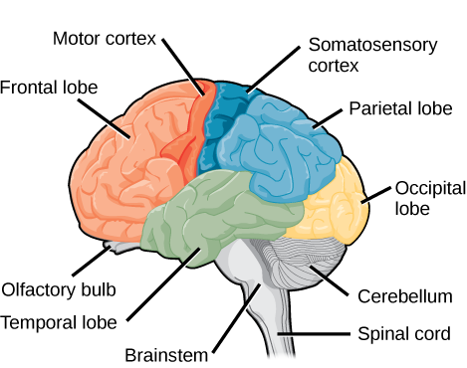
Cerebral Cortex
Notes:
Biology. Provided by: OpenStax CNX. Located at: http://cnx.org/contents/185cbf87-c72e-48f5-b51e-f14f21b5eabd@10.8. License: CC BY: Attribution. License Terms: Download for free at http://cnx.org/contents/185cbf87-c72e-48f5-b51e-f14f21b5eabd@10.8

Slide 28
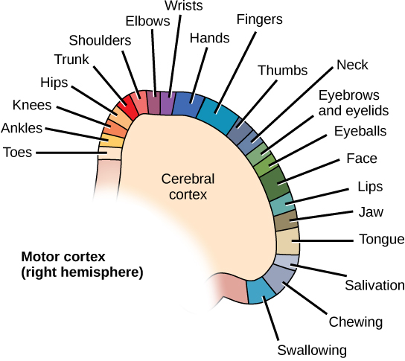
Motor Cortex
Notes:
Biology. Provided by: OpenStax CNX. Located at: http://cnx.org/contents/185cbf87-c72e-48f5-b51e-f14f21b5eabd@10.8. License: CC BY: Attribution. License Terms: Download for free at http://cnx.org/contents/185cbf87-c72e-48f5-b51e-f14f21b5eabd@10.8

Slide 29
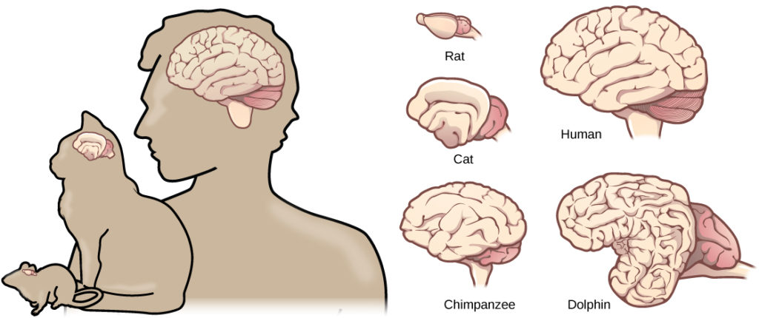
Mammalian Brains
Mammals have larger brain-to-body ratios than other vertebrates. Within mammals, increased cortical folding and surface area is correlated with complex behavior.
Notes:
Biology. Provided by: OpenStax CNX. Located at: http://cnx.org/contents/185cbf87-c72e-48f5-b51e-f14f21b5eabd@10.8. License: CC BY: Attribution. License Terms: Download for free at http://cnx.org/contents/185cbf87-c72e-48f5-b51e-f14f21b5eabd@10.8

Slide 30
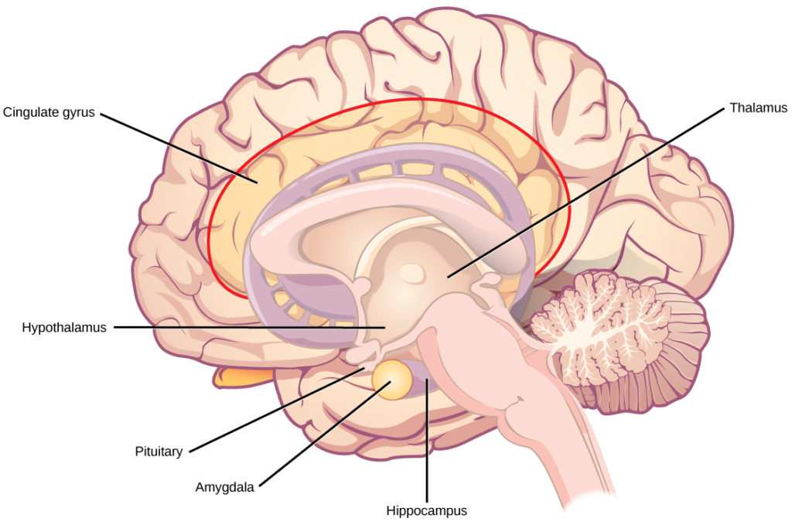
The Limbic System
Notes:
Biology. Provided by: OpenStax CNX. Located at: http://cnx.org/contents/185cbf87-c72e-48f5-b51e-f14f21b5eabd@10.8. License: CC BY: Attribution. License Terms: Download for free at http://cnx.org/contents/185cbf87-c72e-48f5-b51e-f14f21b5eabd@10.8

Slide 31
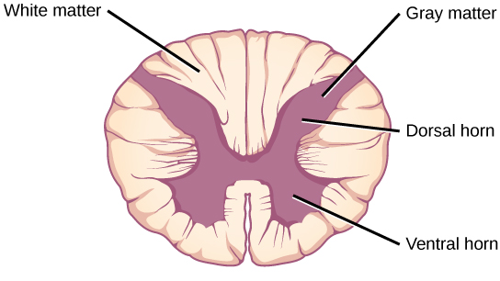
Spinal Cord Cross-section
Notes:
Biology. Provided by: OpenStax CNX. Located at: http://cnx.org/contents/185cbf87-c72e-48f5-b51e-f14f21b5eabd@10.8. License: CC BY: Attribution. License Terms: Download for free at http://cnx.org/contents/185cbf87-c72e-48f5-b51e-f14f21b5eabd@10.8

Slide 32
The Spinal Cord
contained within the bones of the vertebrate column
but is able to communicate signals to and from the body through its connections with spinal nerves of the peripheral nervous system
controls motor reflexes

Slide 33
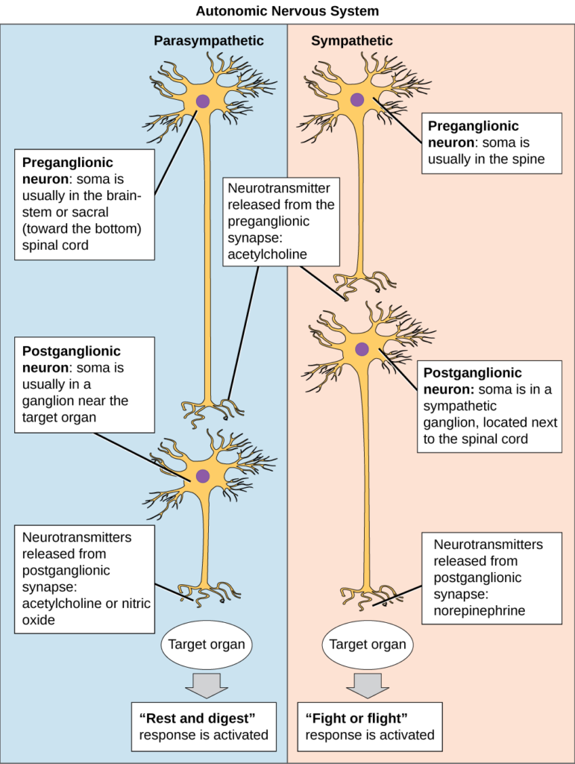
Autonomic Nervous System
Notes:
Biology. Provided by: OpenStax CNX. Located at: http://cnx.org/contents/185cbf87-c72e-48f5-b51e-f14f21b5eabd@10.8. License: CC BY: Attribution. License Terms: Download for free at http://cnx.org/contents/185cbf87-c72e-48f5-b51e-f14f21b5eabd@10.8

Slide 34
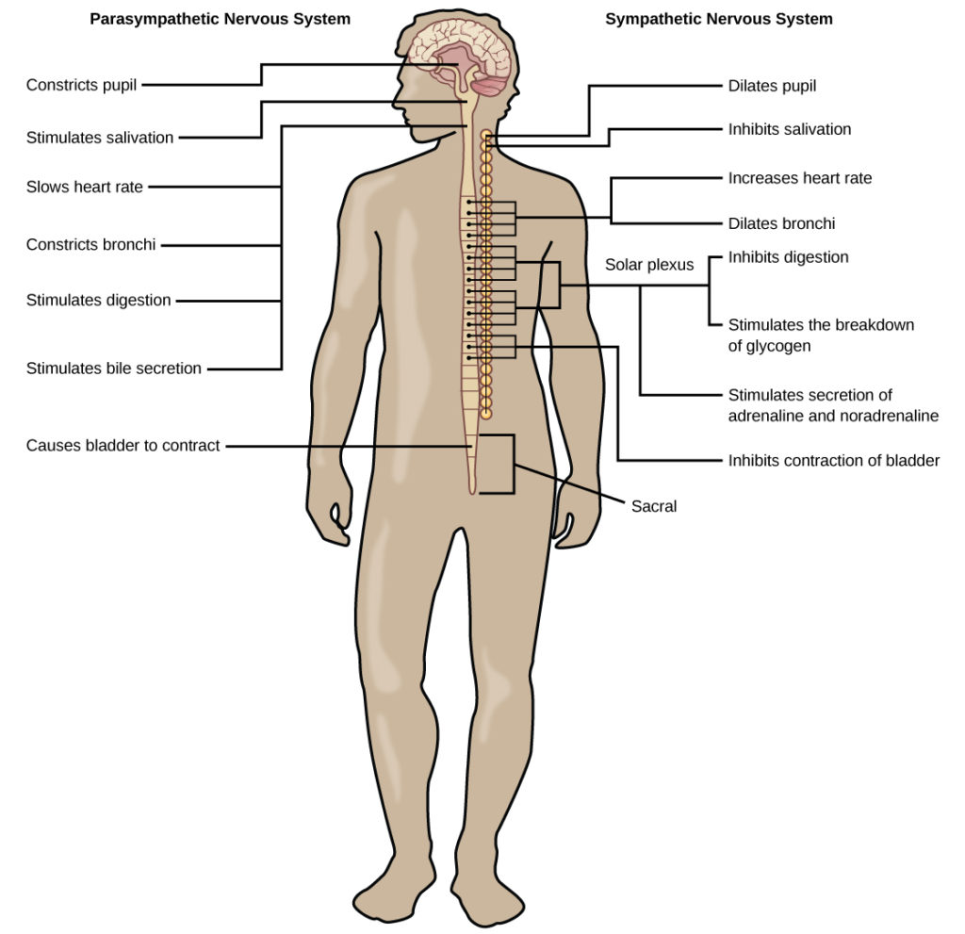
Sympathetic and Parasympathetic Nervous System
Notes:
Biology. Provided by: OpenStax CNX. Located at: http://cnx.org/contents/185cbf87-c72e-48f5-b51e-f14f21b5eabd@10.8. License: CC BY: Attribution. License Terms: Download for free at http://cnx.org/contents/185cbf87-c72e-48f5-b51e-f14f21b5eabd@10.8

Slide 35
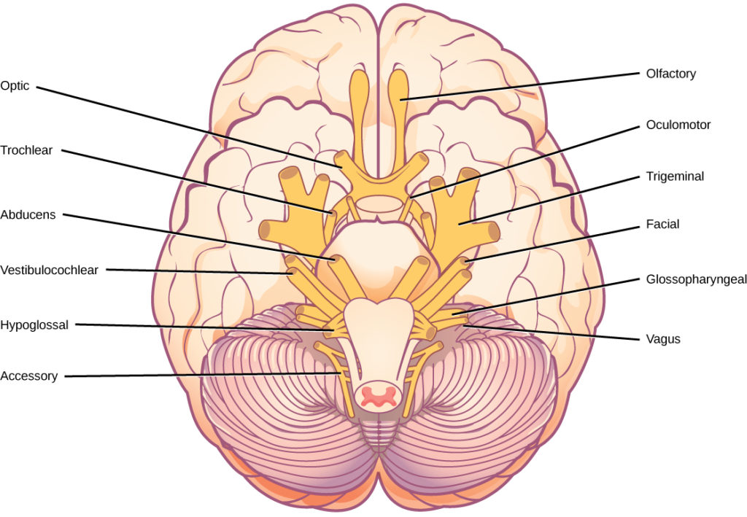
Sensory-Somatic Nervous System: Cranial Nerves
Notes:
Biology. Provided by: OpenStax CNX. Located at: http://cnx.org/contents/185cbf87-c72e-48f5-b51e-f14f21b5eabd@10.8. License: CC BY: Attribution. License Terms: Download for free at http://cnx.org/contents/185cbf87-c72e-48f5-b51e-f14f21b5eabd@10.8

Slide 36
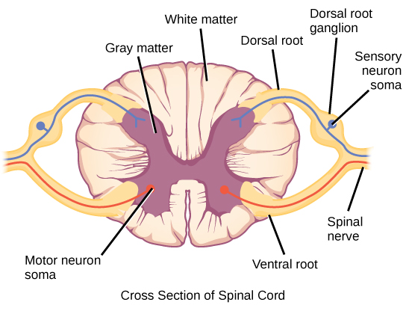
Spinal Nerves
Spinal nerves contain both sensory and motor axons. The somas of sensory neurons are located in dorsal root ganglia. The somas of motor neurons are found in the ventral portion of the gray matter of the spinal cord
Notes:
Biology. Provided by: OpenStax CNX. Located at: http://cnx.org/contents/185cbf87-c72e-48f5-b51e-f14f21b5eabd@10.8. License: CC BY: Attribution. License Terms: Download for free at http://cnx.org/contents/185cbf87-c72e-48f5-b51e-f14f21b5eabd@10.8

Slide 37
Neurodegenerative Disorders
Neurodegenerative disorders are illnesses characterized by a loss of nervous system functioning that are usually caused by neuronal death. Two examples are:
Alzheimer’s
Parkinson’s

Slide 38
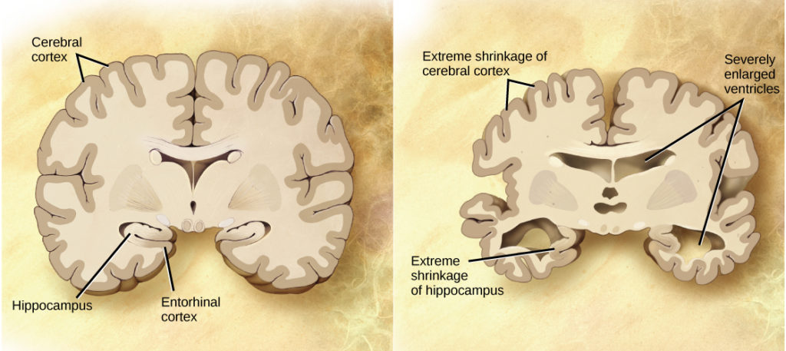
Alzheimer’s
Notes:
(credit: modification of work by “Garrando”/Wikimedia Commons based on original images by ADEAR: “Alzheimer’s Disease Education and Referral Center, a service of the National Institute on Aging”) in Biology. Provided by: OpenStax CNX. Located at: http://cnx.org/contents/185cbf87-c72e-48f5-b51e-f14f21b5eabd@10.8. License: CC BY: Attribution. License Terms: Download for free at http://cnx.org/contents/185cbf87-c72e-48f5-b51e-f14f21b5eabd@10.8

Slide 39
Practice Question
Looking at the images on the last slide of the parts of the brain most affected by Alzheimer’s Disease, what is the connection between the regions of the brain affected and the dementia patients experience?
Notes:
Answers may vary. The hippocampus is responsible for memory formation and it is profoundly impacted. Extreme shrinkage of the cerebral cortex, especially the frontal lobe, could be responsible for difficulty planning and executing tasks.

Slide 40
Neurodevelopmental Disorders
Neurodevelopmental disorders occur when the development of the nervous system is disturbed. Examples include:
Autism Spectrum Disorder
ADHD
Many ASD patients do not feel that they suffer from a disorder and instead think that their brains process information differently

Slide 41
Mental Illnesses
Mental illnesses are nervous system disorders that result in problems with thinking, mood, or relating with other people. Examples include:
schizophrenia
major depression
bipolar disorder
anxiety disorders and phobias
post-traumatic stress disorders
obsessive-compulsive disorder

Slide 42
Other Neurological Disorders
chronic pain conditions
cancers of the nervous system
epilepsy disorders - recurrent seizures
Stroke - blood fails to reach a portion of the brain for a long enough time to cause damage

Slide 43
Quick Review
What are the two primary parts of the nervous system?
What is the function and structure of neurons and glial cells?
How do neurons communicate?
What are the components of the central nervous system?
What are the components of the peripheral nervous system?
What are the symptoms, potential causes, and treatment of several examples of nervous system disorders?

