Slide 1


Biology 2e
Chapter 26 CONSERVATION BIOLOGY AND BIODIVERSITY
PowerPoint Image Slideshow

Slide 2
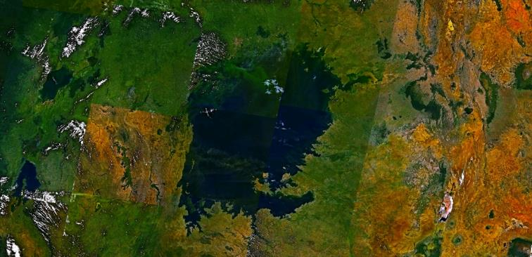
Figure 26.1
Lake Victoria in Africa, shown in this satellite image, was the site of one of the most extraordinary evolutionary findings on the planet, as well as a casualty of devastating biodiversity loss. (credit: modification of work by Rishabh Tatiraju, using NASA World Wind software)

Slide 3
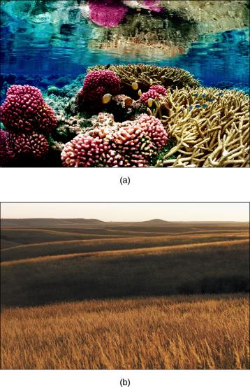
Figure 26.2
The variety of ecosystems on Earth—from (a) coral reef to (b) prairie—enables a great diversity of species to exist. (credit a: modification of work by Jim Maragos, USFWS; credit b: modification of work by Jim Minnerath, USFWS)

Slide 4
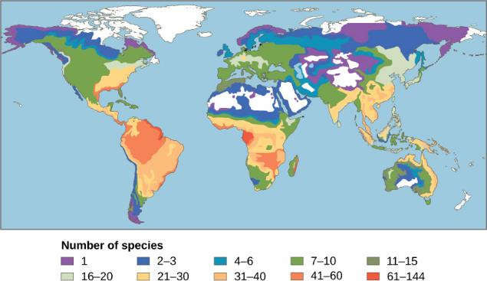
Figure 26.3
This map illustrates the number of amphibian species across the globe and shows the trend toward higher biodiversity at lower latitudes. A similar pattern is observed for most taxonomic groups. The white areas indicate a lack of data in this particular study

Slide 5
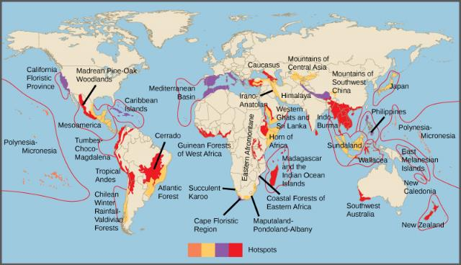
Figure 26.4
Conservation International has identified 34 biodiversity hotspots, which cover only 2.3 percent of the Earth’s surface but have endemic to them 42 percent of the terrestrial vertebrate species and 50 percent of the world’s plants.

Slide 6
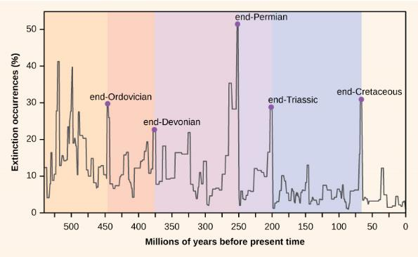
Figure 26.5
Percent extinction occurrences as reflected in the fossil record have fluctuated throughout Earth’s history. Sudden and dramatic losses of biodiversity, called mass extinctions, have occurred five times.

Slide 7
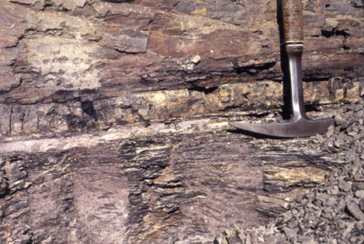
Figure 26.6
In 1980, Luis and Walter Alvarez, Frank Asaro, and Helen Michels discovered, across the world, a spike in the concentration of iridium within the sedimentary layer at the K–Pg boundary. These researchers hypothesized that this iridium spike was caused by an asteroid impact that resulted in the K–Pg mass extinction. In the photo, the iridium layer is the light band. (credit: USGS)

Slide 8
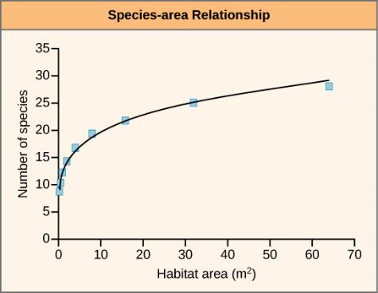
Figure 26.7
Studies have shown that the number of species present increases with the size of the habitat. (credit: modification of work by Adam B. Smith)

Slide 9

Figure 26.8
Catharanthus roseus, the Madagascar periwinkle, has various medicinal properties. Among other uses, it is a source of vincristine, a drug used in the treatment of lymphomas. (credit: Forest and Kim Starr)

Slide 10
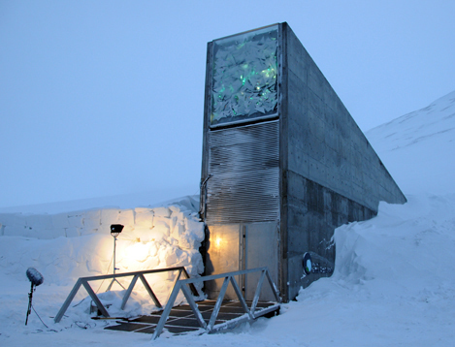
Figure 26.9
The Svalbard Global Seed Vault is a storage facility for seeds of Earth’s diverse crops. (credit: Mari Tefre, Svalbard Global Seed Vault)

Slide 11
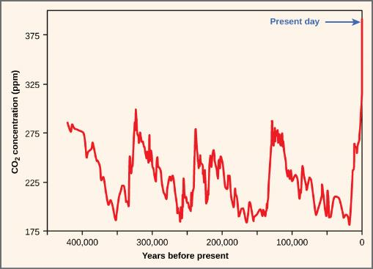
Figure 26.10
Atmospheric carbon dioxide levels fluctuate in a cyclical manner. However, the burning of fossil fuels in recent history has caused a dramatic increase in the levels of carbon dioxide in the Earth’s atmosphere, which have now reached levels never before seen on Earth. Scientists predict that the addition of this “greenhouse gas” to the atmosphere is resulting in climate change that will significantly impact biodiversity in the coming century.

Slide 12
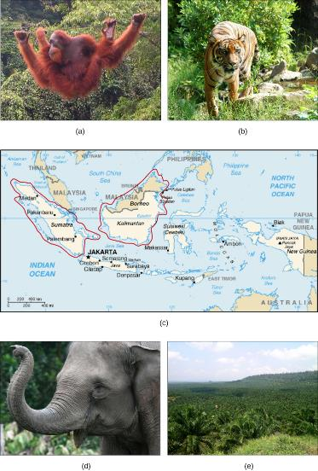
Figure 26.11
(a) One species of orangutan, Pongo pygmaeus, is found only in the rainforests of Borneo, and the other species of orangutan (Pongo abelii) is found only in the rainforests of Sumatra. These animals are examples of the exceptional biodiversity of (c) the islands of Sumatra and Borneo. Other species include the (b) Sumatran tiger (Panthera tigris sumatrae) and the (d) Sumatran elephant (Elephas maximus sumatranus), both critically endangered species. Rainforest habitat is being removed to make way for (e) oil palm plantations such as this one in Borneo’s Sabah Province. (credit a: modification of work by Thorsten Bachner; credit b: modification of work by Dick Mudde; credit c: modification of work by U.S. CIA World Factbook; credit d: modification of work by “Nonprofit Organizations”/Flickr; credit e: modification of work by Dr. Lian Pin Koh)

Slide 13
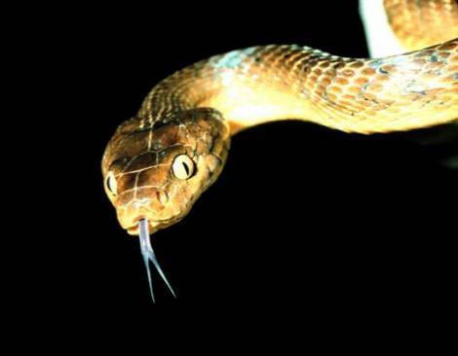
Figure 26.12
The brown tree snake, Boiga irregularis, is an exotic species that has caused numerous extinctions on the island of Guam since its accidental introduction in 1950. (credit: NPS)

Slide 14
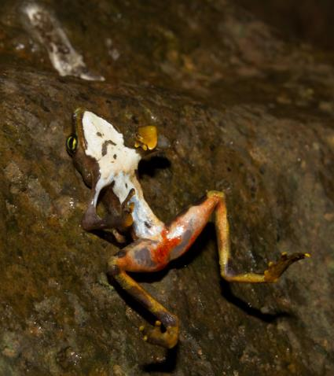
Figure 26.13
This Limosa Harlequin Frog (Atelopus limosus), an endangered species from Panama, died from a fungal disease called chytridiomycosis. The red lesions are symptomatic of the disease. (credit: Brian Gratwicke)

Slide 15
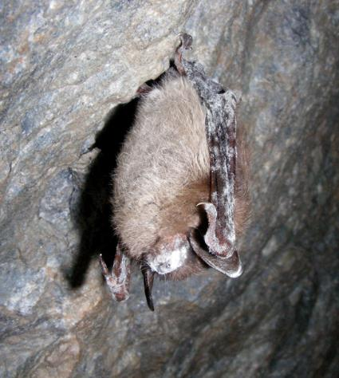
Figure 26.14
This little brown bat in Greeley Mine, Vermont, March 26, 2009, was found to have white-nose syndrome. (credit: Marvin Moriarty, USFWS)

Slide 16
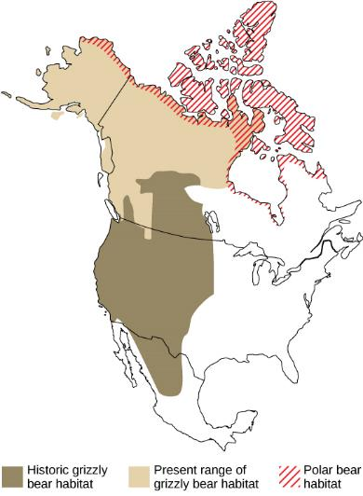
Figure 26.15
Since 2008, grizzly bears (Ursus arctos horribilis) have been spotted farther north than their historic range, a possible consequence of climate change. As a result, grizzly bear habitat now overlaps polar bear (Ursus maritimus) habitat. The two kinds of bears, which are capable of mating and producing viable offspring, are considered separate species as historically they lived in different habitats and never met. However, in 2006 a hunter shot a wild grizzly-polar bear hybrid known as a grolar bear, the first wild hybrid ever found.

Slide 17
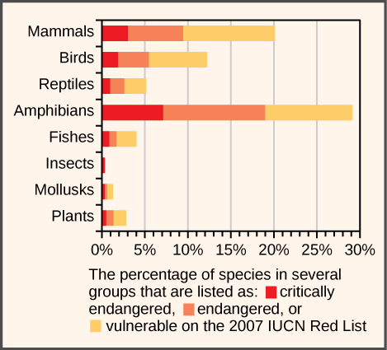
Figure 26.16
This chart shows the percentage of various animal species, by group, on the IUCN Red List as of 2007.

Slide 18
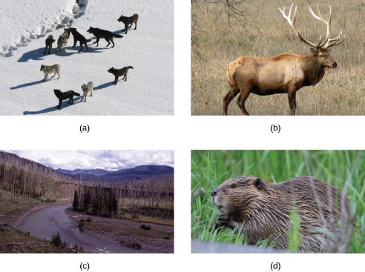
Figure 26.17
(a) The Gibbon wolf pack in Yellowstone National Park, March 1, 2007, represents a keystone species. The reintroduction of wolves into Yellowstone National Park in 1995 led to a change in the grazing behavior of (b) elk. To avoid predation, the elk no longer grazed exposed stream and riverbeds, such as (c) the Lamar Riverbed in Yellowstone. This allowed willow and cottonwood seedlings to grow. The seedlings decreased erosion and provided shading to the creek, which improved fish habitat. A new colony of (d) beaver may also have benefited from the habitat change. (credit a: modification of work by Doug Smith, NPS; credit c: modification of work by Jim Peaco, NPS; credit d: modification of work by “Shiny Things”/Flickr)

