Slide 1


Biology 2e
Chapter 23 ECOLOGY AND THE BIOSPHERE
PowerPoint Image Slideshow

Slide 2
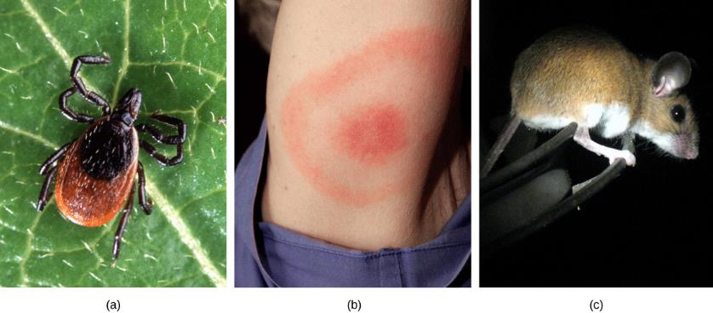
Figure 23.1
The (a) deer tick carries the bacterium that produces Lyme disease in humans, often evident in (b) a symptomatic bull’s eye rash. The (c) white-footed mouse is one well-known host to deer ticks carrying the Lyme disease bacterium. (credit a: modification of work by Scott Bauer, USDA ARS; credit b: modification of work by James Gathany, CDC; credit c: modification of work by Rob Ireton)

Slide 3
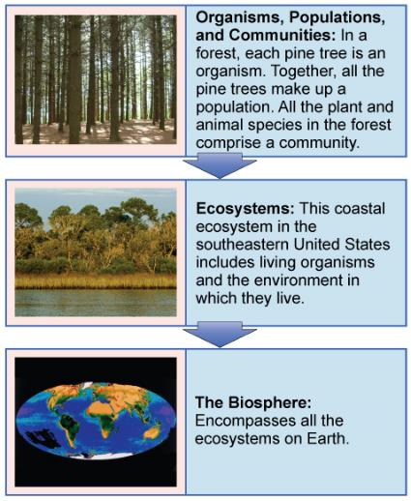
Figure 23.2
Ecologists study within several biological levels of organization. (credit “organisms”: modification of work by “Crystl”/Flickr; credit “ecosystems”: modification of work by Tom Carlisle, US Fish and Wildlife Service Headquarters; credit “biosphere”: NASA)

Slide 4
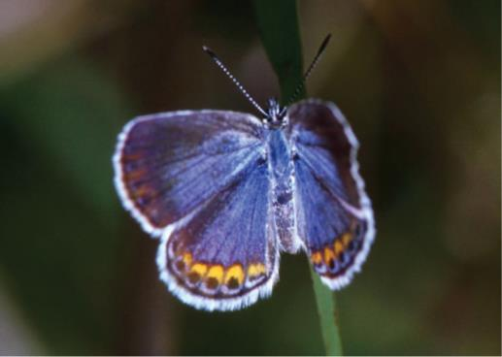
Figure 23.3
The Karner blue butterfly (Lycaeides melissa samuelis) is a rare butterfly that lives only in open areas with few trees or shrubs, such as pine barrens and oak savannas. It can only lay its eggs on lupine plants. (credit: modification of work by J & K Hollingsworth, USFWS)

Slide 5
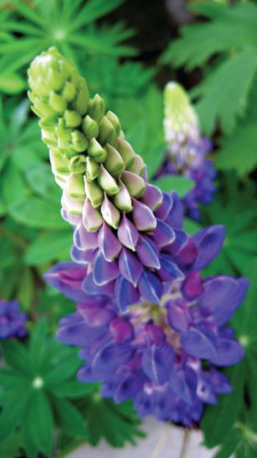
Figure 23.4
The wild lupine (Lupinus perennis) is the host plant for the Karner blue butterfly.

Slide 6
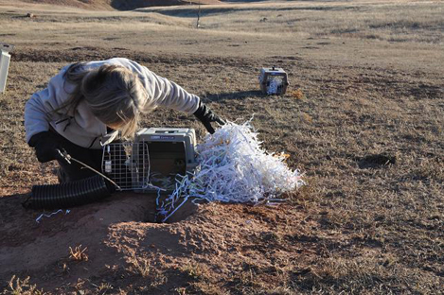
Figure 23.5
This landscape ecologist is releasing a black-footed ferret into its native habitat as part of a study. (credit: USFWS Mountain Prairie Region, NPS)

Slide 7
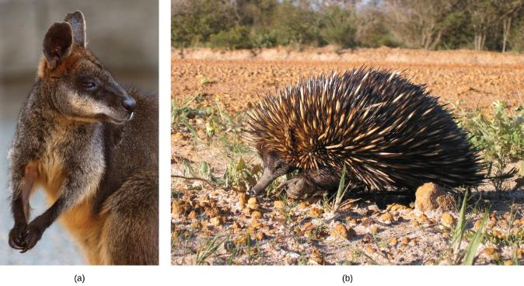
Figure 23.6
Australia is home to many endemic species. The (a) wallaby (Wallabia bicolor), a medium-sized member of the kangaroo family, is a pouched mammal, or marsupial. The (b) echidna (Tachyglossus aculeatus) is an egg-laying mammal. (credit a: modification of work by Derrick Coetzee; credit b: modification of work by Allan Whittome)

Slide 8
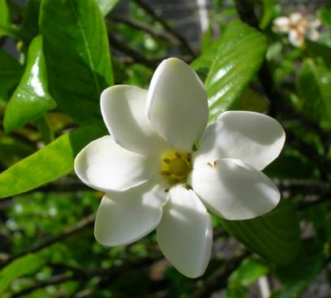
Figure 23.7
Listed as federally endangered, the forest gardenia is a small tree with distinctive flowers. It is found only in five of the Hawaiian Islands in small populations consisting of a few individual specimens. (credit: Forest & Kim Starr)

Slide 9
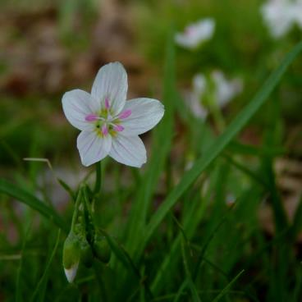
Figure 23.8
The spring beauty is an ephemeral spring plant that flowers early in the spring to avoid competing with larger forest trees for sunlight. (credit: John Beetham)

Slide 10
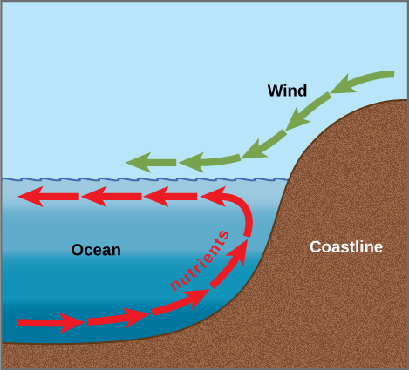
Figure 23.9
Ocean upwelling is an important process that recycles nutrients and energy in the ocean. As wind (green arrows) pushes offshore, it causes water from the ocean bottom (red arrows) to move to the surface, bringing up nutrients from the ocean depths.

Slide 11
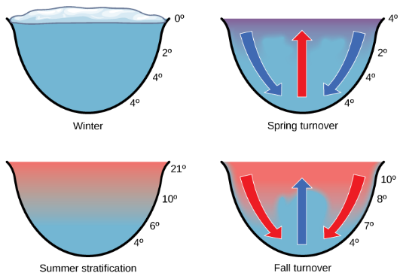
Figure 23.10
The spring and fall turnovers are important processes in freshwater lakes that act to move the nutrients and oxygen at the bottom of deep lakes to the top. Turnover occurs because water has a maximum density at 4 °C. Surface water temperature changes as the seasons progress, and denser water sinks.

Slide 12
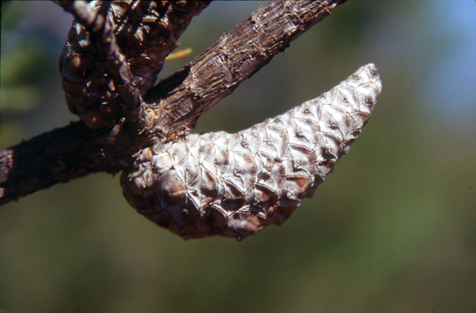
Figure 23.11
The mature cones of the jack pine (Pinus banksiana) open only when exposed to high temperatures, such as during a forest fire. A fire is likely to kill most vegetation, so a seedling that germinates after a fire is more likely to receive ample sunlight than one that germinates under normal conditions. (credit: USDA)

Slide 13
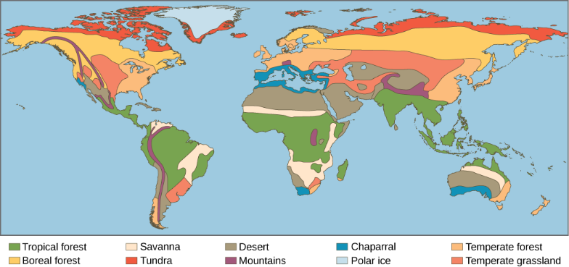
Figure 23.12
Each of the world’s major biomes is distinguished by characteristic temperatures and amounts of precipitation. Polar ice and mountains are also shown.

Slide 14
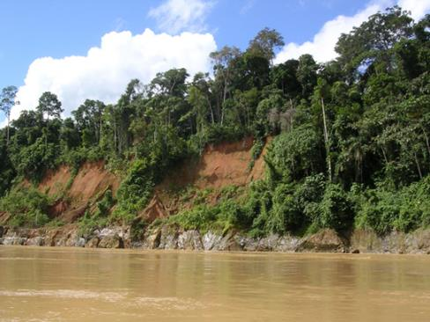
Figure 23.13
Tropical wet forests, such as these forests of Madre de Dios, Peru, near the Amazon River, have high species diversity. (credit: Roosevelt Garcia)

Slide 15
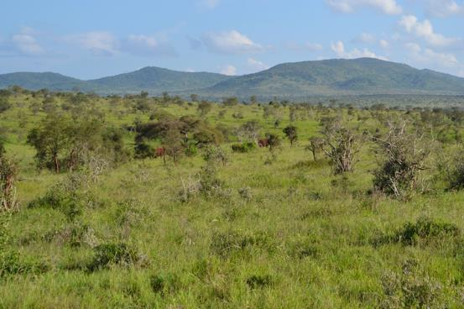
Figure 23.14
Savannas, like this one in Taita Hills Wildlife Sanctuary in Kenya, are dominated by grasses. (credit: Christopher T. Cooper)

Slide 16
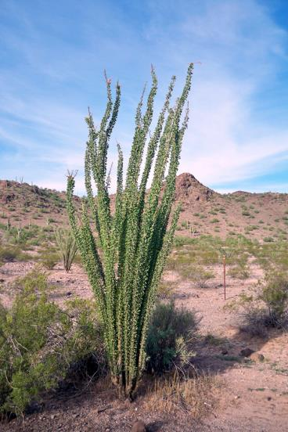
Figure 23.15
To reduce water loss, many desert plants have tiny leaves or no leaves at all. The leaves of ocotillo (Fouquieria splendens), shown here in the Sonora Desert near Gila Bend, Arizona, appear only after rainfall, and then are shed.

Slide 17
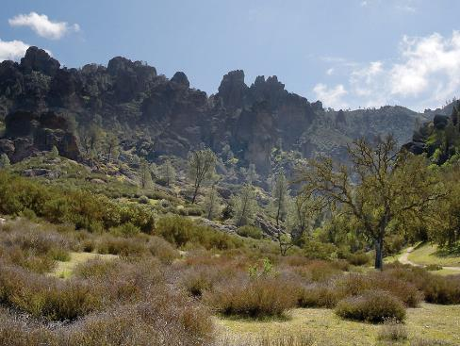
Figure 23.16
The chaparral is dominated by shrubs. (credit: Miguel Vieira)

Slide 18
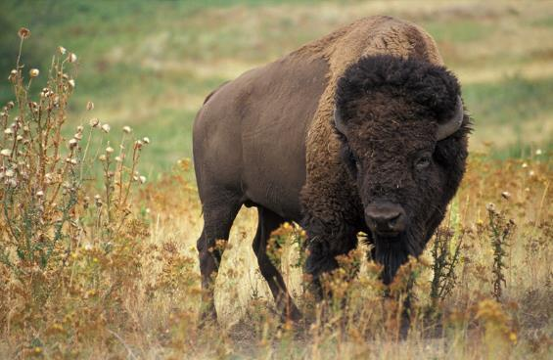
Figure 23.17
The American bison (Bison bison), more commonly called the buffalo, is a grazing mammal that once populated American prairies in huge numbers. (credit: Jack Dykinga, USDA Agricultural Research Service)

Slide 19
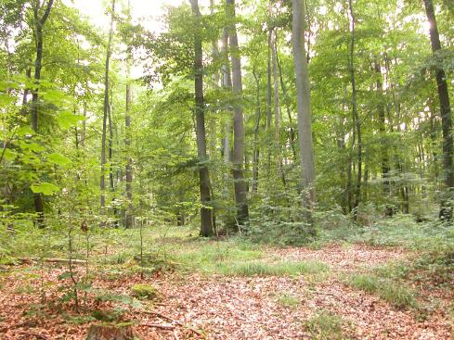
Figure 23.18
Deciduous trees are the dominant plant in the temperate forest. (credit: Oliver Herold)

Slide 20
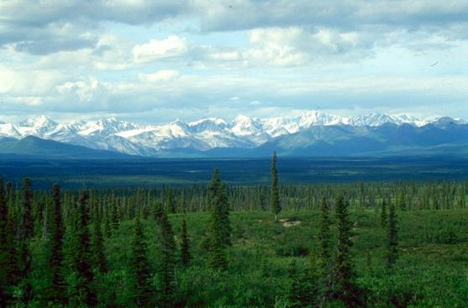
Figure 23.19
The boreal forest (taiga) has low lying plants and conifer trees. (credit: L.B. Brubaker)

Slide 21
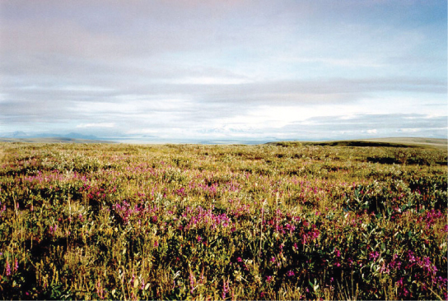
Figure 23.20
Low-growing plants such as shrub willow dominate the tundra landscape, shown here in the Arctic National Wildlife Refuge. (credit: USFWS Arctic National Wildlife Refuge)

Slide 22
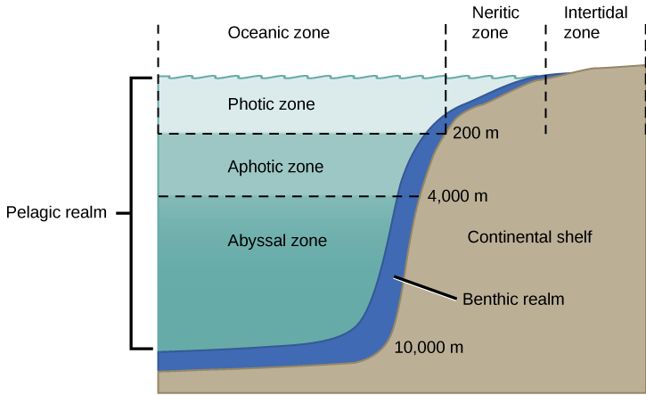
Figure 23.21
The ocean is divided into different zones based on water depth and distance from the shoreline.

Slide 23
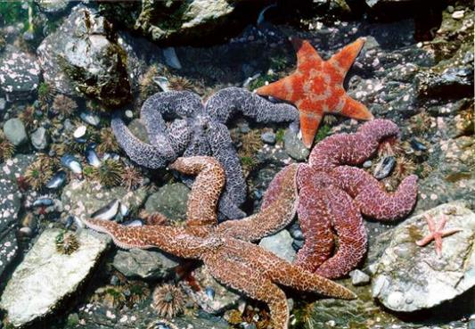
Figure 23.22
Sea urchins, mussel shells, and starfish are often found in the intertidal zone, shown here in Kachemak Bay, Alaska. (credit: NOAA)

Slide 24
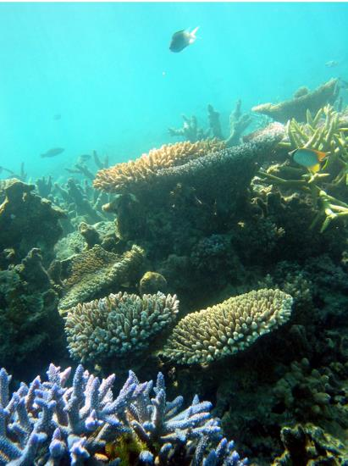
Figure 23.23
Coral reefs are formed by the calcium carbonate skeletons of coral organisms, which are marine invertebrates in the phylum Cnidaria. (credit: Terry Hughes)

Slide 25
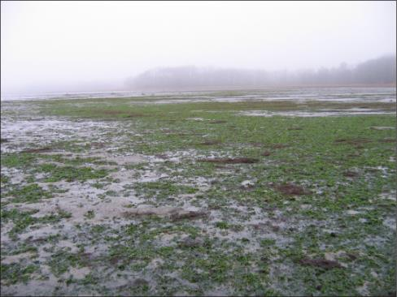
Figure 23.24
The uncontrolled growth of algae in this lake has resulted in an algal bloom. (credit: Jeremy Nettleton)

Slide 26
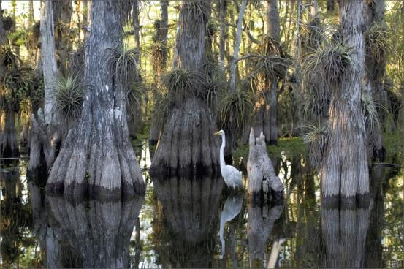
Figure 23.25
Located in southern Florida, Everglades National Park is vast array of wetland environments, including sawgrass marshes, cypress swamps, and estuarine mangrove forests. Here, a great egret walks among cypress trees. (credit: NPS)

Slide 27
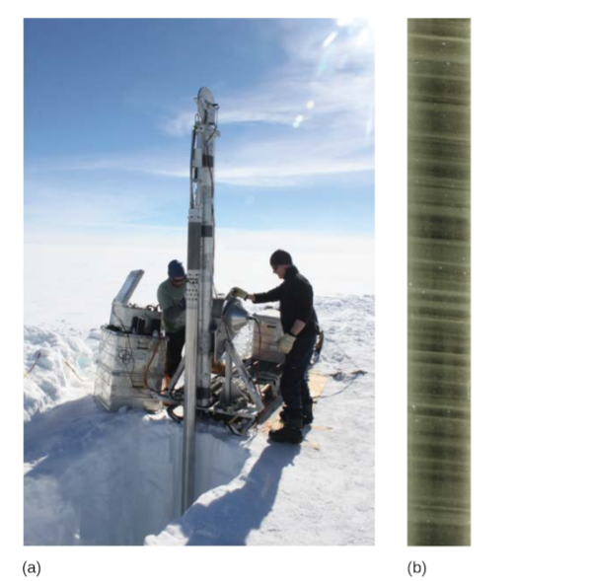
Figure 23.26
Scientists drill for ice cores in polar regions. The ice contains air bubbles and biological substances that provide important information for researchers. (credit: a: Helle Astrid Kjær; b: National Ice Core Laboratory, USGS)

Slide 28
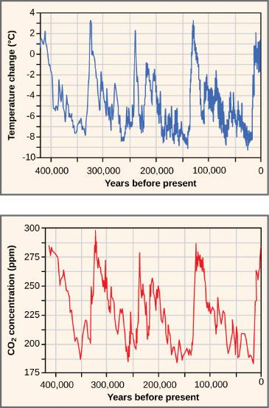
Figure 23.27
Ice at the Russian Vostok station in East Antarctica was laid down over the course 420,000 years and reached a depth of over 3,000 m. By measuring the amount of CO₂ trapped in the ice, scientists have determined past atmospheric CO₂ concentrations. Temperatures relative to modern day were determined from the amount of deuterium (an isotope of hydrogen) present.

Slide 29
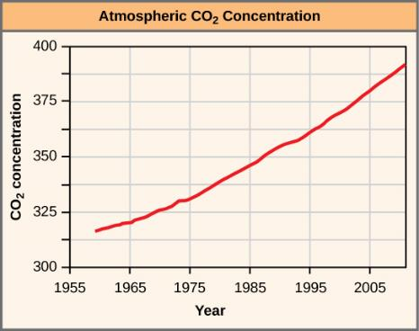
Figure 23.28
The atmospheric concentration of CO₂ has risen steadily since the beginning of industrialization.

Slide 30
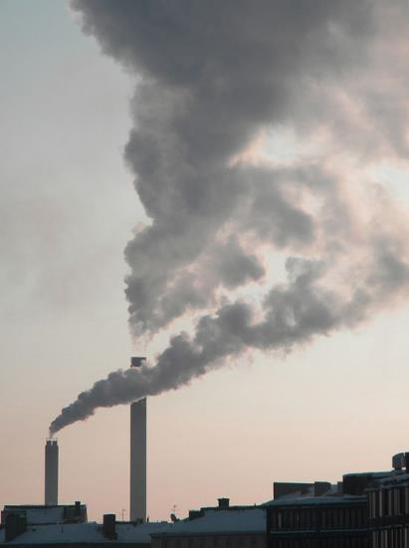
Figure 23.29
The burning of fossil fuels in industry and by vehicles releases carbon dioxide and other greenhouse gases into the atmosphere. (credit: “Pöllö” Wikimedia Commons)

Slide 31
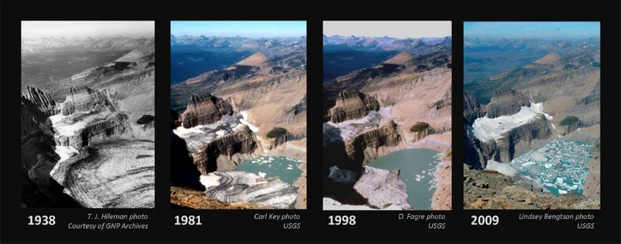
Figure 23.30
The effect of global warming can be seen in the continuing retreat of Grinnel Glacier. The mean annual temperature in the park has increased 1.33 °C since 1900. The loss of a glacier results in the loss of summer meltwaters, sharply reducing seasonal water supplies and severely affecting local ecosystems. (credit: modification of work by USGS)

