Slide 1


Biology 2e
Chapter 25 ECOSYSTEMS
PowerPoint Image Slideshow

Slide 2
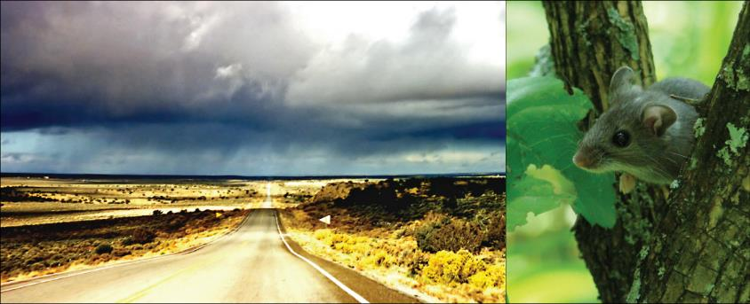
Figure 25.1
In the southwestern United States, rainy weather causes an increase in production of pinyon nuts, causing the deer mouse population to explode. Deer mice may carry a virus called Sin Nombre (a hantavirus) that causes respiratory disease in humans and has a high fatality rate. In 1992–1993, wet El Niño weather caused a Sin Nombre epidemic. Navajo healers, who were aware of the link between this disease and weather, predicted the outbreak. (credit “highway”: modification of work by Phillip Capper; credit “mouse”: modification of work by USFWS)

Slide 3
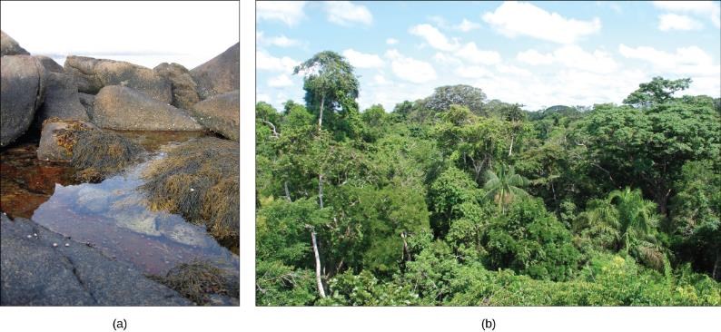
Figure 25.2
A (a) tidal pool ecosystem in Matinicus Island in Maine is a small ecosystem, while the (b) Amazon Rainforest in Brazil is a large ecosystem. (credit a: modification of work by “takomabibelot”/Flickr; credit b: modification of work by Ivan Mlinaric)

Slide 4
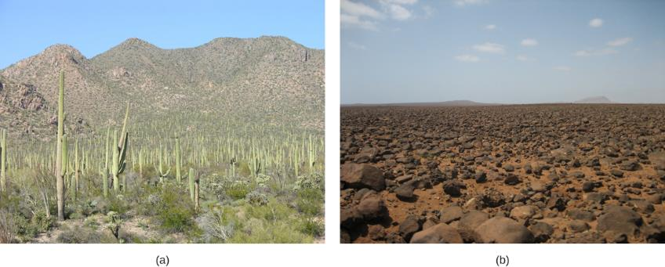
Figure 25.3
Desert ecosystems, like all ecosystems, can vary greatly. The desert in (a) Saguaro National Park, Arizona, has abundant plant life, while the rocky desert of (b) Boa Vista island, Cape Verde, Africa, is devoid of plant life. (credit a: modification of work by Jay Galvin; credit b: modification of work by Ingo Wölbern)

Slide 5
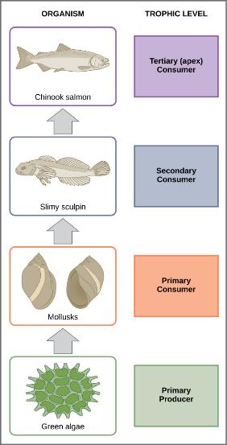
Figure 25.4
These are the trophic levels of a food chain in Lake Ontario at the United States-Canada border. Energy and nutrients flow from photosynthetic green algae at the bottom to the top of the food chain: the Chinook salmon.

Slide 6
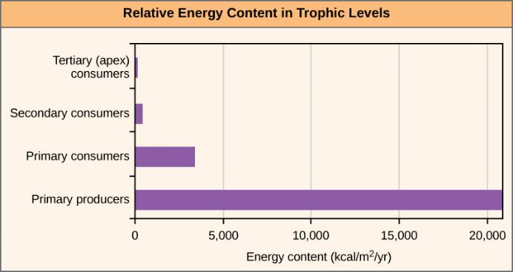
Figure 25.5
The relative energy in trophic levels in a Silver Springs, Florida, ecosystem is shown. Each trophic level has less energy available and supports fewer organisms at the next level.

Slide 7
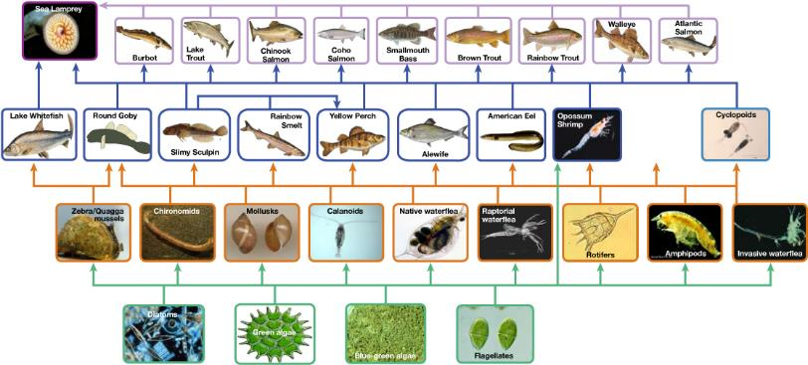
Figure 25.6
This food web shows the interactions between organisms across trophic levels in the Lake Ontario ecosystem. Primary producers are outlined in green, primary consumers in orange, secondary consumers in blue, and tertiary (apex) consumers in purple. Arrows point from an organism that is consumed to the organism that consumes it. Notice how some lines point to more than one trophic level. For example, the opossum shrimp eats both primary producers and primary consumers. (credit: NOAA, GLERL)

Slide 8
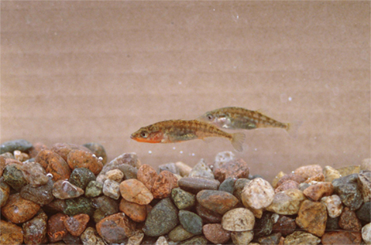
Figure 25.7
The three-spined stickleback evolved from a saltwater fish to freshwater fish. (credit: Barrett Paul, USFWS)

Slide 9
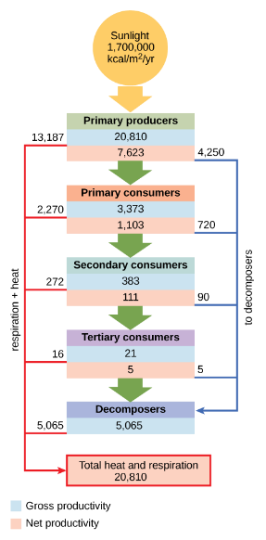
Figure 25.8
This conceptual model shows the flow of energy through a spring ecosystem in Silver Springs, Florida. Notice that the energy decreases with each increase in trophic level.

Slide 10
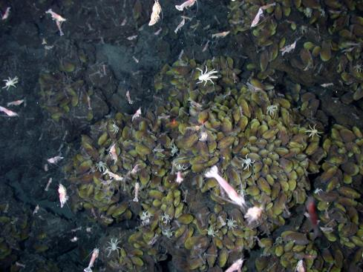
Figure 25.9
Swimming shrimp, a few squat lobsters, and hundreds of vent mussels are seen at a hydrothermal vent at the bottom of the ocean. As no sunlight penetrates to this depth, the ecosystem is supported by chemoautotrophic bacteria and organic material that sinks from the ocean’s surface. This picture was taken in 2006 at the submerged NW Eifuku volcano off the coast of Japan by the National Oceanic and Atmospheric Administration (NOAA). The summit of this highly active volcano lies 1535 m below the surface.

Slide 11
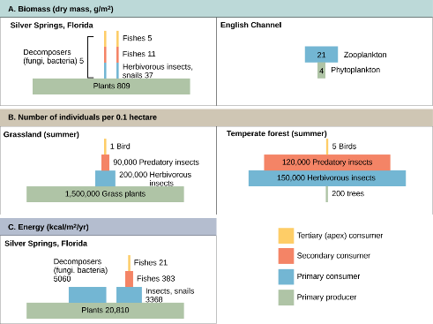
Figure 25.10
Ecological pyramids depict the (a) biomass, (b) number of organisms, and (c) energy in each trophic level.

Slide 12
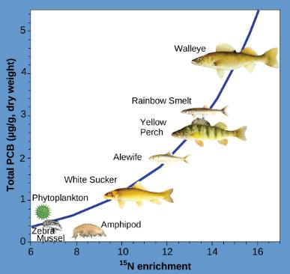
Figure 25.11
This chart shows the PCB concentrations found at the various trophic levels in the Saginaw Bay ecosystem of Lake Huron. Numbers on the x-axis reflect enrichment with heavy isotopes of nitrogen (¹⁵N), which is a marker for increasing trophic level. Notice that the fish in the higher trophic levels accumulate more PCBs than those in lower trophic levels. (credit: Patricia Van Hoof, NOAA, GLERL)

Slide 13
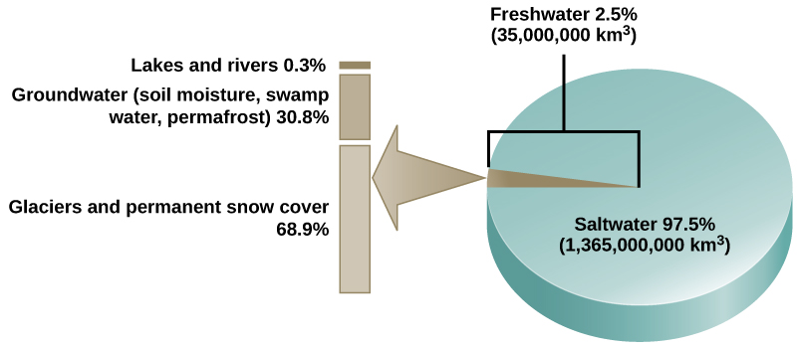
Figure 25.12
Only 2.5 percent of water on Earth is fresh water, and less than 1 percent of fresh water is easily accessible to living things.

Slide 14
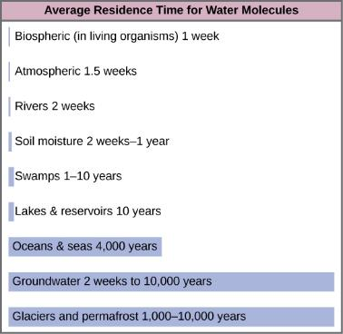
Figure 25.13
This graph shows the average residence time for water molecules in the Earth’s water reservoirs.

Slide 15
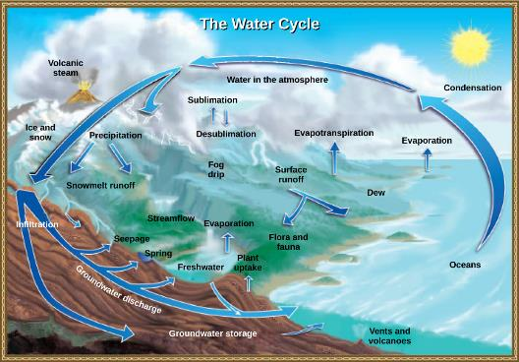
Figure 25.14
Water from the land and oceans enters the atmosphere by evaporation or sublimation, where it condenses into clouds and falls as rain or snow. Precipitated water may enter freshwater bodies or infiltrate the soil. The cycle is complete when surface or groundwater reenters the ocean. (credit: modification of work by John M. Evans and Howard Perlman, USGS)

Slide 16
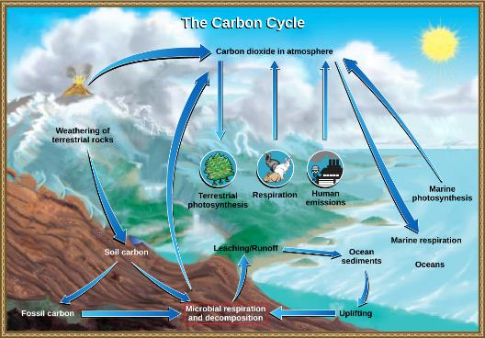
Figure 25.15
Carbon dioxide gas exists in the atmosphere and is dissolved in water. Photosynthesis converts carbon dioxide gas to organic carbon, and respiration cycles the organic carbon back into carbon dioxide gas. Long-term storage of organic carbon occurs when matter from living organisms is buried deep underground and becomes fossilized. Volcanic activity and, more recently, human emissions, bring this stored carbon back into the carbon cycle. (credit: modification of work by John M. Evans and Howard Perlman, USGS)

Slide 17
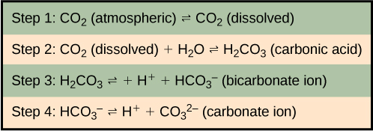
Figure 25.16
Carbon dioxide reacts with water to form bicarbonate and carbonate ions.

Slide 18
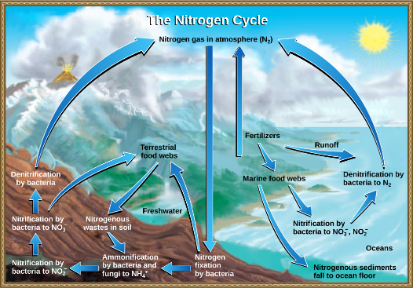
Figure 25.17
Nitrogen enters the living world from the atmosphere via nitrogen-fixing bacteria. This nitrogen and nitrogenous waste from animals is then processed back into gaseous nitrogen by soil bacteria, which also supply terrestrial food webs with the organic nitrogen they need. (credit: modification of work by John M. Evans and Howard Perlman, USGS)

Slide 19
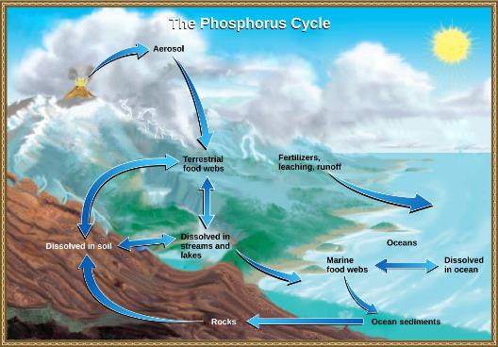
Figure 25.18
In nature, phosphorus exists as the phosphate ion (PO₄³⁻). Weathering of rocks and volcanic activity releases phosphate into the soil, water, and air, where it becomes available to terrestrial food webs. Phosphate enters the oceans via surface runoff, groundwater flow, and river flow. Phosphate dissolved in ocean water cycles into marine food webs. Some phosphate from the marine food webs falls to the ocean floor, where it forms sediment. (credit: modification of work by John M. Evans and Howard Perlman, USGS)

Slide 20
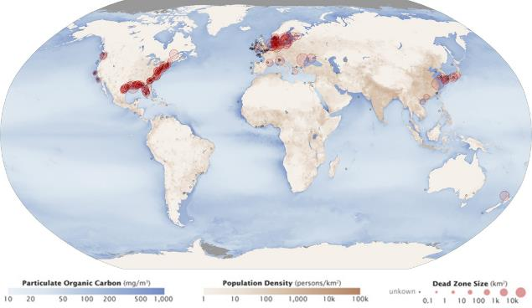
Figure 25.19
Dead zones occur when phosphorus and nitrogen from fertilizers cause excessive growth of microorganisms, which depletes oxygen and kills fauna. Worldwide, large dead zones are found in coastal areas of high population density. (credit: NASA Earth Observatory)

Slide 21
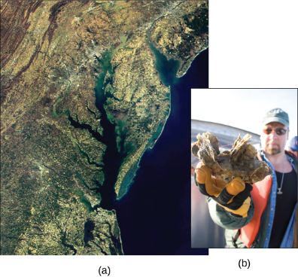
Figure 25.20
This (a) satellite image shows the Chesapeake Bay, an ecosystem affected by phosphate and nitrate runoff. A (b) member of the Army Corps of Engineers holds a clump of oysters being used as a part of the oyster restoration effort in the bay. (credit a: modification of work by NASA/MODIS; credit b: modification of work by U.S. Army)

Slide 22
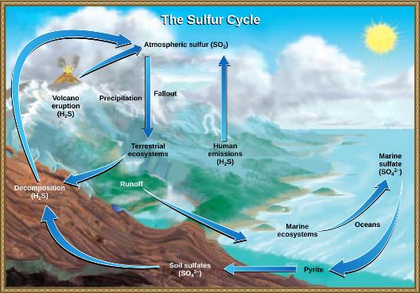
Figure 25.21
Sulfur dioxide from the atmosphere becomes available to terrestrial and marine ecosystems when it is dissolved in precipitation as weak sulfuric acid or when it falls directly to the Earth as fallout. Weathering of rocks also makes sulfates available to terrestrial ecosystems. Decomposition of living organisms returns sulfates to the ocean, soil and atmosphere. (credit: modification of work by John M. Evans and Howard Perlman, USGS)

Slide 23
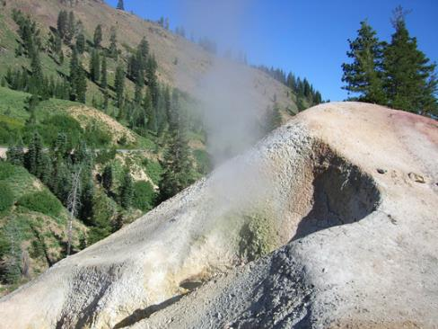
Figure 25.22
At this sulfur vent in Lassen Volcanic National Park in northeastern California, the yellowish sulfur deposits are visible near the mouth of the vent.

