Slide 1
Chapter 5
Introduction to Human Geography (2018)
University of North Georgia Press
LANGUAGE
Figures by Dorrell, Henderson, Lindley, & Connor.

Slide 2
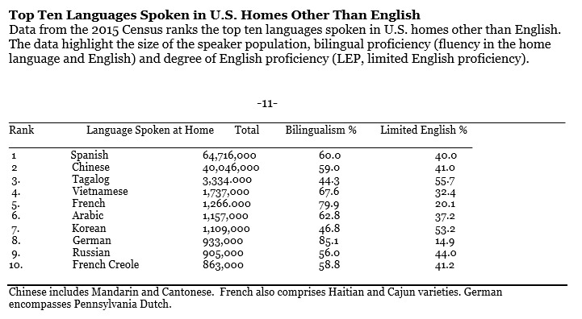
5.2 Language and its Relationship to Culture

Slide 3
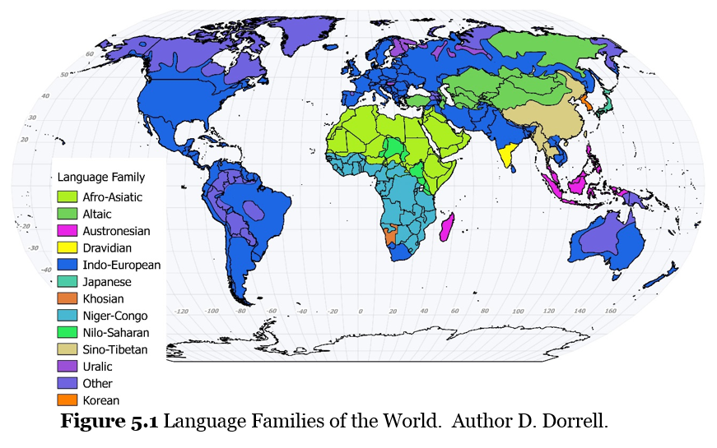
5.3 Classification and Distribution of Languages

Slide 4
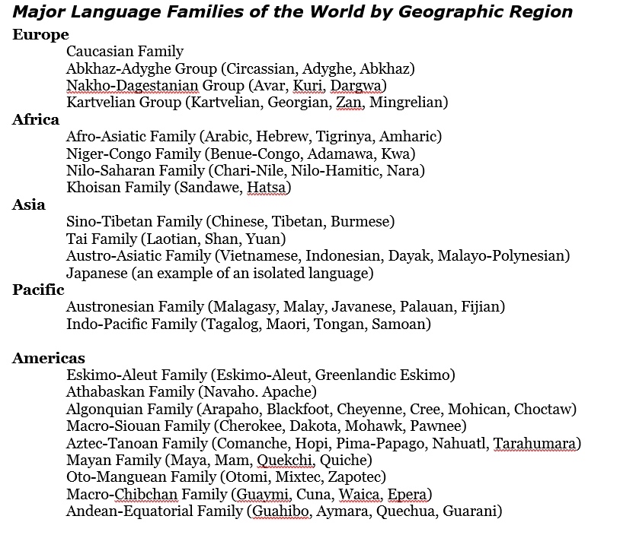

Slide 5
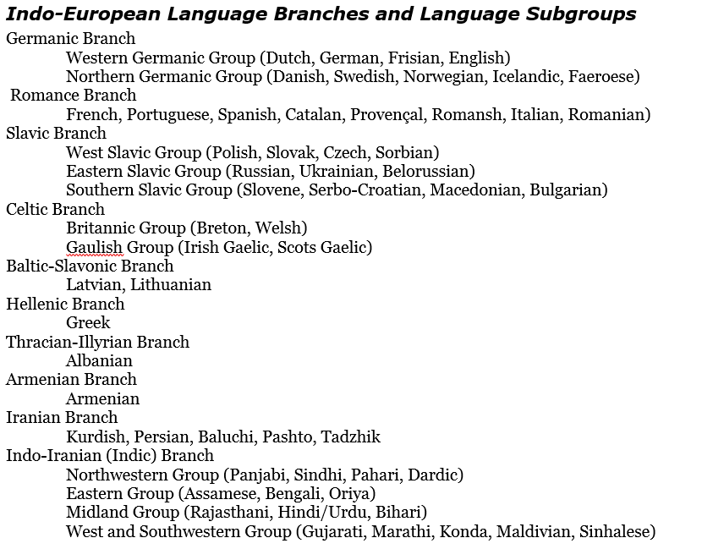

Slide 6
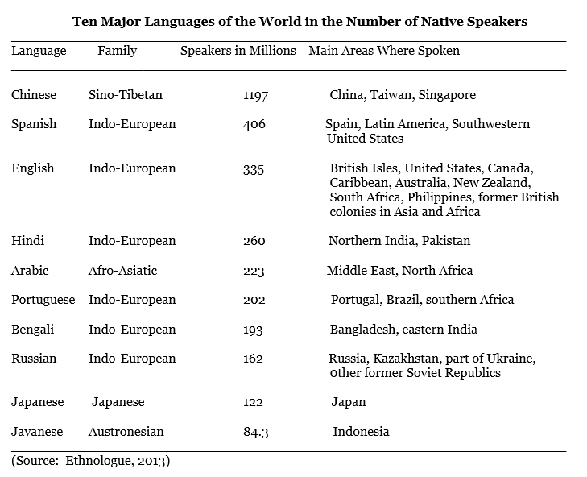
5.4 Language in the Physical, Business and Digital Worlds

Slide 7
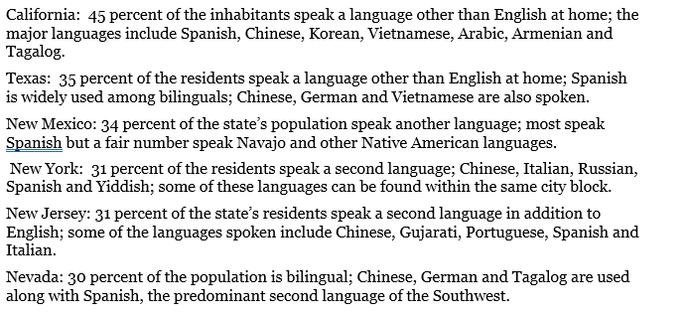
Other languages in the United States

Slide 8
Chapter 5 END
Introduction to Human Geography (2018)
University of North Georgia Press
LANGUAGE
Figures by Dorrell, Henderson, Lindley, & Connor.

