Slide 1

Chapter 2:
The Cell
Microbiology OpenStax
Slides compiled by Adronisha T. Frazier

Slide 2
Clinical Focus: Part 1
Barbara is a 19-year-old college student living in the dormitory. In January, she came down with a sore throat, headache, mild fever, chills, and a violent but unproductive (i.e. no mucus) cough. To treat these symptoms, Barbara began taking an over-the-counter cold medication, which did not seem to work. In fact, over the next few days, while some of Barbara’s symptoms began to resolve, her cough and fever persisted, and she felt very tired and weak.
  What types of respiratory disease may be responsible?

Slide 3
Chapter Outline
2.1 Spontaneous Generation
2.2 Foundations of Modern Cell Theory
2.3 Unique Characteristics of Prokaryotic Cells
2.4 Unique Characteristics of Eukaryotic Cells

Slide 4
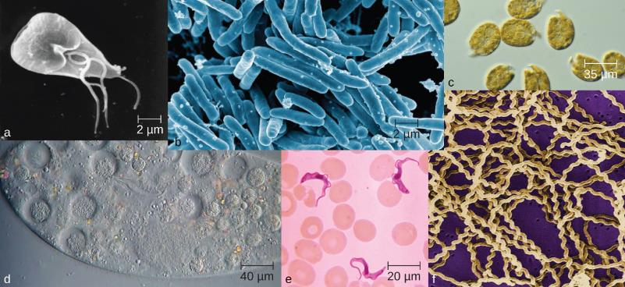
Introduction (1 of 3)
Figure 2.1 Microorganisms vary visually in their size and shape, as can be observed microscopically; but they also vary in invisible ways, such as in their metabolic capabilities. (credit a, e, f: modification of work by Centers for Disease Control and Prevention; credit b: modification of work by NIAID; credit c: modification of work by CSIRO; credit d: modification of work by “Microscopic World”/YouTube)

Slide 5
Introduction (2 of 3)
In the 17th century, observations of microscopic life led to the development of the cell theory:
  The fundamental unit of life is the cell
  All organisms contain at least one cell
  Cells only come from other cells

Slide 6
Introduction (3 of 3)
The two main types of cells are prokaryotic cells (lacking a nucleus) and eukaryotic cells (containing a well-organized, membrane-bound nucleus).
Each type of cell exhibits remarkable variety in structure, function, and metabolic activity.

Slide 7
Spontaneous Generation (1 of 16)
The Greek philosopher Aristotle (384–322 BC) was one of the earliest recorded scholars to articulate the theory of spontaneous generation, the notion that life can arise from nonliving matter.
He noted several instances of the appearance of animals from environments previously devoid of such animals, such as the seemingly sudden appearance of fish in a new puddle of water.

Slide 8
Spontaneous Generation (2 of 16)
This theory persisted into the 17th century, when scientists undertook additional experimentation to support or disprove it.
Jan Baptista van Helmont, a 17th century Flemish scientist proposed that mice could arise from rags and wheat kernels left in an open container for 2 weeks.

Slide 9
Spontaneous Generation (3 of 16)
Italian physician Francesco Redi (1626–1697), performed an experiment in 1668 that was one of the first to refute the idea that maggots (the larvae of flies) spontaneously generate on meat left out in the open air.
He predicted that preventing flies from having direct contact with the meat would also prevent the appearance of maggots.
Redi left meat in each of six containers.

Slide 10
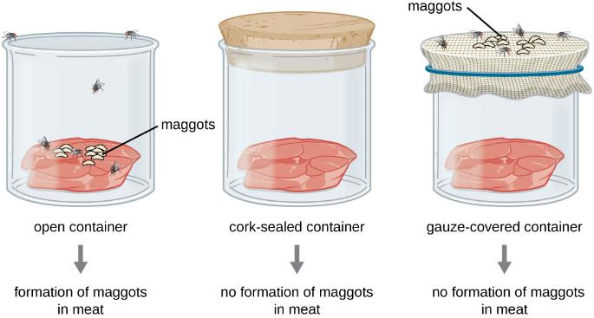
Spontaneous Generation (4 of 16)
Figure 2.2 Francesco Redi’s experimental setup consisted of an open container, a container sealed with a cork top, and a container covered in mesh that let in air but not flies. Maggots only appeared on the meat in the open container. However, maggots were also found on the gauze of the gauze-covered container.

Slide 11
Spontaneous Generation (5 of 16)
Redi concluded that maggots could only form when flies were allowed to lay eggs in the meat, and that the maggots were the offspring of flies, not the product of spontaneous generation.

Slide 12
Spontaneous Generation (6 of 16)
In 1745, John Needham (1713–1781) conducted experiments, in which he briefly boiled broth infused with plant or animal matter, hoping to kills all preexisting microbes.
He then sealed the flasks. After a few days, Needham observed that the broth had become cloudy and a single drop contained numerous microscopic creatures.
This supported his spontaneous generation theory!

Slide 13
Spontaneous Generation (7 of 16)
However, he likely did not boil the broth enough to kill all preexisting microbes.

Slide 14
Spontaneous Generation (8 of 16)
Lazzaro Spallanzani (1729–1799) performed hundreds of carefully executed experiments using heated broth.
Spallanzani infused plant and animal matter in broth in sealed jars and unsealed jars.

Slide 15
Spontaneous Generation (9 of 16)
Spallanzani’s results contradicted the findings of Needham.
  The heated but sealed flasks remained clear without any signs of spontaneous growth, unless the flasks were subsequently opened to the air.
  This suggested that microbes were introduced into these flasks from the air.

Slide 16
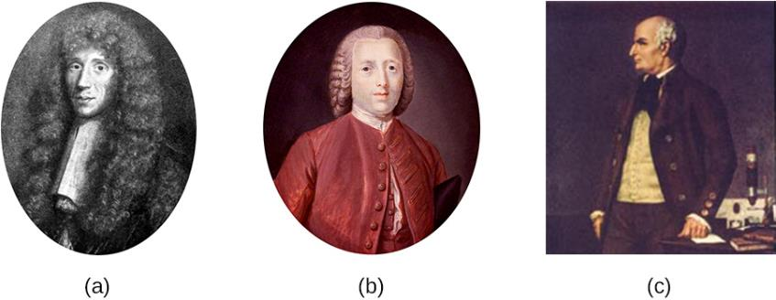
Spontaneous Generation (10 of 16)
Figure 2.3 (a) Francesco Redi, who demonstrated that maggots were the offspring of flies, not products of spontaneous generation. (b) John Needham, who argued that microbes arose spontaneously in broth from a “life force.” (c) Lazzaro Spallanzani, whose experiments with broth aimed to disprove those of Needham.

Slide 17
Spontaneous Generation (11 of 16)
The debate over spontaneous generation continued well into the 19th century, with scientists serving as proponents of both sides.
Louis Pasteur was a prominent French chemist who had been studying microbial fermentation and the causes of wine spoilage.

Slide 18
Spontaneous Generation (12 of 16)
In 1858, Pasteur filtered air through a gun-cotton filter and, upon microscopic examination of the cotton, found it full of microorganisms, suggesting that the exposure of a broth to air was not introducing a “life force” to the broth but rather airborne microorganisms.
Later, Pasteur made a series of flasks with long, twisted necks, in which he boiled broth to sterilize it.

Slide 19
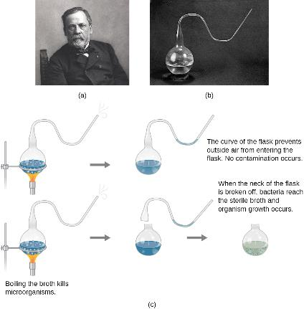
Spontaneous Generation (13 of 16)
Figure 2.4 (a) French scientist Louis Pasteur, who definitively refuted the long-disputed theory of spontaneous generation.
(b) The unique swan-neck feature of the flasks used in Pasteur’s experiment allowed air to enter the flask but prevented the entry of bacterial and fungal spores.
(c) Pasteur’s experiment consisted of two parts. In the first part, the broth in the flask was boiled to sterilize it. When this broth was cooled, it remained free of contamination. In the second part of the experiment, the flask was boiled and then the neck was broken off. The broth in this flask became contaminated. (credit b: modification of work by “Wellcome Images”/Wikimedia Commons)

Slide 20
Spontaneous Generation (14 of 16)
Pasteur’s design allowed air inside the flasks to be exchanged with air from the outside.
This prevented the introduction of any airborne microorganisms, which would get caught in the twists and bends of the flasks’ necks.

Slide 21
Spontaneous Generation (15 of 16)
If a life force besides the airborne microorganisms were responsible for microbial growth within the sterilized flasks, it would have access to the broth, whereas the microorganisms would not.
He correctly predicted that sterilized broth in his swan-neck flasks would remain sterile as long as the swan necks remained intact.

Slide 22
Spontaneous Generation (16 of 16)
Pasteur’s set of experiments irrefutably disproved the theory of spontaneous generation.
For his work, Pasteur earned the prestigious Alhumbert Prize from the Paris Academy of Sciences in 1862.

Slide 23
Foundations of Modern Cell Theory (1 of 6)
Modern cell theory has two basic tenets:
  All cells only come from other cells (the principle of biogenesis)
  Cells are the fundamental units of organisms.
Modern cell theory grew out of the collective work of many scientists.

Slide 24
Foundations of Modern Cell Theory (2 of 6)
The English scientist Robert Hooke first used the term “cells” in 1665 to describe the small chambers within cork that he observed under a microscope of his own design.
At the time, Hooke was not aware that the cork cells were long dead and, therefore, lacked the internal structures found within living cells.

Slide 25
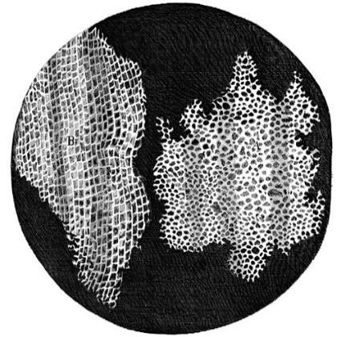
Foundations of Modern Cell Theory (3 of 6)
Figure 2.5 Robert Hooke (1635–1703) was the first to describe cells based upon his microscopic observations of cork. This illustration was published in his work Micrographia.

Slide 26
Foundations of Modern Cell Theory (4 of 6)
Nearly 200 years later, in 1838, Matthias Schleiden (1804–1881), a German botanist who made extensive microscopic observations of plant tissues, described them as being composed of cells.
Theodor Schwann (1810–1882), a noted German physiologist, made similar microscopic observations of animal tissue. He realized that similarities existed between plant and animal tissues.
This laid the foundation for the idea that cells are the fundamental components of plants and animals.

Slide 27
Foundations of Modern Cell Theory (5 of 6)
In 1852, Robert Remak (1815–1865), a prominent neurologist and embryologist, published convincing evidence that cells are derived from other cells as a result of cell division.
Three years later, Rudolf Virchow (1821–1902), a well-respected pathologist, published an editorial essay entitled “Cellular Pathology,” which popularized the concept of cell theory.

Slide 28
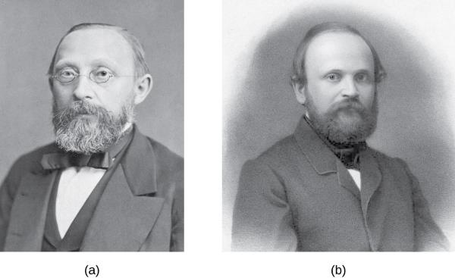
Foundations of Modern Cell Theory (6 of 6)
Figure 2.6 (a) Rudolf Virchow (1821–1902) popularized the cell theory in an 1855 essay entitled “Cellular Pathology.” (b) The idea that all cells originate from other cells was first published in 1852 by his contemporary and former colleague Robert Remak (1815–1865).

Slide 29
Endosymbiotic Theory (1 of 7)
As scientists were making progress toward understanding the role of cells in plant and animal tissues, others were examining the structures within the cells themselves.
In 1831, Scottish botanist Robert Brown (1773–1858) was the first to describe observations of nuclei, which he observed in plant cells.

Slide 30
Endosymbiotic Theory (2 of 7)
In the early 1880s, German botanist Andreas Schimper (1856–1901) was the first to describe the chloroplasts of plant cells, noting that they divided independent of the nucleus.

Slide 31
Endosymbiotic Theory (3 of 7)
Based upon the chloroplasts’ ability to reproduce independently, Russian botanist Konstantin Mereschkowski (1855–1921) suggested in 1905 that chloroplasts may have originated from ancestral photosynthetic bacteria living symbiotically inside a prokaryotic cell.
This was the first articulation of the endosymbiotic hypothesis, and would explain how eukaryotic cells evolved from ancestral bacteria.

Slide 32
Endosymbiotic Theory (4 of 7)
Mereschkowski’s endosymbiotic hypothesis was further supported by American anatomist Ivan Wallin (1883–1969) and American geneticist Lynn Margulis (1938 – 2011).
The endosymbiotic theory is defined as the theory that mitochondria and chloroplasts arose as a result of prokaryotic cells establishing a symbiotic relationship within a eukaryotic host.

Slide 33
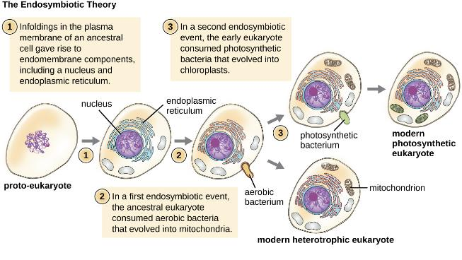
Endosymbiotic Theory (5 of 7)
Figure 2.7 According to the endosymbiotic theory, mitochondria and chloroplasts are each derived from the uptake of bacteria. These bacteria established a symbiotic relationship with their host cell that eventually led to the bacteria evolving into mitochondria and chloroplasts.

Slide 34
Endosymbiotic Theory (6 of 7)
More recent genetic sequencing and phylogenetic analysis show that mitochondrial DNA and chloroplast DNA are highly related to their bacterial counterparts, both in DNA sequence and chromosome structure.
Mitochondrial and chloroplast ribosomes are structurally similar to bacterial ribosomes, rather than to the eukaryotic ribosomes of their hosts.

Slide 35
Endosymbiotic Theory (7 of 7)
The binary fission of these organelles strongly resembles the binary fission of bacteria, as compared with mitosis performed by eukaryotic cells.
Scientists have observed several examples of bacterial endosymbionts in modern-day eukaryotic cells.
Examples include the endosymbiotic bacteria found within the guts of certain insects, such as cockroaches, and photosynthetic bacteria-like organelles found in protists.

Slide 36
The Germ Theory of Disease (1 of 9)
Prior to the discovery of microbes during the 17th century, other theories circulated about the origins of disease.
The ancient Greeks proposed the miasma theory.
In 1546, Italian physician Girolamo Fracastoro served as an early proponent of the germ theory of disease, which states that diseases may result from microbial infection.

Slide 37
The Germ Theory of Disease (2 of 9)
In 1847, Hungarian obstetrician Ignaz Semmelweis observed that mothers who gave birth in hospital wards staffed by physicians and medical students were more likely to suffer and die from puerperal fever after childbirth with a 10%–20% mortality rate than were mothers in wards staffed by midwives with a 1% mortality rate.
Semmelweis observed medical students handling dead tissues and living patients without washing their hands in between.

Slide 38
The Germ Theory of Disease (3 of 9)
Semmelweis suggested that the number of puerperal fever cases could be reduced if physicians and medical students simply washed their hands with chlorinated lime water before and after examining every patient.
The maternal mortality rate in mothers cared for by physicians dropped to the same 1% mortality rate observed among mothers cared for by midwives.
This demonstrated that handwashing was a very effective method for preventing disease transmission.

Slide 39
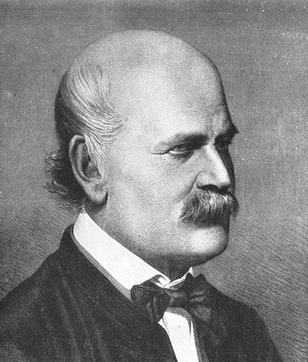
The Germ Theory of Disease (4 of 9)
Figure 2.8 Ignaz Semmelweis (1818–1865) was a proponent of the importance of handwashing to prevent transfer of disease between patients by physicians.

Slide 40
The Germ Theory of Disease (5 of 9)
In 1848, British physician John Snow conducted studies to track the source of cholera outbreaks in London.
Snow’s work is influential in that it represents the first known epidemiological study. This resulted in the first known public health response to an epidemic.

Slide 41
The Germ Theory of Disease (6 of 9)
Although the work of Semmelweis and Snow successfully showed the role of sanitation in preventing infectious disease, the cause of disease was not fully understood.
The subsequent work of Louis Pasteur, Robert Koch, and Joseph Lister would further substantiate the germ theory of disease.

Slide 42
The Germ Theory of Disease (7 of 9)
British surgeon Joseph Lister was trying to determine the causes of postsurgical infections.
In 1867, Lister began using carbolic acid (phenol) spray disinfectant/antiseptic during surgery.
His techniques of reducing postsurgical infection became a standard medical practice that became known as aseptic techniques (method or protocol designed to prevent microbial contamination of sterile objects, locations, or tissues).

Slide 43
The Germ Theory of Disease (8 of 9)
Robert Koch proposed a series of postulates (Koch’s postulates) based on the idea that the cause of a specific disease could be attributed to a specific microbe.
Koch and his colleagues were able to definitively identify the causative pathogens of specific diseases, including anthrax, tuberculosis, and cholera.

Slide 44
Koch’s Postulates
Koch’s Postulates
(1) The suspected pathogen must be found in every case of disease and not be found in healthy individuals.
(2) The suspected pathogen can be isolated and grown in pure culture.
(3) A healthy test subject infected with the suspected pathogen must develop the same signs and symptoms of disease as seen in postulate 1.
(4) The pathogen must be re-isolated from the new host and must be identical to the pathogen from postulate 2.

Slide 45
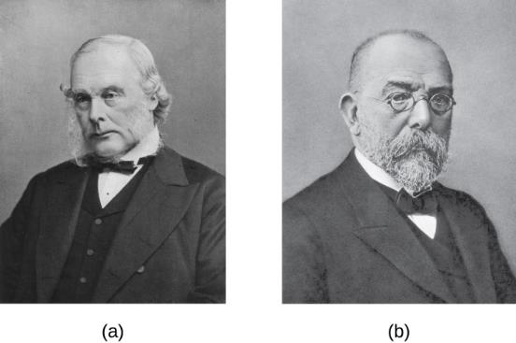
The Germ Theory of Disease (9 of 9)
Figure 2.9 (a) Joseph Lister developed procedures for the proper care of surgical wounds and the sterilization of surgical equipment. (b) Robert Koch established a protocol to determine the cause of infectious disease. Both scientists contributed significantly to the acceptance of the germ theory of disease.

Slide 46
Clinical Focus: Part 2 (1 of 2)
After suffering a fever, congestion, cough, and increasing aches and pains for several days. Barbara suspects that she has a case of the flu and decides to visit the health center at her university. The PA tells Barbara that her symptoms could be due to a range of diseases, such as influenza, bronchitis, pneumonia, or tuberculosis.
During her physical examination, the PA notes that Barbara’s heart rate is slightly elevated. Using a pulse oximeter, a small device that clips on her finger, he finds that Barbara has hypoxemia–a lower-than-normal level of oxygen in the blood. Using a stethoscope, the PA listens for abnormal sounds made by Barbara’s heart, lungs, and digestive system. As Barbara breathes, the PA hears a cackling sound and notes a slight shortness of breath. He collects a sputum sample, noting the greenish color of the mucus, and orders a chest radiograph, which shows a “shadow” in the left lung. All of these signs are suggestive of pneumonia, a condition in which the lungs fill with mucus.
  What kinds of infectious agents are known to cause pneumonia?

Slide 47
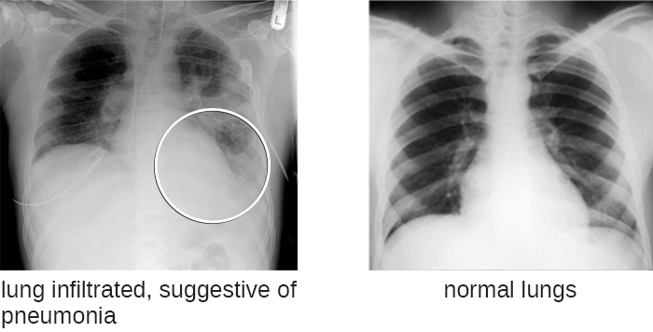
Clinical Focus: Part 2 (2 of 2)
Figure 2.10 (Left) This is a chest radiograph typical of pneumonia. Because X-ray images are negative images, a “shadow” is seen as a white area within the lung that should otherwise be black. In this case, the left lung shows a shadow as a result of pockets in the lung that have become filled with fluid. (credit left: modification of work by “Christaras A”/Wikimedia Commons)

Slide 48
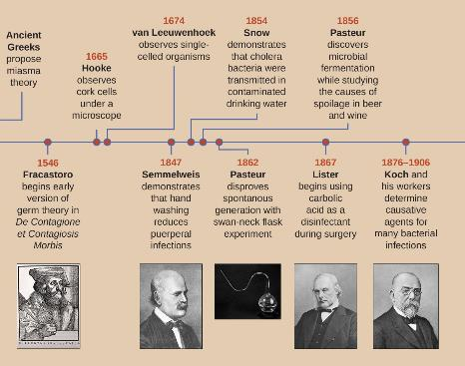
History of Microbiology
Figure 2.11 (credit “swan-neck flask”: modification of work by Wellcome Images)

Slide 49
Unique Characteristics of Prokaryotic Cells (1 of 26)
At the simplest level of construction, all cells possess a few fundamental components.
These include:
  cytoplasm (a gel-like substance composed of water and dissolved chemicals needed for growth), which is contained within a plasma membrane (also called a cell membrane or cytoplasmic membrane)
  One or more chromosomes, which contain the genetic blueprints of the cell
  Ribosomes, organelles used to produce proteins

Slide 50
Unique Characteristics of Prokaryotic Cells (2 of 26)
The two largest categories of cells are defined by major differences in several cell structures.
Prokaryotic cells lack a nucleus surrounded by a complex nuclear membrane and generally have a single, circular chromosome located in a nucleoid.
Eukaryotic cells have a nucleus surrounded by a complex nuclear membrane that contains multiple, rod-shaped chromosomes.

Slide 51
Unique Characteristics of Prokaryotic Cells (3 of 26)
All plant cells and animal cells are eukaryotic.
Prokaryotic microorganisms are classified within the domains Archaea and Bacteria, whereas eukaryotic organisms are classified within the domain Eukarya.

Slide 52
Unique Characteristics of Prokaryotic Cells (4 of 26)
Eukaryotic cells tend to be larger than prokaryotic cells.
The larger size of eukaryotic cells dictates the need to compartmentalize various chemical processes within different areas of the cell, using complex membrane-bound organelles.
In contrast, prokaryotic cells generally lack membrane-bound organelles, but contain inclusions that compartmentalize their cytoplasm.

Slide 53
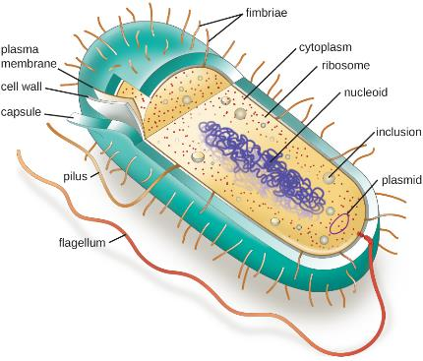
Unique Characteristics of Prokaryotic Cells (5 of 26)
Figure 2.12 A typical prokaryotic cell contains a cell membrane, chromosomal DNA that is concentrated in a nucleoid, ribosomes, and a cell wall. Some prokaryotic cells may also possess flagella, pili, fimbriae, and capsules.

Slide 54
Unique Characteristics of Prokaryotic Cells (6 of 26)
Individual cells of a particular prokaryotic organism are typically similar in shape, or cell morphology.
In addition to cellular shape, prokaryotic cells of the same species may group together in certain distinctive arrangements depending on the plane of cell division.

Slide 55
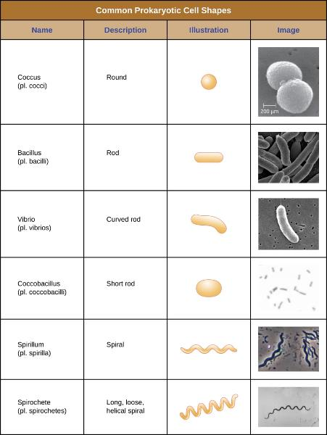
Common Cell Morphologies and Arrangements (1 of 2)
Figure 2.13 (credit “Coccus” micrograph: modification of work by Janice Haney Carr, Centers for Disease Control and Prevention; credit “Coccobacillus” micrograph: modification of work by Janice Carr, Centers for Disease Control and Prevention; credit “Spirochete” micrograph: modification of work by Centers for Disease Control and Prevention)

Slide 56
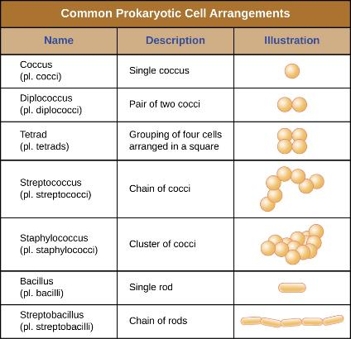
Common Cell Morphologies and Arrangements (2 of 2)
Figure 2.14

Slide 57
Unique Characteristics of Prokaryotic Cells (7 of 26)
In most prokaryotic cells, morphology is maintained by the cell wall, which is a structure found in most prokaryotes and some eukaryotes that envelopes the cell membrane.
The cell membrane protects the cell from changes in osmotic pressure.
Osmotic pressure occurs because of differences in the concentration of solutes on opposing sides of a semipermeable membrane.

Slide 58
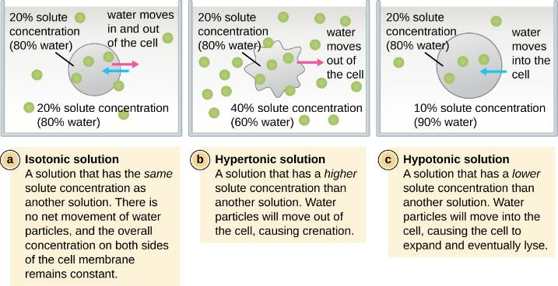
Unique Characteristics of Prokaryotic Cells (8 of 26)
Figure 2.15 In cells that lack a cell wall, changes in osmotic pressure can lead to crenation in hypertonic environments or cell lysis in hypotonic environments.

Slide 59
Unique Characteristics of Prokaryotic Cells (9 of 26)
Water is able to pass through a semipermeable membrane, but solutes (dissolved molecules like salts, sugars, and other compounds) cannot.
When the concentration of solutes is greater on one side of the membrane, water diffuses across the membrane from the side with the lower concentration (more water) to the side with the higher concentration (less water) until the concentrations on both sides become equal.

Slide 60
Unique Characteristics of Prokaryotic Cells (10 of 26)
This diffusion of water is called osmosis.
The external environment of a cell can be described as an isotonic, hypertonic, or hypotonic medium.

Slide 61
Unique Characteristics of Prokaryotic Cells (11 of 26)
In an isotonic medium, the solute concentrations inside and outside the cell are approximately equal, so there is no net movement of water across the cell membrane.
In a hypertonic medium, the solute concentration outside the cell exceeds that inside the cell, so water diffuses out of the cell and into the external medium.
In a hypotonic medium, the solute concentration inside the cell exceeds that outside of the cell, so water will move by osmosis into the cell. This causes the cell to swell and potentially lyse, or burst.

Slide 62
Unique Characteristics of Prokaryotic Cells (12 of 26)
The degree to which a particular cell is able to withstand changes in osmotic pressure is called tonicity.
In hypertonic environments, cells that lack a cell wall can become dehydrated, causing crenation, or shriveling of the cell. The plasma membrane contracts and appears scalloped or notched.
Cells that possess a cell wall undergo plasmolysis rather than crenation.

Slide 63
Unique Characteristics of Prokaryotic Cells (13 of 26)
Cells that lack a cell wall are more prone to lysis in hypotonic environments.
The presence of a cell wall allows the cell to maintain its shape and integrity for a longer time before lysing.

Slide 64
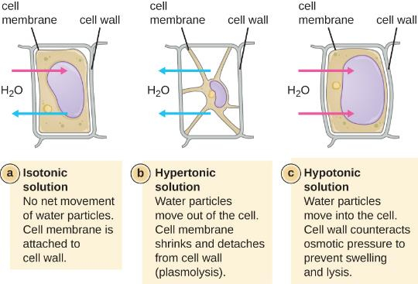
Unique Characteristics of Prokaryotic Cells (14 of 26)
Figure 2.16 In prokaryotic cells, the cell wall provides some protection against changes in osmotic pressure, allowing it to maintain its shape longer. The cell membrane is typically attached to the cell wall in an isotonic medium (left). In a hypertonic medium, the cell membrane detaches from the cell wall and contracts (plasmolysis) as water leaves the cell. In a hypotonic medium (right), the cell wall prevents the cell membrane from expanding to the point of bursting, although lysis will eventually occur if too much water is absorbed.

Slide 65
Unique Characteristics of Prokaryotic Cells (15 of 26)
Prokaryotic DNA and DNA-associated proteins are concentrated within the nucleoid region of the cell.
In general, prokaryotic DNA interacts with nucleoid-associated proteins (NAPs) that assist in the organization and packaging of the chromosome.

Slide 66
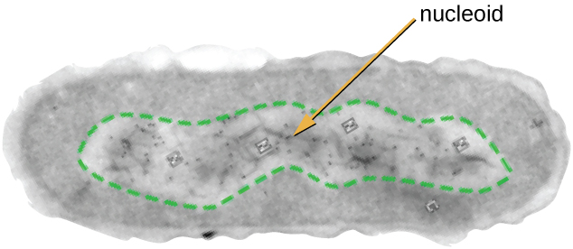
Unique Characteristics of Prokaryotic Cells (16 of 26)
Figure 2.17 The nucleoid region (the area enclosed by the green dashed line) is a condensed area of DNA found within prokaryotic cells. Because of the density of the area, it does not readily stain and appears lighter in color when viewed with a transmission electron microscope.

Slide 67
Unique Characteristics of Prokaryotic Cells (17 of 26)
Prokaryotic cells may also contain extrachromosomal DNA, or DNA that is not part of the chromosome.
This extrachromosomal DNA is found in plasmids, which are small, circular, double-stranded DNA molecules.
Plasmids are more commonly found in bacteria, but have been found in archaea and eukaryotic organisms.
Plasmids often carry genes that confer advantageous traits such as antibiotic resistance.

Slide 68
Unique Characteristics of Prokaryotic Cells (18 of 26)
Ribosomes are constructed from proteins, along with ribosomal RNA (rRNA).
Prokaryotes have 70S ribosomes that are found in the cytoplasm.
Eukaryotes have 80S ribosomes that are found in the cytoplasm and attached to organelles.

Slide 69
Unique Characteristics of Prokaryotic Cells (21 of 26)
Volutin granules, also called metachromatic granules, are inclusions that store polymerized inorganic phosphate that can be used in metabolism and assist in the formation of biofilms.
Polyhydroxybutyrate (PHB) has a phospholipid monolayer and is used as a source of biodegradable polymers for bioplastics.
Gas vacuoles are accumulations of small, protein-lined vesicles of gas and allow the prokaryotic cells that synthesize them to alter their buoyancy.
Magnetosomes are inclusions of magnetic iron oxide or iron sulfide surrounded by a lipid layer, which allow cells to align along a magnetic field, aiding their movement.
Carboxysome inclusions contain RuBisCO and carbonic anhydrase, which are used for carbon metabolism.

Slide 70
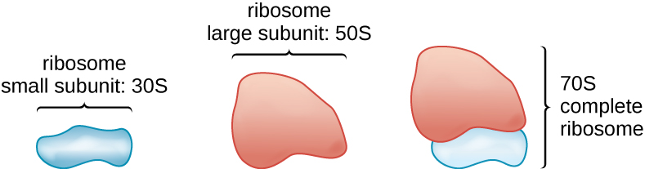
Unique Characteristics of Prokaryotic Cells (19 of 26)
Figure 2.18 Prokaryotic ribosomes (70S) are composed of two subunits: the 30S (small subunit) and the 50S (large subunit), each of which are composed of protein and rRNA components.

Slide 71
Unique Characteristics of Prokaryotic Cells (20 of 26)
As single-celled organisms living in unstable environments, some prokaryotic cells have the ability to store excess nutrients within cytoplasmic structures called inclusions.
Various types of inclusions store glycogen and starches, which contain carbon that cells can access for energy.

Slide 72
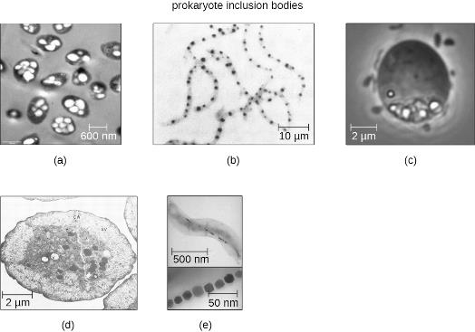
Unique Characteristics of Prokaryotic Cells (22 of 26)
Figure 2.19 Prokaryotic cells may have various types of inclusions. (a) A transmission electron micrograph of polyhydroxybutryrate lipid droplets. (b) A light micrograph of volutin granules. (c) A phase-contrast micrograph of sulfur granules. (d) A transmission electron micrograph of magnetosomes. (e) A transmission electron micrograph of gas vacuoles. (credit b, c, d: modification of work by American Society for Microbiology)

Slide 73
Unique Characteristics of Prokaryotic Cells (23 of 26)
Bacterial cells are generally observed as vegetative cells, but some genera of bacteria have the ability to form endospores.
Endospores protect the bacterial genome in a dormant state when environmental conditions are unfavorable.
They allow some bacterial cells to survive long periods without food or water, as well as exposure to chemicals, extreme temperatures, and even radiation.

Slide 74
Unique Characteristics of Prokaryotic Cells (24 of 26)
The process by which vegetative cells transform into endospores is called sporulation, and it generally begins when nutrients become depleted or environmental conditions become unfavorable.

Slide 75
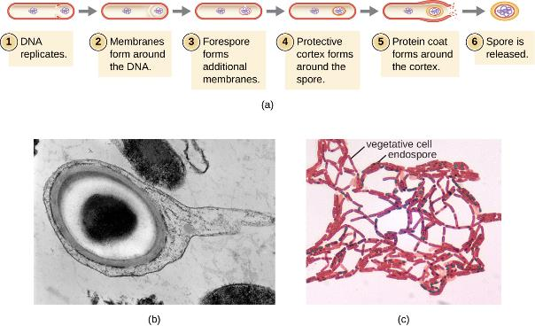
Unique Characteristics of Prokaryotic Cells (25 of 26)
Figure 2.20 (a) Sporulation begins following asymmetric cell division. The forespore becomes surrounded by a double layer of membrane, a cortex, and a protein spore coat, before being released as a mature endospore upon disintegration of the mother cell. (b) An electron micrograph of a Carboxydothermus hydrogenoformans endospore. (c) These Bacillus spp. cells are undergoing sporulation. The endospores have been visualized using Malachite Green spore stain. (credit b: modification of work by Jonathan Eisen)

Slide 76
Unique Characteristics of Prokaryotic Cells (26 of 26)
Some endospores persist in a dormant state for extended periods of time. When living conditions improve, endospores undergo germination, reentering a vegetative state.
After germination, the cell becomes metabolically active again and is able to carry out all of its normal functions, including growth and cell division.

Slide 77
Plasma Membrane (1 of 5)
Structures that enclose the cytoplasm and internal structures of the cell are known collectively as the cell envelope.
All cells (prokaryotic and eukaryotic) have a plasma membrane (also called cytoplasmic membrane or cell membrane) that exhibits selective permeability, allowing some molecules to enter or leave the cell while restricting the passages of others.

Slide 78
Plasma Membrane (2 of 5)
The structure of the plasma membrane is often described in terms of the fluid mosaic model.
The fluid mosaic model refers to the ability of membrane components to move fluidly within the plane of the membrane and include a diverse array of lipid and protein components (mosaic-like composition of the components).

Slide 79
Plasma Membrane (3 of 5)
The plasma membrane structure of most bacterial and eukaryotic cell types is a bilayer composed mainly of phospholipids formed with ester linkages and proteins, which move laterally within the membrane.
Membrane proteins and phospholipids may have carbohydrates (sugars) associated with them and are called glycoproteins or glycolipids, respectively.
  They form complexes that extend out from the surface of the cell, allowing the cell to interact with the external environment.

Slide 80
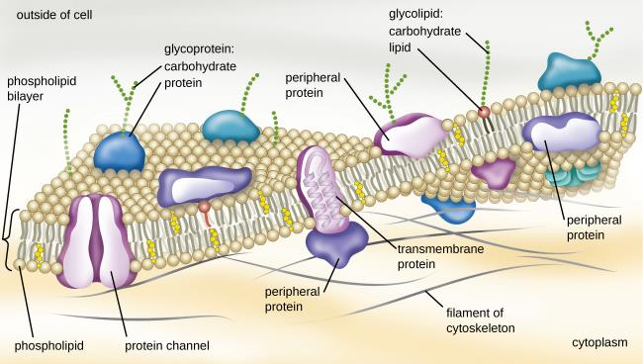
Plasma Membrane (4 of 5)
Figure 2.21 The bacterial plasma membrane is a phospholipid bilayer with a variety of embedded proteins that perform various functions for the cell. Note the presence of glycoproteins and glycolipids, whose carbohydrate components extend out from the surface of the cell. The abundance and arrangement of these proteins and lipids can vary greatly between species.

Slide 81
Plasma Membrane (5 of 5)
Archaeal membranes are different from bacterial and eukaryotic membranes.
  Archaeal membrane phospholipids are formed with ether linkages while bacterial or eukaryotic cell membranes have ester linkages.
  Archaeal phospholipids have branched chains while bacterial and eukaryotic cells are straight chained.
  Some archaeal plasma membranes can be formed of bilayers while others are lipid monolayers.

Slide 82
Membrane Transport Mechanisms (1 of 6)
One of the most important functions of the plasma membrane is to control the transport of molecules into and out of the cell.
Cells use various modes of transport across the plasma membrane.
The processes of simple diffusion, facilitated diffusion, and active transport are used in both eukaryotic and prokaryotic cells.

Slide 83
Membrane Transport Mechanisms (2 of 6)
Molecules moving from a higher concentration to a lower concentration with the concentration gradient are transported by simple diffusion, also known as passive transport.
Charged molecules, as well as large molecules, need the help of carriers or channels in the membrane. These structures ferry molecules across the membrane in a process known as facilitated diffusion.
Active transport occurs when cells move molecules across their membrane against concentration gradients and requires the input of adenosine triphosphate (ATP).

Slide 84
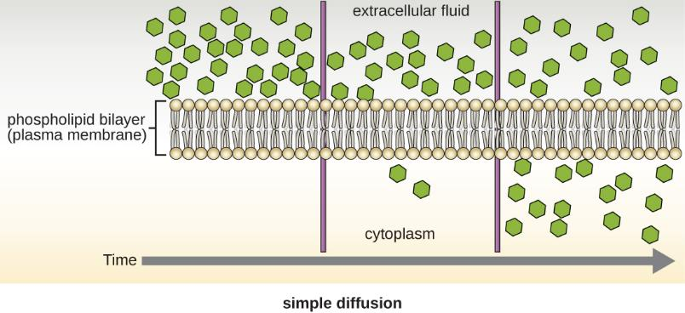
Membrane Transport Mechanisms (3 of 6)
Figure 2.22 Simple diffusion down a concentration gradient directly across the phospholipid bilayer. (credit: modification of work by Mariana Ruiz Villareal)

Slide 85
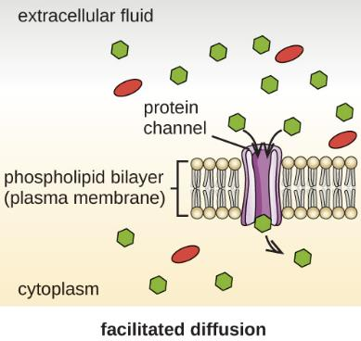
Membrane Transport Mechanisms (4 of 6)
Figure 2.23 Facilitated diffusion down a concentration gradient through a membrane protein. (credit: modification of work by Mariana Ruiz Villareal)

Slide 86
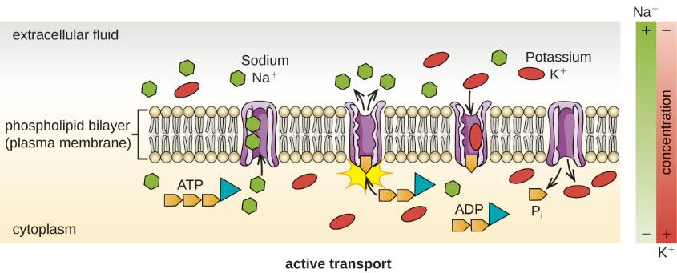
Membrane Transport Mechanisms (5 of 6)
Figure 3.24 Active transport against a concentration gradient via a membrane pump that requires energy. (credit: modification of work by Mariana Ruiz Villareal)

Slide 87
Membrane Transport Mechanisms (6 of 6)
Group translocation occurs when a molecule is chemically modified as it moves into a cell against its concentration gradient.

Slide 88
Photosynthetic Membrane Structures
Some prokaryotic cells have membrane structures that enable them to perform photosynthesis.
These structures consist of an infolding of the plasma membrane that encloses photosynthetic pigments such as green chlorophylls and bacteriochlorophylls.
  In cyanobacteria, these membrane structures are called thylakoids.
  In photosynthetic bacteria, these membrane structures are called chromatophores, lamellae, or chlorosomes.

Slide 89
Cell Wall (1 of 14)
The primary function of the cell wall is to protect the cell from harsh conditions in the outside environment.
The major component of bacterial cell walls is called peptidoglycan.
Each layer of peptidoglycan is composed of long chains of alternating molecules of N-acetylglucosamine (NAG) and N-acetylmuramic acid (NAM).

Slide 90
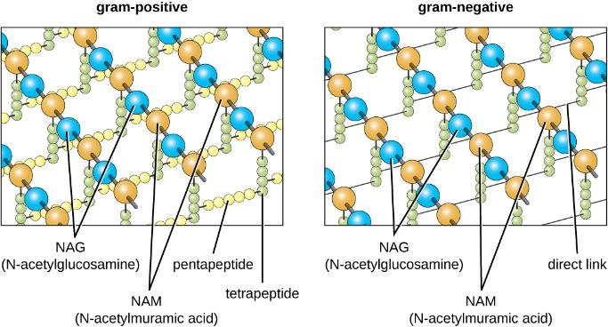
Cell Wall (2 of 14)
Figure 2.25 Peptidoglycan is composed of polymers of alternating NAM and NAG subunits, which are cross-linked by peptide bridges linking NAM subunits from various glycan chains. This provides the cell wall with tensile strength in two dimensions.

Slide 91
Cell Wall (3 of 14)
In gram-negative bacteria, tetrapeptide chains extending from each NAM unit are directly cross-linked.
In gram-positive bacteria, these tetrapeptide chains are linked by pentaglycine cross-bridges.

Slide 92
Cell Wall (4 of 14)
Since peptidoglycan is unique to bacteria, many antibiotic drugs are designed to interfere with peptidoglycan synthesis, weakening the cell wall and making bacterial cells more susceptible to the effects of osmotic pressure.

Slide 93
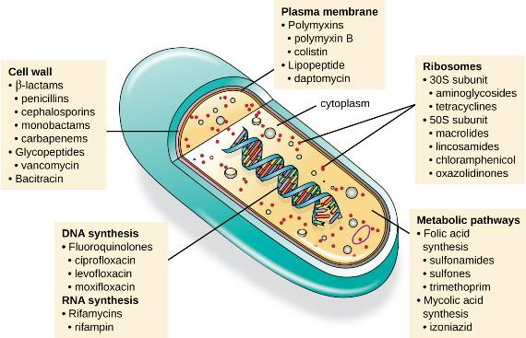
Cell Wall (5 of 14)
Figure 2.25b There are several classes of antibacterial compounds that are typically classified based on their bacterial target.

Slide 94
Cell Wall (6 of 14)
The Gram staining protocol is used to differentiate two common types of cell wall structures.
Gram-positive cells have a cell wall consisting of many layers of peptidoglycan totaling 30 – 100 nm in thickness.
These peptidoglycan layers are commonly embedded with teichoic acids (TAs), carbohydrate chains that extend through and beyond the peptidoglycan layer.

Slide 95
Cell Wall (7 of 14)
Gram-negative cells have a much thinner layer of peptidoglycan (no more than about 4 nm thick) than gram-positive cells.
In gram-negative cells, a gel-like matrix occupies the periplasmic space between the cell wall and the plasma membrane.
There is a second lipid bilayer called the outer membrane, which is external to the peptidoglycan layer.

Slide 96
Cell Wall (8 of 14)
This outer membrane is attached to the peptidoglycan by murein lipoprotein.
The outer membrane contains the molecule lipopolysaccharide (LPS), which functions as an endotoxin in infections involving gram-negative bacteria. This can lead to symptoms such as fever, hemorrhaging, and septic shock.

Slide 97
Cell Wall (9 of 14)
Each LPS molecule is composed of:
  Lipid A
  A core polysaccharide
  An O side chain
    This is composed of sugar-like molecules that comprise the external face of the LPS.
    The composition of the O side chain varies between different species and strains of bacteria.
    Parts of the O side chain called antigens can be detected using serological or immunological tests to identify specific pathogenic strains.

Slide 98
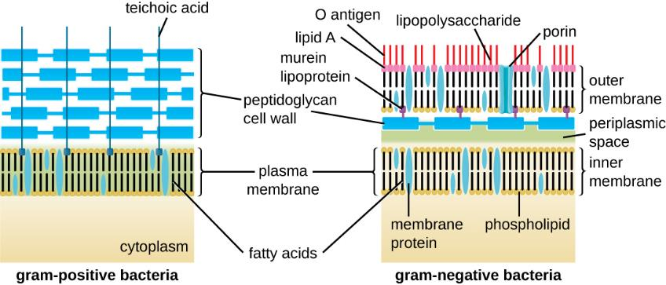
Cell Wall (10 of 14)
Figure 2.26 Bacteria contain two common cell wall structural types. Gram-positive cell walls are structurally simple, containing a thick layer of peptidoglycan with embedded teichoic acid external to the plasma membrane.^{[20]} Gram-negative cell walls are structurally more complex, containing three layers: the inner membrane, a thin layer of peptidoglycan, and an outer membrane containing lipopolysaccharide. (credit: modification of work by “Franciscosp2”/Wikimedia Commons)

Slide 99
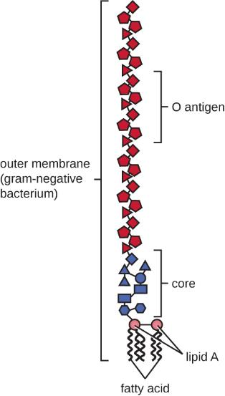
Cell Wall (11 of 14)
Figure 2.28 The outer membrane of a gram-negative bacterial cell contains lipopolysaccharide (LPS), a toxin composed of Lipid A embedded in the outer membrane, a core polysaccharide, and the O side chain.

Slide 100
Cell Wall (12 of 14)
Bacteria of the family Mycobacteriaceae have an external layer of waxy mycolic acids in their cell wall.
Since acid-fast stains must be used to penetrate the mycolic acid layer of purposes of microscopy, these bacteria are referred to as acid-fast.

Slide 101
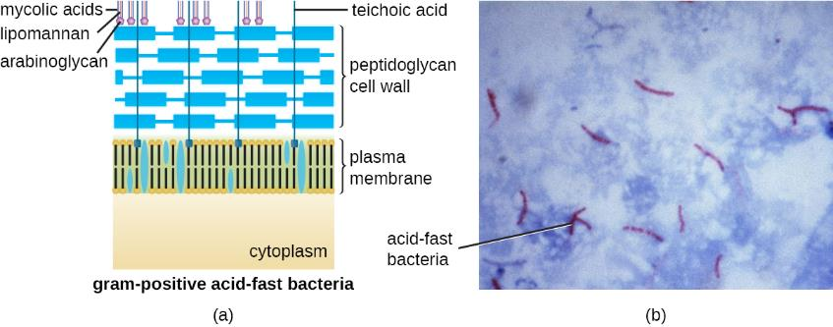
Cell Wall (13 of 14)
Figure 2.27 (a) Some gram-positive bacteria, including members of the Mycobacteriaceae, produce waxy mycolic acids found exterior to their structurally-distinct peptidoglycan. (b) The acid-fast staining protocol detects the presence of cell walls that are rich in mycolic acid. Acid-fast cells are stained red by carbolfuchsin. (credit a: modification of work by “Franciscosp2”/Wikimedia Commons; credit b: modification of work by Centers for Disease Control and Prevention)

Slide 102
Cell Wall (14 of 14)
Archaeal cell wall structure differs from that of bacteria in several significant ways:
  Archaeal cell walls do not contain peptidoglycan. They contain pseudopeptidoglycan (pseudomurein) in which NAM is replaced with a different subunit.
  Other archaea may have a layer of glycoproteins or polysaccharides that serve as the cell wall instead of pseudopeptidoglycan.
  There are a few archaea that appear to lack cell walls entirely.

Slide 103
Glycocalyces and S-Layers (1 of 6)
Some prokaryotic cells may have additional cell envelope structures exterior to the cell wall, such as glycocalyces and S-layers.
A glycocalyx is a sugar coat, of which there are two important types:
  Capsules
  Slime layers

Slide 104
Glycocalyces and S-Layers (2 of 6)
A capsule is an organized, firm layer located outside of the cell wall and usually composed of polysaccharides or proteins.
A slime layer is a less tightly organized layer that is only loosely attached to the cell wall and can be more easily washed off.
  Slime layers may be composed of polysaccharides, glycoproteins, or glycolipids.

Slide 105
Glycocalyces and S-Layers (3 of 6)
Glycocalyces allow cells to adhere to surfaces, aiding in the formation of biofilms.
  Biofilms are colonies of microbes that form in layers on surfaces.
  Biofilms hold water like a sponge, preventing desiccation.
  Biofilms also protect cells from predation and hinder the action of antibiotics and disinfectants.

Slide 106
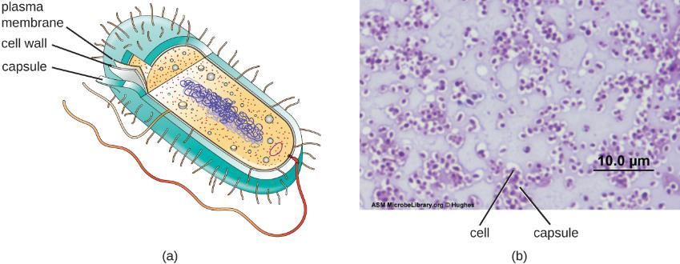
Glycocalyces and S-Layers (4 of 6)
Figure 2.29 (a) Capsules are a type of glycocalyx composed of an organized layer of polysaccharides. (b) A capsule stain of Pseudomonas aeruginosa, a bacterial pathogen capable of causing many different types of infections in humans. (credit b: modification of work by American Society for Microbiology)

Slide 107
Glycocalyces and S-Layers (5 of 6)
The ability to produce a capsule can contribute to a microbe’s pathogenicity (ability to cause disease) because the capsule can make it more difficult for phagocytic cells to engulf and kill the microorganism.
Streptococcus pneumoniae is a microorganism that produces a capsule well known to aid in this bacterium’s pathogenicity.

Slide 108
Glycocalyces and S-Layers (6 of 6)
Another type of cell envelope structure is an S-layer, which is composed of a mixture of structural proteins and glycoproteins.
In bacteria, S-layers are found outside the cell wall.
In some archaea, the S-layer serves as the cell wall.
The exact function of S-layers is not entirely understood.

Slide 109
Clinical Focus: Part 3
After diagnosing Barbara with pneumonia, the PA writes her a prescription for amoxicillin, a commonly-prescribed type of penicillin derivative. More than a week later, despite taking the full course as directed. Barbara still feels weak and is not fully recovered, although she is still able to get through her daily activities. She returns to the health center for a follow-up visit.
Many types of bacteria, fungi, and viruses can cause pneumonia. Amoxicillin targets the peptidoglycan of bacterial cell walls. Since the amoxicillin has not resolved Barbara’s symptoms, the PA concludes that the causative agent probably lacks peptidoglycan, meaning that the pathogen could be a virus, a fungus, or a bacterium that lacks peptidoglycan. Another possibility is that the pathogen is a bacterium containing peptidoglycan but has developed resistance to amoxicillin.
  How can the PA definitively identify the cause of Barbara’s pneumonia?
  What form of treatment should the PA prescribe, given that the amoxicillin was ineffective?

Slide 110
Filamentous Appendages (1 of 12)
Many bacterial cells have protein appendages embedded within their cell envelopes that extend outward, allowing interaction with the environment.
These appendages can attach to other surfaces, transfer DNA, or provide movement.
Filamentous appendages include fimbriae, pili, and flagella.

Slide 111
Filamentous Appendages (2 of 12)
Fimbriae refers to short bristle-like proteins projecting from the cell surface by the hundreds.
Fimbriae enable a cell to attach to surfaces and to other cells.
Adherence to host cells is important for colonization, infectivity, and virulence while adherence to surfaces is important in biofilm formation.

Slide 112
Filamentous Appendages (3 of 12)
Pili (singular: pilus) refers to longer, less numerous protein appendages that aid in attachment to surfaces.
A specific type of pilus, called the F pilus or sex pilus, is important in the transfer of DNA between bacterial cells, which occurs between members of the same generation when two cells physically transfer or exchange parts of their respective genomes.

Slide 113
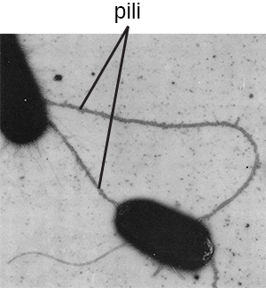
Filamentous Appendages (4 of 12)
Figure 2.30 Bacteria may produce two different types of protein appendages that aid in surface attachment. Fimbriae typically are more numerous and shorter, whereas pili (shown here) are longer and less numerous per cell. (credit: modification of work by American Society for Microbiology)

Slide 114
Filamentous Appendages (5 of 12)
Flagella are structures used by cells to move in aqueous environments.
They are stiff spiral filaments composed of flagellin protein subunits that extend outward from the cell and spin solution.
The basal body is the motor for the flagellum and is embedded in the plasma membrane.
A hook region connects the basal body to the filament.

Slide 115
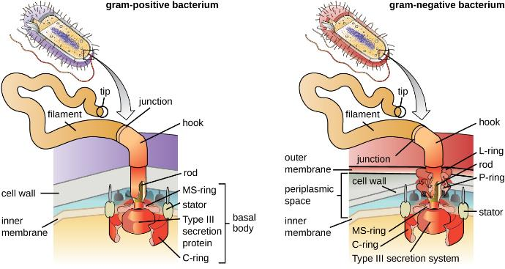
Filamentous Appendages (6 of 12)
Figure 2.31 The basic structure of a bacterial flagellum consists of a basal body, hook, and filament. The basal body composition and arrangement differ between gram-positive and gram-negative bacteria. (credit: modification of work by “LadyofHats”/Mariana Ruiz Villareal)

Slide 116
Filamentous Appendages (7 of 12)
Different types of motile bacteria exhibit different arrangements of flagella.
  A bacterium with a singular flagellum typically located at one end of the cell (polar) is said to have a monotrichous flagellum.
  Cells with amphitrichous flagella have a flagellum or tufts of flagella at each end.
  Cells with lophotrichous flagella have a tuft at one end of the cell.
  Peritrichous flagella cover the entire surface of a bacterial cell.

Slide 117
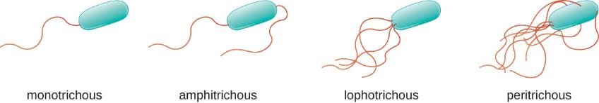
Filamentous Appendages (8 of 12)
Figure 2.32 Flagellated bacteria may exhibit multiple arrangements of their flagella. Common arrangements include monotrichous, amphitrichous, lophotrichous, or peritrichous.

Slide 118
Filamentous Appendages (9 of 12)
Bacteria can move in response to a variety of environmental signals, including:
  Light (phototaxis),
  Magnetic fields using magnetosomes (magnetotaxis), and
  Chemical gradients (chemotaxis)

Slide 119
Filamentous Appendages (10 of 12)
Purposeful movement toward a chemical attractant, like a food source, or away from a repellent, like a poisonous chemical, is achieved by increasing the length of runs and decreasing the length of tumbles.
When running, flagella rotate in a counterclockwise direction, allowing the bacterial cell to move forward.
When tumbling, flagella are splayed out while rotating in a clockwise direction, creating a looping motion and preventing meaningful forward movement but reorienting the cell toward the direction of the attractant.

Slide 120
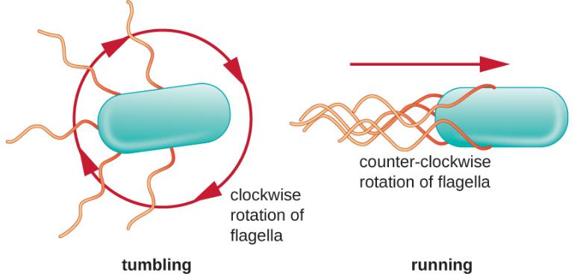
Filamentous Appendages (11 of 12)
Figure 2.33 Bacteria achieve directional movement by changing the rotation of their flagella. In a cell with peritrichous flagella, the flagella bundle when they rotate in a counterclockwise direction, resulting in a run. However, when the flagella rotate in a clockwise direction, the flagella are no longer bundled, resulting in tumbles.

Slide 121
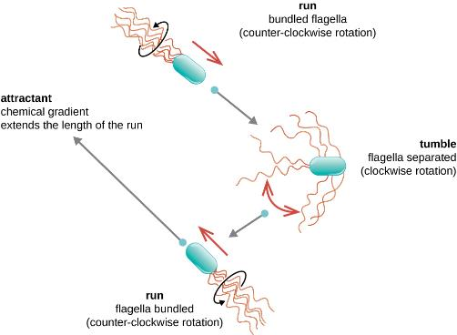
Filamentous Appendages (12 of 12)
Figure 2.34 Without a chemical gradient, flagellar rotation cycles between counterclockwise (run) and clockwise (tumble) with no overall directional movement. However, when a chemical gradient of an attractant exists, the length of runs is extended, while the length of tumbles is decreased. This leads to chemotaxis: an overall directional movement toward the higher concentration of the attractant.

Slide 122
Unique Characteristics of Eukaryotic Cells (1 of 16)
Eukaryotic organisms include protozoans, algae, fungi, plants, and animals.
Eukaryotic cells are defined by the presence of:
  A nucleus surrounded by a complex nuclear membrane,
  Membrane bound organelles in the cytoplasm.

Slide 123
Unique Characteristics of Eukaryotic Cells (2 of 16)
Organelles such as mitochondria, the endoplasmic reticulum (ER), Golgi apparatus, lysosomes, and peroxisomes are held in place by the cytoskeleton.
The cytoskeleton is an internal network that supports transport of intracellular components and helps maintain cell shape.

Slide 124
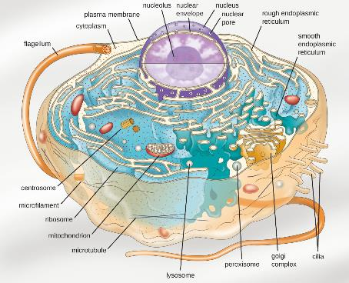
Unique Characteristics of Eukaryotic Cells (3 of 16)
Figure 2.35 An illustration of a generalized, single-celled eukaryotic organism. Note that cells of eukaryotic organisms vary greatly in terms of structure and function, and a particular cell may not have all of the structures shown here.

Slide 125
Table 2.2
Summary of Cell Structures
Cell Structure | Prokaryotes |  | Eukaryotes
 | Bacteria | Archaea
Size | ~0.5–1 μM | ~0.5–1 μM | ~5–20 μM
Surface area-to-volume ratio | High | High | Low
Nucleus | No | No | Yes
Genome characteristics | Single chromosome Circular Haploid Lacks histones | Single chromosome Circular Haploid Contains histones | Multiple chromosomes Linear Haploid or diploid Contains histones
Cell division | Binary fission | Binary fission | Mitosis, meiosis
Membrane lipid composition | Ester-linked Straight-chain fatty acids Bilayer | Ether-linked Branched isoprenoids Bilayer or monolayer | Ester-linked Straight-chain fatty acids Sterols Bilayer
Cell wall composition | Peptidoglycan, or None | Pseudopeptidoglycan, or Glycopeptide, or Polysaccharide, or Protein (S-layer), or None | Cellulose (plants, some algae) Chitin (molluscs, insects, crustaceans, and fungi) Silica (some algae) Most others lack cell walls
Motility structures | Rigid spiral flagella composed of flagellin | Rigid spiral flagella composed of archaeal flagellins | Flexible flagella and cilia composed of microtubules
Membrane-bound organelles | No | No | Yes
Endomembrane system | No | No | Yes (ER, Golgi, lysosomes)
Ribosomes | 70S | 70S | 80S in cytoplasm and rough ER 70S in mitochondria, chloroplasts

Slide 126
Unique Characteristics of Eukaryotic Cells (4 of 16)
Eukaryotic cells display a wide variety of different cell morphologies.
Possible shapes include spheroid, ovoid, cuboidal, cylindrical, flat, lenticular, fusiform, discoidal, crescent, ring stellate, and polygonal.
Some eukaryotic cells are irregular in shape, and some are capable of changing shape.

Slide 127
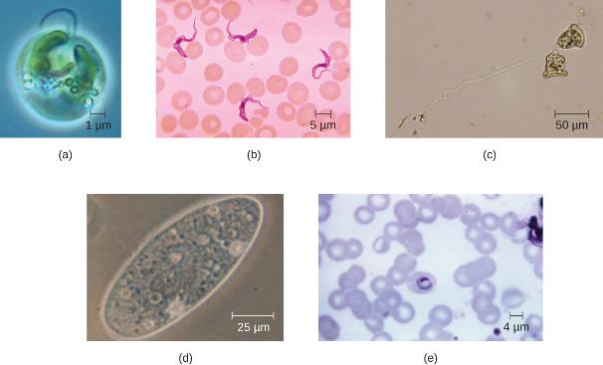
Unique Characteristics of Eukaryotic Cells (5 of 16)
Figure 2.36 Eukaryotic cells come in a variety of cell shapes. (a) Spheroid Chromulina alga. (b) Fusiform shaped Trypanosoma. (c) Bell-shaped Vorticella. (d) Ovoid Paramecium. (e) Ring-shaped Plasmodium ovale. (credit a: modification of work by NOAA; credit b, e: modification of work by Centers for Disease Control and Prevention)

Slide 128
Unique Characteristics of Eukaryotic Cells (6 of 16)
By containing the cell’s DNA, the nucleus ultimately controls all activities of the cell and also serves an essential role in reproduction and heredity.
Eukaryotic cells typically have their DNA organized into multiple linear chromosomes.
The DNA within the nucleus is highly organized and condensed to fit inside the nucleus, which is accomplished by wrapping the DNA around proteins called histones.

Slide 129
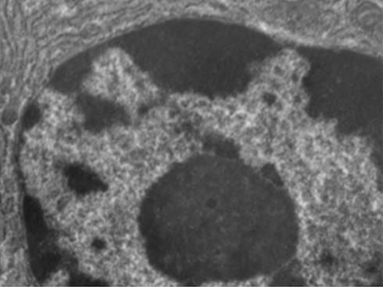
Unique Characteristics of Eukaryotic Cells (7 of 16)
Figure 2.37 Eukaryotic cells have a well-defined nucleus surrounded by a nuclear membrane. The nucleus of this mammalian lung cell is located in the bottom right corner of the image. The large, dark, oval-shaped structure within the nucleus is the nucleolus.

Slide 130
Unique Characteristics of Eukaryotic Cells (8 of 16)
Although most eukaryotic cells have only one nucleus, exceptions exist.
Protozoans of the genus Paramecium typically have two complete nuclei: a small nucleus that is used for reproduction (micronucleus) and a large nucleus that directs cellular metabolism (macronucleus).

Slide 131
Unique Characteristics of Eukaryotic Cells (9 of 16)
Some fungi transiently form cells with two nuclei, called heterokaryotic cells, during sexual reproduction.
Cells whose nuclei divide, but whose cytoplasm does not are called coenocytes.

Slide 132
Unique Characteristics of Eukaryotic Cells (10 of 16)
The nucleus is bound by a complex nuclear membrane, often called the nuclear envelope, that consists of two distinct lipid bilayers that are contiguous with each other.
The nuclear envelope contains nuclear pores, which are large, rosette-shaped protein complexes that control the movement of materials into and out of the nucleus.

Slide 133
Unique Characteristics of Eukaryotic Cells (11 of 16)
The overall shape of the nucleus is determined by the nuclear lamina, a meshwork of intermediate filaments found just inside the nuclear envelope membranes.
Outside the nucleus, additional intermediate filaments form a looser mesh and serve to anchor the nucleus in position within the cell.

Slide 134
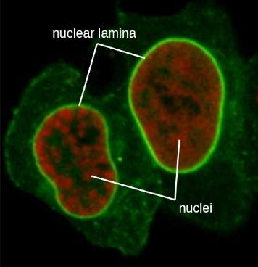
Unique Characteristics of Eukaryotic Cells (12 of 16)
Figure 2.38 In this fluorescent microscope image, all the intermediate filaments have been stained with a bright green fluorescent stain. The nuclear lamina is the intense bright green ring around the faint red nuclei.

Slide 135
Unique Characteristics of Eukaryotic Cells (13 of 16)
The nucleolus is a dense region within the nucleus where ribosomal RNA (rRNA) biosynthesis occurs.
The nucleolus is also the site where assembly of ribosomes begins.
Preribosomal complexes are assembled from rRNA and proteins in the nucleolus. They are transported out to the cytoplasm, where ribosome assembly is completed.

Slide 136
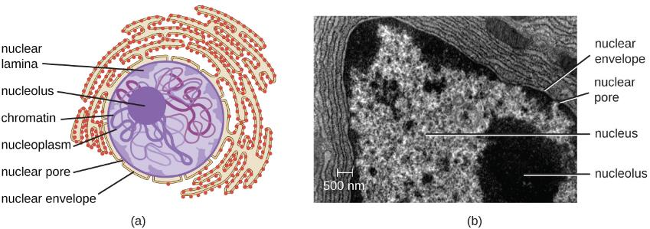
Unique Characteristics of Eukaryotic Cells (14 of 16)
Figure 2.39 (a) The nucleolus is the dark, dense area within the nucleus. It is the site of rRNA synthesis and preribosomal assembly. (b) Electron micrograph showing the nucleolus.

Slide 137
Unique Characteristics of Eukaryotic Cells (15 of 16)
Ribosomes found in eukaryotic organelles such as mitochondria or chloroplasts have 70S ribosomes–the same as prokaryotic ribosomes.
Nonorganelle-associated ribosomes in eukaryotic cells are 80S ribosomes, composed of a 40S small subunit and a 60S large subunit.

Slide 138
Unique Characteristics of Eukaryotic Cells (16 of 16)
The two types of nonorganelle-associated eukaryotic ribosomes are defined by their location in the cell:
  Free ribosomes
    are found in the cytoplasm and serve to synthesize water-soluble proteins.
  Membrane-bound ribosomes
    Are found attached to the rough endoplasmic reticulum and make proteins for insertion into the cell membrane or proteins destined for export from the cell.

Slide 139
Endomembrane System (1 of 12)
The endomembrane system, unique to eukaryotic cells, is a series of membranous tubules, sacs, and flattened disks that synthesize many cell components and move materials around within the cell.
Eukaryotic cells require this system to transport materials that cannot be disperse by diffusion alone.

Slide 140
Endomembrane System (2 of 12)
The endomembrane system comprises several organelles and connections between them, including the:
  Endoplasmic reticulum,
  Golgi apparatus,
  Lysosomes, and
  Vesicles.

Slide 141
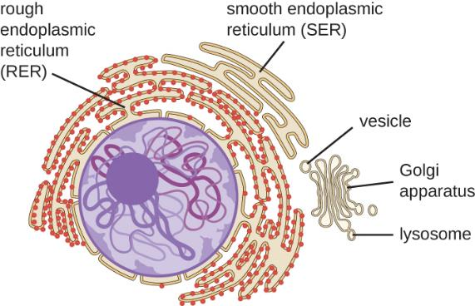
Endomembrane System (3 of 12)
Figure 2.40 The endomembrane system is composed of a series of membranous intracellular structures that facilitate movement of materials throughout the cell and to the cell membrane.

Slide 142
Endomembrane System (4 of 12)
The endoplasmic reticulum (ER) is an interconnected array of tubules and cisternae (flattened sacs) with a single lipid bilayer.
The spaces inside of the cisternae are called lumen of the ER.

Slide 143
Endomembrane System (5 of 12)
There are two types of ER:
  Rough endoplasmic reticulum (RER)
    Is studded with ribosomes bound on the cytoplasmic side of the membrane.
    These ribosomes make proteins destined for the plasma membrane.
    Following synthesis these proteins are inserted into the membrane of the RER.
    Small sacs of the RER containing these newly synthesized proteins then bud off as transport vesicles and move either to the Golgi apparatus for further processing, directly to the plasma membrane, to the membrane of another organelle, or out of the cell.
    Transport vesicles are single-lipid, bilayer, membranous spheres with hollow interiors that carry molecules.

Slide 144
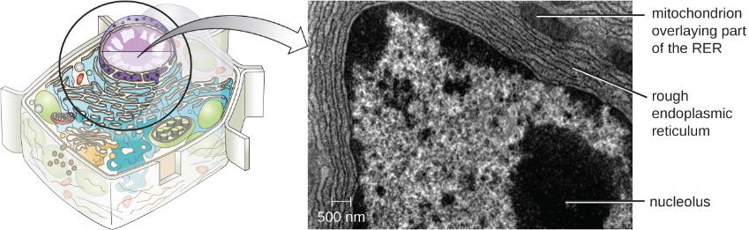
Endomembrane System (6 of 12)
Figure 2.41 The rough endoplasmic reticulum is studded with ribosomes for the synthesis of membrane proteins (which give it its rough appearance).

Slide 145
Endomembrane System (7 of 12)
There are two types of ER:
  Smooth endoplasmic reticulum (SER)
    SER does not have ribosomes and therefore, appears “smooth.”
    It is involved in biosynthesis of lipids, carbohydrate metabolism, and detoxification of toxic compounds within the cell.

Slide 146
Endomembrane System (8 of 12)
The Golgi apparatus was discovered within the endomembrane system in 1898 by Italian scientist Camillo Golgi, who developed a novel staining technique that showed stacked membrane structures within the cells of Plasmodium, the causative agent of malaria.
The Golgi apparatus is composed of a series of membranous disks called dictyosomes, each having a single lipid bilayer, that are stacked together.

Slide 147
Endomembrane System (9 of 12)
Enzymes in the Golgi apparatus modify lipids and proteins transported from the ER to the Golgi, often adding carbohydrate components to them, producing glycolipids, glycoproteins, or proteoglycans.
Different types of cells can be distinguished from one another by the structure and arrangement of the glycolipids and glycoproteins contained in their plasma membranes.

Slide 148
Endomembrane System (10 of 12)
Transport vesicles leaving the ER fuse with a Golgi apparatus on its receiving, or cis, face.
The proteins are processed within the Golgi apparatus and then additional transport vesicles containing the modified proteins and lipids pinch off from the Golgi apparatus on its outgoing, or trans, face.
These outgoing vesicles move to and fuse with the plasma membrane or the membrane of other organelles.

Slide 149
Endomembrane System (11 of 12)
Exocytosis is the process by which secretory vesicles (spherical membranous sacs) release their contents to the cell’s exterior.
All cells have constitutive secretory pathways in which secretory vesicles transport soluble proteins that are released from the cell continually.

Slide 150
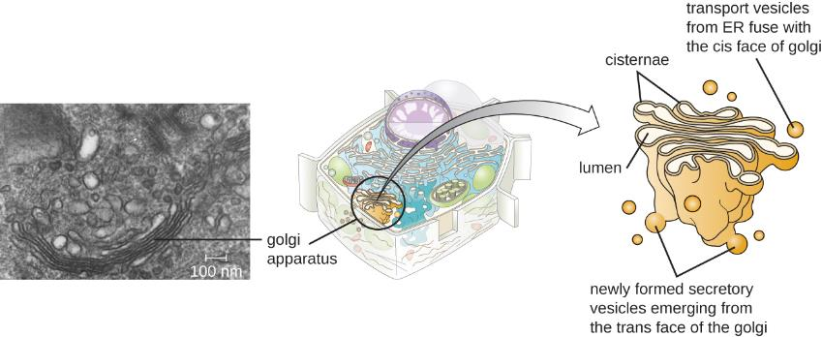
Endomembrane System (12 of 12)
Figure 2.42 A transmission electron micrograph (left) of a Golgi apparatus in a white blood cell. The illustration (right) shows the cup-shaped, stacked disks and several transport vesicles. The Golgi apparatus modifies lipids and proteins, producing glycolipids and glycoproteins, respectively, which are commonly inserted into the plasma membrane.

Slide 151
Lysosomes
In the 1960s, Belgian scientist Christian de Duve discovered lysosomes, membrane-bound organelles of the endomembrane system that contain digestive enzymes.
Certain types of eukaryotic cells use lysosomes to break down various particles, such as food, damaged organelles or cellular debris, microorganisms, or immune complexes.

Slide 152
Peroxisomes (1 of 3)
Christian de Duve is also credited with the discovery of peroxisomes, membrane-bound organelles that are not part of the endomembrane system.
Peroxisomes form independently in the cytoplasm from the synthesis of peroxin proteins by free ribosomes and the incorporation of these peroxin proteins into existing peroxisomes.
Growing peroxisomes then divide by a process similar to binary fission.

Slide 153
Peroxisomes (2 of 3)
Peroxisomes were first named for their ability to produce hydrogen peroxide, a highly reactive molecule that helps to break down molecules such as uric acid, amino acids, and fatty acids.
Peroxisomes also possess the enzyme catalase, which can degrade hydrogen peroxide.
They also play a role in lipid biosynthesis.

Slide 154
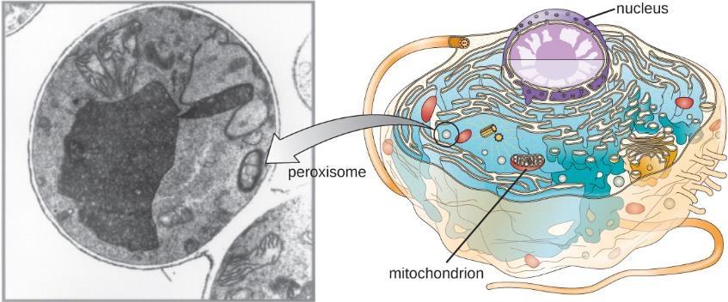
Peroxisomes (3 of 3)
Figure 2.43 A transmission electron micrograph (left) of a cell containing a peroxisome. The illustration (right) shows the location of peroxisomes in a cell. These eukaryotic structures play a role in lipid biosynthesis and breaking down various molecules. They may also have other specialized functions depending on the cell type. (credit “micrograph”: modification of work by American Society for Microbiology)

Slide 155
Cytoskeleton (1 of 12)
Eukaryotic cells have an internal cytoskeleton made of microfilaments, intermediate filaments, and microtubules.
This matrix of fibers and tubes provides structural support as well as a network over which materials can be transported within the cell and on which organelles can be anchored.

Slide 156
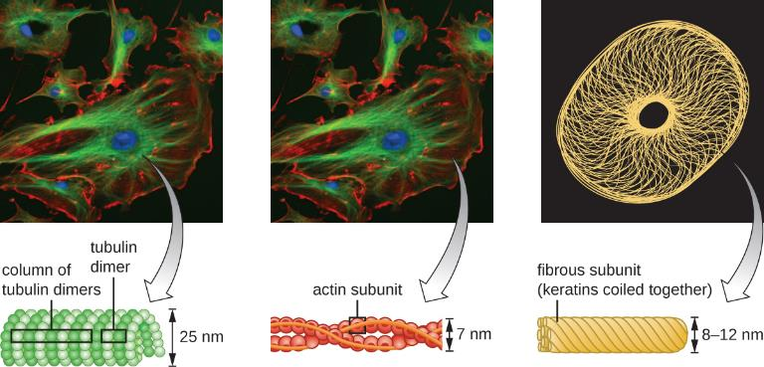
Cytoskeleton (2 of 12)
Figure 2.44 The cytoskeleton is a network of microfilaments, intermediate filaments, and microtubules found throughout the cytoplasm of a eukaryotic cell. In these fluorescently labeled animal cells, the microtubules are green, the actin microfilaments are red, the nucleus is blue, and keratin (a type of intermediate filament) is yellow.

Slide 157
Cytoskeleton (3 of 12)
Microfilaments are composed of two intertwined strands of actin, each composed of actin monomers forming filamentous cables 6nm in diameter.
The actin filaments work together with motor proteins, like myosin, to effect muscle contraction in animals or the amoeboid movement of some eukaryotic microbes.

Slide 158
Cytoskeleton (4 of 12)
Temporary extensions of the cytoplasmic membrane called pseudopodia (meaning “false feet”) are produced through the forward flow of soluble actin filaments into the pseudopodia.

Slide 159
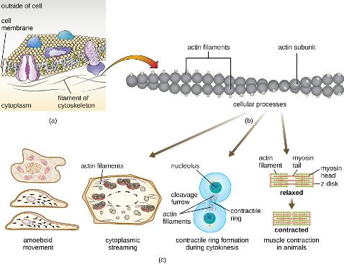
Cytoskeleton (5 of 12)
Figure 2.45 (a) A microfilament is composed of a pair of actin filaments. (b) Each actin filament is a string of polymerized actin monomers. (c) The dynamic nature of actin, due to its polymerization and depolymerization and its association with myosin, allows microfilaments to be involved in a variety of cellular processes, including ameboid movement, cytoplasmic streaming, contractile ring formation during cell division, and muscle contraction in animals.

Slide 160
Cytoskeleton (6 of 12)
Intermediate filaments are a diverse group of cytoskeletal filaments that act as cables within the cell.
They are termed “intermediate” because their 10-nm diameter is thicker than that of actin but thinner than that of microtubules.
Intermediate filaments are composed of several strands of polymerized subunits that are made up of a wide variety of monomers.

Slide 161
Cytoskeleton (7 of 12)
Intermediate filaments tend to be more permanent in the cell and maintain the position of the nucleus.
They also form the nuclear lamina just inside the nuclear envelope.
Additionally, intermediate filaments play a role in anchoring cells together in animal tissues.

Slide 162
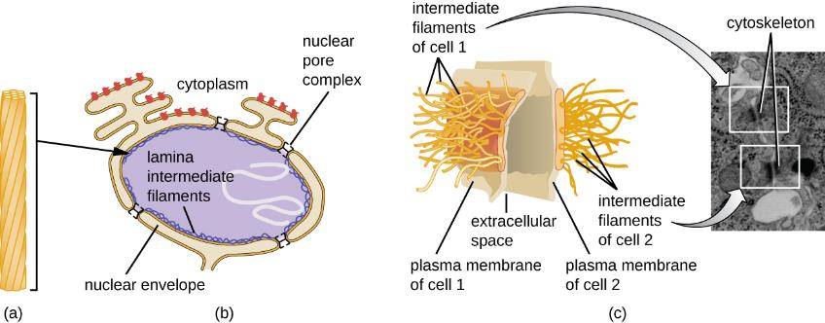
Cytoskeleton (8 of 12)
Figure 2.46 (a) Intermediate filaments are composed of multiple strands of polymerized subunits. They are more permanent than other cytoskeletal structures and serve a variety of functions. (b) Intermediate filaments form much of the nuclear lamina. (c) Intermediate filaments form the desmosomes between cells in some animal tissues. (credit c “illustration”: modification of work by Mariana Ruiz Villareal)

Slide 163
Cytoskeleton (9 of 12)
Microtubules are a third type of cytoskeletal fiber composed of tubulin dimers (α tubulin and β tubulin).
These form hollow tubes 23 nm in diameter that are used as dimers within the cytoskeleton.
Microtubules are the main components of eukaryotic flagella and cilia, composing both the filament and the basal body components.

Slide 164
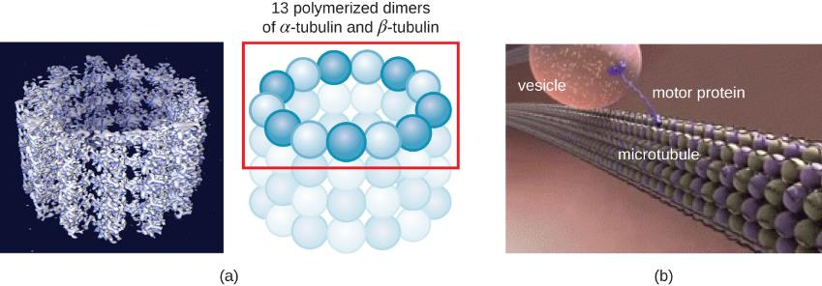
Cytoskeleton (10 of 12)
Figure 2.47 (a) Microtubules are hollow structures composed of polymerized tubulin dimers. (b) They are involved in several cellular processes, including the movement of organelles throughout the cytoplasm. Motor proteins carry organelles along microtubule tracks that crisscross the entire cell. (credit b: modification of work by National Institute on Aging)

Slide 165
Cytoskeleton (11 of 12)
Microtubules are involved in cell division, forming the mitotic spindle that serves to separate chromosomes during mitosis and meiosis.
The mitotic spindle is produced by two centrosomes, which are essentially microtubule-organizing centers, at opposite ends of the cell.
Each centrosome is composed of a pair of centrioles positioned at right angles to each other, and each centriole is an array of nine parallel microtubules arranged in triplets.

Slide 166
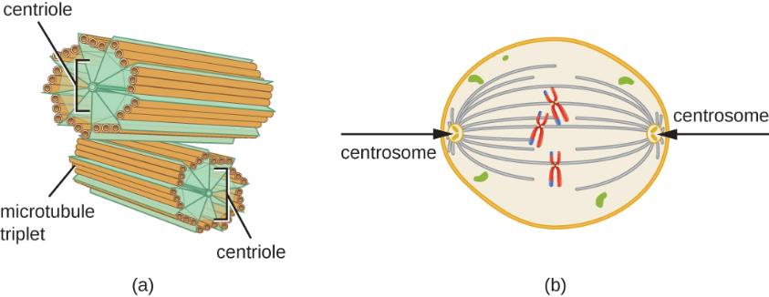
Cytoskeleton (12 of 12)
Figure 2.48 (a) A centrosome is composed of two centrioles positioned at right angles to each other. Each centriole is composed of nine triplets of microtubules held together by accessory proteins. (b) In animal cells, the centrosomes (arrows) serve as microtubule-organizing centers of the mitotic spindle during mitosis.

Slide 167
Mitochondria (1 of 5)
Mitochondria are large, complex organelles in which aerobic cellular respiration occurs in eukaryotic cells.
Scientists during the 1960s discovered that mitochondria have their own genome and 70S ribosomes.
The mitochondrial genome was found to be bacterial, when it was sequenced in 1976, which ultimately supported the endosymbiotic theory.

Slide 168
Mitochondria (2 of 5)
The endosymbiotic theory states that mitochondria originally arose through an endosymbiotic event in which a bacterium capable of aerobic cellular respiration was taken up by phagocytosis into a host cell and remained as a viable intracellular component.

Slide 169
Mitochondria (3 of 5)
Each mitochondrion has two lipid membranes.
The outer membrane is a remnant of the original host cell’s membrane structures.
The inner membrane was derived from the bacterial plasma membrane (according to the endosymbiotic theory).

Slide 170
Mitochondria (4 of 5)
The mitochondrial matrix, corresponding to the location of the original bacterium’s cytoplasm, is the current location of many metabolic enzymes.
It also contains mitochondrial DNA and 70S ribosomes.
Invaginations of the inner membrane, called cristae, evolved to increase surface area for the location of biochemical reactions.

Slide 171
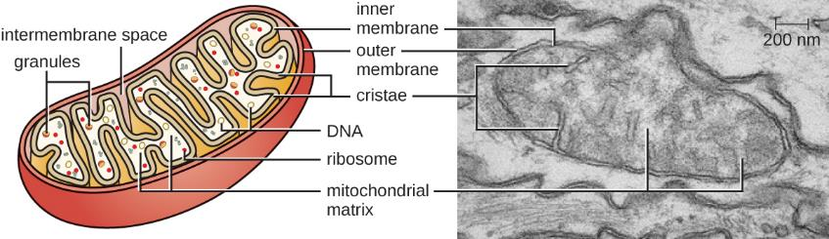
Mitochondria (5 of 5)
Figure 2.49 Each mitochondrion is surrounded by two membranes, the inner of which is extensively folded into cristae and is the site of the intermembrane space. The mitochondrial matrix contains the mitochondrial DNA, ribosomes, and metabolic enzymes. The transmission electron micrograph of a mitochondrion, on the right, shows both membranes, including cristae and the mitochondrial matrix. (credit “micrograph”: modification of work by Matthew Britton; scale-bar data from Matt Russell)

Slide 172
Chloroplasts (1 of 3)
Chloroplasts are organelles found in plant cells and algal cells that serve as the site of photosynthesis.
All chloroplasts have at least three membrane systems:
  outer membrane,
  inner membrane,
  thylakoid membrane

Slide 173
Chloroplasts (2 of 3)
Inside the outer and inner membranes is the chloroplast stroma, a gel-like fluid that makes up much of a chloroplast’s volume and contains the thylakoid system.
The thylakoid system is a highly dynamic collection of folded membrane sacs where the green photosynthetic pigment chlorophyll is found, and the light reactions of photosynthesis occur.
In most plant chloroplasts, the thylakoids are arranged in stacks called grana, whereas in some algal chloroplasts, the thylakoids are free floating.

Slide 174

Chloroplasts (3 of 3)
Figure 2.50 Photosynthesis takes place in chloroplasts, which have an outer membrane and an inner membrane. Stacks of thylakoids called grana form a third membrane layer.

Slide 175
Plasma Membrane (1 of 2)
The plasma membrane of eukaryotic cells is similar in structure to the prokaryotic plasma membrane in that it is composed mainly of phospholipids forming a bilayer with embedded peripheral and integral proteins.
These membrane components move within the plane of the membrane according to the fluid mosaic model.
Unlike the prokaryotic membrane, eukaryotic membranes contain sterols, including cholesterol, that alter membrane fluidity.

Slide 176

Plasma Membrane (2 of 2)
Figure 2.51 The eukaryotic plasma membrane is composed of a lipid bilayer with many embedded or associated proteins. It contains cholesterol for the maintenance of membrane, as well as glycoproteins and glycolipids that are important in the recognition other cells or pathogens.

Slide 177
Membrane Transport Mechanisms (1 of 4)
Endocytosis is a type of membrane transport mechanism besides diffusion, facilitated diffusion, and active transport.
It is the uptake of matter through plasma membrane invagination and vacuole/vesicle formation.
Eukaryotic cells have the unique ability to perform various types of endocytosis:
  Phagocytosis
  Pinocytosis
  Receptor-mediated endocytosis

Slide 178
Membrane Transport Mechanisms (2 of 4)
Phagocytosis (“cell eating”) involves the engulfment of large particles through membrane invagination.
  Particles (or other cells) are enclosed in a pocket within the membrane, which then pinches off from the membrane to form a vacuole that completely surrounds the particle.
In pinocytosis (“cell drinking”), small, dissolved materials and liquids are taken into the cell through small vesicles.
Receptor-mediated endocytosis is a type of endocytosis that is initiated by specific molecules called ligands when they bind to cell surface receptors on the membrane.

Slide 179

Membrane Transport Mechanisms (3 of 4)
Figure 2.52 Three variations of endocytosis are shown. (a) In phagocytosis, the cell membrane surrounds the particle and pinches off to form an intracellular vacuole. (b) In pinocytosis, the cell membrane surrounds a small volume of fluid and pinches off, forming a vesicle. (c) In receptor-mediated endocytosis, the uptake of substances is targeted to a specific substance (a ligand) that binds at the receptor on the external cell membrane. (credit: modification of work by Mariana Ruiz Villarreal)

Slide 180
Membrane Transport Mechanisms (4 of 4)
The process by which secretory vesicles release their contents to the cell’s exterior is called exocytosis.
Vesicles move toward the plasma membrane and then meld with the membrane, ejecting their contents out of the cell.
Exocytosis is used by cells to remove waste products and may also be used to release chemical signals that can be taken up by other cells.

Slide 181
Cell Wall (1 of 2)
In addition to a plasma membrane, some eukaryotic cells have a cell wall.
Cells of fungi, algae, plants, and even some protists have cell walls.
All cell walls provide structural stability for the cell and protection from environmental stresses such as desiccation, changes in osmotic pressure, and traumatic injury.

Slide 182
Cell Wall (2 of 2)
Depending upon the type of eukaryotic cell, cell walls can be made of a wide range of materials, including:
  Cellulose (fungi and plants)
  Biogenic silica, calcium carbonate, agar, and carrageenan (protists and algae)
  Chitin (fungi)
Animal cells do not have a cell wall.

Slide 183
Extracellular Matrix (1 of 3)
Since animal cells and some protozoan cells lack a cell wall, they produce an extracellular matrix.
They secrete a sticky mass of carbohydrates and proteins into the spaces between adjacent cells.
Some protein components assemble into a basement membrane to which the remaining extracellular matrix components adhere.

Slide 184
Extracellular Matrix (2 of 3)
In animal cells, the extracellular matrix allows cells within tissues to withstand external stresses and transmits signals from the outside of the cell to the inside.
A host cell’s extracellular matrix is often the site where microbial pathogens attach themselves to establish infection.

Slide 185

Extracellular Matrix (3 of 3)
Figure 2.53 The extracellular matrix is composed of protein and carbohydrate components. It protects cells from physical stresses and transmits signals arriving at the outside edges of the tissue to cells deeper within the tissue.

Slide 186
Flagella and Cilia (1 of 4)
Some eukaryotic cells use flagella for locomotion.
Whereas the prokaryotic flagellum is a stiff, rotating structure, a eukaryotic flagellum is more like a flexible whip composed of nine parallel pairs of microtubules surrounding a central pair of microtubules.
This arrangement is referred to as a 9 + 2 array.
The parallel microtubules use dynein motor proteins to move relative to each other, causing the flagellum to bend.

Slide 187
Flagella and Cilia (2 of 4)
Cilia are a similar external structure found in some eukaryotic cells.
Cilia are shorter than flagella and often cover the entire surface of a cell. Because of their shorter length, cilia use a rapid, flexible, waving motion.
They are structurally similar to flagella (a 9+2 array of microtubules) and use the same mechanism for movement.

Slide 188
Flagella and Cilia (3 of 4)
A structure called a basal body is found at the base of each cilium and flagellum.
The basal body, which attaches the cilium or flagellum to the cell, is composed of an array of triplet microtubules similar to that of a centriole but embedded in the plasma membrane.

Slide 189

Flagella and Cilia (4 of 4)
Figure 2.54 (a) Eukaryotic flagella and cilia are composed of a 9+2 array of microtubules, as seen in this transmission electron micrograph cross-section. (b) The sliding of these microtubules relative to each other causes a flagellum to bend. (c) An illustration of Trichomonas vaginalis, a flagellated protozoan parasite that causes vaginitis. (d) Many protozoans, like this Paramecium, have numerous cilia that aid in locomotion as well as in feeding. Note the mouth opening shown here. (credit d: modification of work by University of Vermont/National Institutes of Health

Slide 190
Clinical Focus: Resolution
Since amoxicillin has not resolved Barbara’s case of pneumonia, the PA prescribes another antibiotic, azithromycin, which targets bacterial ribosomes rather than peptidoglycan. After taking the azithromycin as directed, Barbara’s symptoms resolve and she finally begins to feel like herself again. Presuming no drug resistance to amoxicillin was involved, and given the effectiveness of azithromycin, the causative agent of Barbara’s pneumonia is most likely Mycoplasma pneumoniae. Even though this bacterium is a prokaryotic cell, it is not inhibited by amoxicillin because it does not have a cell wall and, therefore does not make peptidoglycan.

Slide 191
Acknowledgments
"OpenStax Microbiology Slides" by Adronisha Frazier, Louisiana Community and Technical College System, Northshore Technical Community College is licensed under CC BY-SA 4.0.

