Slide 1
ACELLULAR PATHOGENS
(Viruses, Viroids, Virusoids, Prions)
Ayda Basgul Martin, MD

Slide 2
Learning Objectives
By the end of this section, the students will be able to:
Describe the general characteristics of viruses as pathogens
Describe viral genomes
Describe the general characteristics of viral life cycles
Differentiate among bacteriophages, plant viruses, and animal viruses
Describe the characteristics used to identify viruses as obligate intracellular parasites
Describe the lytic and lysogenic life cycles.
Describe the replication process of animal viruses.
Describe unique characteristics of retroviruses and latent viruses.
Discuss human viruses and their virus-host cell interactions.
Explain the process of transduction.
Describe the replication process of plant viruses
Discuss why viruses were originally described as filterable agents.
Describe the cultivation of viruses and specimen collection and handling.
Compare in vivo and in vitro techniques used to cultivate viruses.
Describe viroids and their unique characteristics.
Describe virusoids and their unique characteristics.
Describe prions and their unique characteristics

Slide 3
Overview:
Acellular organisms are entities that do not possess a cellular structure, such as a nucleus, cell membrane, or cytoplasm, but use the organelles and metabolism of the host cell they enter to survive and replicate themselves. Since they do not have known cell structures, they are not considered "living organisms.
This chapter will discuss viruses, the most well-known acellular microorganisms, viroids, and prions.
  Viruses contain genetic material such as DNA or RNA, but never both.
  Viroids are protein-free naked RNA molecules, and
  Prions are infectious protein particles with no genetic material or organelles.
Viruses can rapidly mutate and spread across populations, making them responsible for severe outbreaks and posing serious health challenges for humans, plants, and other living organisms. Acellular organisms profoundly impact biology and medicine, making them an essential area of study in microbiology. The significance of acellular organisms is not only because they cause diseases in all known organisms, such as bacteria, protozoa, plants, and animals, but also because of their role in research and biotechnology applications.

Slide 4
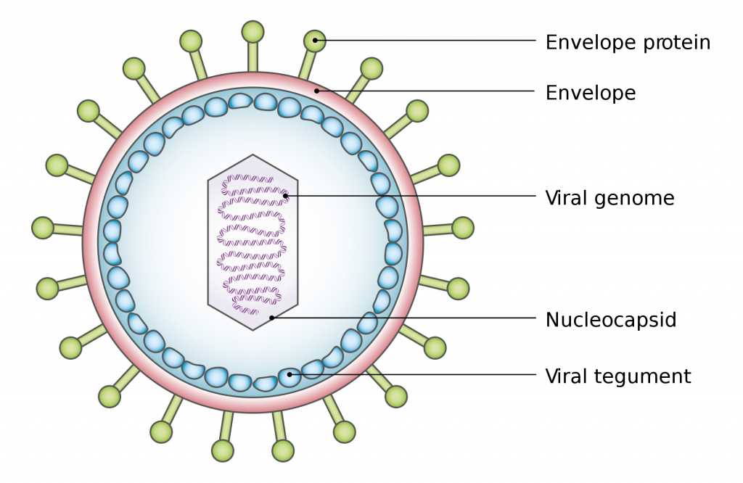
The General Characteristics of Viruses
Viruses are the most abundant biological entities in the biosphere.
They are obligatory intracellular microorganisms. Because they do not possess a cell structure, they require the presence of a host cell to multiply.
Viruses have simple but unique structures. All viruses have two main structures: viral genome and capsid.
Some viruses may also have an envelope and viral enzymes. The nucleic acid and capsid constitute the nucleocapsid
Figure 5.1: Graphic representation of a cross-sectional view of a virion of the Epstein–Barr virus

Slide 5
The Categories of Viruses
There are two categories of viruses based on general composition.
Viruses formed from only a nucleic acid and capsid are called naked viruses or nonenveloped viruses.
The viral genome contains either DNA or RNA, but not both.
The viral genome encodes instructions to replicate the virus within a host cell. The shape of genetic material can be linear or circular, depending on the virus type.
  DNA viruses: Their genetic material is made of deoxyribonucleic acid (DNA), which can be either single-stranded (ssDNA) or double-stranded (dsDNA).
  RNA viruses: Their genetic material is made of ribonucleic acid (RNA), which can be single-stranded (ssRNA) or double-stranded (dsRNA).
  Some RNA viruses, like retroviruses, have an RNA genome that is reverse transcribed into DNA after infecting a host.

Slide 6
The Virus Capsids
Each virus possesses a protein capsid to protect its nucleic acid genome from the harsh environment.
Virus capsids predominantly come in two shapes: helical and icosahedral.
The helix (plural: helices) is a spiral shape that curves cylindrically around an axis. Helical viruses can be enveloped or naked. The first virus described, the tobacco mosaic virus, is a naked helical virus. Most plant viruses are helical, and it is very uncommon that a helical plant virus is enveloped. In contrast, all helical animal viruses are enveloped. These include well-known viruses such as influenza virus, measles virus, mumps virus, rabies virus, and Ebola virus.
The icosahedron is by far more prevalent than the helical architecture. Compared to a helical virus, where the capsid proteins wind around the nucleic acid, the genomes of icosahedral viruses are packaged completely within an icosahedral capsid that acts as a protein shell. Human hepatitis B, dengue, and Norwalk viruses are examples of viruses that have icosahedral shapes.
Unusually designed viruses that do not fit either category is classified as complex viruses. Examples include the poxvirus with a brick-shaped exterior and a complicated internal structure and bacteriophage with tail fibers attached to an icosahedral head.

Slide 7
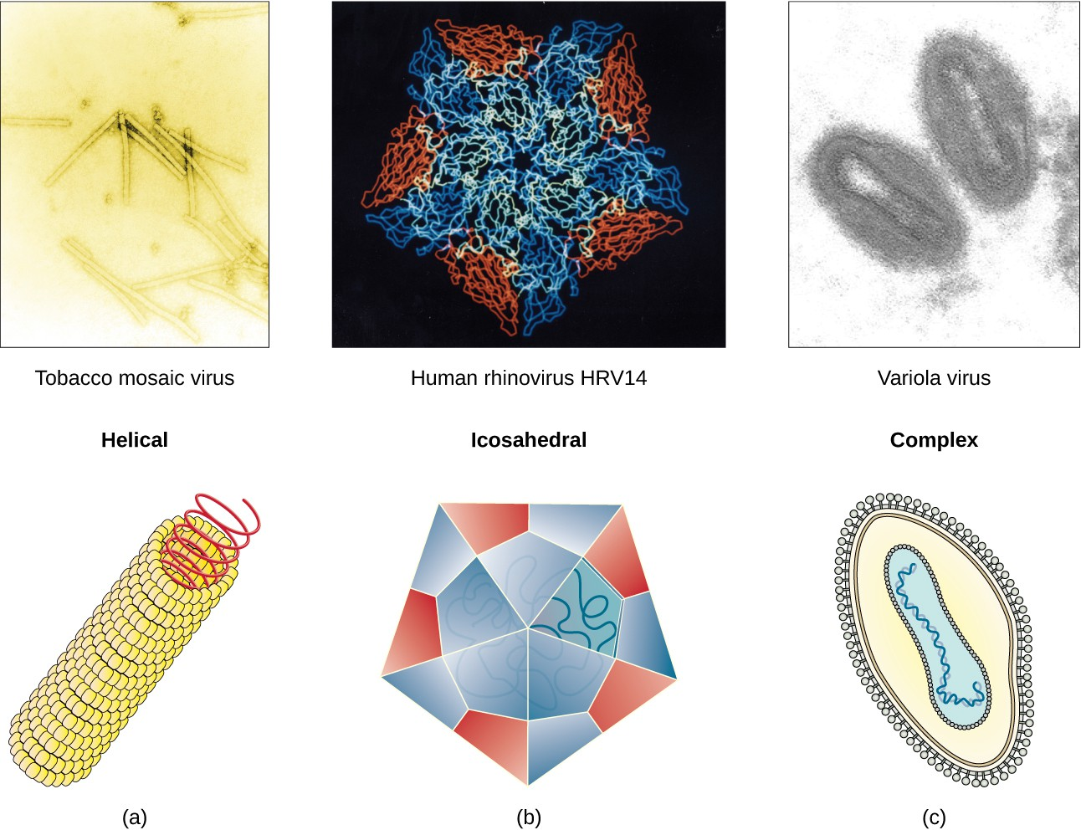
Viral capsids
Viral capsids can be
(a) helical,
(b) polyhedral, or
(c) have a complex shape.
Photo credit a “micrograph”: modification of work by USDA ARS; credit b “micrograph”: modification of work by U.S. Department of Energy)

Slide 8
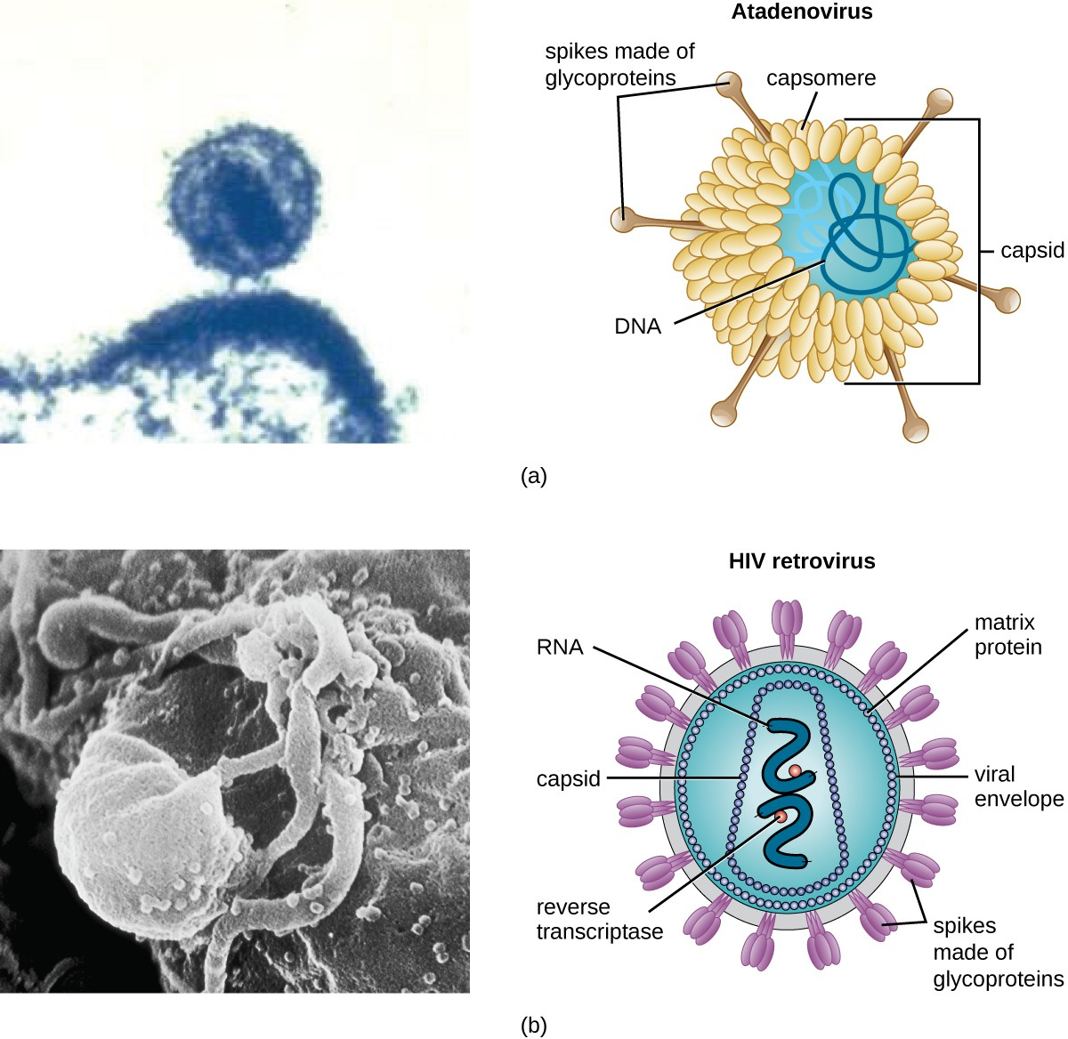
Envelope and Spikes of a Virus
Some viruses can also possess additional components, the most common being an additional membranous layer surrounding the nucleocapsid, called an envelope.
The envelope is acquired from the infected host cell's nuclear or plasma membrane and contains viral surface proteins that are essential for infecting host cells called spikes.

Slide 9
Spikes of a Virus
At the tips of spikes, there are structures that allow the virus to attach and enter a cell, like the influenza virus hemagglutinin spikes (H) or enzymes like the neuraminidase (N) influenza virus spikes that allow the virus to detach from the cell surface during release of new virions.
Influenza viruses are often identified by their H and N spikes. For example, H1N1 influenza viruses were responsible for the pandemics in 1918 and 2009. (OER)

Slide 10
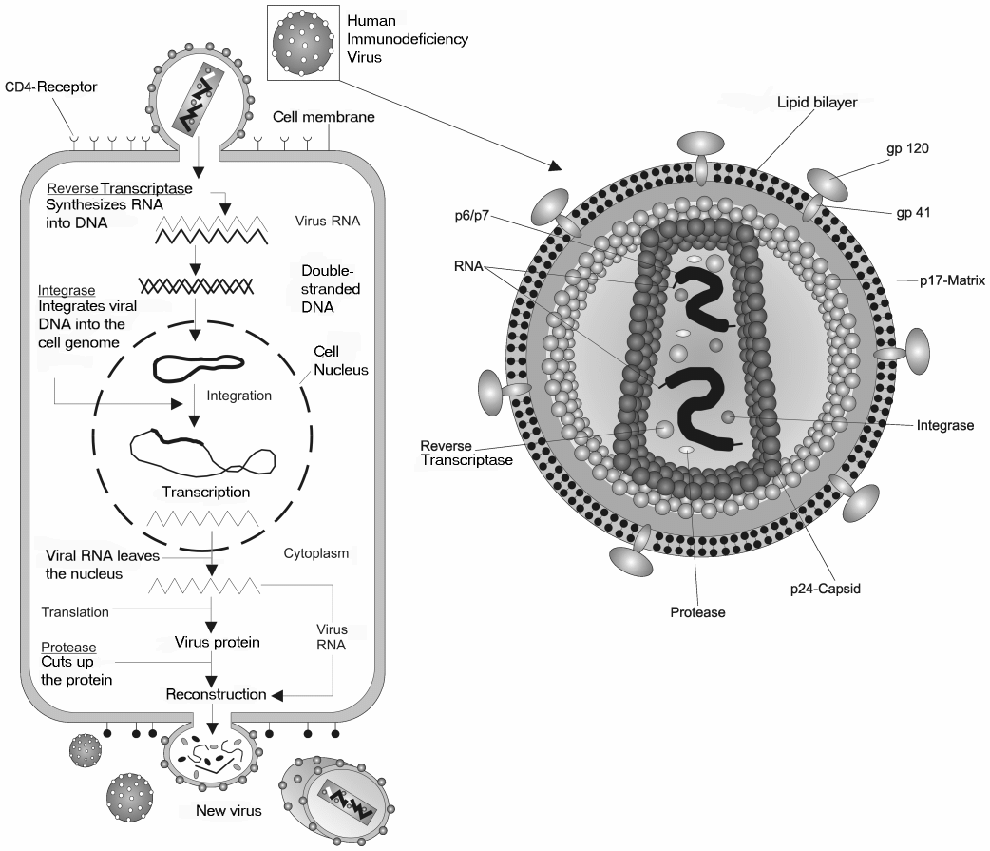
Retroviruses
Some viruses may contain viral enzymes necessary for the infection of a host cell. These can include reverse transcriptase (in retroviruses like HIV) to convert RNA into DNA, RNA polymerase (in RNA viruses) to replicate their RNA genome and integrase (in retroviruses) to insert viral DNA into the host genome.
Photo courtesy: https://en.wikipedia.org/wiki/Retrovirus#/media/File:Hiv_gross.png

Slide 11
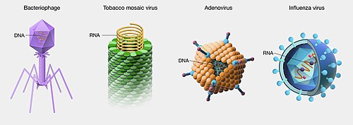
Virion
A complete virus capable of infecting a host cell is called a virion.
In general, virions (viral particles) are small and cannot be observed using a regular light microscope.

Slide 12
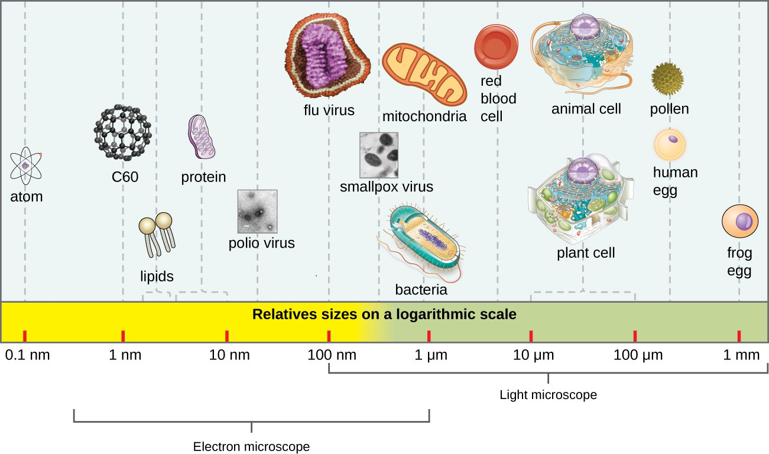
Size of Viruses
Viruses are extremely small, generally ranging from 20 to 300 nanometers in diameter, making them much smaller than bacteria.
Their size can vary depending on the virus type (e.g., the poxvirus can be much larger than most others).
Recent discoveries, however, have identified new giant viral species, such as Pandoravirus salinus and Pithovirus sibericum, with sizes approaching that of a bacterial cell.

Slide 13
Virus Classification
The Latin binomial nomenclature is not used for naming viruses. Virus names should also not include any person's name (although historically, this was how a few viruses were named), and selected names should be easy to use and meaningful.
The Baltimore classification system is an alternative to ICTV nomenclature. The Baltimore system classifies viruses according to their genomes (DNA or RNA, single versus double stranded, and mode of replication).
This system thus creates seven groups of viruses that have common genetics and biology
Double-stranded DNA viruses (Group I).
Single-stranded DNA viruses (Group II).
Double-stranded RNA viruses (Group III).
Positive single-stranded RNA viruses (Group IV).
Negative single-stranded RNA viruses (Group V).
Positive single-stranded RNA viruses with DNA intermediates (Group VI), commonly known as retroviruses; and
The double-stranded DNA retroviruses (Group VII).

Slide 14
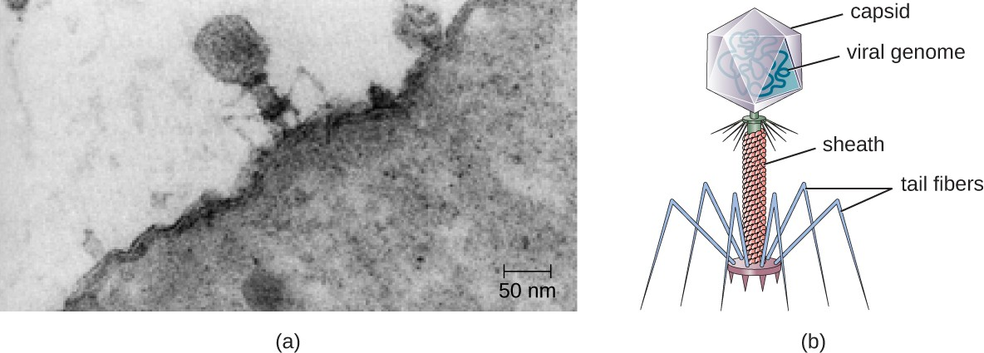
Bacteriophage
Bacteriophage (often abbreviated as phage) is a type of virus that specifically infects bacteria.
Bacteriophages have a relatively simple structure, consisting of a protein coat (capsid) that contains the viral genome (either DNA or RNA). DNA phages are the most common, but RNA bacteriophages are also known.
The capsid may have an icosahedral or helical shape, or in some cases, more complex structures.
Many bacteriophages also have a tail structure used for attaching to bacterial cells. The tail serves as a syringe to inject the phage’s genetic material into the bacterial cell.
Phages are highly specific in terms of the bacteria they infect due to the interaction between the viral surface proteins and receptors on the surface of the bacterial cell.
Photo Credit a: modification of work by U.S. Department of Energy, Office of Science, LBL, PBD

Slide 15
Bacteriophage Use
Bacteriophages are incredibly important in microbiology for several reasons
Phage therapy:
They can be used to help treating the bacterial infections, particularly those caused by antibiotic-resistant bacteria. Phages can be highly specific in targeting the bacteria responsible for an infection without affecting the beneficial microbes in the body.
Bacteriophages can also be used in diagnostic techniques to identify specific bacterial strains by their ability to infect and lyse particular bacterial cells.
Biotechnology:
Bacteriophages are used as tools in molecular biology and genetic engineering. For example, scientists use phages to transfer genes or to study bacterial genetics.

Slide 16
Bacteriophage Use
Food Safety:
Bacteriophages are sometimes used in the food industry to prevent the growth of pathogenic bacteria such as Salmonella and Listeria in food products.
Foods that have been treated with phages must declare “bacteriophage preparation” in the list of ingredients or include a label declaring that the meat has been “treated with antimicrobial solution to reduce microorganisms.

Slide 17
Oncogenic Viruses 1
Several viruses are linked to cancer in humans
Human papillomaviruses (HPVs) are a group of more than 150 related viruses. cause papilloma, which are more commonly known as warts. A few types of HPV are the main causes of cervical cancer, which is the second most common cancer among women worldwide. Vaccines are now available to help protect children and young adults against infection from the main cancer-causing HPV types. HPV vaccination can help prevent more than 90% of HPV cancers. HPV vaccination works best when given to boys and girls between ages 9 and 12.
Epstein-Barr virus (EBV) is a type of herpes virus. It is probably best known for causing infectious mononucleosis, often called “mono” or the “kissing disease.” EBV infection increases a person’s risk of getting nasopharyngeal cancer (cancer of the area in the back of the nose) and certain types of fast-growing lymphoma such as Burkitt lymphoma.

Slide 18
Oncogenic Viruses 2
Hepatitis B virus (HBV) and hepatitis C virus (HCV), both cause viral hepatitis, a type of liver infection and can cause long-term (chronic) infections that increase a person’s chance of liver cancer. There is a vaccine to prevent HBV infection, but none for HCV.
Human immunodeficiency virus (HIV) causes acquired immune deficiency syndrome (AIDS), doesn’t appear to cause cancers directly. But HIV infection increases a person’s risk of getting several types of cancer, especially some linked to other viruses. HIV infection has been linked to a higher risk of developing Kaposi sarcoma and cervical cancer

Slide 19
The Viral Life Cycle
Viruses cannot survive without a host cell. When they enter a cell, they hijack cellular metabolism to produce more viral particles.
A bacteriophage can replicate only in the cytoplasm since the prokaryotes are unicellular organisms without a nucleus.
In eukaryotic cells, most DNA viruses can replicate inside the nucleus, with an exception observed in the large DNA viruses, such as the poxviruses, that can replicate in the cytoplasm.
With a few exceptions, such as the Influenza virus, RNA viruses that infect animal cells replicate in the cytoplasm.
A bacteriophage is a type of virus that infects bacteria.
The life cycle of viruses infecting prokaryotes, like bacteria, involves
  attachment,
  entry,
  replication,
  assembly, and
  release,
which can follow either a lytic or lysogenic cycle.

Slide 20
The Lytic Cycle
Attachment is the first stage in the infection process in which the phage interacts with specific bacterial surface receptors. Most phages have a narrow host range and may infect one species of bacteria or one strain within a species. This unique recognition can be exploited for targeted treatment of bacterial infection by phage therapy or for phage typing to identify unique bacterial subspecies or strains.
Penetration(entry) is the second stage after phage is attached to the bacteria.

Slide 21
The Lytic Cycle
Replication (biosynthesis) of new viral components occur after entering the host cell, the virus synthesizes virus-encoded endonucleases to degrade the bacterial chromosome. It then hijacks the host cell to replicate, transcribe, and translate the necessary viral components (capsomeres, sheath, base plates, tail fibers, and viral enzymes)
During the assembly (maturation) phase, new virions are created.
The final stage is release. Mature viruses burst out of the host cell in a process called lysis and the progeny viruses are liberated into the environment to infect new cells.

Slide 22
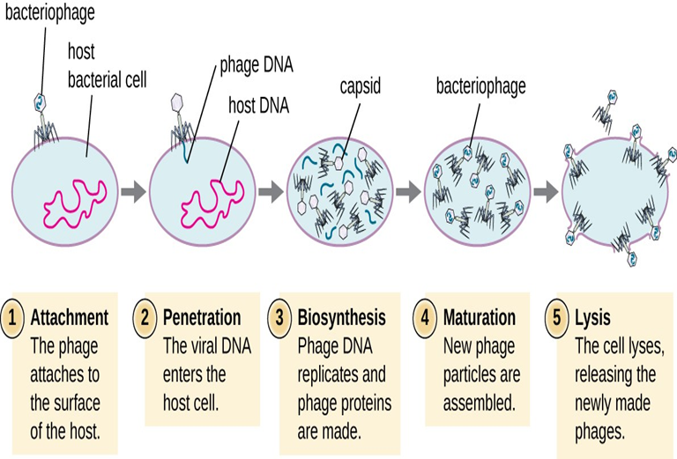
The Lytic Cycle

Slide 23
The Lysogenic Cycle
In a lysogenic cycle, the phage genome also enters the cell through attachment and penetration. A prime example of a phage with this type of life cycle is the lambda phage.
During the lysogenic cycle, instead of killing the host, the phage genome integrates into the bacterial chromosome and becomes part of the host.
The integrated phage genome is called a prophage. A bacterial host with a prophage is called a lysogen.
The process in which a bacterium is infected by a temperate phage is called lysogeny.

Slide 24
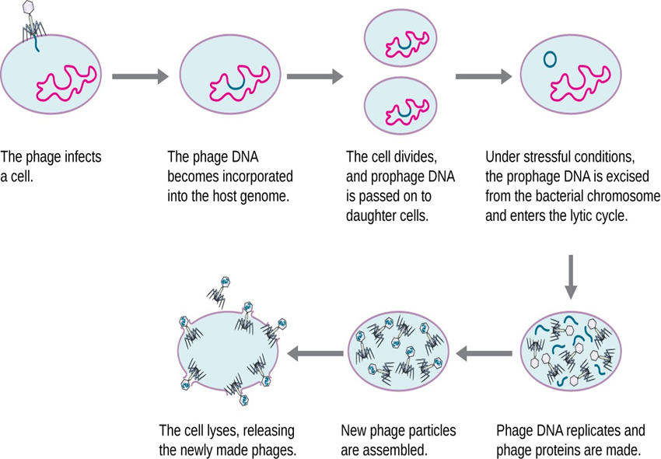
The Lysogenic Cycle

Slide 25
Transduction
Transduction is a process of horizontal gene transfer where genetic material is transferred from one bacterium to another via a virus.
There are two types of transductions: generalized and specialized transduction.
Generalized transduction occurs when a random piece of bacterial chromosomal DNA is transferred by the phage during the lytic cycle.
Specialized transduction occurs at the end of the lysogenic cycle, when the prophage is excised and the bacteriophage enters the lytic cycle.

Slide 26
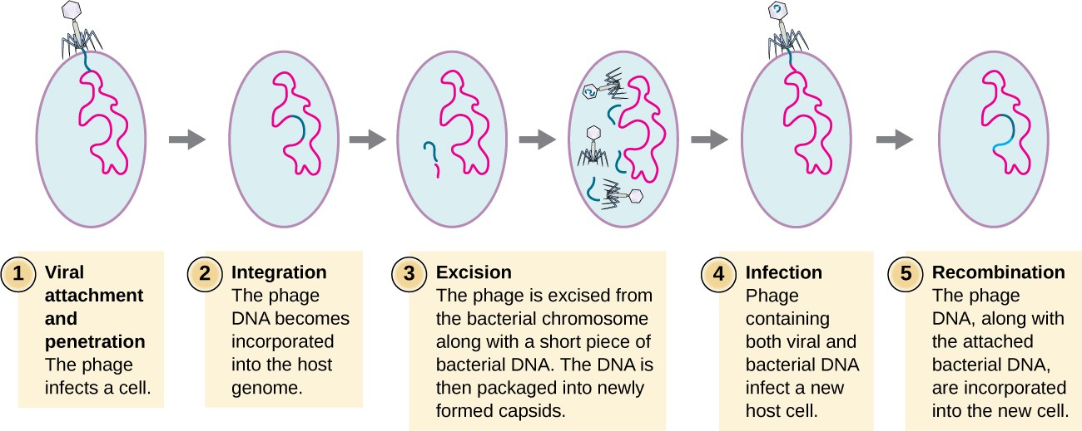
Transduction

Slide 27
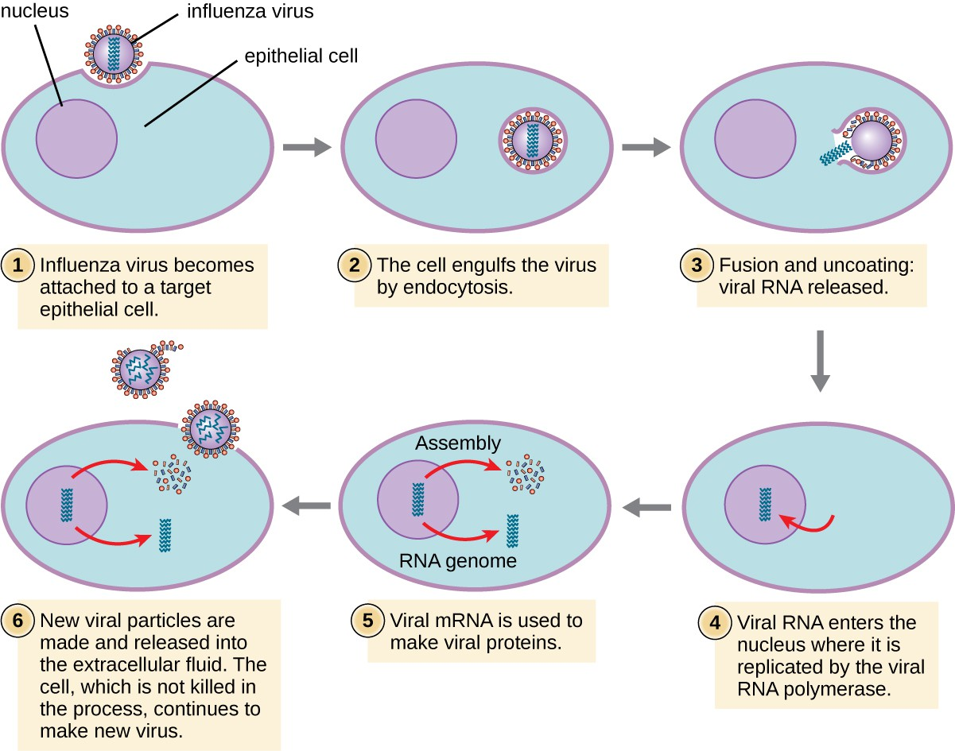
Life Cycles of Viruses in Animal Cells
Lytic animal viruses follow similar infection stages to bacteriophages: attachment, penetration, biosynthesis, maturation, and release. However, the mechanisms of penetration, nucleic-acid biosynthesis, and release differ between bacterial and animal viruses.
After binding to host receptors, animal viruses enter through endocytosis (engulfment by the host cell) or through membrane fusion (viral envelope with the host cell membrane).
Many viruses are host specific, meaning they only infect a certain type of host; and most viruses only infect certain types of cells within tissues. This specificity is called a tissue tropism. Examples of this are demonstrated by the poliovirus, which exhibits tropism for the tissues of the brain and spinal cord, or the influenza virus, which has a primary tropism for the respiratory tract.

Slide 28
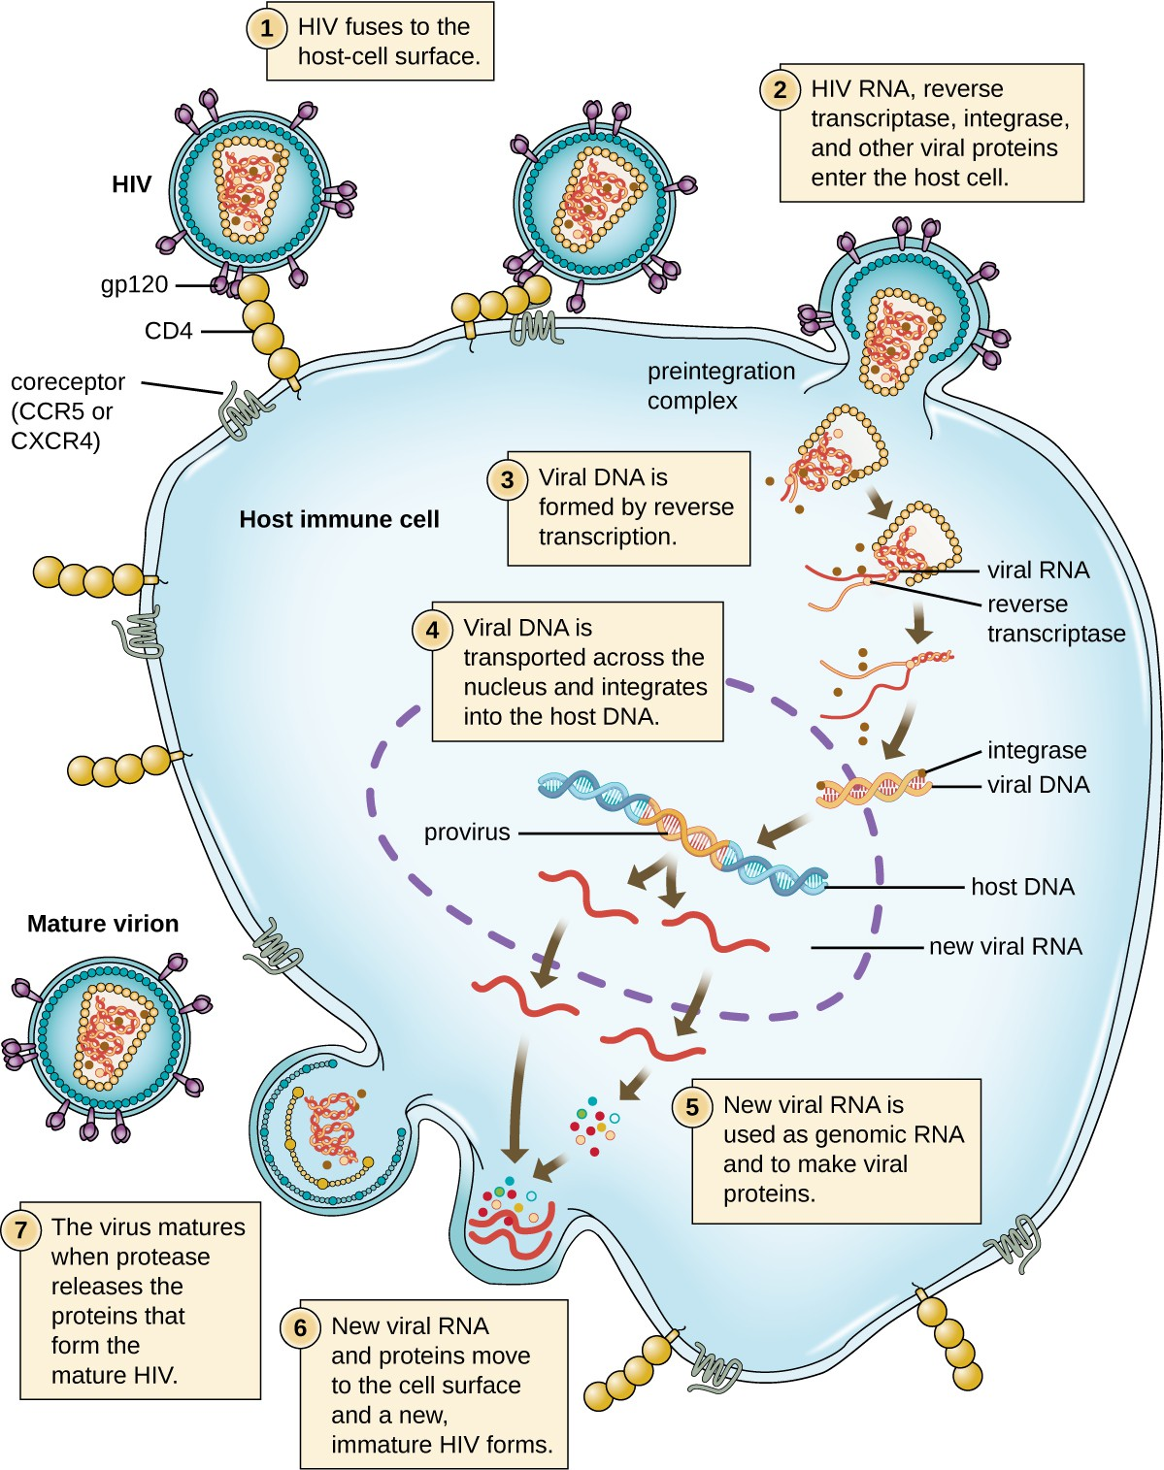
Alternative mechanisms-Retrovirus
An alternative mechanism for viral nucleic acid synthesis is observed in the retroviruses, which are +ssRNA viruses.
Single-stranded RNA viruses such as HIV carry a special enzyme called reverse transcriptase within the capsid that synthesizes a complementary ssDNA (cDNA) copy using the +ssRNA genome as a template. The ssDNA is then made into dsDNA, which can integrate into the host chromosome and become a permanent part of the host.
The integrated viral genome is called a provirus. The virus now can remain in the host for a long time to establish a chronic infection. The provirus stage is similar to the prophage stage in a bacterial infection during the lysogenic cycle. However, unlike prophage, the provirus does not undergo excision after splicing into the genome
Photo credit: modification of work by NIAID, NIH

Slide 29
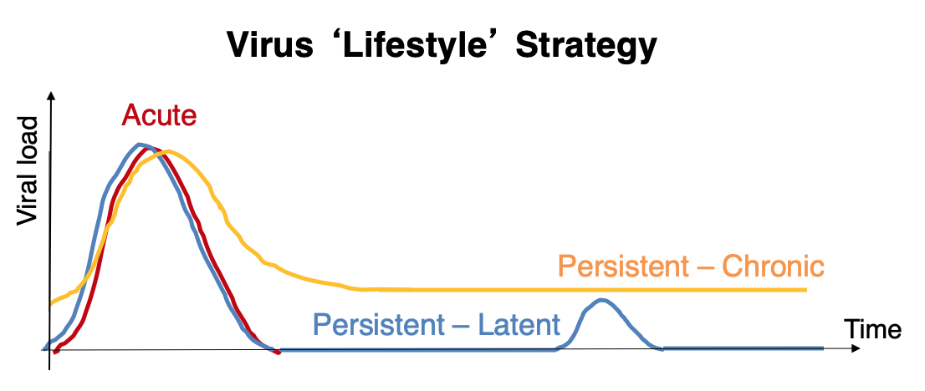
Persistent Infections
Persistent infection occurs when a virus is not completely cleared from the system of the host but stays in certain tissues or organs of the infected person.
The virus may remain silent or undergo productive infection without seriously harming or killing the host.
Mechanisms of persistent infection may involve the regulation of the viral or host gene expressions or the alteration of the host immune response.
The two primary categories of persistent infections are latent infection and chronic infection. Examples of viruses that cause latent infections include herpes simplex virus (oral and genital herpes), varicella-zoster virus (chickenpox and shingles), and Epstein-Barr virus (mononucleosis). Hepatitis C virus and HIV are two examples of viruses that cause long-term chronic infections
https://commons.wikimedia.org/wiki/File:Virus_lifestyle_persistence_strategies.png

Slide 30
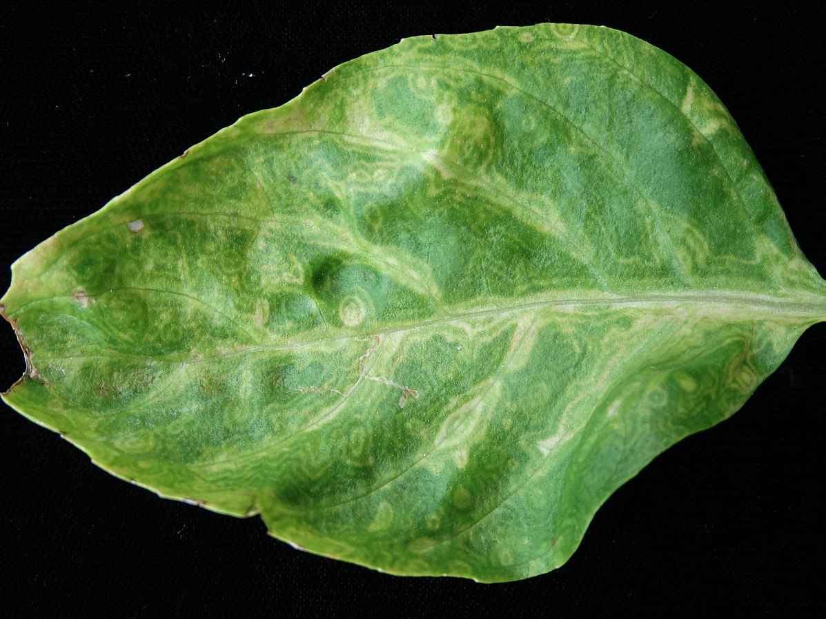
Life Cycle of Viruses with Plant Hosts
Plant viruses are more similar to animal viruses than they are to bacteriophages.
Plant viruses may be enveloped or non-enveloped. Like many animal viruses, plant viruses can have either a DNA or RNA genome and be single stranded or double stranded.
However, most plant viruses do not have a DNA genome; the majority have a +ssRNA genome, which acts like messenger RNA (mRNA).
Viruses that infect plants are considered biotrophic parasites, which means that they can establish an infection without killing the host, similar to what is observed in the lysogeni.c life cycles of bacteriophages
Sweet basil (Ocimum basilicum): Tomato spotted wilt virus (TSWV)
Photo courtesy: https://commons.wikimedia.org/wiki/File:Sweet_basil_%28Ocimum_basilicum%29_-_Tomato_spotted_wilt_virus_%28TSWV%29.jpg

Slide 31
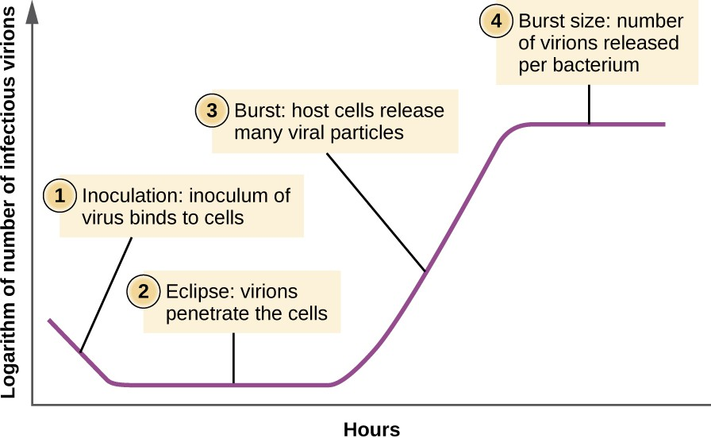
Viral Growth Curve
Unlike the growth curve for a bacterial population, the growth curve for a virus population over its life cycle does not follow a sigmoidal curve.
During the initial stage, an inoculum of virus causes infection.
In the eclipse phase, viruses bind and penetrate the cells with no virions detected in the medium.
The chief difference that next appears in the viral growth curve compared to a bacterial growth curve occurs when virions are released from the lysed host cell at the same time. Such an occurrence is called a burst, and the number of virions per bacterium released is described as the burst size.
In a one-step multiplication curve for bacteriophage, the host cells lyse, releasing many viral particles to the medium, which leads to a very steep rise in viral titer (the number of virions per unit volume).
If no viable host cells remain, the viral particles begin to degrade during the decline of the culture

Slide 32
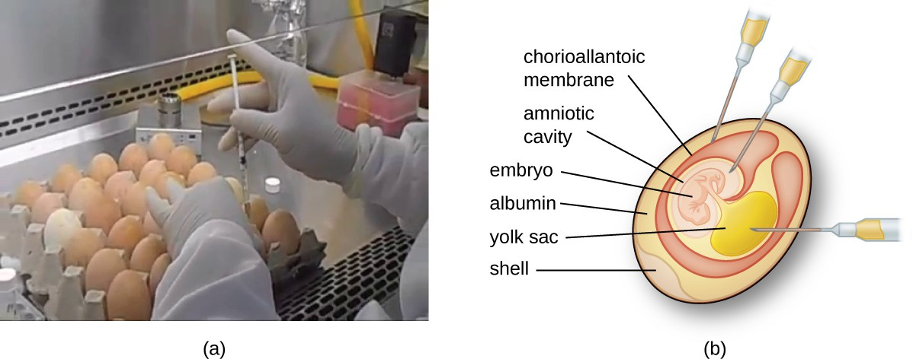
Isolation, Culture, and Identification of Viruses
Unlike bacteria, many of which can be grown on an artificial nutrient medium, viruses require a living host cell for replication. Infected host cells (eukaryotic or prokaryotic) can be cultured and grown, and then the growth medium can be harvested as a source of virus.
Viruses can be grown in vivo (within a whole living organism, plant, or animal) or in vitro (outside a living organism in cells in an artificial environment. Flat horizontal cell culture flasks.
Animal viruses require cells within a host animal, or tissue-culture cells derived from an animal.
The embryo or host animal serves as an incubator for viral replication.
Photo credit a: modification of work by “Chung Hoang”/YouTube

Slide 33
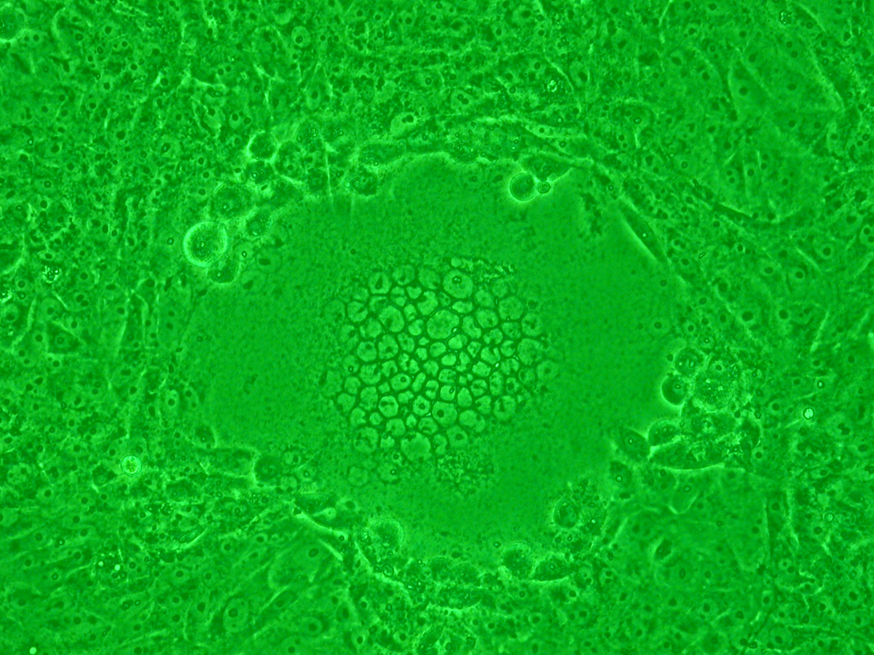
Detection of a Virus
Regardless of the method of cultivation, once a virus has been introduced into a whole host organism, embryo, or tissue-culture cell, a sample can be prepared from the infected host, embryo, or cell line for further analysis under a brightfield, electron, or fluorescent microscope.
Cytopathic effects (CPEs) are distinct observable cell abnormalities due to viral infection.
CPEs can include loss of adherence to the surface of the container, changes in cell shape from flat to round, shrinkage of the nucleus, vacuoles in the cytoplasm, fusion of cytoplasmic membranes and the formation of multinucleated syncytia, inclusion bodies in the nucleus or cytoplasm, and complete cell lysis
"Syncytium forming"-type cytopathic effect induced by the virus infection. (a mutant strain of HSV-1 was infected within Vero cells). Phase-contrast microscopic image of 100-fold magnification under green light.
Photo courtesy https://commons.wikimedia.org/wiki/File:CPE_syncytium.jpg

Slide 34
Detecting Biological Viruses 1
Detecting biological viruses involves identifying either the virus itself or the body’s response to it.
1. Molecular Tests (Nucleic Acid Tests)These detect the virus’s genetic material (RNA or DNA).
  PCR (Polymerase Chain Reaction) – Highly accurate; commonly used for COVID-19, HIV, influenza.
  RT-PCR – Reverse transcription PCR; used for RNA viruses.
  LAMP (Loop-Mediated Isothermal Amplification) – Faster than PCR; used in field testing.
2. Antigen Tests. These detect specific proteins on the virus’s surface. Often used for rapid tests, like for COVID-19 or influenza.

Slide 35
Detecting Biological Viruses 2
3. Virus Culture. Grow the virus in the lab using cells. Used for research or when other methods are unavailable.
4. Serological (Antibody) Tests. These detect antibodies made by the immune system in response to the virus. Used to check past infections, not active ones. Common for viruses like hepatitis B, HIV, and COVID-19.
5. Clinical Diagnosis. Based on symptoms, history, and physical exam. Often combined with lab tests for confirmation

Slide 36
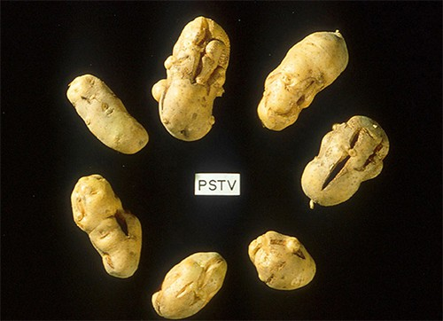
Viroids
Other acellular agents such as viroids, virusoids, and prions also cause diseases.
In 1971, Theodor Diener, a pathologist working at the Agriculture Research Service, discovered an acellular particle that he named a viroid, meaning “virus-like.”
Viroids consist only of a short strand of circular RNA capable of self- replication.
The first viroid discovered was found to cause potato tuber spindle disease, which causes slower sprouting and various deformities in potato plants.
Viroids can result in devastating losses of commercially important agricultural food crops grown in fields and orchards.
Photo credit: Pamela Roberts, University of Florida Institute of Food and Agricultural Sciences, USDA

Slide 37
Virusoids
The virusoids are subviral particles best described as non–self-replicating ssRNAs.
RNA replication of virusoids is similar to that of viroids but, unlike viroids, virusoids require that the cell also be infected with a specific “helper” virus.
There are currently only five described types of virusoids and their associated helper viruses.
The helper viruses are all from the family of Sobemoviruses. An example of a helper virus is the subterranean clover mottle virus, which has an associated virusoid packaged inside the viral capsid.
The HDV helper virus is the hepatitis B virus (HBV). Coinfection with HBV and HDV results in more severe pathological changes in the liver during infection, which is how HDV was first discovered.

Slide 38
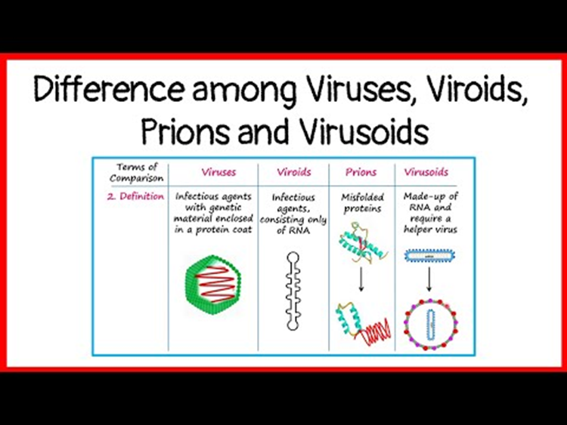
Difference among Viruses, Viroids, Prions and Virusoids

Slide 39
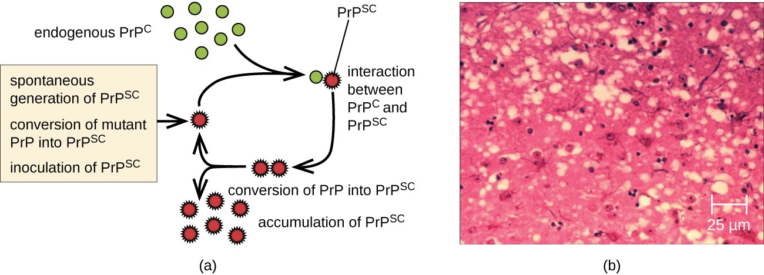
Prions
A prion is a misfolded rogue form of a normal protein (PrPc) found in the cell. This rogue prion protein (PrPsc), which may be caused by a genetic mutation or occur spontaneously, can be infectious, stimulating other endogenous normal proteins to become misfolded, forming plaques
In 1982, Stanley Prusiner, a medical doctor studying scrapie (a fatal, degenerative disease in sheep) discovered that the disease was caused by proteinaceous infectious particles, or prions. Because proteins are acellular and do not contain DNA or RNA, Prusiner’s findings were originally met with resistance and skepticism;
However, his research was eventually validated, and he received the Nobel Prize in Physiology or Medicine in 1997.
Photo credit b: modification of work by USDA

Slide 40
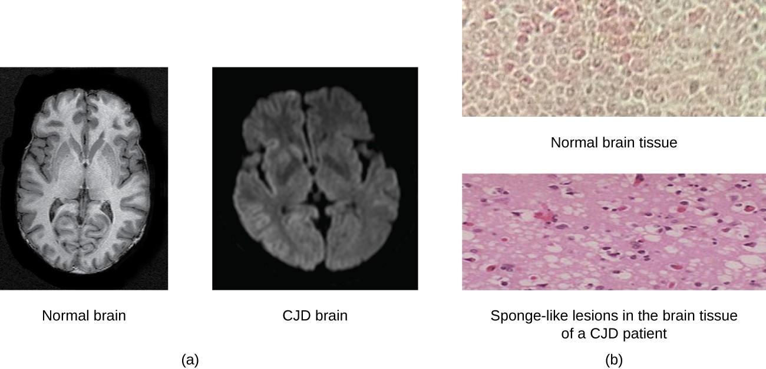
Transmissible Spongiform Encephalopathy (TSE)
Prions are known to cause various forms of transmissible spongiform encephalopathy (TSE) in human and animals.
TSE is a rare degenerative disorder that affects the brain and nervous system. The accumulation of rogue proteins causes the brain tissue to become sponge-like, killing brain cells and forming holes in the tissue, leading to brain damage, loss of motor coordination, and dementia
Prions are extremely difficult to destroy because they are resistant to heat, chemicals, and radiation. Even standard sterilization procedures do not ensure the destruction of these particles.
Currently, there is no treatment or cure for TSE disease, and contaminated meats or infected animals must be handled according to federal guidelines to prevent transmission.
Photo credit a (right): modification of work by Dr. Laughlin Dawes; credit b (top): modification of work by Suzanne Wakim; credit b (bottom): modification of work by Centers for Disease Control and Prevention)

