Slide 1

Microscopy and
Eukaryotic Organisms
Dr. Ayda Basgul Martin

Slide 2
Learning Objectives
Be
By the end of this lab, nursing students will be able to:
Identify
Identify the parts of a compound light microscope and describe their functions. (CLO#1)
Demonstrate
Demonstrate correct use of the microscope, including focusing, adjusting lighting, and using oil immersion. (CLO#1)
Prepare and observe
Prepare and observe wet mounts and stained slides of eukaryotic cells (e.g., protozoa, fungi, human cells).
Differentiate
Differentiate between prokaryotic and eukaryotic cells based on structural features visible under the microscope.
Recognize
Recognize common eukaryotic microorganisms, such as Candida albicans (fungus) or Amoeba and Paramecium (protozoa).
Apply
Apply proper lab safety and cleaning protocols when handling biological samples and microscopes.
Relate
Relate microscopic observations to clinical relevance in infection, immunity, and patient care.

Slide 3
Microscopy Terminology
1. Magnification: The process of enlarging the appearance of an object, typically achieved using a microscope. It is the image size ratio to the object's actual size.
2. Resolution: The ability of a microscope to distinguish between two close points. Higher resolution allows us to observe finer details.
3. Contrast: The difference in light intensity between an object and its background, which helps to visualize the details of the specimen.
4. Field of View (FOV): The area visible through the microscope at a given magnification. As magnification increases, the field of view decreases.
5. Working Distance: The distance between the objective lens and the specimen when the lens is focused.
6. Depth of Field (DOF): The thickness of the specimen layer that remains in focus at one time. Higher magnifications typically have a shallower depth of field.
7. Numerical Aperture (NA): A unit to measure the ability of a lens to gather light and resolution for a fixed object distance.
8. Parfocal: a feature of a microscope where, once a specimen is in focus at one magnification, it will remain nearly in focus when switching to a higher or lower magnification.
9. Inversion: In microscopy, inversion refers to the phenomenon where the image viewed through the microscope is upside down and/or reversed from left to right. This happens because of the way light rays are bent and manipulated as they pass through the lenses.

Slide 4
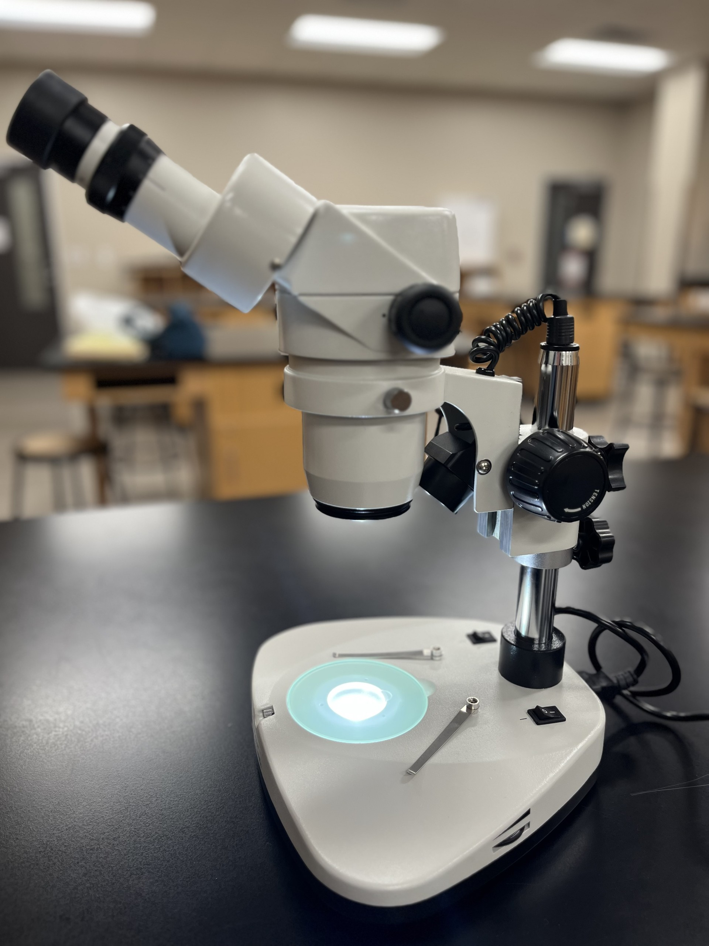
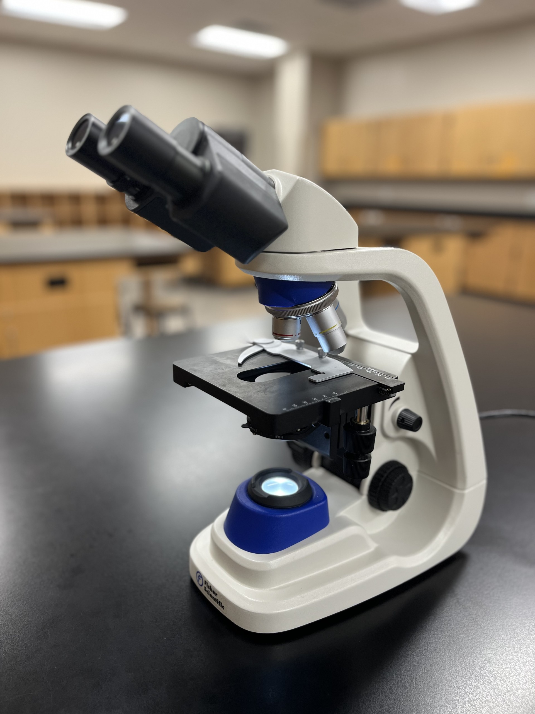



Compound Light Microscopes
Stereomicroscope (Dissection Microscope)
Brightfield light microscope
A. B. Martin

Slide 5
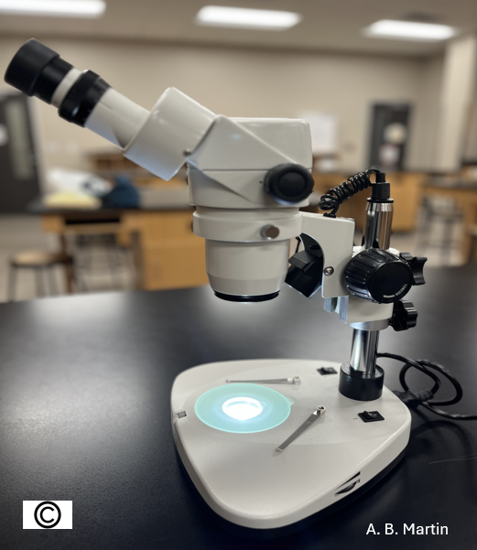
Parts of Stereomicroscope
Eyepieces or Ocular are the optical components at the top of the microscope. It contains a lens with 10 times magnification power.
Diopter adjustment rings allow correction of possible inconsistencies in our eyesight in one or both eyes. Binocular microscopes also swivel (interpupillary adjustment) to allow for different distances between the eyes of other individuals.
The objective lens provides fixed or zoom magnification with x2 and x3 magnification.
  Total magnification is always ocular x objective magnification powers.
Most stereo microscopes have only one coarse focus control knob.
The Working Stage is where the specimen should be placed.
Stage plates can come in light or dark colors to provide better contrast for a particular sample.
Stage Clips works to secure the specimen.
Illuminators allow us to use the light from above, below, or both together. When the specimen is opaque, a top light (Transmitted Illumination) sheds light on the specimen. It's helpful to see opaque samples with reflected light, such as circuits or insects. Some stereo microscopes also include a bottom light (Incident Illumination), which is helpful for thin or transparent samples.

Slide 6
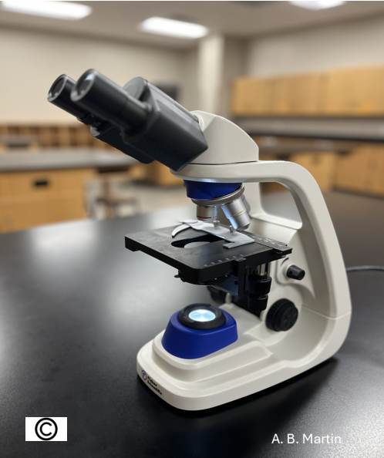
Parts of Brightfield Light Microscope-A
A. Optical System: The optical system gathers light and magnifies the viewed object.
Eyepiece (Ocular Lens): The lens at the top of the microscope that you look through. The magnification power is 10x or 15x.
Objective Lenses: These lenses are on the rotating nosepiece and provide different magnification levels. Common magnifications include:
Condenser: Located below the stage, the condenser focuses light onto the specimen to improve image clarity and contrast.
Diaphragm (Aperture or Iris Diaphragm): This controls the amount of light that reaches the specimen. It adjusts the contrast and resolution.
Illuminator (Light Source): Provides the light needed to view the specimen, typically in the form of an LED or mirror reflecting light onto the slide.

Slide 7
Parts of Brightfield Light Microscope -B
B. Mechanical System: The mechanical system holds and moves the components of the microscope.
Base: The bottom support of the microscope, which houses the illuminator and provides stability.
Arm/Neck: The curved structure that connects the base to the head of the microscope and supports the optical components.
Stage: The flat platform to place the slide. The stage has clips to hold the slide in place.
Coarse Focus Knob: This large knob moves the stage to quickly adjust the focus by moving the objective lens up and down.
Fine Focus Knob: This smaller knob for precise adjustments to the focus after using the coarse focus knob.
Nosepiece (Revolving Turret): The rotating part of the microscope holds the objective lenses and allows the user to switch between them.
Stage Clips: Hold the microscope slide in place on the stage.
Stage adjustment knobs: A mechanical system used for adjusting the position of the stage.

Slide 8
How to carry a compound microscope:
First, determine a sturdy, level, and clean location with enough space for the microscope and close to a power outlet.
Always use both hands to carry your microscope. Use your dominant hand (the hand that you use to hold a spoon when you eat) to hold the microscope firmly from its arm and place your non-dominant hand under the microscope's base.
Hold the microscope firmly with grasping hands and closer to the front of your body.
Move slowly and carefully, avoiding sudden movements.
Make sure you are not dragging any cable.
Avoid touching ocular or objective lenses or focusing knobs during transportation.
Place your microscope at least 6-8 inches away from the sides of the table.
You may use both hands to hold the arm of the microscope for repositioning; do not drag the microscope across the surface of your table.

Slide 9
Care of microscopes:
The microscope is a delicate and expensive instrument. Always carry the microscope with two hands, a dominant hand on the arm or stand and the other supporting the base.
You should clean the ocular, objectives, and condenser before and after using the microscope, using only the lens solution and chemical free lens paper as other materials will scratch the lenses.
If any fluids spill on any part of the microscope, clean them immediately. If you used the oil immersion objective, you should remove all traces of oil from the objective.
Always begin and end and store a microscope with the lowest power objective. For the dissecting microscope, lower the head between uses.
Before putting away the microscope, turn off the lamp, return the scanning (red color-coded) objective to the center position, and remove the slide from the stage.
Always unplug a microscope by grasping the plug, not the cord.
Wind the cord and cover the microscope with the dust cover.
Place the microscope in a cabinet where the ocular is toward the wall, and the arm is easy to grab for the next student.
Report any problems with the microscope to your instructor immediately.

Slide 10
How to Use a Compound Microscope:
Place the microscope on a flat surface safely.
Take dust cover off and plug in.
Either use a dry slide or prepare a thin specimen on a glass slide and cover it with a coverslip.
Place the slide on the stage and secure it with stage clips.
Use stage adjustment knobs to position the specimen on the slide.
Use the condenser to focus the light through the specimen.
Always start with the lowest magnification objective.
Rotate the coarse focus knob to bring the stage as close as possible to the objective.
Look through ocular and focus by rotating the fine focus knob on one direction a few times. If it is going out of focus, then turn the opposite side twice.
After you scanned the specimen on the slide, you may switch to higher magnification lenses and fine-tune the focus as needed.

Slide 11

How to practice and understand inversion:
In microscopy, inversion refers to the phenomenon where the image viewed through the microscope is upside down and/or reversed from left to right. Inversion occurs because of the way light travels through the microscope's lenses. Most light microscopes will invert images when viewed.
Start with the specimen: Place a small, simple dry mount specimen (such as the letter "e" on a slide) so that it is read as an "e" without magnification on the stage and secure with stage clips.
Look through the eyepiece: You'll notice that the letter appears inverted. Move the slide around, and you'll see that the image in the eyepiece moves in the opposite direction as you move the slide in one direction.
Move the stage: Use the microscope's stage controls (coarse and fine adjustment) to move the slide in different directions. This action will help you understand how the image shifts opposite to the direction of movement. For example, moving the slide to the right makes the image move to the left.
Draw: the "e" at scanning, low and high magnification.

Slide 12
Practice and Calculate the Field of View (FOV)
The field of view refers to the area visible under the microscope, and it changes depending on the magnification used. The FOV becomes smaller at higher magnifications, and the image becomes more detailed.
Use a ruler or scale: Place a transparent ruler with precise measurements or a stage micrometer under the microscope and view it at low magnification. Measure how much the ruler is visible in the field of view (FOV).
Switch to higher magnification: After noting the FOV at low magnification, switch to a higher magnification objective lens and observe how the FOV changes. The area visible will be smaller, but the image will be more detailed.
Estimate the FOV at different magnifications: Practice estimating how much of a specimen you can see at various magnifications. This can be done by counting the number of visible cells or features in the field of view at each magnification level.
Comparing specimens: If you're studying multiple specimens (e.g., different types of cells), move from lower to higher magnification. Notice how the FOV narrows as the magnification increases, which allows for better examination of fine details.
Calculating Field of View. To practice calculating Field of View (FOV) in a microbiology lab, you can use the formula:
FOV diameter = Field Number (FN) / Objective Magnification.
You can find the "Field Number" listed on your microscope's objective lens and divide it by the magnification power of that lens to get the diameter of the visible area under the microscope at that magnification level.

Slide 13
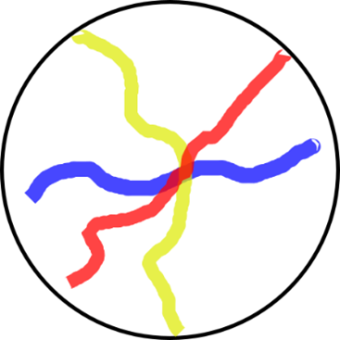
Practice Depth of the Field (DOF)
The range of distances within the object appears sharply focused under the microscope. Understanding and manipulating the depth of field is crucial when examining samples at various magnifications.
Start with the scanning objective (4x) and examine the slide of colored threads under scanning power so the cross-point of the threads is at the center of the field.
You will observe three different color-coded overlapping threads under a microscope. You can focus on one thread at a time. When you focus on one color, you will notice how other colors become blurred.
Gradually move up to higher magnifications and observe the effect of changing magnification on DOF. Higher magnification (e.g., 100x or oil immersion lenses) results in a narrower depth of field because only a thin slice of the specimen will be in focus.

Slide 14
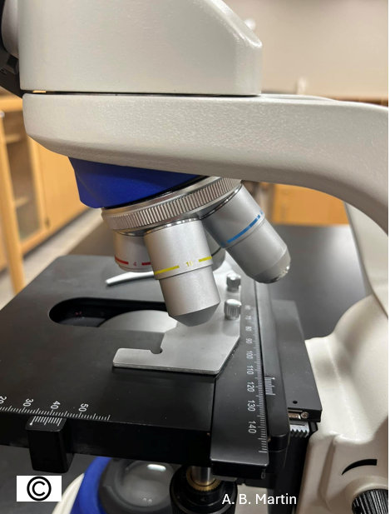
Calculating Magnification Power
The light microscopy uses visible light and two sets of lenses to produce a magnified image. To calculate the total Magnification of a light microscope, you should multiply the eyepiece (ocular) lens's Magnification with the objective lens. The total Magnification will depend on which objective lens you are using.
Total Magnification = Eyepiece Magnification x Objective Magnification.
Example: If you look through 10x ocular and a 40x objective lens, the total Magnification would be 10x40=400 times.
If you are using an oil immersion objective with 100x Magnification power, you will achieve the highest magnification possible on these microscopes with 10x100= 1000X (meaning that objects appear to your eyes 1000X larger than they are).
A. B. Martin

Slide 15
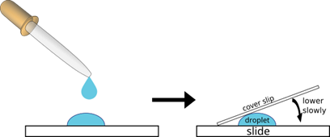
How to Prepare a Wet-mount slide
In clinical applications, the professionals may examine bodily fluids using a wet mount slide. In a vaginal discharge for the presence of Trichomonas vaginalis; in a urine sample for bacteria, yeast, or red blood cells; in a stool sample for parasites like Entamoeba histolytica and in cerebrospinal fluid look for meningitis causing organisms.
Wet mount preparation involves placing a specimen on a glass slide and covering it with a cover slip to create a wet mount for viewing under a microscope.

Slide 16
Prepare and Examine the Protists in Wet Mount Slide
Procedure: You can use the same procedure for Paramecium and Euglena. You do not need a slowing agent for Amoeba (amoeba proteus) since they already move slowly.
Prepare a wet mount slide of cultured pond sample following the directions below. You need a clean glass slide, a cover slip, one toothpick, a drop of cultured paramecium specimen, and a slowing agent.
  Put one drop of slowing agent (like "Protoslo" to slow down the Paramecium's movement for easier observation) on the center of a clean glass slide.
  Use a toothpick to spread the slowing agent on the slide
  Squeeze a clean pipette before putting it into a cultured paramecium specimen and gradually release the pressure of your fingers to pull a small amount of specimen.
  Place a drop of specimen sample on the center of the slide above the slowing agent.
  Touch the liquid on the slide with the side of the coverslip first and slowly cover it.
2. View the slide using darkfield, phase-contrast, or compound light microscope to observe the motility and feeding behavior. Can you determine the method of locomotion for the organisms you are observing?
3. Estimate the length and width of a Paramecium, Euglena and Amoeba.
4. Identify organelles of the microorganism you are observing.
5. Make drawings of organisms and its organelles.

Slide 17
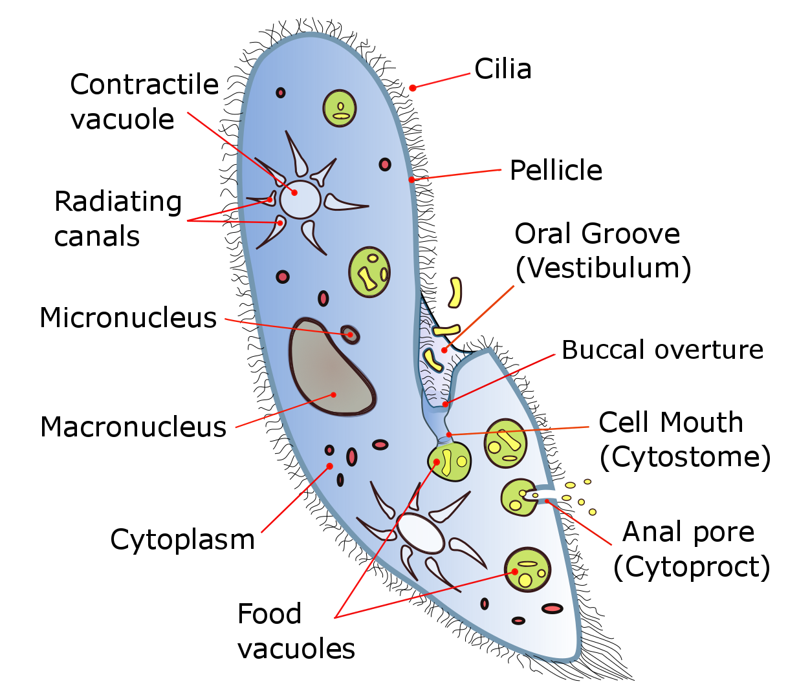
Paramecium
Paramecium is a unicellular ciliate that swims in fresh water by beating thousands of cilia. It has lived in ponds and lakes all over the world for hundreds of millions of years.
The Paramecium cell contains one macronucleus and one to several micronuclei. The number of micronuclei is a species–specific character.
When it is stimulated (mechanically, chemically, optically, thermally…), it often swims backward then turns and swims forward again. Paramecium length may change 100–300 μm long depending on species. (Brette)
The contractile vacuoles actively expel water from the cell to compensate for the fluid absorbed and regulate the osmotic pressure of an organism’s body fluids.
It has a deep oral groove running from the anterior of the cell to its midpoint and an anal pore (cytoproct) on the ventral surface.

Slide 18
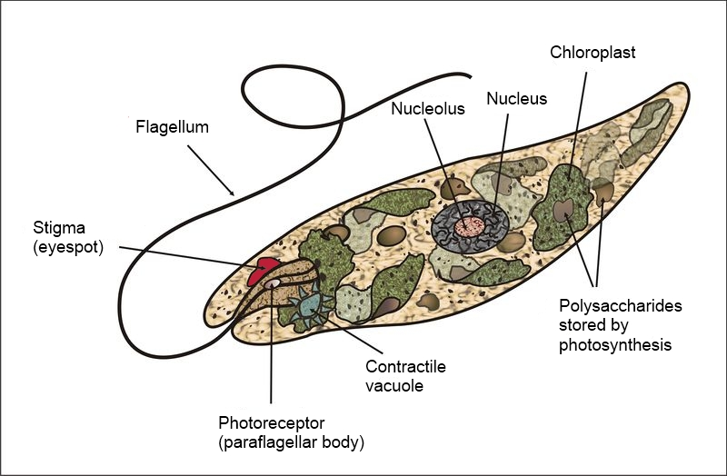
Euglena
The prominent organelles found in a Euglena cell include chloroplasts, flagellum, nucleus, contractile vacuole, pellicle, stigma (eyespot), reservoir, mitochondria, endoplasmic reticulum, and Golgi apparatus, with chloroplasts enabling photosynthesis, the flagellum for movement, the contractile vacuole for regulating water balance, and the pellicle providing structural support to the cell. Most Euglena species have two flagella.
The genus Euglena's length is average 100 micrometers but can range from 15 to 500 micrometers long depending on the species. (Basel)

Slide 19
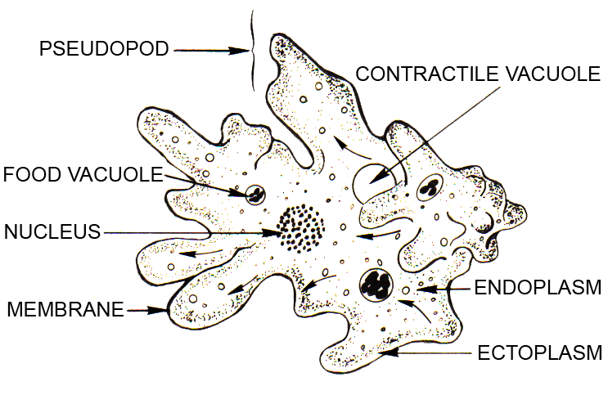
Amoeba
Amoebae are unique in their ability to alter their shape by extending and retracting plasma membranes, creating a false feed (pseudopods).
Through phagocytosis (a process involves engulfing and destroying the foreign substances), consume bacteria and other protists. The most common amoeba species is the Amoeba Proteus, which is about 0.2 to 0.3 mm in size.

Slide 20
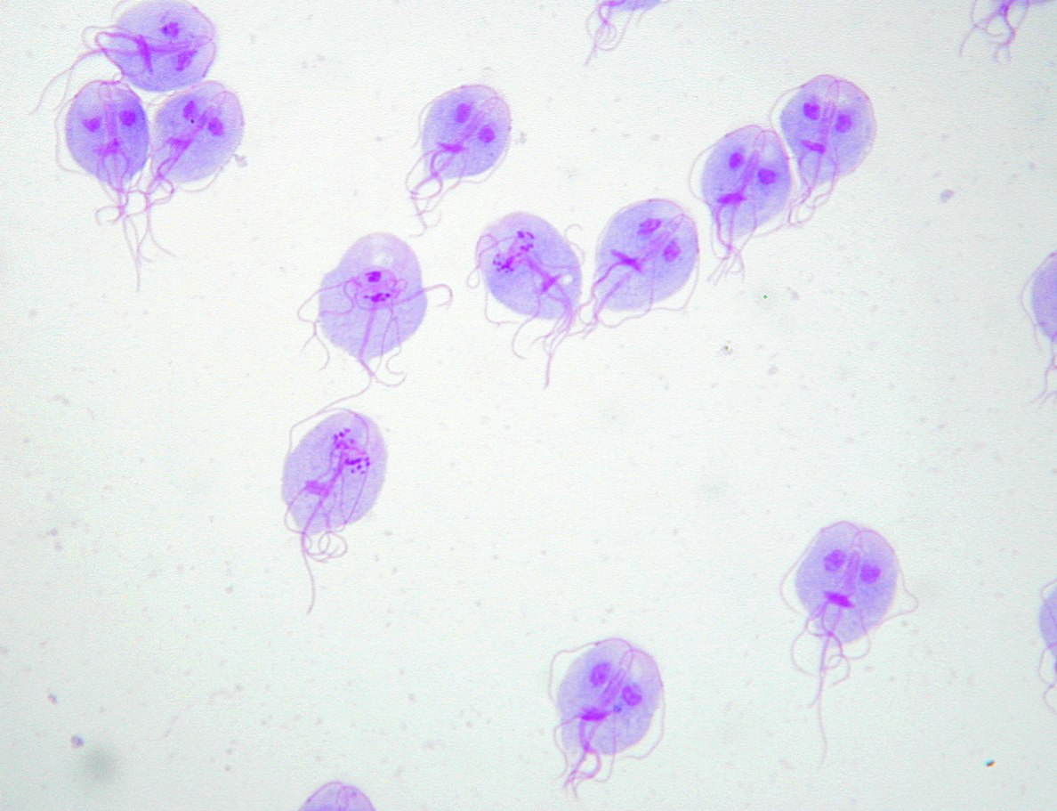
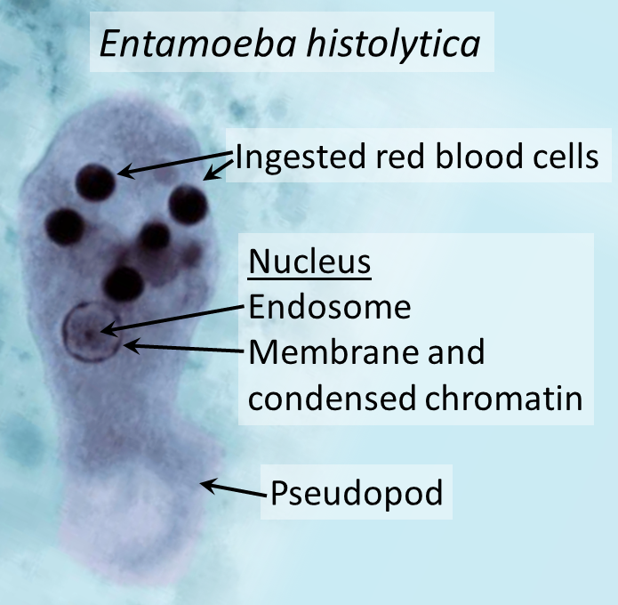
Examine Parasitic Microorganisms on Dry Mount Slides
Giardia Lamblia
Entamoeba histolytica:

Slide 21
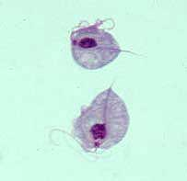
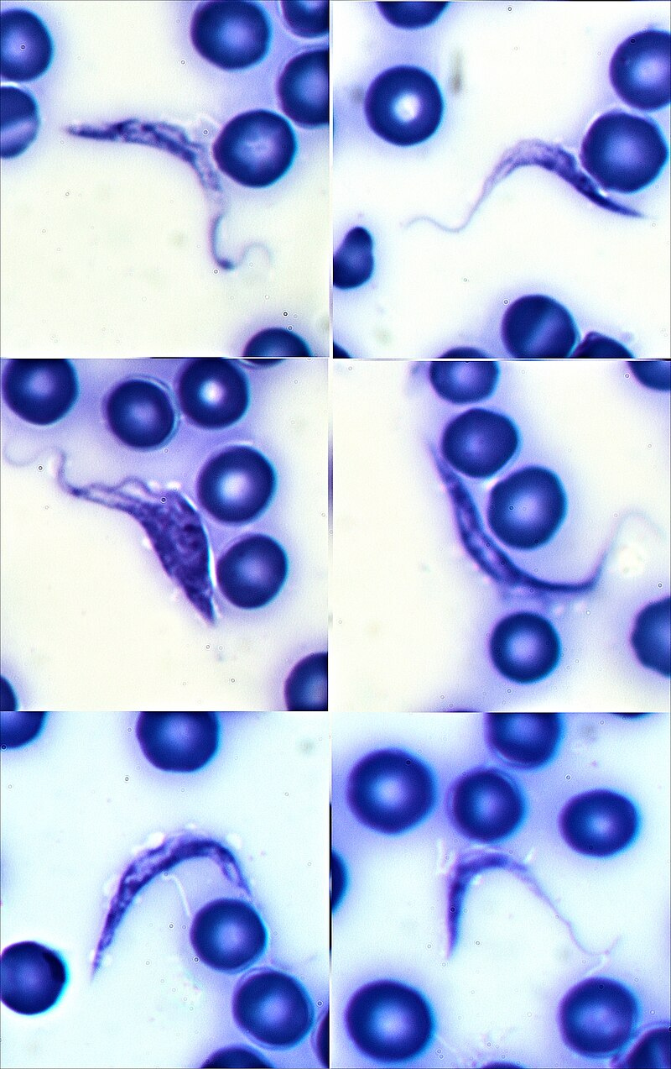
Examine Parasitic Microorganisms on Dry Mount Slides
Trichomonas vaginalis
Trypanosoma Cruzi

Slide 22
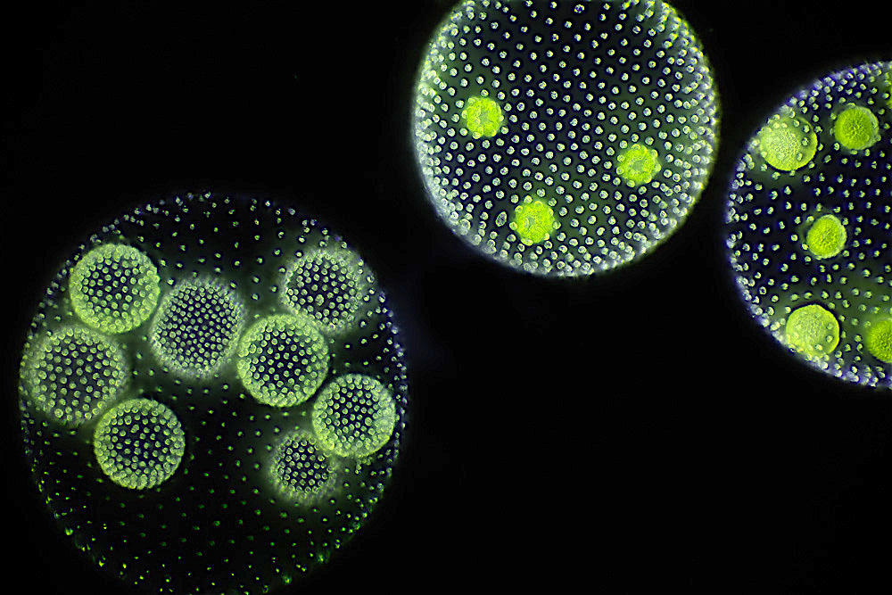
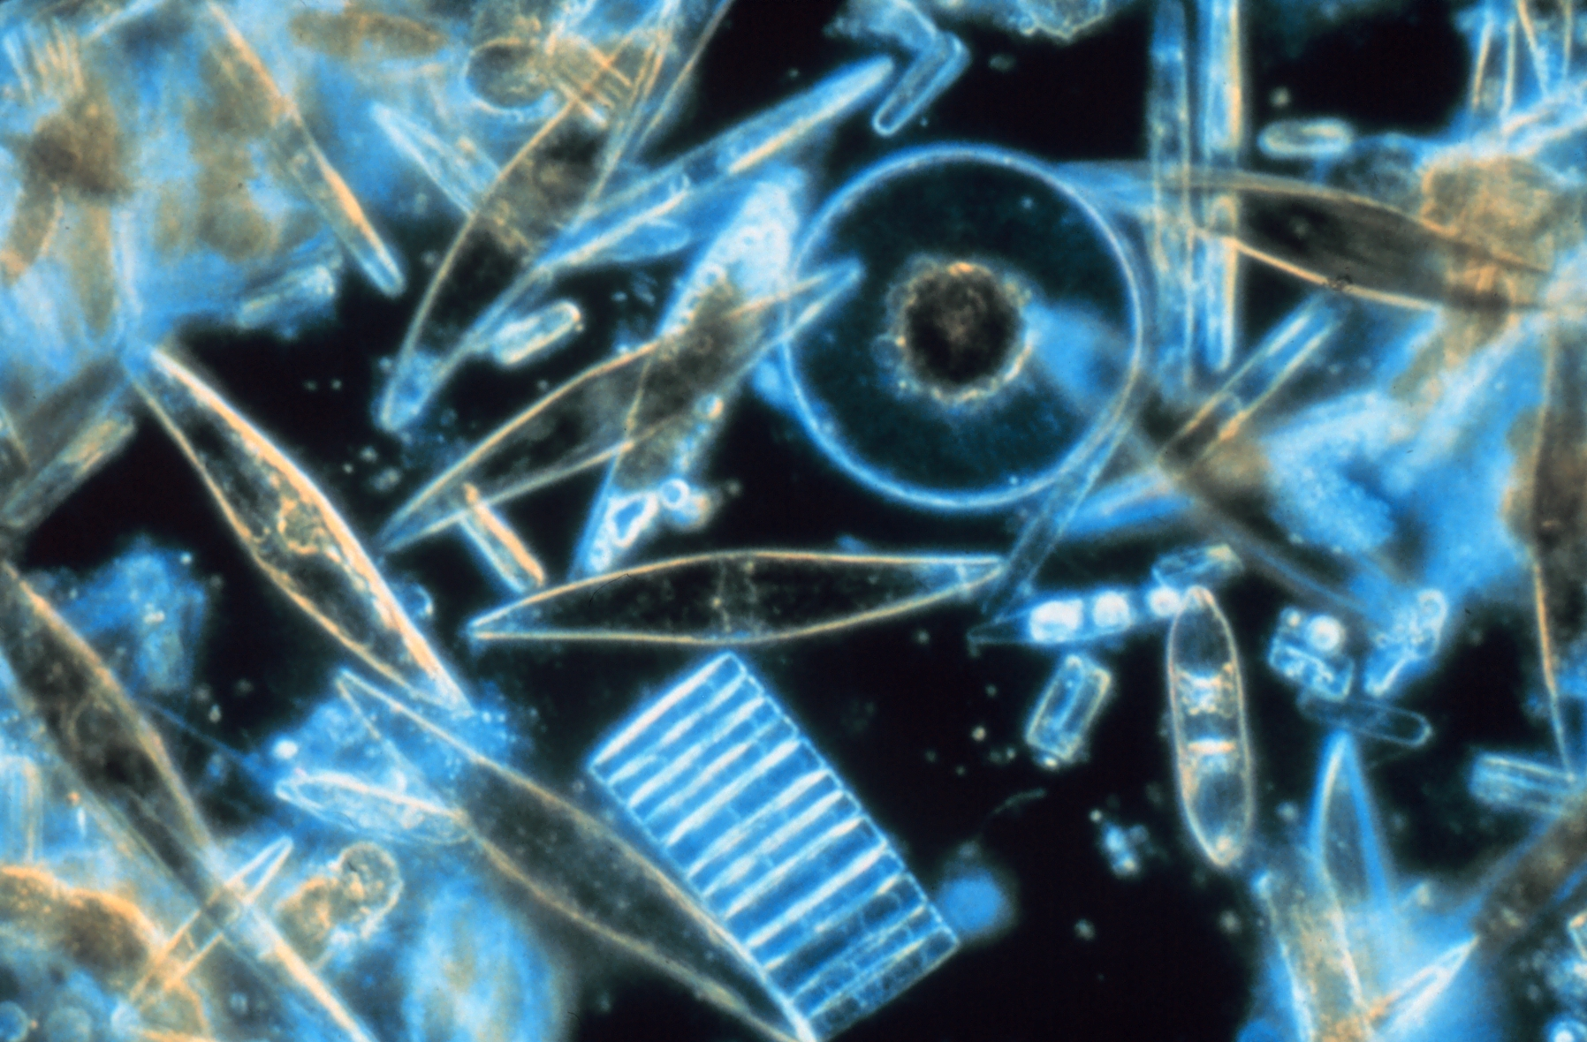
Algae
Volvox
Diatoms

Slide 23
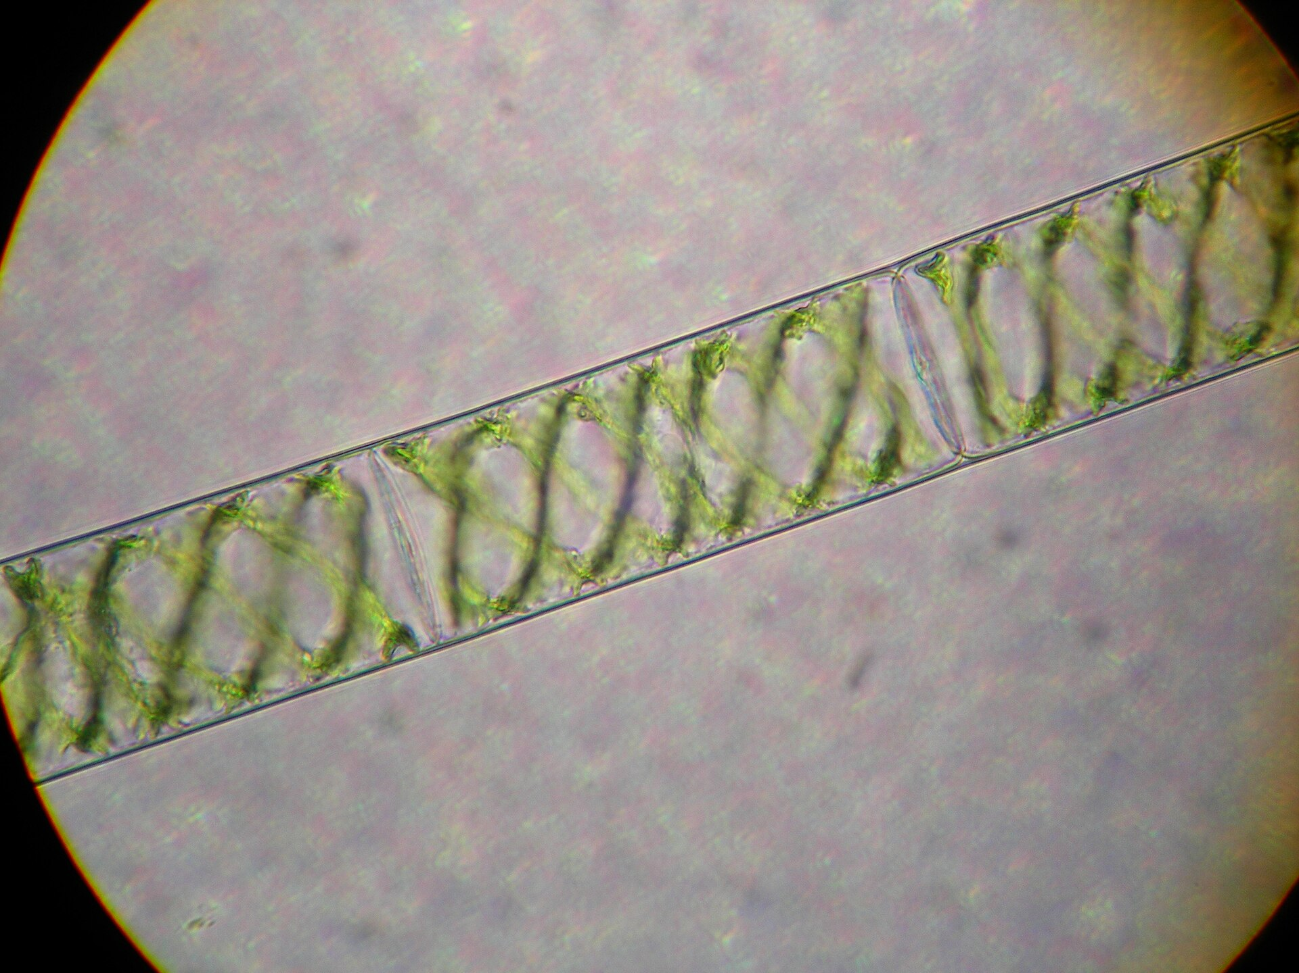
Algae
Spirogyra (water silk)
Spirogyra is a filamentous charophyte green algae. The helical or spiral arrangement of the chloroplasts gives a characteristic view and name. More than 500 Spirogyra species exist and can be found in freshwater habitats.
Spirogyra measures approximately 10 to 150 micrometers in width (though not usually more than 60) and may grow to several centimeters in length.

Slide 24
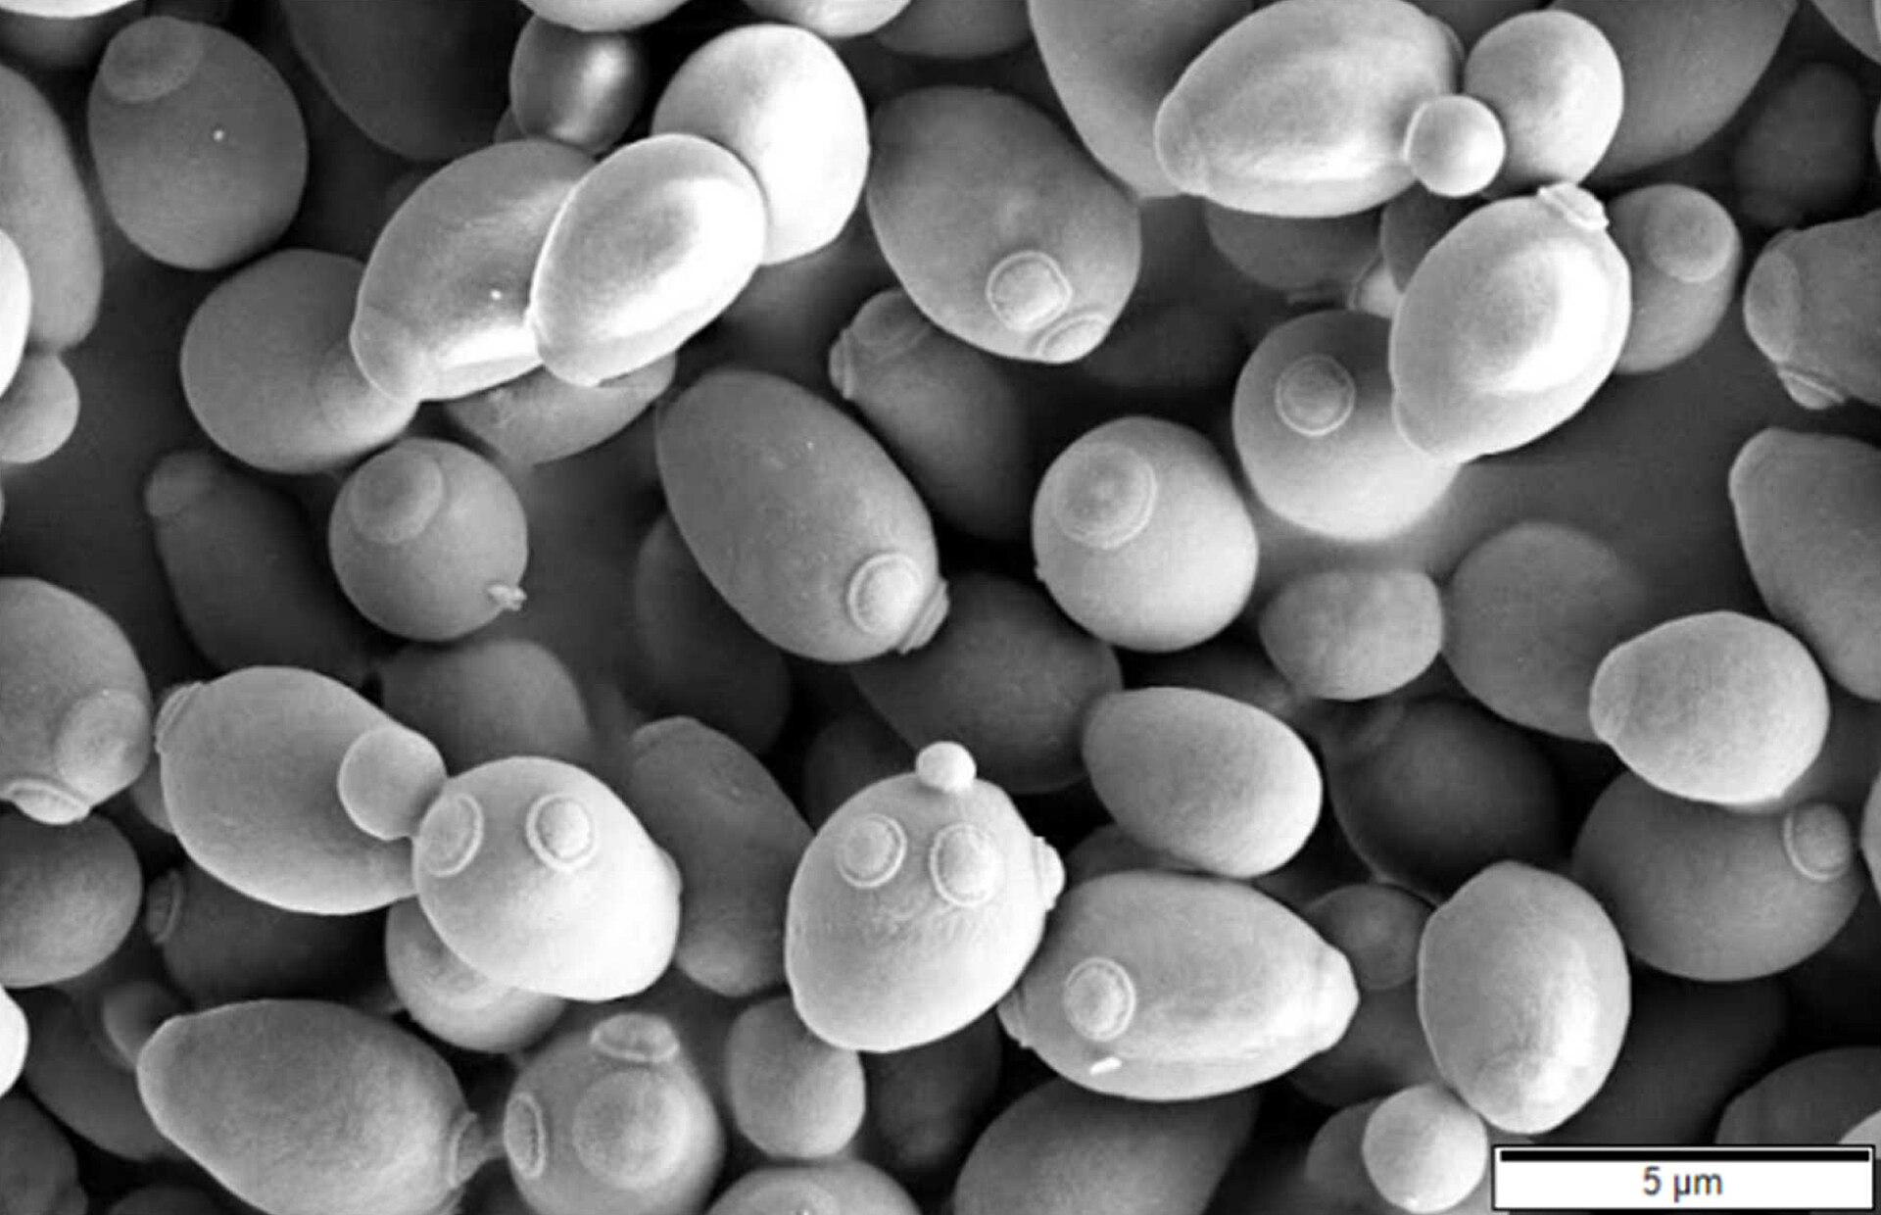
Fungi
Fungi are saprotrophs (organisms that decompose dead organisms) and heterotrophs (require organic carbon to survive). Fungi are grown on specialized media (like Sabouraud's agar) that promote fungal growth and inhibit bacterial growth.
Fungi are eukaryotic organisms which grow as either yeast or mold. However, there are some fungi that are dimorphic, meaning they can grow as yeast under certain environmental conditions (such as the warm moist lungs in the body) and mold under other conditions (such as in soil in the environment). Yeasts are single-celled forms that reproduce by budding, whereas molds form multicellular hyphae which grow by apical extension. Hyphae may or may not have septa that partially separate the cytoplasm. Example for pathogenic fungi: Pneumocystis jiroveci: is the leading cause of pneumonia among AIDS patients. Cryptococcus neoformans: found in pigeon droppings; can cause severe infections in immunocompromised patients
You may observe the following slides under the microscope. Draw diagrams of the slides to help you remember them.
1. Rhizopus stolonifor- zygospore
2. Rhizopus stolonifor- sporangiospore
3. Penicillium notatum- conidiospore
4. Aspergillus niger- conidiospore
5. Candida albicans
6. Saccharomyces cereviseae (budding yeast

Slide 25
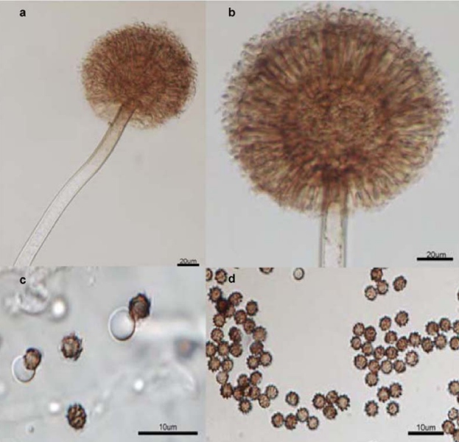
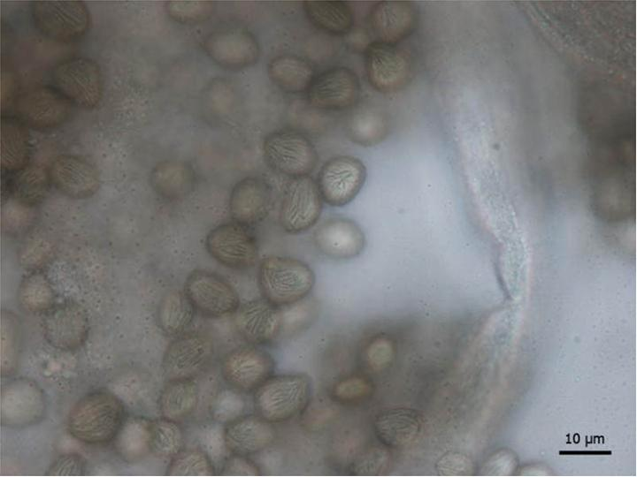
Fungi
Aspergillus niger
Rhizopus stolonifer

Slide 26
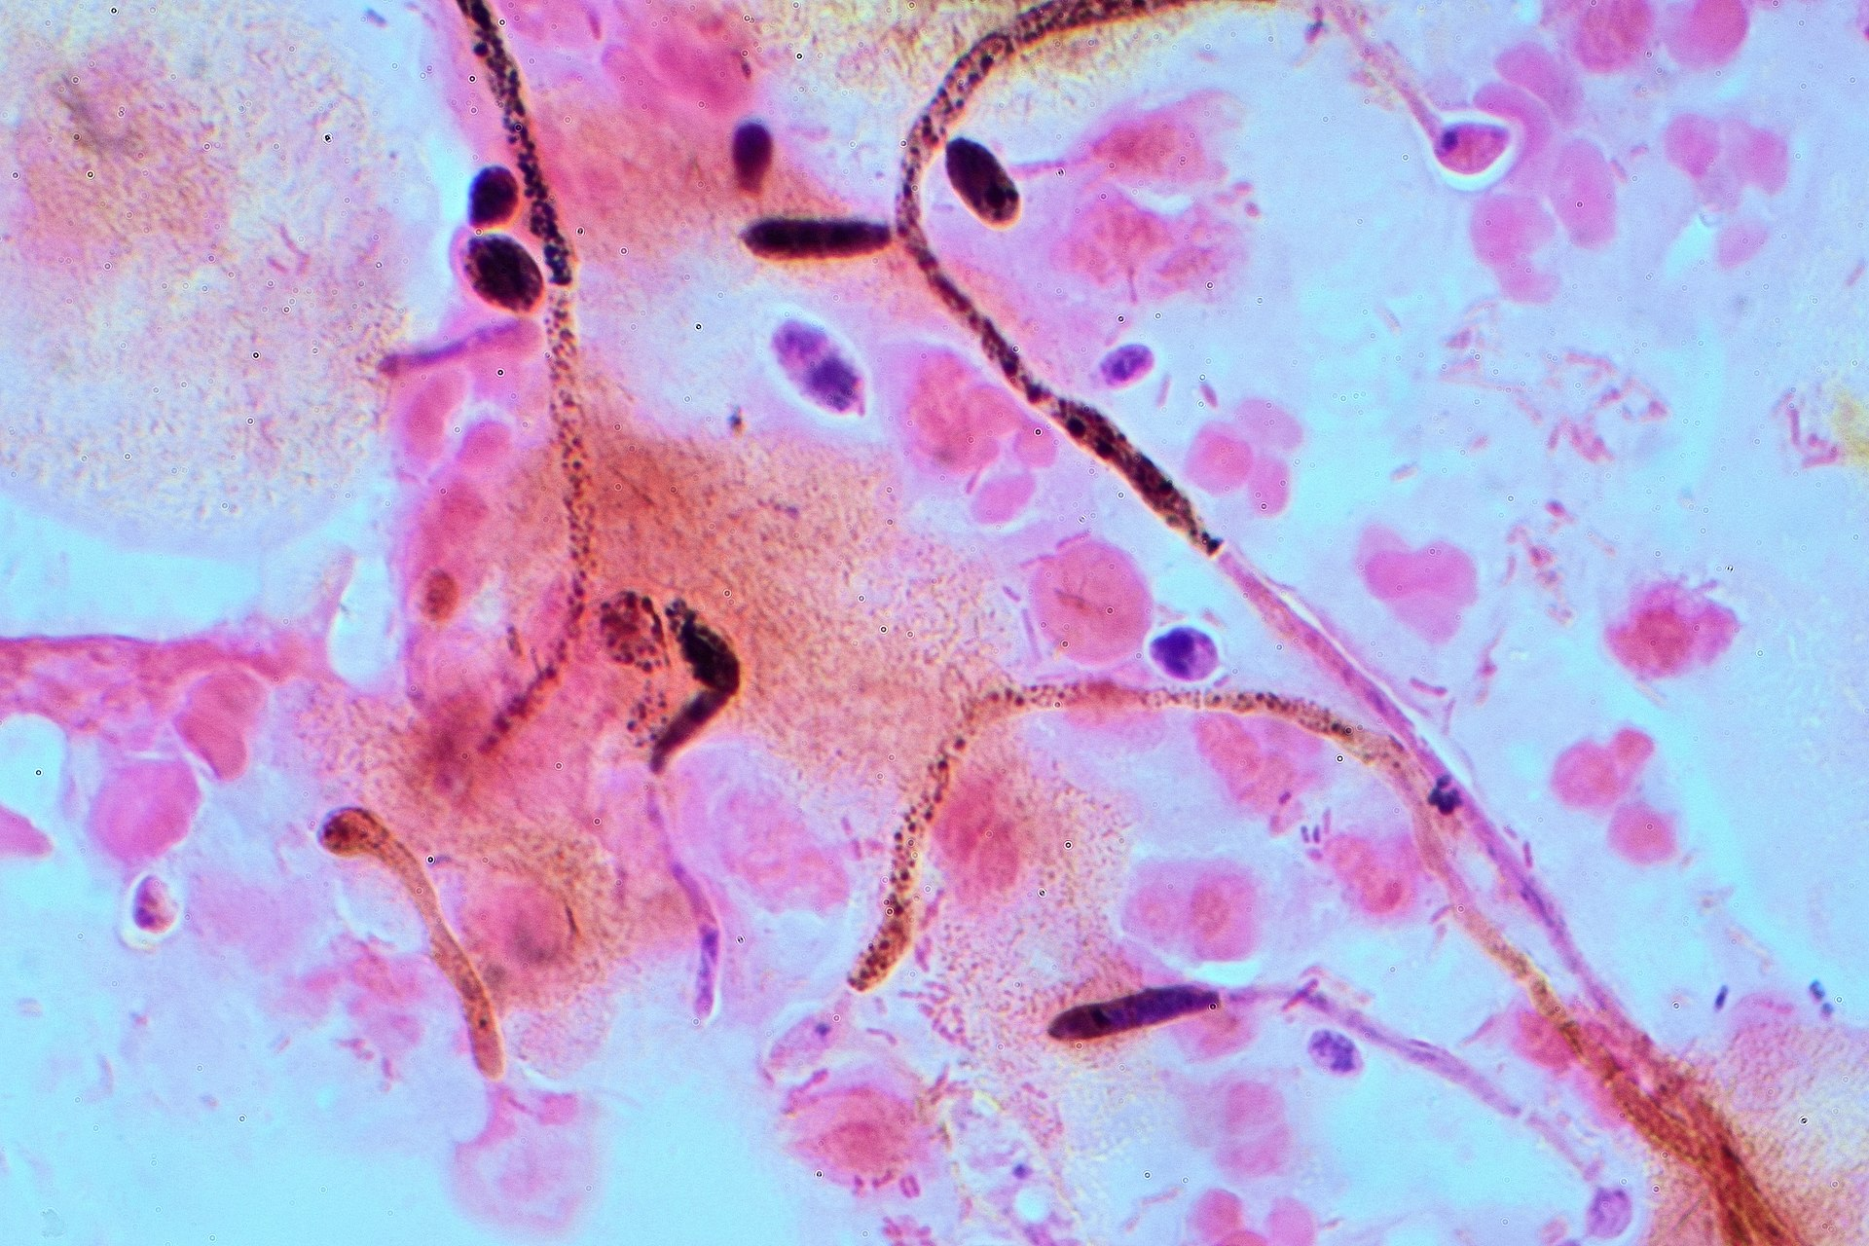
Fungi- Candida albicans
Dimorphic Fungi: Some fungi can exist in both yeast and mold forms, depending on the environment (e.g., Candida, Histoplasma, Blastomyces).
Candida albicans is an opportunistic human fungal pathogen that causes candidiasis. It is a harmless commensal in the gastrointestinal and genitourinary tracts in about 70% of humans and about 75% of women suffer from Candida infection at least once in their lifetime

Slide 27
HELMINTS
Parasitic helminths are both hermaphroditic and bisexual species. The definitive classification is based on the external and internal morphology of egg, larval (juvenile), and adult stages.
You may observe the following slides and preserved specimens. Draw diagrams that will help you remember them.
  Enterobius vermicularis
  Necator americanus
  Schistosoma mansoni
  Fasciola hepatica
  Trichinella spiralis
  Wuchereria bancrofti
  Taenia solium
  Taenia pisiformis slides
  Preserved samples of tapeworms
  Preserved samples of Ascaris lumbricoides

Slide 28
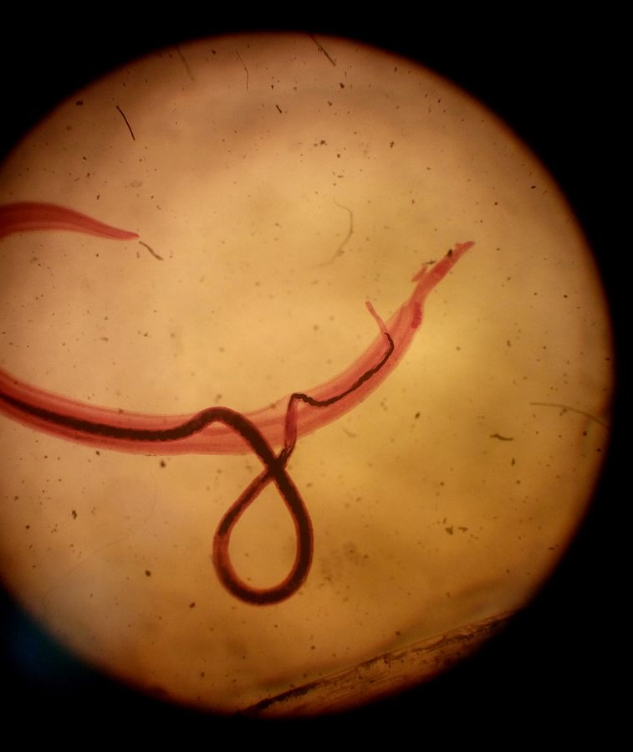
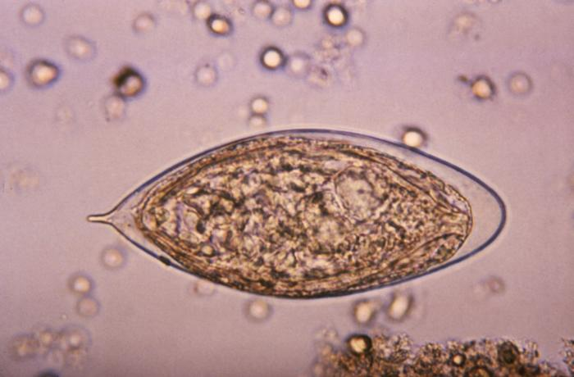
Flukes (Trematodes)
Adult flukes are leaf-shaped flatworms. Prominent oral and ventral suckers help adhere to the host tissues. Flukes are hermaphroditic except for blood flukes, which are bisexual. The life cycle includes a snail intermediate host. Ex: Schistosomes are known as blood flukes.
Schistosomiasis is the most prevalent parasite in humans, and the most common type is S. mansoni.

Slide 29
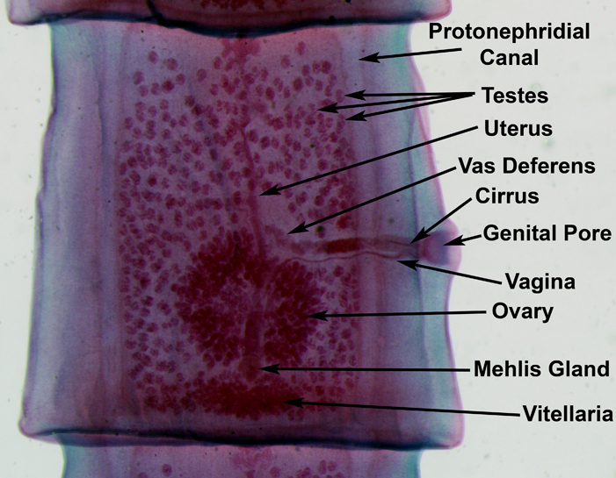
Tapeworms (Cestodes)
Adult tapeworms are elongated, segmented, hermaphroditic flatworms that inhabit the intestinal lumen. Larval forms, which are cystic or solid, inhabit extraintestinal tissues.
Examples of medically important cestodes are Taenia solium (pork tapeworm), Taenia saginata (beef tapeworm), Diphyllobothrium (fish tapeworm) and Echinococcus granulosus.

Slide 30
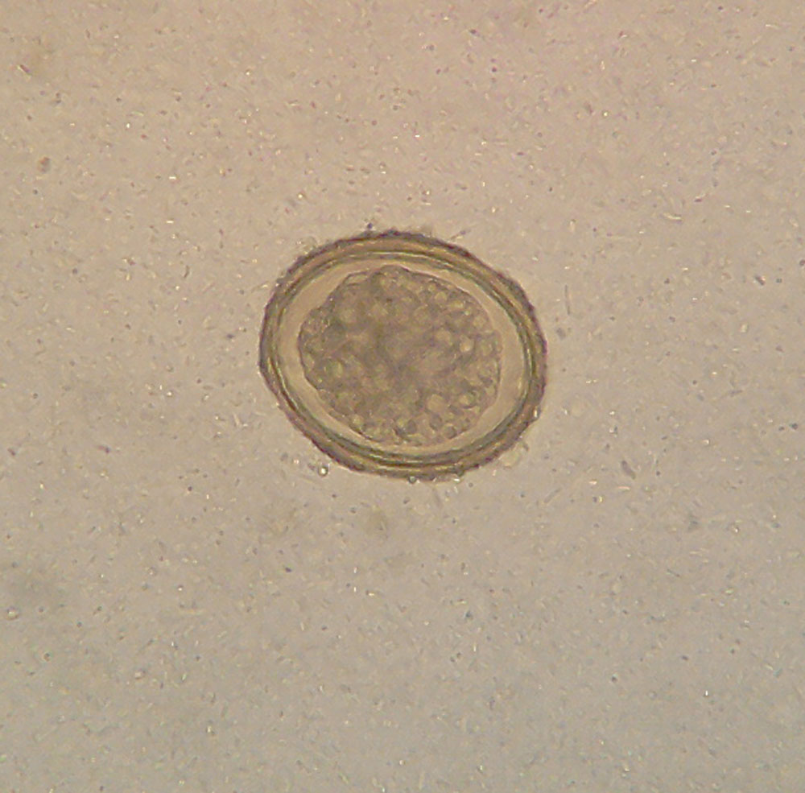
Roundworms (Nematodes)
Adult and larval roundworms are bisexual, cylindrical worms. They inhabit intestinal and extraintestinal sites. Ascaris lumbricoides and Enterobius vermicularis are examples for round worms that you may have a chance to observe.
Ascaris lumbricoides
It is the most common parasitic worm in humans.
Ascaris lumbricoides is a large roundworm with the size of male form 2-4 mm in diameter and 15-31cm long. Females form has 3-6 mm wide and 20-49 cm length. The female worms are thicker and have a straight rear end. The male worm is slenderer with a ventrally incurvated rear end with two retractile copulating spicules.
The female can produce approximately 200,000 eggs per day.

Slide 31
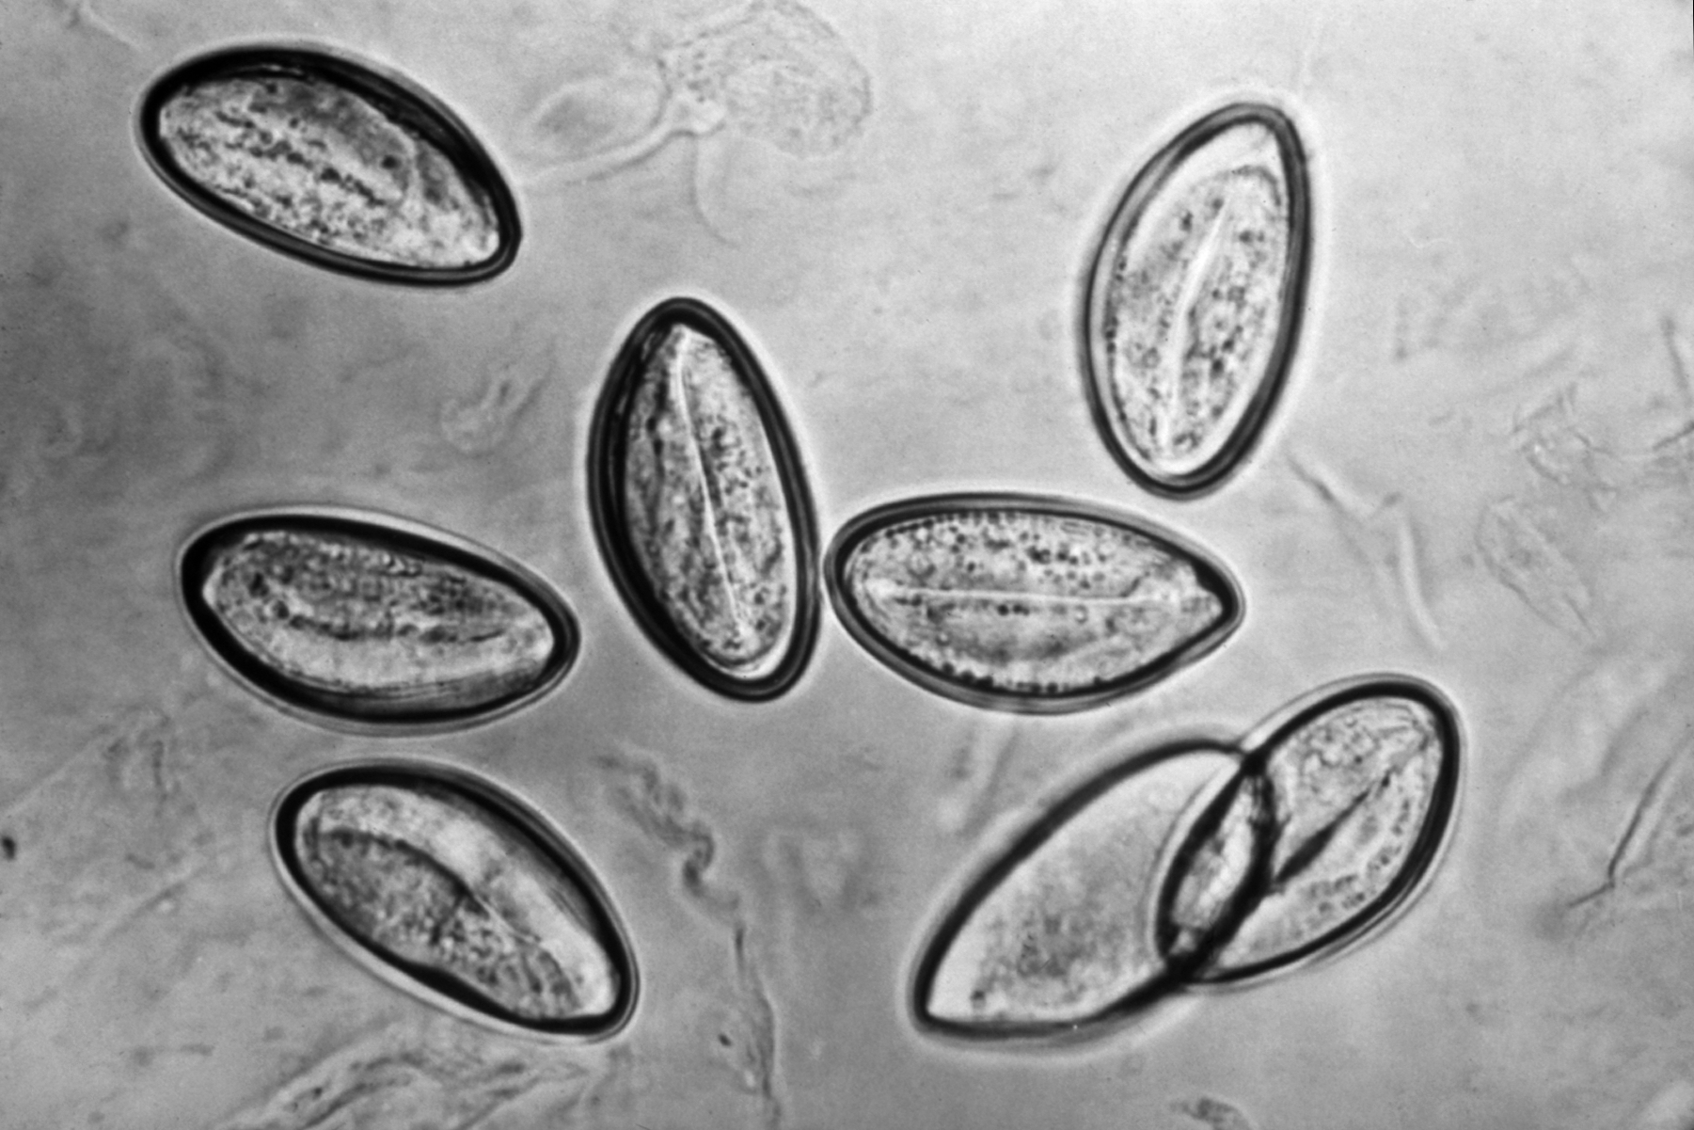
Enterobius vermicularis
Enterobius vermicularis, also called pinworm, is one of the most common helminth infections in the world, with most cases occurring in children.
Enterobius can be diagnosed through a cellophane tape test or pinworm paddle test where an adhesive tape-like material is applied to the perianal area and then examined under a microscope. The examination might reveal characteristic ova which are 50 by 30 microns in size and have a flattened surface on one side or may reveal the worms. Female worms are around 8 to 13 mm long while male worms are 2 to 5 mm long. (Rawla)It spreads between people through ingested pinworm eggs. The most common symptom is pruritus ani (itching in the anal area). The period from swallowing eggs to the appearance of new eggs around the anus is 4 to 8 weeks. Some people who are infected do not have symptoms.

