Slide 1
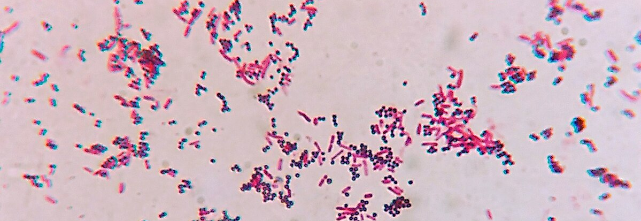
Gram Staining
Photo credit to https://commons.wikimedia.org/wiki/File:Gram_positive_cocci_and_Gram_negative_bacilli.jpg
Dr. Ayda Basgul Martin

Slide 2
Learning Objectives
By the end of this lab, nursing students will be able to:
Explain the purpose of Gram staining and its importance in clinical microbiology.
Describe the differences between Gram-positive and Gram-negative bacteria based on cell wall structure and stain uptake.
Perform the Gram stain procedure step-by-step using proper laboratory technique.
Identify bacteria under the microscope as Gram-positive or Gram-negative based on color and morphology.
Demonstrate correct microscope handling and slide preparation skills.
Interpret Gram stain results to aid in preliminary diagnosis and treatment decisions.

Slide 3
Overview
What is Gram Staining?
Gram stain is a key diagnostic tool that guides clinical decisions in infection management.
It is a differential staining technique used to classify bacteria into two groups : Gram-positive and Gram-negative.
Why gram staining matter in nursing?
Provide quick identification of bacteria type
Helps guide antibiotic therapy
Aids in understanding infection control protocols
Clinical Relevance:
Gram-negative infections may be more resistant to antibiotics
Certain infections require rapid identification for isolation (e.g., MRSA)
Knowing the Gram status helps predict severity and course of treatment
Bacteria Type | Color After Staining | Cell Wall Structure
Gram Positive | Purple / Violet | Thick peptidoglycan
Gram Negative | Pink / Red | Thin peptidoglycanwall and have an outer membrane

Slide 4
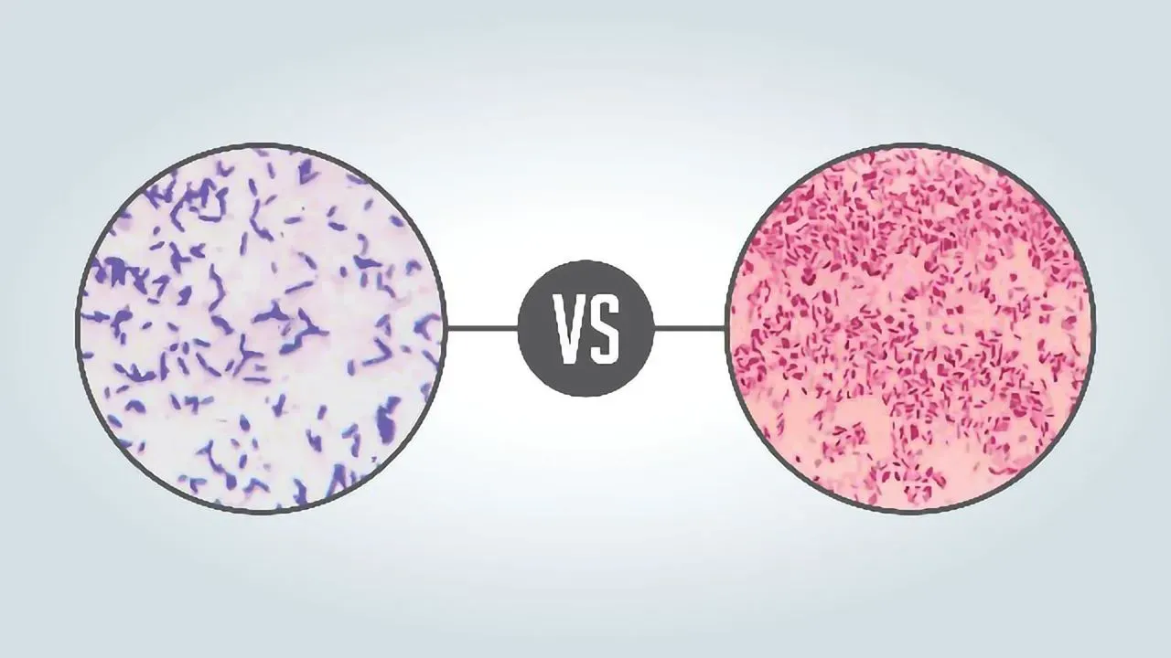
Examples of Gram Negative and Positive Bacteria
Gram-positive:
Staphylococcus aureus (Cocci in clusters)
Streptococcus pneumoniae (Cocci in chain)
Bacillus subtilis (Rod-shaped)
Gram-negative:
Escherichia coli (Rod-shaped)
Pseudomonas aeruginosa (Rod-shaped)
Photo credit to https://assets.technologynetworks.com/production/dynamic/images/content/323007/gram-positive-vs-gram-negative-323007-1280x720.webp?cb=13323480

Slide 5
Step-by-Step Gram Staining Procedure:
Prepare a Bacterial Smear
  Place a small drop of water on a clean slide (if using solid culture).
  Using a sterile loop, transfer a small amount of bacteria to the drop and spread thinly.
  Air dry the smear completely.
Heat Fix the Slide
  Pass the slide through a flame 2–3 times (smear side up) to fix the bacteria.
Stain with Crystal Violet (Primary Stain)
  Cover the smear with crystal violet for 1 minute.
  Rinse gently with distilled water.
Apply Gram's Iodine (Mordant)
  Flood the slide with iodine solution for 1 minute (acts as a mordant).
  Rinse with distilled water.
4. Decolorize with Alcohol or Acetone
  Gently apply alcohol or acetone for 10–20 seconds (until runoff is clear).
  Immediately rinse with distilled water to stop decolorization.
5. Counterstain with Safranin
  Stain with safranin for 1 minute.
  Rinse with distilled water and blot dry with bibulous paper.
6. Examine Under Microscope
  Use oil immersion (100x objective) to observe bacteria.
  Gram-positive bacteria appear purple/violet.
  Gram-negative bacteria appear pink/red.

