Slide 1
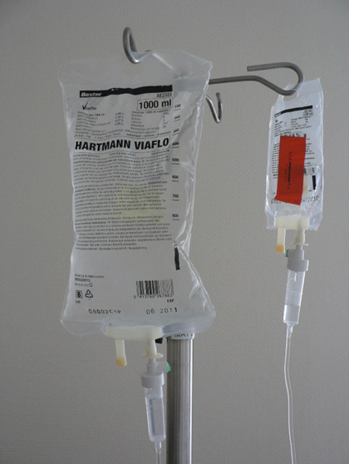
Maintaining and Monitoring Intravenous Therapy
Best practices for safe and effective IV treatment
Harmid, Public domain, https://commons.wikimedia.org/wiki/File:Infuuszakjes.jpg
Notes:
AI-generated content may be incorrect. --- This presentation covers essential practices in intravenous (IV) therapy, focusing on evidence-based guidelines, patient education, maintenance, monitoring, and documentation to ensure safe and effective treatment outcomes. Image source: Microsoft 365 content library

Slide 2
Learning Objectives
Demonstrate knowledge of evidence-based guidelines and best practices for safe intravenous therapy administration to reduce complications.
Explain how to monitor infusion rates and adjust according to healthcare provider orders or patient needs.
Discuss how to assess IV sites for clinical manifestations of infiltration, phlebitis, extravasation, or infection.
Record patient assessment and changes to the IV site or therapy.
Describe strategies for minimizing infection risks.
Explain the importance of changing IV dressings and tubing according to protocol to reduce the risk of infection.
Discuss considerations for the individuals with cardiovascular and/or renal disorders when monitoring IV therapy.

Slide 3
Evidence-Based Guidelines and Key Components of IV Therapy
Notes:
--- This slide references information from the following file: https://ololc-my.sharepoint.com/personal/ldorsey_franu_edu/_layouts/15/Doc.aspx?sourcedoc=%7B1802AA70-F1EA-4CCC-94B2-EC9D0FD5A15E%7D&file=OER%20IVT%20Chapter%206.docx&action=default&mobileredirect=true Overview of evidence-based guidelines and best practices for IV therapy, Common elements and key components of IV therapy, Indications, equipment, site care, monitoring, complication management, documentation, infection control, and discontinuation

Slide 4

Key Components of IV Therapy
Indications for Use
IV therapy use depends on patient's medical condition and required IV solutions like saline or glucose.
IV Equipment and Supplies
Proper protocols govern use and maintenance of IV catheters, infusion pumps, and sterile supplies.
Monitoring and Site Care
Continuous monitoring of vital signs, infusion rates, and proper site care prevent complications during IV therapy.
Complication Management
Procedures for recognizing and managing potential complications, such as infiltration, phlebitis, or infection
Infection Control and Documentation
Aseptic technique and thorough documentation ensure patient safety and regulatory compliance.
Discontinuation
Guidelines for the safe removal of IV access devices and management of the site discontinuation
Credit: modification of work “EMT/Nursing Pediatric Emergency Simulation - April 2013 18” by COD Newsroom/Flickr; CC BY 2.0
Notes:
--- This slide references information from the following file: https://ololc-my.sharepoint.com/personal/ldorsey_franu_edu/_layouts/15/Doc.aspx?sourcedoc=%7B1802AA70-F1EA-4CCC-94B2-EC9D0FD5A15E%7D&file=OER%20IVT%20Chapter%206.docx&action=default&mobileredirect=true After inserting and securing a peripheral intravenous catheter, the healthcare professional can initiate IV therapy if ordered. The IV system must then be maintained and monitored. The agency policies will mandate several key components to ensure patient safety and effective care. Although agency policies vary by institution, common elements such as IV equipment and supplies, site care, monitoring, complication management, documentation, infection control, and discontinuation will be discussed in this chapter. Key Components of IV Therapy There are several key components of IV therapy to ensure individual safety and effective care. These components aim to standardize practices, enhance individual safety, and ensure compliance with regulatory requirements. While specific policies may vary by agency, let’s discuss common aspects of IV therapy. 1. Indications for Use – The individual’s specific medical conditions will determine appropriate use of IV therapy. The type of IV solution administered will be based on the individual’s needs (e.g., saline, Ringer’s solution, glucose). 2. IV equipment and supplies – protocols for use and maintenance of IV equipment, catheters, infusion pumps, and sterile supplies. 3. Site care – protocols for maintenance and care of IV access devices. 4. Monitoring – requirements for monitoring individuals during and after IV therapy, including vital signs, infusion rates, and signs of complications. 5. Complication management – procedures for recognizing and managing potential complications, such as infiltration, phlebitis, or infection. Complications will be discussed further in Chapter 7. 6. Documentation – standards for documenting IV therapy procedures, individual responses, and any adverse events. 7. Infection Control - maintain aseptic technique during IV care, including handling of IV site and ports, changing dressings, and accessing the IV line. 8. Discontinuation – guidelines for the safe removal of IV access devices and management of the site discontinuation. Image source: Microsoft 365 content library

Slide 5
Patient Education and Communication in IV Therapy
Notes:
--- This slide references information from the following file: https://ololc-my.sharepoint.com/personal/ldorsey_franu_edu/_layouts/15/Doc.aspx?sourcedoc=%7B1802AA70-F1EA-4CCC-94B2-EC9D0FD5A15E%7D&file=OER%20IVT%20Chapter%206.docx&action=default&mobileredirect=true Importance of patient and family education before IV therapy, Purpose, indications, risks, and when to seek help, Addressing patient fears and providing clear instructions

Slide 6
Addressing Patient Fears and Providing Clear Instructions
Clear Education on IV Therapy
Communicate purpose, indications, and potential risks of IV therapy clearly and empathetically to patients and families.
Addressing Patient Fears
Acknowledge anxiety and fears about IV therapy and provide reassurance to ease concerns.
Providing Instructions and Support
Offer written instructions and answer patient questions to ensure understanding and confidence in IV therapy.
Notes:
--- This slide references information from the following file: https://ololc-my.sharepoint.com/personal/ldorsey_franu_edu/_layouts/15/Doc.aspx?sourcedoc=%7B1802AA70-F1EA-4CCC-94B2-EC9D0FD5A15E%7D&file=OER%20IVT%20Chapter%206.docx&action=default&mobileredirect=true Before initiating IV therapy, it’s important to educate the individual and family on what to expect with IV therapy. Let’s consider what should be communicated clearly and empathetically to the individual and family to ensure they understand the purpose, indications, potential risks and complications, and clinical manifestations to report when receiving IV therapy. The healthcare professional should acknowledge any fears or anxiety the individual or family may have about IV therapy and provide reassurance. To ensure they are fully informed, written instructions may be provided and answering any questions they have will help ease concerns. Image source: Microsoft 365 content library

Slide 7
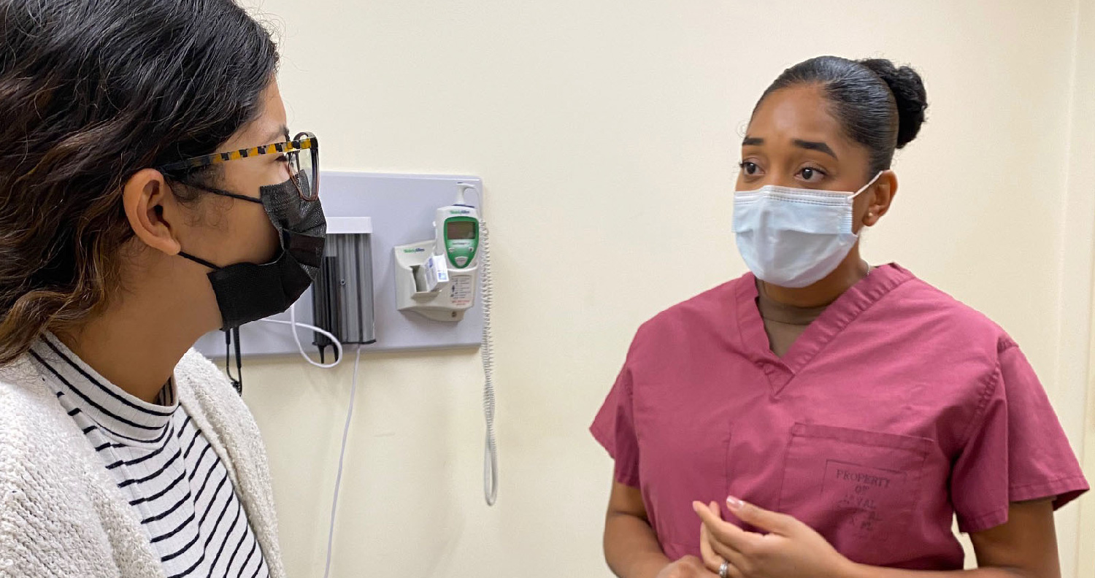
Importance of Patient and Family Education Before IV Therapy
Purpose of IV Therapy
Explain IV therapy administers fluids, medications, or nutrients directly into veins for rapid effect and patient care.
Indications for IV Therapy
Inform patients about IV therapy uses such as rehydration, medication delivery, nutrition, and blood product administration.
Risks and Complications
Discuss common side effects and serious complications like infection, infiltration, phlebitis, and air embolism risks.
When to Seek Help
Encourage reporting symptoms like redness, swelling, pain, air bubbles, dizziness, or unusual reactions immediately.
credit: modification of work “Naval Branch Health Clinic Mayport nurse midwife 211027-N-QA097-020” by U.S. Navy/Deidre Smith/Flickr, Public Domain
Notes:
--- This slide references information from the following file: https://ololc-my.sharepoint.com/personal/ldorsey_franu_edu/_layouts/15/Doc.aspx?sourcedoc=%7B1802AA70-F1EA-4CCC-94B2-EC9D0FD5A15E%7D&file=OER%20IVT%20Chapter%206.docx&action=default&mobileredirect=true Before initiating IV therapy, it’s important to educate the individual and family on what to expect with IV therapy. Let’s consider what should be communicated clearly and empathetically to the individual and family to ensure they understand the purpose, indications, potential risks and complications, and clinical manifestations to report when receiving IV therapy. The healthcare professional should acknowledge any fears or anxiety the individual or family may have about IV therapy and provide reassurance. To ensure they are fully informed, written instructions may be provided and answering any questions they have will help ease concerns. First, its purpose. Intravenous therapy involves administering fluids, medications, or nutrients directly into the vein through a peripheral IV catheter. The healthcare professional should also inform them of the duration of the therapy and how frequently they may receive treatment. The fluids, electrolytes, and medications act rapidly in the body to restore fluid and/or electrolyte balance and deliver medications. Because of its rapid action in the body, it’s crucial to administer it safely to the patient. Second, its indications. The reason for IV therapy could be for rehydration, providing medications (e.g., antibiotics, pain management, electrolyte replacement), delivering nutrients, or blood products. Some individuals may experience fluid and electrolyte imbalances that require treatment through IV fluid and electrolyte therapy. Other reasons for IV therapy include restricted diets during and after surgery (i.e., nothing by mouth diet) and corrective or replacement losses (e.g., excessive vomiting, urination, and/or diarrhea). Third, its potential risks and complications. Some common side effects of IV therapy might include pain, swelling, or redness at the insertion site. Complications of IV therapy include infection, infiltration, phlebitis, extravasation, air embolism, and bleeding. We will discuss complications in further detail in Chapter 7. Fourth, when to seek help. The healthcare professional should discuss the clinical manifestations to be aware of. Tell them to report excessive redness, swelling, pain, or signs of infection such as drainage or warmth at the site. Explain how air bubbles in the tubing are a concern and they should immediately inform the healthcare professional if this happens. Lastly, encourage the individual to report if they feel faint, dizzy, or experience any unusual reaction. Image source: Microsoft 365 content library

Slide 8
IV Therapy Maintenance and Monitoring Practices
Notes:
--- This slide references information from the following file: https://ololc-my.sharepoint.com/personal/ldorsey_franu_edu/_layouts/15/Doc.aspx?sourcedoc=%7B1802AA70-F1EA-4CCC-94B2-EC9D0FD5A15E%7D&file=OER%20IVT%20Chapter%206.docx&action=default&mobileredirect=true Evidence-based practices for IV maintenance and monitoring (Table 6.1), Assessment of IV site for patency and complications, Sterile dressing and tubing replacement protocols

Slide 9

Evidence-based Practices for IV Maintenance and Monitoring (Table 6.1)
Continuous IV Site Assessment
Ongoing monitoring of the IV site and patient ensures early detection of complications during infusion.
Scheduled Dressing and Tubing Changes
Regular sterile dressing and tubing changes reduce infection risks and maintain system integrity.
Infusion Rate and Bag Inspections
Adjusting infusion rates and inspecting IV bags ensures proper medication delivery and patient safety.
Patient Monitoring and Aseptic Technique
Continuously monitor the patient for complications and maintain aseptic technique throughout IV care to ensure safety, prevent infection, and promote effective treatment.
Discontinuation of Vascular Access Device (VAD)
Discontinue the vascular access device as ordered when clinically indicated due to resolution of need, infection, mechanical failure, or complications.
Accurate Documentation Practices
Detailed documentation supports effective communication and regulatory compliance among healthcare teams.
Notes:
--- This slide references information from the following file: https://ololc-my.sharepoint.com/personal/ldorsey_franu_edu/_layouts/15/Doc.aspx?sourcedoc=%7B1802AA70-F1EA-4CCC-94B2-EC9D0FD5A15E%7D&file=OER%20IVT%20Chapter%206.docx&action=default&mobileredirect=true Now that you’ve covered IV therapy components and education, let’s review the maintenance and monitoring of the IV system (Table 6.1) to ensure its safety, effectiveness, and functionality. Table 6.1 Evidence-based practices for IV maintenance and monitoring (OpenAI, 2024) - IV site assessment and patient monitoring are continuous tasks during IV infusion. - Sterile dressing changes and IV tubing changes are scheduled at regular intervals to minimize infection risks. - Infusion rate adjustments and IV bag inspections are performed as needed to ensure proper medication delivery and patient safety. - Documentation is an ongoing task to ensure effective communication and compliance with regulations. The table outlines various maintenance and monitoring tasks associated with IV therapy, emphasizing the importance of continuous assessment and patient monitoring to identify complications early and ensure proper function. Sterile dressing changes and IV tubing changes are scheduled every 48-72 hours and 72-96 hours, respectively, to reduce infection risks. Infusion rate adjustments and IV bag inspections are performed as ordered to ensure the correct delivery of fluids or medications and to maintain patient safety. Aseptic techniques are maintained throughout the IV process to prevent infections. The discontinuation of the vascular access device (VAD) is done as ordered, based on clinical need or complications. Documentation of all activities and patient responses is crucial for effective communication among healthcare providers and compliance with legal and ethical standards. Image source: Microsoft 365 content library

Slide 10
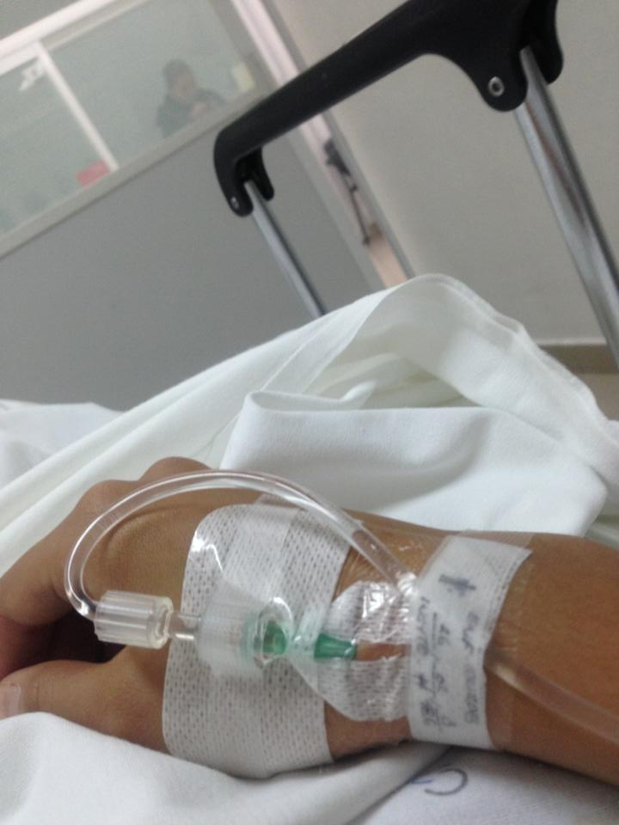
Assessment of IV site for Patency and Complications
IV Site Patency Assessment
Assess IV site by flushing with normal saline to ensure catheter patency without resistance or leakage.
Monitoring for Complications
Check for leakage, discomfort, and other signs of complications during and after flushing the IV catheter.
Continuous IV Therapy Assessment
When continuous IV fluids are running, visually inspect and palpate IV site through transparent dressing regularly.
Documentation of Findings
Record all IV site assessments and findings promptly in the patient's electronic medical record (EMR).
By LeoCarbajal - Own work, CC BY-SA 3.0, https://commons.wikimedia.org/w/index.php?curid=24896486
Notes:
--- This slide references information from the following file: https://ololc-my.sharepoint.com/personal/ldorsey_franu_edu/_layouts/15/Doc.aspx?sourcedoc=%7B1802AA70-F1EA-4CCC-94B2-EC9D0FD5A15E%7D&file=OER%20IVT%20Chapter%206.docx&action=default&mobileredirect=true IV Assessment As long as the peripheral catheter is in place, the healthcare professional is responsible for assessing the IV site for patency (link in glossary) and signs of complications. The IV site should be assessed per agency policy or protocol (link to glossary). The peripheral catheter may be saline locked (not receiving continuous IV therapy) or receiving continuous IV therapy. If the peripheral catheter is saline locked, only receiving an intravenous push (IV push) medication, intravenous piggyback (IVPB) (link to glossary), or blood products, the healthcare professional should flush the peripheral catheter with normal saline (link to glossary) per agency policy or protocol or before and after these administrations to assess patency. In some cases, normal saline followed by heparinized saline (link to glossary) may be indicated (e.g., central lines) (Ignatavisius, et al., 2024). As the catheter is being flushed, assess for leakage, discomfort, and signs of complications. If the catheter is patent, the flush should flow freely without resistance or leakage and the patient should not report any discomfort upon palpation. If the patient is receiving continuous IV fluids, the IV site is assessed for signs of complications by visualizing the site through the transparent dressing and lightly palpating around the site. Document your findings in the patient’s electronic medical record (EMR). Image source: Microsoft 365 content library

Slide 11
Sterile Dressing and Tubing Replacement Protocols
Sterile Dressing Replacement
Sterile dressings protect IV sites from pathogens and should be replaced every 48-72 hours or if compromised.
IV Tubing Replacement Timing
IV tubing replacement typically occurs every 72-96 hours, or more frequently for treatments like TPN to reduce infection risk.
Minimizing Contamination
Change IV tubing and solutions simultaneously when possible to limit system openings and contamination risks.
Preventing Air Emboli
Properly prime IV tubing to remove air bubbles to prevent air emboli during tubing replacement.
Notes:
--- This slide references information from the following file: https://ololc-my.sharepoint.com/personal/ldorsey_franu_edu/_layouts/15/Doc.aspx?sourcedoc=%7B1802AA70-F1EA-4CCC-94B2-EC9D0FD5A15E%7D&file=OER%20IVT%20Chapter%206.docx&action=default&mobileredirect=true Sterile Dressing Replacement The sterile dressing (transparent dressing) protects the IV site from pathogens entering the surrounding tissue or bloodstream. The healthcare professional should follow the agency’s policy on routine expectations for replacing the sterile dressing. This usually occurs every 48-72 hours or when the dressing becomes wet, soiled (link to glossary), or loose. IV Tubing Replacement The IV tubing integrity is crucial for safe and effective treatment for patients. The healthcare professional should follow the agency’s policy on routine expectations when replacing the IV tubing. This usually occurs every 72-96 hours but may occur more frequently based upon the type of treatment. For example, total parenteral nutrition (TPN) (link to glossary) typically requires that tubing be replaced every 24 hours to reduce the risk of infection because it contains high concentration of glucose which is a medium for bacterial growth. If possible, change the IV tubing and solutions at the same time to minimize the number of times the IV system is opened, which limits contamination. The IV tubing should be inspected for punctures, contamination, or occlusions. When replacing the IV tubing, the healthcare professional should take precautions to prevent air emboli by properly priming the IV tubing to remove any air bubbles. Image source: Microsoft 365 content library

Slide 12
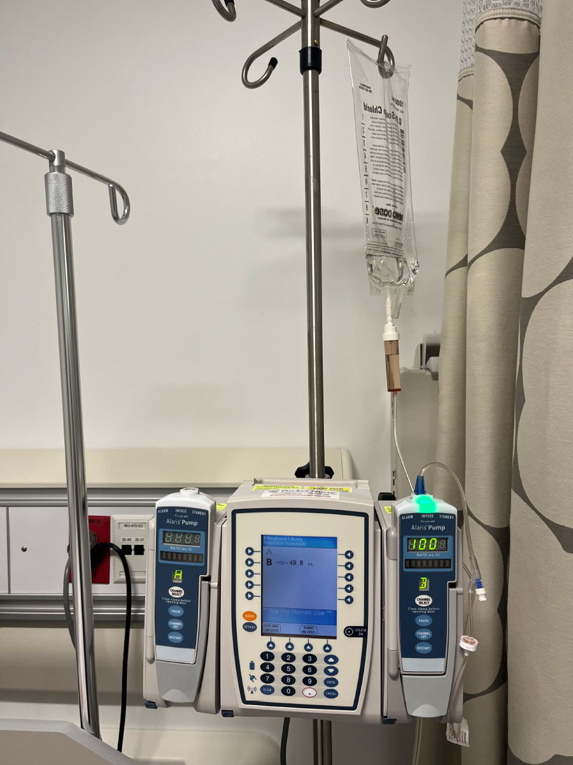
Infusion Rate Adjustment and Pump Verification
Routine Infusion Monitoring
Healthcare professionals must regularly check the IV pump to confirm proper infusion rates and fluid delivery.
Ensuring Correct Fluid Delivery
Adjusting infusion rates ensures patients receive the correct speed and amount of IV fluids for safe treatment.
Source: Image by Rice University, OpenStax, under CC BY 4.0 license
Notes:
--- This slide references information from the following file: https://ololc-my.sharepoint.com/personal/ldorsey_franu_edu/_layouts/15/Doc.aspx?sourcedoc=%7B1802AA70-F1EA-4CCC-94B2-EC9D0FD5A15E%7D&file=OER%20IVT%20Chapter%206.docx&action=default&mobileredirect=true Infusion Rate Adjustment To ensure that the patient is receiving the correct amount and speed of the IV fluids, the healthcare professional must routinely assess the IV pump to verify it is infusing properly. Image source: Microsoft 365 content library

Slide 13
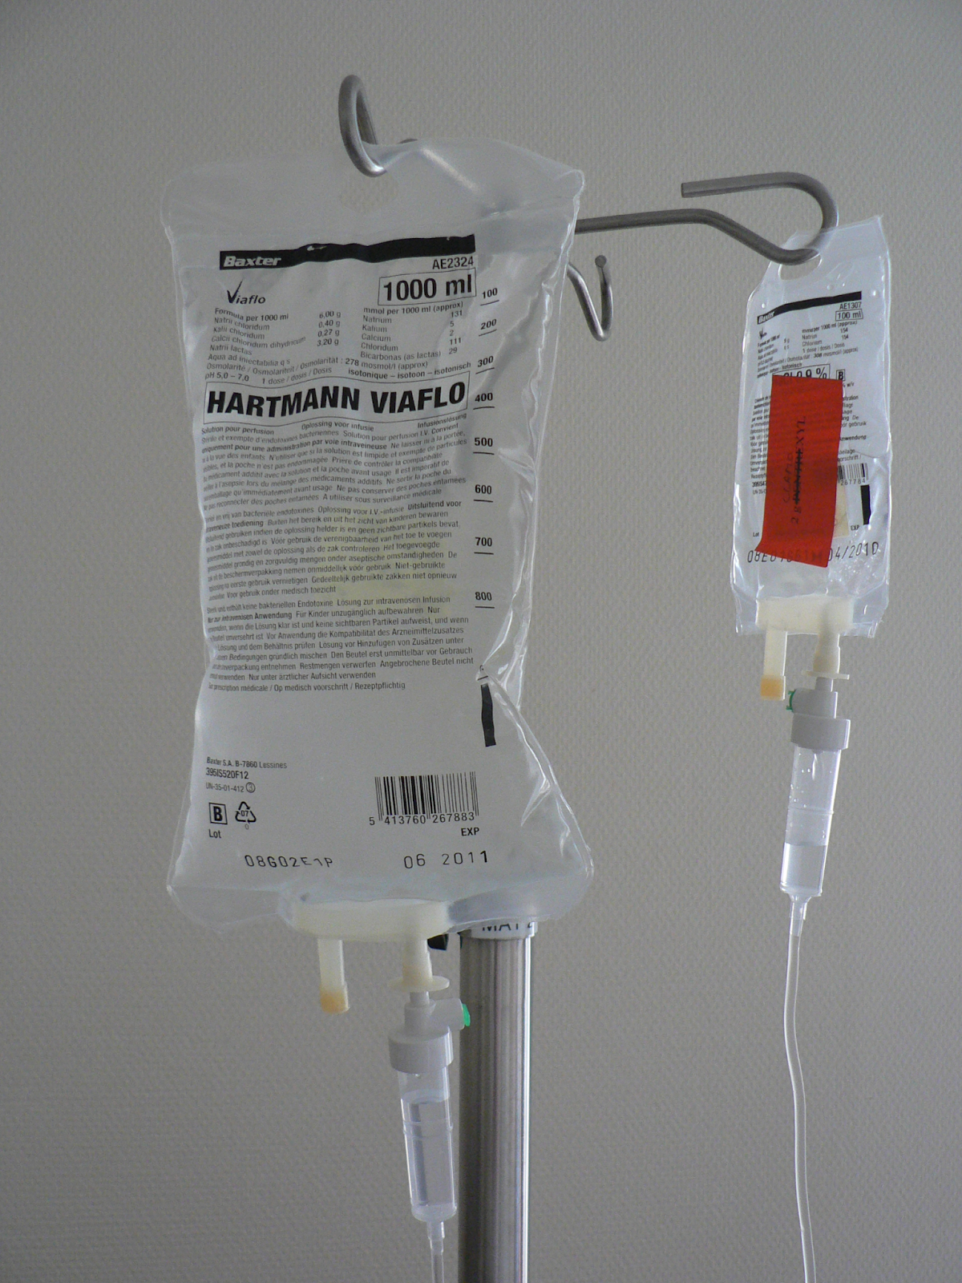
IV Bag Inspection for Safety and Integrity
Visual Inspection Criteria
Check IV bag for discoloration, cloudiness, or leakage to ensure solution quality and safety.
Expiration Date Check
Verify expiration date on IV bag before use to prevent administering expired solutions.
Patient Safety Assurance
Thorough inspection prevents infection and ensures patient receives safe IV therapy.
Infusion bags. Source: Infuuszakjes by Harmid is in the public domain
Notes:
--- This slide references information from the following file: https://ololc-my.sharepoint.com/personal/ldorsey_franu_edu/_layouts/15/Doc.aspx?sourcedoc=%7B1802AA70-F1EA-4CCC-94B2-EC9D0FD5A15E%7D&file=OER%20IVT%20Chapter%206.docx&action=default&mobileredirect=true IV Bag Inspection Before replacing the IV solution, the healthcare professional should inspect the bag for discoloration, cloudiness, leakage, and expiration. This inspection ensures the integrity of the solution and patient safety to prevent infection. Image source: Microsoft 365 content library

Slide 14

Monitoring for Adverse Reactions
Adverse Reaction Monitoring
Healthcare professionals must closely observe patients for any adverse reactions during IV therapy to ensure safety and timely intervention.
Fluid Overload and Electrolyte Imbalances Awareness
Monitoring for fluid overload and electrolyte imbalances is critical to prevent complications and maintain proper fluid balance in patients receiving IV therapy.
Patient Check Frequency
Stable patients should be monitored every 1-2 hours, while critically ill patients require checks every 15-30 minutes to ensure safety.
Wikimedia Commons](https://commons.wikimedia.org/wiki/File:Infuuszakjes.jpg
Notes:
--- This slide references information from the following file: https://ololc-my.sharepoint.com/personal/ldorsey_franu_edu/_layouts/15/Doc.aspx?sourcedoc=%7B1802AA70-F1EA-4CCC-94B2-EC9D0FD5A15E%7D&file=OER%20IVT%20Chapter%206.docx&action=default&mobileredirect=true Patient Monitoring Monitoring the patient for adverse reactions, fluid overload, or electrolyte imbalances, is an essential responsibility of the healthcare professional during IV therapy (Infusion Nurses Society (INS), 2024). For stable patients, the healthcare professional should monitor the patient every 1-2 hours (INS, 2024). Monitor every 15–30 minutes for critically ill patients, those receiving vesicants or irritants, or those unable to report symptoms (e.g., pediatric, unconscious, nonverbal) (INS, 2024). Image source: Microsoft 365 content library

Slide 15
Maintaining Aseptic Technique and Infection Prevention
Aseptic Technique Importance
Using aseptic technique ensures infection prevention by maintaining IV tubing and catheter integrity during manipulation.
Proper Tubing Handling
Avoid letting IV tubing touch the floor and use caution when disconnecting to maintain sterility and aid patient care.
Cleaning Needleless Ports
Clean needleless injection ports with alcohol-based 2% chlorhexidine or equivalent antiseptics before medication administration.
Notes:
--- This slide references information from the following file: https://ololc-my.sharepoint.com/personal/ldorsey_franu_edu/_layouts/15/Doc.aspx?sourcedoc=%7B1802AA70-F1EA-4CCC-94B2-EC9D0FD5A15E%7D&file=OER%20IVT%20Chapter%206.docx&action=default&mobileredirect=true Aseptic Technique Maintaining the integrity of the IV tubing and peripheral catheter is essential in preventing infection. To accomplish this, the healthcare professional must use aseptic technique when manipulating the IV tubing and peripheral catheter. Use caution when disconnecting tubing to aid in mobility or patient care and never let the tubing touch the floor. The IV tubing has needleless injection ports where syringes and other adaptors can be inserted to administer medications. Before accessing the port, thoroughly clean the port with alcohol-based 2% chlorhexidine (preferred), 70% alcohol, or povidone-iodine solution and let it dry (INS, 2024). Image source: Microsoft 365 content library

Slide 16
Safe Removal of VAD and Patient Communication
Importance of Patient Communication
Explain the removal procedure clearly to the patient and answer any questions to ensure comfort and cooperation.
Proper Removal Technique
Gently lift the dressing edges and pull laterally while stabilizing the catheter to safely remove the device.
Post-Removal Care
Cover puncture site with dry gauze, apply pressure until bleeding stops, and inspect catheter tip for integrity.
Documentation
Record removal time and IV site condition to ensure proper patient care documentation and follow-up.
Notes:
--- This slide references information from the following file: https://ololc-my.sharepoint.com/personal/ldorsey_franu_edu/_layouts/15/Doc.aspx?sourcedoc=%7B1802AA70-F1EA-4CCC-94B2-EC9D0FD5A15E%7D&file=OER%20IVT%20Chapter%206.docx&action=default&mobileredirect=true Discontinuing the VAD The technique for removing the vascular access device depends on the type of VAD. Regardless of the type of VAD, the procedure should be explained to the patient and any questions should be answered accordingly. When removing a short peripheral catheter, gently lift the edges of the transparent dressing and pull it laterally to detach it from the site while keeping the catheter stable. Carefully withdraw the catheter from the skin and promptly cover the puncture site with dry gauze. Apply pressure to the site until bleeding stops. Inspect the catheter tip to ensure it is intact and fully removed. Record the time of catheter removal and note the condition of the IV site (Ignatavicius et al., 2024; OpenAI, 2024) Image source: Microsoft 365 content library

Slide 17
Key Elements to Document During IV Therapy
IV Site Location and Condition
Document the precise location and assess the condition of the IV therapy site regularly for complications.
Type and Gauge of VAD
Record the vascular access device type and gauge to ensure appropriate therapy and management.
Dressing and Securement Device
Note the type of dressing and securement used to maintain IV site stability and prevent infection.
IV Therapy Rate
Document the infusion rate of IV therapy to monitor fluid administration accurately.
Patient and Family Education
Record education provided to patient and family about IV therapy care and safety measures.
Notes:
--- This slide references information from the following file: https://ololc-my.sharepoint.com/personal/ldorsey_franu_edu/_layouts/15/Doc.aspx?sourcedoc=%7B1802AA70-F1EA-4CCC-94B2-EC9D0FD5A15E%7D&file=OER%20IVT%20Chapter%206.docx&action=default&mobileredirect=true · Location and condition of the IV therapy site · Type and gauge of VAD · Type of dressing and/or securement device · Rate of the IV therapy · Patient and family education provided Image source: Microsoft 365 content library

Slide 18
Examples of Documentation
Expected Findings
IV catheter on left forearm discontinued with IV catheter tip intact. Site free of redness, warmth, tenderness, or swelling. Gauze applied with pressure for one minute with no bleeding noted. Dressing applied to the site. (WisTech Open, 2023).
Unexpected Findings
IV catheter on left forearm discontinued with IV catheter tip intact. Site free of redness, warmth, tenderness, or swelling. Gauze applied with pressure for one minute. Bleeding noted to continue around gauze dressing. Pressure held for five minutes, and hemostasis achieved. Dressing applied to site. (WisTech Open, 2023).

Slide 19

Special Considerations for Vulnerable Populations
Monitoring Fluid Overload
Patients with cardiovascular or renal issues need frequent monitoring for fluid overload signs like high blood pressure and lung crackles.
IV Site Assessment in Vulnerable Patients
Pediatric and elderly patients require careful IV site assessment due to fragile veins, ensuring patency and avoiding moisture.
Preventing IV Tubing Blockage
Children need guidance to avoid blocking IV tubing by sitting or lying on it, preventing infusion disruption.
Adjusting Infusion Rates in Elderly
Elderly patients require close monitoring of IV patency during high volume infusions and infusion rate adjustments as needed.
Notes:
--- This slide references information from the following file: https://ololc-my.sharepoint.com/personal/ldorsey_franu_edu/_layouts/15/Doc.aspx?sourcedoc=%7B1802AA70-F1EA-4CCC-94B2-EC9D0FD5A15E%7D&file=OER%20IVT%20Chapter%206.docx&action=default&mobileredirect=true Special Considerations Because of the vulnerable nature of patients with cardiovascular and/or renal conditions, safety measures to avoid fluid volume overload must be considered. A patient with an IV infusion who has altered cardiovascular and/or renal function must be frequently monitored for signs of fluid overload which include elevated blood pressure and respiratory rate, crackles in the lungs, decreased oxygen saturation, and peripheral edema. Another important consideration when caring for the pediatric or elderly patient with an IV infusion is careful assessment of the IV site. Because of the fragility of the venous walls in these populations, IV sites must be monitored and assessed carefully for patency. Ensure that the IV site is secured and it remains free of moisture. Mobile children may need guidance to avoid accidentally sitting or lying on the tubing and causing a blockage. In elderly patients, it's important to closely monitor IV site patency when administering large volumes of fluids at higher rates and adjust the infusion rate as needed. Image source: Microsoft 365 content library

Slide 20
References
Attribution 23.5 Sample Documentation – Nursing Skills – 2
Ignatavisius, D. D., Rebar, C. R., & Heimgartner, N. M. (2024). Concepts of infusion therapy. In J. H. Ingalls (Ed.), Medical-Surgical nursing: Concepts for clinical judgment and collaborative care (11 ed., pp. 285-315). Elsevier.
Infusion Nurses Society (INS). (2024). Infusion therapy standards of practice (9th ed.). Journal of Infusion Nursing, 47(Suppl. S1), S1–S285.
OpenStax (2025). Clinical Nursing Skills. Rice University. Creative Commons Attribution 4.0 International License Retrieved from https://openstax.org/books/clinical-nursing-skills/pages/13-3-intravenous-infusion
WisTech Open (2023). Nursing Skills (2nd edition).Creative Commons Attribution 4.0 International License Retrieved from https://wtcs.pressbooks.pub/nursingskills/chapter/23-7-sample-documentation/

